Slide 1
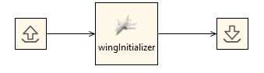
RCE tool integration
wingInitializer

Slide 2
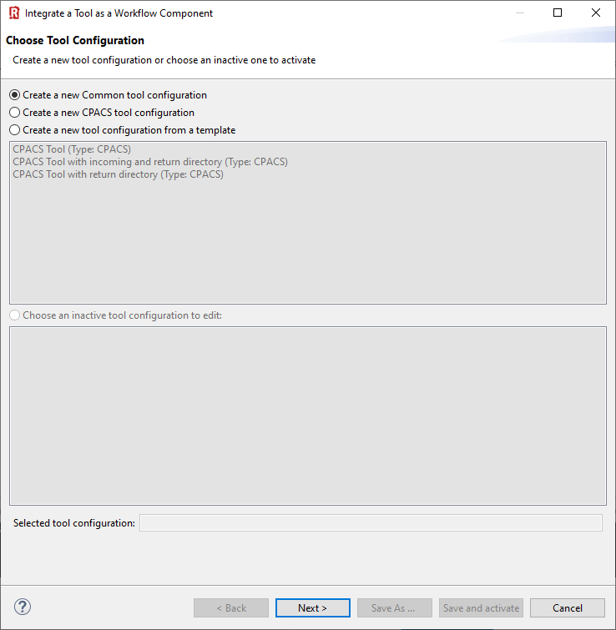
(1) In this example we use the "common tool configuration".
(2) Click “Next >”

Slide 3
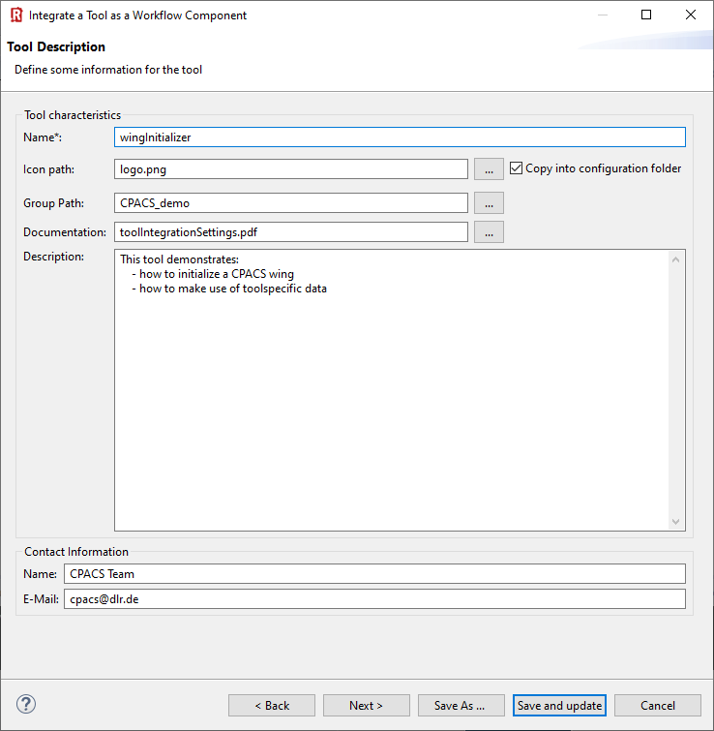

(1) Provide you tool name
(2) Choose a pretty icon
(3) Your tool palette might be structured by groups:
(4) Link a documentation
(5) Add description
(6) Provide contact information
(7) Next >

Slide 4
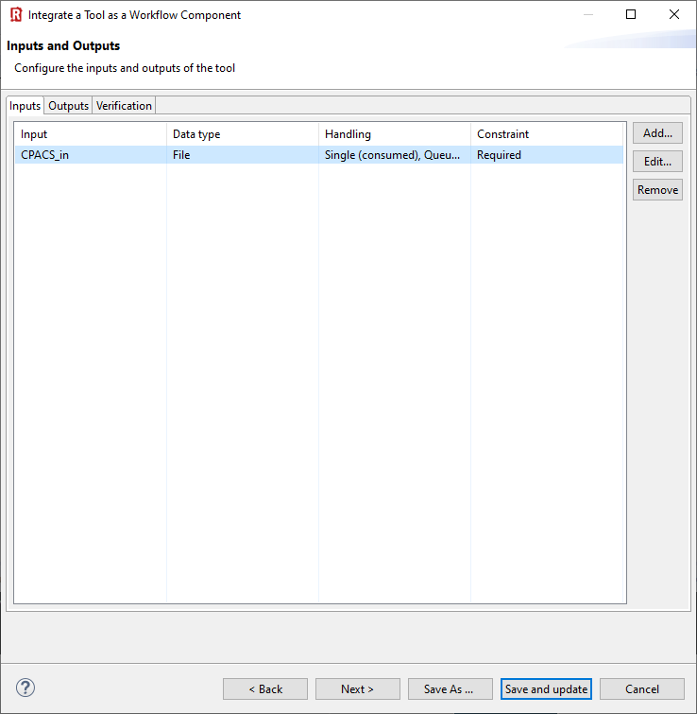
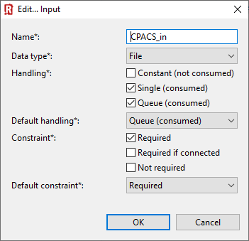
(1) Click “Add”
(2) Define RCE input variable of type “File”
(3) Choose these file handling settings and click “OK”
(4) Next >

Slide 5
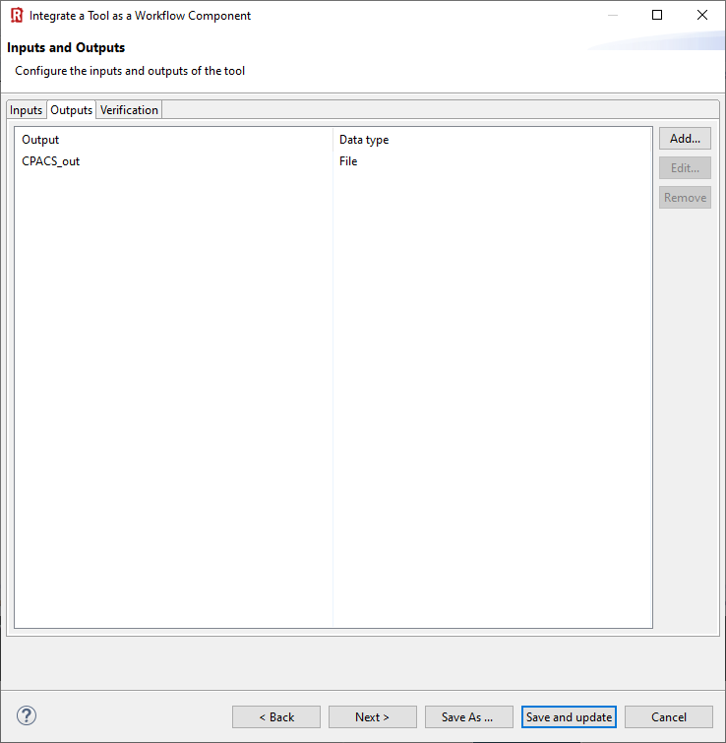
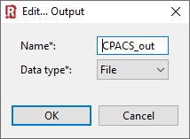
(1) Click “Add”
(2) Define RCE output variable of type “File”
(3) Next >

Slide 6
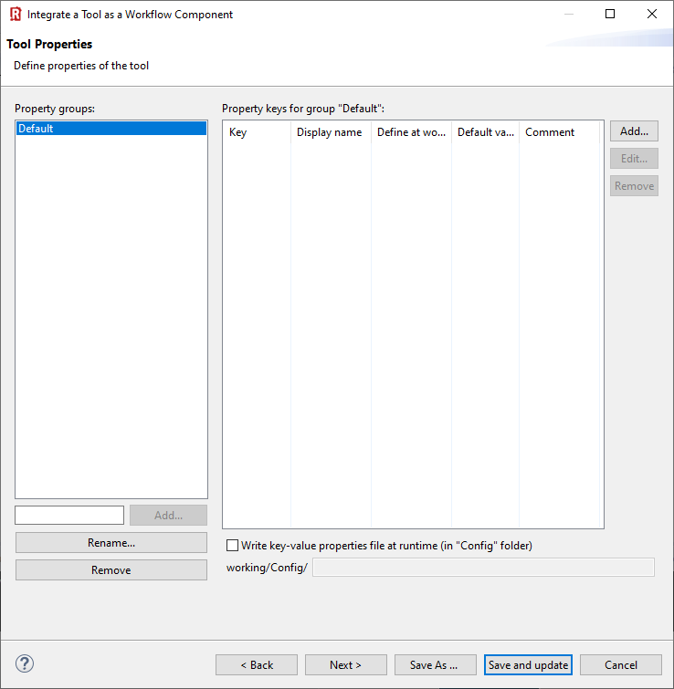
Nothing to do …
(1) Next >

Slide 7
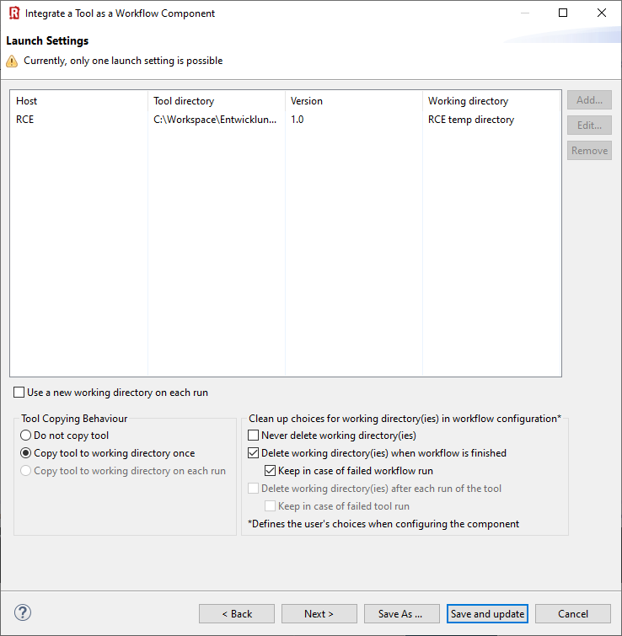
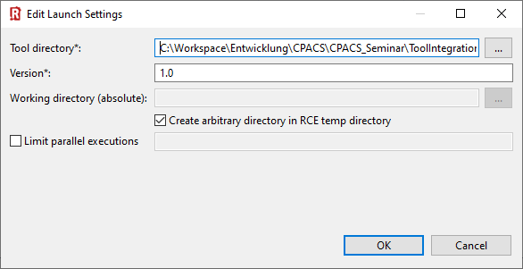
(1) Add launch setting
(2) Point to tool directory
(3) Select tool version
(4) Select checkboxes like this
(6) Convenient for debugging…
(5) Select your preferred copying behavior
(7) Next >

Slide 8
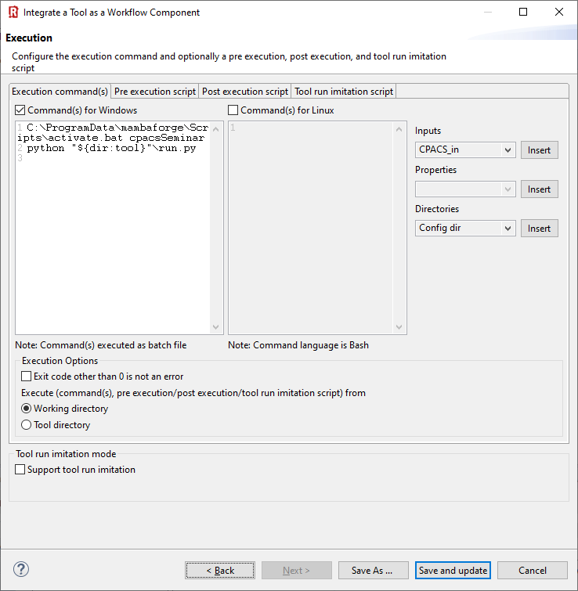
C:\ProgramData\mambaforge\Scripts\activate.bat cpacsSeminar
python "${dir:tool}"\run.py
(1) Specify execution commands for Windows and/or Linux
🛈 This example is written in Python, so we need to activate the correct interpreter first.
(2) Select “Working directory”

Slide 9
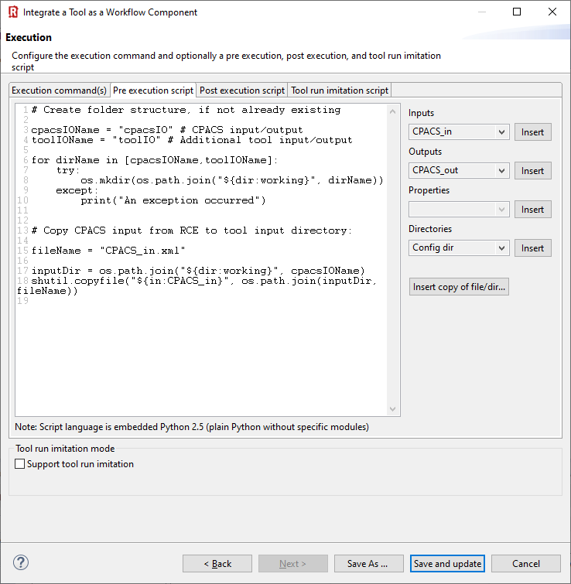
# Create folder structure, if not already existing
cpacsIOName = "cpacsIO" # CPACS input/output
toolIOName = "toolIO" # Additional tool input/output
for dirName in [cpacsIOName,toolIOName]:
try:
os.mkdir(os.path.join("${dir:working}", dirName))
except:
print("An exception occurred")
# Copy CPACS input from RCE to tool input directory:
fileName = "CPACS_in.xml"
inputDir = os.path.join("${dir:working}", cpacsIOName)
shutil.copyfile("${in:CPACS_in}", os.path.join(inputDir, fileName))
(1) Insert pre-execution script in Python
🛈 Pre-execution: What happens before the actual tool is activated. Use this to create the required folder structure, if necessary, and copy the input file into it.

Slide 10
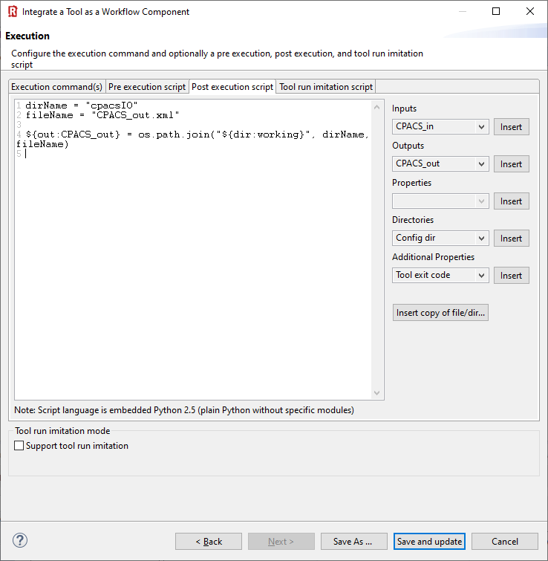
dirName = "cpacsIO"
fileName = "CPACS_out.xml"
${out:CPACS_out} = os.path.join("${dir:working}", dirName, fileName)
🛈 Post-execution: What happens after the actual tool has finished. Here we’re telling RCE where to find the output file.
(1) Insert post-execution script in Python
(2) “Save and update/activate”

Slide 11
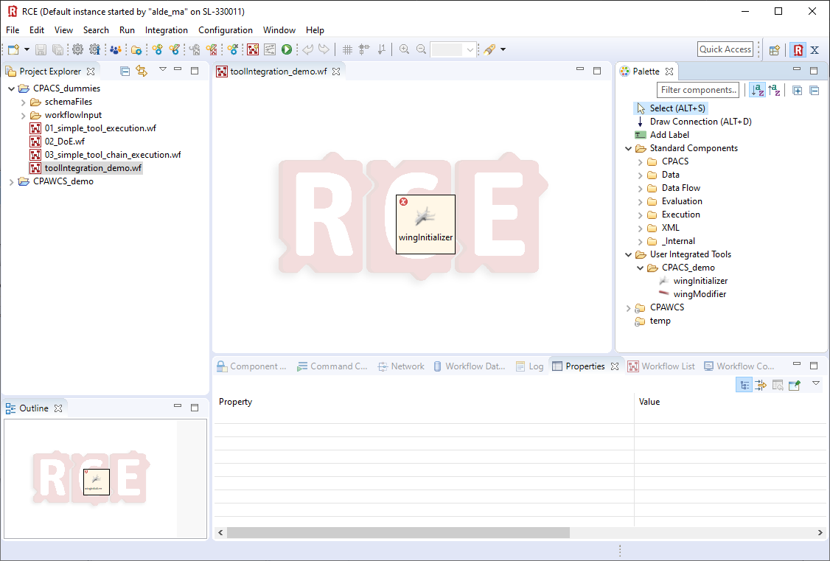

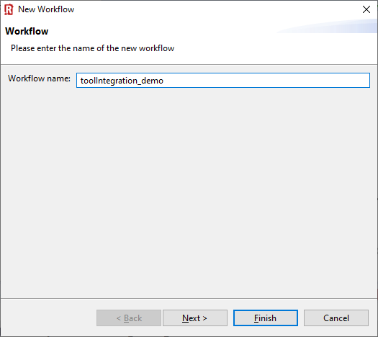
1
drag & drop
3
2

Slide 12
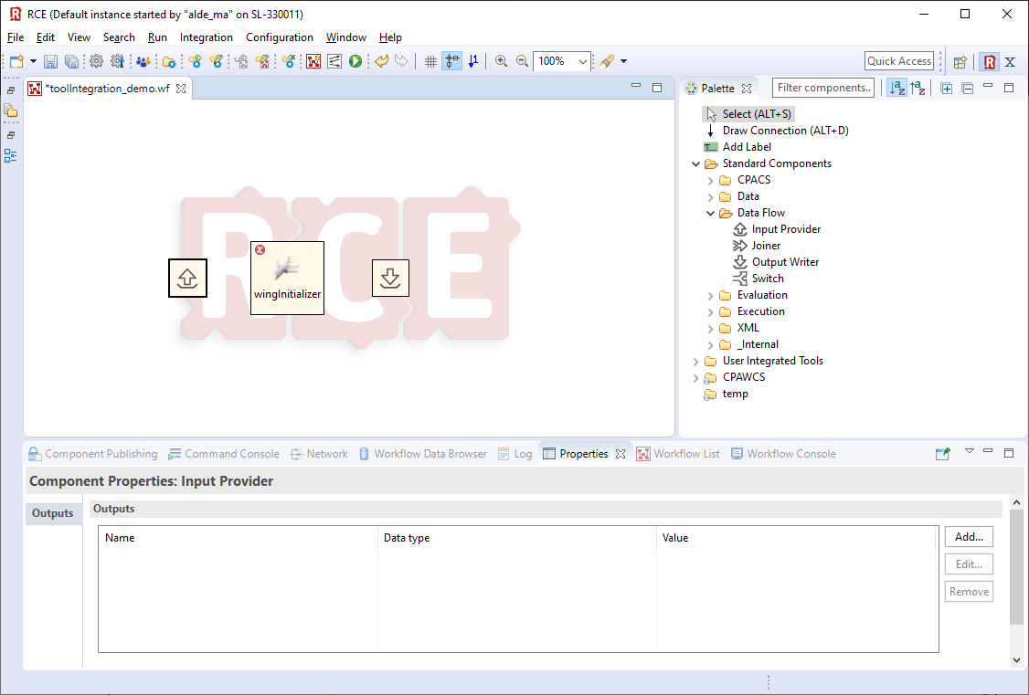
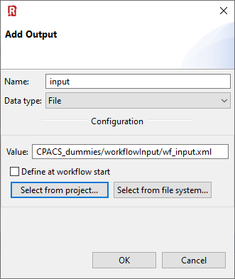
1
drag & drop
2
(3) Select Input provider
(4) Select “Properties”
(5) Select “Add”
6.1
6.2
6.3
6.4
6

Slide 13
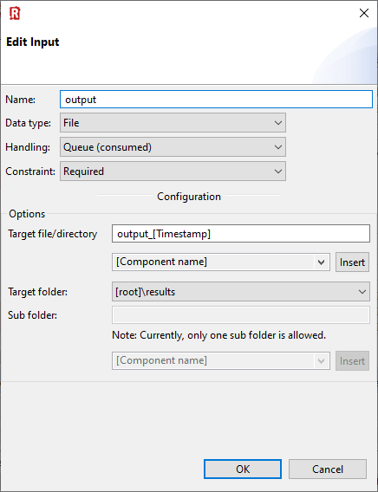
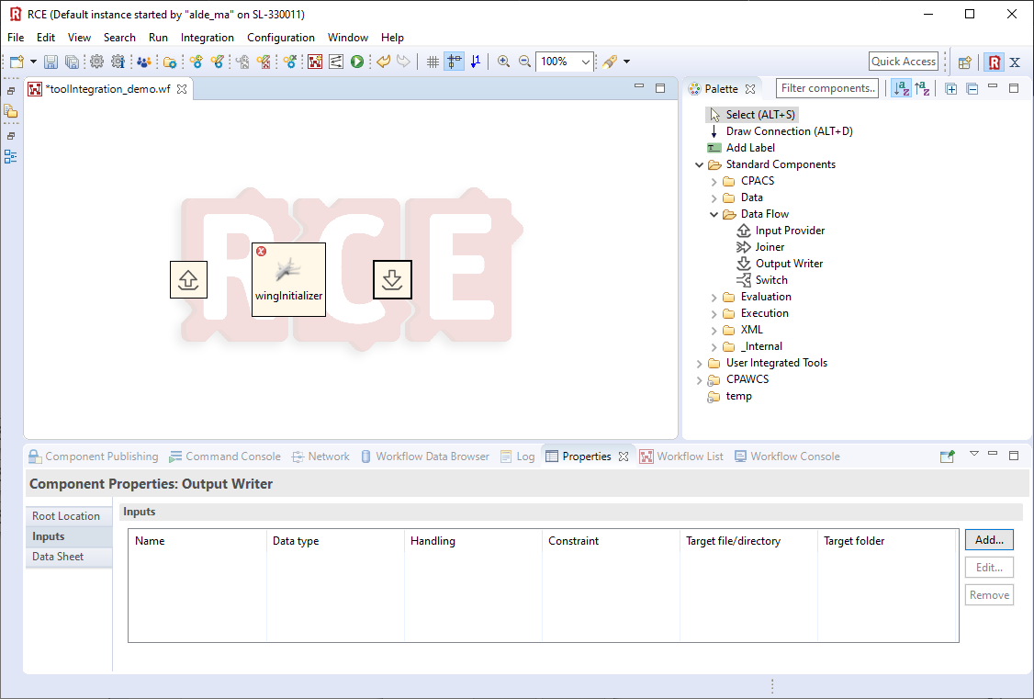
4.1
(1) Select Output provider
4.2
4.3
(2) Select “Properties”
4
(3) Select “Add”

Slide 14
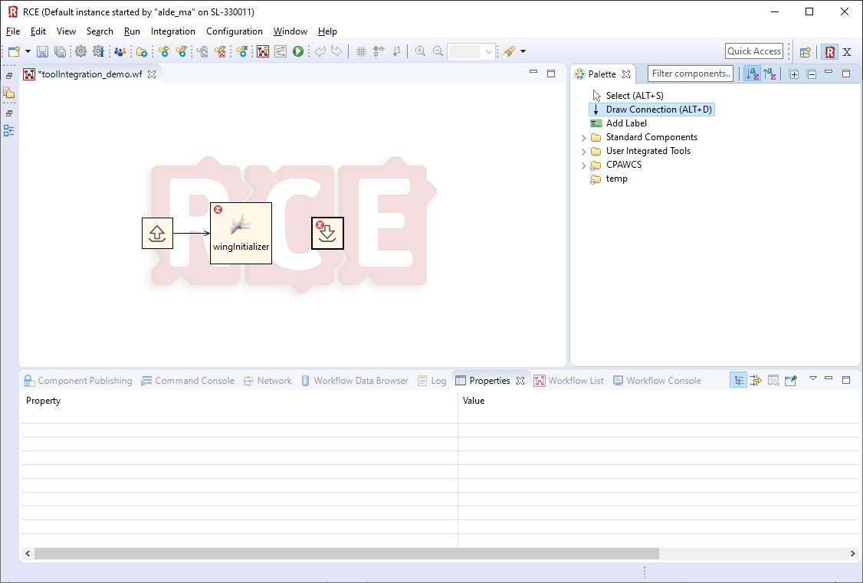
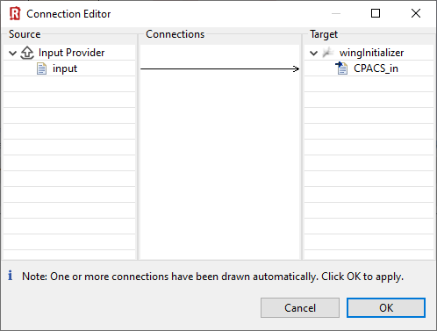
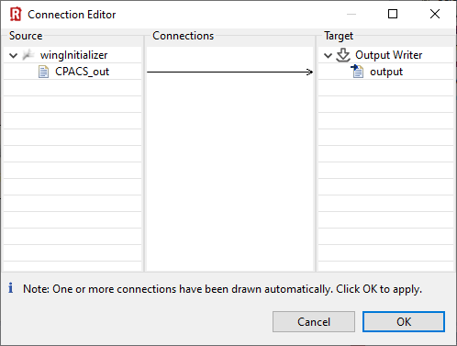
🛈 Ctrl+S to remove red error-indicators
(1) Draw connection between input provider and tool
1.1
3.1
(3) Draw connection between input provider and tool
1.2
1.3
3.2
3.3
2
4

Slide 15
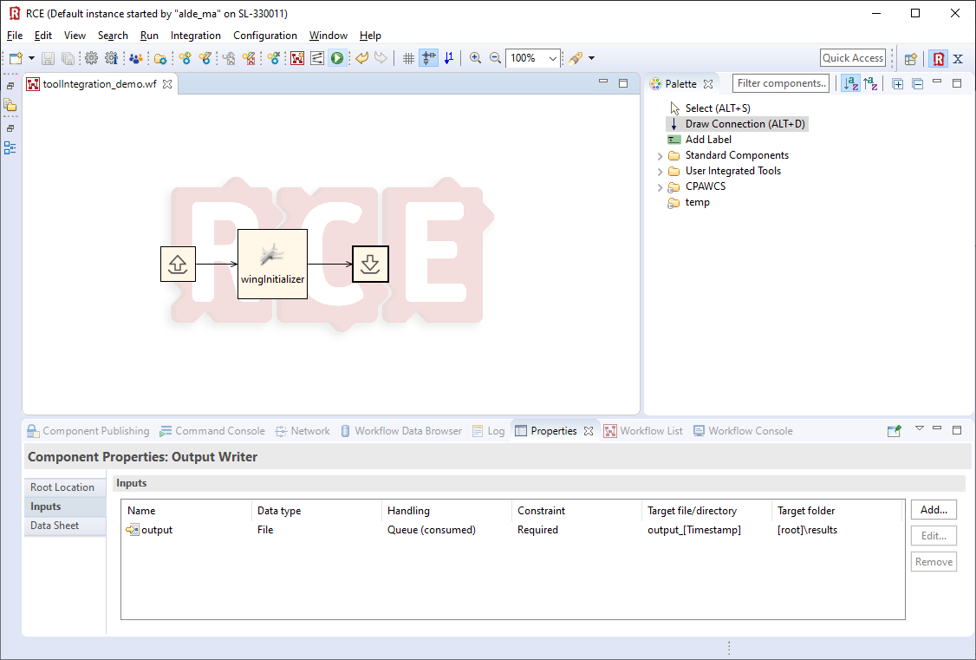
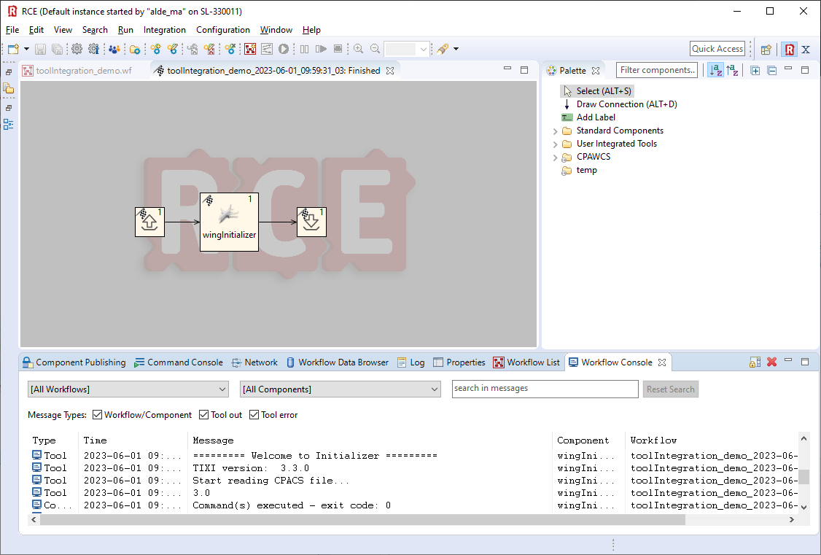
Click to run the workflow
1

Slide 16
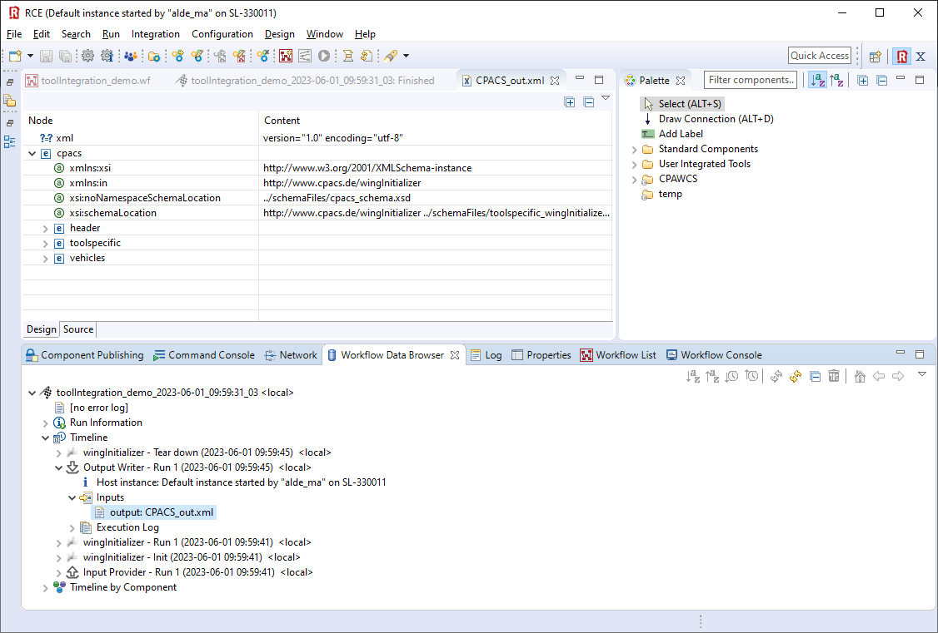
(2) Refresh
(1) Select Workflow Data Browser
(3) Inspect input to the Output Writer

