Slide 1
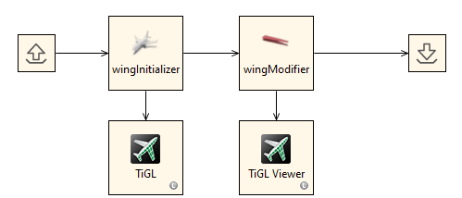
RCE tool integration
wingModifier

Slide 2
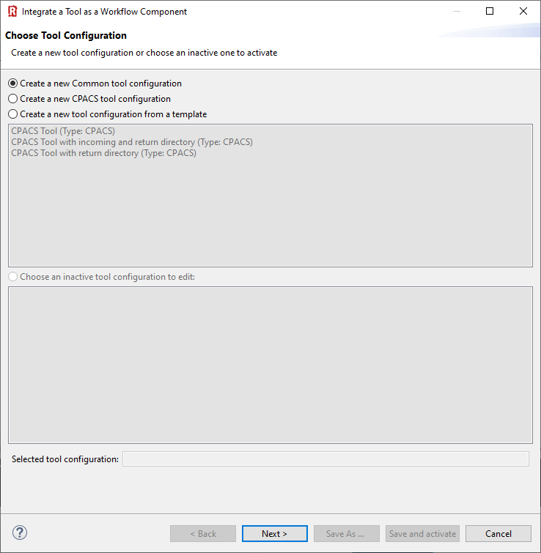
(1) In this example we use the "common tool configuration".
(2) Click “Next >”

Slide 3
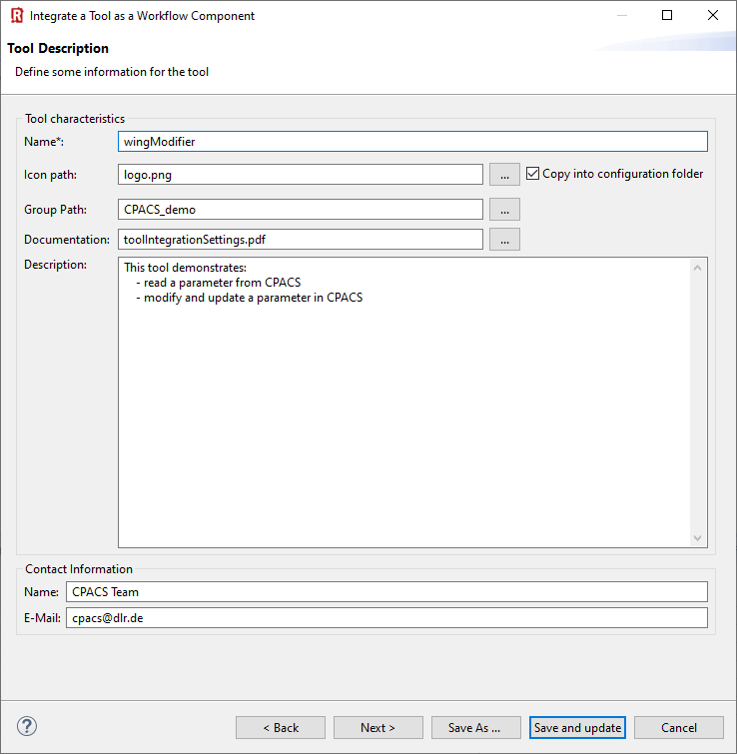
(1) Provide you tool name
(2) Choose a pretty icon
(3) Your tool palette might be structured by groups
(4) Link a documentation
(5) Add description
(6) Provide contact information
(7) Next >

Slide 4
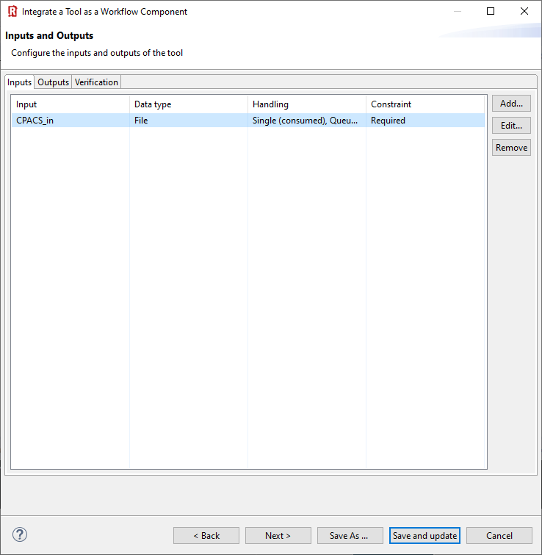
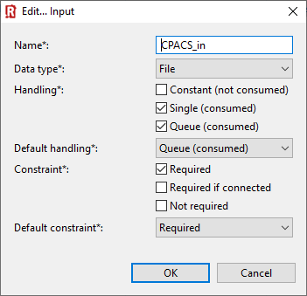
(1) Click “Add”
(2) Define RCE input variable of type “File”
(3) Choose these file handling settings and click “OK”
(4) Next >

Slide 5
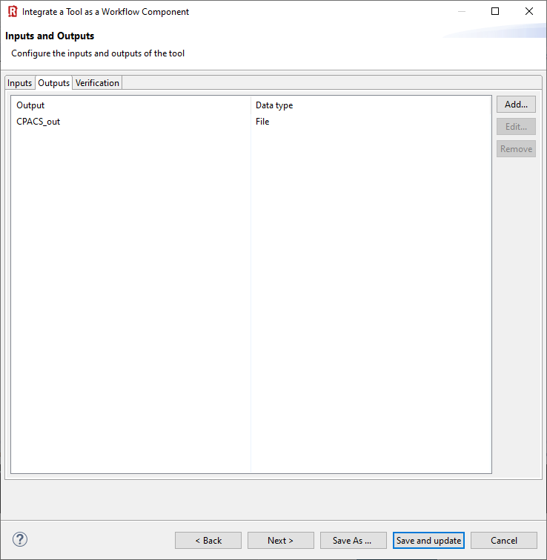
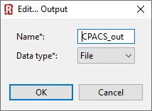
(1) Click “Add”
(2) Define RCE output variable of type “File”
(3) Next >

Slide 6
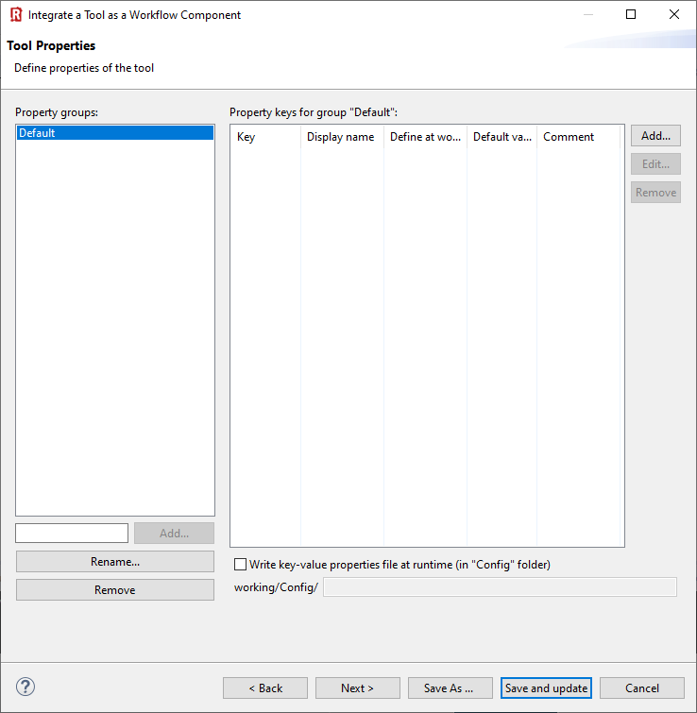
Nothing to do …
(1) Next >

Slide 7
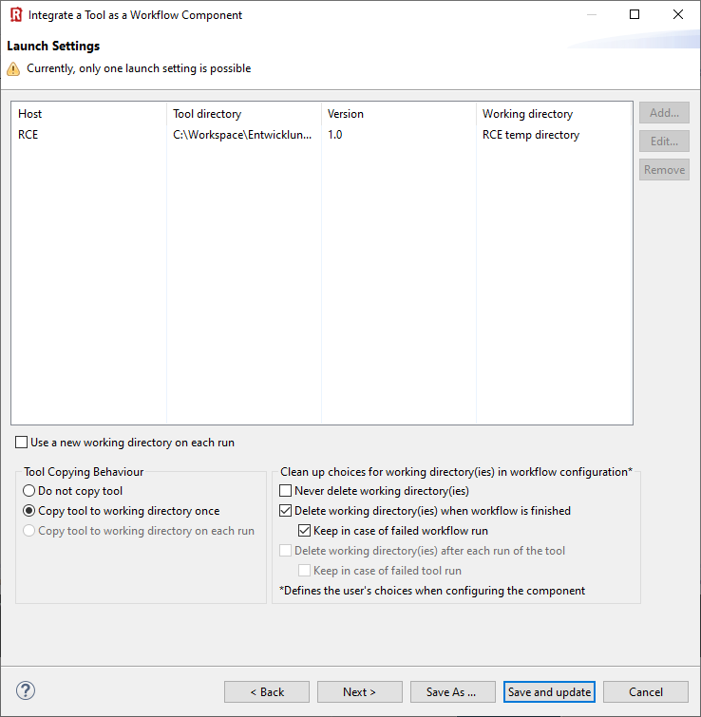
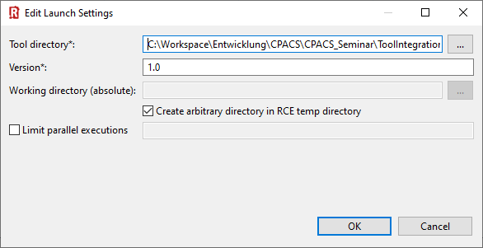
(1) Add launch setting
(2) Point to tool directory
(3) Select tool version
(4) Select checkboxes like this
(6) Convenient for debugging…
(5) Select your preferred copying behavior
(7) Next >

Slide 8
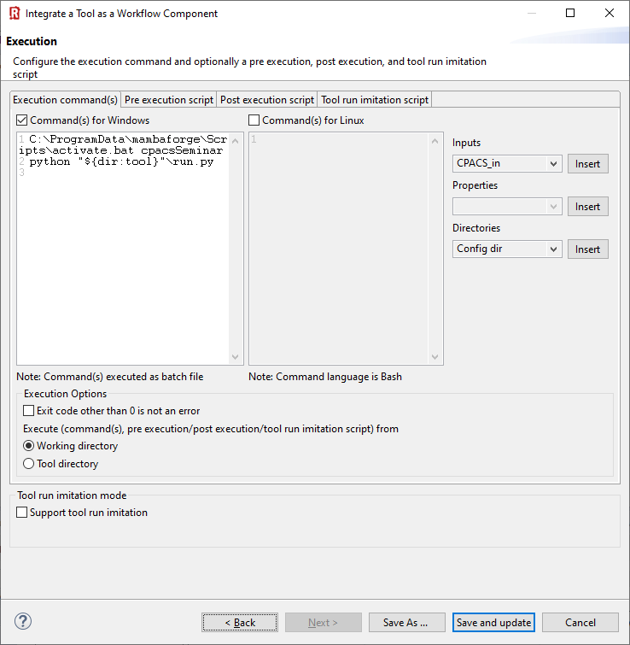
C:\ProgramData\mambaforge\Scripts\activate.bat cpacsSeminar
python "${dir:tool}"\run.py
(1) Specify execution commands for Windows and/or Linux
🛈 This example is written in Python, so we need to activate the correct interpreter first.
(2) Select “Working directory”

Slide 9
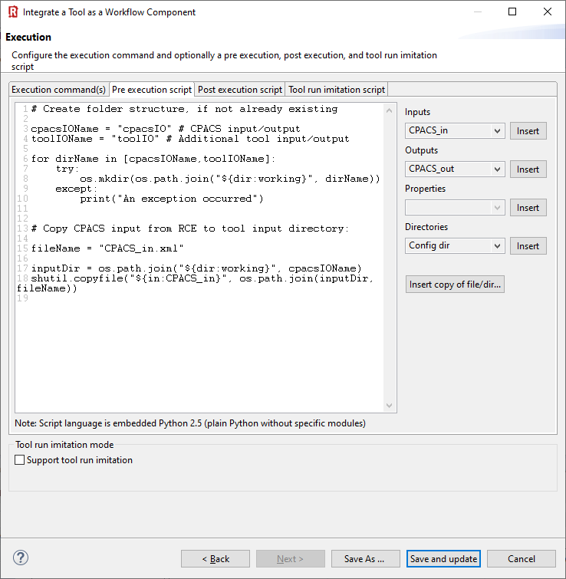
# Create folder structure, if not already existing
inputDirName = "ToolInput"
outputDirName = "ToolOutput"
for dirName in [inputDirName,outputDirName]:
try:
os.mkdir(os.path.join("${dir:working}", dirName))
except:
print("An exception occurred")
# Copy CPACS input from RCE to tool input directory:
fileName = "CPACS_in.xml"
inputDir = os.path.join("${dir:working}", inputDirName)
shutil.copyfile("${in:CPACS input}", os.path.join(inputDir, fileName))
(1) Insert pre-execution script in Python
🛈 Pre-execution: What happens before the actual tool is activated. Use this to create the required folder structure, if necessary, and copy the input file into it.

Slide 10
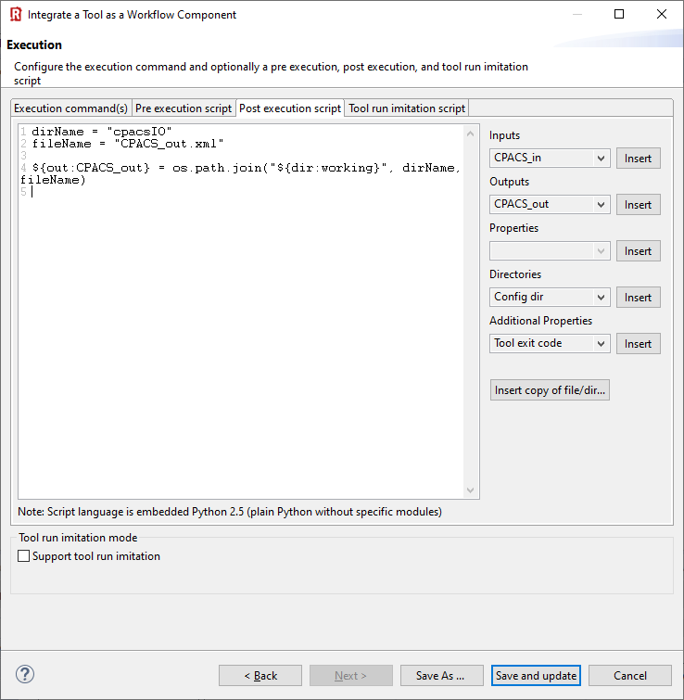
dirName = "ToolOutput"
fileName = "CPACS_out.xml"
${out:CPACS output} = os.path.join("${dir:working}", dirName, fileName)
🛈 Post-execution: What happens after the actual tool has finished. Here we’re telling RCE where to find the output file.
(1) Insert post-execution script in Python
(2) “Save and update/activate”

