Slide 1
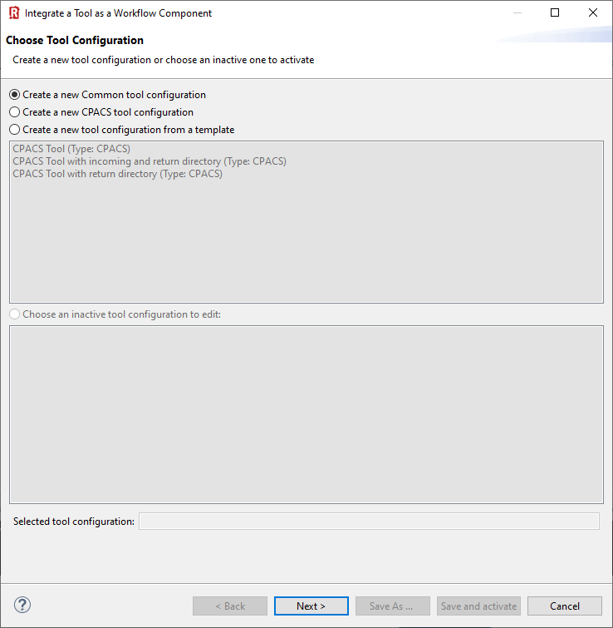
(1) In this example we use the "common tool configuration".
(2) Click “Next >”

Slide 2
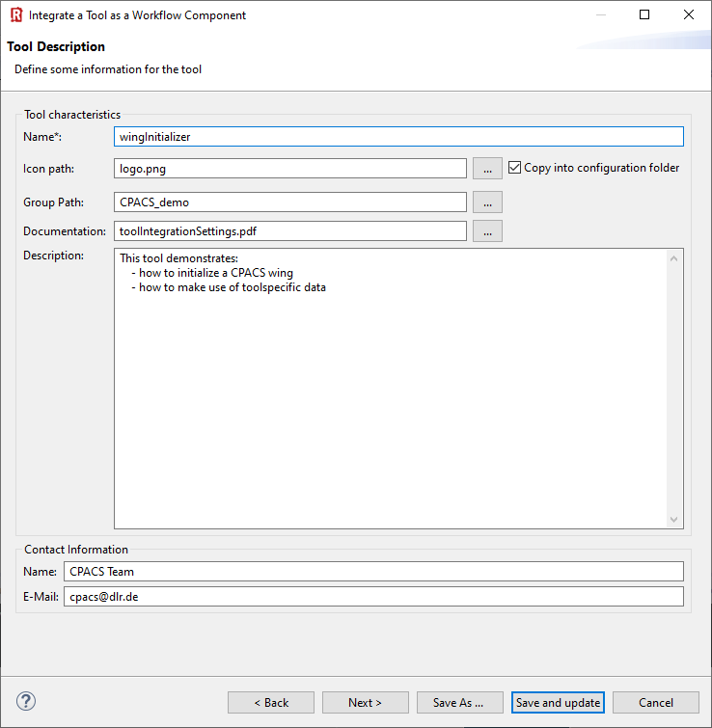

(1) Provide you tool name
(2) Choose a pretty icon
(3) Your tool palette might be structured by groups:
(4) Link a documentation
(5) Add description
(6) Provide contact information
(6) “Save and update”

Slide 3
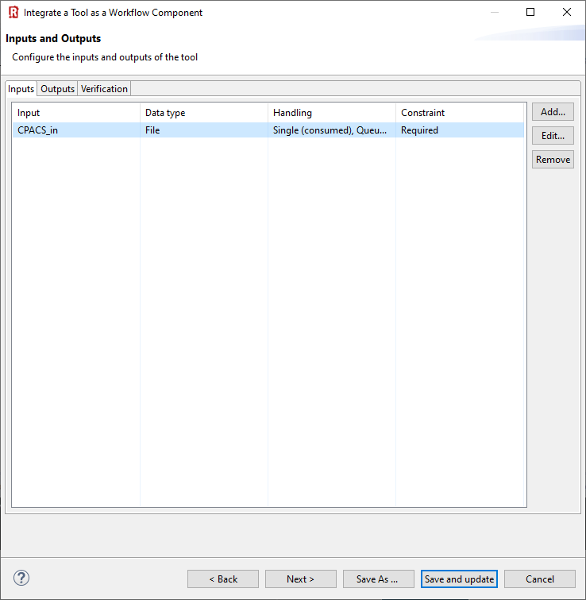
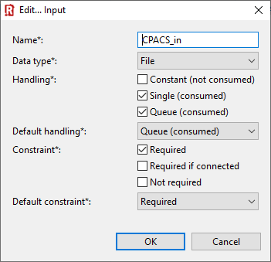
(1) Click “Add”
(2) Define RCE input variable of type “File”
(3) Choose these file handling settings and click “OK”
(4) “Save and Update”

Slide 4
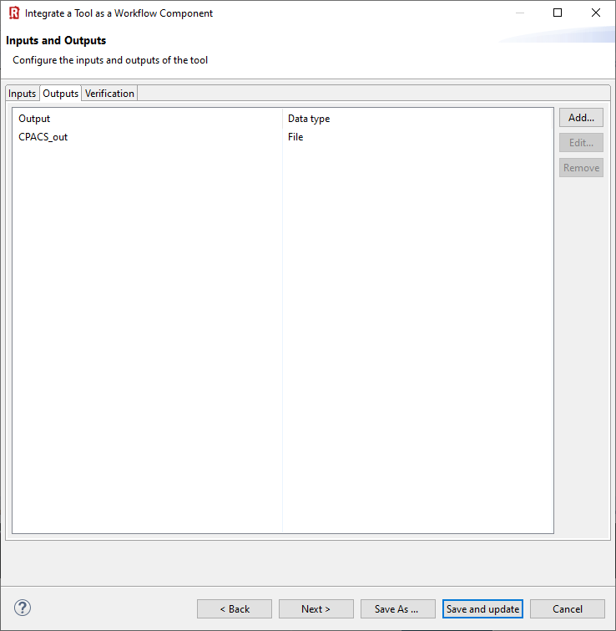
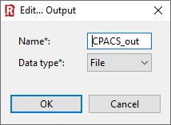
(1) Click “Add”
(2) Define RCE output variable of type “File”
(3) “Save and Update”

Slide 5
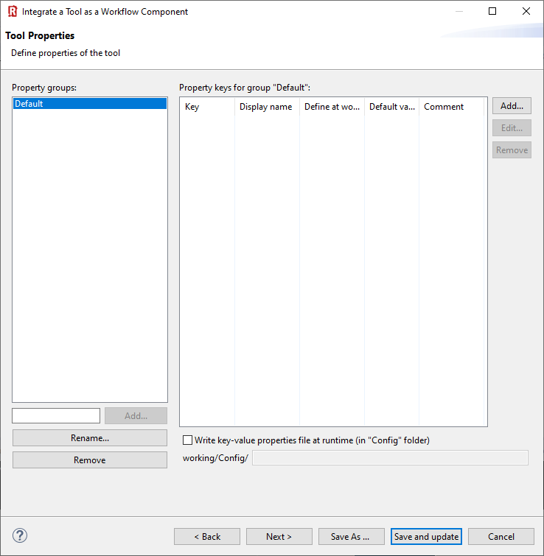
Nothing to do …
“Save and Update”

Slide 6
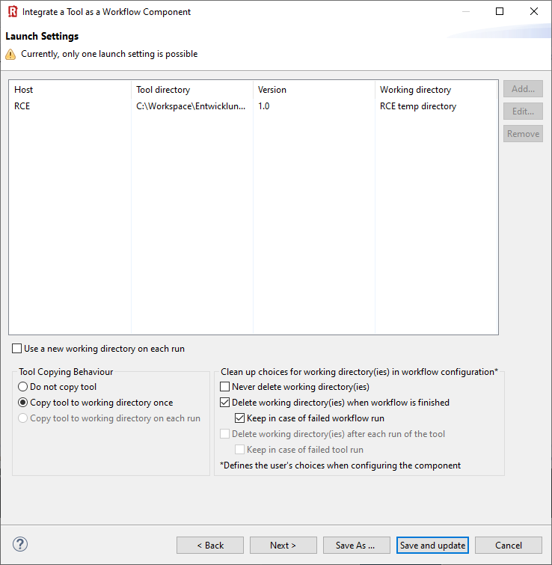
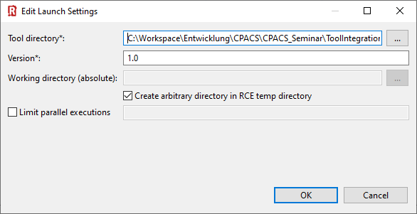

Slide 7
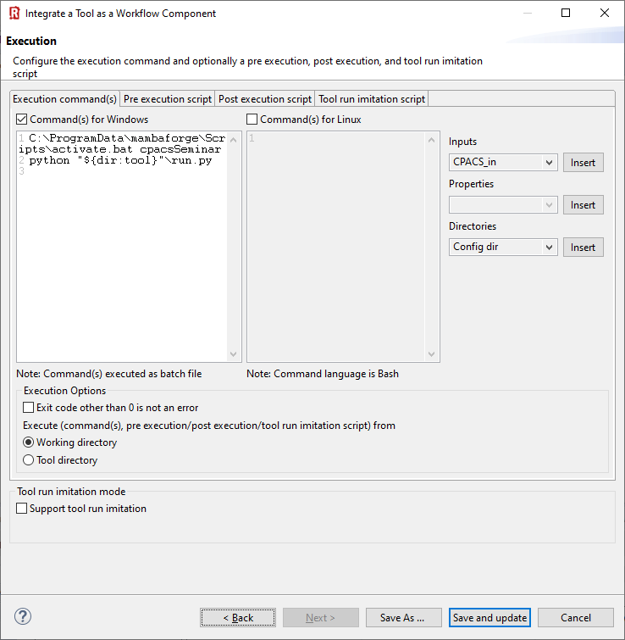
C:\ProgramData\mambaforge\Scripts\activate.bat cpacsSeminar
python "${dir:tool}"\run.py

Slide 8
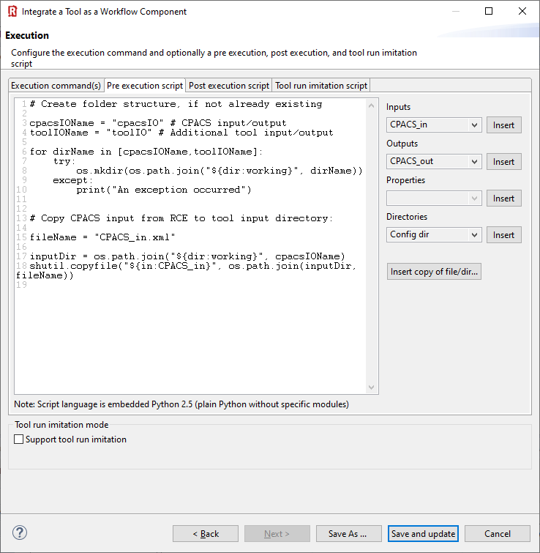
# Create folder structure, if not already existing
cpacsIOName = "cpacsIO" # CPACS input/output
toolIOName = "toolIO" # Additional tool input/output
for dirName in [cpacsIOName,toolIOName]:
try:
os.mkdir(os.path.join("${dir:working}", dirName))
except:
print("An exception occurred")
# Copy CPACS input from RCE to tool input directory:
fileName = "CPACS_in.xml"
inputDir = os.path.join("${dir:working}", cpacsIOName)
shutil.copyfile("${in:CPACS_in}", os.path.join(inputDir, fileName))

Slide 9
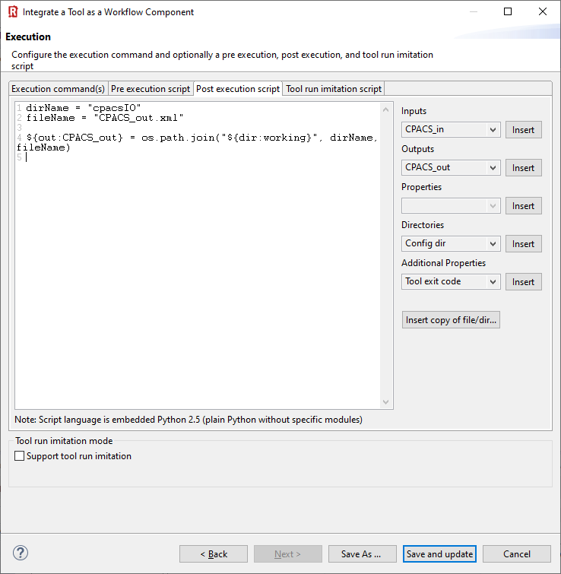
dirName = "cpacsIO"
fileName = "CPACS_out.xml"
${out:CPACS_out} = os.path.join("${dir:working}", dirName, fileName)

