Slide 1

RCE Tool integration
Dummy Tool Wrapper
DLR Institute for System Architectures in Aeronautics

Slide 2
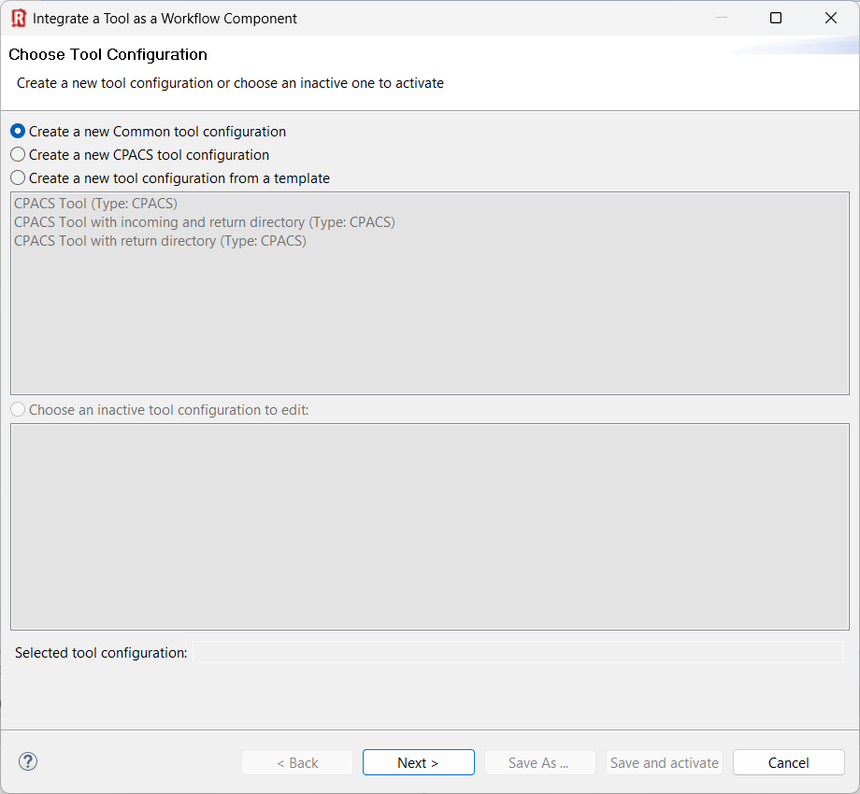
(1) In this example we use the “Common tool configuration".
(2) Click “Next >”

Slide 3
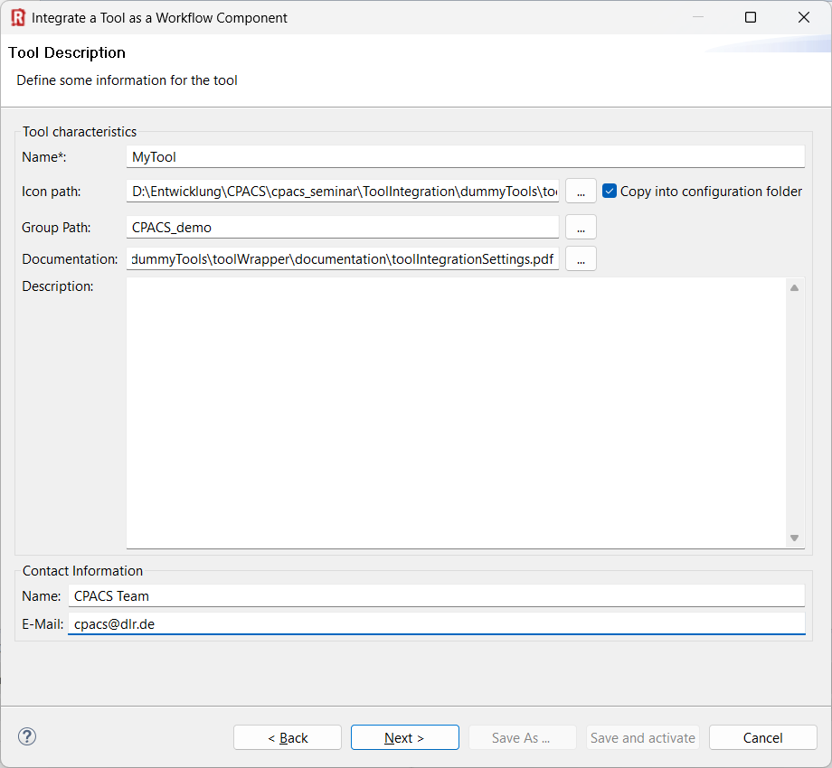

(1) Provide you tool name
(2) Choose a pretty icon
(3) Your tool palette might be structured by groups:
(4) Link a documentation
(5) Add description
(6) Provide contact information
(7) Next >

Slide 4
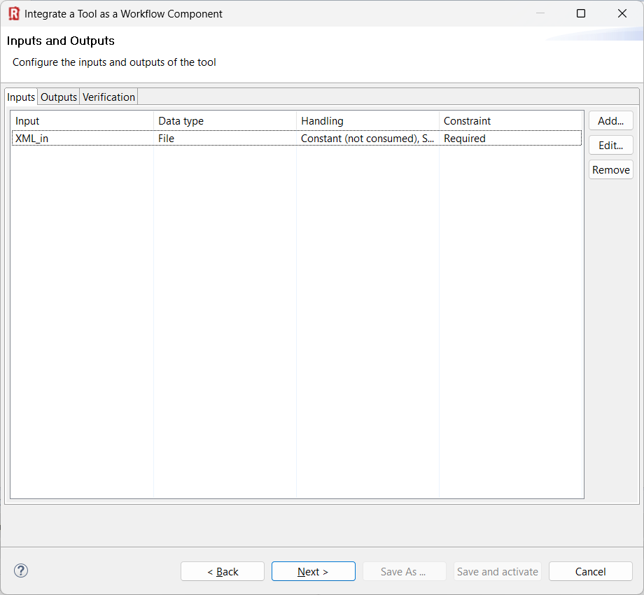
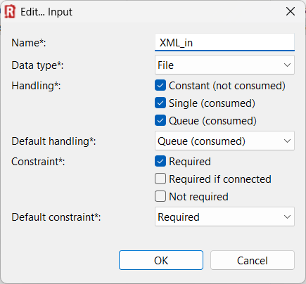
(1) Click “Add”
(2) Define RCE input variable of type “File”
(3) Choose the file handling settings and click “OK”
(4) Next >

Slide 5
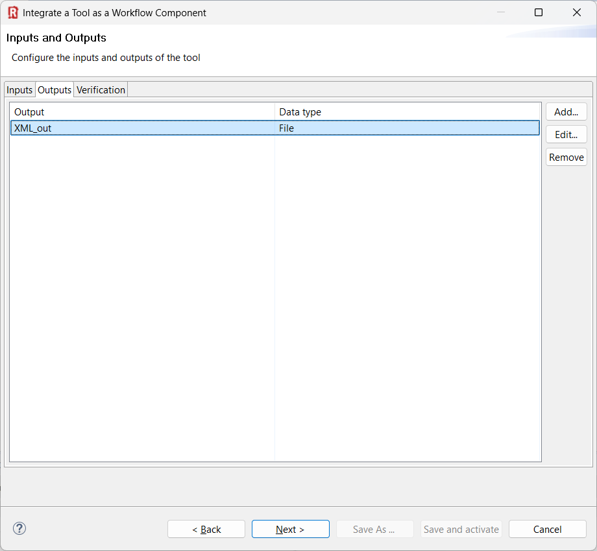
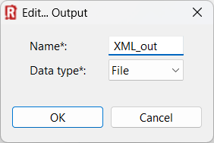
(1) Click “Add”
(2) Define RCE output variable of type “File”
(3) Next >

Slide 6
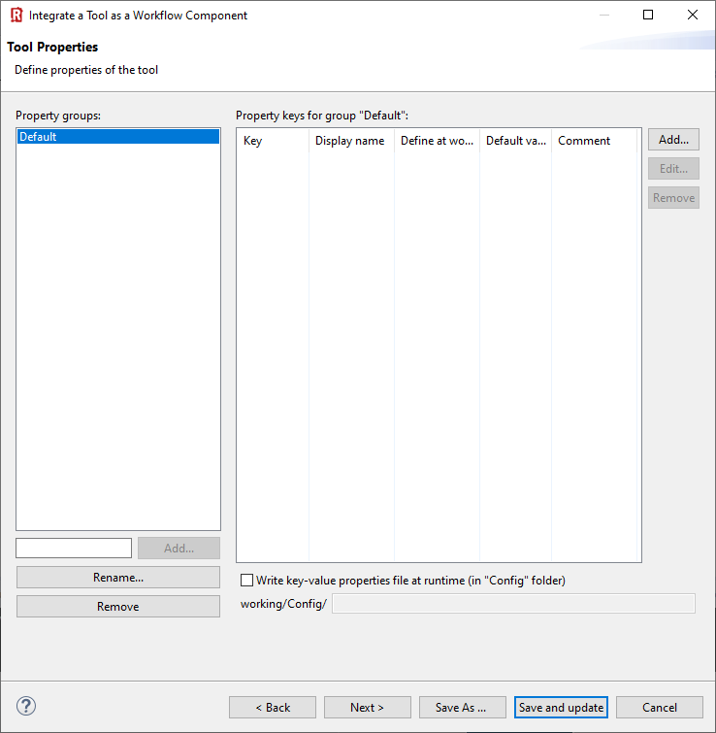
Nothing to do …
(1) Next >

Slide 7
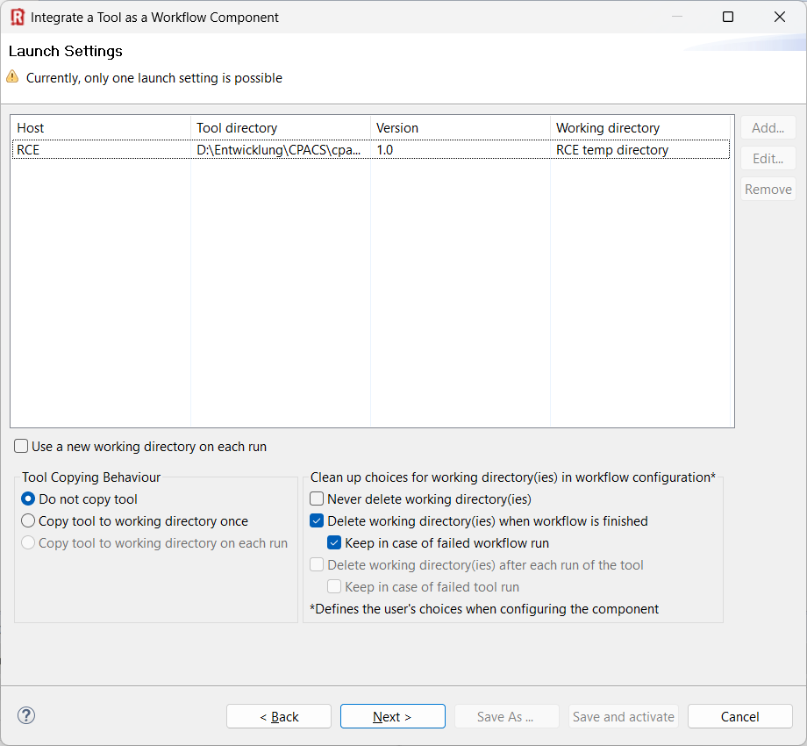
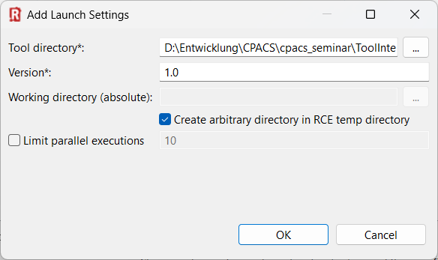
(1) Add launch setting
(2) Point to tool directory
(3) Specify tool version
(4) Select checkboxes like this
(5) Select your preferred copying behavior
(6) Good for debugging…
(7) Next >

Slide 8
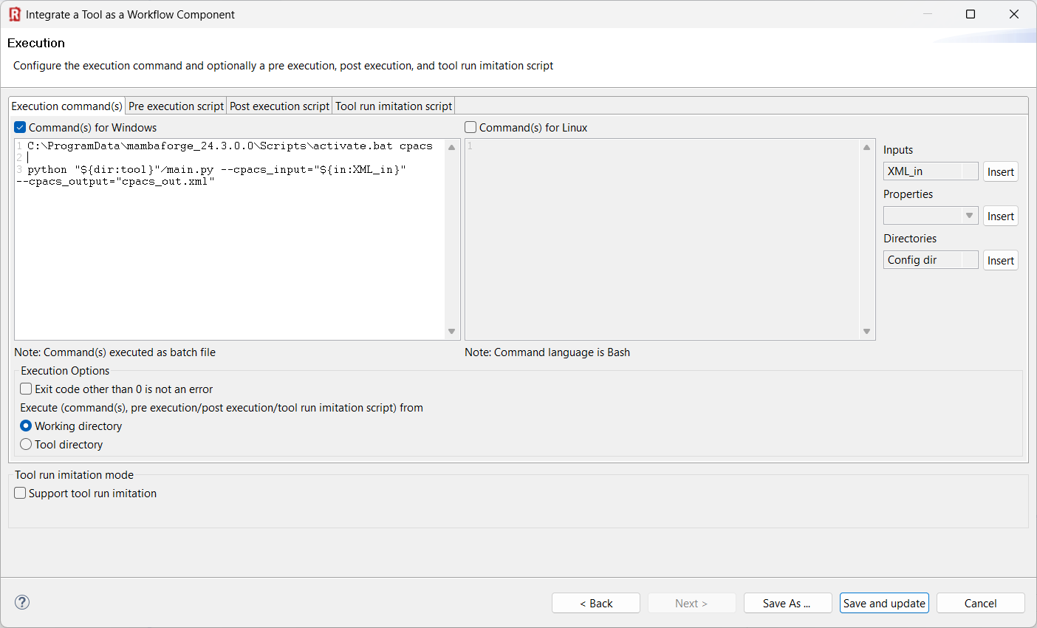
C:\ProgramData\mambaforge_24.3.0.0\Scripts\activate.bat cpacs
python "${dir:tool}"/main.py --cpacs_input="${in:XML_in}" --cpacs_output="cpacs_out.xml"
(1) Specify execution commands for Windows and/or Linux
💡This example is written in Python, so we need to activate the correct interpreter first.
(2) Select “Working directory”

Slide 9
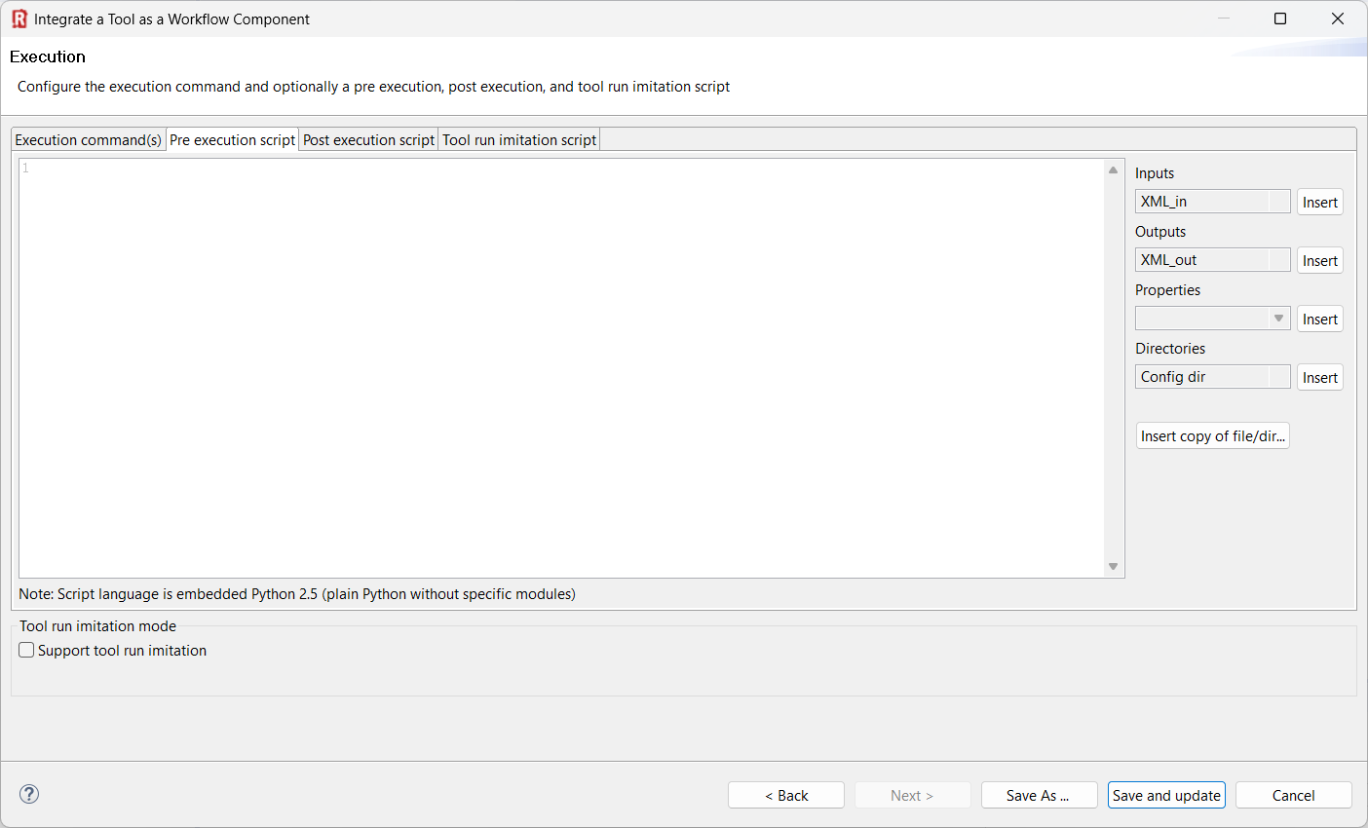
(1) Insert pre-execution script in Python
💡Pre-execution: What happens before the actual tool is activated. This is useful if you need to prepare a specific folder structure or copy resources before execution.

Slide 10
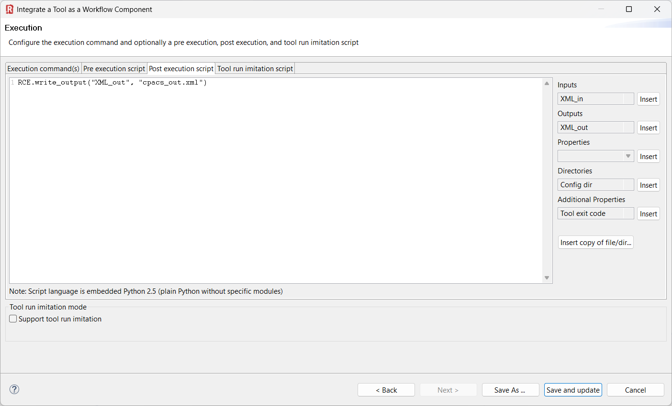
RCE.write_output("XML_out", "cpacs_out.xml")
💡Post-execution: What happens after the actual tool has finished. Here we’re telling RCE where to find the output file.
(1) Insert post-execution script in Python
(2) “Save and update/activate”

Slide 11
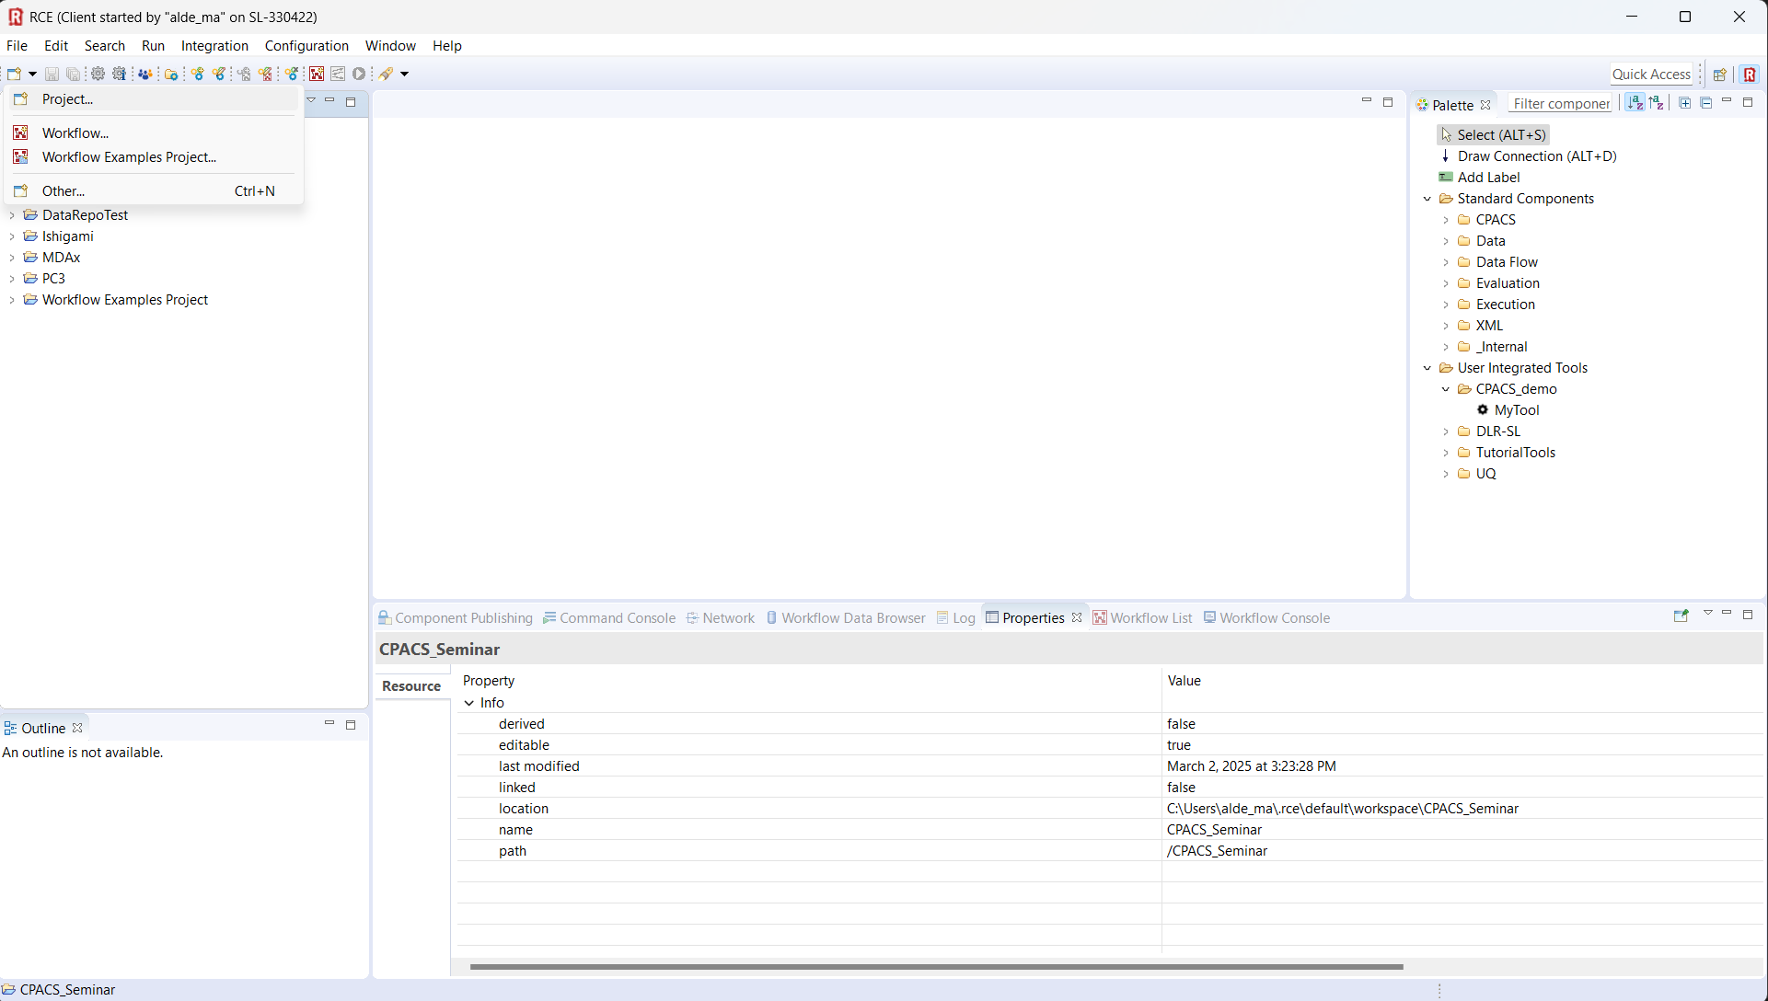
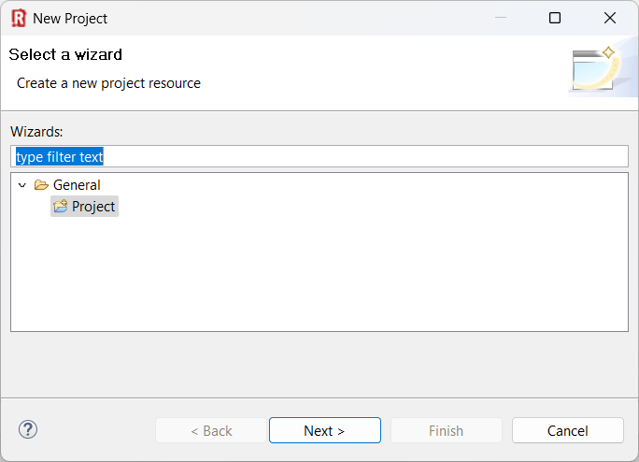
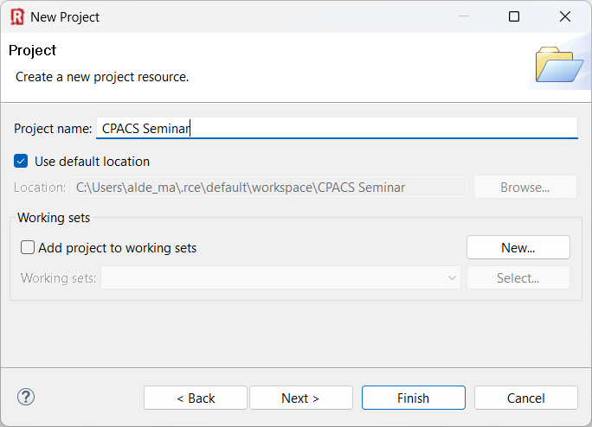
1
2
3

Slide 12
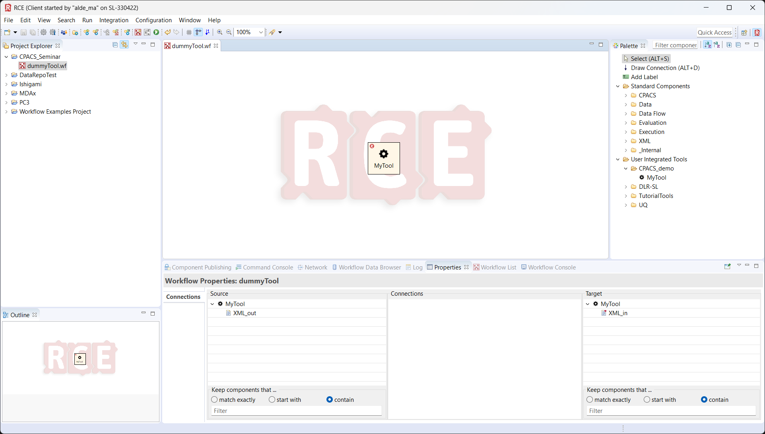
drag & drop

Slide 13
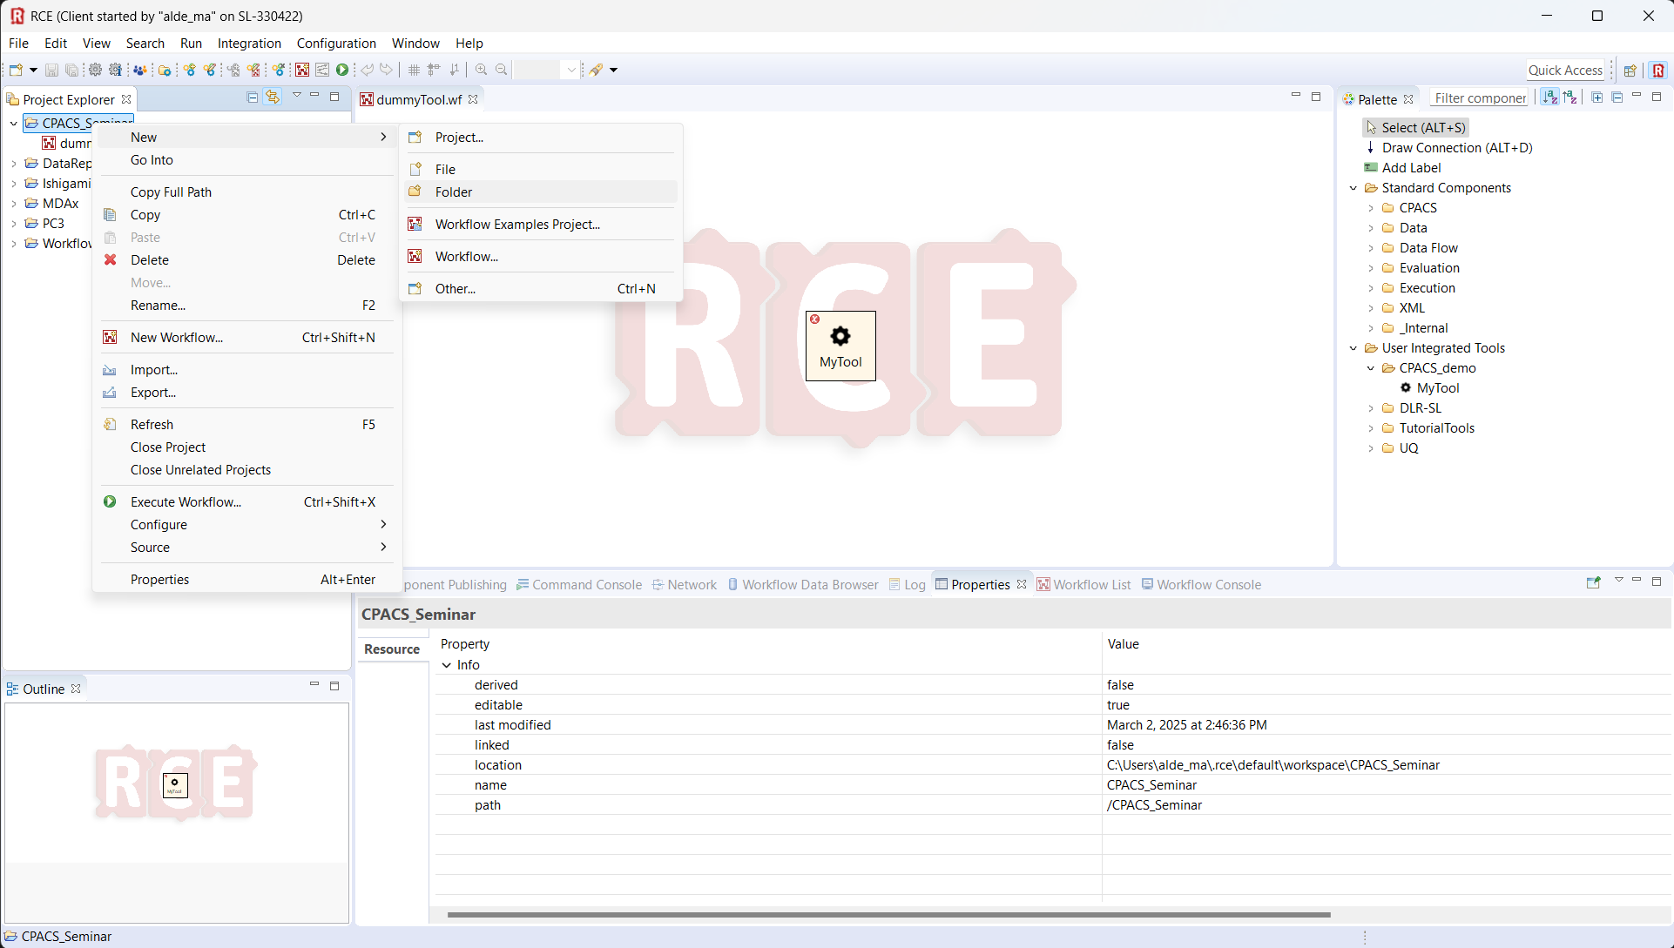
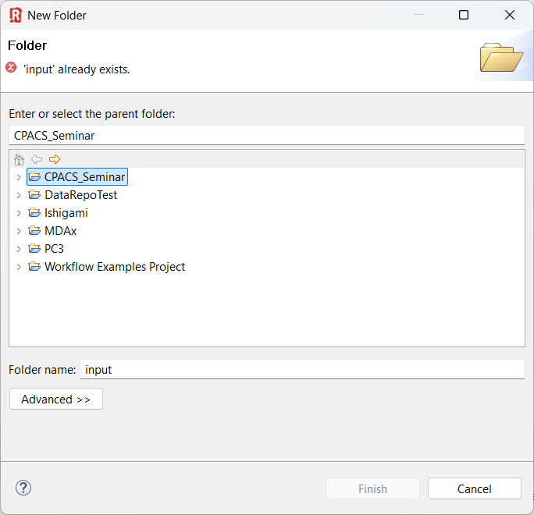
1

Slide 14
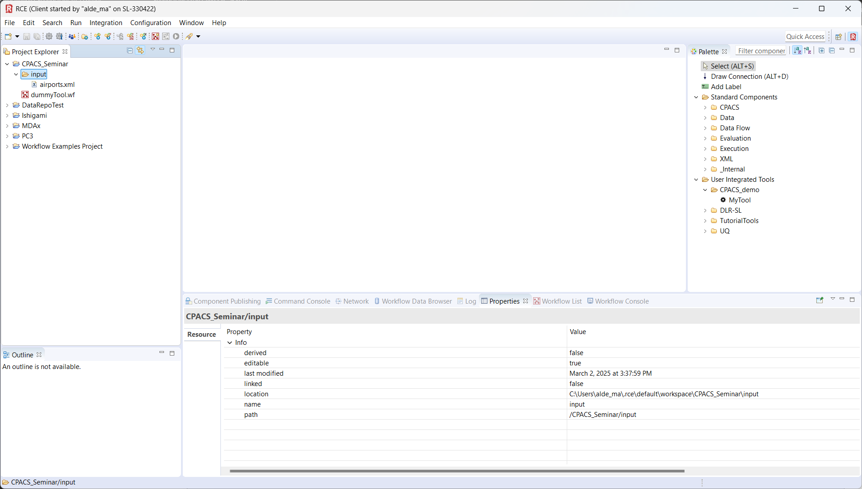
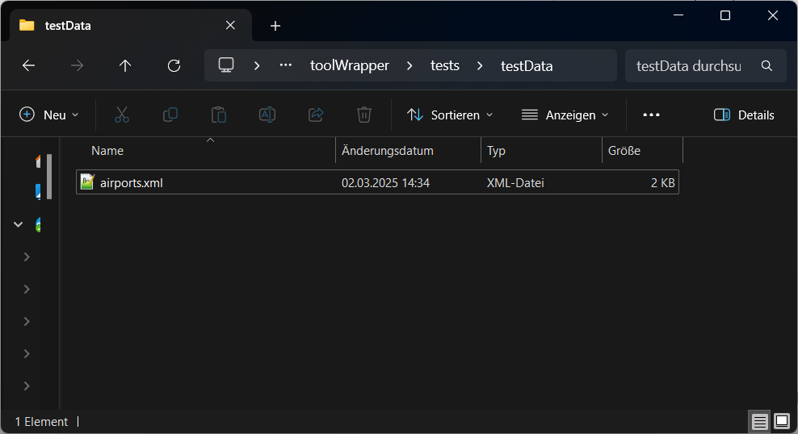
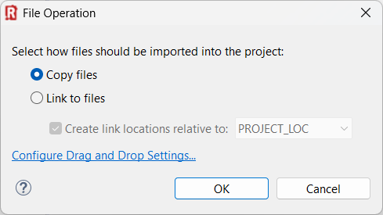
1
drag & drop
2

Slide 15
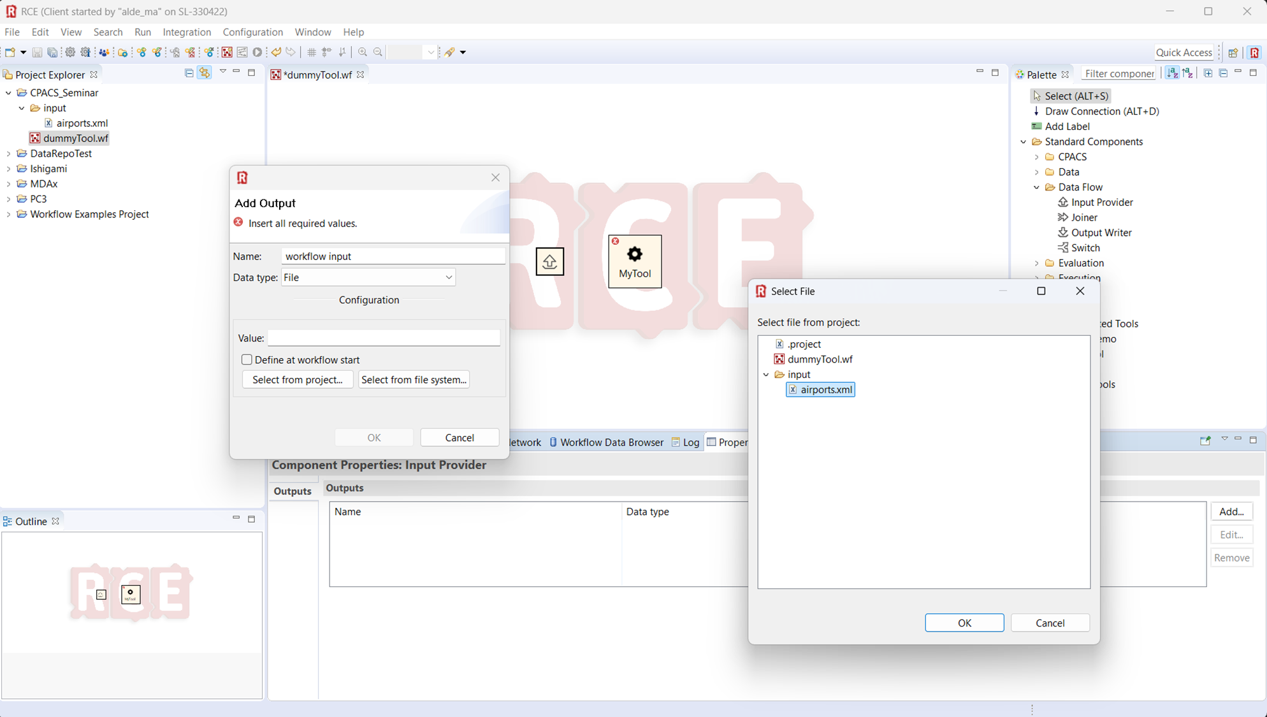
4
1
2
3
5

Slide 16
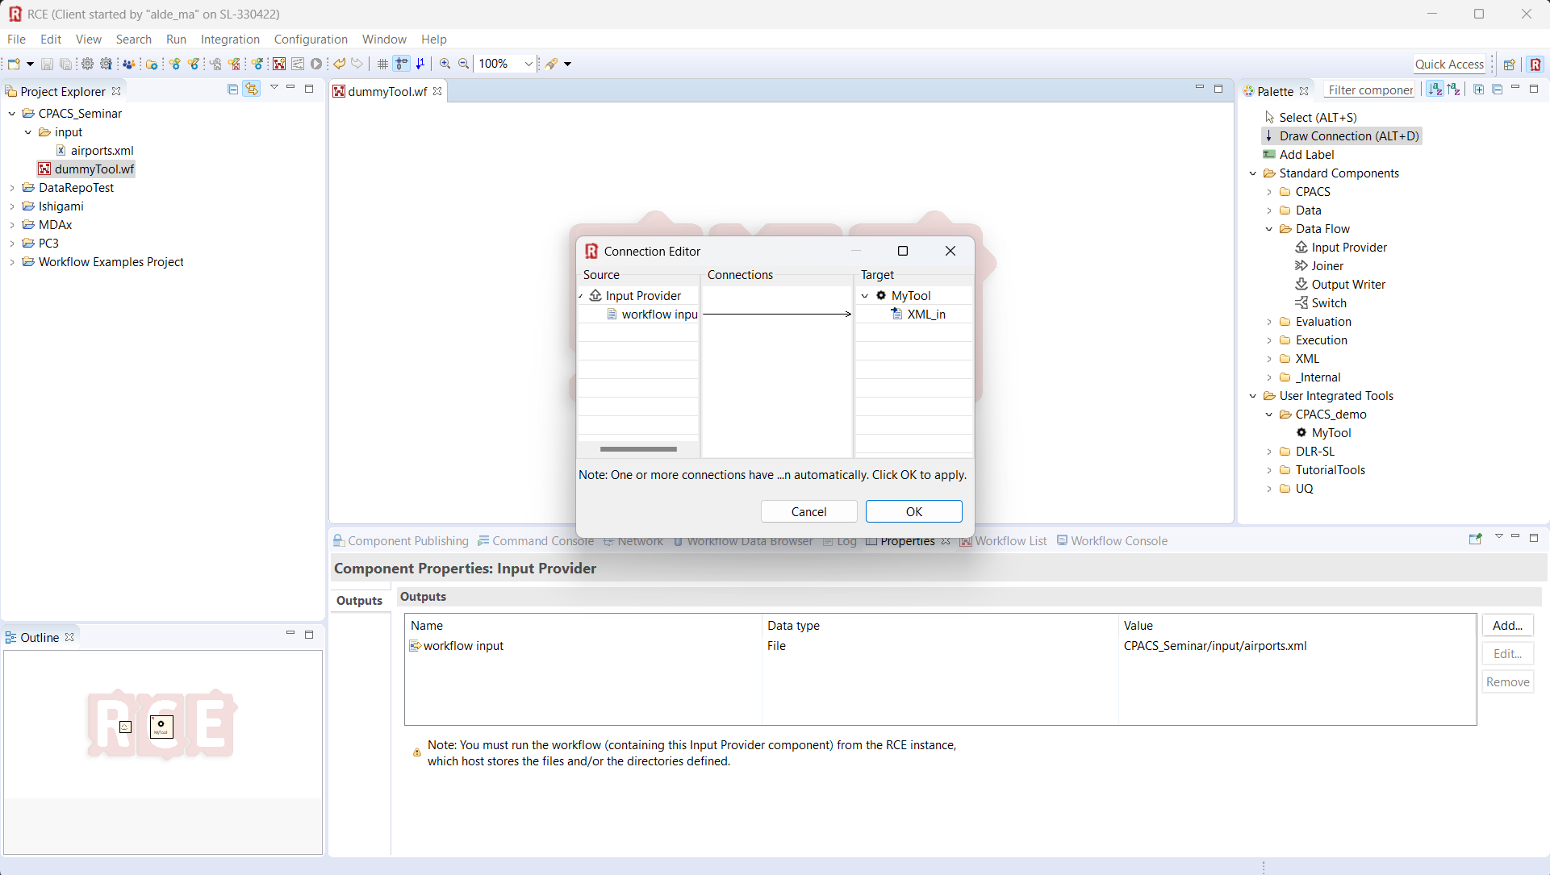
1
2
3

Slide 17
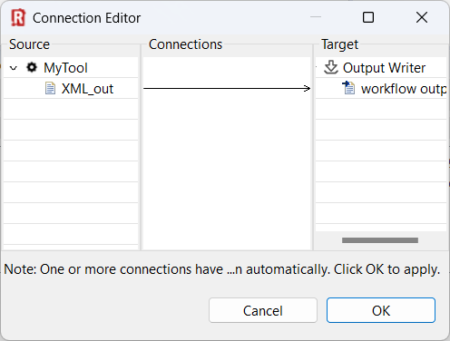
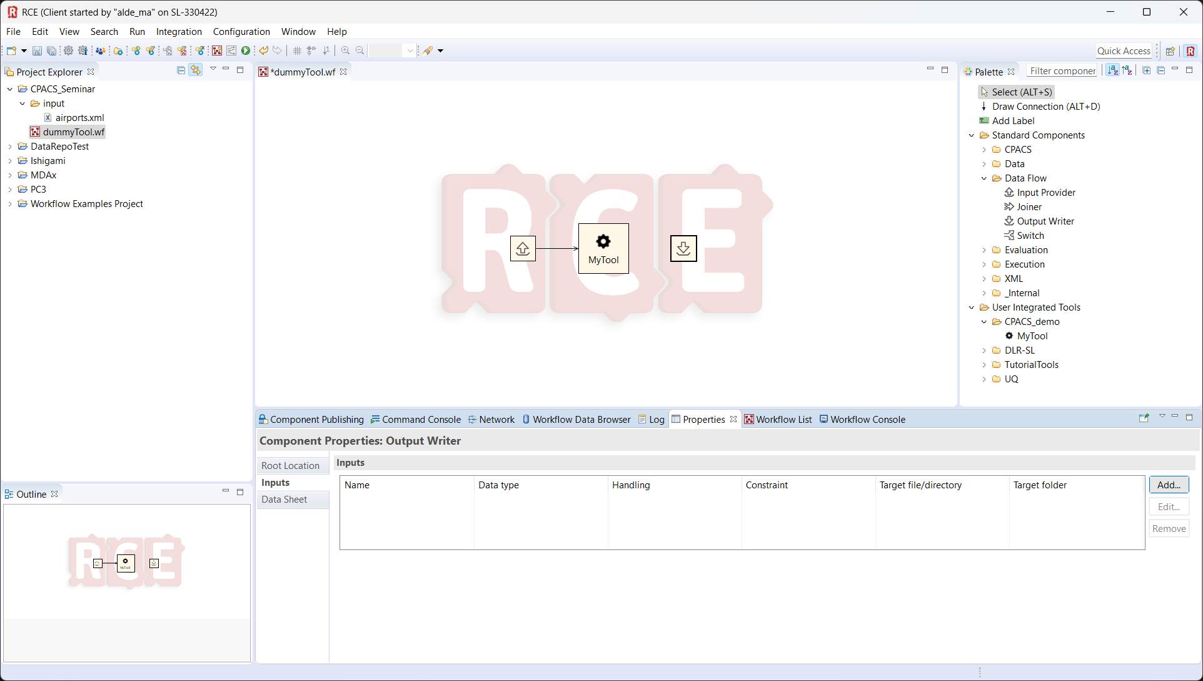
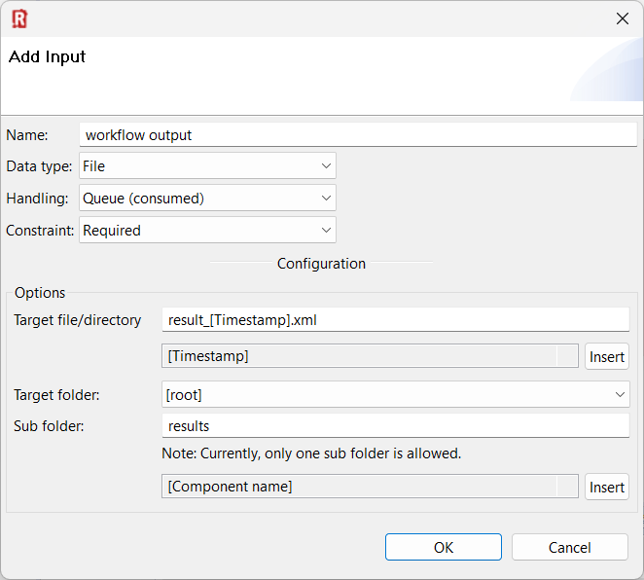
4
3
1
2

Slide 18
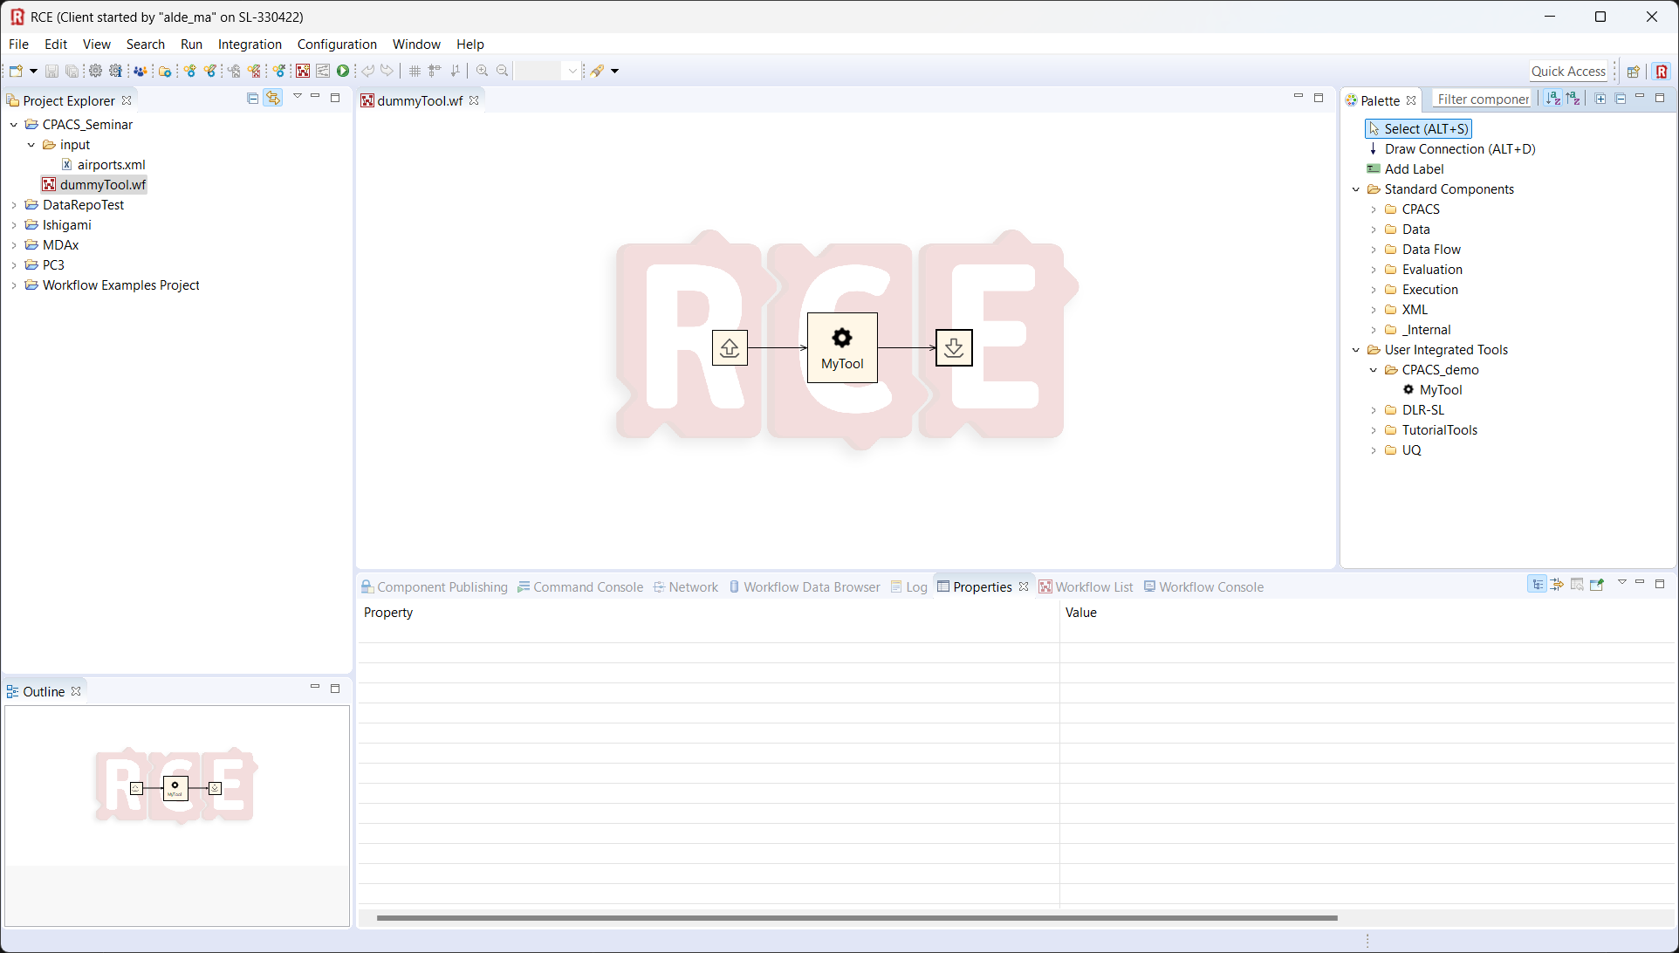
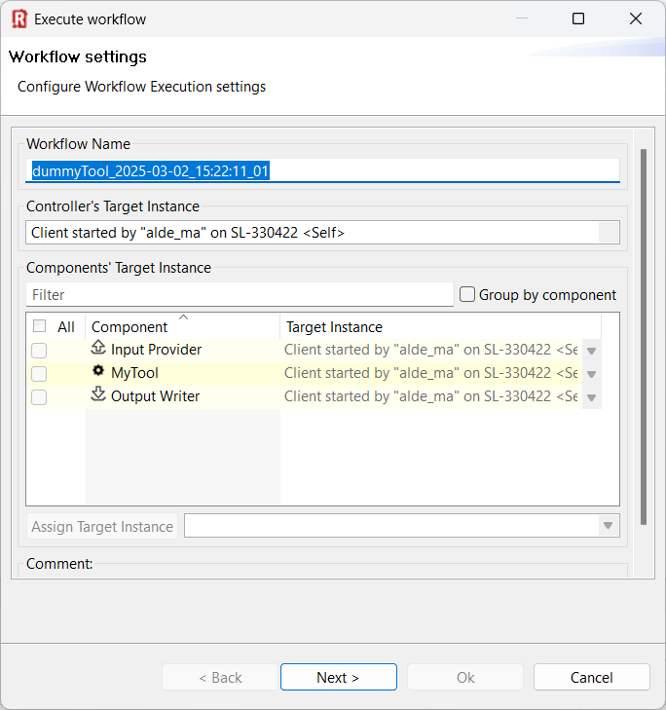
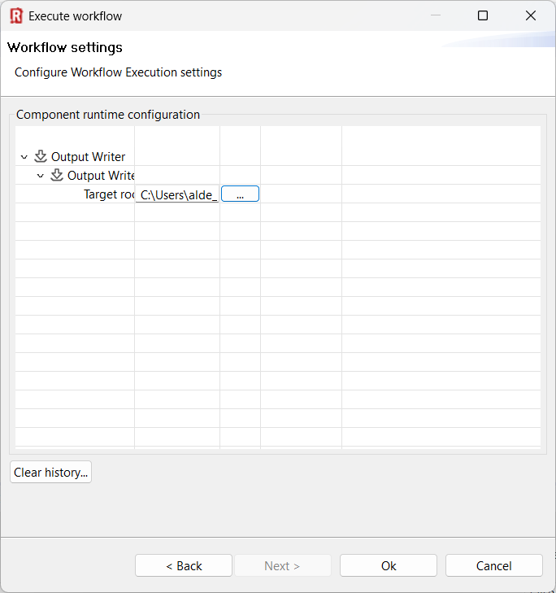
1
2
3

Slide 19
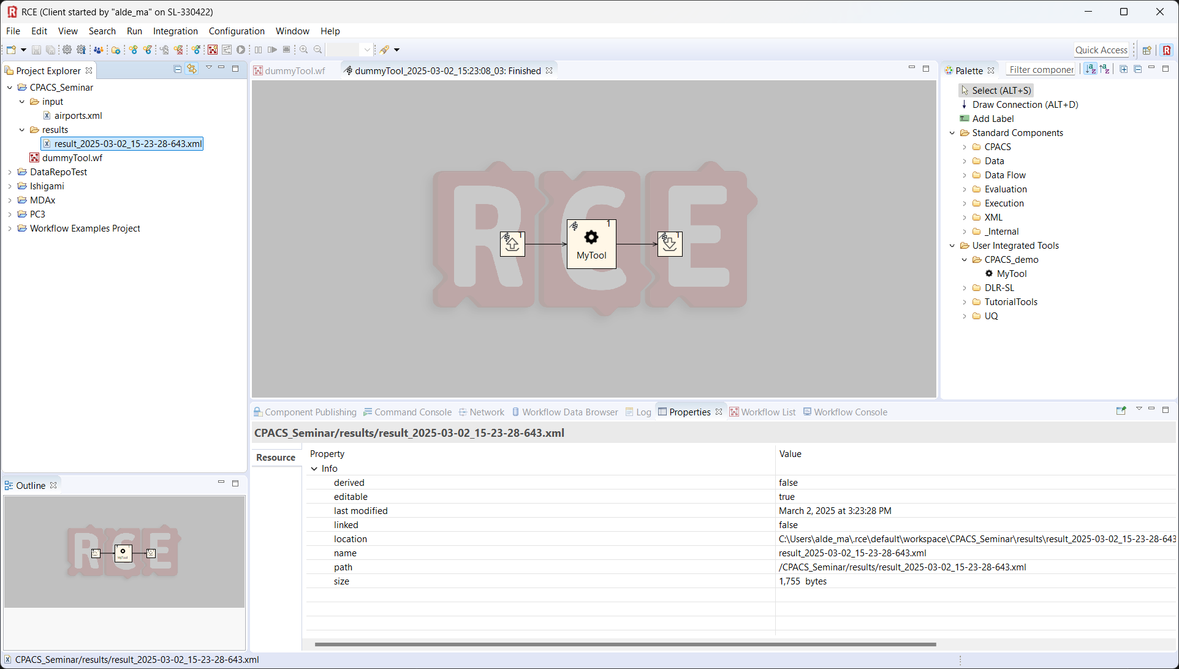

Slide 20
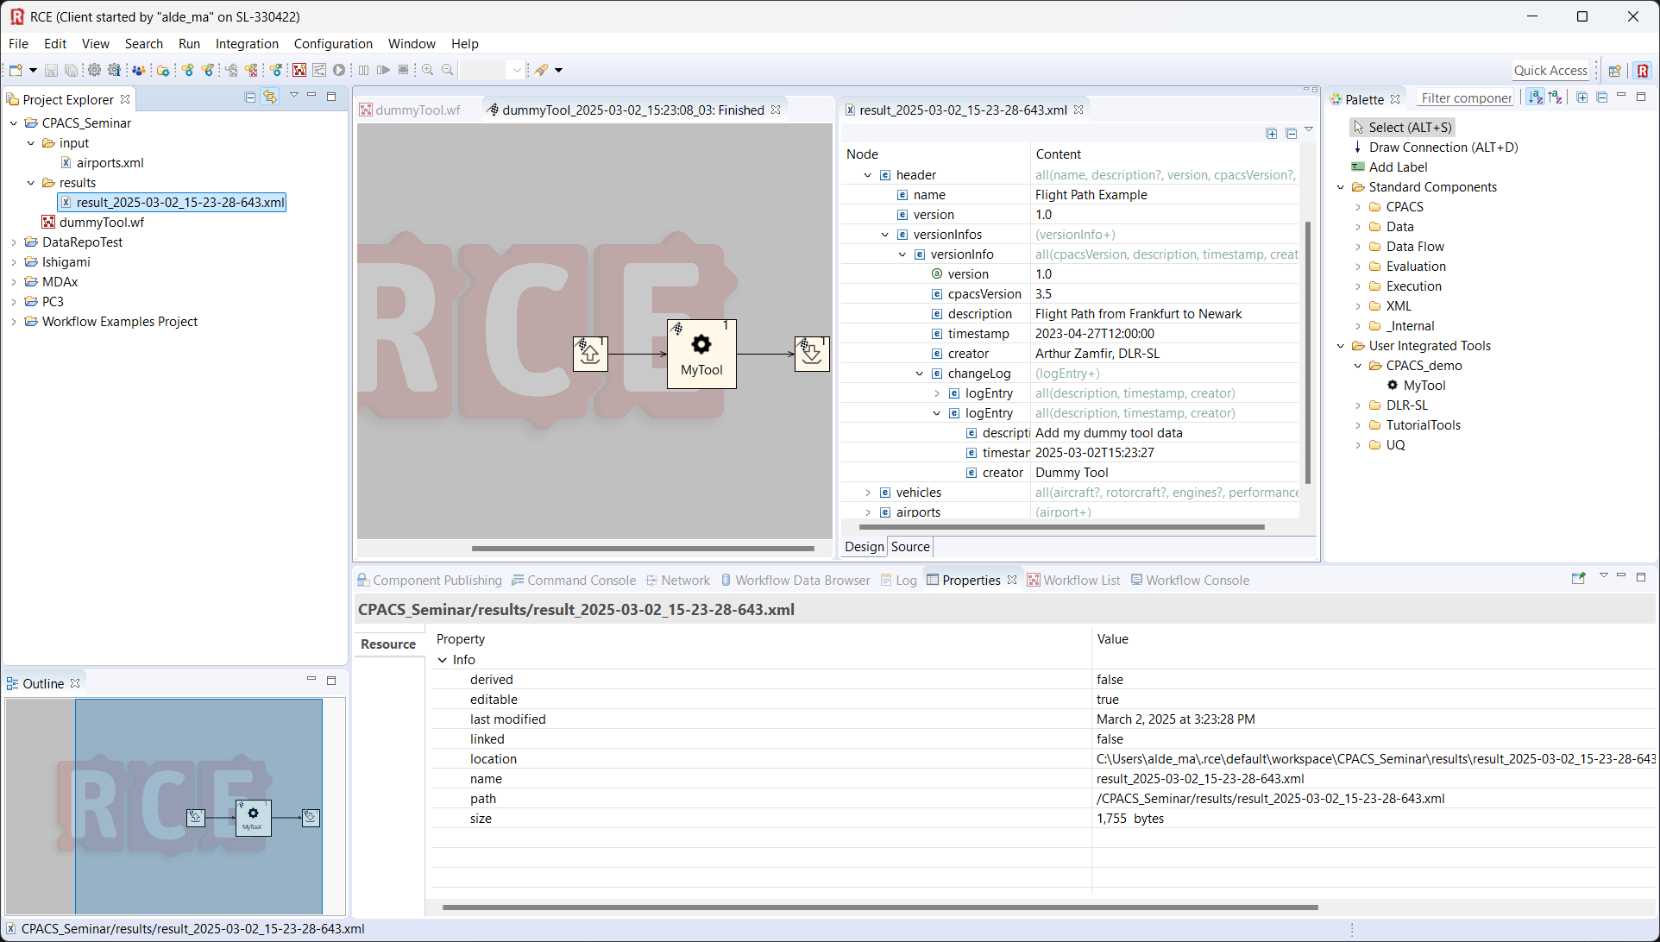
1
2

Slide 21
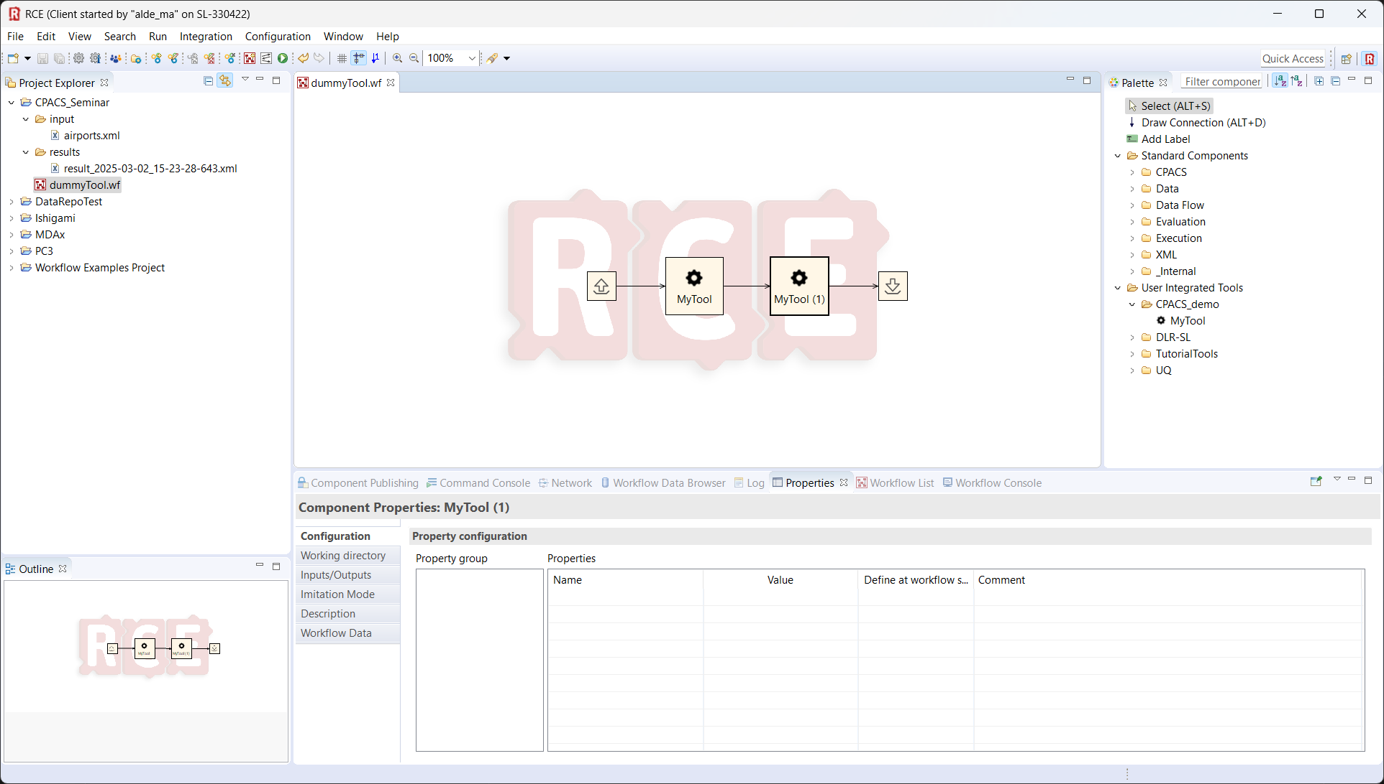
2
1

Slide 22
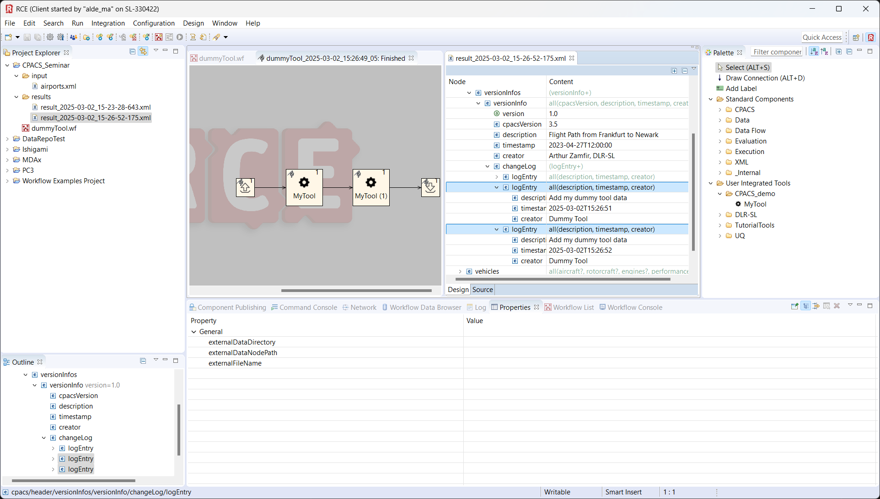
1
2

Slide 23
Imprint
Topic: RCE Tool Integration Dummy Tool wrapper
Date: 2025-03-02
Author: CPACS Team
Institute: DLR Institute for System Architectures in Aeronautics
Image sources: All images “DLR (CC BY-NC-ND 3.0)” unless otherwise stated

