Slide 1
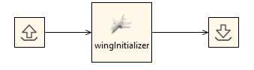
RCE tool integration
wingInitializer

Slide 2
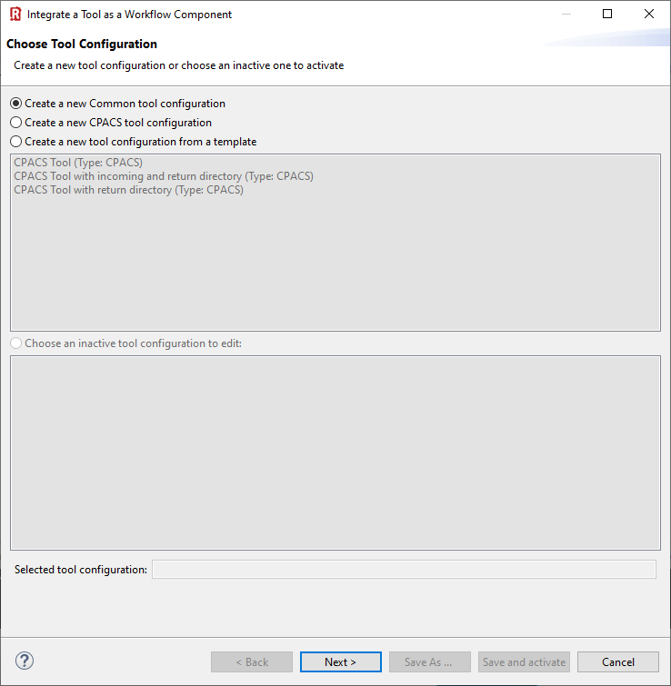
(1) In this example we use the "common tool configuration".
(2) Click “Next >”

Slide 3
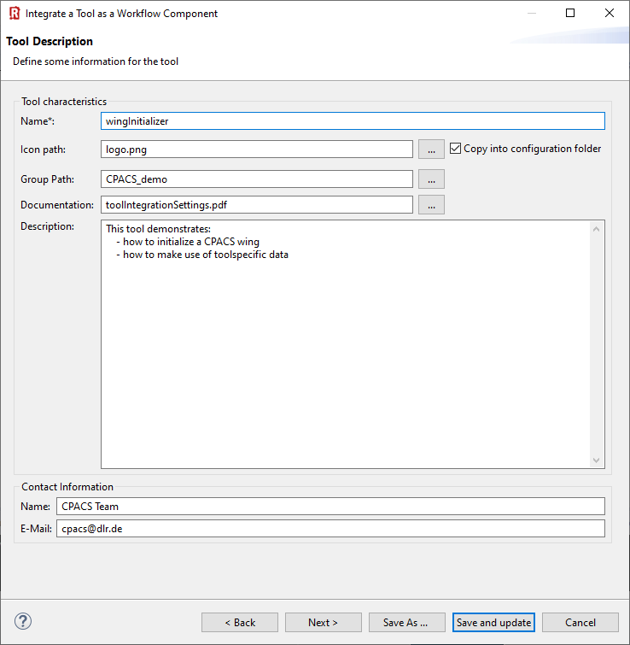

(1) Provide you tool name
(2) Choose a pretty icon
(3) Your tool palette might be structured by groups:
(4) Link a documentation
(5) Add description
(6) Provide contact information
(7) Next >

Slide 4
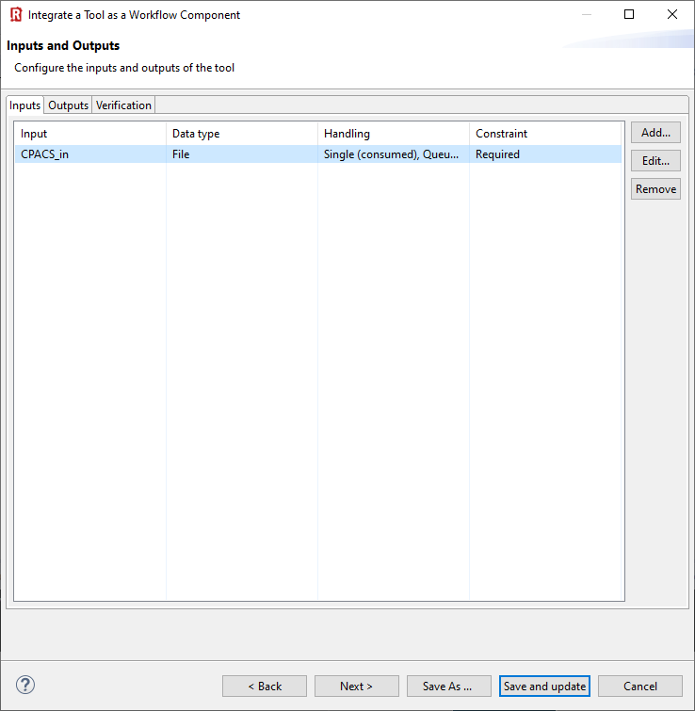
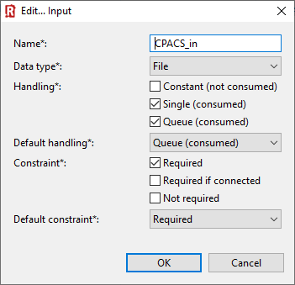
(1) Click “Add”
(2) Define RCE input variable of type “File”
(3) Choose these file handling settings and click “OK”
(4) Next >

Slide 5
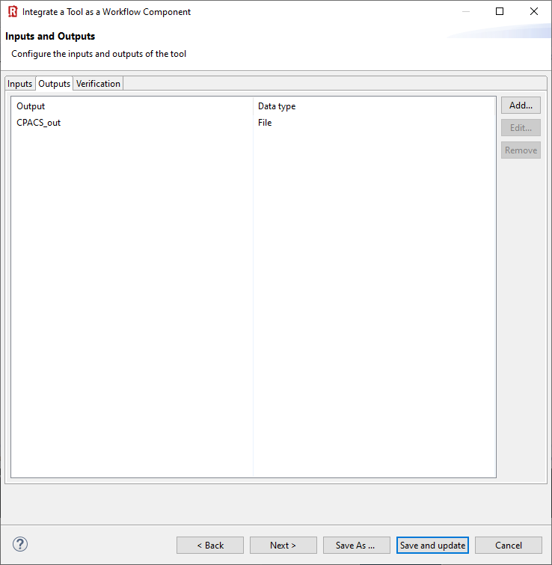
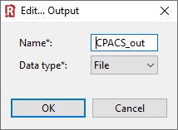
(1) Click “Add”
(2) Define RCE output variable of type “File”
(3) Next >

Slide 6
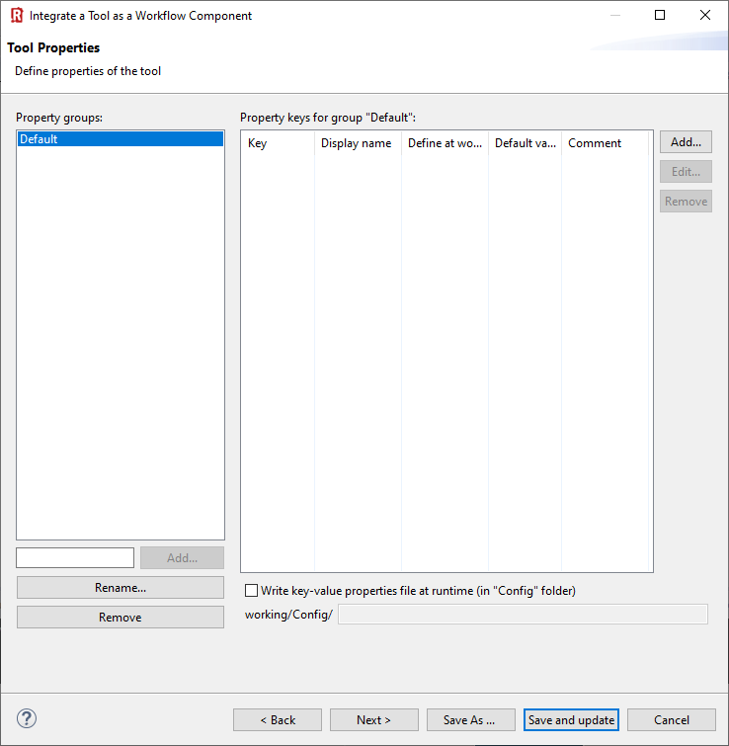
Nothing to do …
(1) Next >

Slide 7
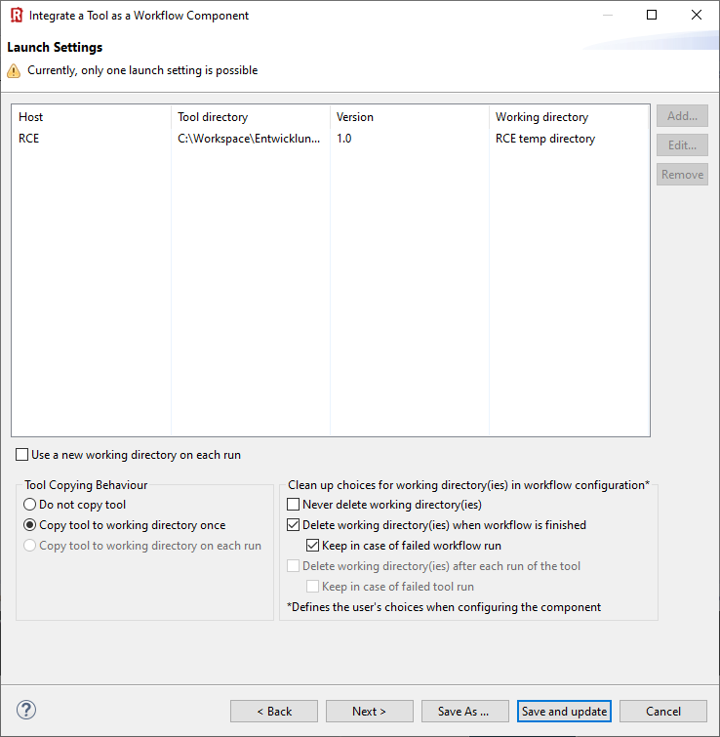
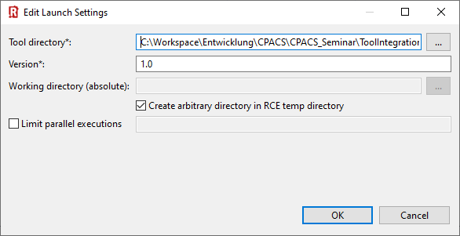
(1) Add launch setting
(2) Point to tool directory
(3) Select tool version
(4) Select checkboxes like this
(6) Convenient for debugging…
(5) Select your preferred copying behavior
(7) Next >

Slide 8
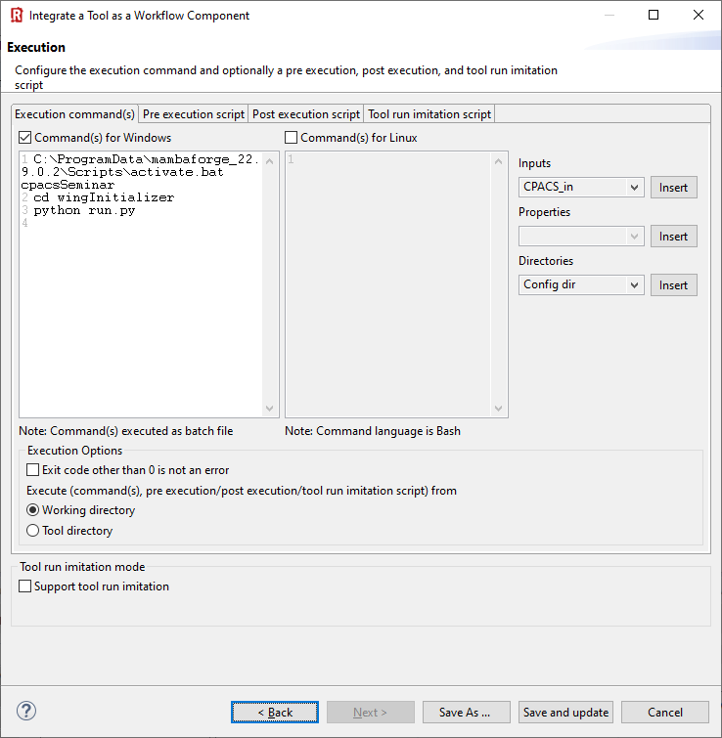
C:\ProgramData\mambaforge_22.9.0.2\Scripts\activate.bat cpacsSeminar
cd wingInitializer
python run.py
(1) Specify execution commands for Windows and/or Linux
🛈 This example is written in Python, so we need to activate the correct interpreter first.
(2) Select “Working directory”

Slide 9
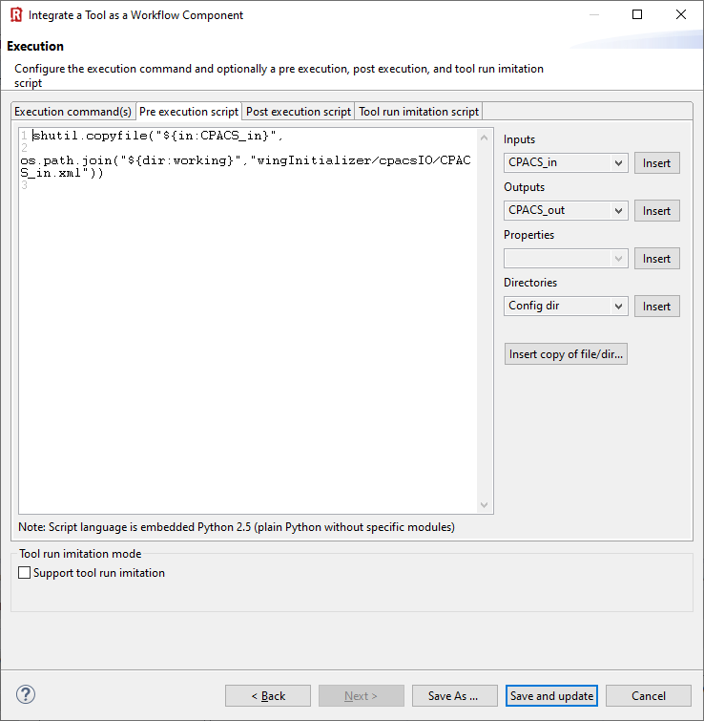
shutil.copyfile("${in:CPACS_in}",
os.path.join("${dir:working}","wingInitializer/cpacsIO/CPACS_in.xml"))
(1) Insert pre-execution script in Python
🛈 Pre-execution: What happens before the actual tool is activated. Use this to create the required folder structure, if necessary, and copy the input file into it.

Slide 10
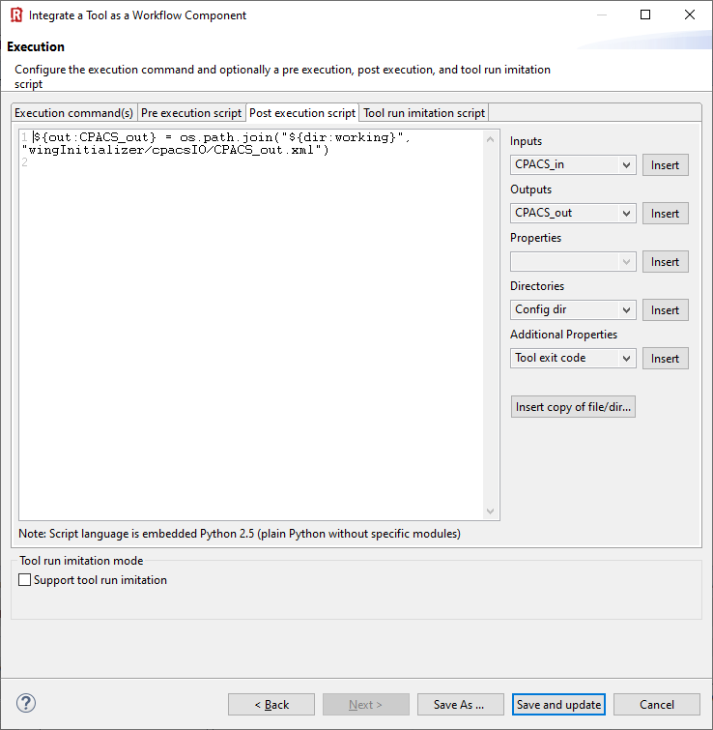
${out:CPACS_out} = os.path.join("${dir:working}", "wingInitializer/cpacsIO/CPACS_out.xml")
🛈 Post-execution: What happens after the actual tool has finished. Here we’re telling RCE where to find the output file.
(1) Insert post-execution script in Python
(2) “Save and update/activate”

