Slide 1
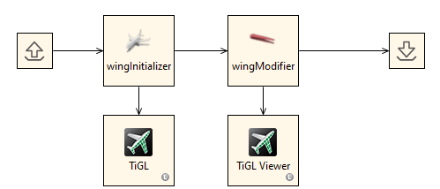
RCE tool integration
wingModifier

Slide 2
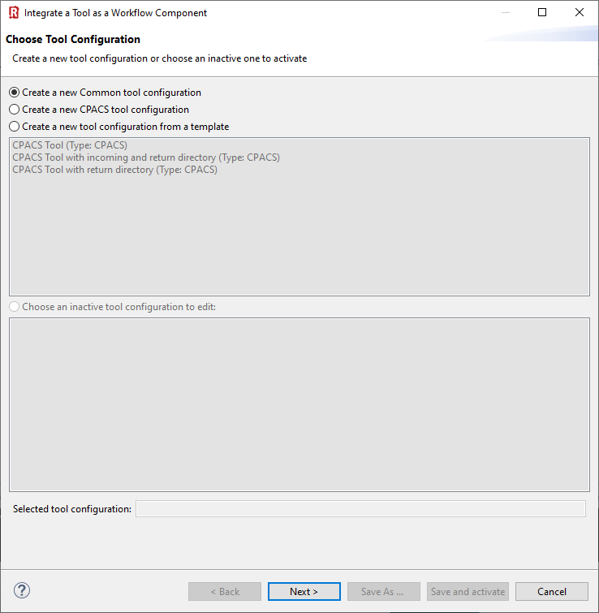
(1) In this example we use the "common tool configuration".
(2) Click “Next >”

Slide 3
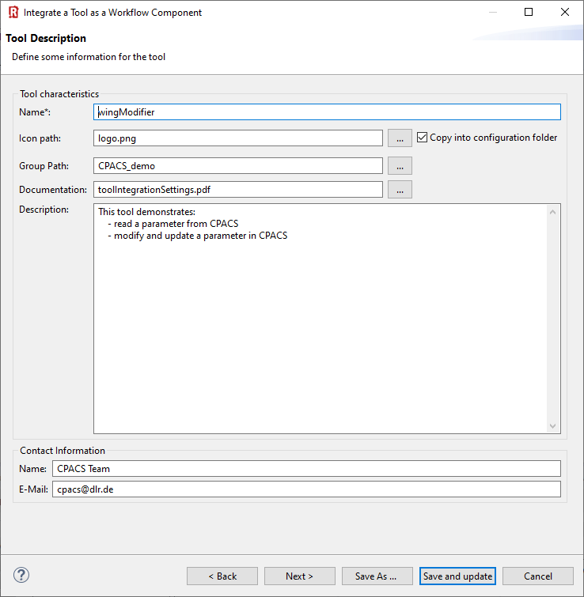
(1) Provide you tool name
(2) Choose a pretty icon
(3) Your tool palette might be structured by groups
(4) Link a documentation
(5) Add description
(6) Provide contact information
(7) Next >

Slide 4
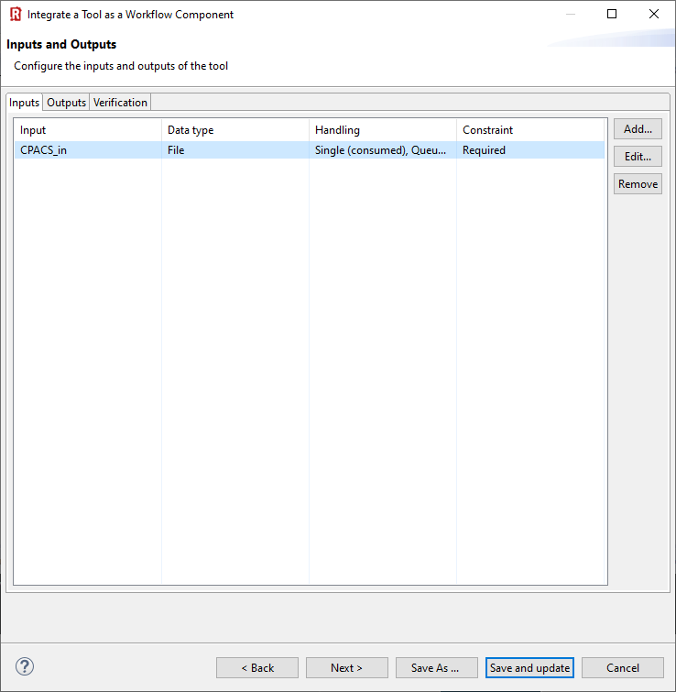
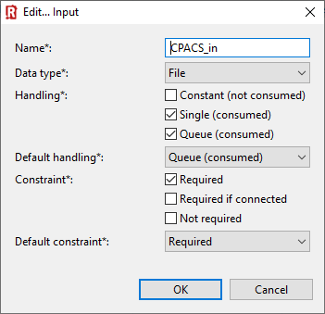
(1) Click “Add”
(2) Define RCE input variable of type “File”
(3) Choose these file handling settings and click “OK”
(4) Next >

Slide 5
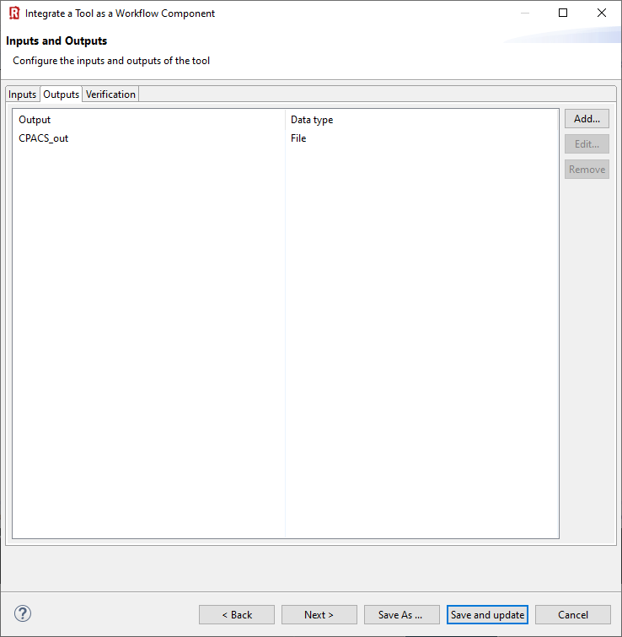
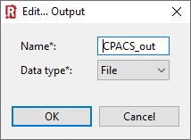
(1) Click “Add”
(2) Define RCE output variable of type “File”
(3) Next >

Slide 6
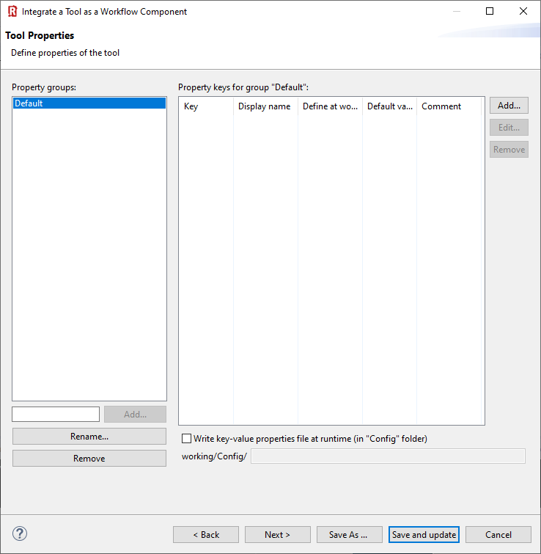
Nothing to do …
(1) Next >

Slide 7
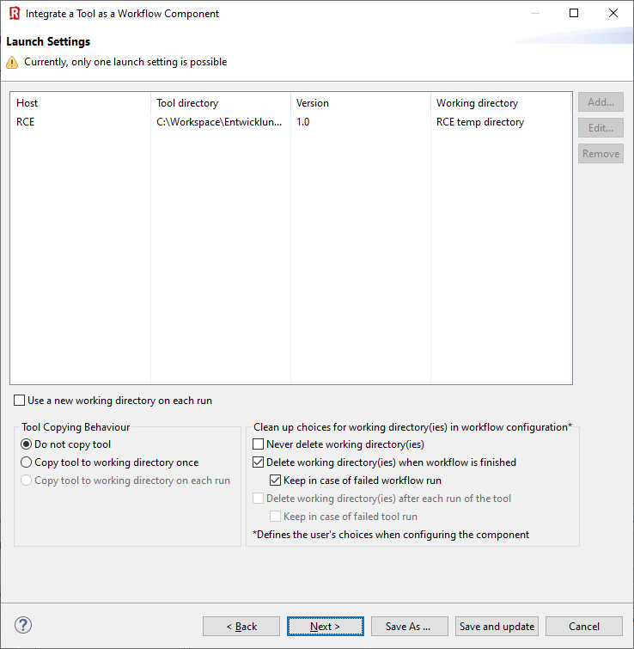
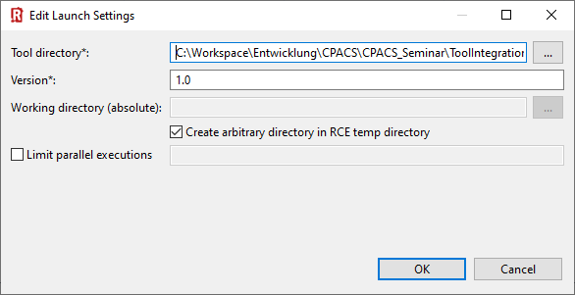
(1) Add launch setting
(2) Point to tool directory
(3) Select tool version
(4) Select checkboxes like this
(6) Convenient for debugging…
(5) Select your preferred copying behavior
(7) Next >

Slide 8
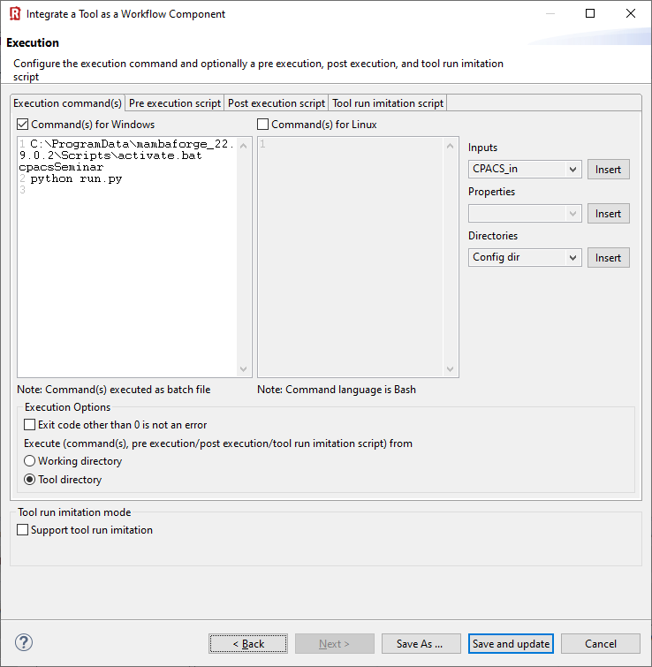
C:\ProgramData\mambaforge_22.9.0.2\Scripts\activate.bat cpacsSeminar
python run.py
(1) Specify execution commands for Windows and/or Linux
🛈 This example is written in Python, so we need to activate the correct interpreter first.
(2) Select “Tool directory”

Slide 9
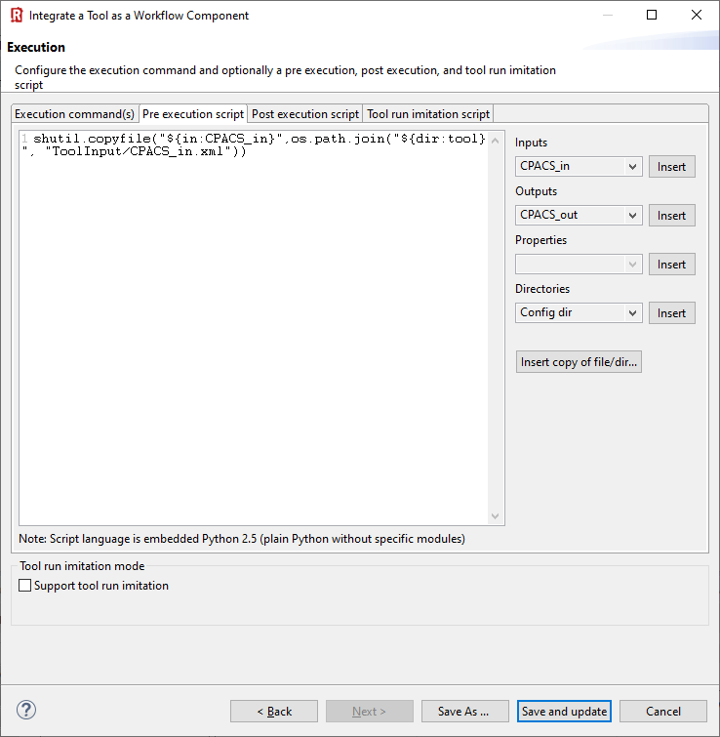
shutil.copyfile("${in:CPACS_in}",os.path.join("${dir:tool}", "ToolInput/CPACS_in.xml"))
(1) Insert pre-execution script in Python
🛈 Pre-execution: What happens before the actual tool is activated. Use this to create the required folder structure, if necessary, and copy the input file into it.

Slide 10
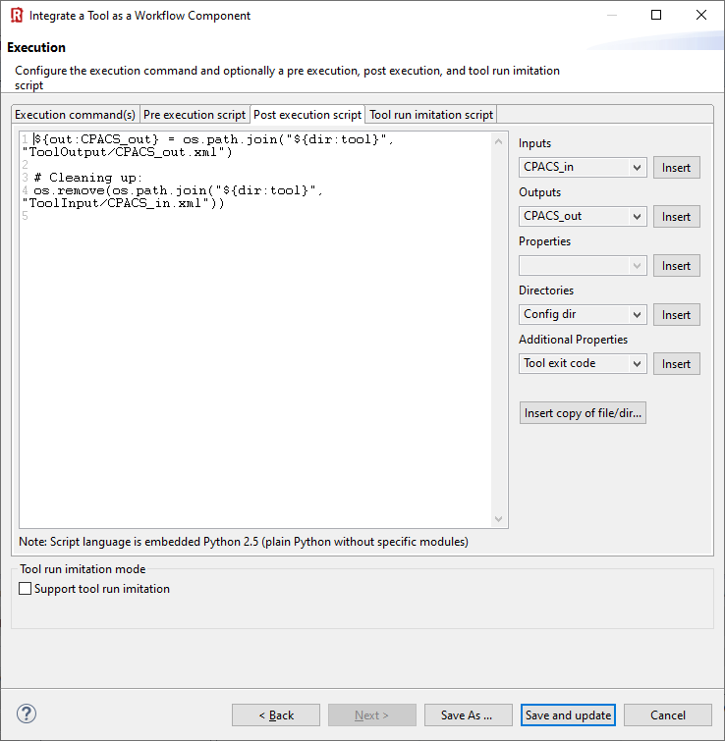
🛈 Post-execution: What happens after the actual tool has finished. Here we're telling RCE where to find the output file. In this example the tool is not copied, it is run locally. So we clean up the input file to avoid any confusion when the workflow is run again.
${out:CPACS_out} = os.path.join("${dir:tool}", "ToolOutput/CPACS_out.xml")
# Cleaning up:
os.remove(os.path.join("${dir:tool}", "ToolInput/CPACS_in.xml"))
(1) Insert post-execution script in Python
(2) “Save and update/activate”

