Slide 1
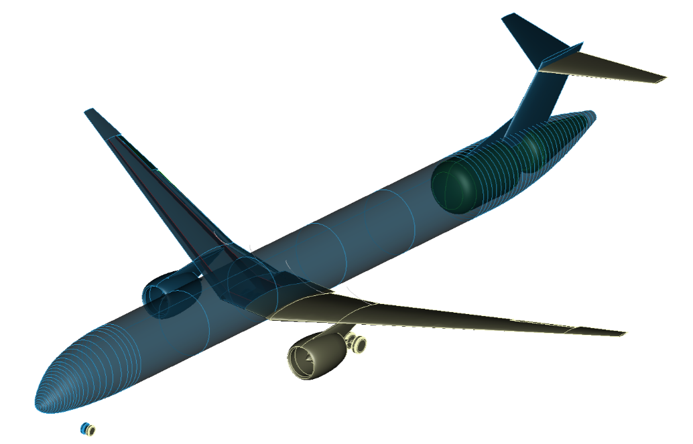
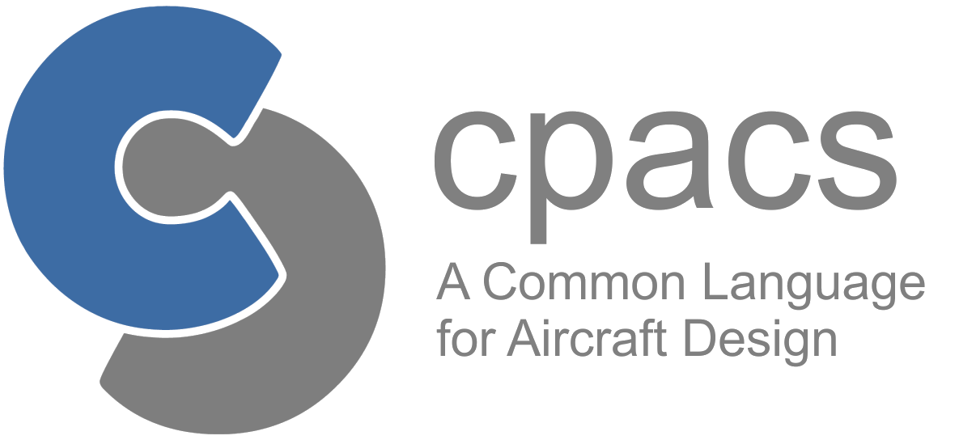
Introduction to CPACS
German Aerospace Center e. V. (DLR)
Institute of System Architectures in Aeronautics

Slide 2
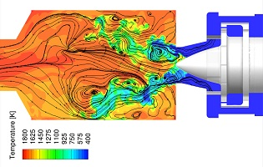
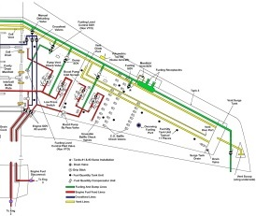
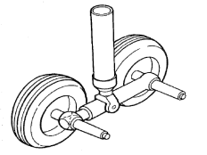
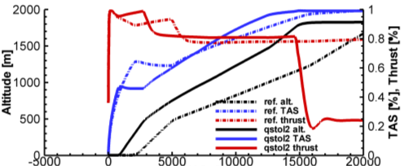
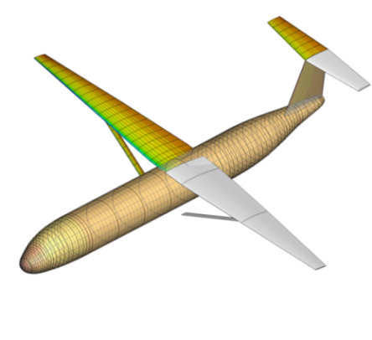
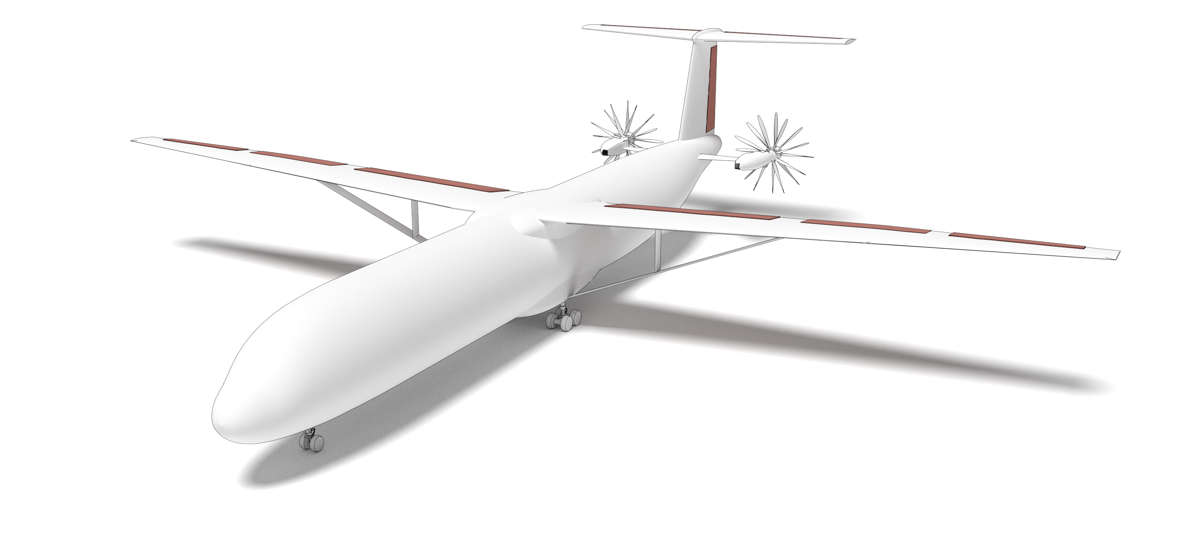
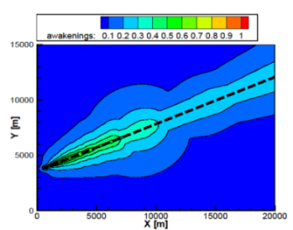
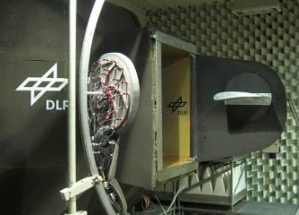
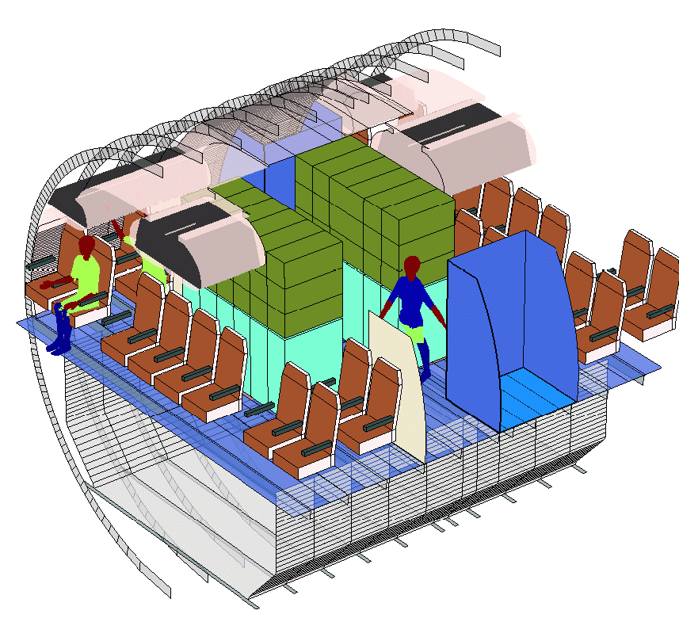
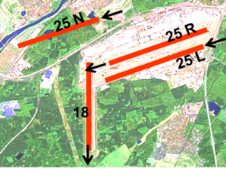
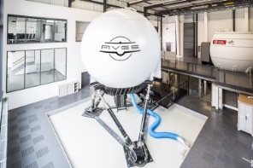
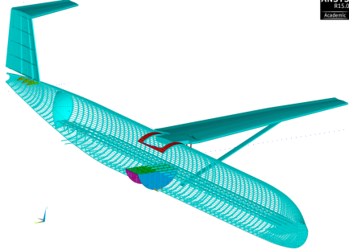
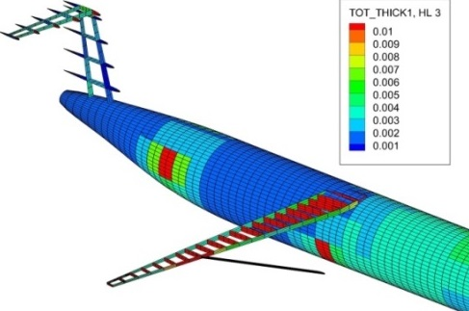
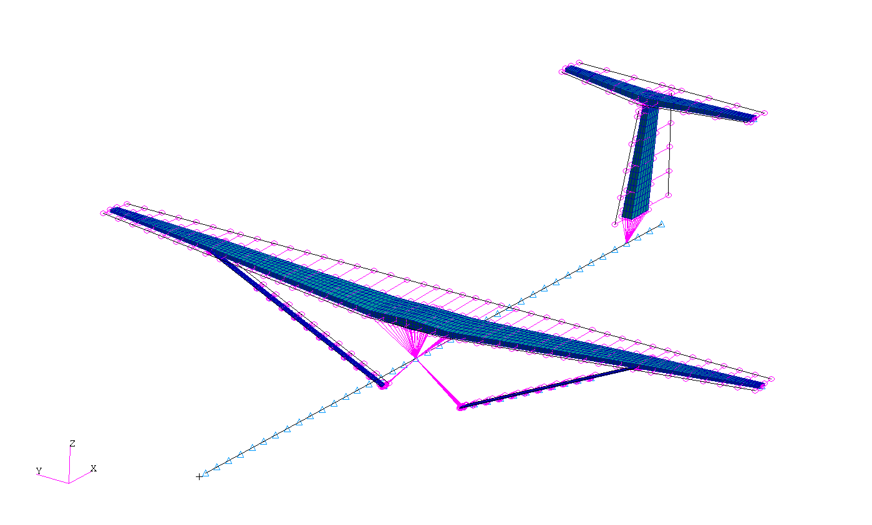
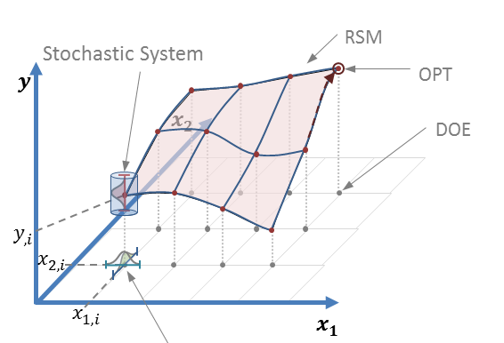
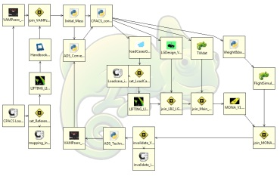
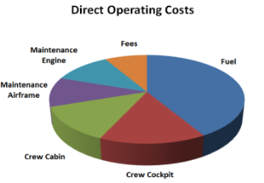
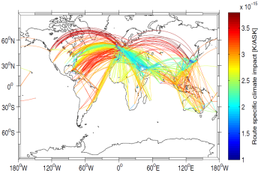

Slide 3
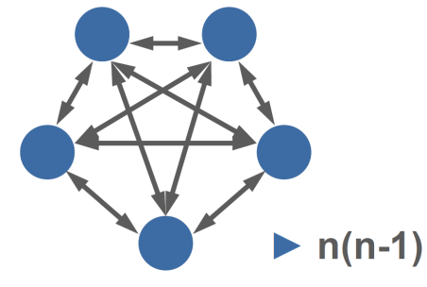

Slide 4


Common Parametric Aircraft Configuration Schema

Slide 5
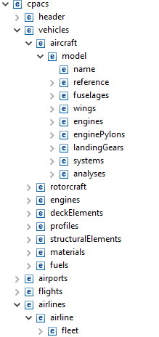
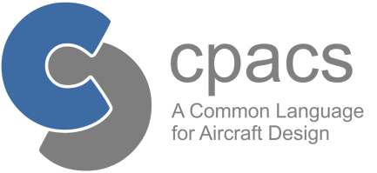
Introduction to CPACS

Slide 6
Introduction to CPACS

Slide 7
Introduction to CPACS

Slide 8
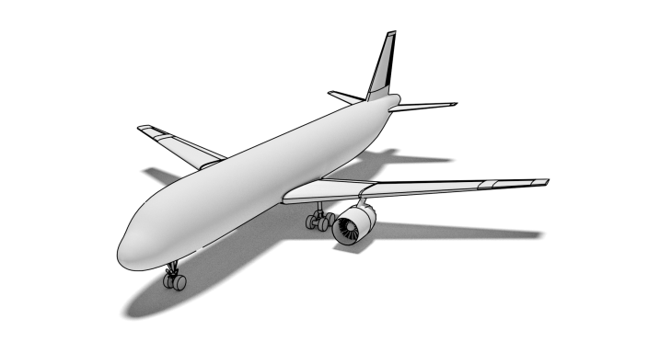
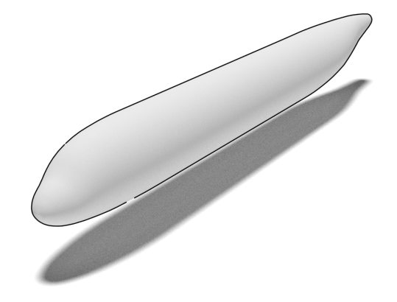
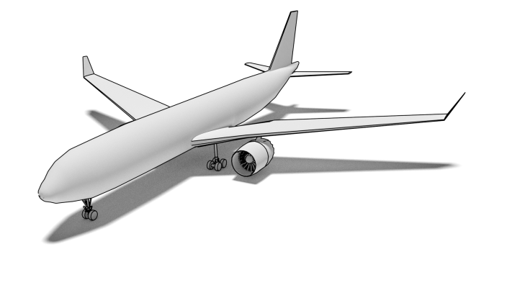
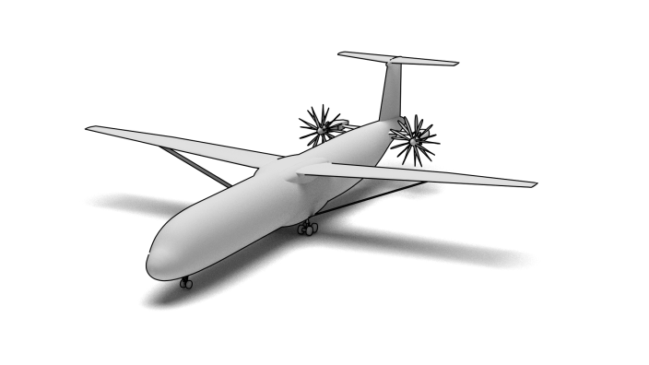
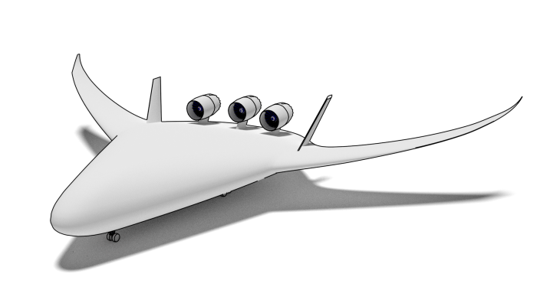
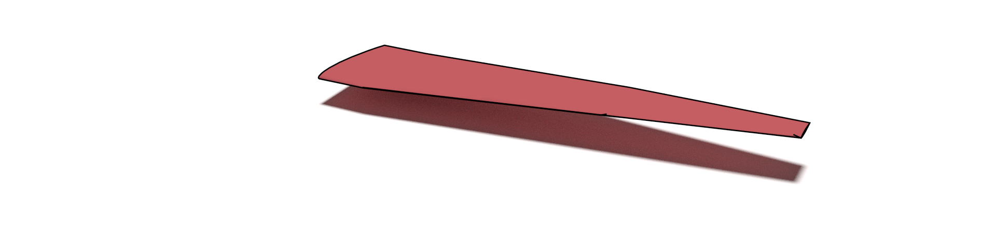
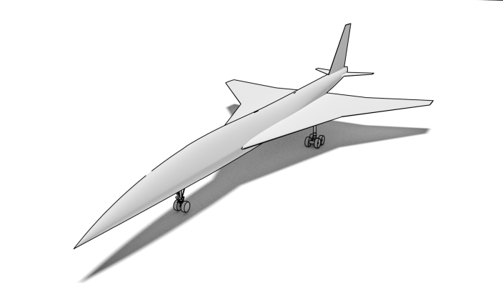
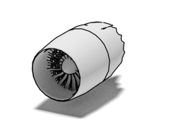
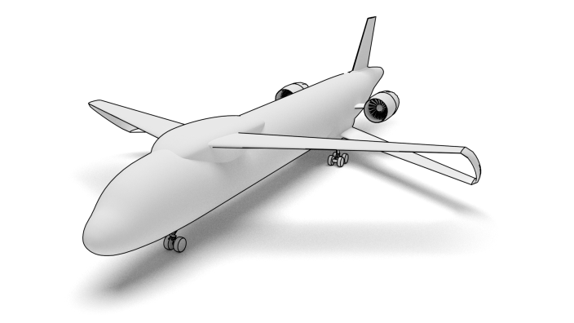
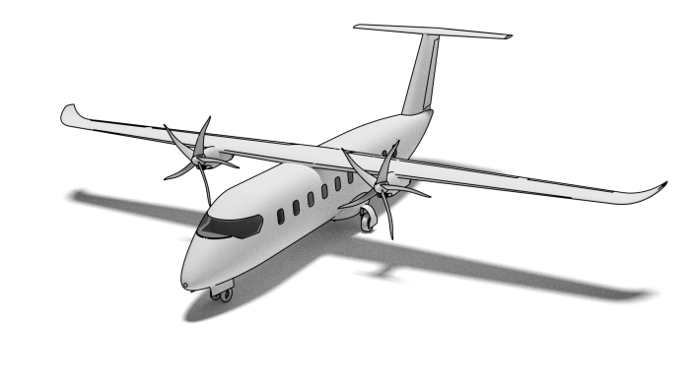
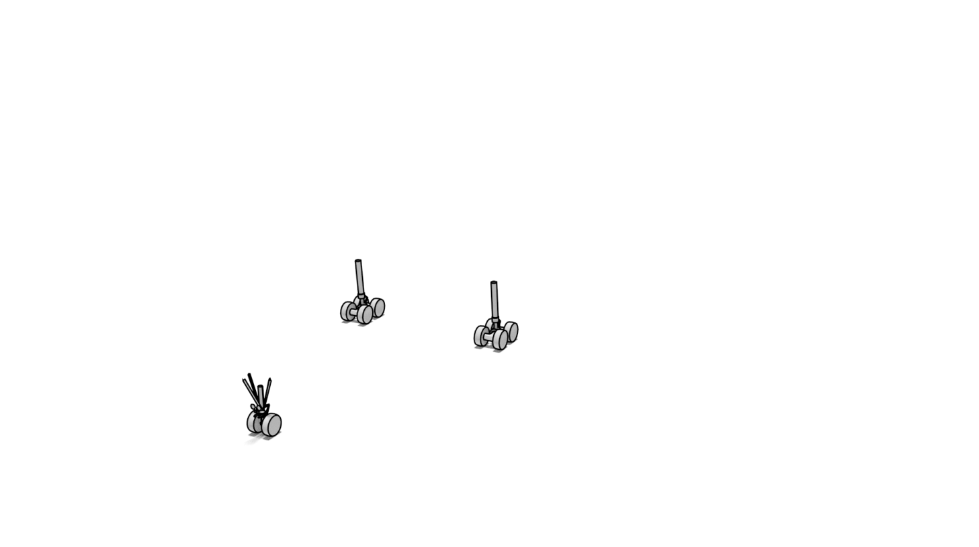
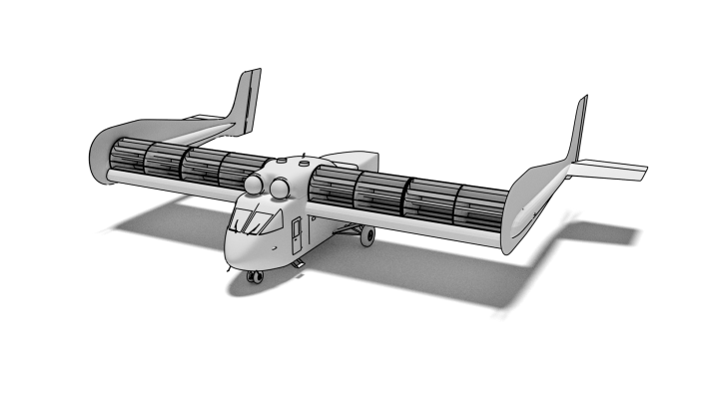

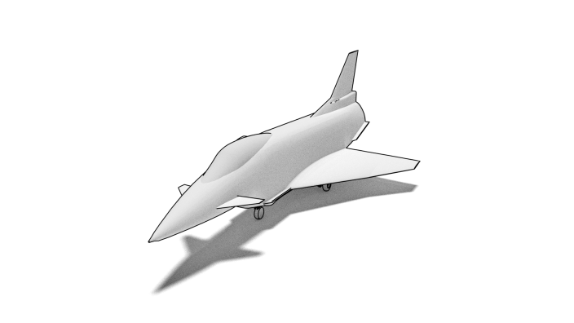
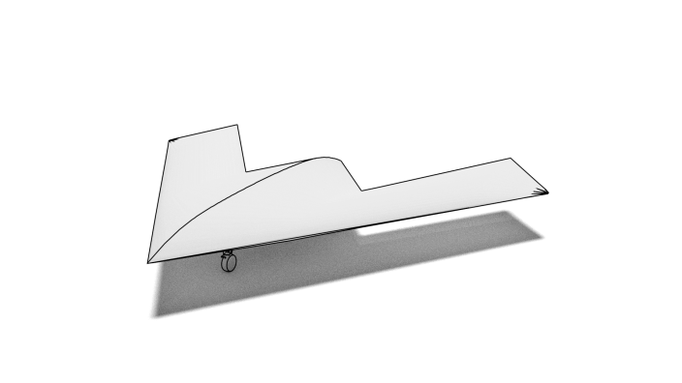
Introduction to CPACS
Hierarchical Structure
top level
2. level
3. level

Slide 9
Introduction to CPACS
Hierarchical Structure
top level
2. level
3. level

Slide 10
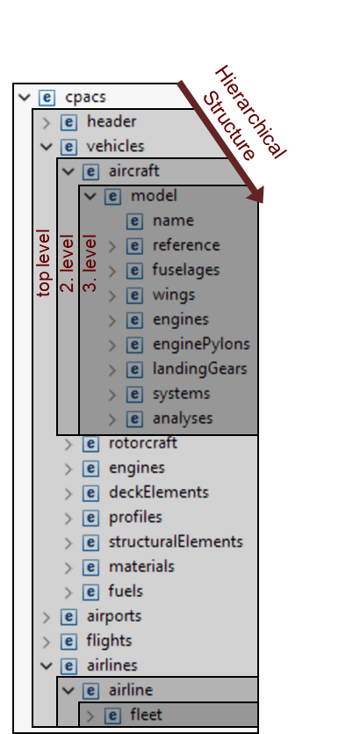


Introduction to CPACS
Common language for aircraft design
Exchange of specialist knowledge
Developed since 2005, based on XML / XSD
Human readable
Standardized
Open-source

Slide 11

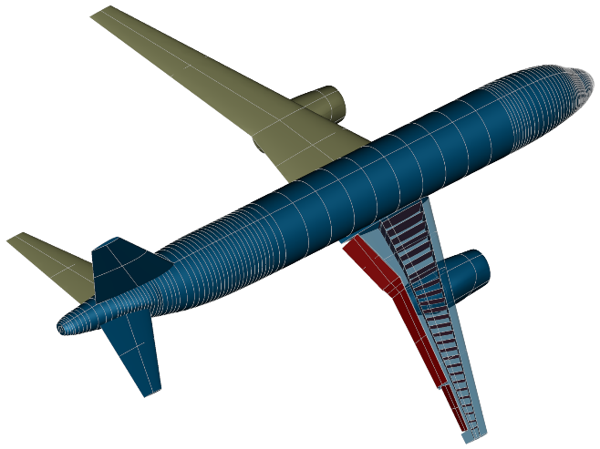
Introduction to CPACS
Common language for aircraft design
Exchange of specialist knowledge
Developed since 2005, based on XML / XSD
Human readable
Standardized
Open-source
Supporting libraries:
TiXI: fast & simple XML Interfacing
TiGL: Geometric Library (based on OpenCASCADE)
- query functions: tiglGetWingArea
- export to IGES/VTK
- geometry viewer
external interfaces for: C, C++, Python, Java, MATLAB and Fortran

Slide 12
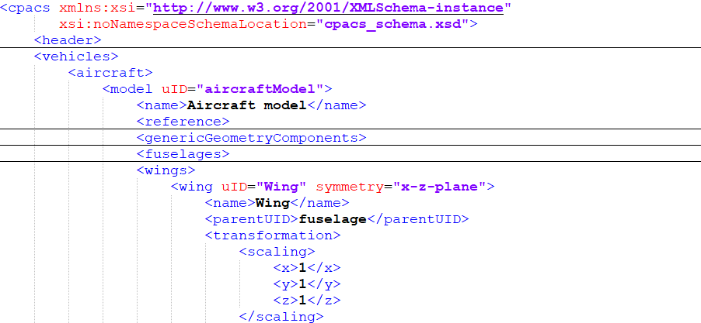
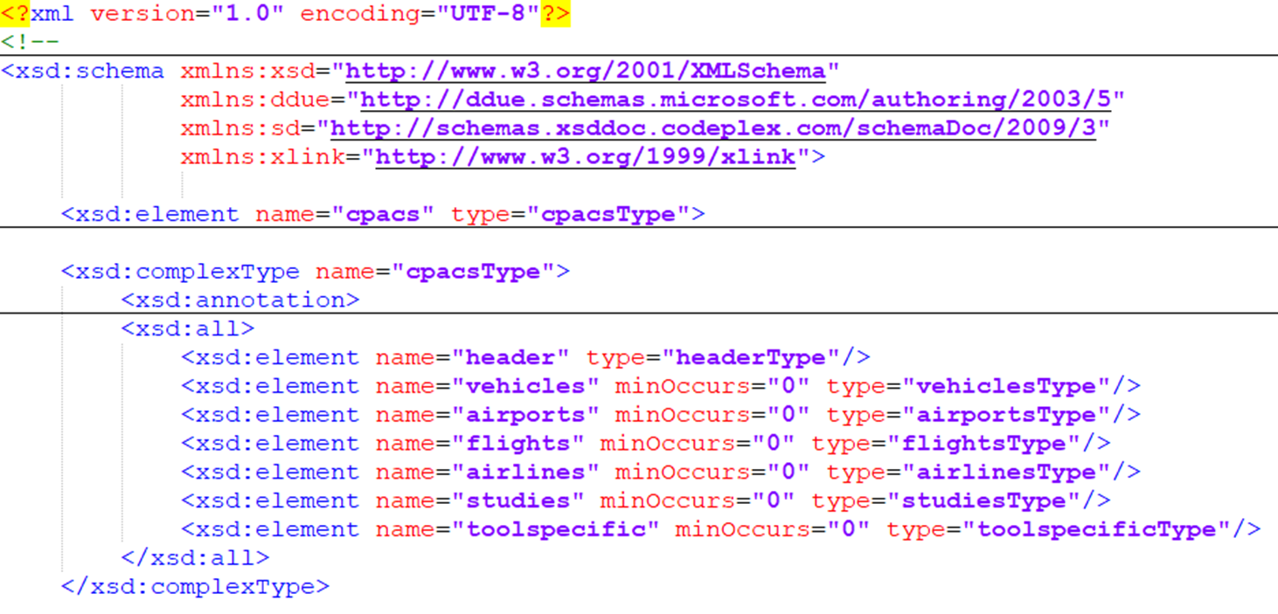
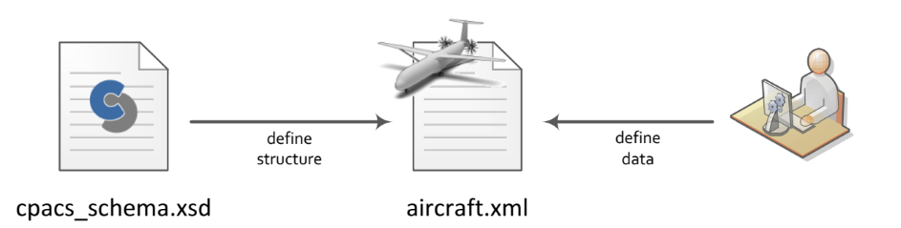
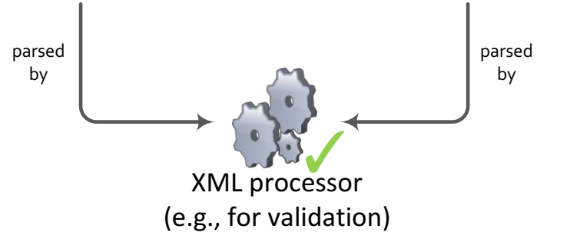
CPACS utilization

Slide 13
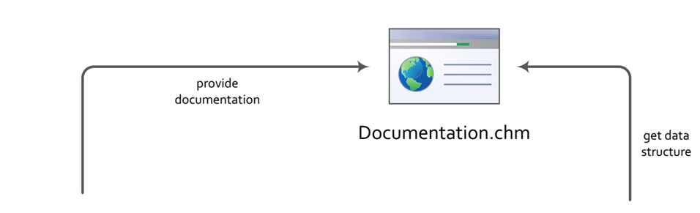
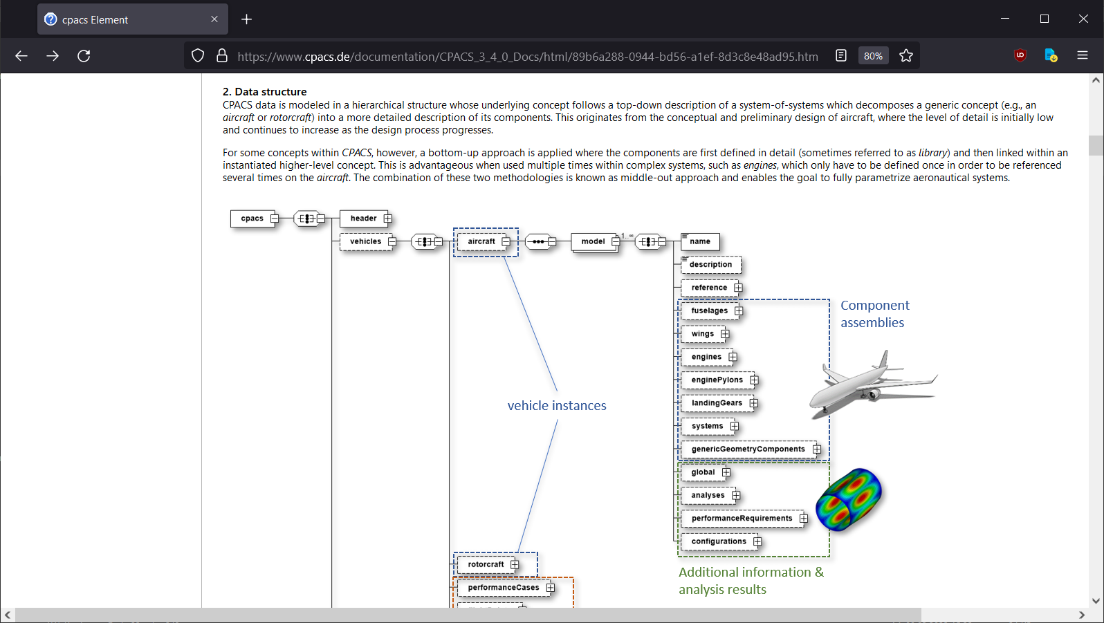
CPACS utilization

Slide 14
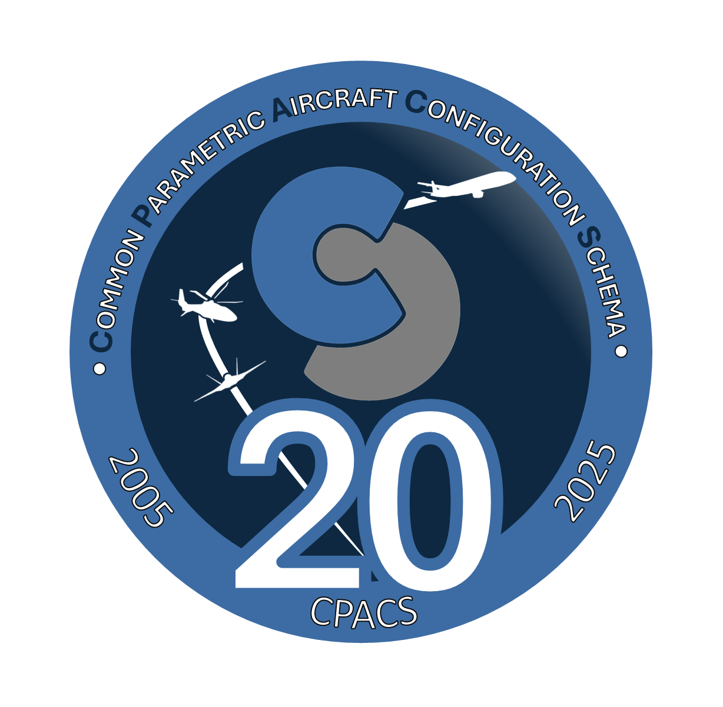

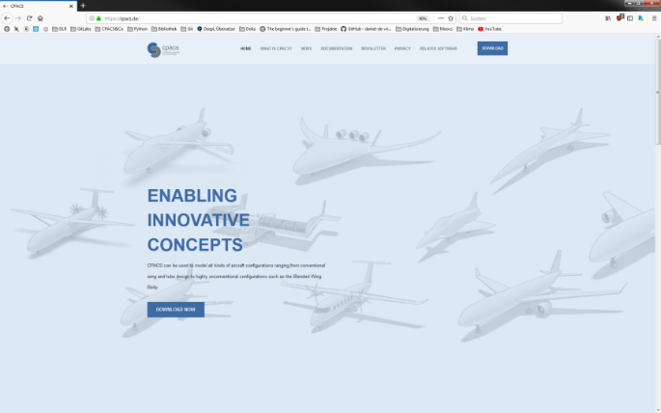
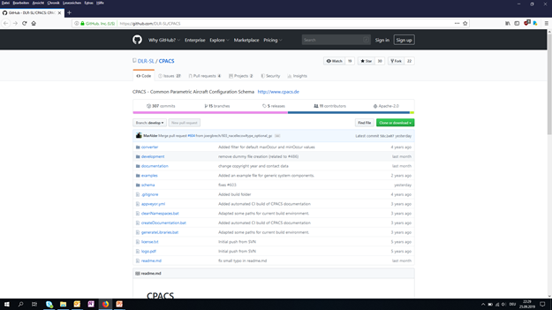
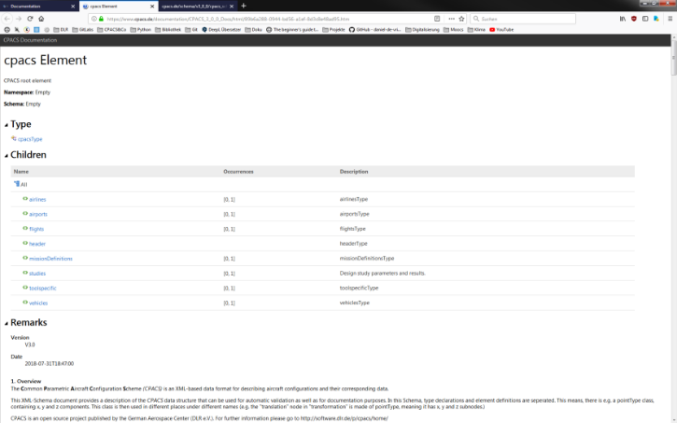
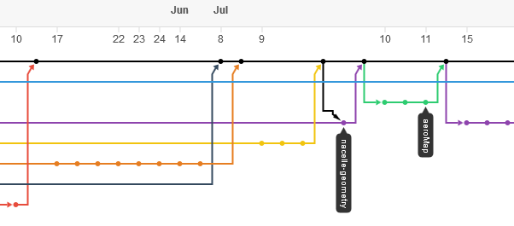

Homepage
Download · News · Newsletter · Online Help · Links to other parts of eco-system
GitHub
Version Management · Release Planning · Q&A Forum
https://cpacs.de
https://github.com/DLR-SL/CPACS

Slide 15
Imprint
Topic: Introduction to CPACS
Date: 2026-05-04
Author: M. Alder
Institute: DLR-SL
Image sources: All images “DLR (CC BY-NC-ND 3.0)” unless otherwise stated
Voice: Voiceover generated with Kyutai Pocket TTS (MIT License). Voice "eve" is based on the VCTK Corpus (speaker p361, enhanced), © University of Edinburgh, CC BY 4.0.

