Slide 1
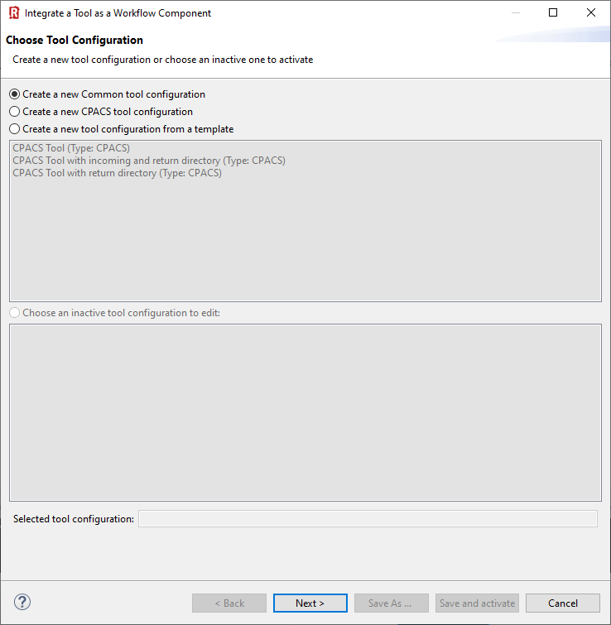

Slide 2
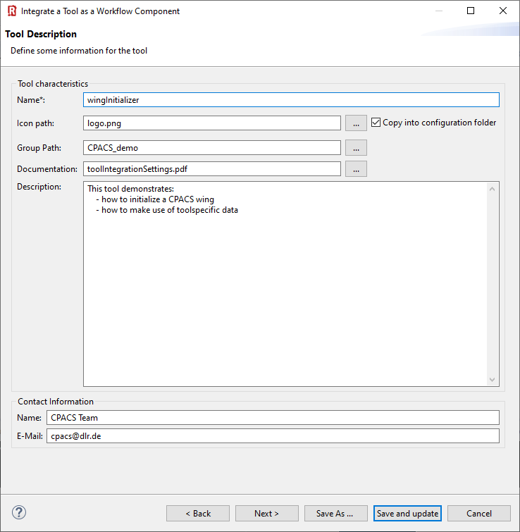

Slide 3
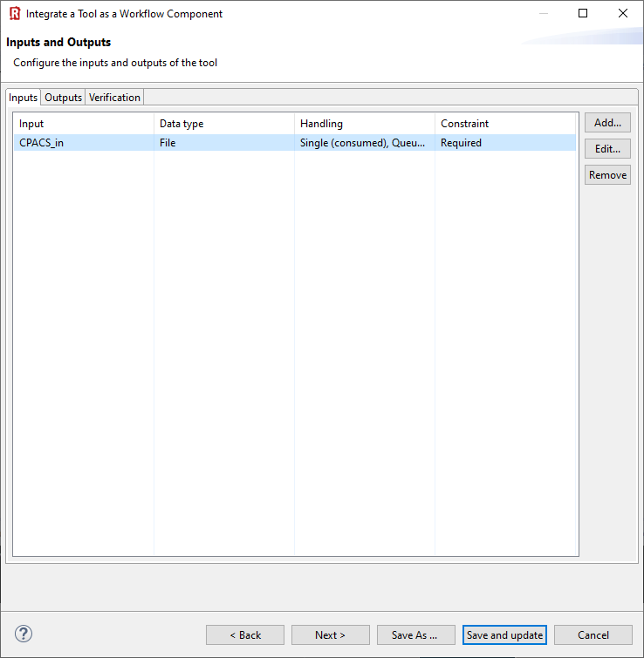
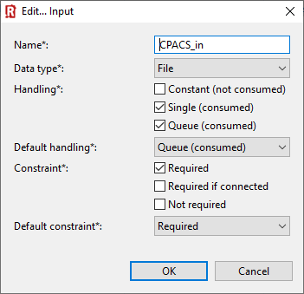

Slide 4
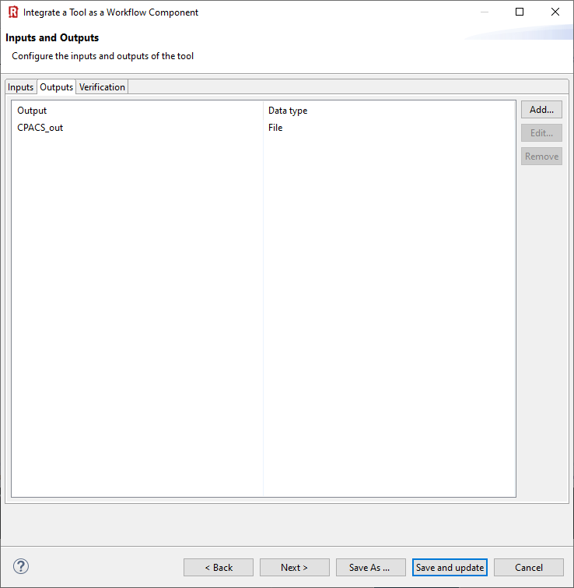
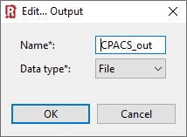

Slide 5
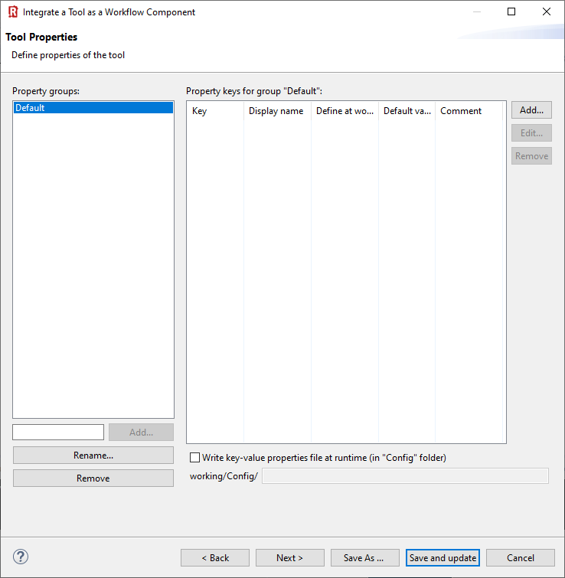

Slide 6
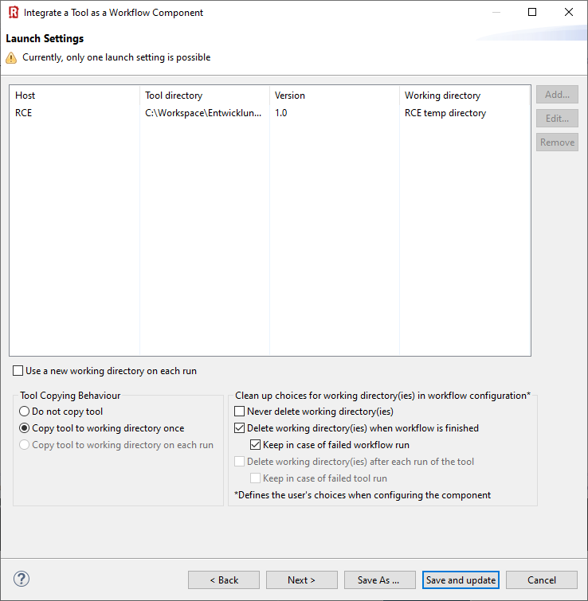
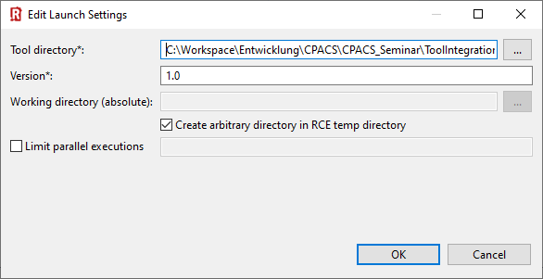

Slide 7
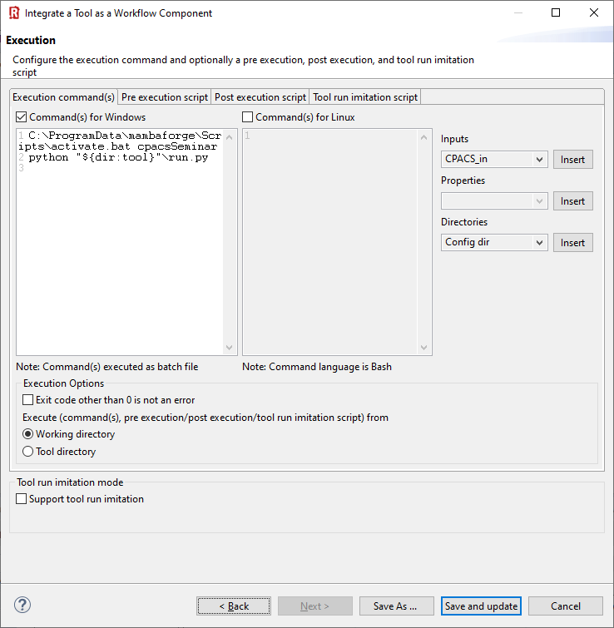
C:\ProgramData\mambaforge\Scripts\activate.bat cpacsSeminar
python "${dir:tool}"\run.py

Slide 8
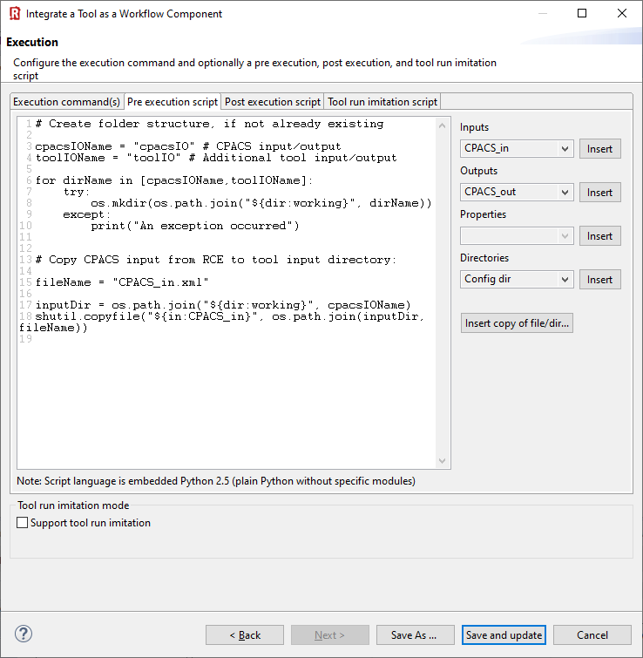
# Create folder structure, if not already existing
cpacsIOName = "cpacsIO" # CPACS input/output
toolIOName = "toolIO" # Additional tool input/output
for dirName in [cpacsIOName,toolIOName]:
try:
os.mkdir(os.path.join("${dir:working}", dirName))
except:
print("An exception occurred")
# Copy CPACS input from RCE to tool input directory:
fileName = "CPACS_in.xml"
inputDir = os.path.join("${dir:working}", cpacsIOName)
shutil.copyfile("${in:CPACS_in}", os.path.join(inputDir, fileName))

Slide 9
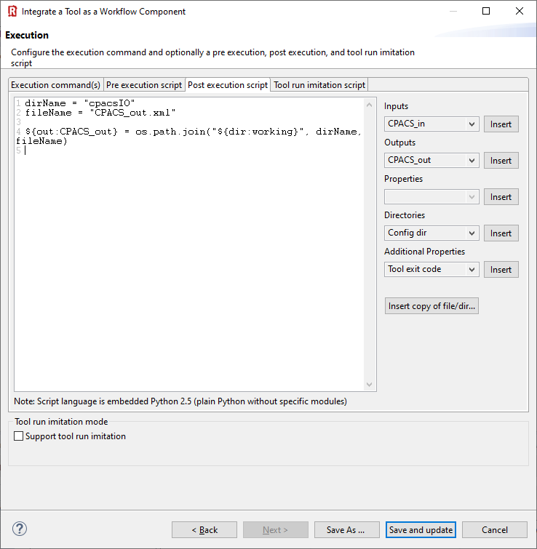
dirName = "cpacsIO"
fileName = "CPACS_out.xml"
${out:CPACS_out} = os.path.join("${dir:working}", dirName, fileName)

