Slide 1

CPACS Stakeholder Meeting
First Stakeholder meeting on the CPACS 3.3 release

Slide 2




Agenda
12:45 Virtual welcome coffee
13:30 Introduction
13:30 Mission and point performance definition
14:30 AeroLimitMap adaptions
15:00 Break
15:15 Load analysis
16:15 General CPACS features
16:50 Wrap up and announcement of next meetings
17:00 The End!
Introduction round with > 20 participants: only one representative briefly introduces his institution/department and colleagues
Mute your microphone if you’re just listening
Type Question or Comment in the chat to announce a contribution
If Corona hairstyle allows, we encourage to enable your video for comments

Slide 3
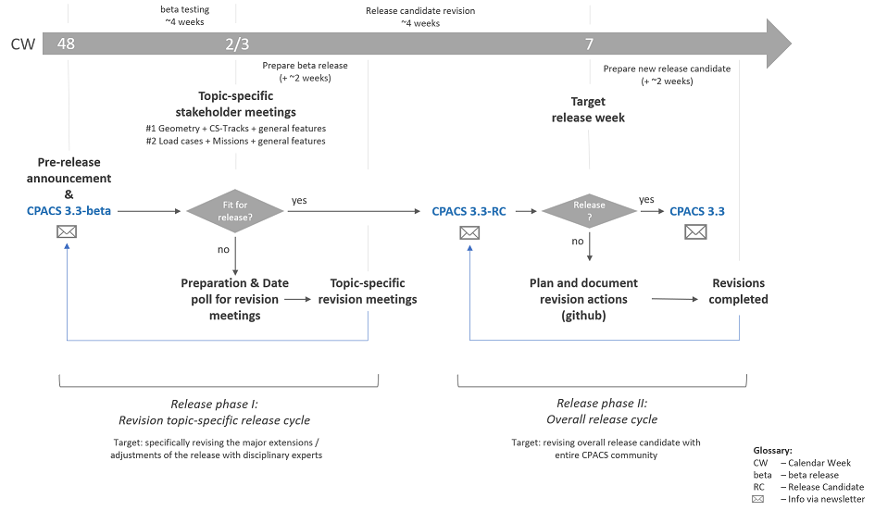
Objectives of the workshop
Introduce and discuss the planned enhancements and modifications
Decide whether the developments are ready for creating the official release candidate for CPACS v3.3

Slide 4
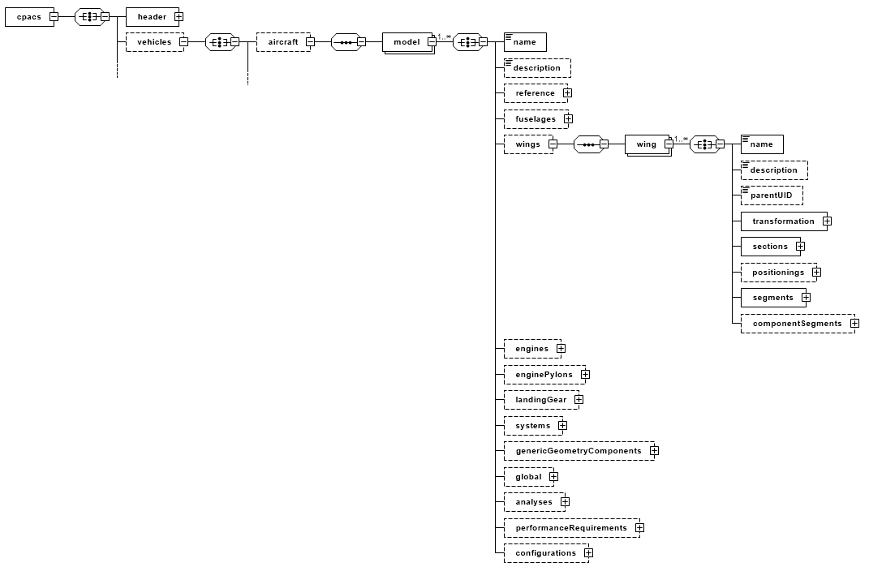
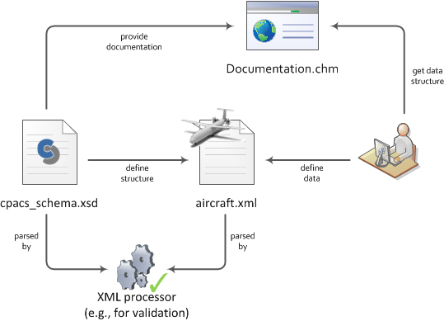
Short introduction

Slide 5
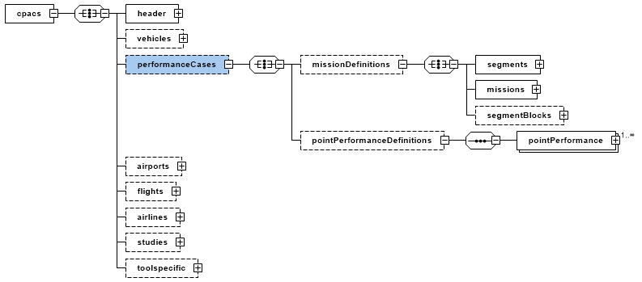
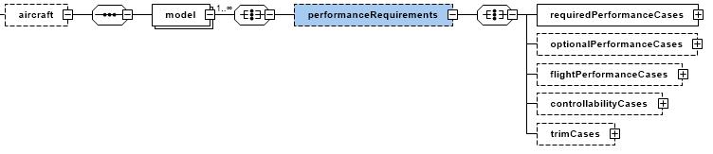
Mission and point performance definition
Revision of mission definition
Parameter lapses within segments
Performance requirements

Slide 6

Mission and point performance definition cpacs · performanceCases
Erwin Moerland
SL-FSI HF - Aircraft Design & System Integration

Slide 7
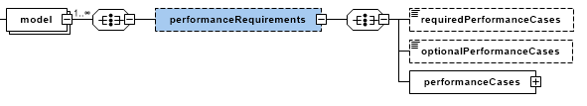
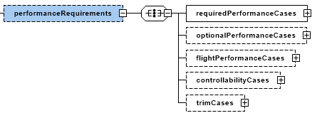
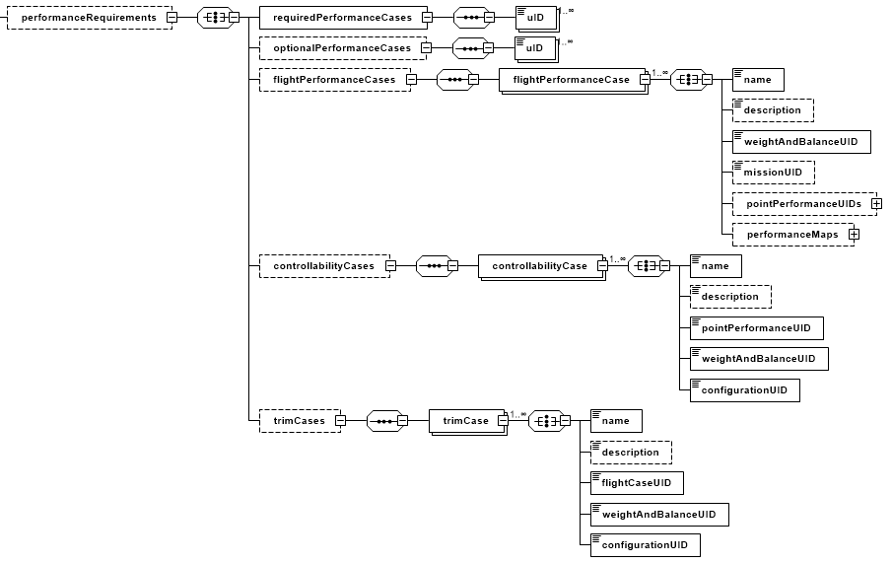
Mission and point performance definition cpacs · vehicles · aircraft · model · performanceRequirements
CPACS 3.2
occurence
CPACS 3.3-beta
occurence
stringBaseType -> uIDSequenceType

Slide 8
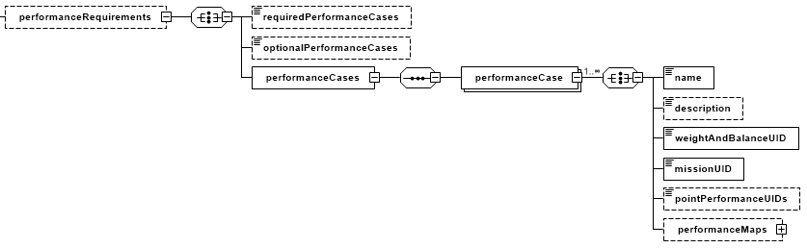
Mission and point performance definition cpacs · vehicles · aircraft · model · performanceRequirements
CPACS 3.2

Slide 9
Mission and point performance definition cpacs · vehicles · aircraft · model · performanceRequirements
CPACS 3.3-beta

Slide 10
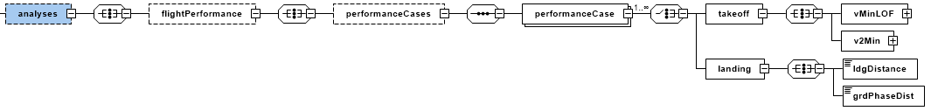
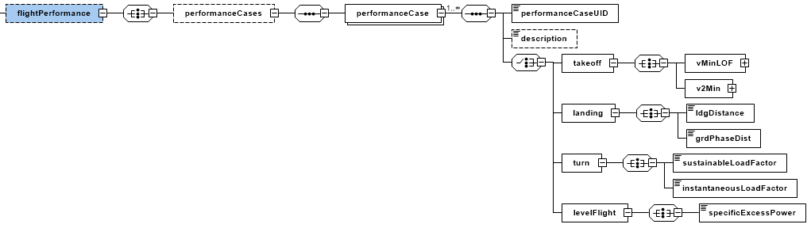
Mission and point performance definition cpacs · vehicles · aircraft · model · analyses · flightPerformance
CPACS 3.2
CPACS 3.3-beta

Slide 11
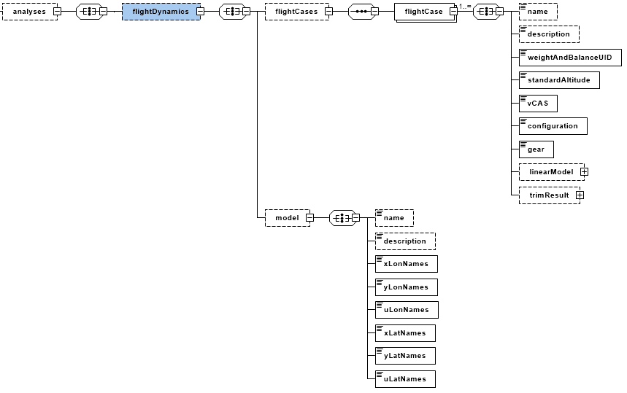
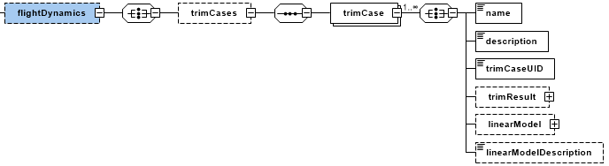
Mission and point performance definition cpacs · vehicles · aircraft · model · analyses · flightDynamics
CPACS 3.2
CPACS 3.3-beta

Slide 12
AeroLimitMap adaptions
Multiple increment maps
Minima and maxima in aeroLimitMaps

Slide 13
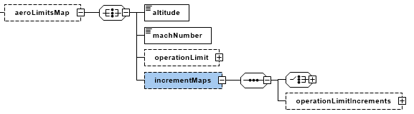
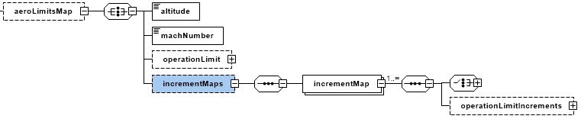
AeroLimitMap adaptions cpacs · vehicles · aircraft · model · analyses · aeroPerformance · aeroMap · aeroLimitMaps
CPACS 3.2
CPACS 3.3-beta

Slide 14
AeroLimitMap adaptions cpacs · vehicles · aircraft · model · analyses · aeroPerformance · aeroMap · aeroLimitMaps
Carsten Liersch
AS-TFZ BS – Transport Aircraft

Slide 15

Break

Slide 16
Load analysis
Load case definition
Flight envelopes
AeroCase definition
Load envelopes

Slide 17
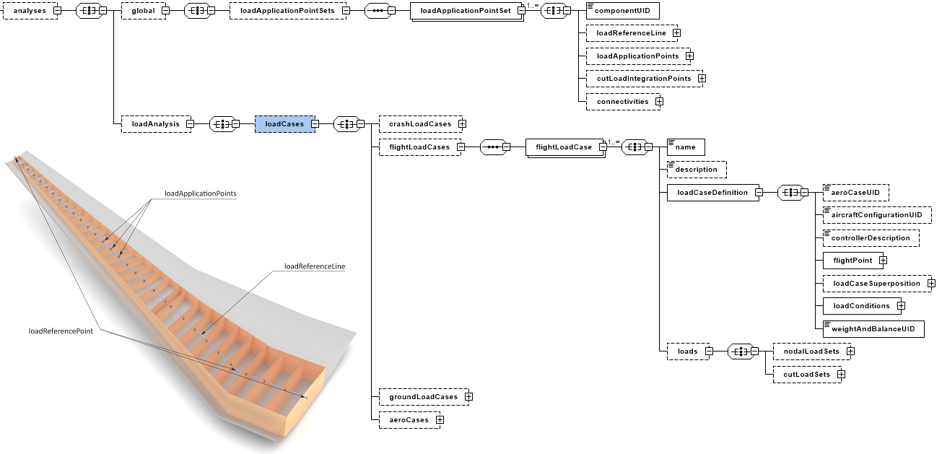
Load analysis cpacs · vehicles · aircraft · model · analyses · loadAnalysis · loadCases

Slide 18
Load analysis cpacs · vehicles · aircraft · model · analyses · loadAnalysis · loadCases
Thiemo Kier
SR-FLS OP – Aircraft System-Dynamics

Slide 19
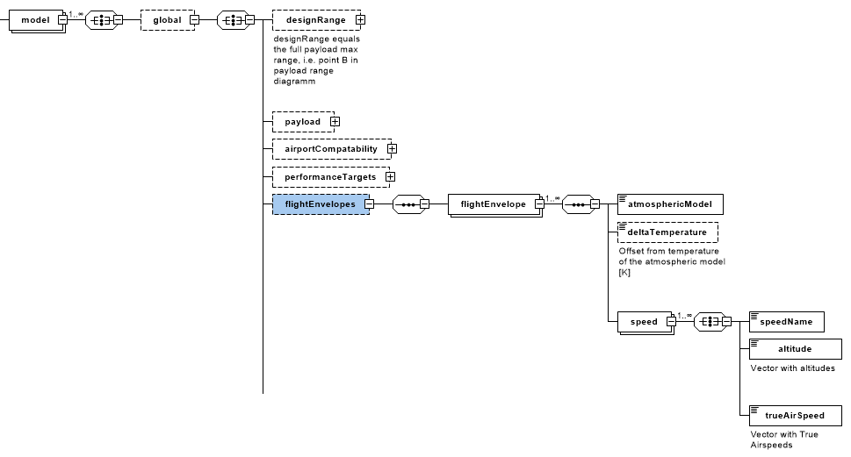
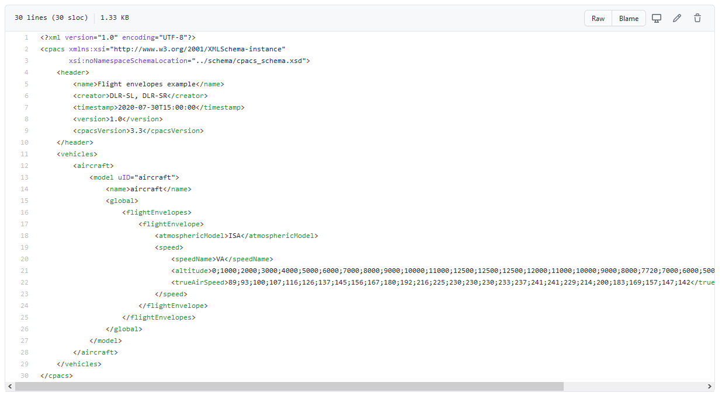
Load analysis cpacs · vehicles · aircraft · model · gobal · flightEnvelopes

Slide 20
Load analysis cpacs · vehicles · aircraft · model · analyses · loadAnalysis · loadCases · aeroCases
Carsten Liersch
AS-TFZ BS – Transport Aircraft

Slide 21
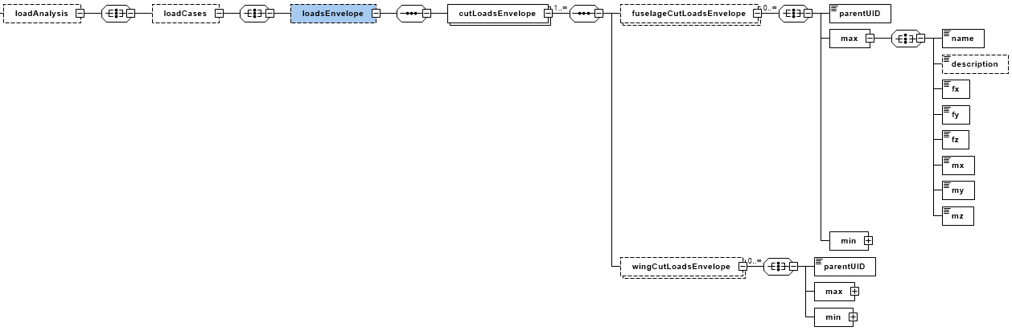
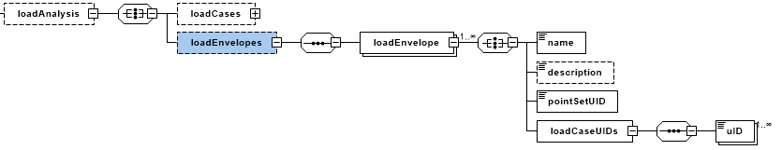
Load analysis cpacs · vehicles · aircraft · model · analyses · loadAnalysis · loadEnvelopes
CPACS 3.2
CPACS 3.3-beta

Slide 22
General CPACS features
Configuration node
mapType attribute not obligatory
New base types
Documentation and example files

Slide 23
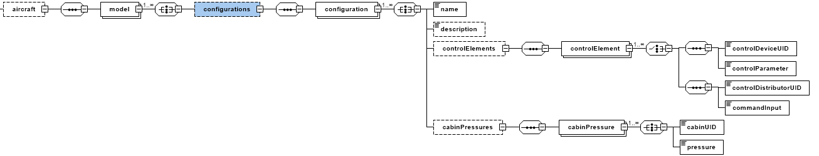
General CPACS features cpacs · vehicles · aircraft · model · configurations

Slide 24
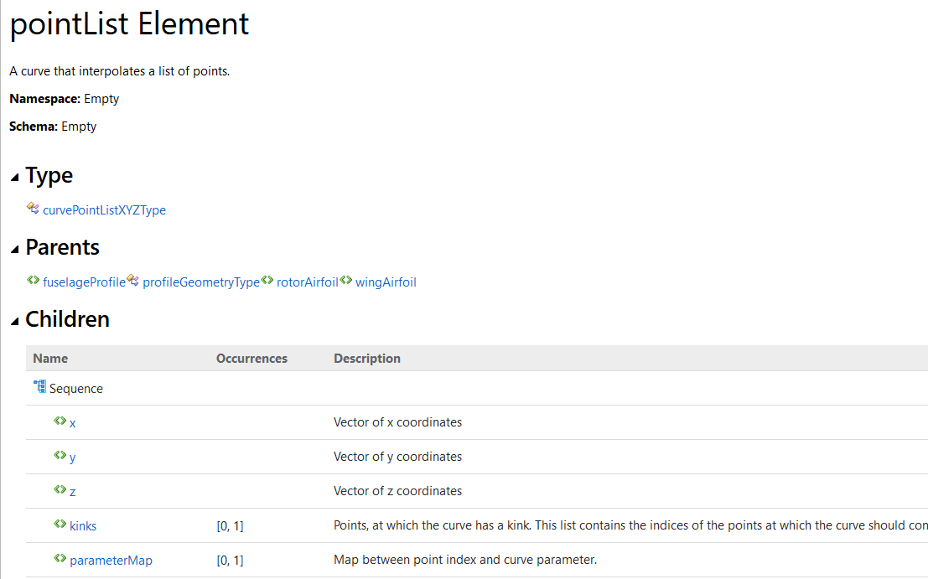
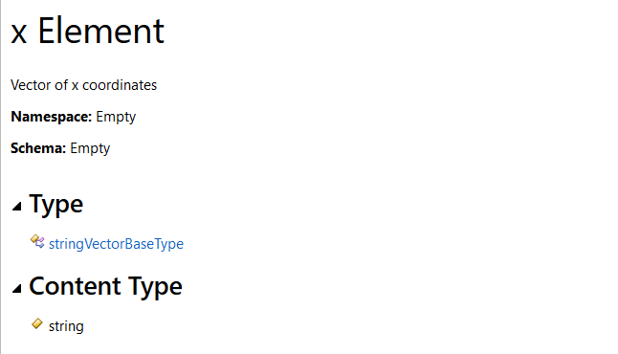
General CPACS features mapType
<profiles>
<wingAirfoils>
<wingAirfoil uID="NACA0012">
<name>NACA0012</name>
<pointList>
<x mapType="vector">1;0.955135;…;0.955135;1</x>
<y mapType="vector">0;0;…;0</y>
<z mapType="vector">0;-0.00557559;...;0</z>
</pointList>
</wingAirfoil>
</wingAirfoils>
</profiles>

Slide 25
General CPACS features new baseTypes
doubleVectorBaseType
doubleVectorConstraintBaseType
doubleArrayBaseType
posIntVectorBaseType
timeConstraintBaseType

Slide 26
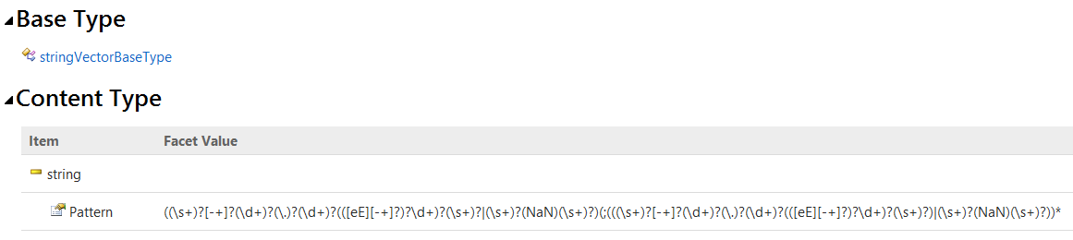
General CPACS features new baseTypes
<x>123.456;+123.456;-1.234e56;-.45E-6;NaN</x>
<x>123.456</x>
<x>123.456,+1234.456</x>
<x>123.456; mainWingUID</x>
<x>123.456;1234.4E 56;-1.234e5.6</x>
doubleVectorBaseType
doubleVectorConstraintBaseType
doubleArrayBaseType
posIntVectorBaseType
timeConstraintBaseType

Slide 27
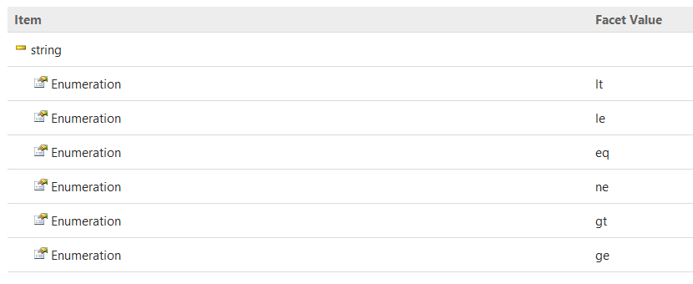
General CPACS features new baseTypes
doubleVectorBaseType
doubleVectorConstraintBaseType
doubleArrayBaseType
posIntVectorBaseType
timeConstraintBaseType
<x relationalOperator="le">0.1;0.2;0.3</x>

Slide 28
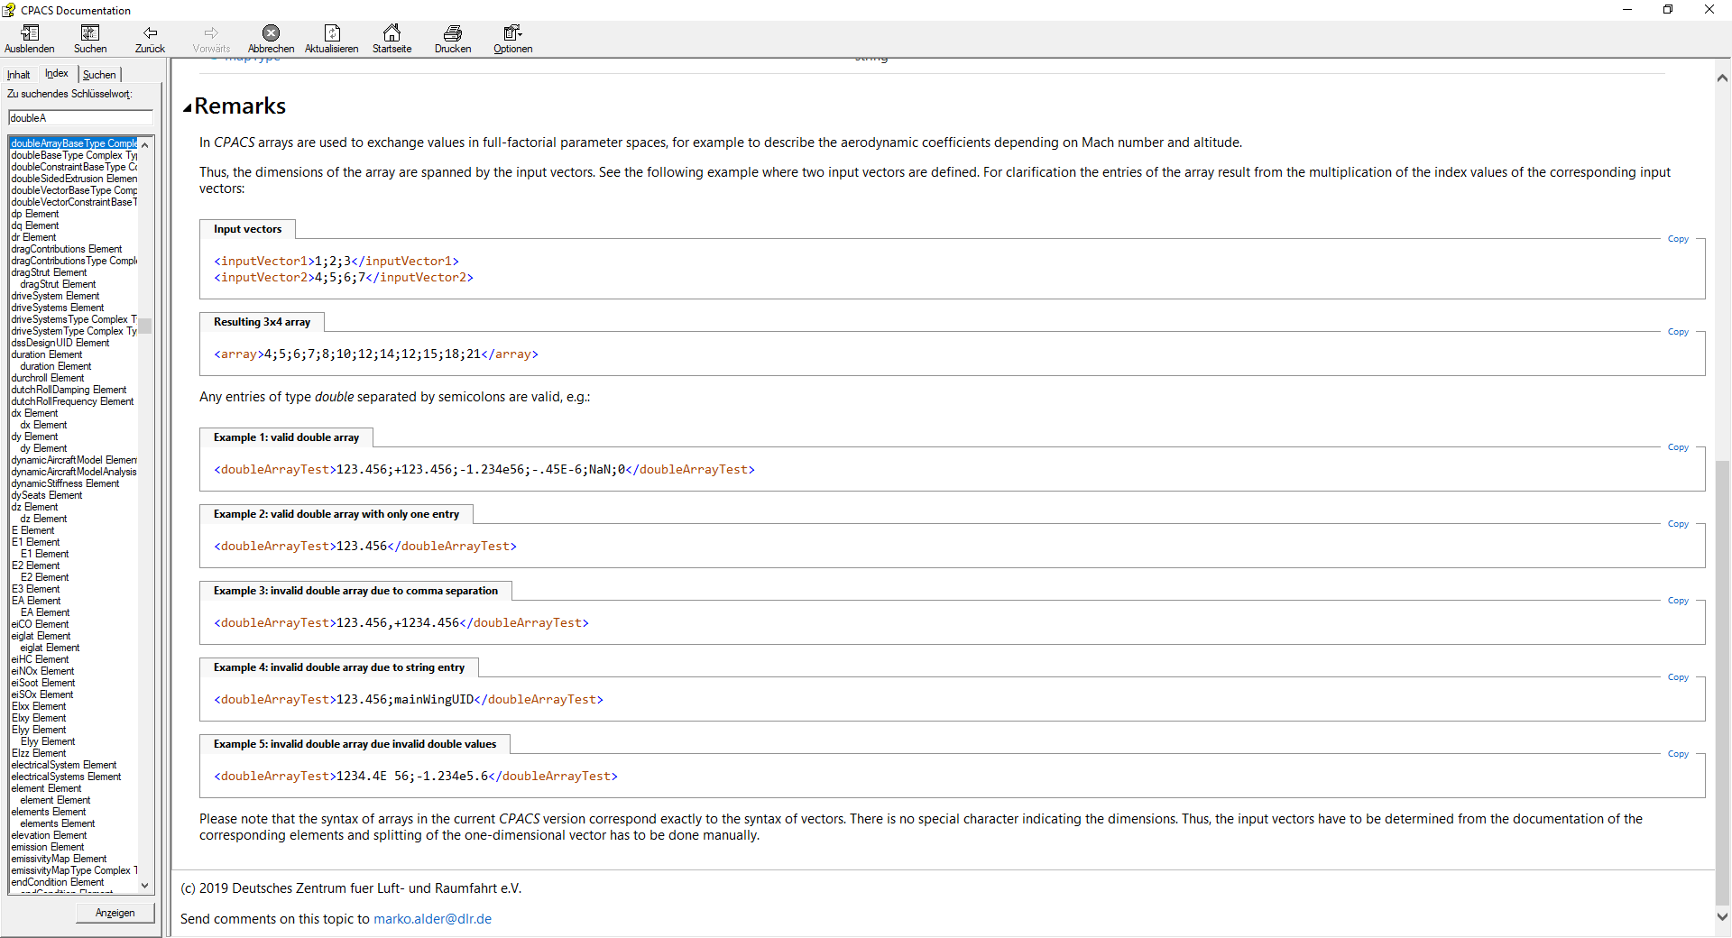
General CPACS features new baseTypes
doubleVectorBaseType
doubleVectorConstraintBaseType
doubleArrayBaseType
posIntVectorBaseType
timeConstraintBaseType

Slide 29
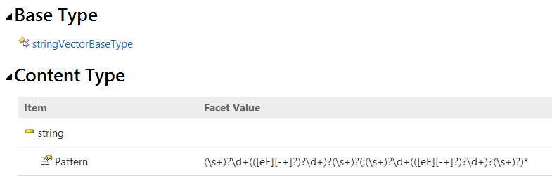
General CPACS features new baseTypes
<x>0;1;2;3;4;5</x>
<x>1</x>
<x>0,1,2,3,4,5</x>
<x>0.;1.;2.</x>
<x>-1;0;1</x>
doubleVectorBaseType
doubleVectorConstraintBaseType
doubleArrayBaseType
posIntVectorBaseType
timeConstraintBaseType

Slide 30
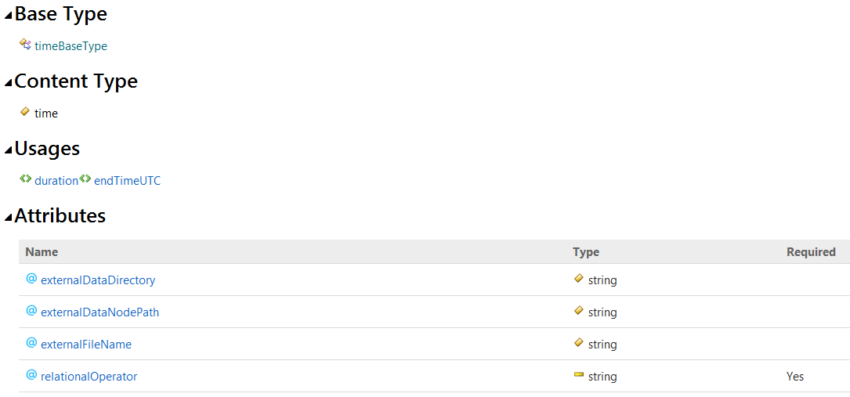
General CPACS features new baseTypes
doubleVectorBaseType
doubleVectorConstraintBaseType
doubleArrayBaseType
posIntVectorBaseType
timeConstraintBaseType
<t relationalOperator="le">00:15:00</t>

Slide 31
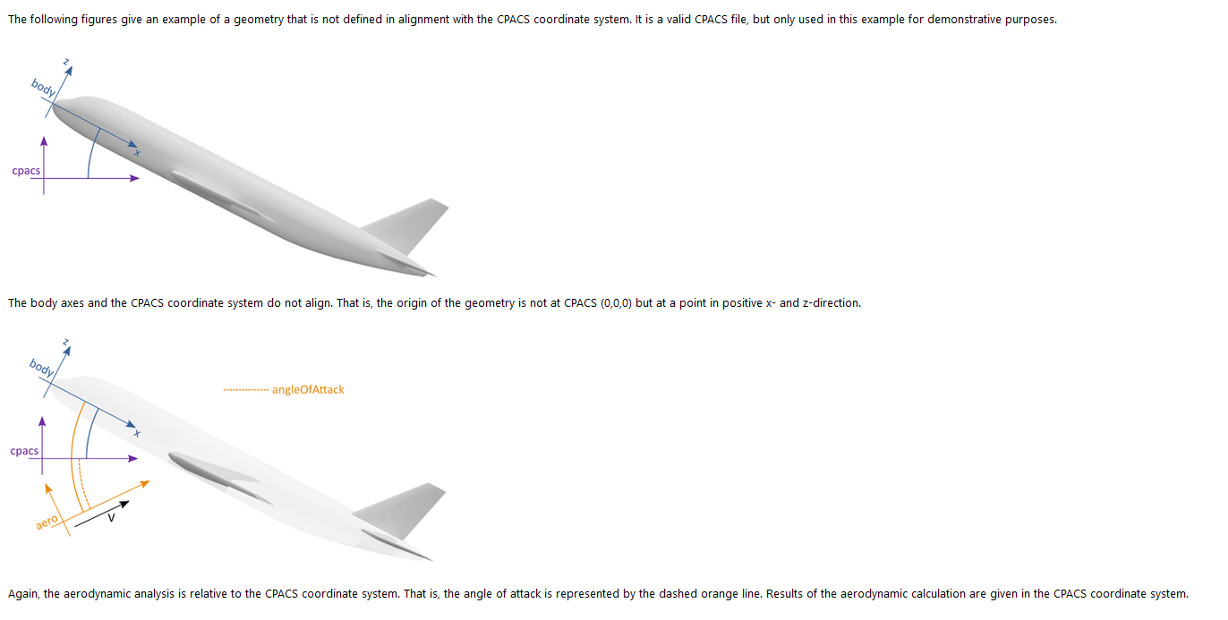
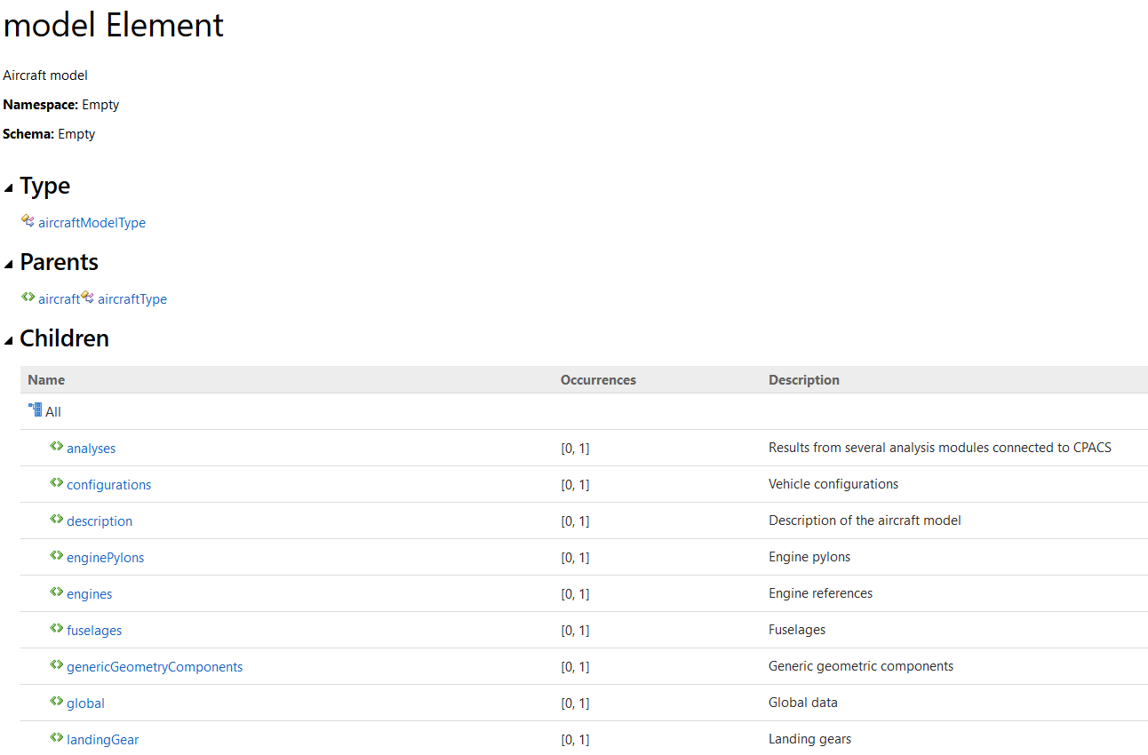
General CPACS features documentation

Slide 32
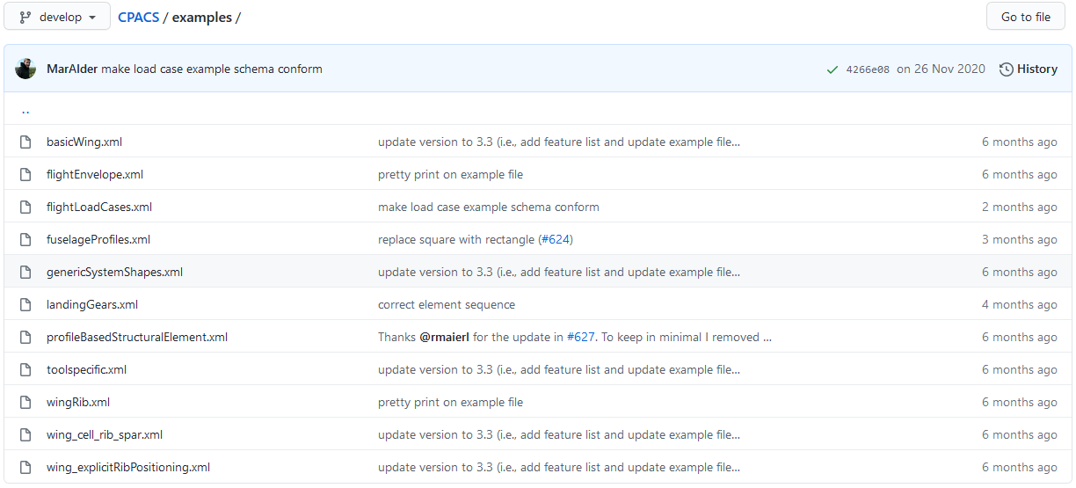
General CPACS features example files

Slide 33
Wrap up and announcement next meetings
11 February 2021: Stakeholder meeting (part 2)
March 2021: CPACS core features
experience with introduced features in practice
uID-references; tool-specifics; cpacsVersion element;
initiation of future core features
implications of symmetry attribute
extended parametrization

