Slide 1

CPACS Developer Meeting
November 2021

Slide 2
Agenda
9:00 Exchange on ideas for the content and organization of quarterly developer meetings
10:00 Schema development
Update of release process planning
Open CPACS issues
tbd
11:00 Library development
Introduction, status and way forward of cpacsLibrary
tbd

Slide 3
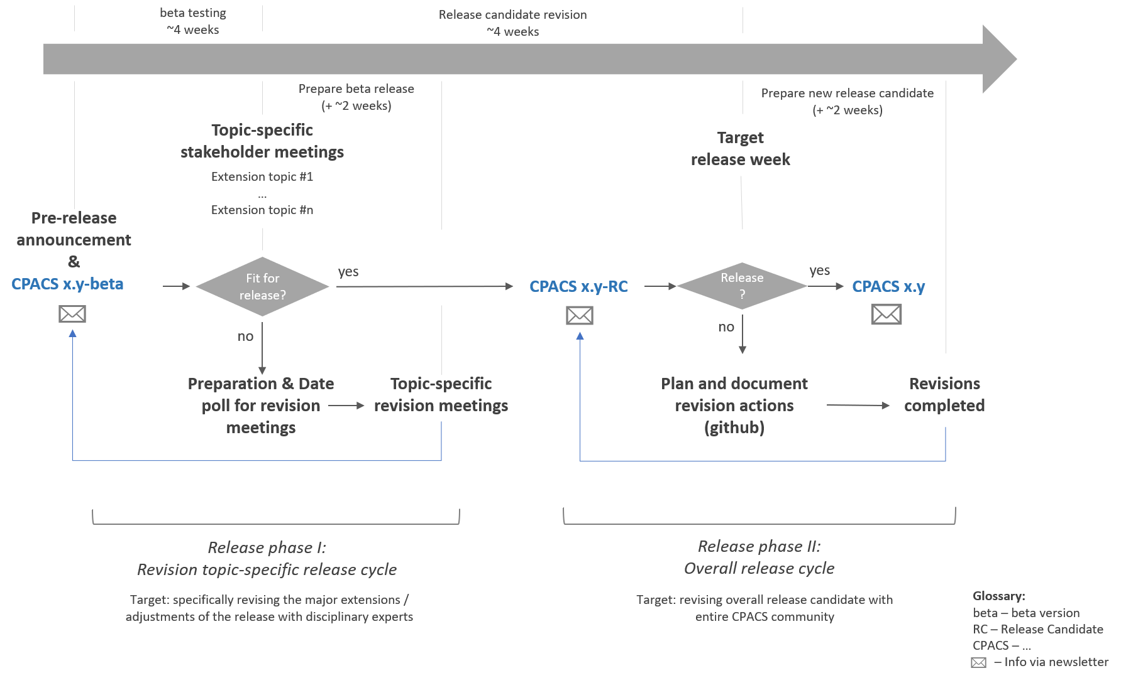
Organization Current situation
…we should discuss this in a separate meeting …

Slide 4
Organization Target of developer meetings
Room for (initiation of) general topics related to CPACS and its libraries
Regular (informal) exchange → less organizational effort
What’s going on in the community?
Development trends
Experiences from projects
…
Gluing the community
Common web page?
Initiation of workshops
…
Increase development speed
Share responsibilities

Slide 5
Organization Mindmapping ideas
very detailed topics (e.g., symmetry) should be initiated as separate meeting
discuss small topics directly
initiating disciplinary meetings
3h online, longer if face-to-face
establishing responsibilities
will be tested in practice
every 13 weeks
length?
content
proposed before developer meeting
scheduling
result of first developer meeting
rather general topics
Library development
every second meeting as face-to-face (post-covid…)
fix categories
topic priorization
CPACS schema
high traveling effort, maybe in connection with project meeting or workshops
different places?
online survey
important to do some weeks in advance for the sake of preparation
in previous meeting

Slide 6
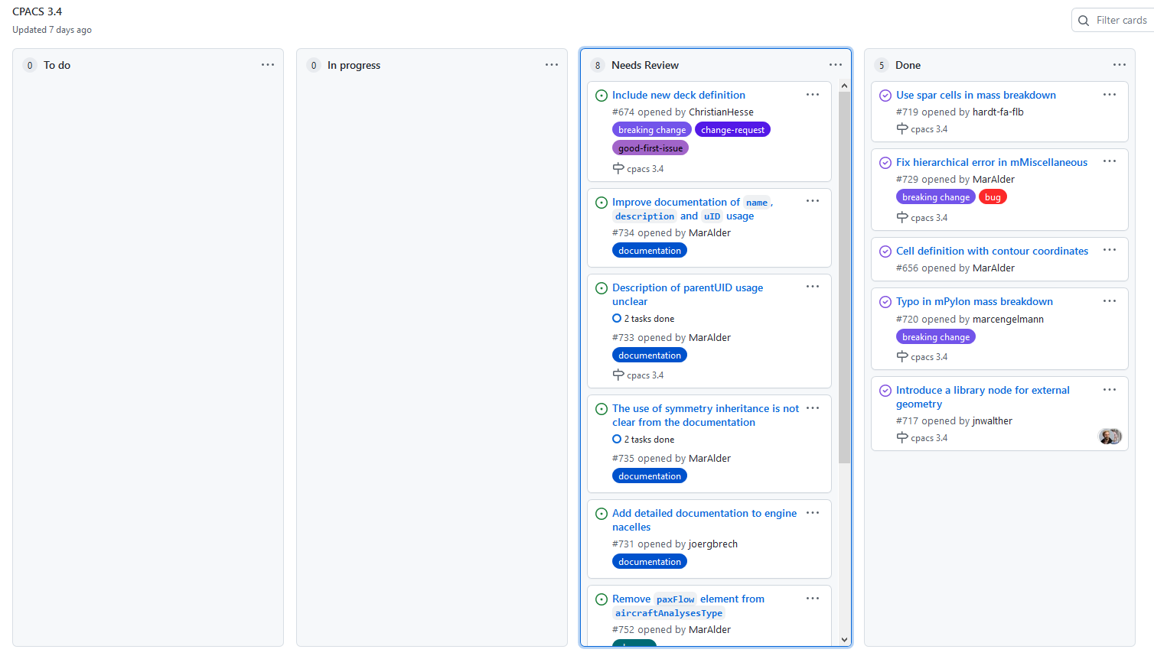
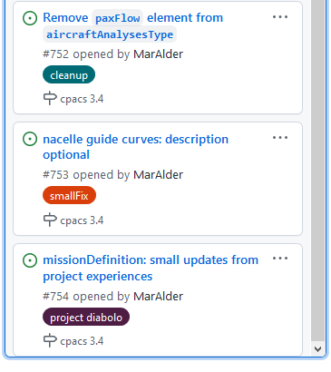
Schema development Update of release process planning

Slide 7
Schema development Update of release process planning
CPACS 3.4-RC
mid December
beginning December
CPACS 3.4
mid January
CPACS 3.4-beta
2nd half Nov.

Slide 8
Schema development Update of release process planning
Continuing at 11:35…
General topics | Disciplinary topics
Interpretation and use of symmetry | Introduciton of Systems
Parameteric operations | Introduction of system failures
Usage of update element | Revision of trajectory node
Explicity of reference values | Revision of enginePerformanceMaps
Usage of toolspecifics | Revision of hinge lines
Usage of <type>-nodes | Introduction of spar caps
 | #574, #575 stringer and frame sets
 | Structural references within fuselage

Slide 9
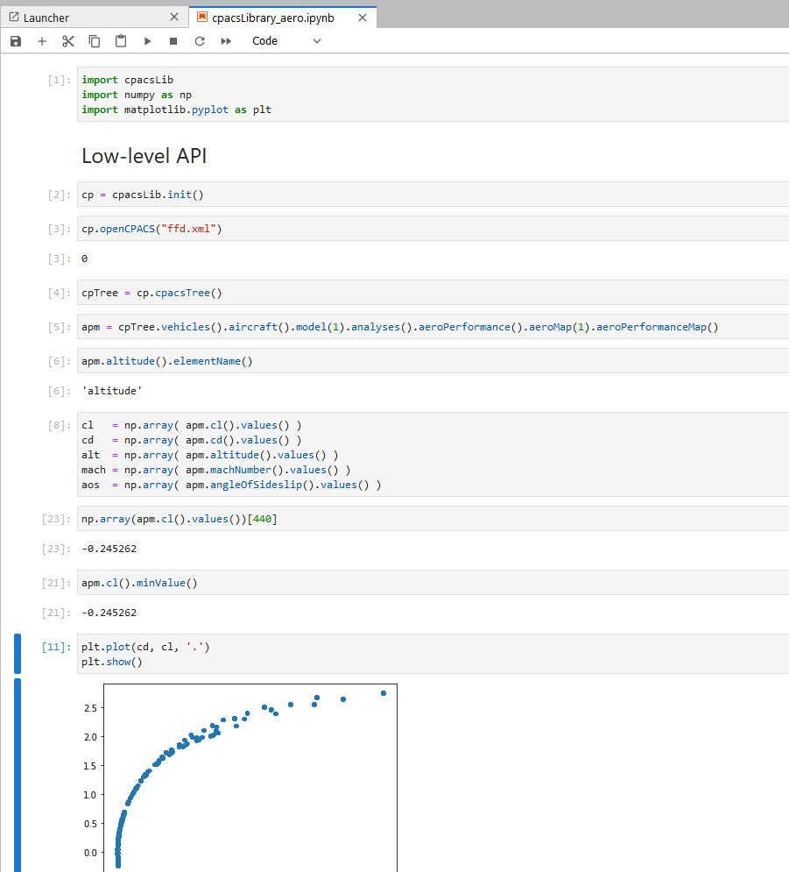
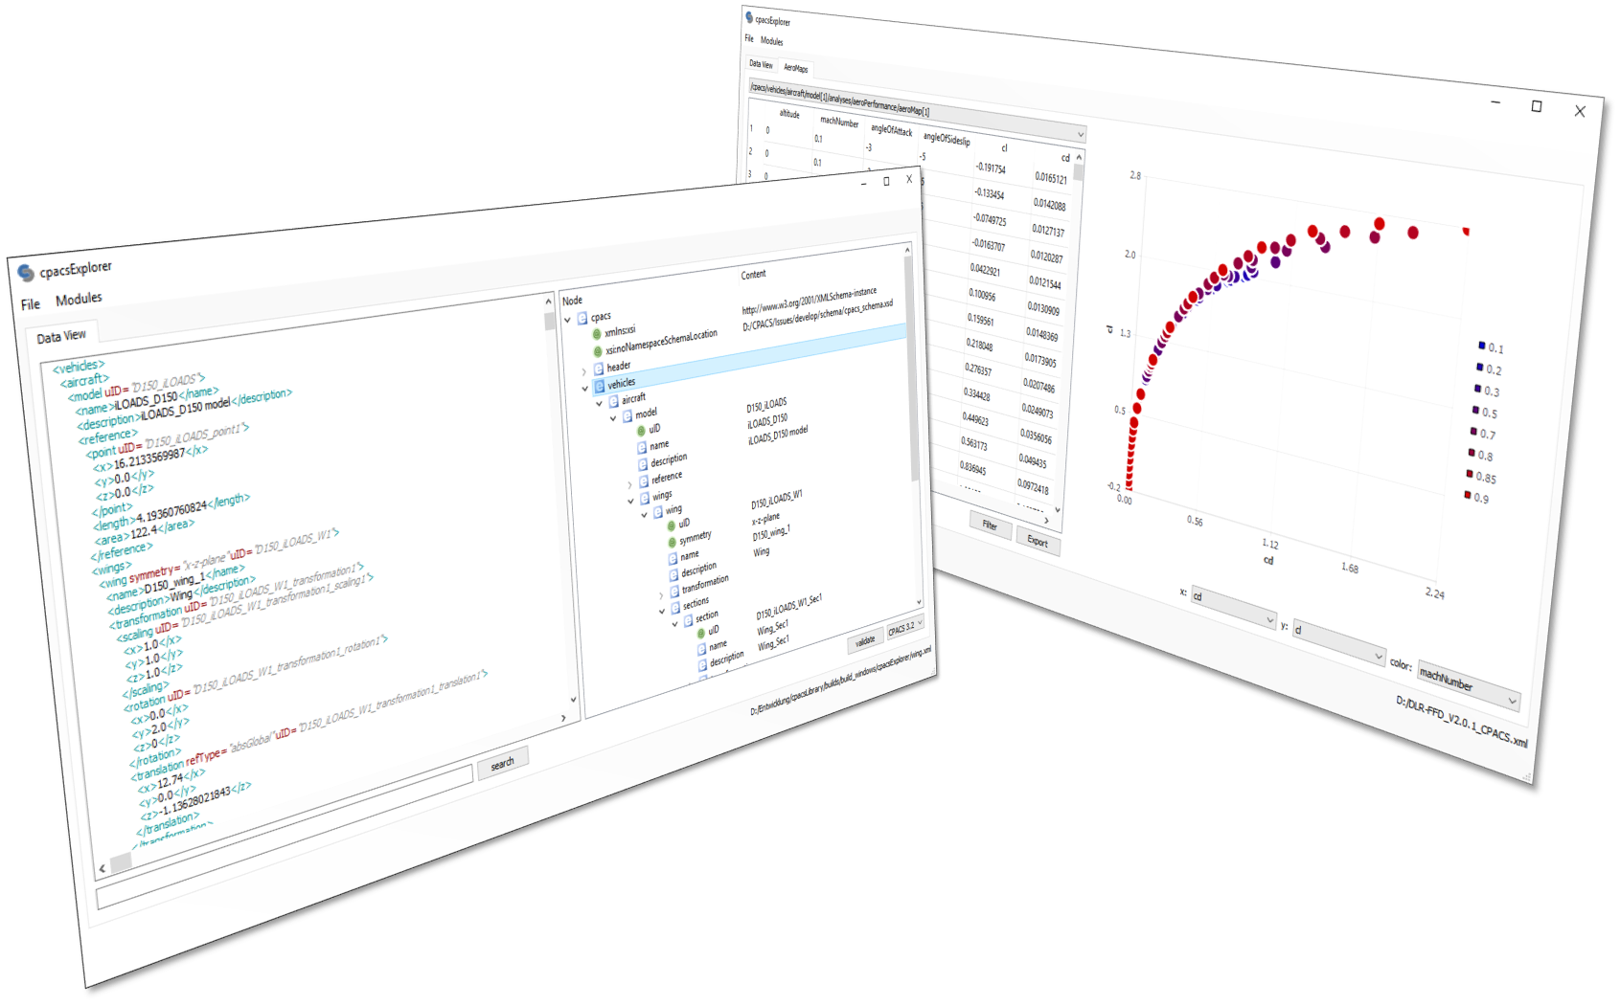
Library development cpacsLibrary

