Slide 1
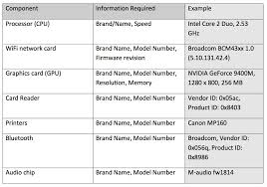

APPLICATION LIFECYCLE
DEVELOPMENT
STAGE
ACCEPTANCE
STAGE
TEST
STAGE
PRODUCTION
STAGE
DEVELOPERS
DEVELOPERS
TESTERS
OPERATIONS
$
ENTERPRISE
CI/CD SERVER
ENTERPRISE
ORCHESTRATION SERVER
ENTERPRISE
SCM
ENTERPRISE
ARTIFACT REPOSITORY

Slide 2
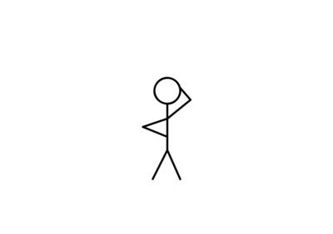
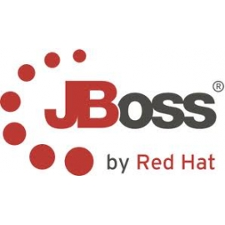
APPLICATION LIFECYCLE
DEVELOPMENT
STAGE
ACCEPTANCE
STAGE
TEST
STAGE
PRODUCTION
STAGE
DEVELOPERS
DEVELOPERS
TESTERS
OPERATIONS
ENTERPRISE
CI/CD SERVER
ENTERPRISE
ORCHESTRATION SERVER
ENTERPRISE
SCM
ENTERPRISE
ARTIFACT REPOSITORY

Slide 3
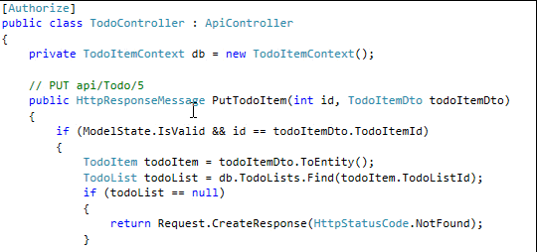
APPLICATION LIFECYCLE
DEVELOPMENT
STAGE
ACCEPTANCE
STAGE
TEST
STAGE
PRODUCTION
STAGE
DEVELOPERS
DEVELOPERS
TESTERS
OPERATIONS
Push
Pull
ENTERPRISE
CI/CD SERVER
ENTERPRISE
ORCHESTRATION SERVER
ENTERPRISE
SCM
ENTERPRISE
ARTIFACT REPOSITORY

Slide 4
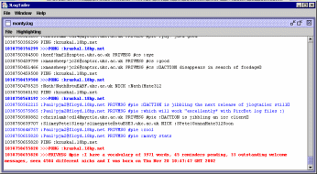

APPLICATION LIFECYCLE
DEVELOPMENT
STAGE
ACCEPTANCE
STAGE
TEST
STAGE
PRODUCTION
STAGE
DEVELOPERS
DEVELOPERS
TESTERS
OPERATIONS
Push
ENTERPRISE
CI/CD SERVER
ENTERPRISE
ORCHESTRATION SERVER
Change Detected
ENTERPRISE
SCM
Retrieves Dependencies (libraries)
ENTERPRISE
ARTIFACT REPOSITORY
NOTE: You can install artifact repositories that check
third party libraries for security and license vulnerabilities
Retrieves Dependencies (libraries)

Slide 5
APPLICATION LIFECYCLE
DEVELOPMENT
STAGE
ACCEPTANCE
STAGE
TEST
STAGE
PRODUCTION
STAGE
DEVELOPERS
DEVELOPERS
TESTERS
OPERATIONS
Push
ENTERPRISE
CI/CD SERVER
ENTERPRISE
ORCHESTRATION SERVER
Change Detected
ENTERPRISE
SCM
Builds and Executes Unit Tests
NOTE: You can insert static source code checks here
To check any security-related vulerabilities that
Developers may have introduced.
ENTERPRISE
ARTIFACT REPOSITORY

Slide 6
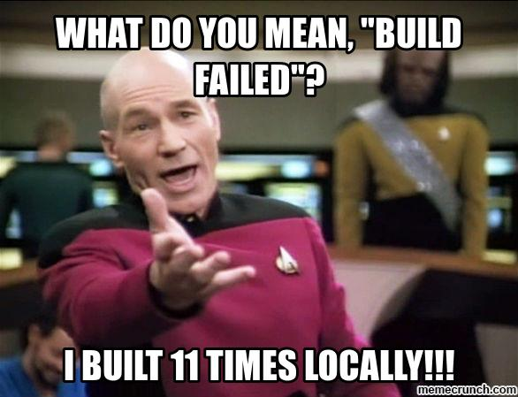

APPLICATION LIFECYCLE
DEVELOPMENT
STAGE
ACCEPTANCE
STAGE
TEST
STAGE
PRODUCTION
STAGE
DEVELOPERS
DEVELOPERS
TESTERS
OPERATIONS
Build failed, email/notification sent*
* - There are several options to notify developers and other stakeholders,
especially if it is through a ticketing or bug system
ENTERPRISE
CI/CD SERVER
ENTERPRISE
ORCHESTRATION SERVER
ENTERPRISE
SCM
Builds and Executes Unit Tests
ENTERPRISE
ARTIFACT REPOSITORY

Slide 7
APPLICATION LIFECYCLE
DEVELOPMENT
STAGE
ACCEPTANCE
STAGE
TEST
STAGE
PRODUCTION
STAGE
DEVELOPERS
DEVELOPERS
TESTERS
OPERATIONS
Push
ENTERPRISE
CI/CD SERVER
ENTERPRISE
ORCHESTRATION SERVER
Change Detected
ENTERPRISE
SCM
Builds and Executes Unit Tests
ENTERPRISE
ARTIFACT REPOSITORY

Slide 8


APPLICATION LIFECYCLE
DEVELOPMENT
STAGE
ACCEPTANCE
STAGE
TEST
STAGE
PRODUCTION
STAGE
DEVELOPERS
DEVELOPERS
TESTERS
OPERATIONS
4. Infrastructure configuration deployed
5. Application configuration deployed
ENTERPRISE
CI/CD SERVER
ENTERPRISE
ORCHESTRATION SERVER
ENTERPRISE
SCM
2. Deployment request sent
1. Builds succeeds,
runtime binary files saved
3. Application runtime artifacts retrieved
ENTERPRISE
ARTIFACT REPOSITORY

Slide 9

APPLICATION LIFECYCLE
DEVELOPMENT
STAGE
ACCEPTANCE
STAGE
TEST
STAGE
PRODUCTION
STAGE
DEVELOPERS
DEVELOPERS
TESTERS
OPERATIONS
4. Testing server configuration, software, and scripts deployed,
then automated tests* are executed
3. Testing server configuration and scripts retrieved
ENTERPRISE
CI/CD SERVER
ENTERPRISE
ORCHESTRATION SERVER
ENTERPRISE
SCM
2. “Tester” software retrieved
1. Integration Tests initiated
* - Initiated by the Enterprise CI/CD Server
ENTERPRISE
ARTIFACT REPOSITORY

Slide 10
APPLICATION LIFECYCLE
DEVELOPMENT
STAGE
ACCEPTANCE
STAGE
TEST
STAGE
PRODUCTION
STAGE
DEVELOPERS
DEVELOPERS
TESTERS
OPERATIONS
CI Tests Succeed, QA ready for new build
4. Application configuration and platform deployed
1. QA initiates Test deployment request, or initiated by successful CI build
ENTERPRISE
CI/CD SERVER
ENTERPRISE
ORCHESTRATION SERVER
ENTERPRISE
SCM
3. Application configuration retrieved
2. Application runtime artifacts retrieved
ENTERPRISE
ARTIFACT REPOSITORY

Slide 11

APPLICATION LIFECYCLE
DEVELOPMENT
STAGE
ACCEPTANCE
STAGE
TEST
STAGE
PRODUCTION
STAGE
DEVELOPERS
DEVELOPERS
TESTERS
OPERATIONS
3. System Integration Testing infrastructure and scripts retrieved
4. Tester software and
scripts deployed,
then automated tests*
are executed
1. System Integration Testing initiated
ENTERPRISE
CI/CD SERVER
ENTERPRISE
ORCHESTRATION SERVER
ENTERPRISE
SCM
4. If automated tests succeed,
QA Testers alerted and/or
System Integration Tests executed
2. “Tester” software retrieved
ENTERPRISE
ARTIFACT REPOSITORY
* - Initiated by the Enterprise CI/CD Server

Slide 12
APPLICATION LIFECYCLE
Application build could be simultaneously pushed to
Load Test environment for volume and performance testing!!!!
DEVELOPMENT
STAGE
ACCEPTANCE
STAGE
TEST
STAGE
PRODUCTION
STAGE
DEVELOPERS
DEVELOPERS
LOAD
OPERATIONS
2. Application configuration and platform deployed
ENTERPRISE
CI/CD SERVER
ENTERPRISE
ORCHESTRATION SERVER
ENTERPRISE
SCM
1. Application runtime artifacts retrieved
ENTERPRISE
ARTIFACT REPOSITORY

Slide 13

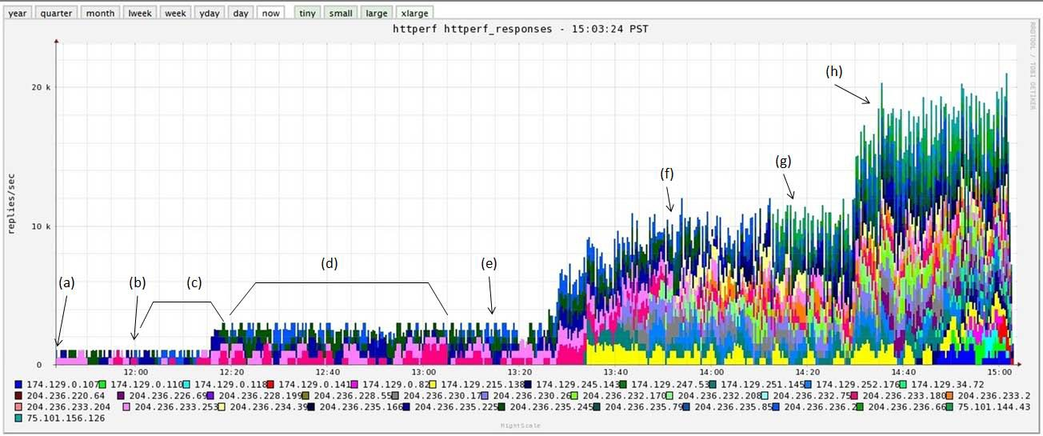
APPLICATION LIFECYCLE
DEVELOPMENT
STAGE
ACCEPTANCE
STAGE
TEST
STAGE
PRODUCTION
STAGE
DEVELOPERS
DEVELOPERS
LOAD
OPERATIONS
3. Load Testing scripts retrieved
4. Load Tester software and
scripts deployed,
then automated tests
are executed
1. Load/Perf Testing initiated
ENTERPRISE
CI/CD SERVER
ENTERPRISE
ORCHESTRATION SERVER
ENTERPRISE
SCM
5. If performance tests succeed,
Stakeholders alerted
2. “Load Tester” software retrieved
ENTERPRISE
ARTIFACT REPOSITORY

Slide 14
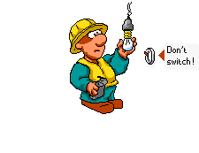
APPLICATION LIFECYCLE
1. System Tests or performance testing failed, email/notification, ticket sent
DEVELOPMENT
STAGE
ACCEPTANCE
STAGE
TEST
STAGE
PRODUCTION
STAGE
TEST
STAGE
DEVELOPERS
DEVELOPERS
TESTERS
OPERATIONS
Push
2. Lots of options here... you can rollback the environment to the last successful application build
Or remove the environment completely to conserve resources.
ENTERPRISE
CI/CD SERVER
ENTERPRISE
ORCHESTRATION SERVER
ENTERPRISE
SCM
ENTERPRISE
ARTIFACT REPOSITORY

Slide 15
APPLICATION LIFECYCLE
DEVELOPMENT
STAGE
ACCEPTANCE
STAGE
TEST
STAGE
PRODUCTION
STAGE
DEVELOPERS
DEVELOPERS
TESTERS
LOAD
OPERATIONS
All Tests Succeed, Prod ready for new build
3. Application
configuration and
platform deployed
1. Operations initiates deployment request
ENTERPRISE
CI/CD SERVER
ENTERPRISE
ORCHESTRATION SERVER
ENTERPRISE
SCM
2. Application runtime artifacts retrieved
ENTERPRISE
ARTIFACT REPOSITORY

Slide 16
APPLICATION LIFECYCLE
DEVELOPMENT
STAGE
ACCEPTANCE
STAGE
TEST
STAGE
PRODUCTION
STAGE
DEVELOPERS
DEVELOPERS
TESTERS
OPERATIONS
3. User Acceptance Testing scripts retrieved
4. Tester software and scripts deployed,
then automated UAT cases are executed
1. User Acceptance Testing initiated
ENTERPRISE
CI/CD SERVER
ENTERPRISE
ORCHESTRATION SERVER
ENTERPRISE
SCM
5. If automated UAT cases succeed,
QA Testers and Operations alerted
and human UAT cases executed
2. “Tester” software retrieved
ENTERPRISE
ARTIFACT REPOSITORY

Slide 17


APPLICATION LIFECYCLE
DEVELOPMENT
STAGE
ACCEPTANCE
STAGE
TEST
STAGE
PRODUCTION
STAGE
DEVELOPERS
DEVELOPERS
TESTERS
OPERATIONS
ENTERPRISE
CI/CD SERVER
ENTERPRISE
ORCHESTRATION SERVER
ENTERPRISE
SCM
Happy Users make happy Bosses!
ENTERPRISE
ARTIFACT REPOSITORY

Slide 18
APPLICATION LIFECYCLE
DEVELOPMENT
STAGE
ACCEPTANCE
STAGE
TEST
STAGE
PRODUCTION
STAGE
DEVELOPERS
DEVELOPERS
TESTERS
OPERATIONS
ENTERPRISE
CI/CD SERVER
ENTERPRISE
ORCHESTRATION SERVER
ENTERPRISE
SCM
Happy Users make happy Bosses!
ENTERPRISE
ARTIFACT REPOSITORY

Slide 19
APPLICATION LIFECYCLE
Feedback; positive and negative (defects)
DEVELOPMENT
STAGE
ACCEPTANCE
STAGE
TEST
STAGE
PRODUCTION
STAGE
DEVELOPERS
DEVELOPERS
TESTERS
OPERATIONS
ENTERPRISE
CI/CD SERVER
ENTERPRISE
ORCHESTRATION SERVER
ENTERPRISE
SCM
$
ENTERPRISE
ARTIFACT REPOSITORY

Slide 20

APPLICATION LIFECYCLE
Feedback; positive and negative (defects)
DEVELOPMENT
STAGE
ACCEPTANCE
STAGE
TEST
STAGE
PRODUCTION
STAGE
DEVELOPERS
DEVELOPERS
TESTERS
OPERATIONS
ENTERPRISE
CI/CD SERVER
ENTERPRISE
ORCHESTRATION SERVER
ENTERPRISE
SCM
$
ENTERPRISE
ARTIFACT REPOSITORY

Slide 21
APPLICATION LIFECYCLE
Feedback; positive and negative (defects)
DEVELOPMENT
STAGE
ACCEPTANCE
STAGE
TEST
STAGE
PRODUCTION
STAGE
DEVELOPERS
DEVELOPERS
TESTERS
OPERATIONS
ENTERPRISE
CI/CD SERVER
ENTERPRISE
ORCHESTRATION SERVER
ENTERPRISE
SCM
$
ENTERPRISE
ARTIFACT REPOSITORY

Slide 22

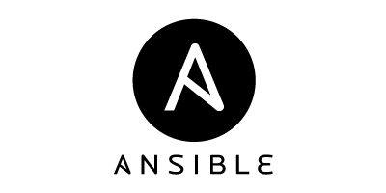

APPLICATION LIFECYCLE
Feedback; positive and negative (defects)
DEVELOPMENT
STAGE
ACCEPTANCE
STAGE
TEST
STAGE
PRODUCTION
STAGE
DEVELOPERS
DEVELOPERS
TESTERS
OPERATIONS
$
ENTERPRISE
ARTIFACT REPOSITORY
TBD
ENTERPRISE
SCM

Slide 23
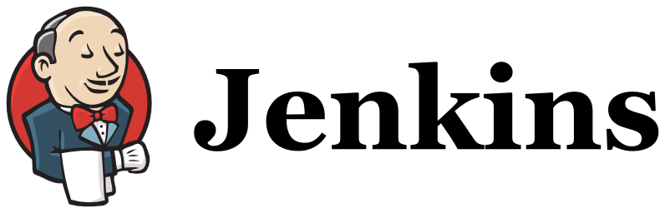


APPLICATION LIFECYCLE - PaaS
DEVELOPMENT
STAGE
ACCEPTANCE
STAGE
TEST
STAGE
PRODUCTION
STAGE
DEVELOPERS
DEVELOPERS
TESTERS
OPERATIONS
Automated
Test Team
Approves
Operations
Team
Approves
ENTERPRISE
CI/CD SERVER
ENTERPRISE
ARTIFACT (IMAGE) REPOSITORY
ENTERPRISE
ORCHESTRATION SERVER
ENTERPRISE
SCM

Slide 24
APPLICATION LIFECYCLE - PaaS
DEVELOPMENT
STAGE
ACCEPTANCE
STAGE
TEST
STAGE
PRODUCTION
STAGE
DEVELOPERS
DEVELOPERS
TESTERS
OPERATIONS
Automated
Test Team
Approves
Operations
Team
Approves
ENTERPRISE
CI/CD SERVER
ENTERPRISE
ARTIFACT (IMAGE) REPOSITORY
ENTERPRISE
ORCHESTRATION SERVER
ENTERPRISE
SCM

Slide 25
APPLICATION LIFECYCLE
DEVELOPMENT
STAGE
ACCEPTANCE
STAGE
TEST
STAGE
PRODUCTION
STAGE
DEVELOPERS
DEVELOPERS
TESTERS
OPERATIONS
Automated
Test Team
Approves
Operations
Team
Approves
ENTERPRISE
CI/CD SERVER
ENTERPRISE
ARTIFACT (IMAGE) REPOSITORY
ENTERPRISE
SCM

Slide 26
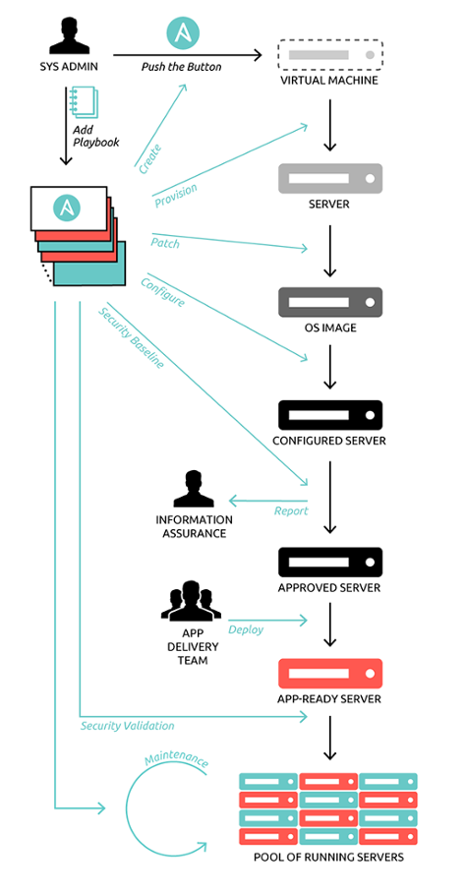
APPLICATION LIFECYCLE

