Slide 1

Notes:
Hello everyone and welcome to my next tutorial! In this series, I’ll be covering React Query, the best data fetching library I’ve used so far.

Slide 2

React Query
Introduction
Notes:
Before we go through how React Query works, it’s important to discuss what problems React Query solves.

Slide 3
🤔 Scenario
We want to build a React application that fetches & updates data from a server.
Notes:
Let’s discuss a common scenario.
If you’re building a React application, at some point or another you’ll need to communicate with a backend server. You’ll likely want to be fetching data, as well as updating some form of data.
As an example, take a simple todo application, where you can fetch a list of todos, create a new todo item, and complete a new todo item. All of this is server state, because the source of truth is our backend database, not the frontend React client application.

Slide 4
😢 The Problem
But…React does not have an opinionated way of fetching data.
What about useEffect, useState,…?
In a larger application, things can get complicated quite fast!
Notes:
Even though React is a very flexible framework, it does not have an opinionated way of fetching data. You might start brainstorming and think of approaches such as useEffect, useState, and other hooks from React.
Now this would be a valid approach! But in a larger application, things can get complicated quite fast!

Slide 5
😭 More Problems
Let’s ask ourselves some more questions.
Separation between “client” and “server” state?
Caching?
Updating “out of date” data in the background?
Knowing when data is “out of date”?
Managing memory and garbage collection of server state?
…and so on.
Notes:
Let’s complicate this even further and ask ourselves some more questions!

Slide 6
😄 The Solution
“React Query makes fetching, caching, synchronizing and updating server state in your web applications a breeze.”
Notes:
This is where React Query can help us. As described by the official documentation, …

Slide 7
Core Concepts
Queries, Mutations, and Query Invalidation
Notes:
So now that we have an understanding of the problems React Query aims to solve, let’s go through some of the core concepts of the library.

Slide 8
Core Concepts
1. 🔍 Queries
2. 🔨 Mutations
3. 🕵️ Query Invalidation
Notes:
To have a good grasp of React Query, there are 3 core concepts you’ll need to understand: queries, mutations, and query invalidation. Let’s go through each one.

Slide 9
Queries
Notes:
First we can discuss Queries.

Slide 10
🔍 Queries
“A query is a declarative dependency on an asynchronous source of data that is tied to a unique key.”
Notes:
https://tanstack.com/query/latest/docs/react/guides/queries
The definition found from the official docs is the following^
In simple terms, what this means is: a query can be used to fetch data from a server. A simple example would be making a GET request to retrieve a list of todo items.

Slide 11
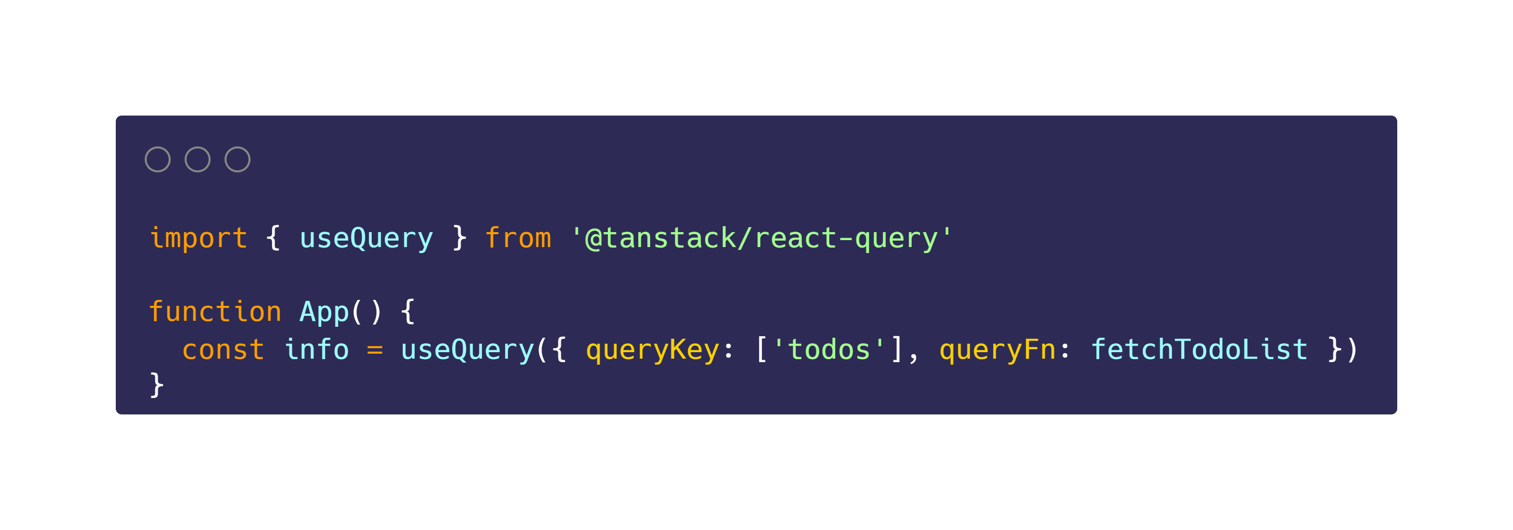
🔍 Queries
The 🔑unique key you provide is used internally for refetching, caching, and sharing your queries throughout your application.
Notes:
To subscribe to a query in your React components, all you need to do is call the useQuery hook.
You’ll see here that we provide the hook with 2 things:
A unique key
A function to retrieve the data
The unique key you provide is very important, because it is used internally for refetching, caching, and sharing your queries throughout your application.

Slide 12
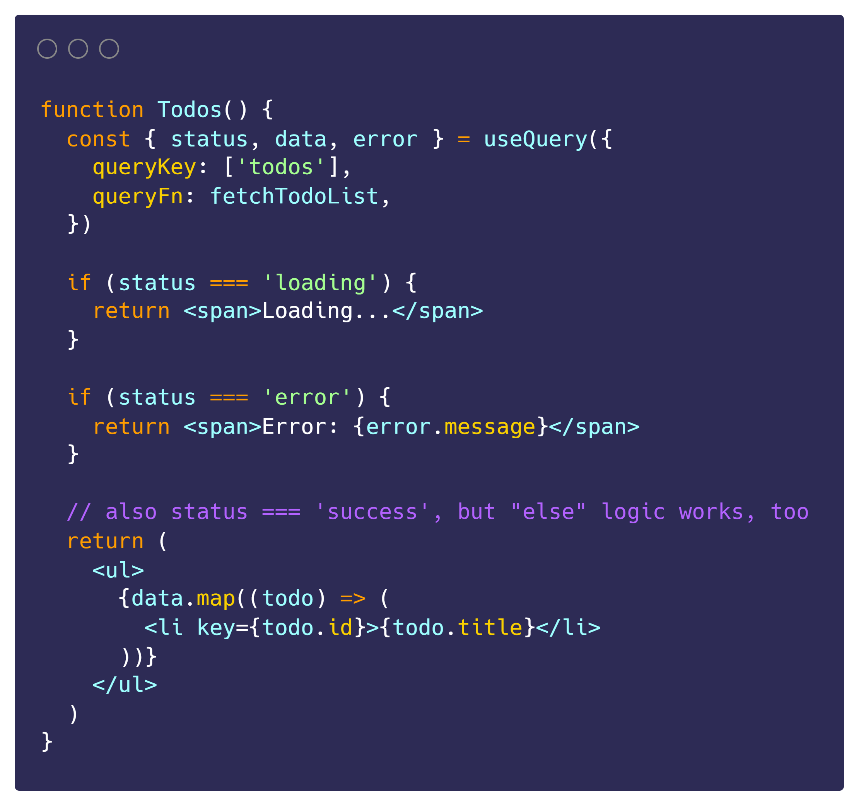
🔍 Queries
React Query keeps track of loading and error states for us!
status === `loading` | The query has no data yet
status === `error` | The query encountered an error
status === `success` | The query was successful, and data is available
Notes:
Let’s expand this example to see how it can be used in a React component.
What’s important to note here is that React Query keeps track of loading and error states for us! (So, we can easily render a loading message or error message).
If the query is in a success state, the data is available from the data property.

Slide 13
Mutations
Notes:
Next up let’s talk about mutations.

Slide 14
🔨 Mutations
“Unlike queries, mutations are typically used to create/update/delete data or perform server side-effects.”
Notes:
https://tanstack.com/query/latest/docs/react/guides/mutations

Slide 15
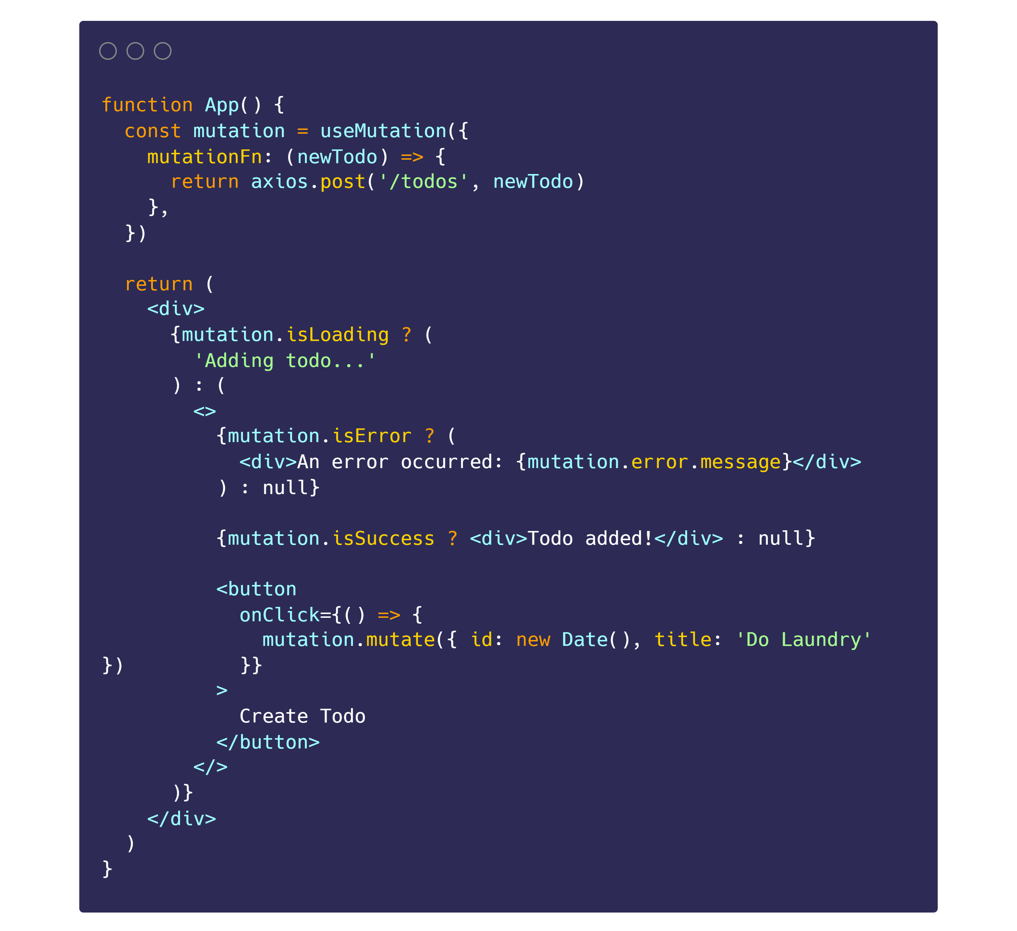
🔨 Mutations
👉
Specify `mutationFn`
👉
Call `mutate` in event handler
Notes:
Let’s see how this works in a React application. First, we call the useMutation hook, and pass in a function.
In this specific example we pass a function to create a new todo item.
And then we call the mutate function in the onClick handler of the button.

Slide 16
Query Invalidation
Notes:
The third core concept to discuss is query invalidation.

Slide 17
🕵️ Query Invalidation
“Usually when a mutation in your app succeeds, it's VERY likely that there are related queries in your application that need to be invalidated and possibly refetched to account for the new changes from your mutation.”
Notes:
The official docs outline query invalidation as the following^
So a simple example is that when we create a new todo item, our todos query is now invalid because we have mutated the data.

Slide 18
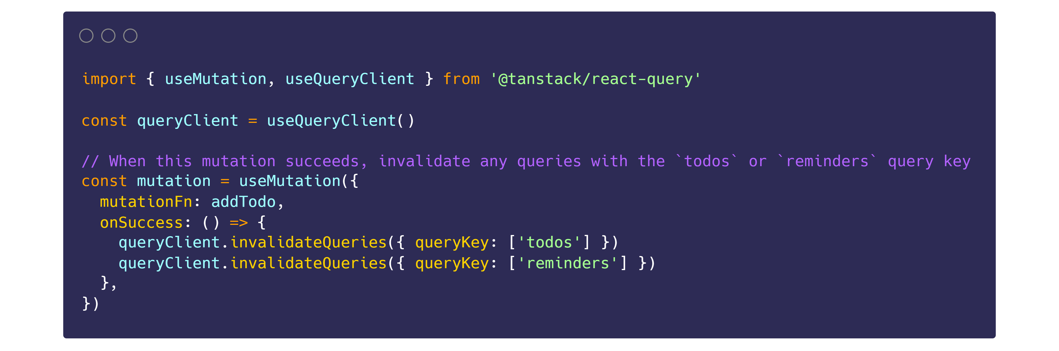
🕵️ Query Invalidation
React Query supports “partial matching” (you can match multiple queries by their prefix, or get really specific and match an exact query).
Notes:
For that purpose, React Query has an invalidateQueries method that lets you mark queries as stale and refetch them too!
A side note worth mentioning is that React Query supports “partial matching” (you can match multiple queries by their prefix, or get really specific and match an exact query).

Slide 19
Important Defaults
StaleTime and CacheTime
Notes:
Now that we covered the key concepts, I want to go through some terminology in more detail.

Slide 20
👨‍🏫 Important Defaults
Caching?
Stale??
What???
Notes:
Up to now I’ve been using the terms caching and stale quite a bit, and you might be confused about what this all means. Let’s clarify these terms.

Slide 21
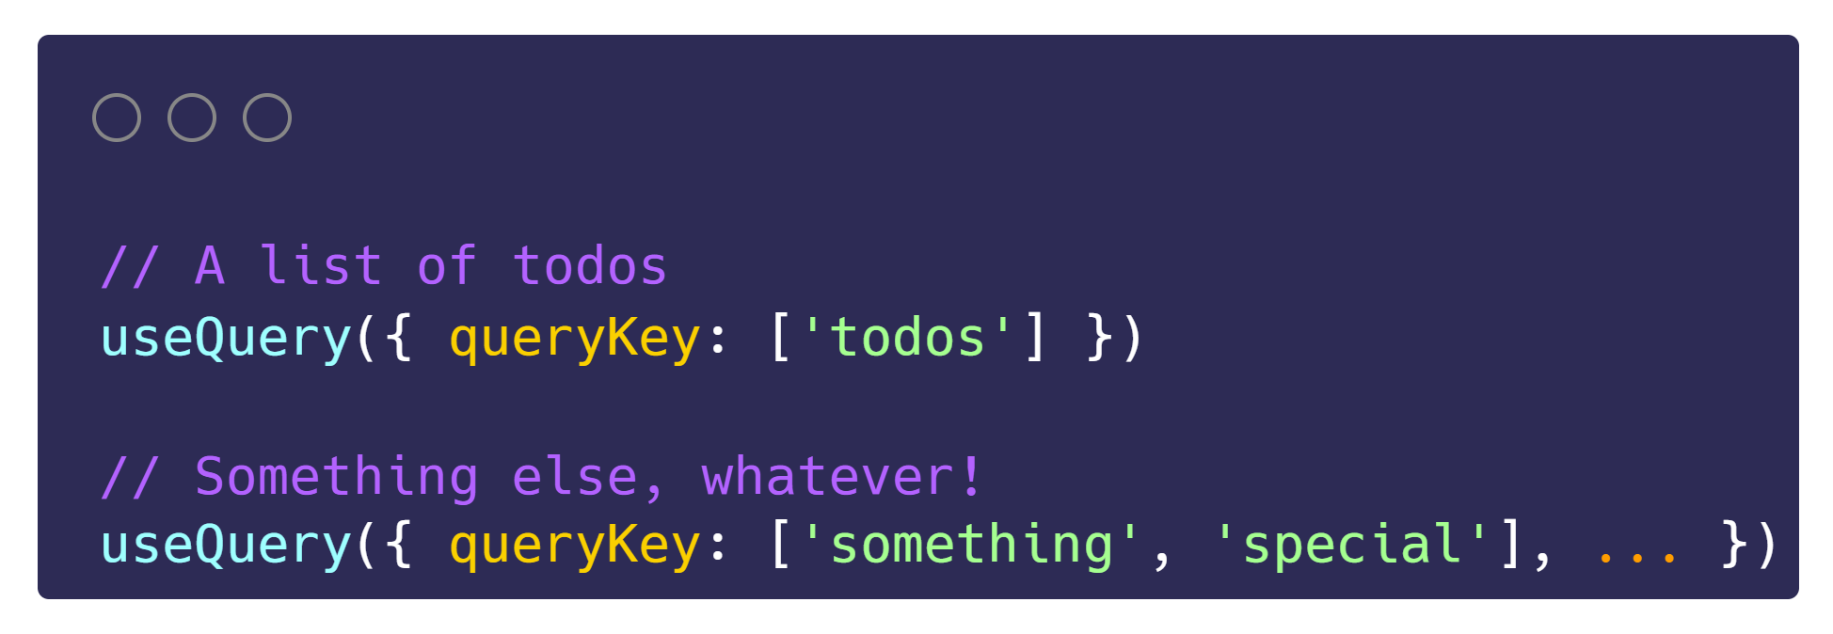
👨‍🏫 Important Defaults
At its core, React Query manages query caching for you based on 🔑query keys.
Notes:
I want to remind you of something we touched upon earlier: React Query manages caching for you based on query keys.
This is used to uniquely identify the data.

Slide 22
👨‍🏫 Important Defaults
StaleTime: The duration until a query transitions from 👶fresh to 👴stale.
👶fresh → As long as the query is fresh, data will always be read from the cache only - no network request will happen!
👴stale → If the query is stale (which by default is instantly), you will still get data from the cache, but a background refetch can happen under certain conditions.

Slide 23
👨‍🏫 Important Defaults
Stale queries are refetched automatically in the background when:
New instances of the query mount
The window is refocused
The network is reconnected
The query is optionally configured with a refetch interval
Notes:
Let’s elaborate on those “conditions”
In greater detail, …
So we can see that React Query handles a lot of refetching logic for us!

Slide 24
👨‍🏫 Important Defaults
CacheTime: The duration until inactive queries will be removed from the cache.
This defaults to 5 minutes. Queries transition to the inactive state as soon as there are no observers registered, so when all components which use that query have unmounted.
Notes:
CacheTime, on the other hand, is the duration until inactive queries will be completely removed from the cache.

Slide 25
Let’s Practice!
By Building a “To Do” App
Notes:
Now that we went through a whole bunch of theory, let’s actually practice by actually building an application that uses React Query!
If that interests you, stay tuned for the next video!

