Slide 1
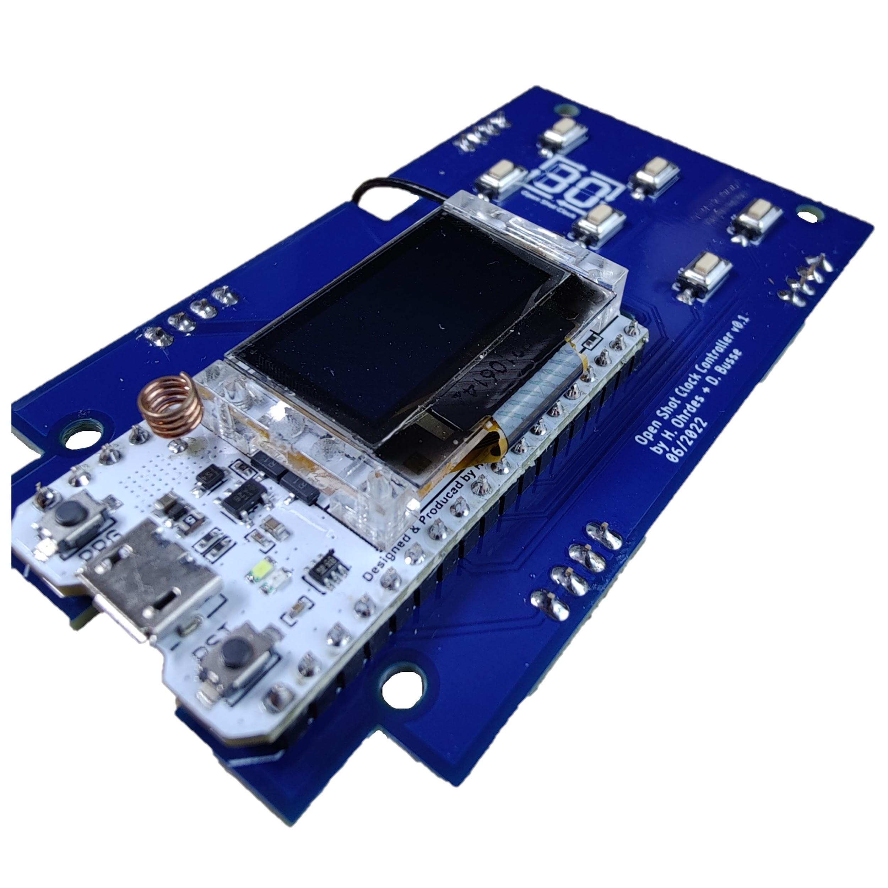
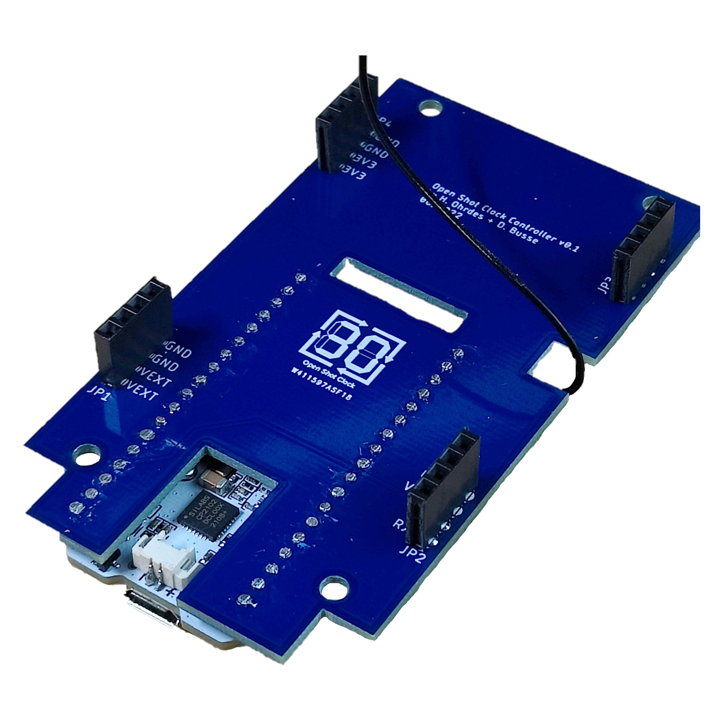
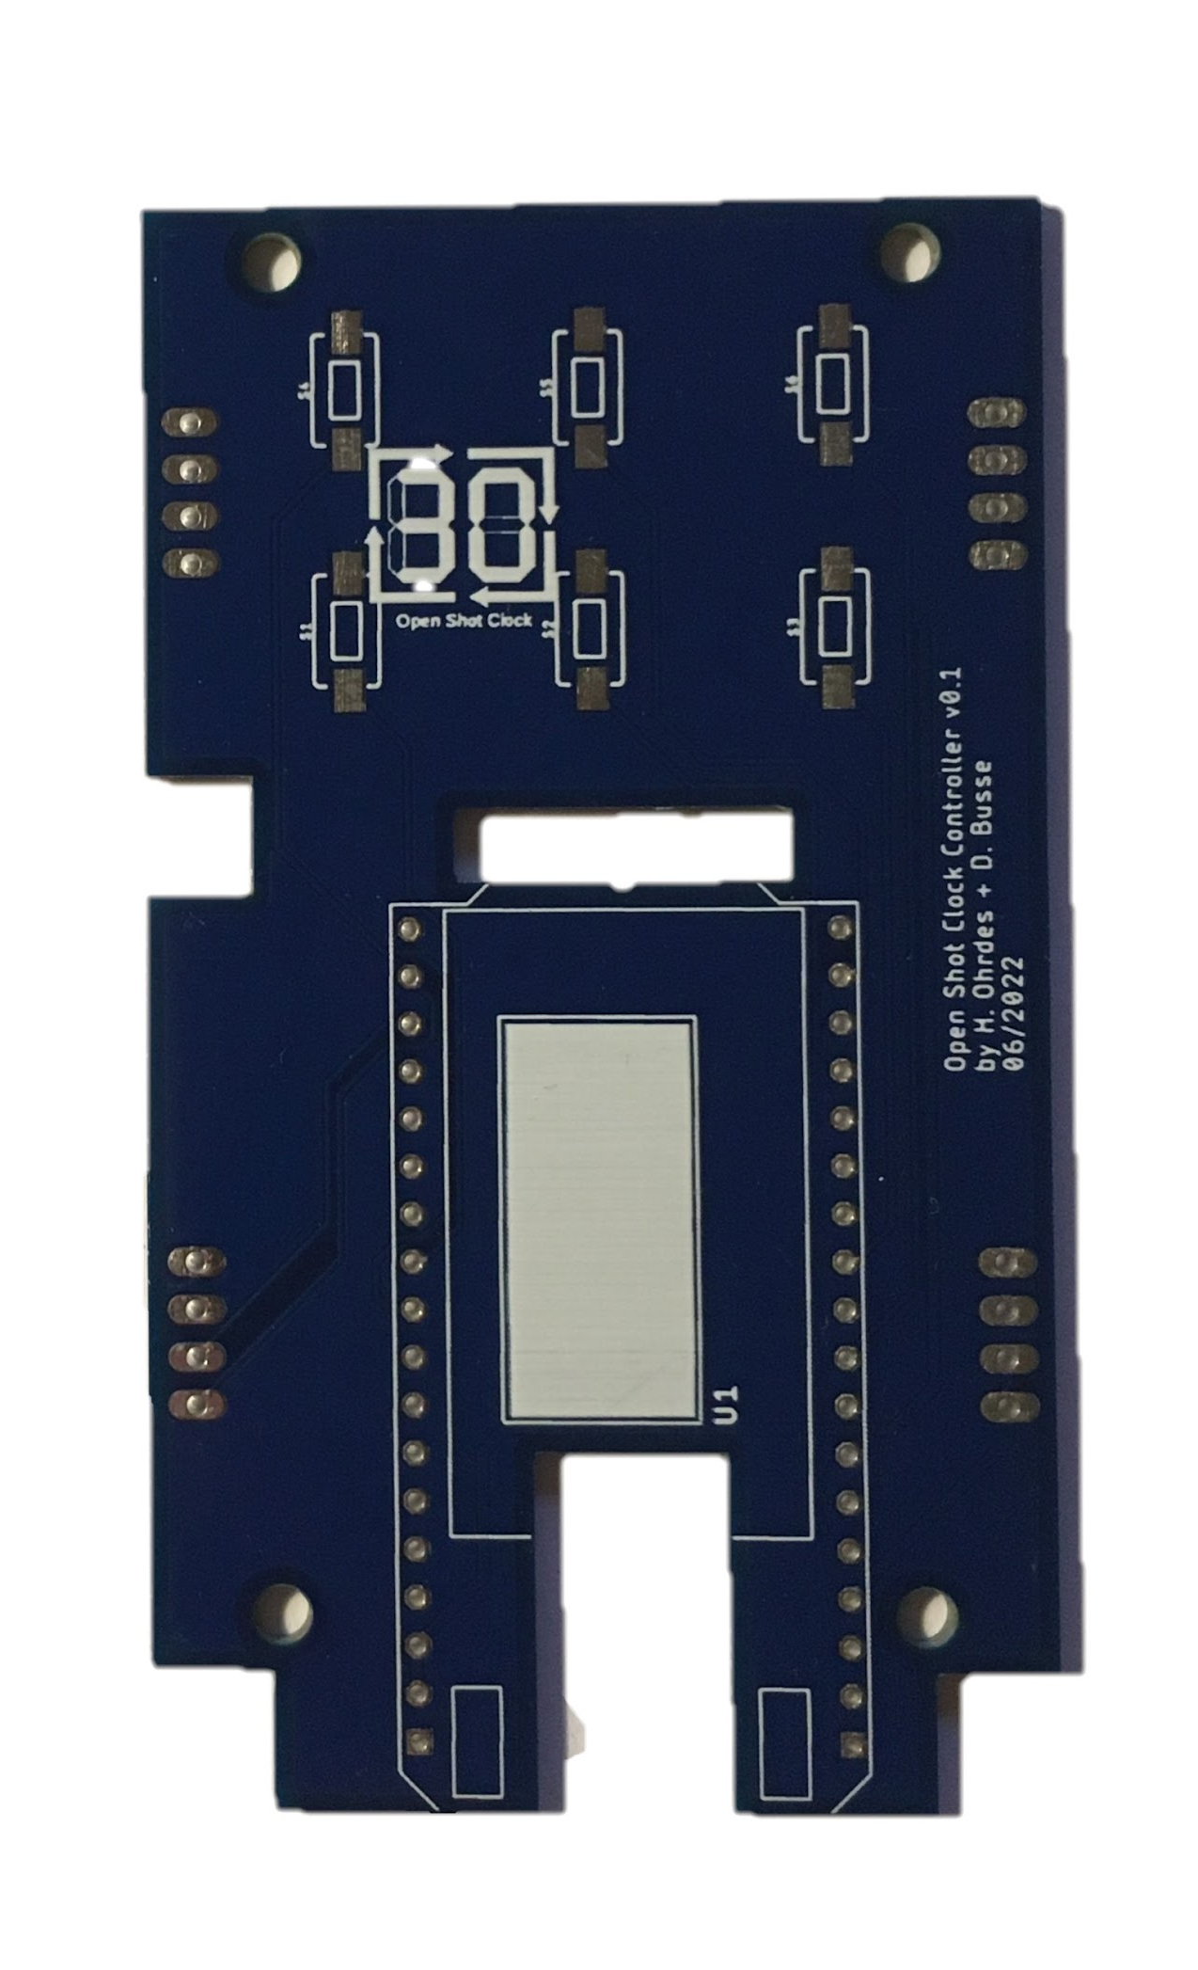
3
2
1
4
3
3
3
3
Heltec Lora 32 (433 MHz)
Button
Female Header
433 mhz Antenna

