Slide 1
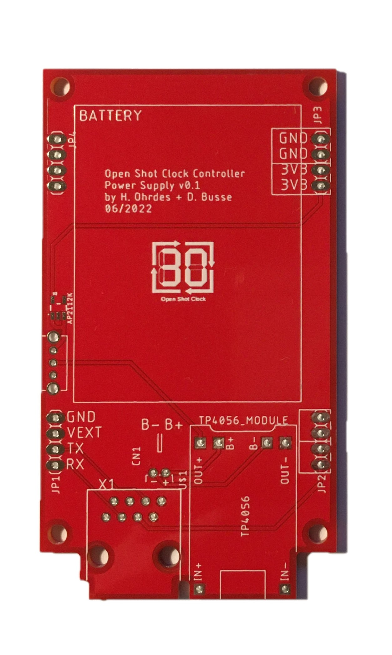
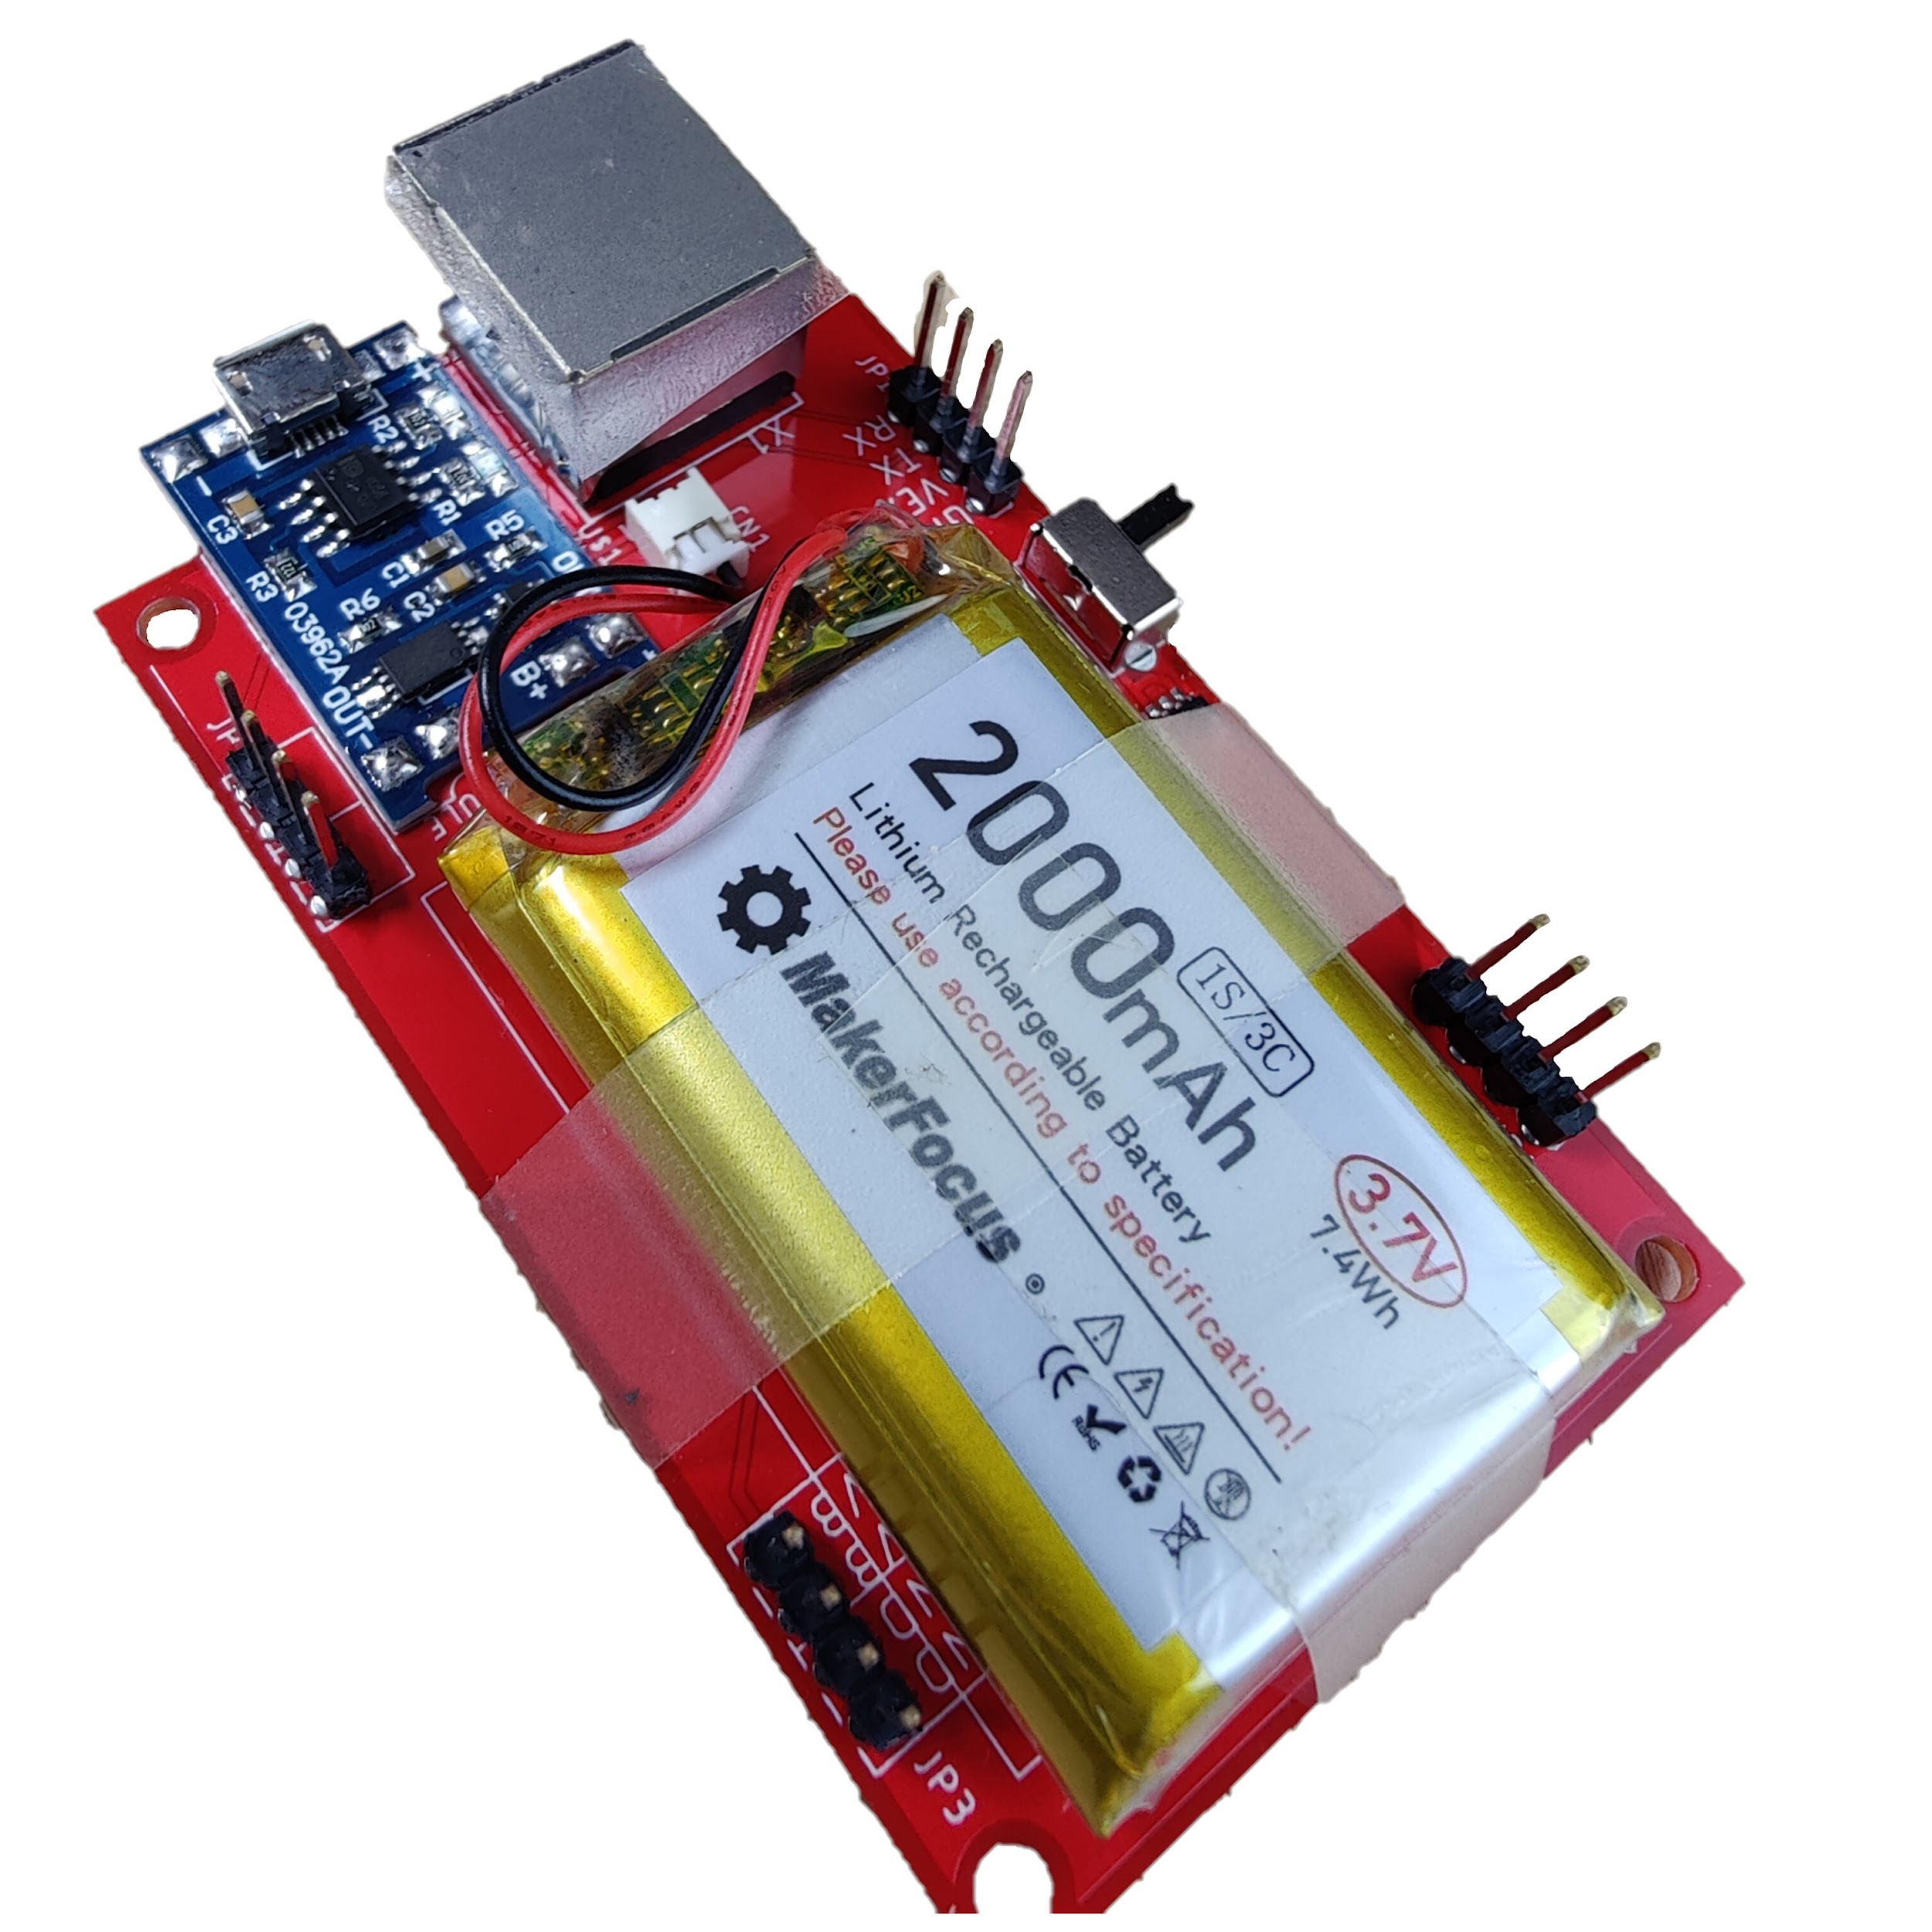
5
3
1
4
2
3
7
6
3
3
TP4056
Switch
Male Header
JST Socket PH 1.25
Ethernet Socket
Lipo 2000mah
LDO SOT23-5

