Slide 1
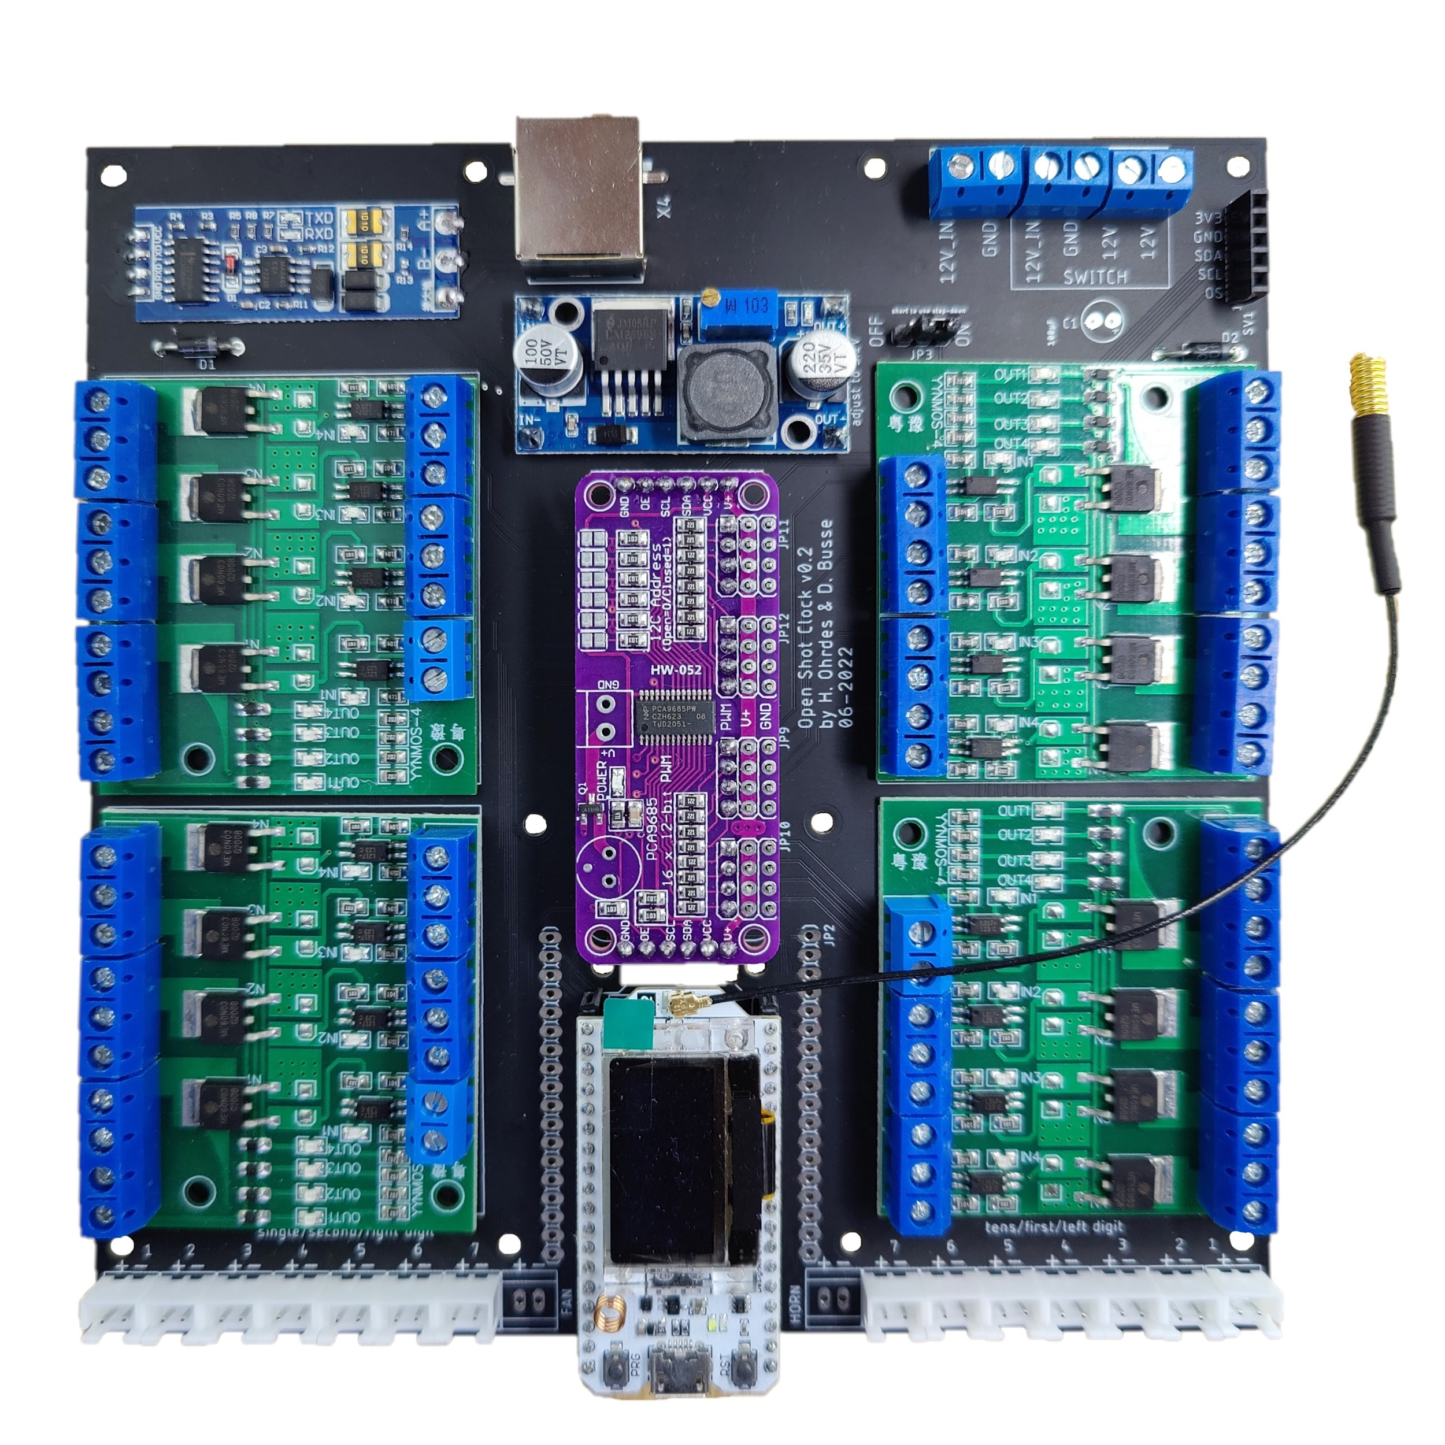
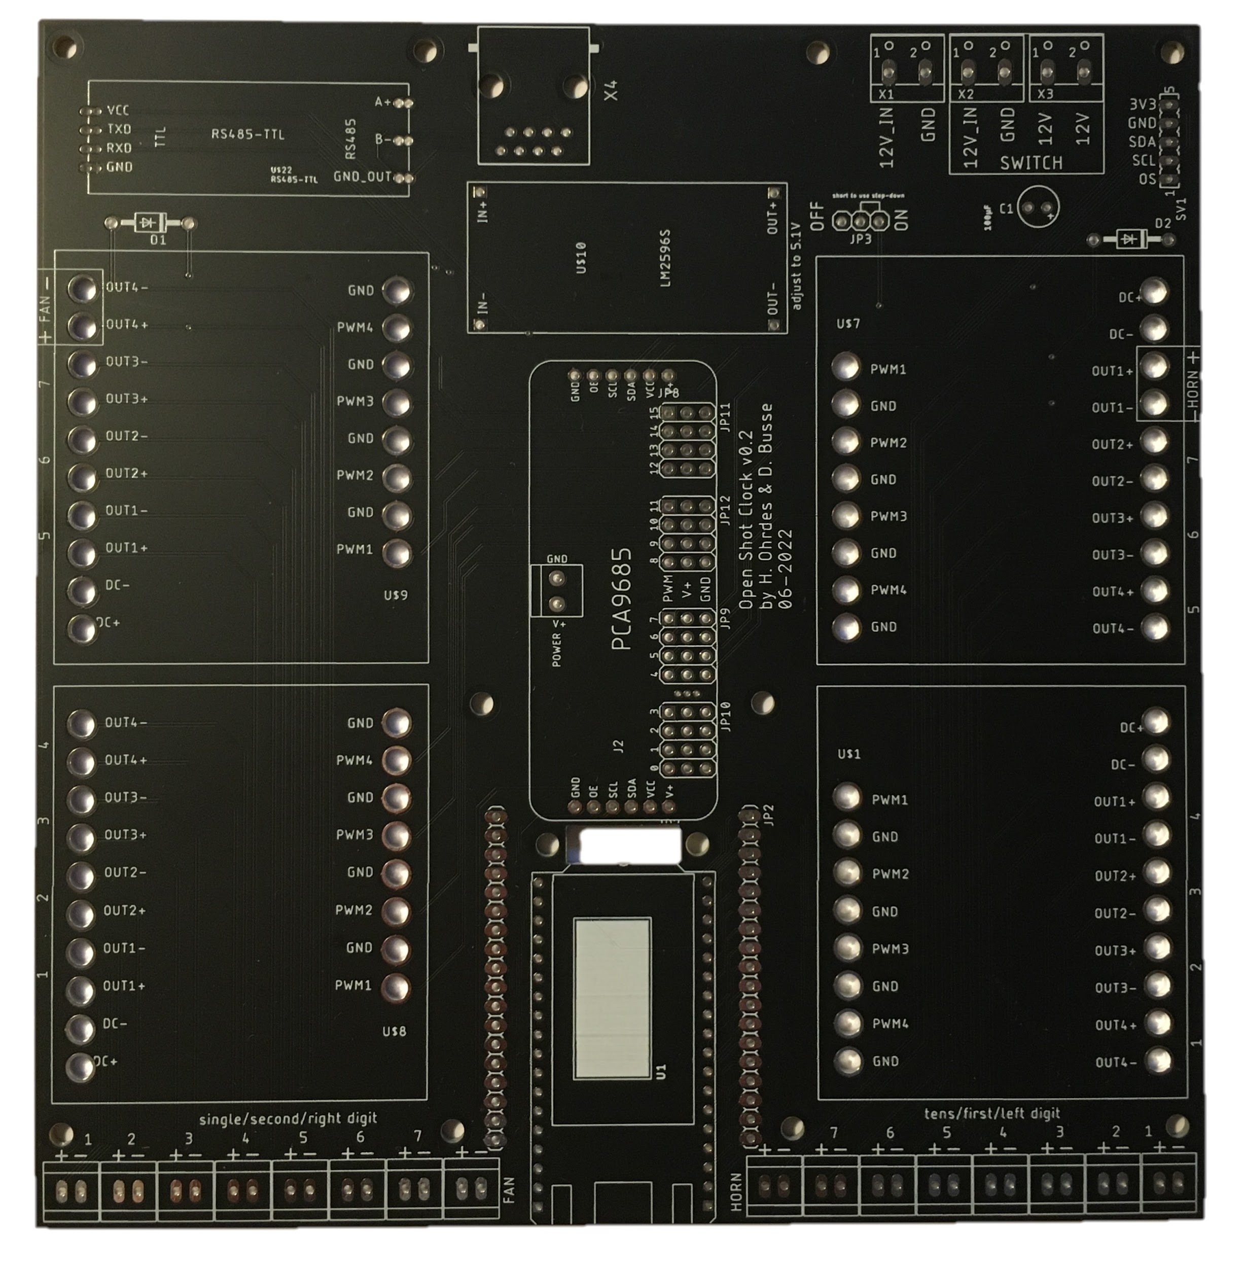
6
3
12
9
7
8
2
10
8
5
5
11
4
5
5
1
13
13
Heltec Lora 32 (433 mhz)
Step Down (LM2596S)
TTL to RS485
PCA9685
Mosfet Modules (YYNMOS-4)
12V Input and Switch IN/OUT Terminals
Temperature Sensor Terminal (LM75A)
Diodes Horn/Fan (1N4004)
3.3V Jumper
Elko 100 or 200 µF (optional)
433 mhz Antenna
Ethernet Socket (for RS485)
LED Module Sockets (JST XH 2.54)

