Slide 1
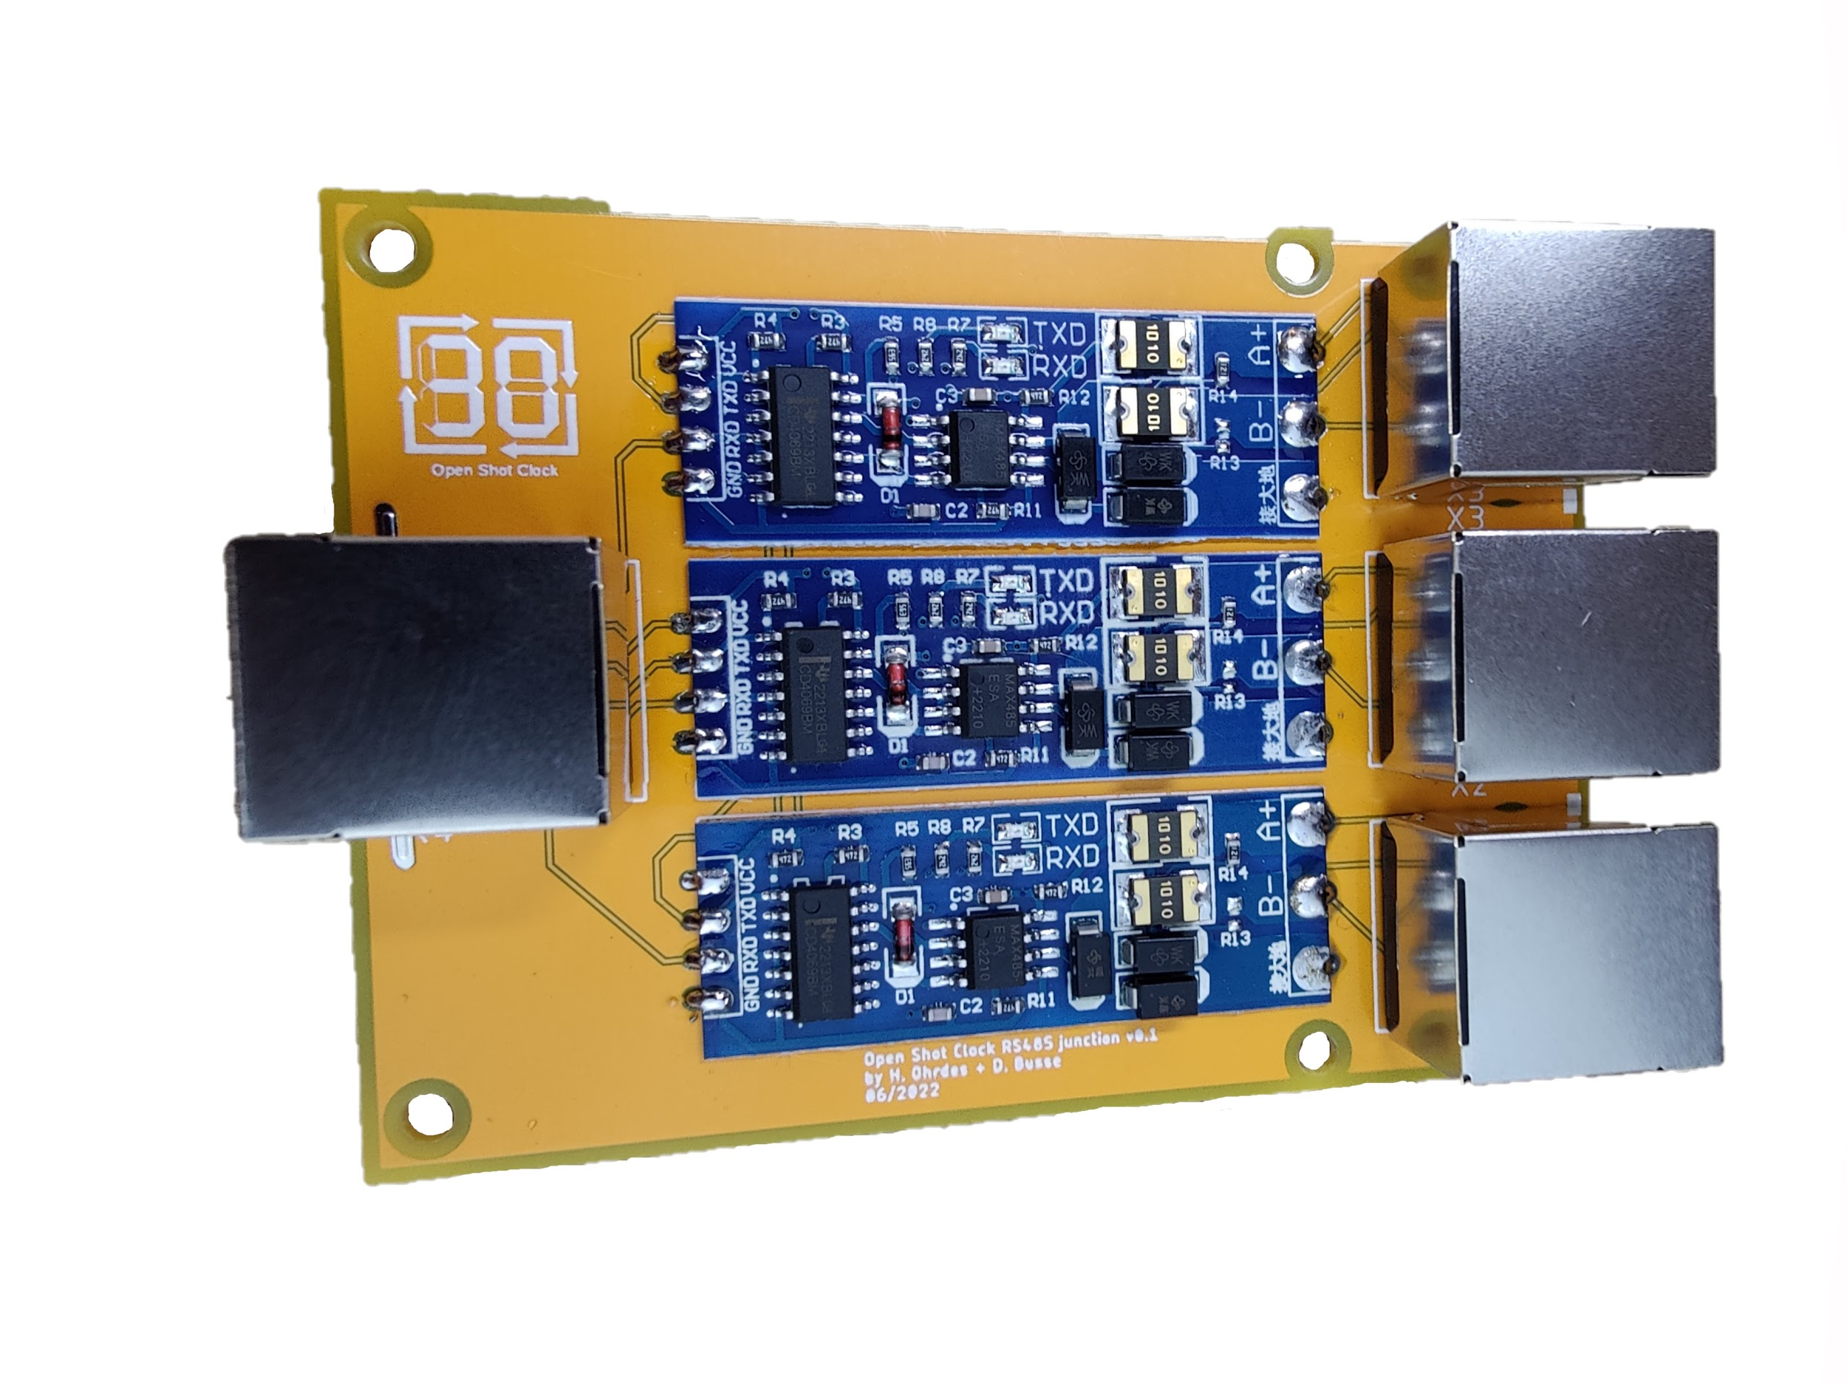
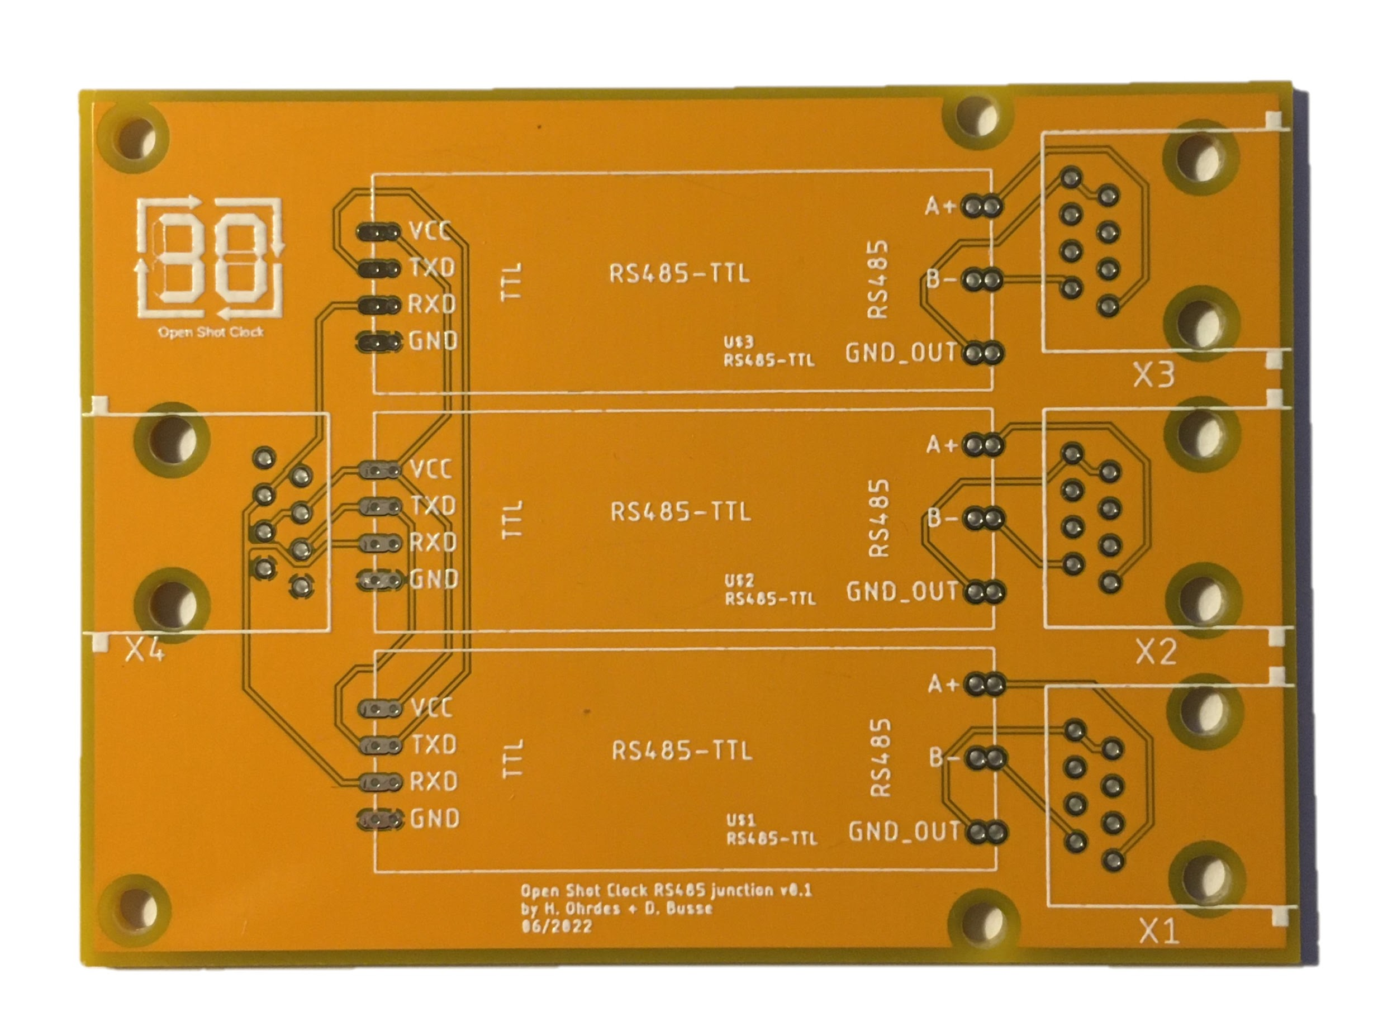
2
1
2
1
1
2
1
Ethernet Socket
TTL to RS485

