Slide 1
The Driverless TNC
Waymo's Safety Record and What It Means for Progressive TNC
Doan Le · Progressive InVIZtational 2026

Slide 2
A new kind of TNC just entered the market.
Human Driver
Human Driver
WAYMO

Slide 3
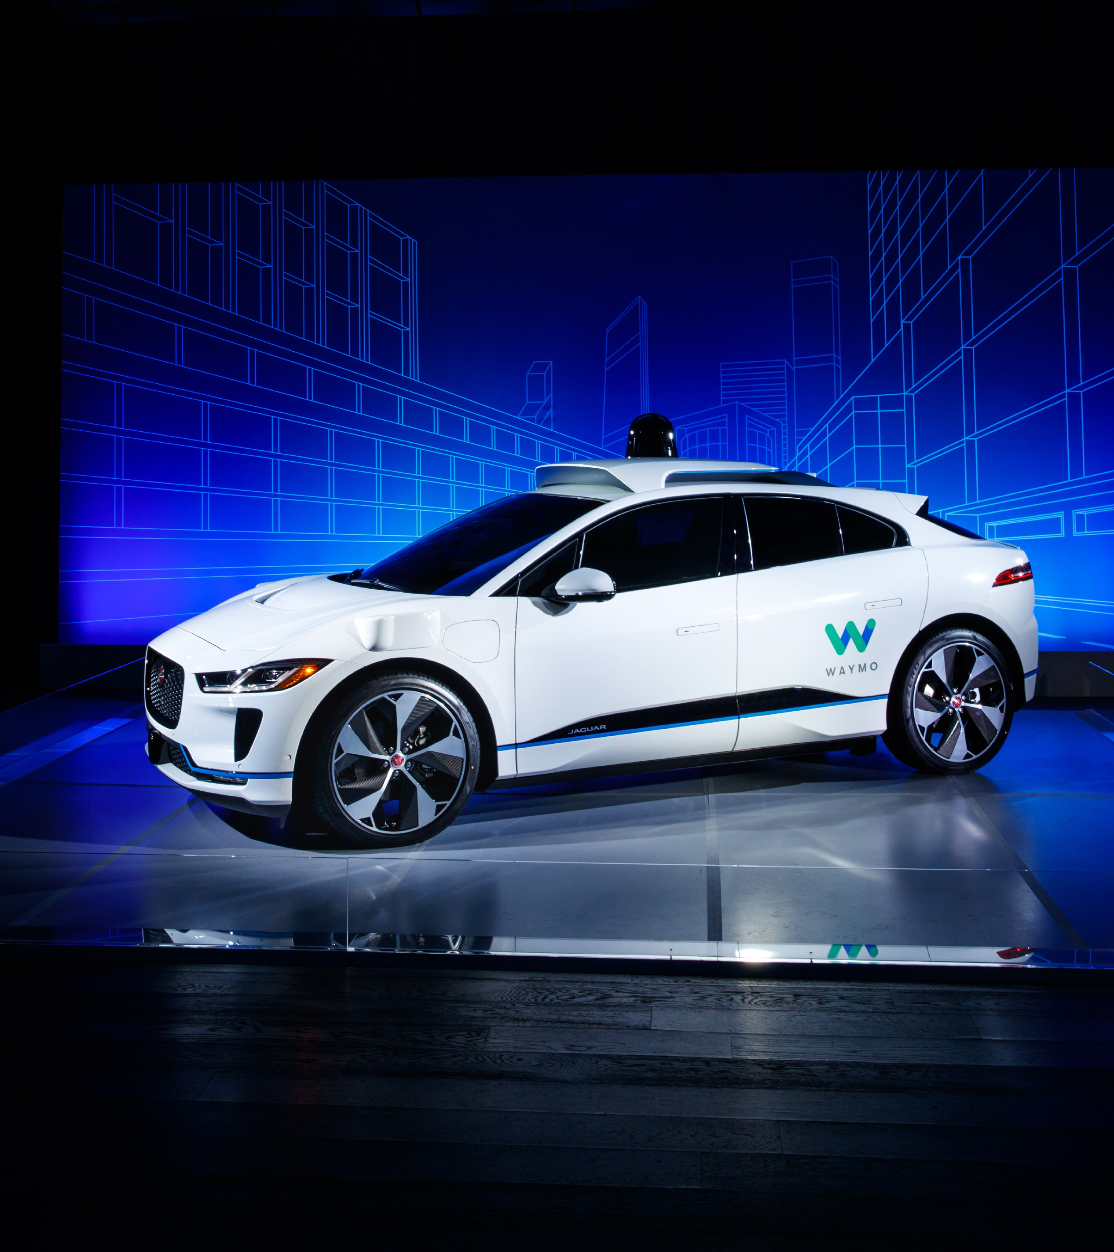
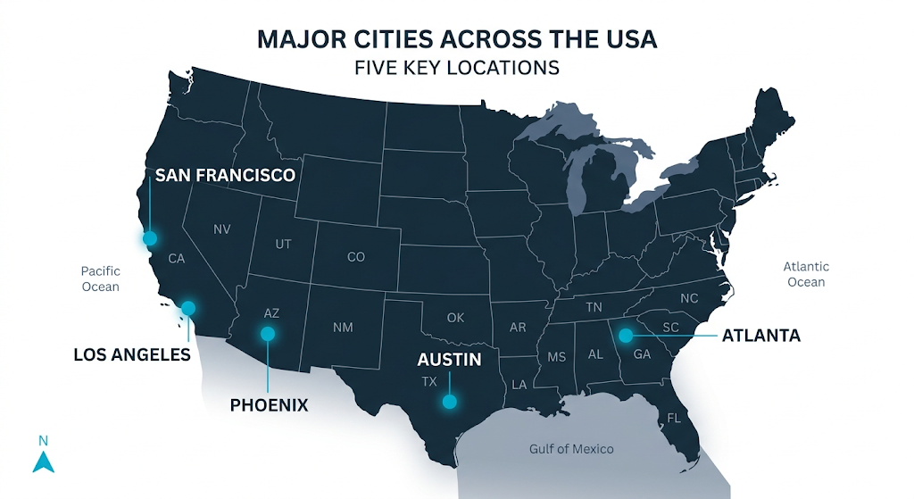
What is Waymo?
Same TNC permit. Very different crash rate.
Waymo is Alphabet's (Google's parent) autonomous vehicle division
Holds a CPUC TNC permit — the same permit class as Uber and Lyft
Vehicles: Jaguar i-Pace with autonomous sensor dome
170.7 million rider-only miles logged Sep 2020 – Dec 2025
Progressive InVIZtational 2026

Slide 4
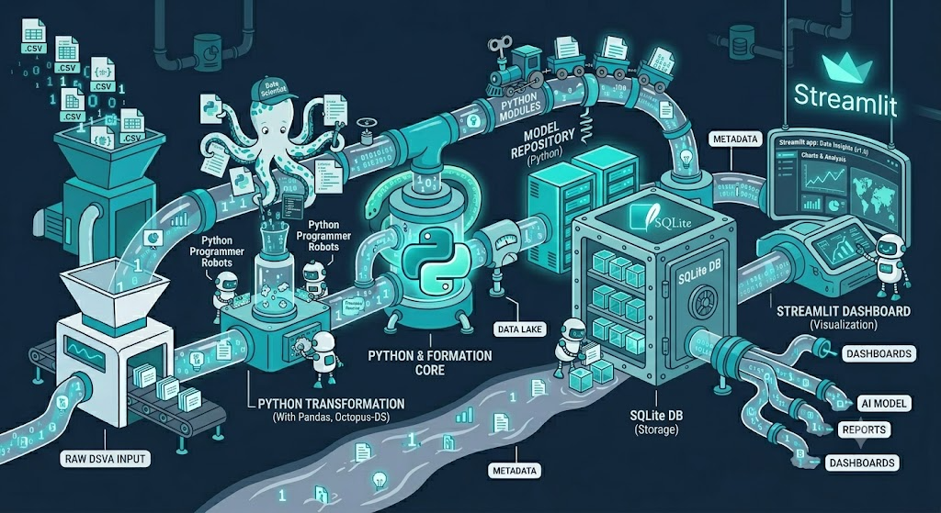
The Data Pipeline
Raw CSVs → Python → SQLite → Streamlit
Raw Data
Python Pipeline
Streamlit App
4 Waymo CSVs
170.7M miles
Sep 2020–Dec 2025
clean_data.py
load_db.py
Pandas + SQLite
5 interactive pages
Publicly deployed
Streamlit Cloud
Progressive InVIZtational 2026

Slide 5
Safety Gap
Waymo vs. human-driver benchmark — crashes per million miles (IPMM)
[ Paste screenshot: Safety Gap page from Streamlit app ]
Progressive InVIZtational 2026

Slide 6
County Deep Dive
Police-reported IPMM by county vs. human TNC benchmark
[ Paste screenshot: County Deep Dive page from Streamlit app ]
Progressive InVIZtational 2026

Slide 7
Crash Profile
What kinds of crashes does Waymo have? (n = 1,390)
[ Paste screenshot: Crash Profile page from Streamlit app ]
Progressive InVIZtational 2026

Slide 8
The Scale Question
What if Waymo ran at CA TNC scale? (3.5B miles/year)
[ Paste screenshot: The Scale Question page from Streamlit app ]
Progressive InVIZtational 2026

Slide 9
So What?
Why Progressive should be paying attention right now
$1.5B
65–90%
Same
permit
TNC Premium
(last 10 years)
Fewer crashes
vs. human TNC drivers
Waymo holds the same
CPUC TNC permit as Uber/Lyft
Progressive InVIZtational 2026

Slide 10
Explore the Data
progressiveinviztational2026-5pfedegdmgjfycvuybaeyd.streamlit.app
Built with Python · SQLite · Streamlit · Plotly
Data: Waymo Safety Impact Data Hub · Sep 2020 – Dec 2025
Doan Le · Progressive InVIZtational 2026

