Slide 1
Practice section for MR using MR-Base R package
Jie Zheng

Slide 2
Necessary R packages
> R version 3.3.0
Necessary R Packages for this practical:
Visualization
install.packages("ggplot2")
MR-Base R package
install.packages("devtools")
library(devtools)
install_github("MRCIEU/MRInstruments")
install_github("MRCIEU/TwoSampleMR")
Install.packages(“plyr”)

Slide 3
Check the installation
library(ggplot2)
library(MRInstruments) #call pre-calculated MR instruments
library(TwoSampleMR) #you should jump to authorization step
toggle_api("test") #use the API for the course
ao<-available_outcomes() #no error message means it is working now.
Setwd(~/21_MR-practice/) #change working directory

Slide 4
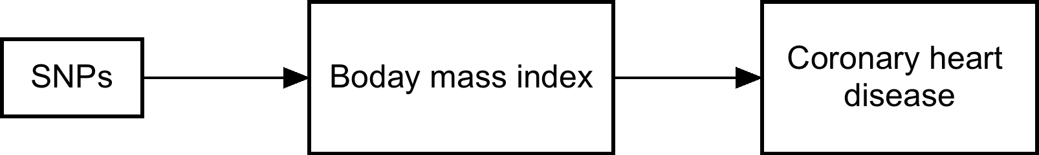
Practice 1: one exposure one outcome
In this practice, we are going to test the hypothesis of whether body mass index (BMI) is associated with coronary heart disease (CHD)
We will have four major steps for this practice:
Select instruments for one exposure (BMI) from MR-Base database
Select outcome (CHD) from MR-Base database too.
Run IVW, MR Egger and WM MR analyses
Visualise the causal estimate for BMI on CHD – Single SNP forest plot, funnel plot, Leave one out forest plot and scatter plot

Slide 5
Effect of body mass index on CHD
outcome | exposure | method | nsnp | b | se | pval
Coronary heart disease | Body mass index | Inverse variance weighted | 79 | 0.4459091 | 0.05898302 | 4.03E-14
Coronary heart disease | Body mass index | MR Egger | 79 | 0.5024935 | 0.14396056 | 8.01E-04
Coronary heart disease | Body mass index | Weighted median | 79 | 0.3870065 | 0.07106542 | 5.16E-08

Slide 6
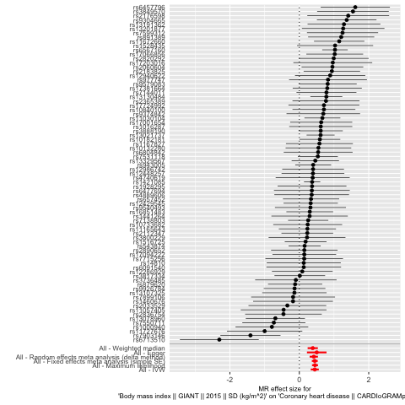
Effect of body mass index on CHD

Slide 7
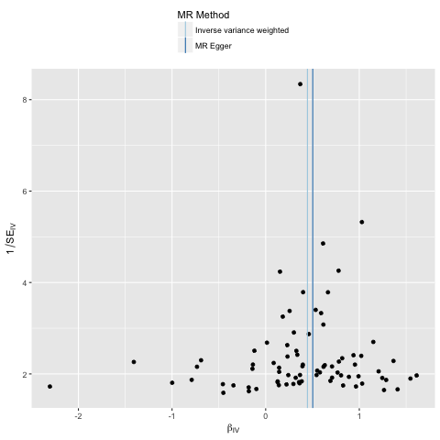
Effect of body mass index on CHD

Slide 8
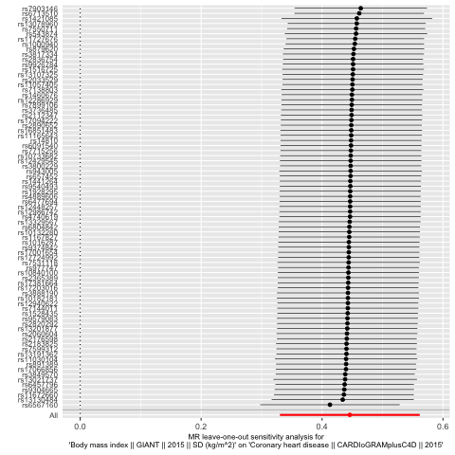
Effect of body mass index on CHD

Slide 9
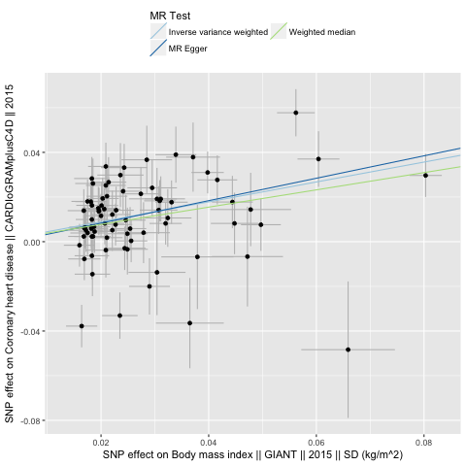
Effect of body mass index on CHD

