Slide 1

Statistical colocalization of genetic association signals for a pair of traits
Jie Zheng

Slide 2
Preparation
Files you will need:
R script: coloc-practice.final.R
Input file for GWAS summary data of protein level of CSF-1 and years of schooling: CSF1-Schooling.txt
Input file for GWAS summary data of protein level of MUC16 and asthma: MUC16-Asthma.txt
In R studio, you will need to:
open script: coloc-practice.final.R
Change working directory: setwd("~/directory/to/the/data/")
Install coloc R package: install.packages("coloc")
source(“http://Bioconductor.org/biocLite.R”)
biocLite(“snpStats”)

Slide 3
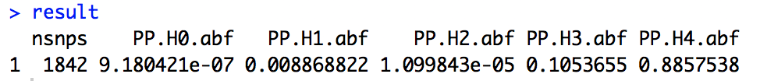
Results for case study 1
CSF-1
Years of schooling

Slide 4
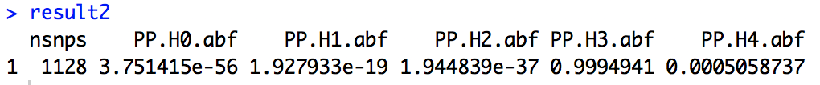
Results for case study 2
MUC16
Asthma

Slide 5
Quick recap
In this practice:
Have a better understanding of colocalization analysis
We create two functions to run colocalization on a binary trait (e.g. a disease) and a continuous trait (e.g. protein expression)
Run two real-case examples for proteins on human traits.
Coloc is designed but not limited to molecular traits.

Slide 6
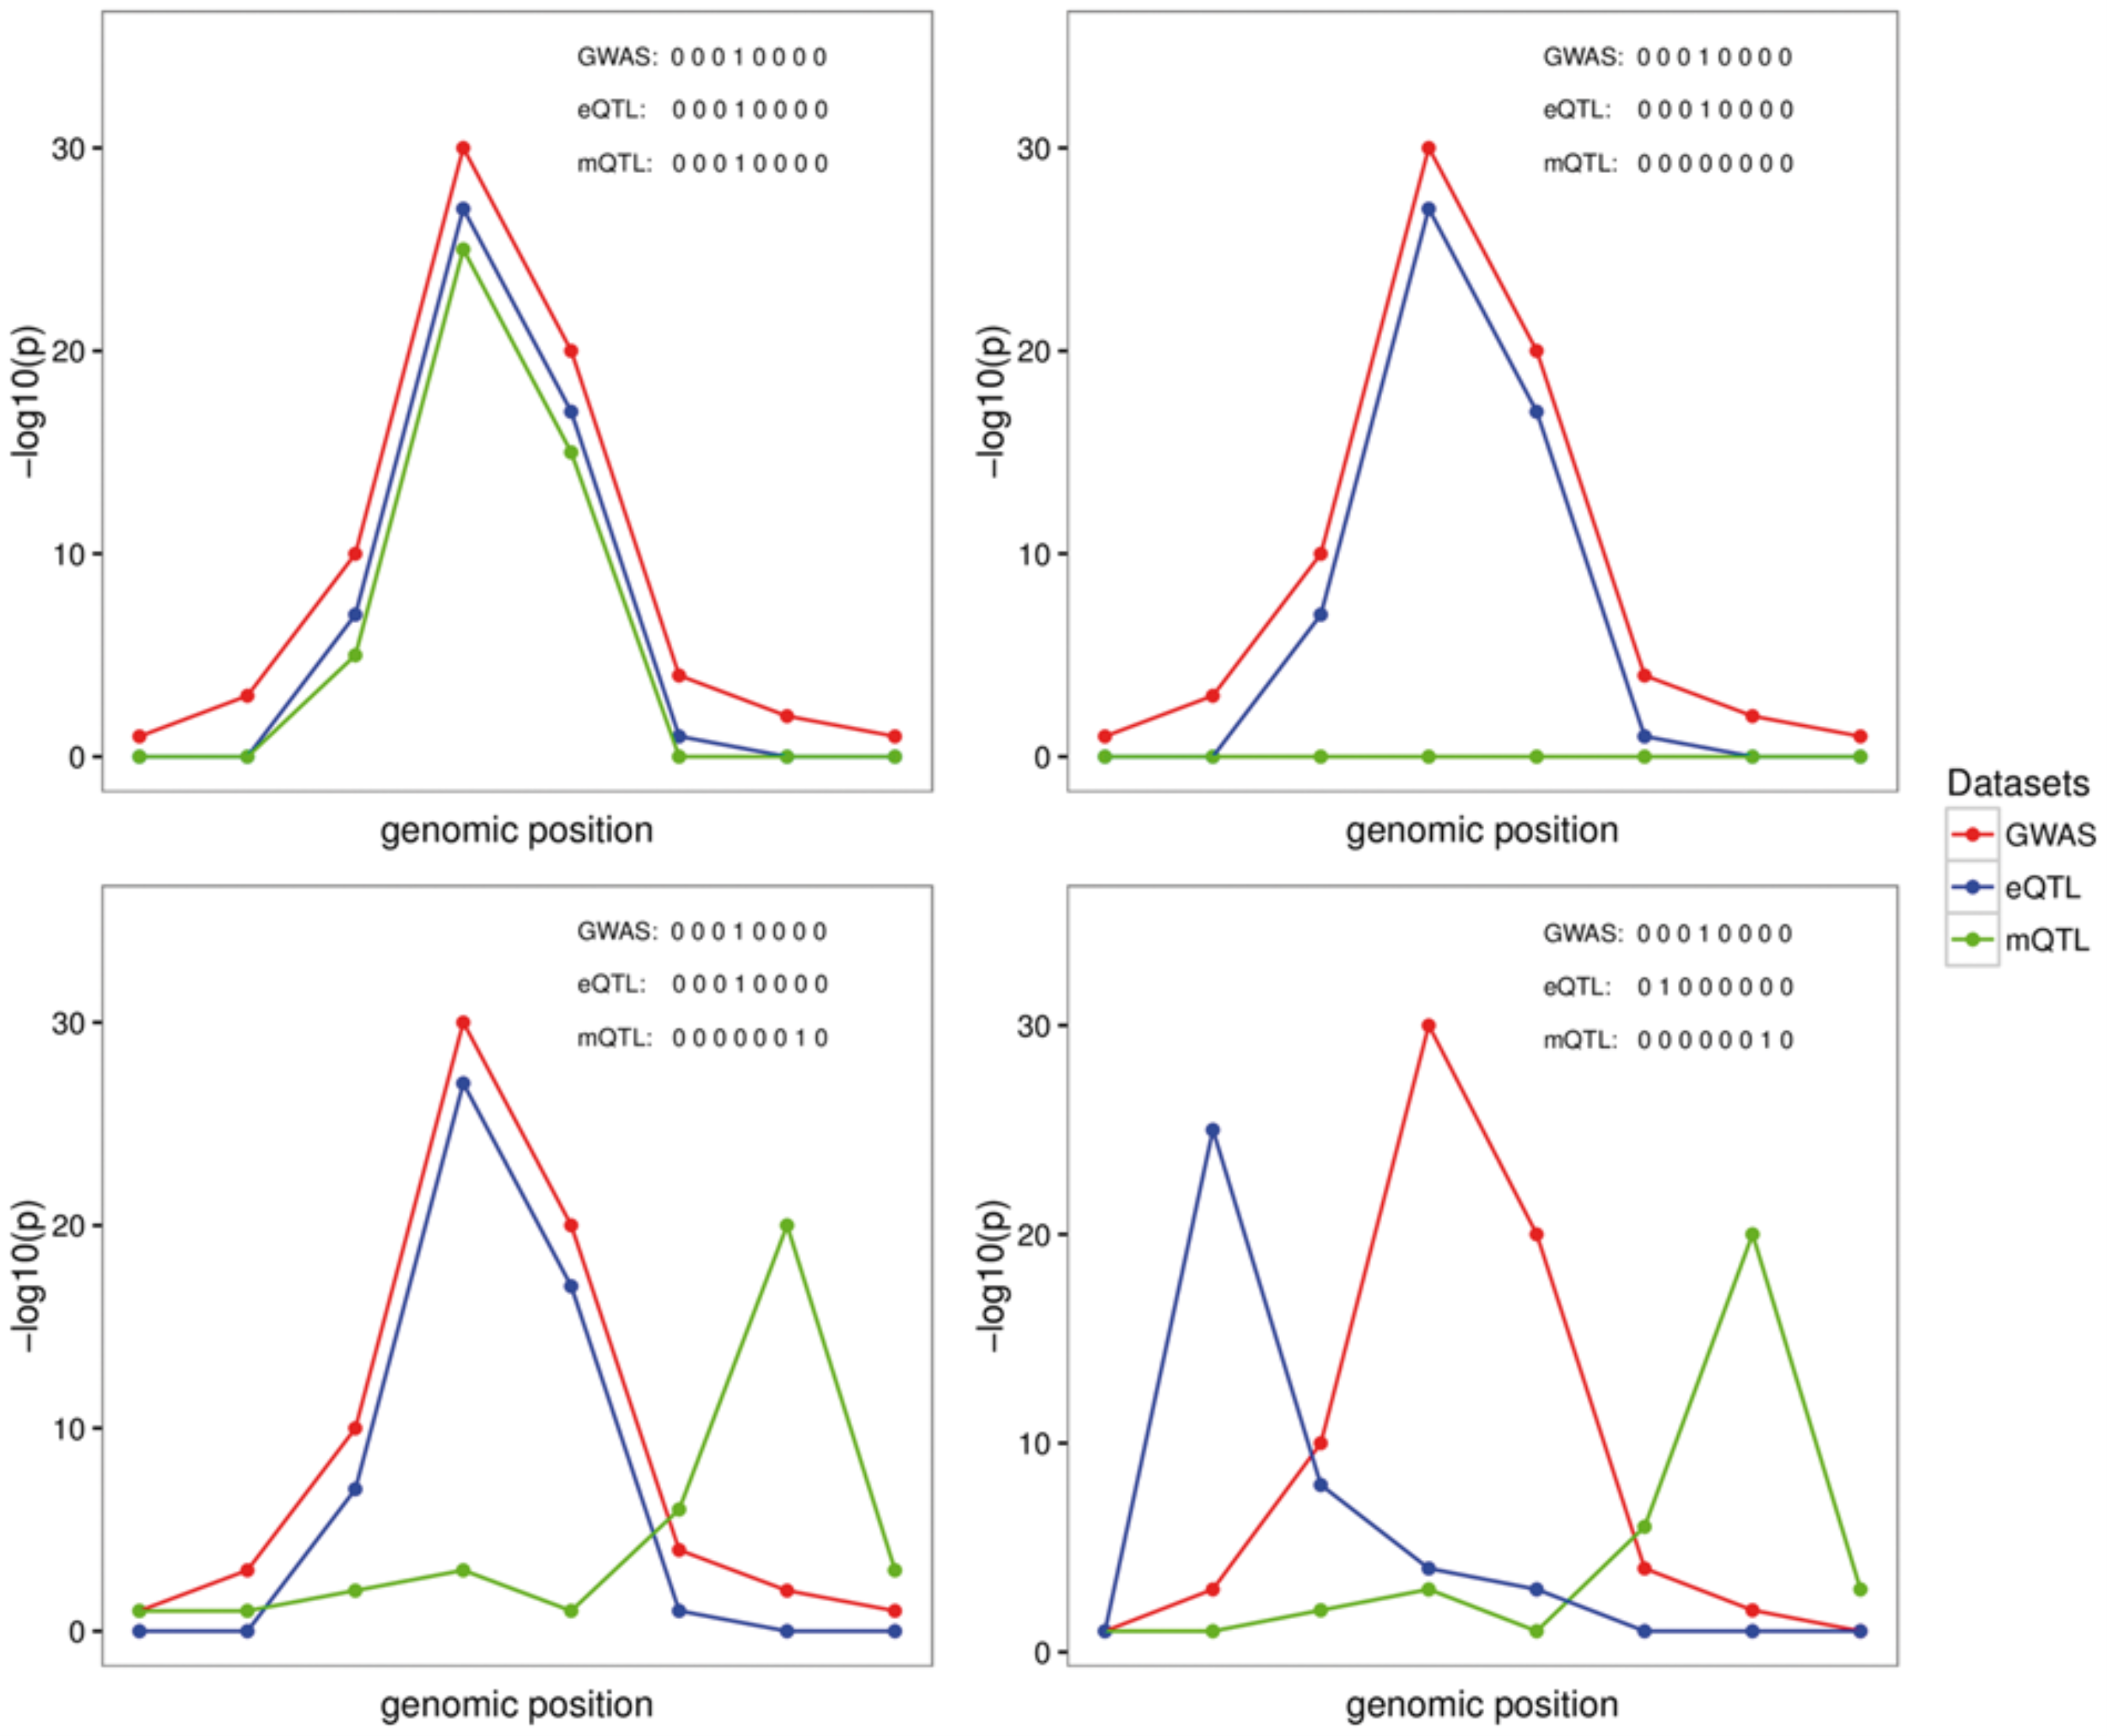
Coloc can be applied to more than two traits, for example, to investigate the shared genetic signal between methylation, gene expression and a disease
Moloc:
A Bayesian framework for multiple trait colocalization from summary association statistics
Bioinformatics. Published online March 19, 2018.
HyPr coloc – James Staley
Notes:
Fig. 1. Graphical representation of four possible configurations at a locus with eight SNPs in common across three traits. The traits are labeled as G, E, M representing GWAS (G), eQTL (E) and mQTL (M) datasets, respectively. Each plot represents one possible configuration, which is a possible combination of three sets of binary vectors indicating whether the variant is associated with the selected trait. Left plot top panel (GEM scenario): points to one causal variant behind all of the associations; Right plot top panel (GE scenario): represent the scenario with the same causal variant behind the GE and no association or lack of power for the M association; Left plot bottom panel (GE.M scenario): represents the case with two causal variants, one shared by the G and E and a different causal variant for M; Right plot bottom panel (G.E.M. scenario): represents the case of three distinct causal variants behind each of the datasets considered
6

Slide 7
Quick recap
In this analysis, we prepare the genetic association information for both exposure and outcome for you. In real-life you will need:
Find all SNP rsids within the genomic region
Lookup SNP association info for both exposure and outcome
MR-Base have such a lookup function
extract_outcome_data()
more details here: https://mrcieu.github.io/TwoSampleMR/
Phenoscanner can also do SNP lookups:
http://www.phenoscanner.medschl.cam.ac.uk/phenoscanner

