Slide 1


Intro to Git & Github
Daniel J Leirer
25/Jan/2021

Slide 2
What are Git & Github?
Git
Github
Version Control Tool.
Tracks history of project
Create git repositories.
Store git repositories in cloud.
Store private git repositories.
Share code with collaborators.
Notes:
Git is a free version control system.
Stores Code online in Private repository
Collaboration
Reproducibility

Slide 3
Why?
Revert to working code
Archive of Project Development
Sharing code
Collaboration
Notes:
Git is a free version control system.
Stores Code online in Private repository
Collaboration
Reproducibility

Slide 4




Git Version Control:
Master Branch
Workspace
Start project
+ Code
+ Plot
- Code
+ Code

Slide 5
Git Branches:
Switch to PLINK v2.0
Master Branch
Workspace
Testing new workflow.

Slide 6
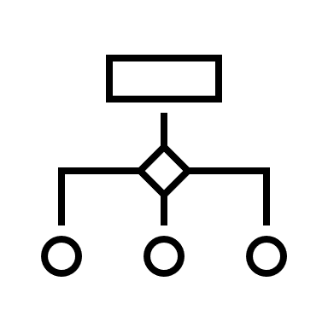


Git Workflow:
Workspace
Index
Local Repository
Remote Repository
git add .
git commit –m “”
git push
git commit –a –m “”
git pull
git merge
git fetch
Notes:
Talk about:
Workspace (add –a, commit -a)
Git Index (commit –m “”)
Local Repository (push)
Remote Repository (pull)

Slide 7
Practical:
1. Go to Github.com and make an account.
2. Join Exeter Genetics.
3. Log into Cook or Install git on your local machine.
4. Clone the repository from the remote:
$ git clone https://github.com/ExeterGenetics/github_workshop.git
5. Make a change to the file:
$ git status
$ git add .
$ git commit –m “your commit message here”
$ git push
Notes:
Make Github Account
Join ExeterGenetics
Log into Cook / or install git on your local machine.
Clone the repository from the remote.
Make a change use git add, commit and push.

