Slide 1

COMP6822001 Speech Recognition
Kelompok 3
DAVE ANELKA ALIM
2602102712
NICHOLAS FARANDI HARJANTO
2602065553
DEANZEN LIE
2602115785
DAVE TJONG
2602077736
KEVIN BRIVIO
2602077263
CHRISTIAN LUIS EFENDY
2602106963
STANLEY BENEDICT KODYAT
2602103463

Slide 2
Calendar
7 Feb | 21 Feb | 28 Feb | 6 Mar | 13 Mar | 20 Mar | 27 Mar
F2F | F2F | F2F | GSLC | F2F | F2F | F2F
Grouping |  |  | - Submit Project Idea - Case Solving
8 May | 15 May | 22 May | 5 Jun | 12 Jun | 19 Jun | 22 Jun
F2F | GSLC | F2F | F2F | F2F | F2F | No class
 | - Submit Project Report - Case Solving |  |  |  | Project Presentation | - Submit Project Final Report

Slide 3
Material
HMM-GMM in Speech Recognition
https://jonathan-hui.medium.com/speech-recognition-gmm-hmm-8bb5eff8b196
Playground
https://colab.research.google.com/drive/1dNm-4YnfSLk61Wo87tpF6m8hRS_-A27o?usp=sharing

Slide 4
Introduction - Deep-Voice
Deep-Voice is an innovative application designed to detect AI-generated fake speech, also known as deepfakes. As AI technology advances, the ability to mimic human voices with retrieval-based voices has become a significant concern, leading to the spread of misinformation, privacy breaches, and cybersecurity risks.
Deep-Voice combines extensive data collection, appropriate machine learning models, feature extraction with speech recognition techniques, and robust training procedures to identify and prevent the spread of fake speech.
By focusing on security and ethics, Deep-Voice aims to uphold the integrity of audio information in a complex and rapidly evolving digital era.

Slide 5
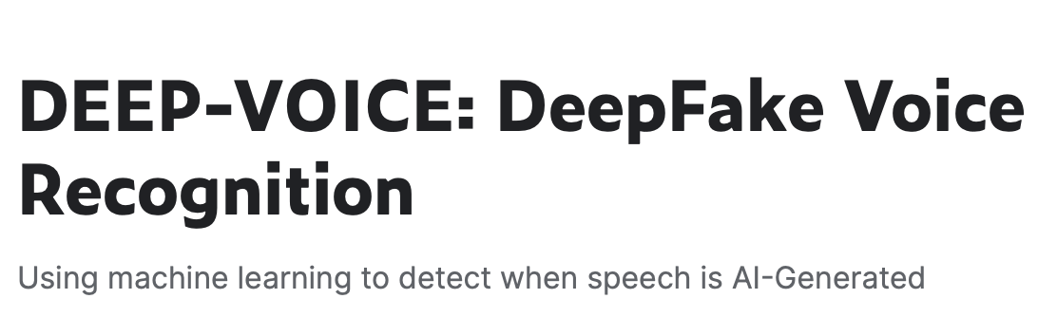
Dataset
This dataset contains of real human speech and DeepFake versions of those speeches by using Retrieval-based Voice Conversion.
https://www.kaggle.com/datasets/birdy654/deep-voice-deepfake-voice-recognition

Slide 6
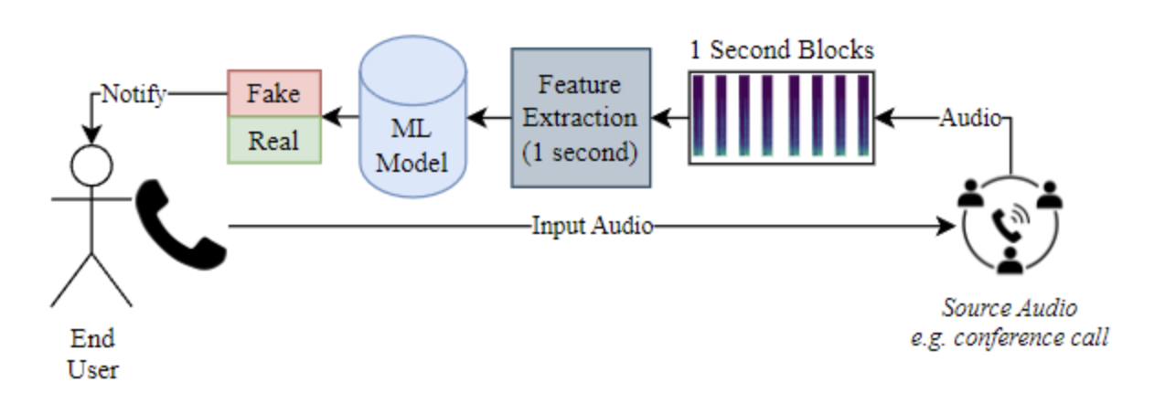
Dataset
The datasets:
Raw audio with “REAL” and “FAKE” type

Slide 7
Data Exploration

Slide 8
Preprocessing

Slide 9
Method

Slide 10
Evaluation

Slide 11
Demo

