Slide 1
Predicting the Stanley Cup Playoffs
David Liszewski
Intro to Data Science
Spring 2020

Slide 2
Background
National Hockey League (NHL):
31 teams, ~82 game regular season
16 teams make the playoffs
Playoff format:
Better regular season teams = better seed
Best-of-7 games series (must win 4) between 2 teams
Winner advances to next round
Final winner is crowned Stanley Cup champion

Slide 3
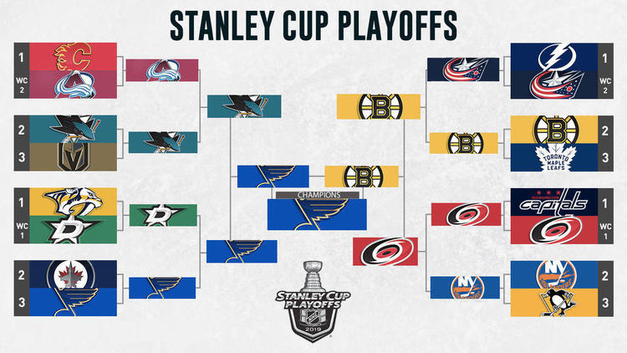
Motivating Example

Slide 4
Questions and Goals
Can we predict which teams will perform successfully in the playoffs?
How much of a role does ‘puck luck’ truly play in hockey?
Build a prediction model for playoff matchups
Compare model to a trivial model
Reflect on the nature of randomness in hockey

Slide 5

Approach
Ordered variables
Multinomial models
outcome = {losein4 < losein5 < losein6 < losein7 < winin7 < winin6 < winin5 < winin4}
P(win) = P(winin7) + P(winin6) + P(winin5) + P(winin4)
BinaryOutcome = {0 : loss, 1 : win}

Slide 6
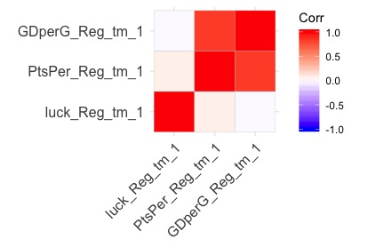
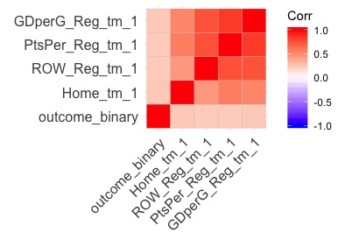
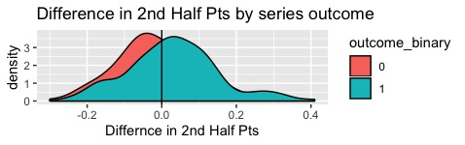

Slide 7
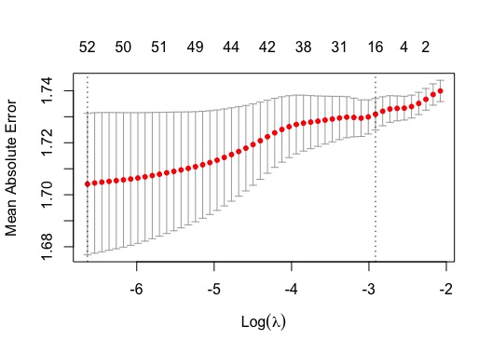
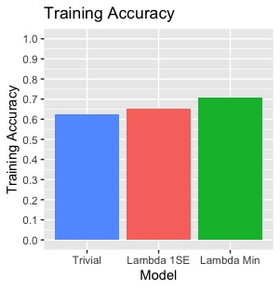
Model Tuning

Slide 8
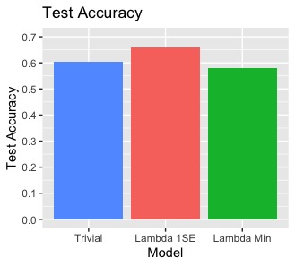
Results
65.8% Prediction accuracy
Performed better than trivial model and the overfit model

Slide 9
Conclusion and Limitations
Successfully predicted 66% of playoff series
The randomness of Puck Luck is very prevalent in the NHL playoffs
Season-level Data instead of game-level
Lack of advanced statistics
(Ex: Corsi)

