Slide 1
15-122: Principles of Imperative Computation
Iliano Cervesato, Dilsun Kaynar
https://cs.cmu.edu/~15122
Notes:
In Fall semesters, welcome the freshmen especially.

Slide 2
Activity
T A B L E
R E P L Y
H A N D L E
B E L O W
D E F I N E
B L _ _ _
P I A _ _
C L _ _ _
S T U _ _
D A _ _ _
Copy these words on a sheet of paper
Complete the blanks to create new words (in any language)
Turn the sheet of paper over and leave it that way

Slide 3
Overview
Goals of this course
Interactions
Lectures, labs, recitations, office hours
Assessment
Quizzes, homework (written, prog.), exams
The course begins …

Slide 4
Goals
Computational Thinking
Algorithms
Programming
Technical Comprehension
Notes:
15-122 is not primarily a “programming class” (112 is)

Slide 5
Programming Skills
Transforming algorithmic ideas into code
Code that works the first time around
Deliberate programming
… well, nearly the first time around
Writing tests
Imperative programming in C and C0
Basic Unix survival
Notes:
“Programming” = someone gives you an algorithm and you code it.
You did that in 15-112 (or whatever programming course you took)
We will take it to another level: transition from coder to programmer.
122 will teach 2 languages:
C0 – 2/3 of the course: a well-behaved subset of C
C – 1/3 of the course: the wild west

Slide 6
Algorithmic Ideas
Asymptotic complexity
time/space
worst case/average case/amortized analysis
important classes: O(1), O(log n), O(n log n), O(n^{k}), O(2^{n})
Important ideas like order and randomness
Lots of fundamental data structures
(Psst… this is often what tech interviews test on!)
Notes:
Knowing what algorithms are out there and developing a vocabulary to talk about them.
This slide will make a lot more sense after taking the class.

Slide 7
Computational Thinking
“Thinking like a computer scientist”
Systematic approach to solving a problem
Finding solutions that are correct
Finding solutions that are efficient
Develop vocabulary and tool kit
Notes:
This is the real interesting meat of the course: the transition from programmer to computer scientist.
All future lectures will have a 2nd theme rooted in computational thinking.

Slide 8
Technical Comprehension
Learning to read technical specifications is an important skill you will be acquiring in this class
Problem statements will get longer
Dots to be connected will be further apart
You will become more confident
You will try more things on your own

Slide 9
The Big Picture
Pre- or co-requisites
either 15-151 (Math Foundations for CS)
or 21-127 (Concepts of Mathematics)
Counterpart
15-150 (Principles of Functional Programming)
Pre-requisite for
15-213 (Introduction to Computer Systems)
15-210 (Parallel and Sequential Data Structures and Algorithms)
15-214 (Principles of Software System Construction)
Notes:
In average, students who don’t do 15-151 or 21-127:
spend more time on the course
don’t learn as much
get a lower grade (one letter grade in average)

Slide 10
Overview
Goals of this course
Interactions
Lectures, recitations, office hours
Assessment
Quizzes, homework, exams
The course begins …

Slide 11
Lectures
Tuesday and Thursday
Please be here, please be active
Ask and answer questions, pay attention
Lecture notes for review
NEW! a few online modules (optional)
Laptops for note-taking only
No surfing, email, games, …
Work on your homework elsewhere
If you can see board from the back row, be there
Too distracting for other students
Notes:
There is no need to read the lecture notes before class.

Slide 12
Lectures
2019 special
Go to the lecture you are registered for
15-122 is at capacity
We can’t violate the fire code
10:30 lecture
DH 2315 until full
overflow students in DH 1211
lecture is video-streamed with TA support
Notes:
There is no need to read the lecture notes before class.

Slide 13
Labs and Recitations
Labs Monday (programming exercises)
Recitations Friday (review & written exercises)
Collaborative problem solving
Help others if you are done early!
How-to programming and tool support
Attend the lab/recitation you’re registered for
Notes:
Review/practice things done in lecture, sometimes complement.

Slide 14
Getting-started Help
Laptop setup office hours
Wednesday 7:30 to 9:30pm, PH 100
Set up using the C0 tools with Andrew Linux
Format: drop in for half an hour
or do it yourself: http://c0.typesafety.net/tutorial/C0-at-CMU.html)
Linux workshops
Tuesday 7:30 to 9:30pm, PH 100
Wednesday 4:30 to 6:30pm, TBA
Learn useful Linux commands
Notes:
Adapt for each semester.

Slide 15
Lab 01 (Setup Lab)
2018 special
Wed 4:30-5:30 and 5:30-6:30 in PH 100
BRING YOUR OWN LAPTOP
Thu, Fri 5:30-6:30 and 6:30-7:30 in CS clusters (GHC 5207, 5208, 5210)
Self-paced session, about an hour, ungraded
No Lab next Monday (22 Jan)
Linux workshop: 5-7pm in PH100
Notes:
This slide was needed only for S’18, where MLK day was (just before) the very first day of classes.
It is not not needed if the first lab is the first day of classes.

Slide 16
Online Resources
Course home page
http://cs.cmu.edu/~15122
Schedule, lecture notes, calendar, contact info…
Links to resources
C0 home page
http://c0.typesafety.net/
Tutorial, reference, examples, binaries
Notes:
Web page:
show tabs
mention feedback
show calendars
Ask them to READ “about” page
Office hours:
Temporary office hours 2nd part of this week
Office hour schedule starting next week (when we get the rooms)
Other:
Tutoring services by Academic Development

Slide 17
Online communication
Diderot for announcements, questions, and communication with course staff
Get help, help each other!
Autolab and Gradescope for homework
Grades from web page
Cluster Linux machines and SSH to shared machines for assignments
Notes:
Piazza:
turn off notifications (lots of posts every day)
check instructor posts once a day <= show them how

Slide 18
Help through the Semester
Office hours
Calendar on course web page
Schedule coming soon
Supplemental Instruction Support
twice a week
Peer tutoring
TBA
Run by the Office of Academic Development
Notes:
Adapt for each semester.

Slide 19
Overview
Goals of this course
Interactions
Lectures, recitations, office hours
Assessment
Quizzes, homework, exams
The course begins …

Slide 20
Assessment
50% - Exams (2 midterms and a final)
45% - Weekly Homework
Written due Monday by 9pm through Gradescope
No late days: 50% penalty if handed in within 12 hours
∞ submissions
Programming due Thursday 9pm through Autolab
Download assignments and code from Autolab or Diderot
3 late days, at most 1 per homework
No extensions
5% - Quizzes and lab participation
Quizzes in lecture and recitation
Basically: attend, make a good effort, get full credit
Written 1 already 0ut.
Due this Monday
Notes:
Details on web page (also linkable calendar)
Don’t use late days in first half of semester, unless you really have to

Slide 21
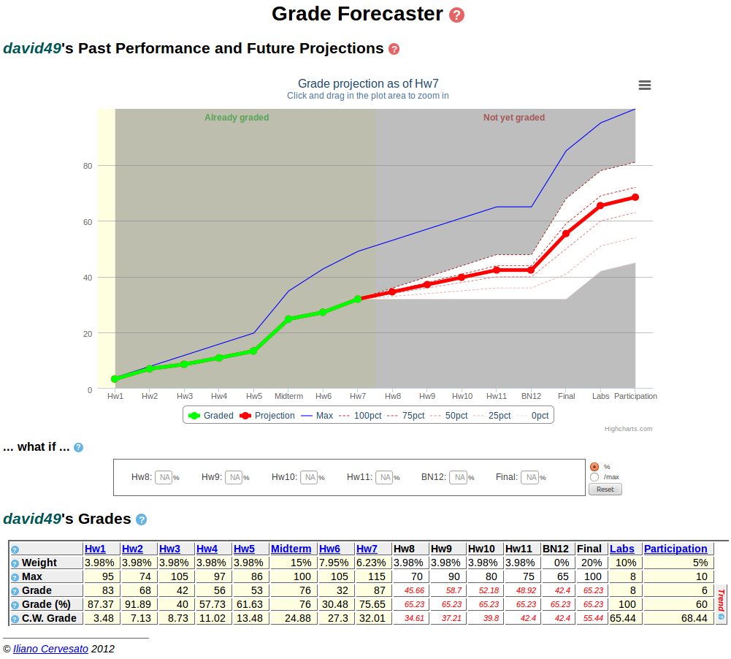
Grades

Slide 22
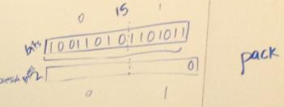
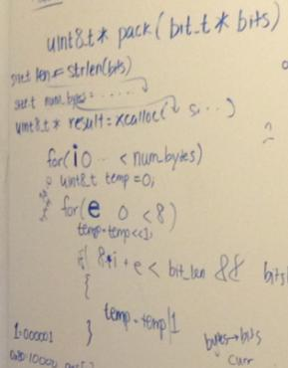
Academic integrity
Quizzes, exams, homework must be your own
You must hand in your work
OK: discussing course material, practice problems, study sessions, going over handed-back homework in groups
Not OK: copying or discussing answers, looking at or copying code or tests (even parts)
Not OK: talking through the assignment as you code with a classmate
Whiteboard policy
OK: discussing approaches to solving a problem
Wait at least 4 hours, write solutions individually
Not OK: taking notes or pictures, memorizing answers
Never OK: sharing/writing code together (even pseudocode)
We use MOSS to catch code duplication across semesters
If you make a mistake, come to us, don’t let us come to you
OK
Not OK

Slide 23
How to do Well in this Course
Do not stress over grades
Participate
Manage your time wisely
Don’t use late days in 1st half of course
Start homework early
Get all the help you need
ask for help, tell us when you’re having trouble
Make time for fun

Slide 24
Activity debrief
Without looking at your paper, write down as many of those words as you can recall
How many people got more from the left column?
From the right column?
It’s going to be a lot easier if you take good handwritten notes
Notes:
Words on the right: you had to process the concepts before writing them in your own words
Words on the left: you just copied them, they didn’t stick as much

Slide 25
Overview
Goals of this course
Interactions
Lectures, recitations, office hours
Assessment
Quizzes, homework, exams
The course begins …

Slide 26
A Mysterious Function Approaches …

