Slide 1
Complexity

Slide 2
LAST
Linear search
Correctness
Contract exploits
TODAY
Cost
big-O
Complexity classes
Sorting
NEXT
Faster search
Binary search

Slide 3
Final Code for seach
int search(int x, int[] A, int n)
//@requires n == \length(A);
/*@ensures (\result == -1 && !is_in(x, A, 0, n))
|| (0 <= \result && \result < n && A[\result] == x);
@*/
{
for (int i = 0; i < n; i++)
//@loop_invariant 0 <= i && i <= n;
//@loop_invariant !is_in(x, A, 0, i);
{
if (A[i] == x) return i;
}
return -1;
}
How long does it take to run?
with contract-checking off

Slide 4
What do we mean by “How long”?
First idea: wall-clock time
Time the code takes to run on a benchmark
Compiling with contracts disabled
The search function
main that generates random tests and runs them
Runs a.out 200 times on arrays of size 1000000
Linux Terminal
# cc0 search.c0 search-time.c0
# time ./a.out -r 200 -n 1000000
0
real 0.83
user 0.82
sys 0.00
Execution took 0.82 seconds
Unix utility that times execution

Slide 5
What do we mean by “How long”?
Wall-clock time
Gives different results depending on
what else is running on computer
what specific computer it is running on
Is this a useful notion of “how long”?
Linux Terminal
# cc0 search.c0 search-time.c0
# time ./a.out -r 200 -n 1000000
0
real 0.83
user 0.82
sys 0.00
# time ./a.out -r 200 -n 1000000
0
real 0.91
user 0.90
sys 0.00
# time ./a.out -r 200 -n 1000000
0
real 0.81
user 0.80
sys 0.00
Different runs of the same code take different times!
Different runs of the same code take different times!
Different runs of the same code take different times!

Slide 6
What do we mean by “How long”?
Wall-clock time
Is this a useful notion of “how long”?
Time is about double when we double the length of the array
not exactly double though
Linux Terminal
# cc0 search.c0 search-time.c0
# time ./a.out -r 200 -n 1000000
0
real 0.83
user 0.82
sys 0.00
# time ./a.out -r 200 -n 2000000
0
real 1.62
user 1.61
sys 0.00
# time ./a.out -r 200 -n 4000000
0
real 3.17
user 3.15
sys 0.01

Slide 7
What do we mean by “How long”?
Can we do better than wall-clock time?
What are we looking for? A measure that is
general
applicable to a large class of programs (and algorithms)
independent of particular hardware
applicable to many types of resources
time, space, energy, …
mathematically rigorous
useful
help us select among various algorithms for the same problem
e.g., POW vs. mystery function for exponentiation
Wall clock?
yes
no
no
just time
no
result varies
unclear

Slide 8
What do we mean by “How long”?
Second idea: count the number of execution steps
How many operations do we do to search an n-element array?
i = 0 1 step
loop n times
i < n 1 step
if (A[i] == x) 1 step
i++ 1 step
return -1 1 step
int search(int x, int[] A, int n) {
for (int i = 0; i < n; i++) {
if (A[i] == x) return i;
}
return -1;
}
Omitting contracts
3n + 2 steps

Slide 9
What do we mean by “How long”?
Step count
3n + 2 steps to search an n-element array
Always?
only if element is not found
This is a worst-case analysis
Gives an upper bound on the number of steps
int search(int x, int[] A, int n) {
for (int i = 0; i < n; i++) {
if (A[i] == x) return i;
}
return -1;
}

Slide 10
What do we mean by “How long”?
Step count
3n + 2 steps to search an n-element array
Depends only on n
value of x doesn’t matter
contents of A doesn’t matter
other than its length
n is a measure of the input of the function
Let’s call the (upper bound on the) number of steps T(n)
T(n) = 3n + 2
int search(int x, int[] A, int n) {
for (int i = 0; i < n; i++) {
if (A[i] == x) return i;
}
return -1;
}

Slide 11
What do we mean by “How long”?
Step count
What is a step?
is i++ one step? 2 steps? 3 steps?
what about if (A[i] == x) ?
… this gets complicated
Each instruction takes a constant number of steps
exact number is tricky to tell, but it’s constant
In the worst case, search makes
a constant b number of steps outside the loop
a constant a number of steps in each iteration of the loop
So,
T(n) = an + b
int search(int x, int[] A, int n) {
for (int i = 0; i < n; i++) {
if (A[i] == x) return i;
}
return -1;
}
i = 0
return -1
i < n
OOPS!!!
loop guard runs n+1 times!
i < n
if (A[i] == x)
i++

Slide 12
What do we mean by “How long”?
Step count tells us “how long” a function takes to run
Time (here, number of steps) is a type of resource
Other resources of interest
Space: how much memory does the function use?
Energy: how much energy does running it consume?
Connectivity: how many network connection does it make?
…
In this course, we will be mainly interested in execution time
The amount of resources a function uses is called its cost
T(n) = an + b is a cost function
Argument is a measure of the input
Computes the cost of executing it on an input of size n

Slide 13
Comparing Cost
Given two C0 functions that solve the same problem
F has cost f(n)
G has cost g(n)
we want to answer the question “is F better than G?”
We will do so by answering the question
“is f better than g?”
How do we define this?
f and g are functions that
take a natural number as input
return a natural number as output
Cost
g
f
a non-negative integer
n

Slide 14
“Is f better than g?”
Attempt #1:
“f is better than g” if
for all n, f(n) ≤ g(n)
It’s Ok if f(n) = g(n) for some (or all) n
Cost
g
Cost
g
f
f

n

n

Slide 15
“Is f better than g?”
Attempt #1:
“f is better than g” if
for all n, f(n) ≤ g(n)
But is this useful?
f is initially worse than g
but f is better beyond a certain point
For small inputs, both costs are low
0.12 ms vs. 0.23 ms doesn’t matter for most applications
For large inputs, we want lower cost
1.35 ms vs. 200 years matters for all applications
Solution: ignore small inputs
Asymptotic notion of cost
g
Cost
f

n

Slide 16
“Is f better than g?”
Attempt #2:
“f is better than g” if there exists a natural number n₀ such that for all n ≥ n₀, f(n) ≤ g(n)
Cost
g
Cost
f
f
g
n₀

n
n₀

n

Slide 17
“Is f better than g?”

Attempt #2:
“f is better than g” if there exists a natural number n₀ s.t. for all n ≥ n₀, f(n) ≤ g(n)
But is this useful?
f and g are both linear functions
f(n) = a₁n and g(n) = a₂n
a₁ and a₂ summarize unknown instruction-level step constants
we can’t easily know if a₁ > a₂ or a₁ < a₂ or even a₁ = a₂
Solution: scale g
Cost
f
g
n₀
n
Scaling factor
Cost
cg
f
× c
g
n₀
n

Slide 18
“Is f better than g?”
Final attempt:
“f is better than g” if there exists a natural number n₀ and a real c > 0 s.t. for all n ≥ n₀, f(n) ≤ c g(n)
cg
Cost
× c
Cost
f
cg
g
× c
f
g
n₀

n
n₀

n

Slide 19
Big-O
cg
Cost
× c
Rather than “f is better than g”, we say f ∈ O(g)
“f is in big-O of g”
O(g) is a set:
O(g) = { f s.t. there exists a natural number n₀ and a real c > 0 s.t. for all n ≥ n₀, f(n) ≤ c g(n) }
g
f
n₀
n
f ∈ O(g) if there exists a natural number n₀ and a real c > 0 s.t. for all n ≥ n₀, f(n) ≤ c g(n)

Slide 20
Big-O
cg
Cost
× c
g
f
Given two concrete functions f and g, how to tell if f ∈ O(g)?
do the math
find n₀ and c and show that the definition holds
or show that the definition cannot hold for any n₀ or c
recall what you learned in your calculus classes
enough for most of this course
n₀
n

Slide 21
Big-O
Is 3n + 2 ∈ O(n)?
f(n) = 3n+2
g(n) = n
Cost
Cost
cg
f
Take c = 3.5 and n₀ = 4
f
× c
g
g
n
n₀
n

Any bigger values work too!

Slide 22
Big-O
cg
Cost
× c
g
f
Is n ∈ O(3n + 2)?
n₀
n
f(n) = n
g(n) = 3n+2
Cost
g

Take c = 1.0 and n₀ = 0
f
n

Slide 23
Big-O
cg
Cost
× c
g
f
Every linear cost function is in O(n)
as long as the coefficient of n is not 0
Every linear cost function is also in O(3n + 2)
As sets, O(n) = O(3n + 2)
O(n) is simpler however
g(n) = n is the simplest linear function
We describe a cost function is linear by saying that it is in O(n)
n₀
n

Slide 24
Big-O
Similarly, every quadratic cost function is in O(n²)
as long as the coefficient of n² is not 0
the other coefficients don’t matter
g(n) = n² is the simplest quadratic function
We describe a cost function is quadratic by saying that it is in O(n²)
In general, every polynomial cost function of degree p is in O(n^{p})
as long as the lead coefficient of n is not 0
g(n) = n^{p} is the simplest polynomial of degree p
We describe a cost function is polynomial of degree p by saying that it is in O(n^{p})

Slide 25
Big-O
Is 3n + 2 ∈ O(n²)?
f(n) = 3n + 2
g(n) = n²
cg
Cost
Cost
f
Take c = 1.5 and n₀ = 3
f
× c
g
g
n
Any bigger values work too!
n


Slide 26
Big-O
3n + 2 ∈ O(n) and 3n + 2 ∈ O(n²)
O(n) is tighter however
Every linear function is in O(n²)
O(n) ⊆ O(n²)
In general, if p ≤ q
O(n^{p}) ⊆ O(n^{q})

Slide 27
Big-O
Is n² ∈ O(3n + 2)?
n² eventually dominates c(3n+2) no matter the scaling factor c
n² ∉ O(3n + 2)
Not every quadratic function is in O(n)
O(n²) ⊄ O(n)
O(n) ⊂ O(n²)
Cost
f
f(n) = n²
g(n) = 3n + 2
cg
× c
??
g
n


Slide 28
Complexity Classes
We learned that O(n) ⊂ O(n²)
O(n) ⊆ O(n²)
but O(n²) ⊄ O(n)
O(n) and O(n²) are called complexity classes
Simplest and tightest expressions for sets of cost functions

Slide 29
Complexity Classes
Complexity classes we will use in this course
O(1) ⊂ O(log n) ⊂ O(n) ⊂ O(n log n) ⊂ O(n²) ⊂ O(2^{n})
There are many more, though
Complexity class | Common name
O(1) | Constant
O(log n) | Logarithmic
O(n) | Linear
O(n log n) | (just “n log n”)
O(n²) | Quadratic
O(2^{n}) | Exponential

Slide 30
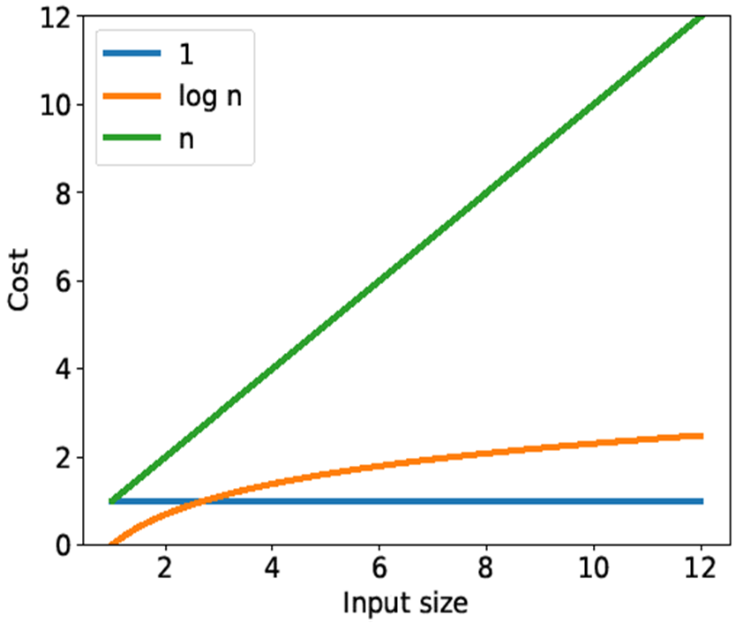
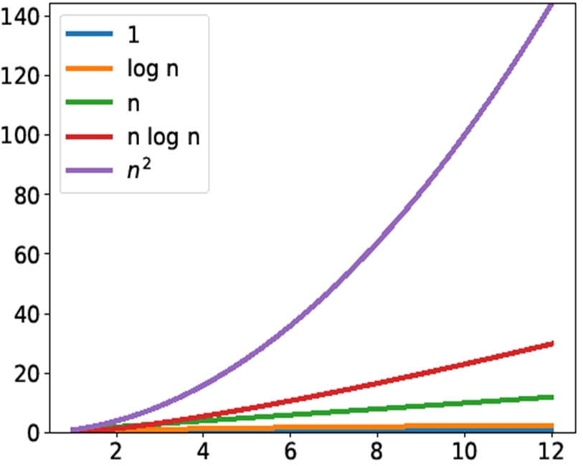
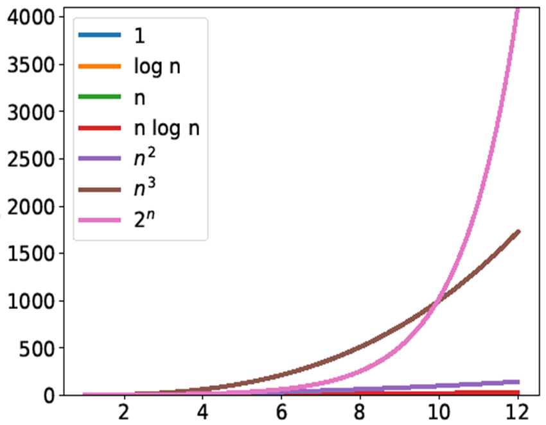
Complexity Classes

Slide 31
Complexity of Linear Search

Slide 32
What do we mean by “How long”?
int search(int x, int[] A, int n) {
for (int i = 0; i < n; i++) {
if (A[i] == x) return i;
}
return -1;
}
T(n) = 3n + 2
So T(n) ∈ O(n)
Linear search has cost O(n)
It has linear complexity in the size n of its input
That’s why it is caller linear search
Simplest and tightest class

Slide 33
Big-O
int search(int x, int[] A, int k) {
for (int i = 0; i < k; i++) {
if (A[i] == x) return i;
}
return -1;
}
There is nothing special about “n”
If we call the size of the input k,
then this function has cost O(k)
still linear

Slide 34
Big-O
h
An input may have multiple size parameters
For example, an image has a width w and a height h
Brightening an image: O(wh)
We change every one of its w × h pixels
Putting a border: O(w+h)
we touch about 2(w + h) pixels
w
h
w
h
w

Slide 35
Towards a Better Search

Slide 36
Algorithms vs. Problems
int search(int x, int[] A, int n) {
for (int i = 0; i < n; i++) {
if (A[i] == x) return i;
}
return -1;
}
Linear search has cost O(n)
But this is only one of the many algorithms to search an array
Can a different algorithm find an element faster?
No: the problem of searching a generic n-element array has complexity O(n)
some algorithms have worse complexity
but no algorithm has better complexity
unless we radically change what we mean by “step”
Can we do better if we make (reasonable) assumptions?
Say, the array is sorted

Slide 37
Searching Sorted Arrays
int search(int x, int[] A, int n)
//@requires n == \length(A);
//@requires is_sorted(A, 0, n);
/*@ensures (\result == -1 && !is_in(x, A, 0, n))
|| (0 <= \result && \result < n && A[\result] == x);
@*/
{
for (int i = 0; i < n; i++)
//@loop_invariant 0 <= i && i <= n;
//@loop_invariant !is_in(x, A, 0, i);
{
if (A[i] == x) return i;
}
return -1;
}
A is sorted
the segment A[0,n) is sorted
(useful for later)
Idea:
If we find an element larger than x, we can stop searching
All elements behind it will also be larger than x
That’s because A is sorted
x: 4
0 | 1 | 2 | 3 | 4
3 | 5 | 7 | 8 | 12
A:
5 > 4

Slide 38
Searching Sorted Arrays
int search(int x, int[] A, int n)
//@requires n == \length(A);
//@requires is_sorted(A, 0, n);
/*@ensures (\result == -1 && !is_in(x, A, 0, n))
|| (0 <= \result && \result < n && A[\result] == x);
@*/
{
for (int i = 0; i < n; i++)
//@loop_invariant 0 <= i && i <= n;
//@loop_invariant !is_in(x, A, 0, i);
{
if (A[i] == x) return i;
if (x < A[i]) return -1;
//@assert A[i] < x;
}
return -1;
}
If A[i] is not equal to x and not larger than x then it must be smaller than x

Slide 39
Searching Sorted Arrays
int search(int x, int[] A, int n)
//@requires is_sorted(A, 0, n);
{
for (int i = 0; i < n; i++) {
if (A[i] == x) return i;
if (x < A[i]) return -1;
//@assert A[i] < x;
}
return -1;
}
What is the cost of this search?
Still O(n)
worst case is when searching an element bigger than anything in A
But that’s just one algorithm for searching in a sorted array
Can we do better?
… next lecture …

Slide 40
Searching Sorted Arrays
int search(int x, int[] A, int n)
//@requires n == \length(A);
//@requires is_sorted(A, 0, n);
/*@ensures (\result == -1 && !is_in(x, A, 0, n))
|| (0 <= \result && \result < n && A[\result] == x);
@*/
{
for (int i = 0; i < n; i++)
//@loop_invariant 0 <= i && i <= n;
//@loop_invariant !is_in(x, A, 0, i);
{
if (A[i] == x) return i;
if (x < A[i]) return -1;
//@assert A[i] < x;
}
return -1;
}
Is this code safe?
Yes, no new array accesses
Is it correct?
Original argument still holds
but we have a new place where the function returns
Is it correct there?
no good argument
we need new insight

Slide 41
Searching Sorted Arrays
int search(int x, int[] A, int n)
//@requires n == \length(A);
//@requires is_sorted(A, 0, n);
/*@ensures (\result == -1 && !is_in(x, A, 0, n))
|| (0 <= \result && \result < n &&
A[\result] == x); @*/
{
for (int i = 0; i < n; i++)
//@loop_invariant 0 <= i && i <= n;
//@loop_invariant !is_in(x, A, 0, i);
{
if (A[i] == x) return i;
if (x < A[i]) return -1;
//@assert A[i] < x;
}
return -1;
}
What do we know at iteration i?
Let’s draw pictures!
A[0, i) < x: every element in segment A[0,i) is less than x
A[0, i) ≤ A[i, n): everything in A[0,i) is ≤ everything in A[i, n)
0 | i | n
A:
A[0, i) < x
A[0, i) ≤ A[i, n)

Slide 42
Reasoning about Array Segments
A[0, i) < x, etc are useful to reason about array segments
Implement them into specification functions: arrayutil
A[lo, hi) is sorted is_sorted(A, lo, hi)
x ∈ A[lo, hi) is_in(x, A, lo, hi)
x < A[lo, hi) lt_seg(x, A, lo, hi)
x ≤ A[lo, hi) le_seg(x, A, lo, hi)
x > A[lo, hi) gt_seg(x, A, lo, hi)
x ≥ A[lo, hi) ge_seg(x, A, lo, hi)
A[lo₁, hi₁) < B[lo₂, hi₂) lt_segs(A, lo1, hi1, B, lo2, hi2)
A[lo₁, hi₁) ≤ B[lo₂, hi₂) le_segs(A, lo1, hi1, B, lo2, hi2)
A[lo₁, hi₁) > B[lo₂, hi₂) gt_segs(A, lo1, hi1, B, lo2, hi2)
A[lo₁, hi₁) ≥ B[lo₂, hi₂) ge_segs(A, lo1, hi1, B, lo2, hi2)
math
code
Includes contracts
See arrayutil.c0 file

Slide 43
Searching Sorted Arrays
int search(int x, int[] A, int n)
//@requires n == \length(A);
//@requires is_sorted(A, 0, n);
/*@ensures (\result == -1 && !is_in(x, A, 0, n))
|| (0 <= \result && \result < n &&
A[\result] == x); @*/
{
for (int i = 0; i < n; i++)
//@loop_invariant 0 <= i && i <= n;
//@loop_invariant gt_seg(x, A, 0, i);
//@loop_invariant le_segs(A,0, i, A, i, n);
{
if (A[i] == x) return i;
if (x < A[i]) return -1;
//@assert A[i] < x;
}
return -1;
}
What do we know at iteration i?
Let’s draw pictures!
Candidate loop invariants
gt_seg(x, A, 0, i): that’s A[0, i) < x
This implies !is_in(x, A, 0, i), that’s x ∉ A[0, i)
le_segs(A, 0, i, A, i, n): that’s A[0, i) ≤ A[i, n)
0 | i | n
A:
A[0, i) < x
A[0, i) ≤ A[i, n)

Slide 44
Searching Sorted Arrays
int search(int x, int[] A, int n)
//@requires n == \length(A);
//@requires is_sorted(A, 0, n);
/*@ensures (\result == -1 && !is_in(x, A, 0, n))
|| (0 <= \result && \result < n &&
A[\result] == x); @*/
{
for (int i = 0; i < n; i++)
//@loop_invariant 0 <= i && i <= n;
//@loop_invariant gt_seg(x, A, 0, i);
//@loop_invariant le_segs(A,0, i, A, i, n);
{
if (A[i] == x) return i;
if (x < A[i]) return -1;
//@assert A[i] < x;
}
return -1;
}
Is this code correct?
To show: !is_in(x, A, lo, hi)
(assuming invariants are valid)
A[0, i) < x by line 10 (LI 2)
x ∉ A[0, i) by math on A,
x < A[i] by line 14 (conditional)
x < A[i, n) by math on C and line 3 (precondition)
x ∉A[0, n) by math on B, D

Slide 45
Searching Sorted Arrays
int search(int x, int[] A, int n)
//@requires n == \length(A);
//@requires is_sorted(A, 0, n);
/*@ensures (\result == -1 && !is_in(x, A, 0, n))
|| (0 <= \result && \result < n &&
A[\result] == x); @*/
{
for (int i = 0; i < n; i++)
//@loop_invariant 0 <= i && i <= n;
//@loop_invariant gt_seg(x, A, 0, i);
//@loop_invariant le_segs(A,0, i, A, i, n);
{
if (A[i] == x) return i;
if (x < A[i]) return -1;
//@assert A[i] < x;
}
return -1;
}
x > A[0, i) is a valid loop invariant
INIT: x > A[0, i) before any iteration of the loop
i = 0 by line 7
x > A[0, 0) by definition of gt_seg
A[0,0) is the empty array segment
Nothing is in it
PRES: if x > A[0, i), then x > A[0, i’)
x > A[0, i) by assumption
x > A[i] by line 15 (math on lines 13 and 14)
x > A[0, i+1) by math on A and B
i’ = i+1 by line 8
x > A[0, i’) by math on C and D

Slide 46
Searching Sorted Arrays
int search(int x, int[] A, int n)
//@requires n == \length(A);
//@requires is_sorted(A, 0, n);
/*@ensures (\result == -1 && !is_in(x, A, 0, n))
|| (0 <= \result && \result < n &&
A[\result] == x); @*/
{
for (int i = 0; i < n; i++)
//@loop_invariant 0 <= i && i <= n;
//@loop_invariant gt_seg(x, A, 0, i);
//@loop_invariant le_segs(A,0, i, A, i, n);
{
if (A[i] == x) return i;
if (x < A[i]) return -1;
//@assert A[i] < x;
}
return -1;
}
A[0,i) ≤ A[i,n) is a valid loop invariant
INIT: A[0, i) ≤ A[i,n) before any iteration of the loop
i = 0 by line 7
A[0, 0) ≤ A[i,n) by definition of le_segs
A[0,0) is the empty array segment
Nothing is in it
PRES: if A[0, i) ≤ A[i, n), then A[0, i’) ≤ A[i’, n)
A[0, i) ≤ A[i, n) by assumption
A[0, n) sorted by line 3 (precondition)
A[0, i+1) ≤ A[i+1, n) by math on B
i’ = i+1 by line 8
A[0, i’) ≤ A[i’, n) by math on C and D

Slide 47
Selection Sort

Slide 48
Sorting an Array
Reorder the elements to put them in increasing order
Duplicate elements are allowed
There are many algorithms to sort arrays
0 | 1 | 2 | 3 | 4 | 5 | 6 | 7
9 | 13 | 18 | 3 | 13 | 5 | 7 | 6
A:
0 | 1 | 2 | 3 | 4 | 5 | 6 | 7
3 | 5 | 6 | 7 | 9 | 13 | 13 | 18
A:

Slide 49
Selection Sort
0 | 1 | 2 | 3 | 4 | 5 | 6 | 7
9 | 13 | 18 | 3 | 13 | 5 | 7 | 6
Find element that shall go in A[0]
Smallest element in A[0, n)
Swap it with A[0]
Find element that shall go in A[1]
Smallest element in A[1, n)
Swap it with A[1]
… carry on …
Stop when A is entirely sorted
A:
0 | 1 | 2 | 3 | 4 | 5 | 6 | 7
3 | 13 | 18 | 9 | 13 | 5 | 7 | 6
A:
0 | 1 | 2 | 3 | 4 | 5 | 6 | 7
3 | 13 | 18 | 9 | 13 | 5 | 7 | 6
A:
0 | 1 | 2 | 3 | 4 | 5 | 6 | 7
3 | 5 | 18 | 9 | 13 | 13 | 7 | 6
A:
0 | 1 | 2 | 3 | 4 | 5 | 6 | 7
3 | 5 | 6 | 7 | 9 | 13 | 13 | 18
A:

Slide 50
Selection Sort
We need two operations
find the minimum of an array segment A[lo, hi)
and return its index
swap two elements of an array (given their indices)
Implementation left as exercise
A[lo,hi) can’t be empty
int find_min(int[] A, int lo, int hi)
//@requires 0 <= lo && lo < hi && hi <= \length(A);
/*@ensures lo <= \result && \result < hi
&& le_seg(A[\result], A, lo, hi); @*/ ;
That’s A[\result] ≤ A[lo, hi)
// swaps A[i] and A[j]; all other elements are unchanged
void swap(int[] A, int i, int j)
//@requires 0 <= i && i < \length(A);
//@requires 0 <= j && j < \length(A);
returns no value
swap is in-place
We can’t say this as a postcondition. We use a comment instead

Slide 51
Selection Sort
Let’s capture our intuition about how it works in code
Generalization: sort array segment A[lo, hi)
sort is in-place
A[lo,hi) can be empty
void sort(int[] A, int lo, int hi)
//@requires 0 <= lo && lo <= hi && hi <= \length(A);
//@ensures is_sorted(A, lo, hi);
{
for (int i = lo; i < hi; i++)
{
int min = find_min(A, i, hi);
swap(A, i, min);
}
}
for every index i
from lo to hi
find the minimum of A[i, hi)
swap it with A[i]

Slide 52
Selection Sort
int find_min(int[] A, int lo, int hi)
//@requires 0 <= lo && lo < hi && hi <= \length(A);
/*@ensures … @*/ ;
Is this code safe?
find_min(A, i, hi)
To show: 0 ≤ i && i < hi && hi ≤ \length(A)
hi ≤ \length(A) by line 2
i < hi by line 5
0 ≤ i oops! we need the usual loop invariant
//loop_invariant lo <= i; then
0 ≤ lo by line 2
lo ≤ i by new LI
0 ≤ i by math
void sort(int[] A, int lo, int hi)
//@requires 0 <= lo && lo <= hi && hi <= \length(A);
//@ensures is_sorted(A, lo, hi);
{
for (int i = lo; i < hi; i++)
{
int min = find_min(A, i, hi);
swap(A, i, min);
}
}


Slide 53
Selection Sort
int find_min(int[] A, int lo, int hi)
//@requires 0 <= lo && lo < hi && hi <= \length(A);
/*@ensures lo <= \result && \result < hi
&& le_seg(A[\result], A, lo, hi); @*/ ;
void swap(int[] A, int i, int j)
//@requires 0 <= i && i < \length(A);
//@requires 0 <= j && j < \length(A);
Is this code safe?
swap(A, i, min)
To show: 0 ≤ min && min < \length(A)
0 ≤ lo by line 2
lo ≤ min by line postconditions of int_min
i < min by line postconditions of int_min
min ≤ \length(A) by line 2
To show: 0 ≤ i && i < \length(A)
(similar)
0 ≤ min by math
void sort(int[] A, int lo, int hi)
//@requires 0 <= lo && lo <= hi && hi <= \length(A);
//@ensures is_sorted(A, lo, hi);
{
for (int i = lo; i < hi; i++)
//@loop_invariant lo <= i;
{
int min = find_min(A, i, hi);
swap(A, i, min);
}
}
Added


Slide 54
Selection Sort
void sort(int[] A, int lo, int hi)
//@requires 0 <= lo && lo <= hi && hi <= \length(A);
//@ensures is_sorted(A, lo, hi);
{
for (int i = lo; i < hi; i++)
//@loop_invariant lo <= i;
{
int min = find_min(A, i, hi);
swap(A, i, min);
}
}
Is this code correct?
To show: is_sorted(A, lo, hi)
What do we know at iteration i?
Let’s draw pictures!
Candidate loop invariants
lo <= i && i <= hi
is_sorted(A, lo, i)
le_segs(A, lo, i, A, i, hi)
0 | lo | i | hi | \length(A)
… |  |  | …
A:
A[lo, i) is sorted
A[lo, i) ≤ A[i, hi)

Slide 55
Selection Sort
Resulting code
We need to prove that the added invariants are valid
void sort(int[] A, int lo, int hi)
//@requires 0 <= lo && lo <= hi && hi <= \length(A);
//@ensures is_sorted(A, lo, hi);
{
for (int i = lo; i < hi; i++)
//@loop_invariant lo <= i && i <= hi;
//@loop_invariant is_sorted(A, lo, i);
//@loop_invariant le_segs(A, lo, i, A, i, hi);
{
int min = find_min(A, i, hi);
swap(A, i, min);
}
}
Added

Slide 56
Selection Sort
void sort(int[] A, int lo, int hi)
//@requires 0 <= lo && lo <= hi && hi <= \length(A);
//@ensures is_sorted(A, lo, hi);
{
for (int i = lo; i < hi; i++)
//@loop_invariant lo <= i && i <= hi;
//@loop_invariant le_segs(A, lo, i, A, i, hi);
//@loop_invariant is_sorted(A, lo, i);
{
int min = find_min(A, i, hi);
swap(A, i, min);
}
}
Is this code correct?
To show: is_sorted(A, lo, hi)
(assuming invariants are valid)
i ≥ hi by line 5 (negation of loop guard)
i ≤ hi by line 6 (LI 1)
i = hi by math on A, B
is_sorted(A, lo, hi) by line 8 (LI 2) and C
This is a standard EXIT argument
But are the loop invariants valid?
We didn’t need LI 3 A[lo, i) ≤ A[i, hi)

Slide 57
Selection Sort
void sort(int[] A, int lo, int hi)
//@requires 0 <= lo && lo <= hi && hi <= \length(A);
//@ensures is_sorted(A, lo, hi);
{
for (int i = lo; i < hi; i++)
//@loop_invariant lo <= i && i <= hi;
//@loop_invariant is_sorted(A, lo, i);
//@loop_invariant le_segs(A, lo, i, A, i, hi);
{
int min = find_min(A, i, hi);
swap(A, i, min);
}
}
Are the loop invariants valid?
INIT
To show: lo ≤ lo by math
To show: lo ≤ hi by line 2 (preconditions)
To show: A[lo, lo) sorted by math (empty interval)
To show: A[lo, lo) ≤ A[lo, hi) by math (empty interval)
PRES
To show: if lo ≤ i && i ≤ hi, then lo ≤ i’ && i’ ≤ hi
Proof left as exercise

Slide 58
Selection Sort
void sort(int[] A, int lo, int hi)
//@requires 0 <= lo && lo <= hi && hi <= \length(A);
//@ensures is_sorted(A, lo, hi);
{
for (int i = lo; i < hi; i++)
//@loop_invariant lo <= i && i <= hi;
//@loop_invariant is_sorted(A, lo, i);
//@loop_invariant le_segs(A, lo, i, A, i, hi);
{
int min = find_min(A, i, hi);
swap(A, i, min);
}
}
Are the loop invariants valid?
PRES
To show: if A[lo, i) is sorted, then A[lo, i’) is sorted
A[lo, i) is sorted assumption
A[lo, i) ≤ A[i, hi) by line 8 (LI 3)
A[lo, i) ≤ A[i] by math on B
A[lo, i+1) is sorted by math on C
i’ = i+1 by line 5
This is where we need LI 3!

Slide 59
Selection Sort
void sort(int[] A, int lo, int hi)
//@requires 0 <= lo && lo <= hi && hi <= \length(A);
//@ensures is_sorted(A, lo, hi);
{
for (int i = lo; i < hi; i++)
//@loop_invariant lo <= i && i <= hi;
//@loop_invariant is_sorted(A, lo, i);
//@loop_invariant le_segs(A, lo, i, A, i, hi);
{
int min = find_min(A, i, hi);
swap(A, i, min);
}
}
Are the loop invariants valid?
PRES
To show: if A[lo, i) ≤ A[i, hi), then A[lo, i’) ≤ A[i’, hi)
A[lo, i) ≤ A[i, hi) assumption
A[min] ≤ A[i, hi) by postcondition of find_min
A[i] ≤ A[i, hi) after swap by definition (in comment)
A[i] ≤ A[i+1, hi) by math
A[lo, i) ≤ A[i] by math on A and definition of swap
A[lo, i+1) ≤ A[i+1, hi) by math on E and D
i’ = i+1 by line 5
after swap

Slide 60
Selection Sort
void sort(int[] A, int lo, int hi)
//@requires 0 <= lo && lo <= hi && hi <= \length(A);
//@ensures is_sorted(A, lo, hi);
{
for (int i = lo; i < hi; i++)
//@loop_invariant lo <= i && i <= hi;
//@loop_invariant is_sorted(A, lo, i);
//@loop_invariant le_segs(A, lo, i, A, i, hi);
{
int min = find_min(A, i, hi);
swap(A, i, min);
}
}
We have proved it correct


Slide 61
Cost of Selection Sort
void sort(int[] A, int lo, int hi) {
for (int i = lo; i < hi; i++) {
int min = find_min(A, i, hi);
swap(A, i, min);
}
}
Assume array segment A[lo, hi) has length n
The loop runs n time
At each iteration,
call find_min on segment of length j = i - lo
j ranges over 1, …, n
find_min needs to scan the entire segment once: cost O(j)
in particular, it makes j comparisons
number of comparisons is a convenient proxy for our unit of cost
call swap
simply swaps values at two indices: cost O(1)
Number of comparisons to sort an n-element array segment
n + (n-1) + … + 1 = ∑_{j=0}^{n} j = n(n-1)/2
Contracts omitted

Slide 62
Cost of Selection Sort
void sort(int[] A, int lo, int hi) {
for (int i = lo; i < hi; i++) {
int min = find_min(A, i, hi);
swap(A, i, min);
}
}
Assume array segment A[lo, hi) has length n
Number of comparisons to sort an n-element array segment
n(n-1)/2
n(n-1)/2 ∈ O(n²)
Selection sort has cost is in O(n²)

