Slide 1

122 Hash Tables

Slide 2
Last time
Unbounded arrays
Amortized analysis

Slide 3
Amortized analysis
Move array append from O(n) to O(1)
Average frequent cheap operations
with infrequent expensive operations
Answering the important questions in life…

Slide 4
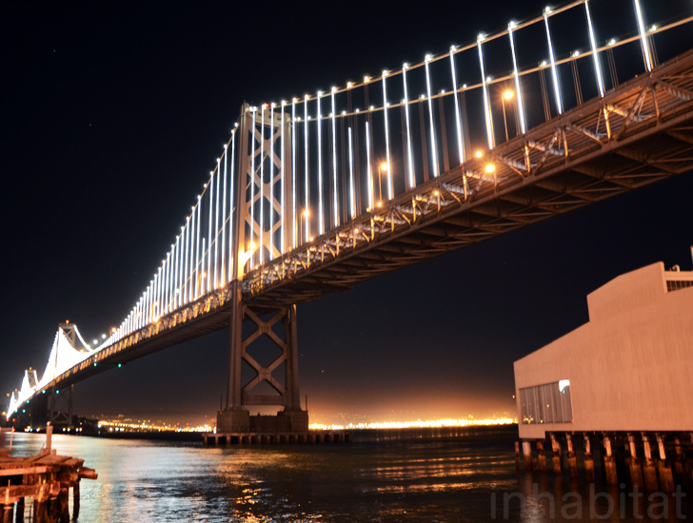

Bay Bridge Counter!
https://www.baybridgecounter.org
WEBCAM!!
Push to add 1!

Slide 5
n-bit counter
Reserve 2 tokens Pay 1 1 in reserve
Reserve 2 tokens Pay 2 1 in reserve
Reserve 2 tokens Pay 1 2 in reserve
Reserve 2 tokens Pay 3 1 in reserve
Reserve 2 tokens Pay 1 2 in reserve
Reserve 2 tokens Pay 2 2 in reserve
Reserve 2 tokens Pay 1 3 in reserve
Reserve 2 tokens Pay 4 1 in reserve
000000
000001
000010
000011
000100
000101
000110
000111
001000

Slide 6
Unbounded arrays
Double when we hit limit
“a” | “b” | “c” | “d”
“a” | “b” | “c” | “d” | “e”
“a” | “b” | “c” | “d” | “e” | “f”
“a” | “b” | “c” | “d” | “e” | “f” | “g”
“a” | “b” | “c” | “d” | “e” | “f” | “g” | “h”
“a” | “b” | “c” | “d” | “e” | “f” | “g”
“a” | “b” | “c” | “d” | “e” | “f” | “g” | “h” | “I”

Slide 7
Last time
Today
Next
Unbounded arrays
Amortized analysis
Hashing
Dictionaries
Hash tables
Randomness
Generic data types
Hash table implementation

Slide 8
122 Hash Tables

Slide 9
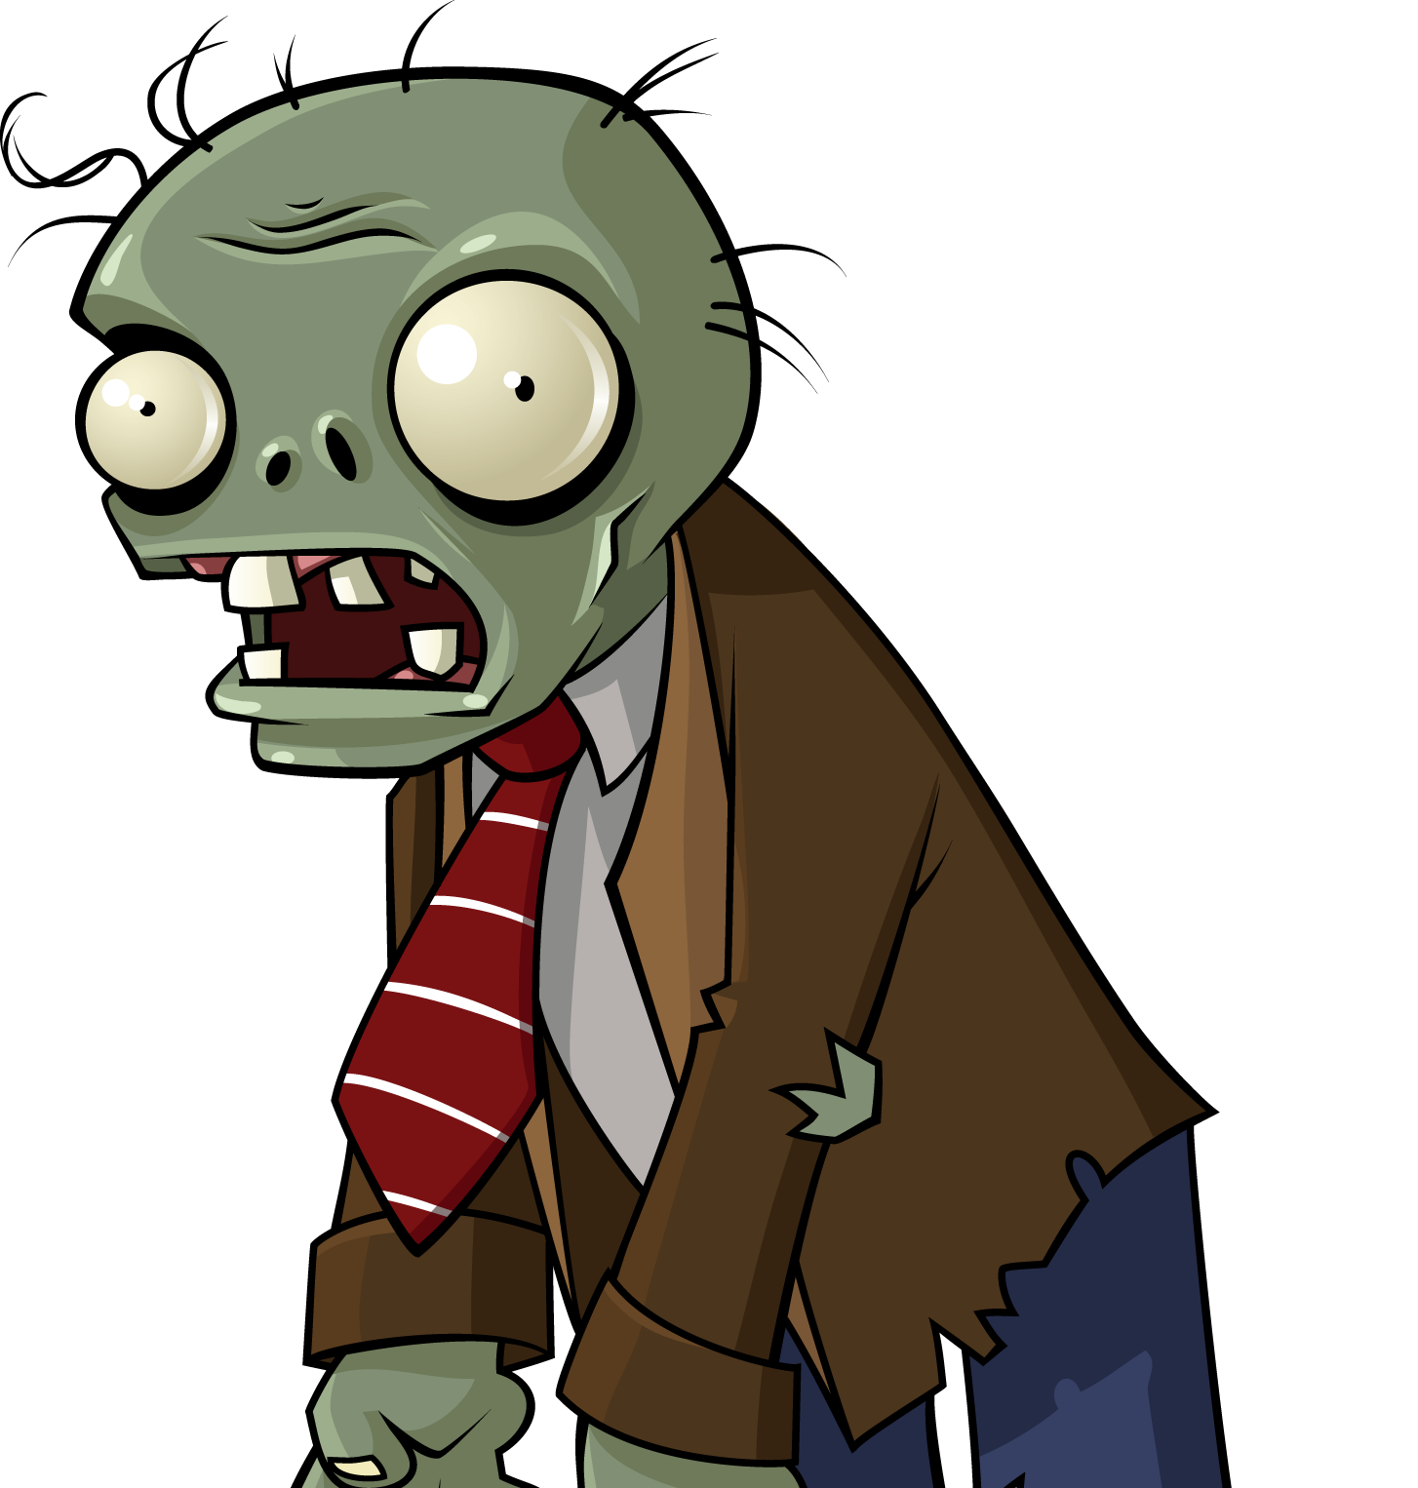
Post-apocalyptic Preparation

Slide 10
Post-apocalyptic Preparation
Skills

Slide 11
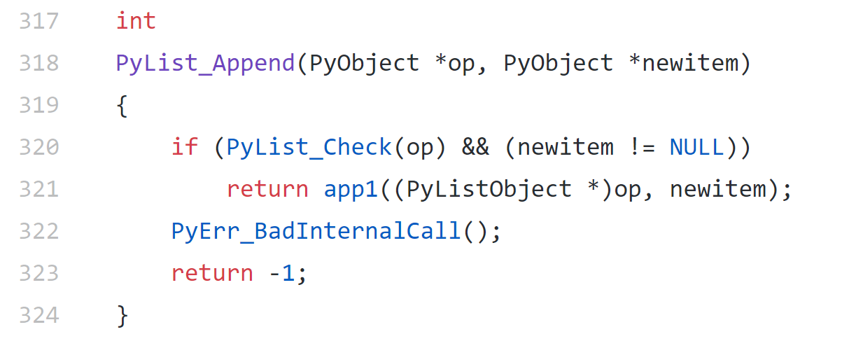
How are python lists implemented?
https://github.com/python/cpython/blob/master/Objects/listobject.c

Slide 12
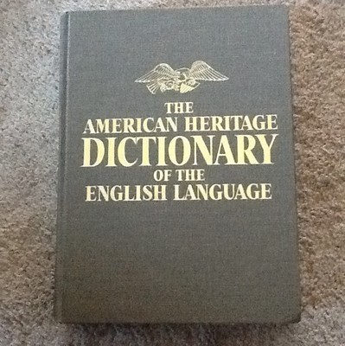
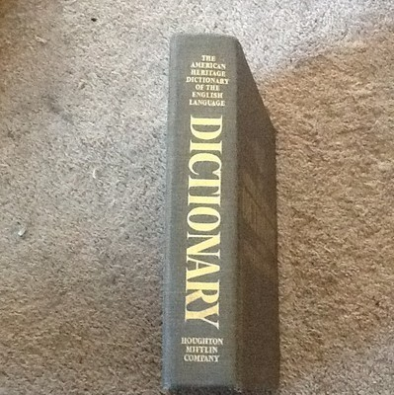
Post-apocalyptic Preparation
Back in my day…

Slide 13
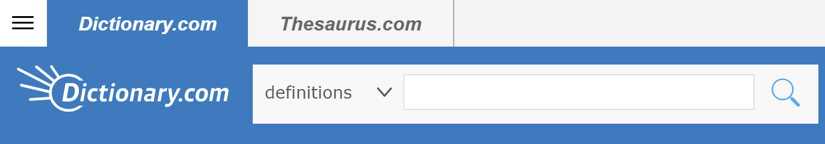

Dictionary Implementation

Slide 14
Dictionary Implementation
Discuss with your neighbor

Slide 15
How are python dictionaries implemented?
>>> words = {}
>>> words["apple"] = "red fruit, sometimes delicious"
>>> words["banana"] = "long yellow fruit, makes good bread"
>>> words["jackfruit"] = "giant spikey fruit thing"
>>> words["banana"]
'long yellow fruit, makes good bread'
key → value
https://github.com/python/cpython/blob/master/Objects/dictobject.c

Slide 16
Dictionary Implementation
key → value
"apple" → "red fruit"

Slide 17
Cost of dictionary implementations
Array of structs
Doubly linked list
Sorted array of structs
Lookup
Insert

Slide 18
Zip codes
key → value
zip code → neighborhood
insert key, value

Slide 19
Cost of collisions

Slide 20
Pseudorandom hash functions

Slide 21
Sets

Slide 22
Quiz!

Slide 23
Generic types

Slide 24
Generic types

