Slide 1
GitHub for Windows Users
Briana Swift
Jeremy Foster

Slide 2
Agenda
1
Basic Concepts and the GitHub Workflow
4
GitHub Integrations with Visual Studio
2
GitHub in the Browser
5
GitHub on the Command Line
3
GitHub Desktop
6
Beyond the Basics

Slide 3
Beyond the Basics
Briana Swift
Jeremy Foster

Slide 4
In this module…
Multiple remotes
Remote tracking branches
Combination commands
Git configs
GitHub Pages
Changing history

Slide 5
Multiple Remotes
Briana Swift
Jeremy Foster

Slide 6
There you have it.

Slide 7
Remote Tracking Branches
Briana Swift
Jeremy Foster

Slide 8
There you have it.

Slide 9
Combination Commands
Briana Swift
Jeremy Foster

Slide 10
There you have it.

Slide 11
Git Configs
Briana Swift
Jeremy Foster

Slide 12
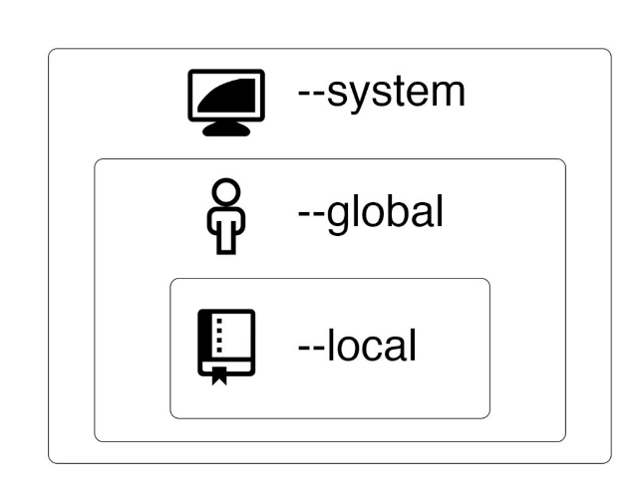
Git configurations
- 3 levels of configuration

Slide 13
Git configurations
- git config —global user.name “First Last”
- git config —global user.email “you@email.com”
- For Windows: git config —global core.autocrlf true
- For Mac: git config —global push.default simple
- git config —global push.default simple

Slide 14
There you have it.

Slide 15
GitHub Pages
Briana Swift
Jeremy Foster

Slide 16
DEMO
- Create gh-pages branch, make sure there’s index.html
- https://pages.github.com/

Slide 17
There you have it.

Slide 18
Changing History
Briana Swift
Jeremy Foster

Slide 19
Danger Zone: Changing History
- Watch out for changing commit IDs
- git revert
- cherry-pick
- rebase
- reset
- commit amend
- git reflog

Slide 20
There you have it.

Slide 21
In summary…
Multiple remotes
Remote tracking branches
Combination commands
Git configs
GitHub Pages
Changing history

