Slide 1
GitHub for Windows Users
Briana Swift
Jeremy Foster

Slide 2
Agenda
1
Basic Concepts and the GitHub Workflow
4
GitHub Integrations with Visual Studio
2
GitHub in the Browser
5
GitHub on the Command Line
3
GitHub Desktop
6
Beyond the Basics

Slide 3
GitHub Desktop
Briana Swift
Jeremy Foster

Slide 4
GitHub Desktop
Available on Windows and Mac
Manage local repos
Create
Branch/Merge
Commits (including line-by-line)
History view
Pull requests

Slide 5
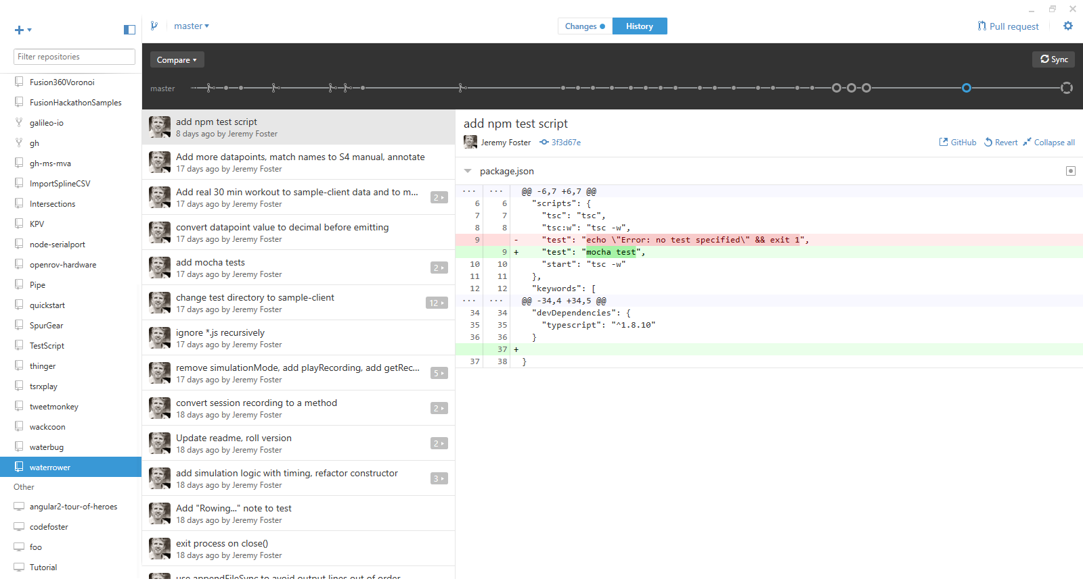

Slide 6
When to Use GitHub Desktop
Not a fan of the command line
Not using Visual Studio
Bouncing between IDE’s
Prefer native app to web app

Slide 7
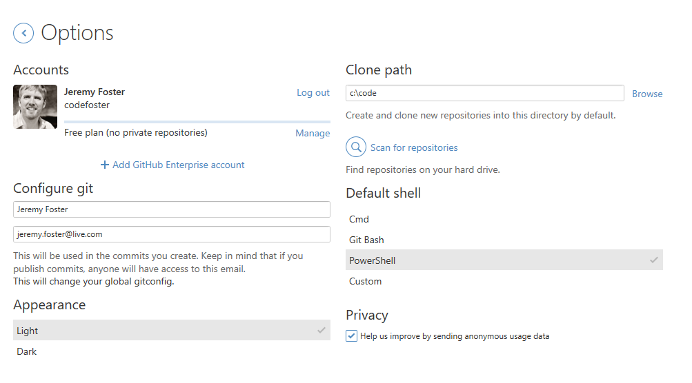
Options

Slide 8
Install
Briana Swift
Jeremy Foster

Slide 9
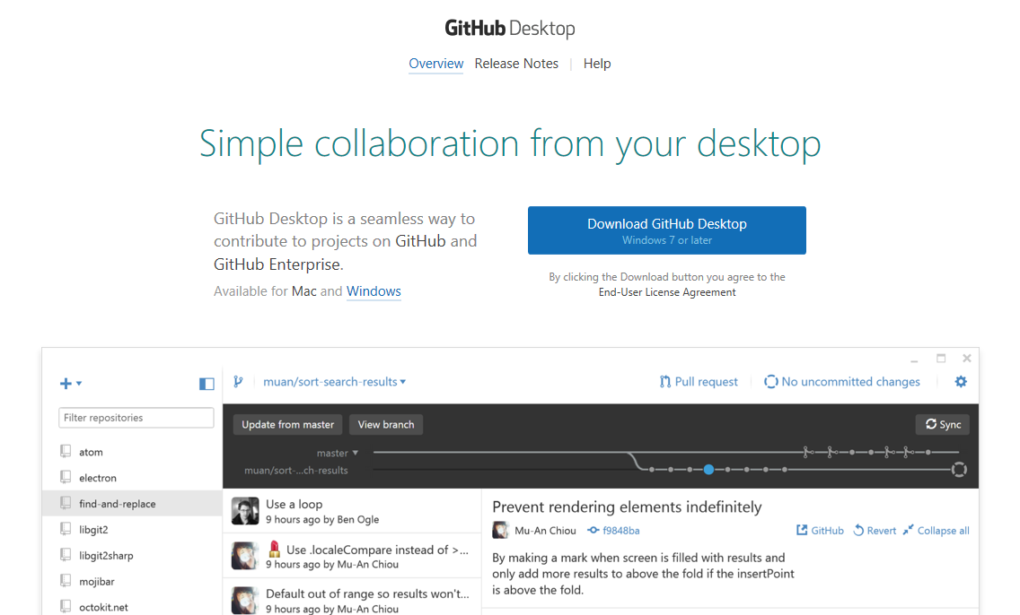
desktop.github.com

Slide 10
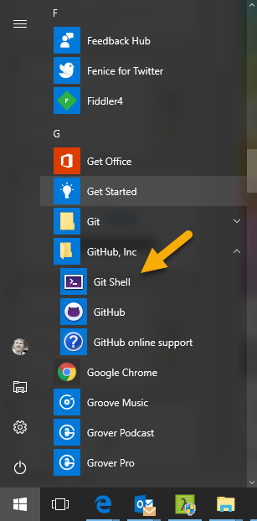
GitHub Desktop + Git Shell
Complete local copy of Git for Windows
Poshgit
Notes:
Open file location and show how Git Shell opens the shell.ps1 file

Slide 11
Repositories
Briana Swift
Jeremy Foster

Slide 12
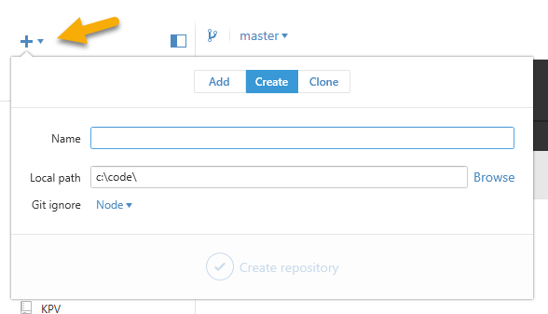
Creating
Hit the plus…
Choose a sensible .gitignore template
You get a .gitattributes and a .gitignore and your first commit

Slide 13
Cloning
Nowhere (that I can find!) to enter a clone URL in the program
Add | Clone | Choose one of your repos
OR
Browse to a repo | Clone or download | Open in desktop

Slide 14
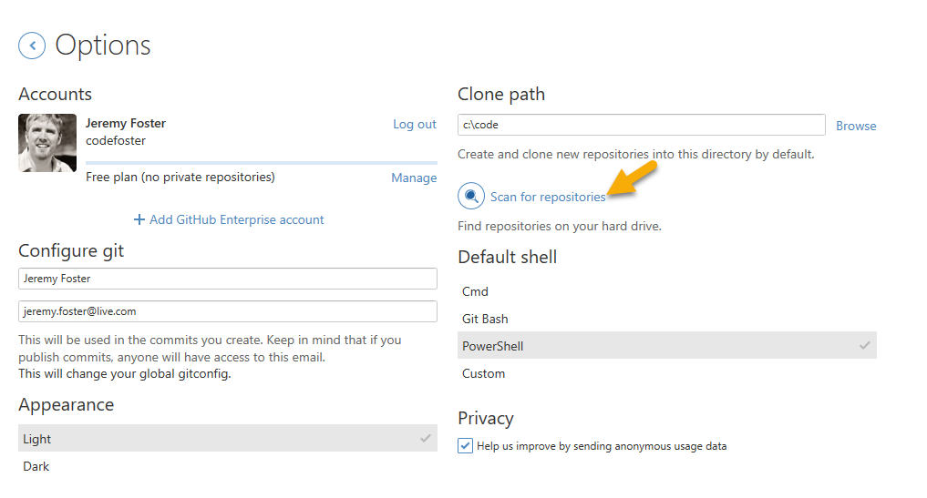
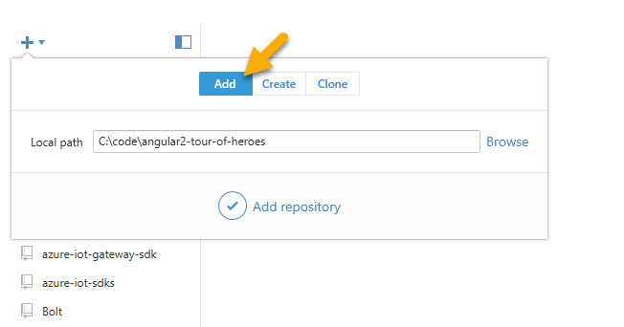
Adding and Scanning

Slide 15
Diffing and Committing
Briana Swift
Jeremy Foster

Slide 16
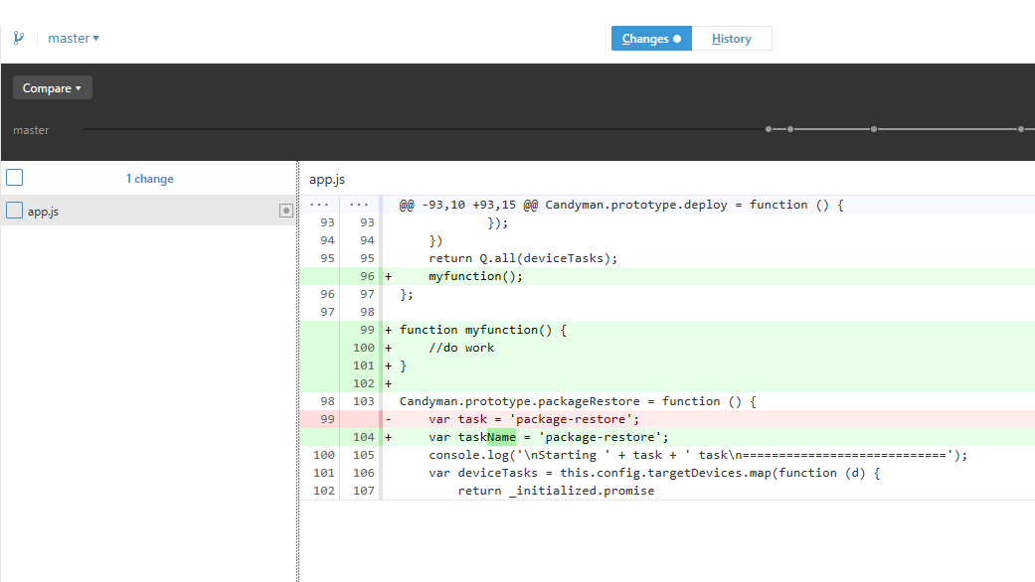
Difference Viewer

Slide 17
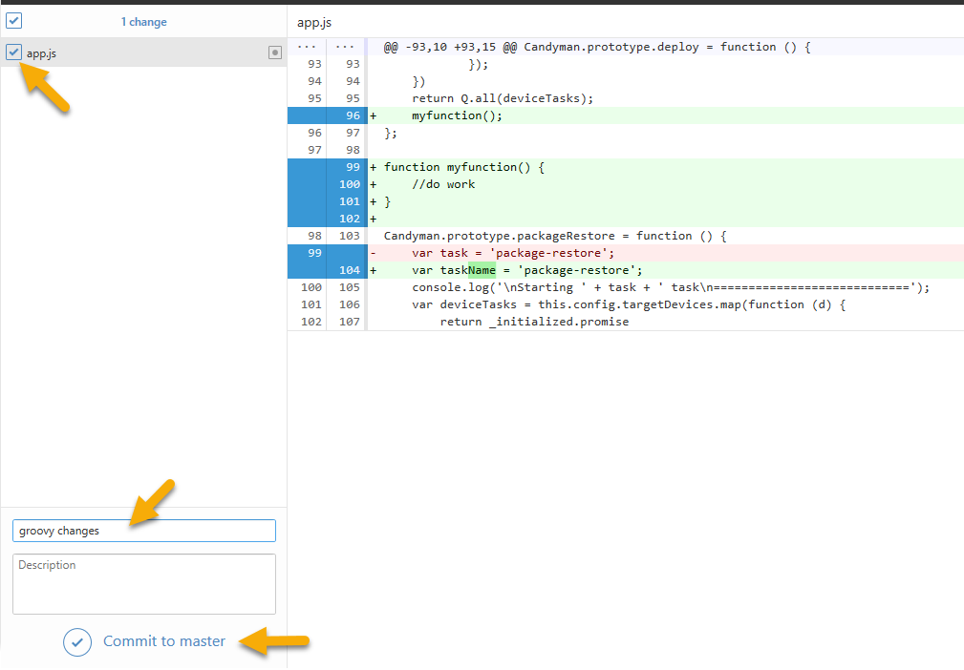
Committing

Slide 18
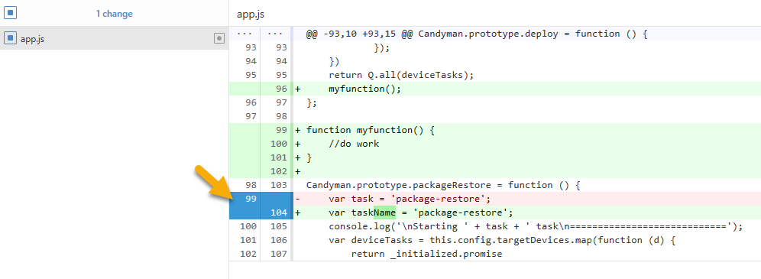
Committing by Line

Slide 19
Branching
Briana Swift
Jeremy Foster

Slide 20

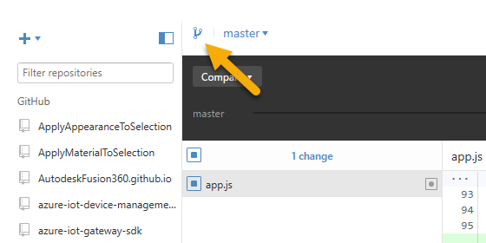
Managing Branches
Create using the icon
Switch using the dropdown
Delete a branch from the Settings menu
Click View Branch to see your new branch’s history

Slide 21
Collaborating
Briana Swift
Jeremy Foster

Slide 22
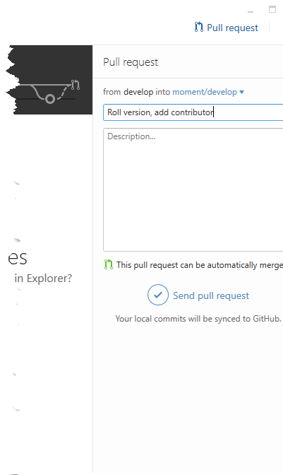
Pull Request
Fork a repo
Open your fork (not the original) in GitHub Desktop
Commit some changes
Hit Pull Request

