Slide 1
GitHub for Windows Users
Briana Swift
Jeremy Foster

Slide 2
Agenda
1
Basic Concepts and the GitHub Workflow
4
GitHub Integrations with Visual Studio
2
GitHub in the Browser
5
GitHub on the Command Line
3
GitHub Desktop
6
Beyond the Basics

Slide 3
GitHub Desktop
Briana Swift
Jeremy Foster

Slide 4
In this module…
Introducing GitHub Desktop
Repositories
Changes
Branches
Collaboration
Other desktop tools

Slide 5
Introducing GitHub Desktop
Briana Swift
Jeremy Foster

Slide 6
What’s so great about GitHub Desktop?
Available on Windows and Mac
Manage local repos
Create
Branch/Merge
Commits
Pull requests
Staging by line
Excellent history view
No conversations

Slide 7
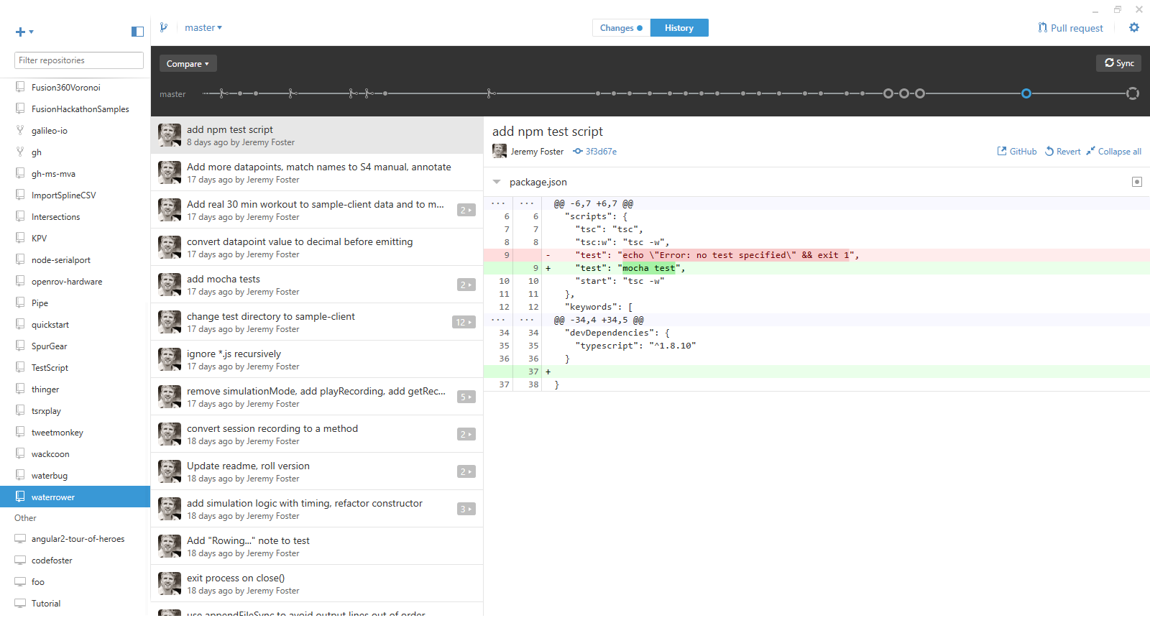

Slide 8
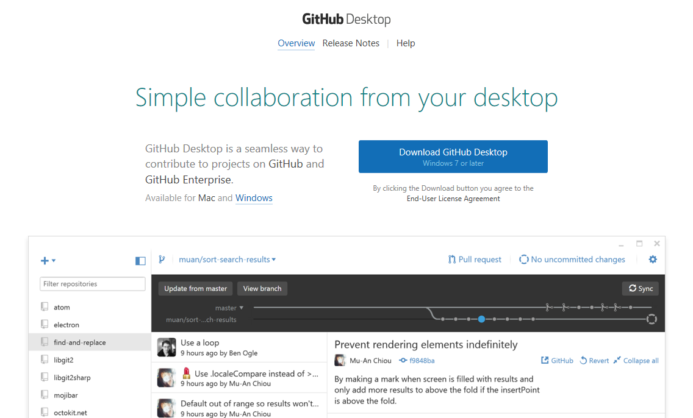
desktop.github.com

Slide 9
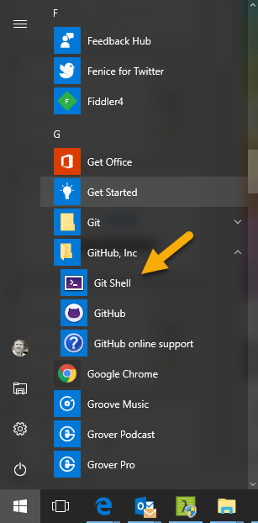
GitHub Desktop + Git Shell
Complete local copy of Git for Windows
Poshgit
Notes:
Open file location and show how Git Shell opens the shell.ps1 file

Slide 10
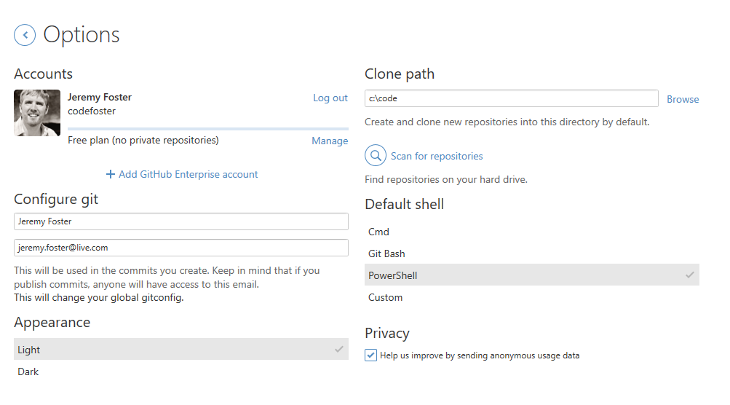
Options

Slide 11
There you have it.

Slide 12
Repositories
Briana Swift
Jeremy Foster

Slide 13
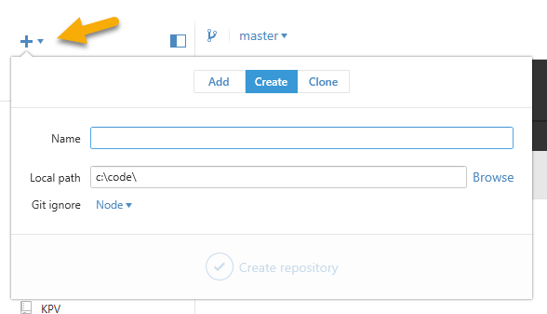
Creating
Hit the plus…
Choose a sensible .gitignore template
You get a .gitattributes and a .gitignore and your first commit

Slide 14
Cloning
Add, clone, or choose one of your repos
OR
Browse to any repo on github.com | Clone or download | Open in desktop

Slide 15
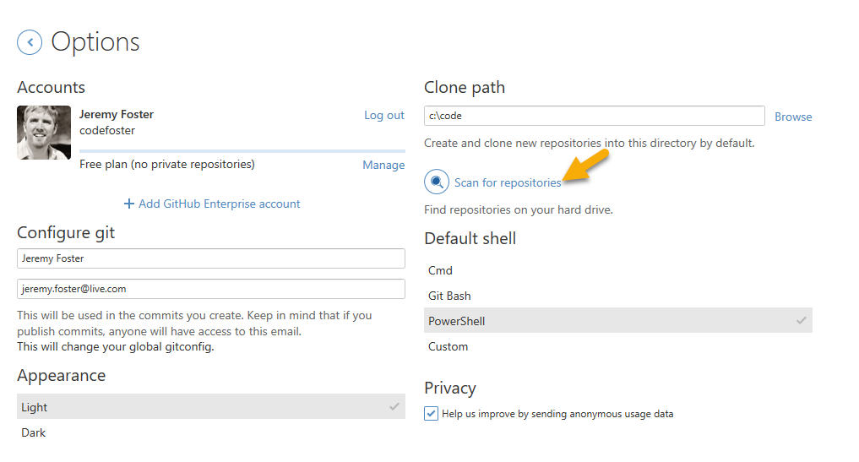
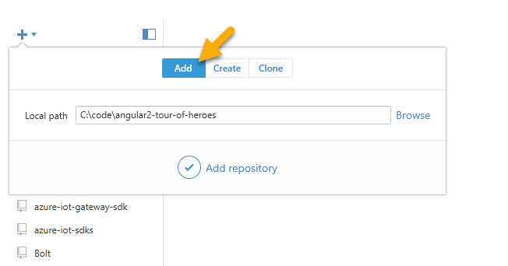
Adding and Scanning

Slide 16
DEMO
MANAGING REPOSITORIES

Slide 17
There you have it.

Slide 18
Branches and Changes
Briana Swift
Jeremy Foster

Slide 19

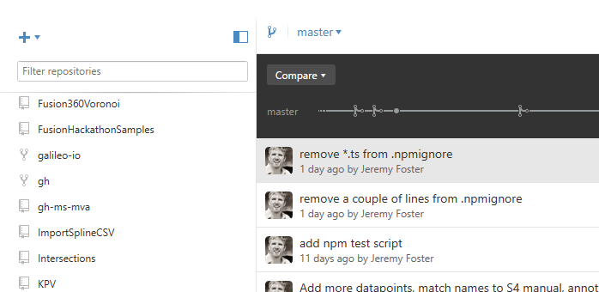
Managing Branches
Create using the icon
Switch using the dropdown
Delete a branch from the Settings menu
Click View Branch to see your new branch’s history

Slide 20
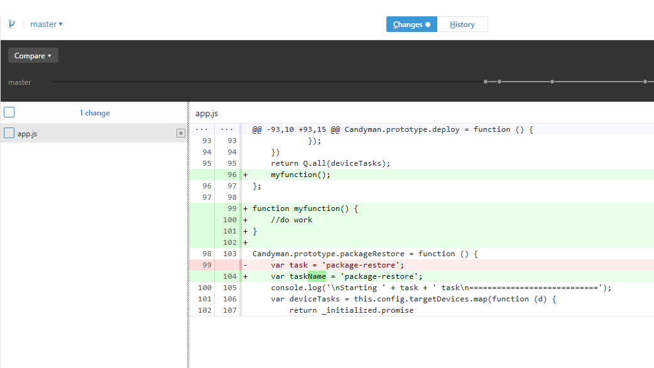
Difference Viewer

Slide 21
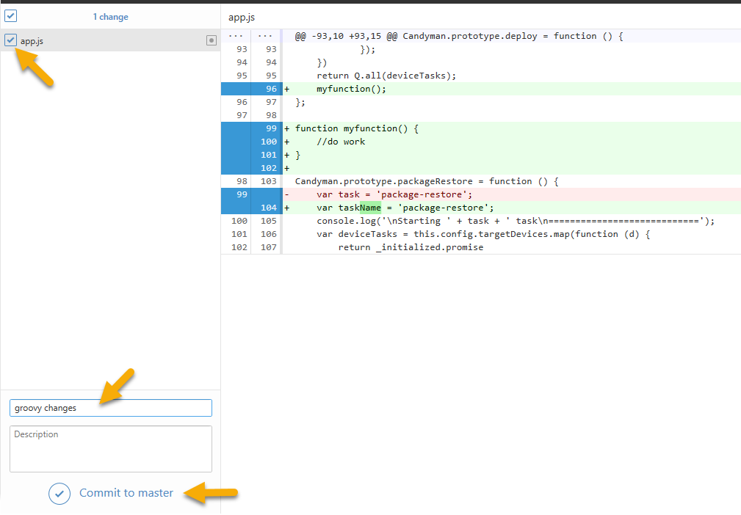
Committing

Slide 22
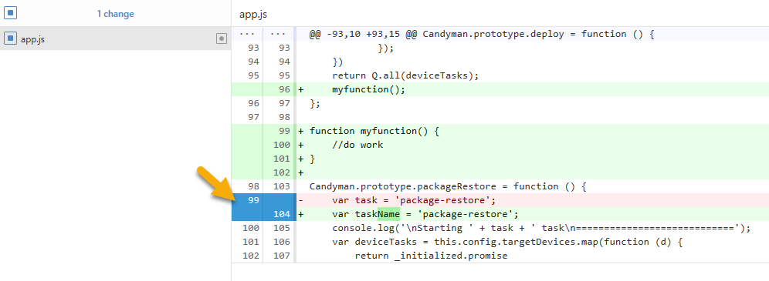
Committing by Line

Slide 23
Collaboration
Simple PR’s
No PR conversations
No issues

Slide 24
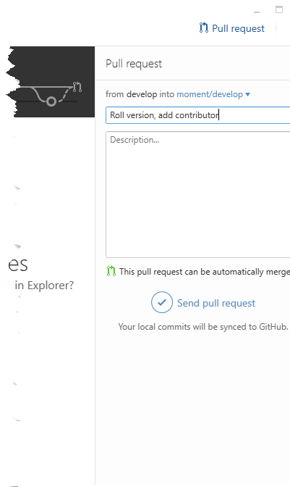
Pull Request
Fork a repo
Open your fork (not the original) in GitHub Desktop
Commit some changes
Hit Pull Request

Slide 25
DEMO
THE GITHUB FLOW USING GITHUB DESKTOP

Slide 26
There you have it.

Slide 27
Other Desktop Tools
Briana Swift
Jeremy Foster

Slide 28
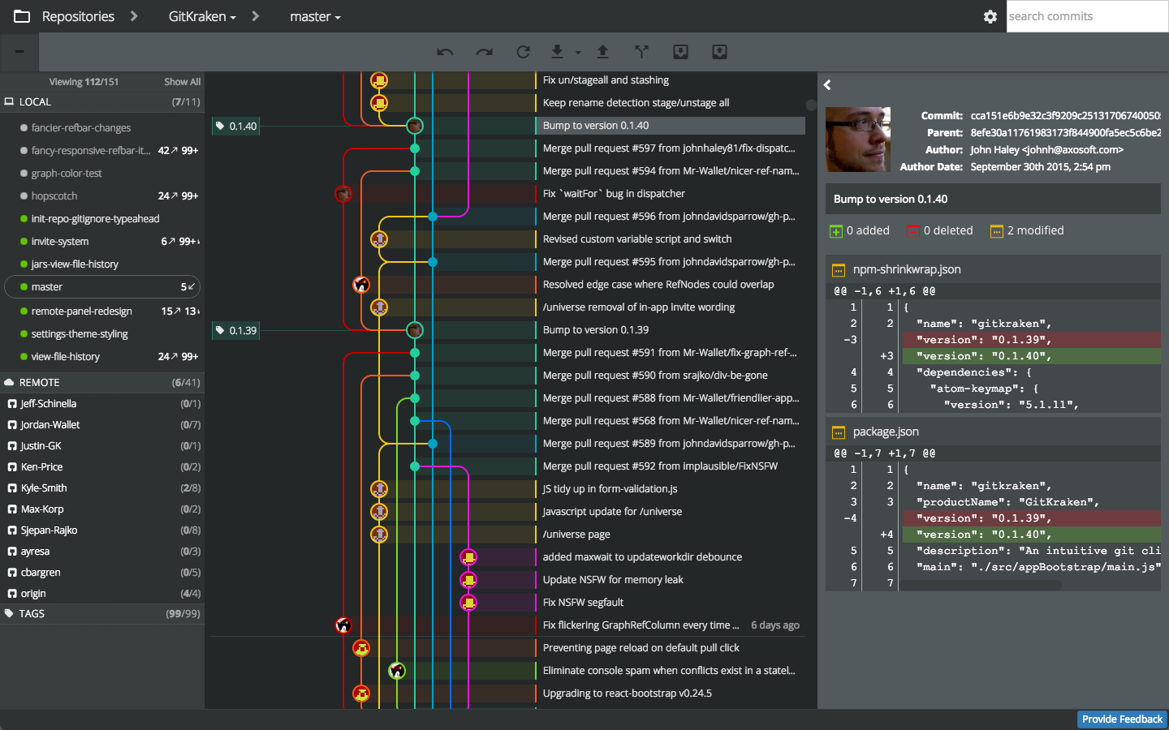
Other Desktop Tools
Tortoise Git
SourceTree
Git Extensions
SmartGit
git-cola
GitEye
Git Kraken

Slide 29
There you have it.

Slide 30
In summary…
Introducing GitHub Desktop
Repositories
Changes
Branches
Collaboration
Other desktop tools

