Slide 1
GitHub for Windows Users
Briana Swift
Jeremy Foster

Slide 2
Agenda
1
Basic Concepts and the GitHub Workflow
4
GitHub Integrations with Visual Studio
2
GitHub in the Browser
5
GitHub on the Command Line
3
GitHub Desktop
6
Beyond the Basics

Slide 3
Beyond the Basics
Briana Swift
Jeremy Foster

Slide 4
In this module…
Changing history
GitHub Pages
Git configs
Multiple remotes
Remote tracking branches
Combination commands

Slide 5
Changing History
Briana Swift
Jeremy Foster

Slide 6
Danger Zone: Changing History
- Watch out for changing commit IDs
- git revert
- cherry-pick
- rebase
- reset
- commit amend
- git reflog

Slide 7
There you have it.

Slide 8
GitHub Pages
Briana Swift
Jeremy Foster

Slide 9
DEMO
- Create gh-pages branch, make sure there’s index.html
- https://pages.github.com/

Slide 10
There you have it.

Slide 11
Git Configs
Briana Swift
Jeremy Foster

Slide 12
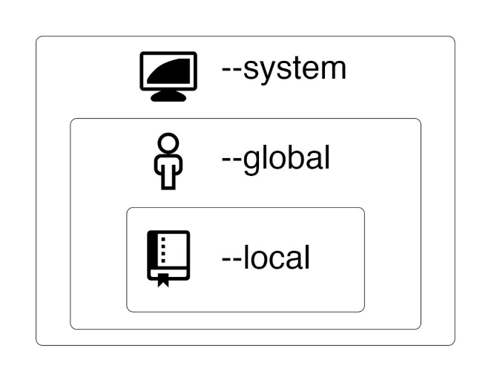
Git configurations
- 3 levels of configuration

Slide 13
Git configurations
- git config —global user.name “First Last”
- git config —global user.email “you@email.com”
- For Windows: git config —global core.autocrlf true
- For Mac: git config —global push.default simple
- git config —global push.default simple

Slide 14
There you have it.

Slide 15
Multiple Remotes
Briana Swift
Jeremy Foster

Slide 16
There you have it.

Slide 17
Remote Tracking Branches
Briana Swift
Jeremy Foster

Slide 18
There you have it.

Slide 19
Combination Commands
Briana Swift
Jeremy Foster

Slide 20
There you have it.

Slide 21
In summary…
Changing history
GitHub Pages
Git configs
Multiple remotes
Remote tracking branches
Combination commands

