Slide 1
Drug Resistance

Slide 2
Scenario
Four Nodes
0 initial prevalence
Zero vectors
1000 people per node
2 markers
4 outbreaks on day 10
Node 1 gets no markers
Node 2 gets marker A
Node 3 gets marker B
Node 4 gets markers A & B
1.0 coverage
Day 30 all nodes, all people get Chloroquin
FullTreatmentCourse
Drug Resistance
Goals
See drugs have different effectiveness depending on what strain it is trying to kill.
Test
Both resistant modifiers
Scenario C50
Scenario MaxKilling
"Resistance" : {
"A" : {
"PKPD_C50_Modifier" : 8.0,
"Max_IRBC_Kill_Modifier" : 1.0
},
"B" : {
"PKPD_C50_Modifier" : 16.0,
"Max_IRBC_Kill_Modifier" : 1.0
}
},
"Resistance" : {
"A" : {
"PKPD_C50_Modifier" : 1.0,
"Max_IRBC_Kill_Modifier" : 0.5
},
"B" : {
"PKPD_C50_Modifier" : 1.0,
"Max_IRBC_Kill_Modifier" : 0.25
}
},

Slide 3
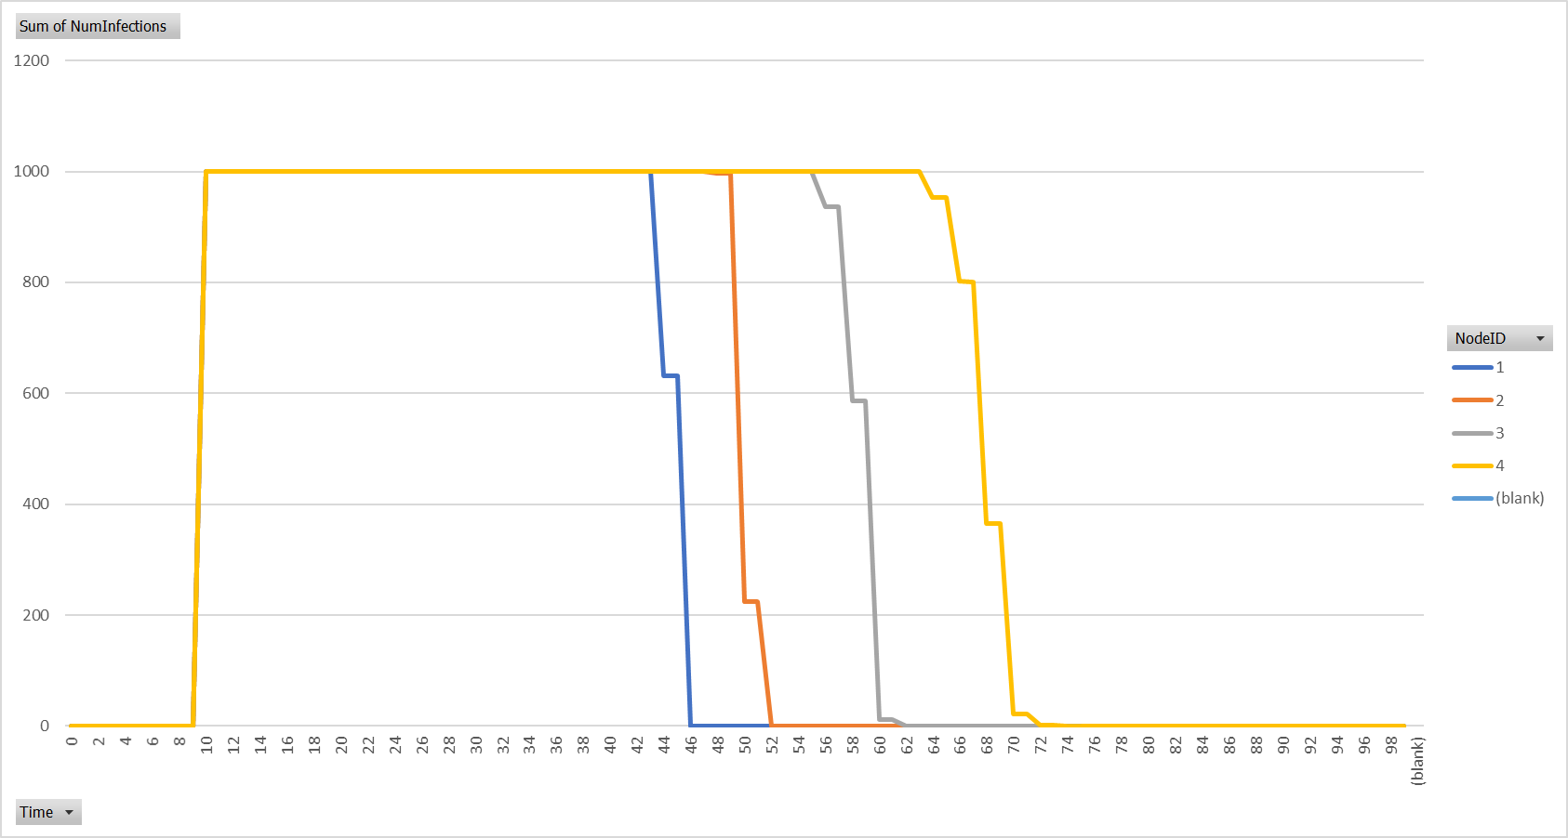
Scenario MaxKilling - NumInfections

Slide 4
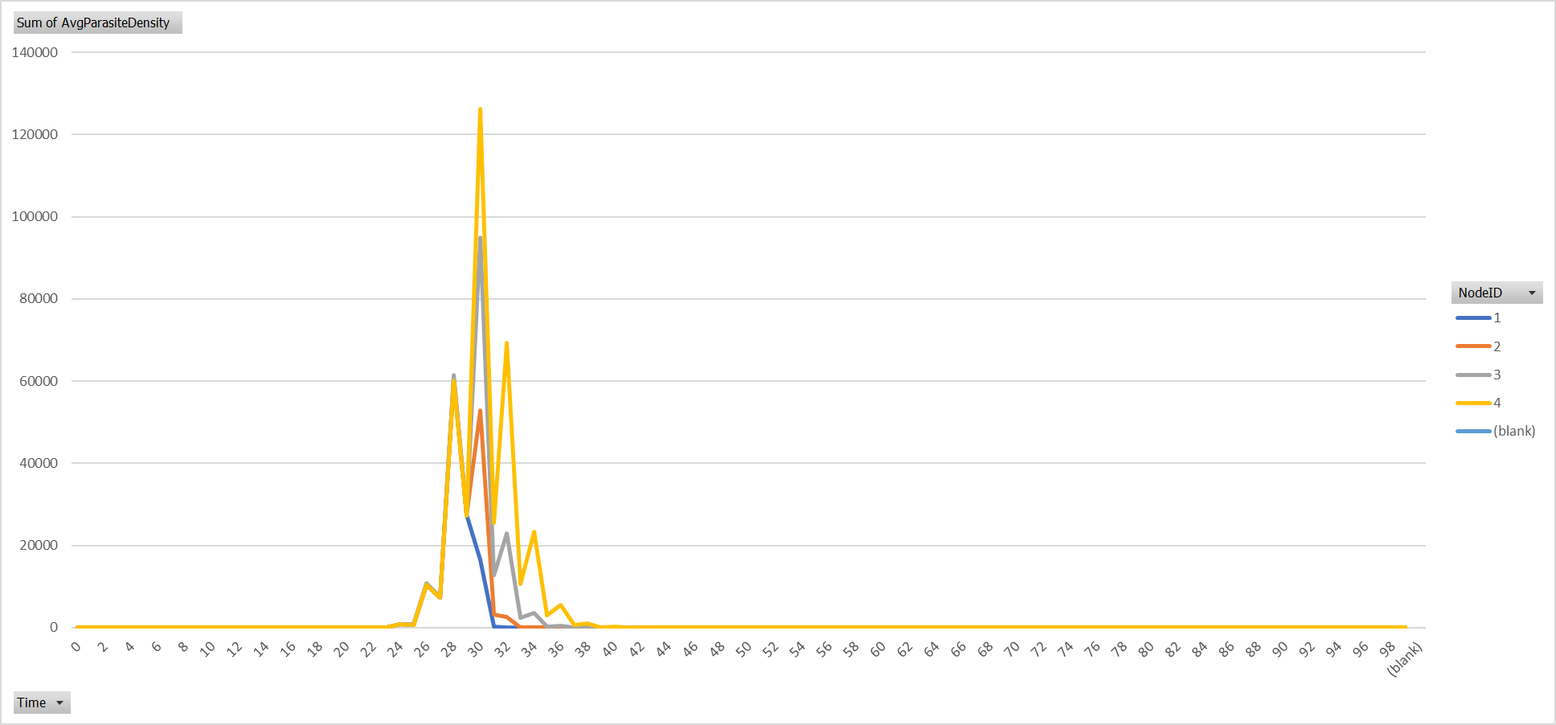
Scenario MaxKilling – Average Parasite Density

Slide 5
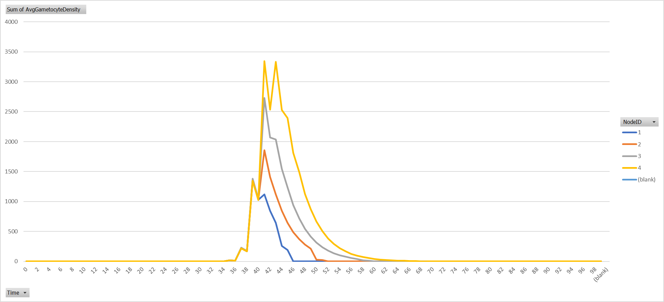
Scenario MaxKilling – Average Gameocyte Density

Slide 6
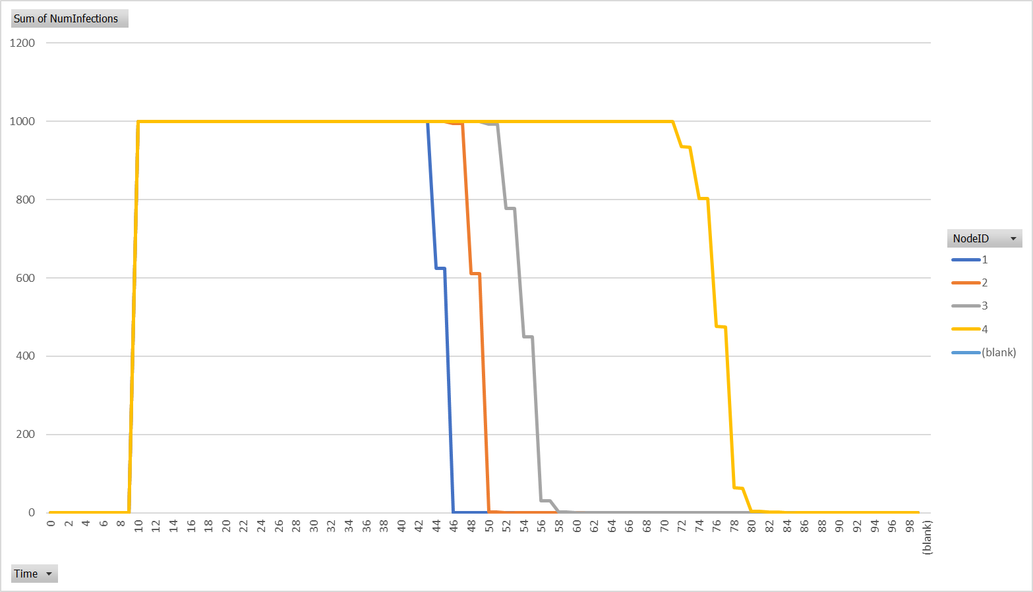
Scenario C50 - NumInfections

Slide 7
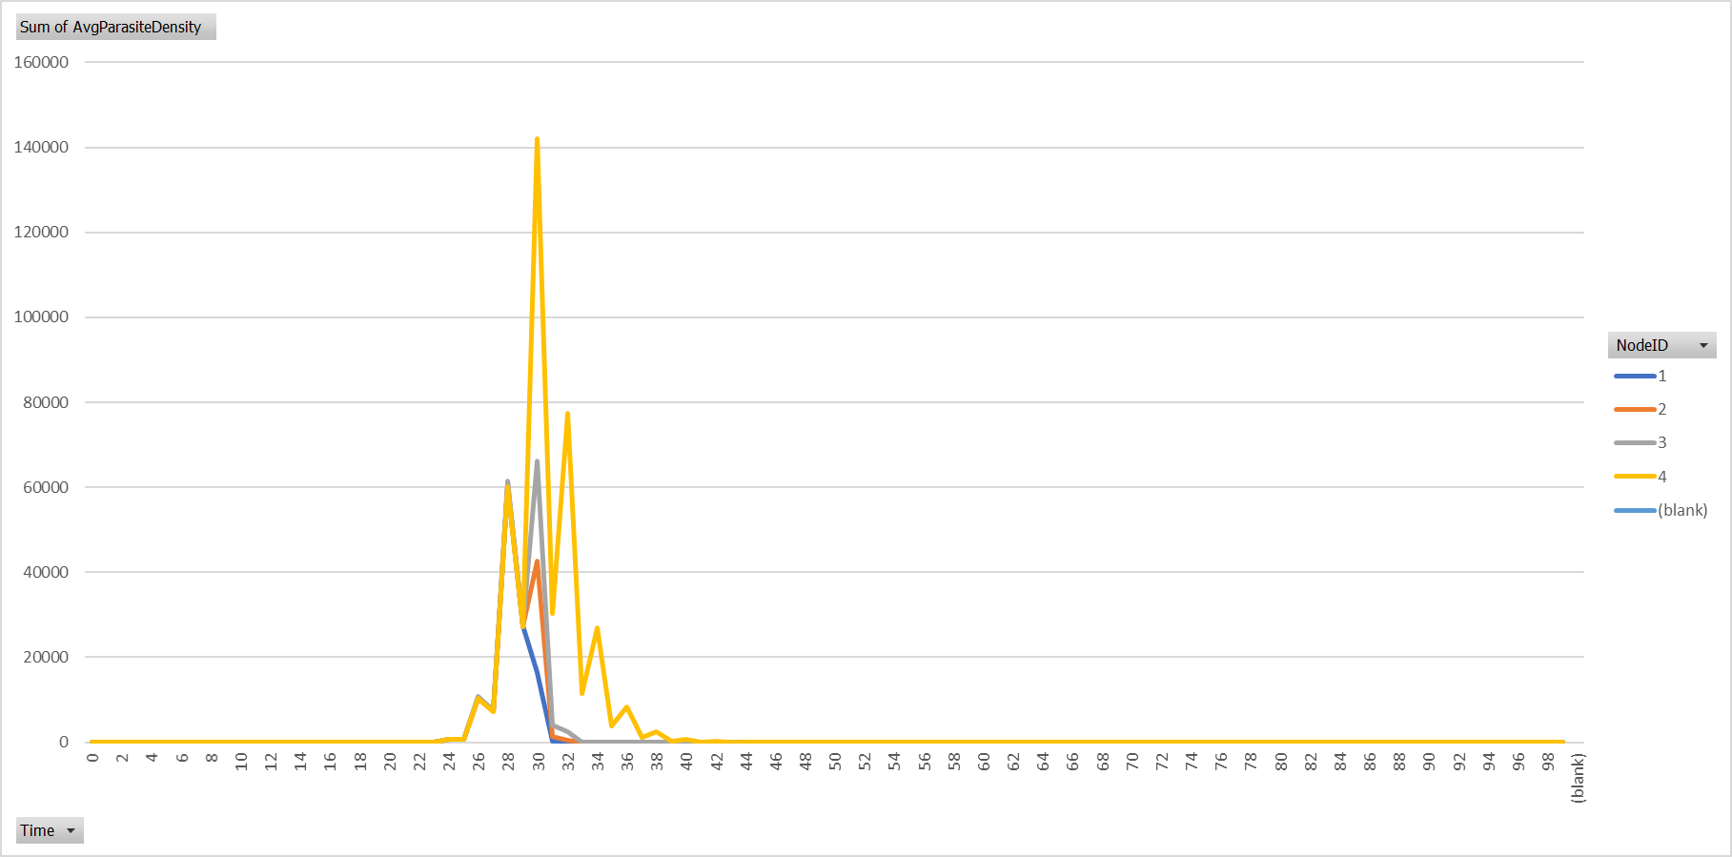
Scenario C50 – Average Parasite Density

Slide 8
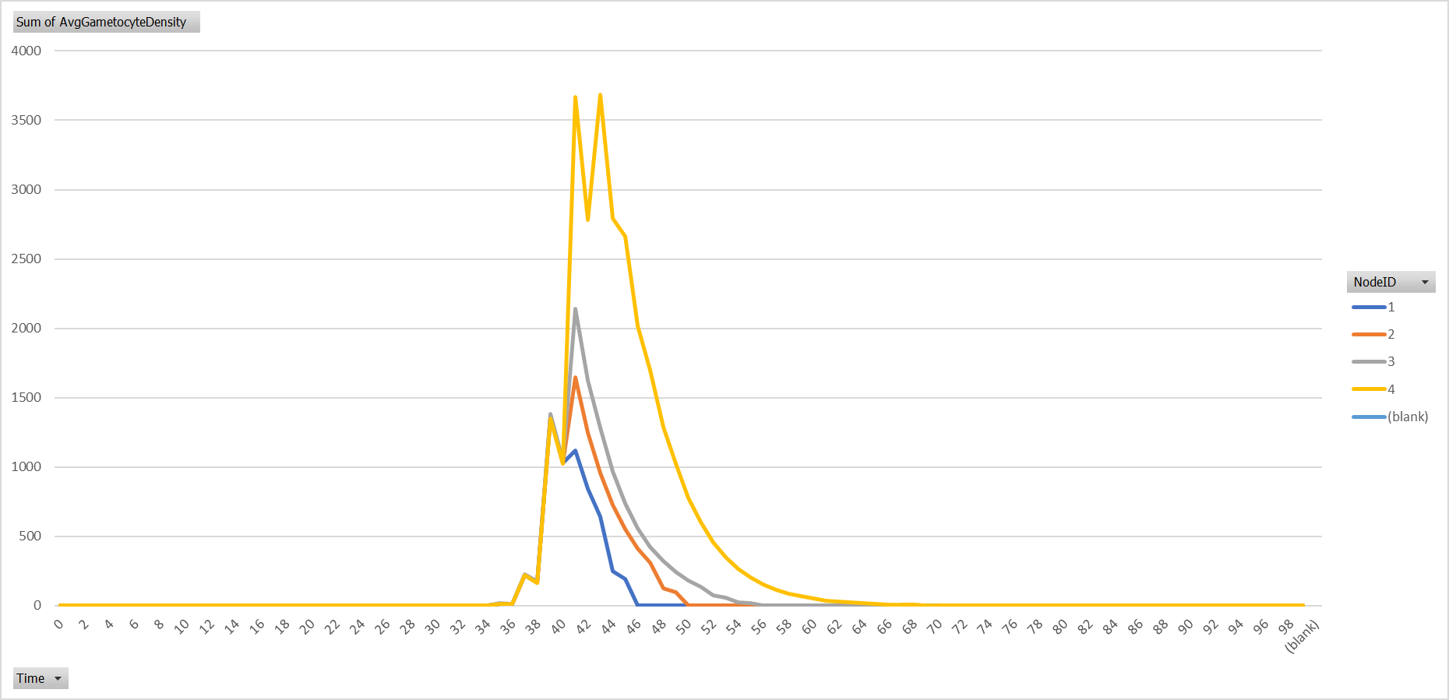
Scenario C50 – Average Gameocyte Density

