Slide 1
Drug Resistance Strain Dominance

Slide 2
Scenario
Four Nodes
0 initial prevalence
Constant Temperature
x_Temporary_Larval_Habitat=0.1
1000 people per node
2 markers
5 outbreaks on day 10
Node 1 gets no markers, coverage = 0.04
Node 2 gets marker A, coverage = 0.04
Node 3 gets marker B, coverage = 0.04
Node 4 gets markers A, coverage = 0.02
Node 4 gets markers B, coverage = 0.02
Day 700 all nodes, 75% of people get FullTreatmentCourse
Chloroquin
Quinine
Drug Resistance
Goals
See that the A-B strain of the infection in Node 4 becomes dominant because it is resistant to both drugs.
Tests
Infection with one strain is impacted by one drug but not the other
Infection with both strains is not effective to either drug
Each modifier
Resistance to different drugs
"Chloroquine": {
"Resistance" : {
"A" : {
"PKPD_C50_Modifier" : 1.0,
"Max_IRBC_Kill_Modifier" : 0.05
},
"B" : {
"PKPD_C50_Modifier" : 1.0,
"Max_IRBC_Kill_Modifier" : 1.0
}
}
},
"Quinine": {
"Resistance" : {
"A" : {
"PKPD_C50_Modifier" : 1.0,
"Max_IRBC_Kill_Modifier" : 1.0
},
"B" : {
"PKPD_C50_Modifier" : 500.0,
"Max_IRBC_Kill_Modifier" : 1.0
}
}
}

Slide 3
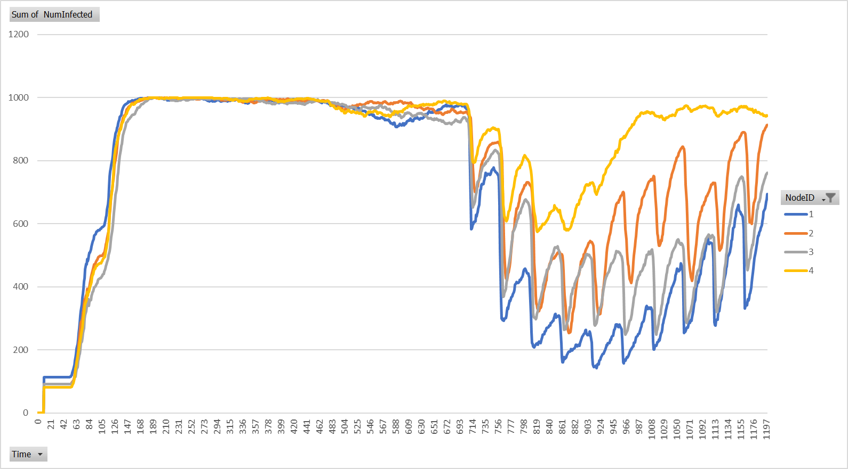
NumInfected

Slide 4
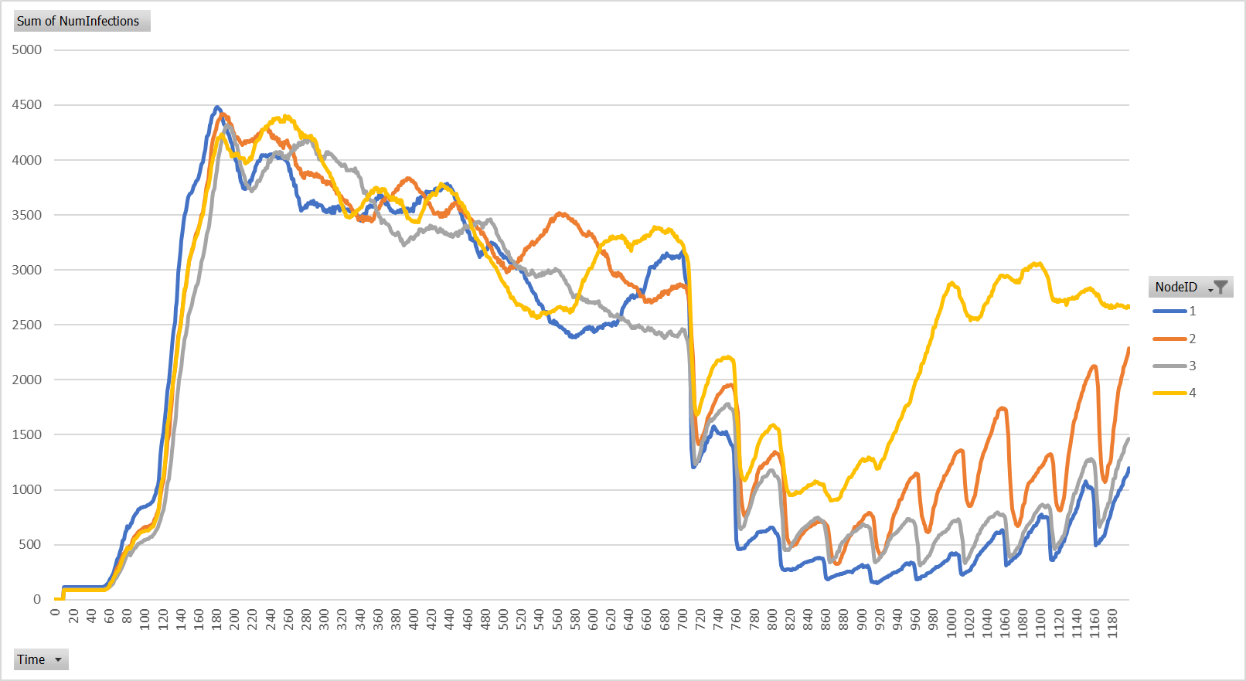
NumInfections

Slide 5
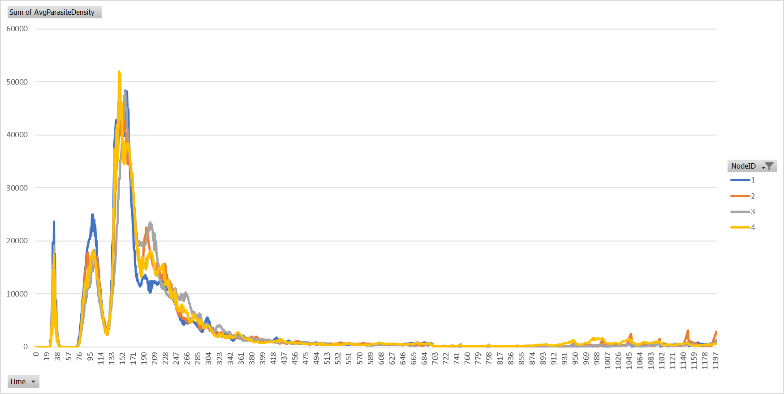
Average Parasite Density

Slide 6
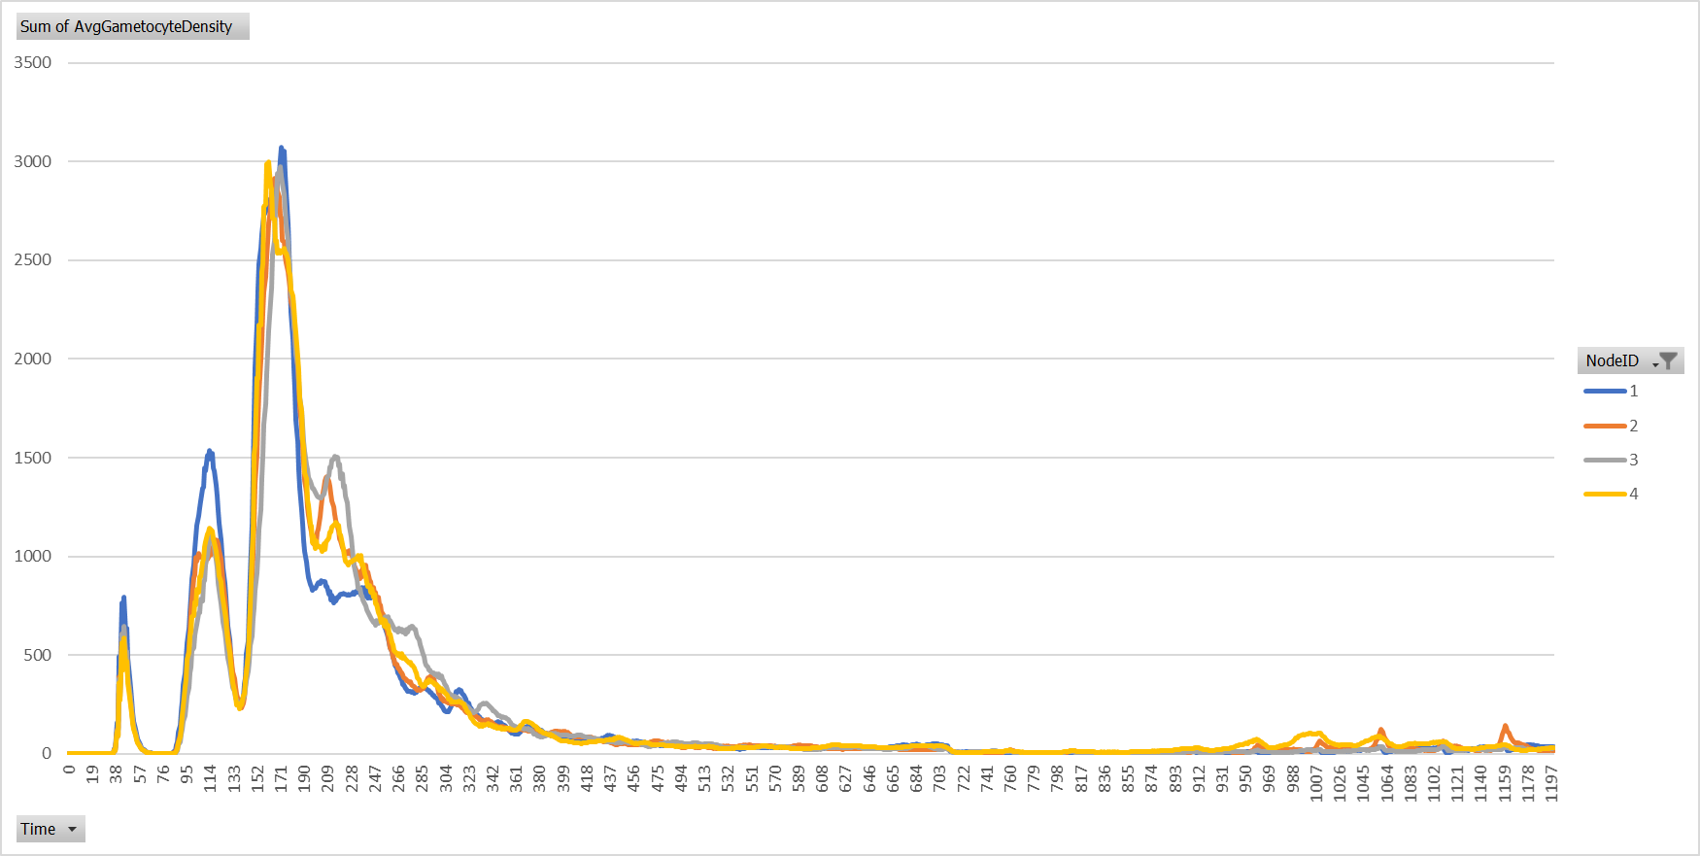
Average Gameocyte Density

Slide 7
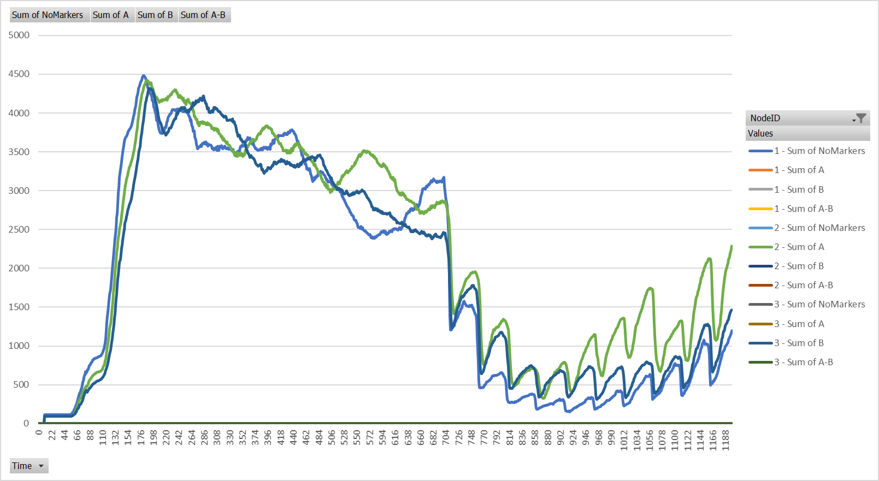
Infections Per Marker Nodes 1, 2, 3

Slide 8
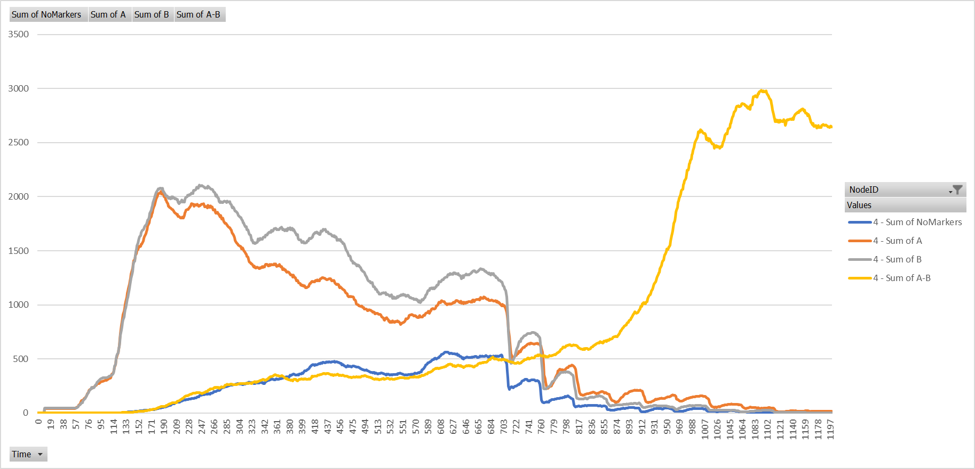
Infections Per Marker Node 4

Slide 9
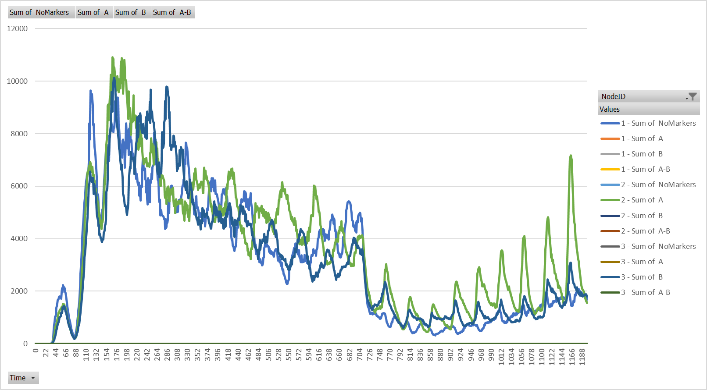
Vectors – Infected Per Marker – Nodes 1, 2, 3

Slide 10
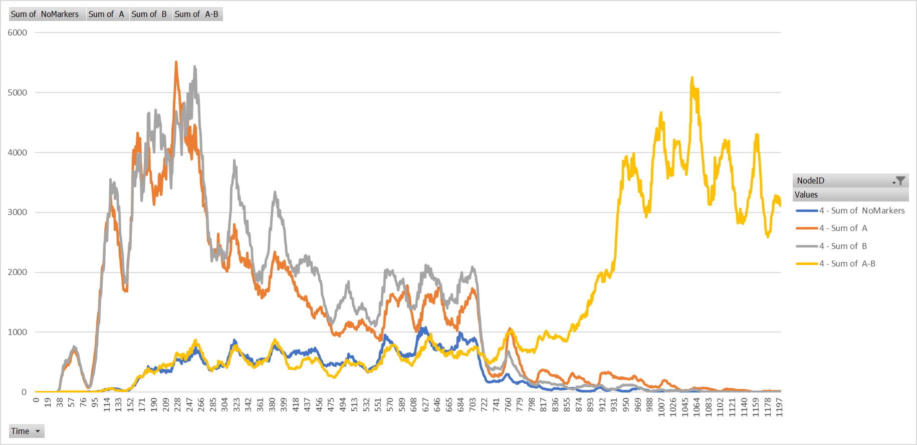
Vectors – Infected Per Marker – Nodes 4

Slide 11
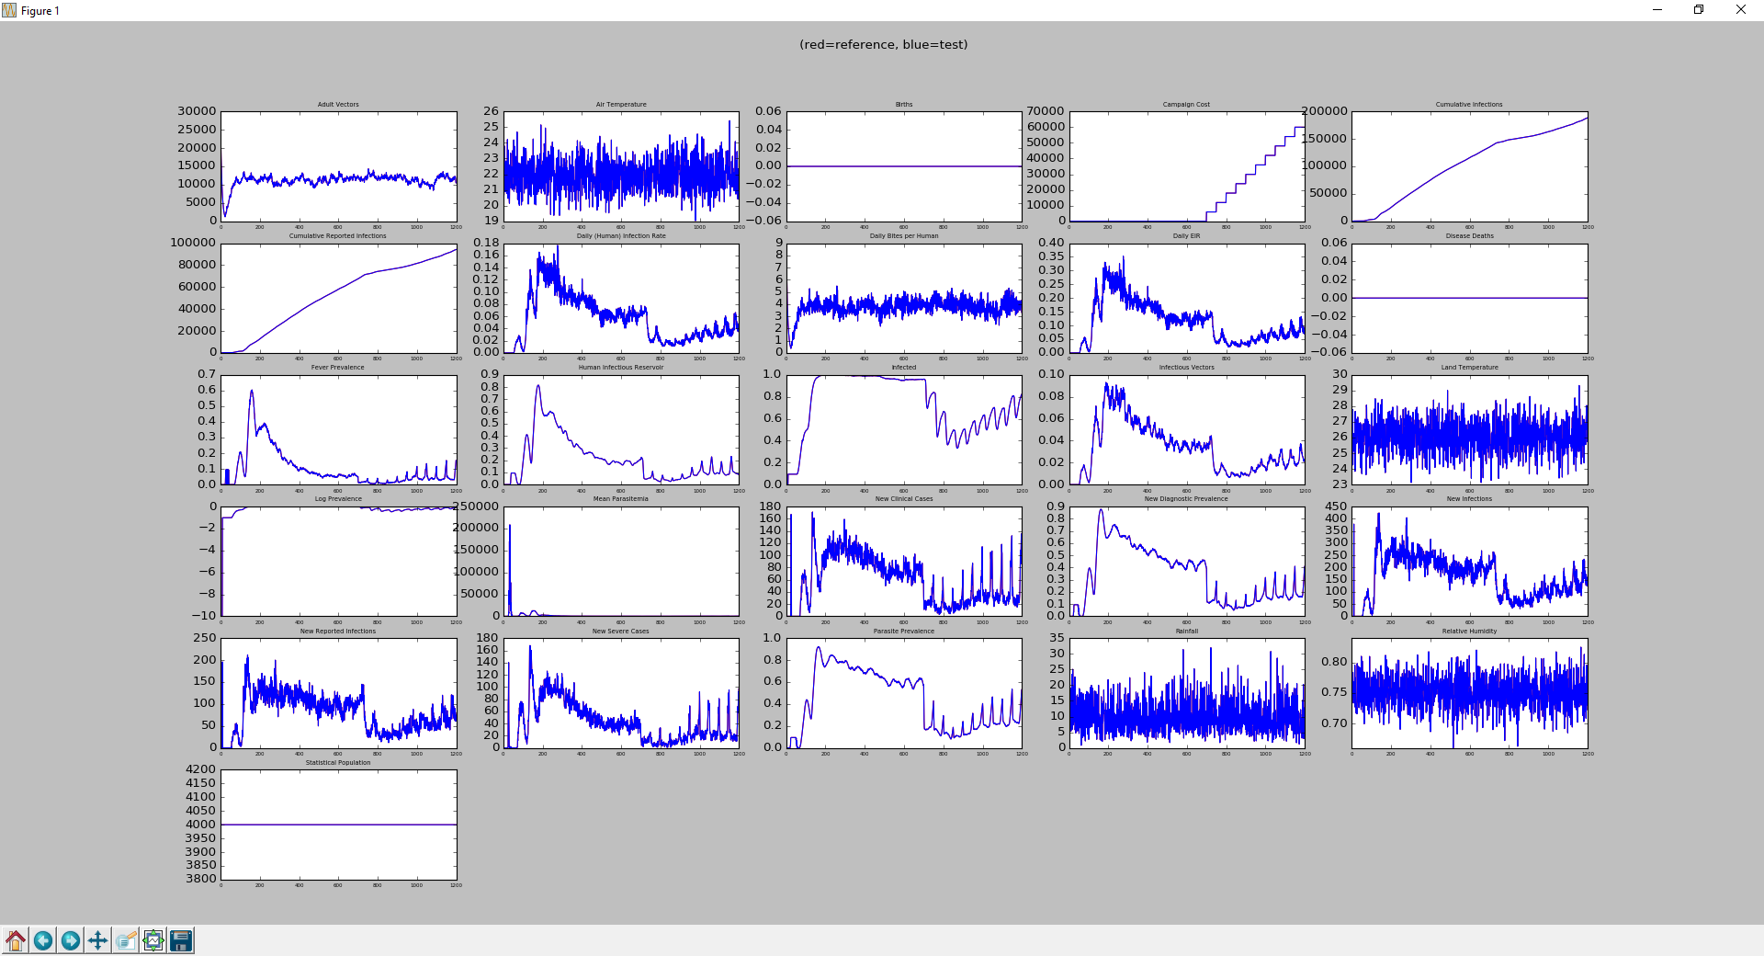
InsetChart

