Slide 1
BLE2TCP
Suggestion for application improvement

Slide 2
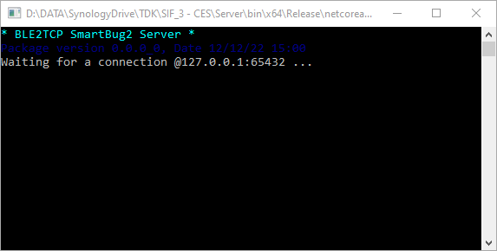
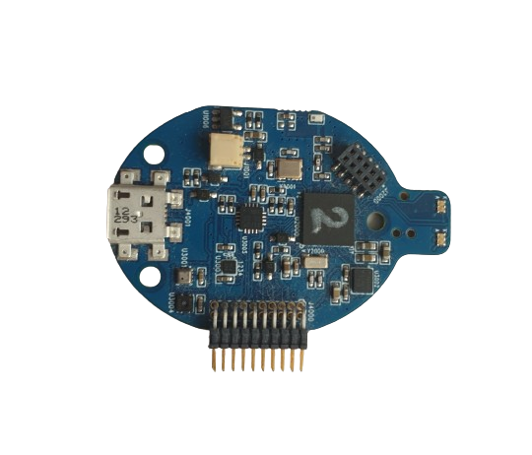

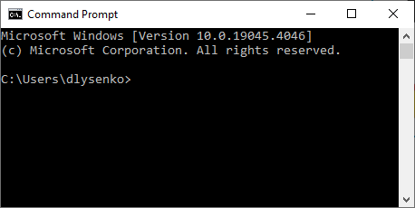



SIF1, SIF3, DiceDemo application structure
Smart Bug board
Client browser
Windows API
BLE2TCP Server
TCP
USB
HTTP
BLE
Flask WEB Server

Slide 3
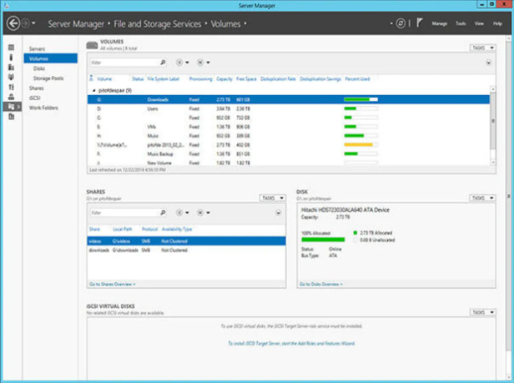
Suggestion for application improvement
BLE2TCP server
Sensor board connect application
Implemented features
Supports Smart Bug boards
Supports BLE interface
Supports USB connection via BLE interface emulation
Provides information on available boards
Accessible through TCP interface
New features
Supports a wide range of sensor boards
Supports all available board interfaces
Provides board status information
Has log and debug functions
Has GUI

Slide 4
Advantages
Accelerate development by simplifying the addition of new hardware support
Add flexibility to hardware connectivity from any platform, including JavaScript
Simplify development by providing hardware logging information
Improve end user experience by using GUI
Improves stability by using a single connection library for all sensor boards
Secure and easy distribution via MS Store

Slide 5
Sensor board connect application structure
Sensor board
WIFI
Sensor board connect application
Application
TCP
TCP
USB
BLE

Slide 6


Usage example
Client PC
Internet
Web based software distribution
Client browser application
TDK Web server
WebApp
Smart Bug board
Smart Bug Server application
Microsoft Store
WIFI
TCP
USB
BLE

Slide 7


Usage example
Client PC
Internet
File based software distribution
Demo Application
TDK File server
Smart Bug board
Smart Bug Server application
Microsoft Store
WIFI
TCP
USB
BLE

Slide 8

Usage example
Client PC
Internet
User application development
User Application
TDK File server
Smart Bug board
Library
Smart Bug Server application
Microsoft Store
WIFI
TCP
USB
BLE

Slide 10


Slide 11
SIF2 application structure
Smart Motion board
Client browser
Serial interface
HTTP
Flask WEB Server
USB

