Slide 1




DOCUMENT ANALYSIS
USING LLM’S
Project Presentation

Slide 2
DOCUMENT ANALYSIS USING LLM’S
TEAM MEMBERS
A
B
PRASHANT MISHRA
SIMRAN KODWANI
UNDER THE GUIDANCE OF MR. AKSHAY KUMAR
AVISHKANT PATIDAR
A
B
ANURAG
KANISHKA RAVISHANKAR
A
B
DEVANSI MAHATAR
A
SOUMYADIP PAL
UDITA SINHA
A
B
KIRUTHICK RAJ

Slide 3
Table of Content
Introduction
Tools and Technologies
Problem Statement
Identified Gaps and Applied Solutions
Project Objectives
Use Cases and Applications
Literature Review
Future Enhancements
System Architecture
Conclusion
Document Processing Pipeline
Core Features

Slide 4
INTRODUCTION
In today's data-driven world, professionals and researchers encounter vast amounts of unstructured data daily. Traditional data analysis tools fail to extract meaningful insights from unstructured formats like PDFs, YouTube transcripts, and DOCX files. Recognizing this challenge, the project InsightPulse was developed. InsightPulse is a comprehensive solution leveraging the power of Large Language Models (LLMs) and retrieval-augmented generation (RAG) pipelines to perform smart analysis on documents and multimedia transcripts. The goal is to minimize the manual effort required to analyze lengthy documents or videos by transforming the way users interact with content. With InsightPulse, users can simply upload their files or provide a YouTube video URL and receive intelligent summaries, answers, and data breakdowns in a conversational manner

Slide 5
PROBLEM STATEMENT
Data exists in many formats, including PDF reports, research papers, Word documents, spreadsheets, and video lectures. The real challenge is that extracting insights from these sources typically requires significant manual effort and time.
Manual reading and summarization of long documents is inefficient.
Lack of real-time conversational interfaces for interacting with content. Inability to query databases without SQL knowledge.
Absence of tools that consolidate multimedia and textual information in a unified analysis platform.
Solution Goal: A context-aware document intelligence system leveraging local LLMs and semantic search for accurate, privacy-preserving insights from diverse document types
PROBLEMS FACED

Slide 6
PROJECT OBJECTIVES
Design and implement a user-friendly web-based application that supports document and video transcript analysis.
Integrate multiple agents for document, database, and multimedia content handling using LangChain.
Enable conversational interaction with documents, allowing users to ask questions and receive relevant, context-aware answers.
Build support for YouTube link input that fetches video transcripts and allows users to interact with them using LLMs.
Add support for SQL agents that allow users to query a connected database conversationally.
Develop a modular system with flexibility for future enhancements and model integrations.

Slide 7
LITERATURE REVIEW
Foundation Models and Attention Mechanism
Transformers (Vaswani et al., 2017): Introduced the self-attention mechanism that fundamentally transformed NLP and serves as the architecture behind modern LLMs
BERT (Devlin et al., 2019) and Sentence-BERT (Reimers & Gurevych, 2019): Advanced dense embeddings enabling semantic search capabilities beyond traditional lexical matching
Retrieval and Knowledge Integration
Retrieval-Augmented Generation (Lewis et al., 2020): Pioneered the integration of external knowledge retrieval with generative text models to enhance factual accuracy
Vector databases and hybrid retrieval systems (Karpukhin et al., 2020): Enabling efficient similarity search across large document collections
Multimodal Processing and System Integration
Whisper (Radford et al., 2022): Robust speech recognition model supporting multilingual audio transcription with high accuracy
LangChain (Chase, 2023): Framework for orchestrating complex document processing workflows with modular agent architectures

Slide 8
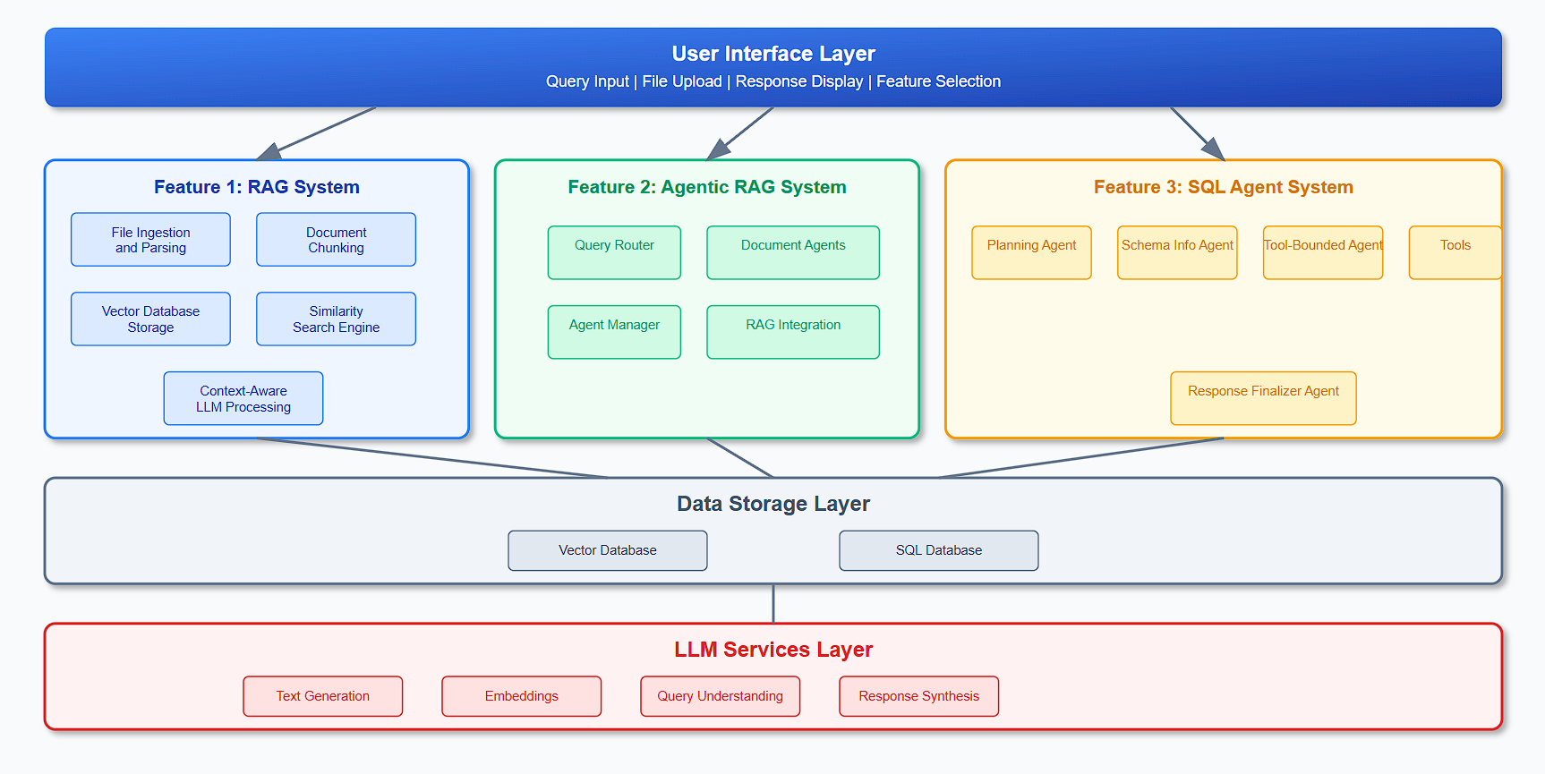
SYSTEM ARCHITECTURE

Slide 9
DOCUMENT PROCESSING PIPELINE
File Ingestion
Detects format (PDF, Word, TXT, CSV, YouTube) and Validates
Converts audio to text
Efficient Parsing
Uses LangChain’s document loaderes
Uses PyPDF2, PDFPlumber to preserve layout and formatting.
Intelligent Chunking
Uses 20-30% overlap for context awareness.
Keeps chunks in the 800-1000 characters range
Embedding Generation
Uses Sentence Transformers (all-MiniLM-L6-v2 by default)
Optimized for semantic similarity
Vector Indexing
Stores embeddings in Pinecone vector database
Supports metadata

Slide 10
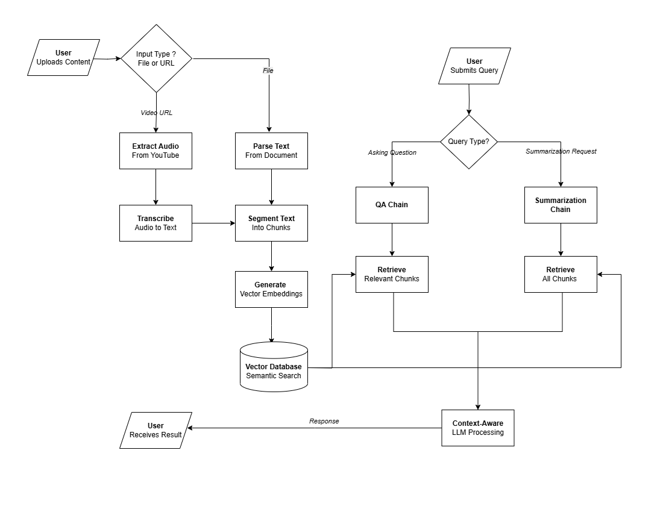
Core Features
RAG SYSTEM
Smart query analysis
Top-k retrieval with tunable parameter
Optimized context assembly for maximum relevance
Structured prompt design using retrieved evidence
Task-based temperature tuning for better generation control
​
RAG FLOW DIAGRAM

Slide 11
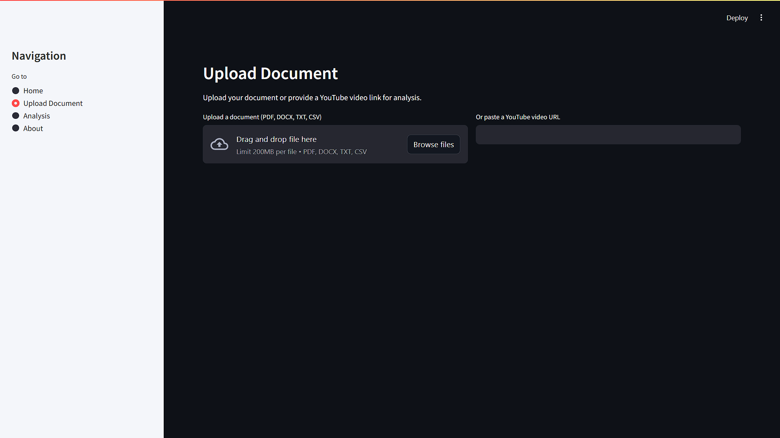

Slide 12
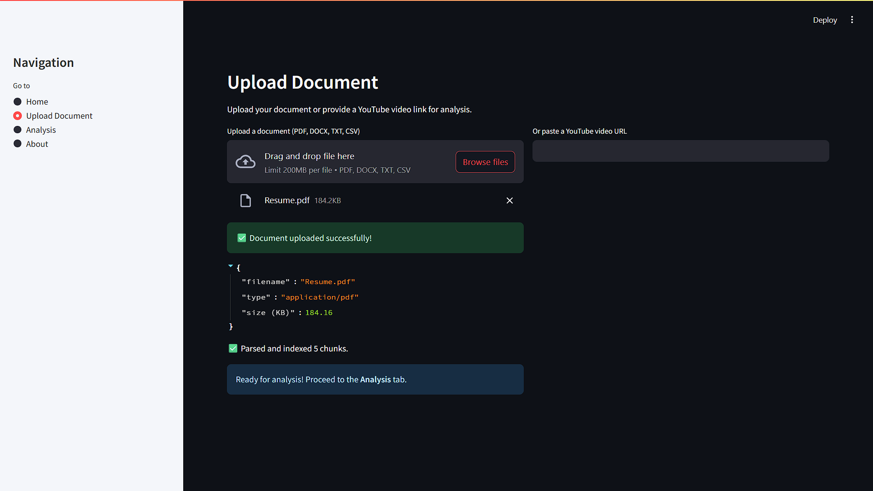

Slide 13
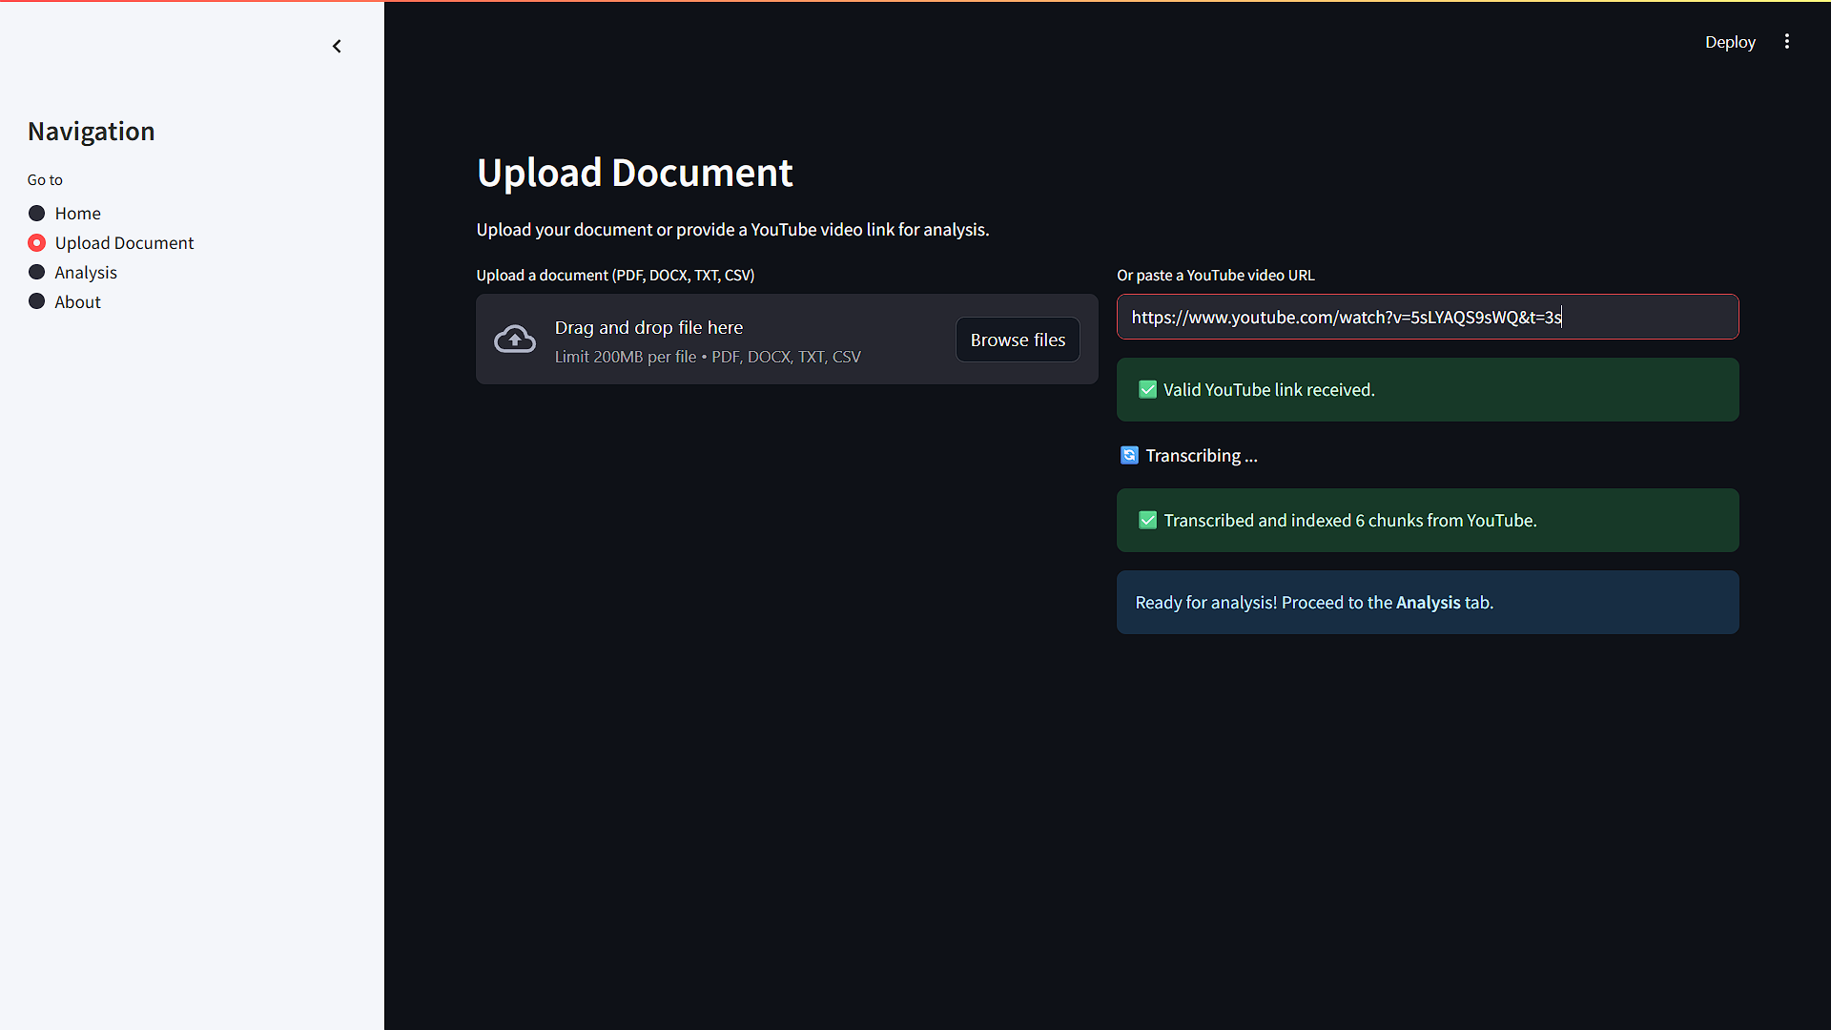

Slide 14
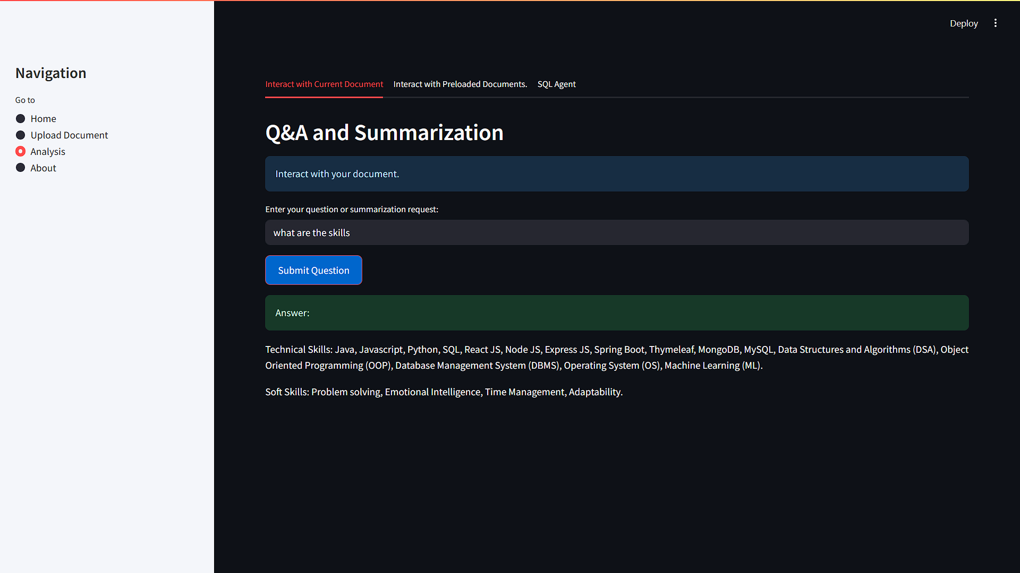

Slide 15
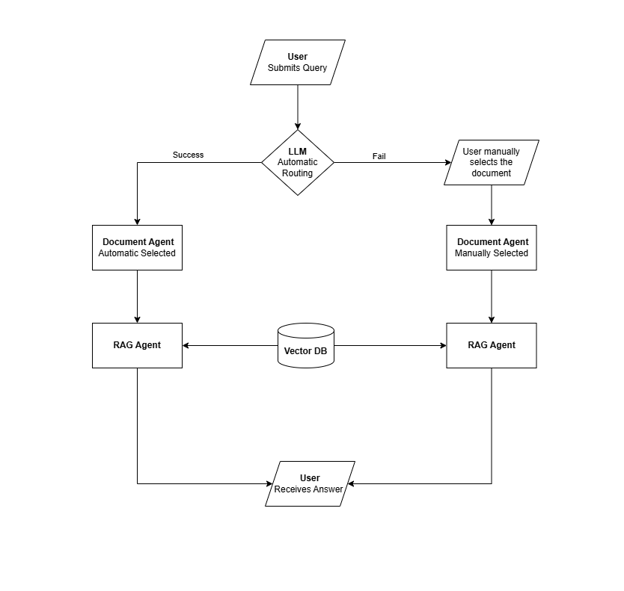
Core Features
2. AGENTIC RAG SYSTEM
Used preloaded document-specific agents that autonomously handle user queries.
If automatic routing fails, users can manually select the appropriate agent.
Each agent internally performs retrieval-augmented generation using a vector database to generate precise, context-aware responses.
This design combines automation with fallback control for improved reliability.
​
AGENTIC RAG FLOW DIAGRAM

Slide 16
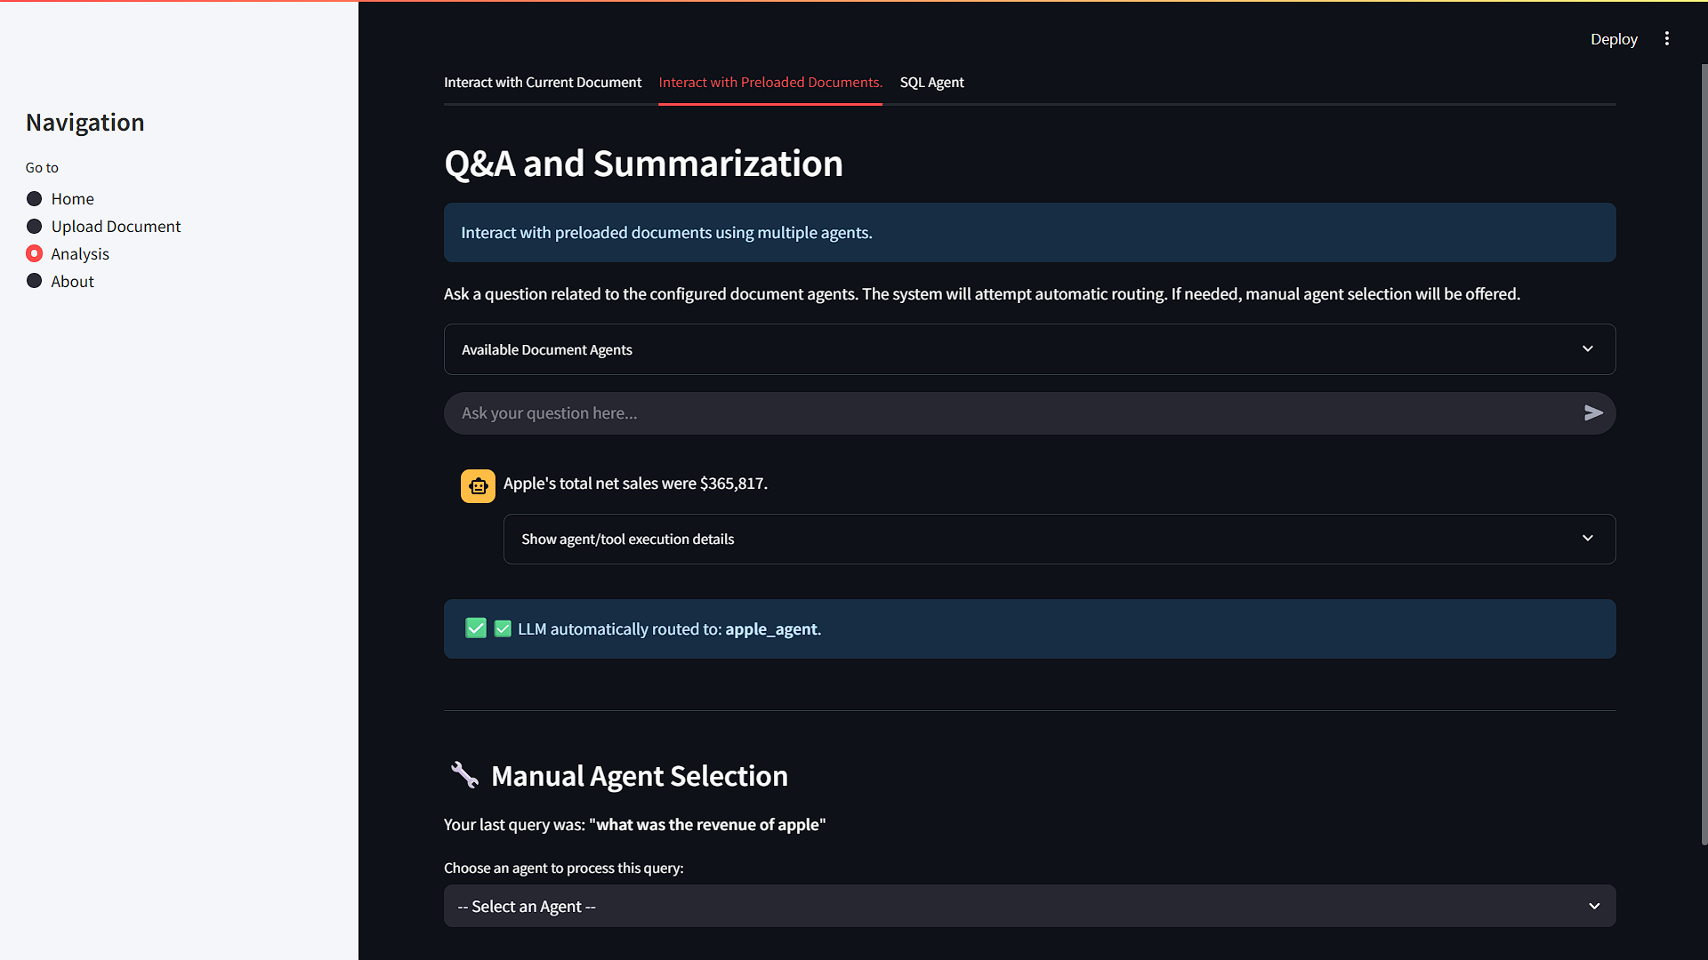

Slide 17
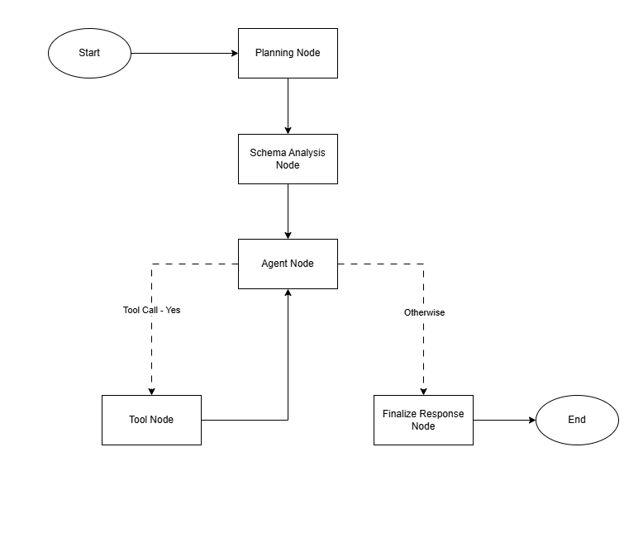
Core Features
3. SQL-AGENT
Planning Node: Interprets the user's natural language query and generates a structured query plan with reasoning and relevant table names.
Schema Info Node: Retrieves and analyzes the database schema to identify relevant tables and their structures when needed.
Agent Node: Acts as a decision-maker, coordinating the flow between planning, schema analysis, tool usage, and finalization based on the query plan.
Tool Node: Executes the planned SQL query using the appropriate tools and returns structured results including rows, columns, and execution success.
Finalize Response Node: Synthesizes the final response by combining query results and reasoning into a user-friendly natural language answer as well as structured output with confidence score.
​
SQL-AGENT FLOW DIAGRAM

Slide 18
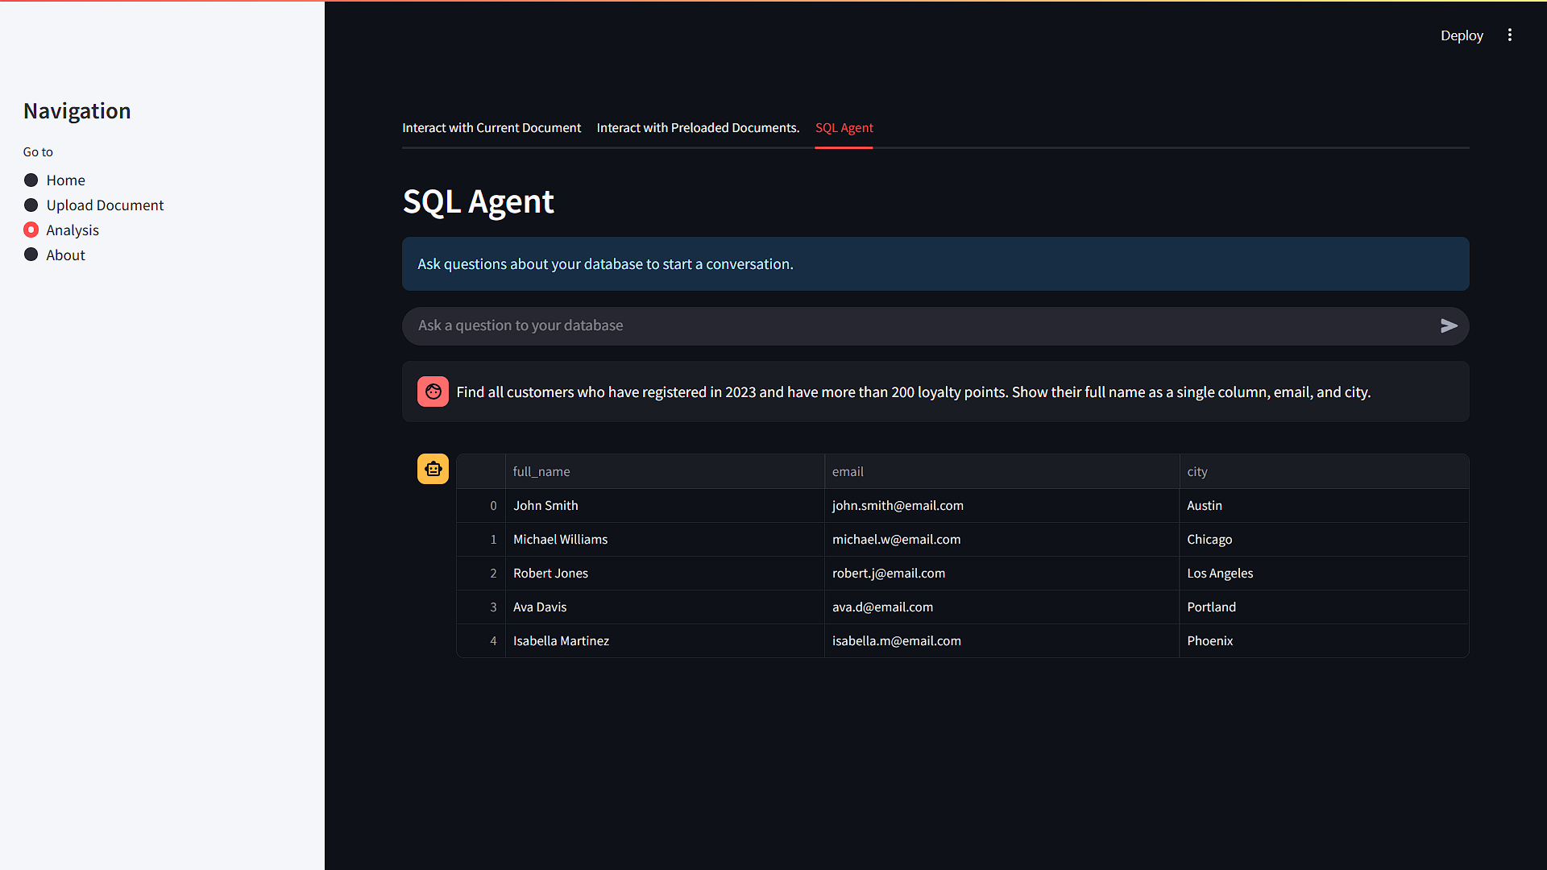

Slide 19
TOOLS AND TECHNOLOGIES
LLM Models & APIs
Gemini 1.5 Flash (via API key) for cloud-based reasoning and generation
Ollama for running local LLMs like Mistral and Phi3
Vector Store & Embeddings
Pinecone for vector similarity search using cosine similarity
Hugging Face all-MiniLM-L6-V2 fro generating dense text embeddings
Frameworks
LangChain for multi-agent RAG workflows
LangGraph for building agentic ai systems like SQL agent workflows
Development & Interface
Streamlit for building the user interface
VS Code for development environment
Git & GitHub for version control and collaboration

Slide 20
IDENTIFIED GAPS AND APPLIED SOLUTIONS
Gap: LLMs prone to hallucinations and inconsistent outputs Solutions:
Adopted Retrieval-Augmented Generation (RAG) using Pinecone for grounding responses
Used task-specific temperature control to balance creativity and accuracy
Crafted well-structured prompts to guide the LLM effectively
Gap: Inability to route queries accurately to relevant documents Solution:
Built a multi-agent routing system that auto-selects document-specific agents based on query intent, with a fallback manual selection
Gap: No structured or inspectable outputs from agents
Solution:
Designed a structured LangGraph SQL Agent returning Pydantic- based outputs for clarity and DataFrame conversion.
Gap: Data privacy concerns with cloud-based LLMs Solution:
Enabled local LLM inference via Ollama to process sensitive documents securely without external API calls

Slide 21
USE CASES AND APPLICATIONS
Legal Document Analysis:
Contract automation & compliance checks
Case-law research & M&A due diligence
Academic Research:
Automated literature reviews
Lecture-video insights & citation analysis
Business Intelligence:
Report & filing analysis
Meeting summaries & action-item extraction
Customer-feedback analytics
Healthcare & Life Sciences:
Summarize clinical trial reports & research papers
Extract insights from patient records & EHRs

Slide 22
FUTURE ENHANCEMENTS
Integrate Layout-Aware Models: Enhance RAG accuracy by incorporating domain-specific agents powered by layout-aware models (e.g., LayoutLMv3) for better document structure understanding.
Enable Natural Language SQL Editing: Allow users to refine or edit auto-generated SQL queries through conversational feedback loops for more transparency and control.
Role-Based Agent Routing: Introduce user-role-based agent routing (e.g., finance, legal) to personalize answers based on context and permissions
Evaluation and Monitoring Dashboard: Build a metrics dashboard to track retrieval accuracy, LLM performance, query success rates, and hallucination detection.

Slide 23
CONCLUSION
InsightPulse demonstrates how Large Language Models can be effectively integrated with document retrieval systems to build intelligent, interactive document analysis tools.
Through a modular agentic architecture, it handles diverse tasks such as summarization, question answering, and SQL-based data exploration with precision.
By combining RAG pipelines, structured agent responses, and local LLM support, the system ensures both accuracy and data privacy.
The project highlights the potential of hybrid AI systems to bring scalable, context-aware insights from unstructured and structured data alike.

Slide 24
Thank You

