Slide 1
LPA-Offload
Location Privacy-Aware Task Offloading
in Mobile Edge Computing
IEEE Transactions on Mobile Computing · Vol. 23, No. 3 · March 2024
Wang, Sun, Liu, Hu, Pang, Hu & Ren
Differential Privacy
MEC Task Offloading
Location Perturbation
Multi-Server Security

Slide 2
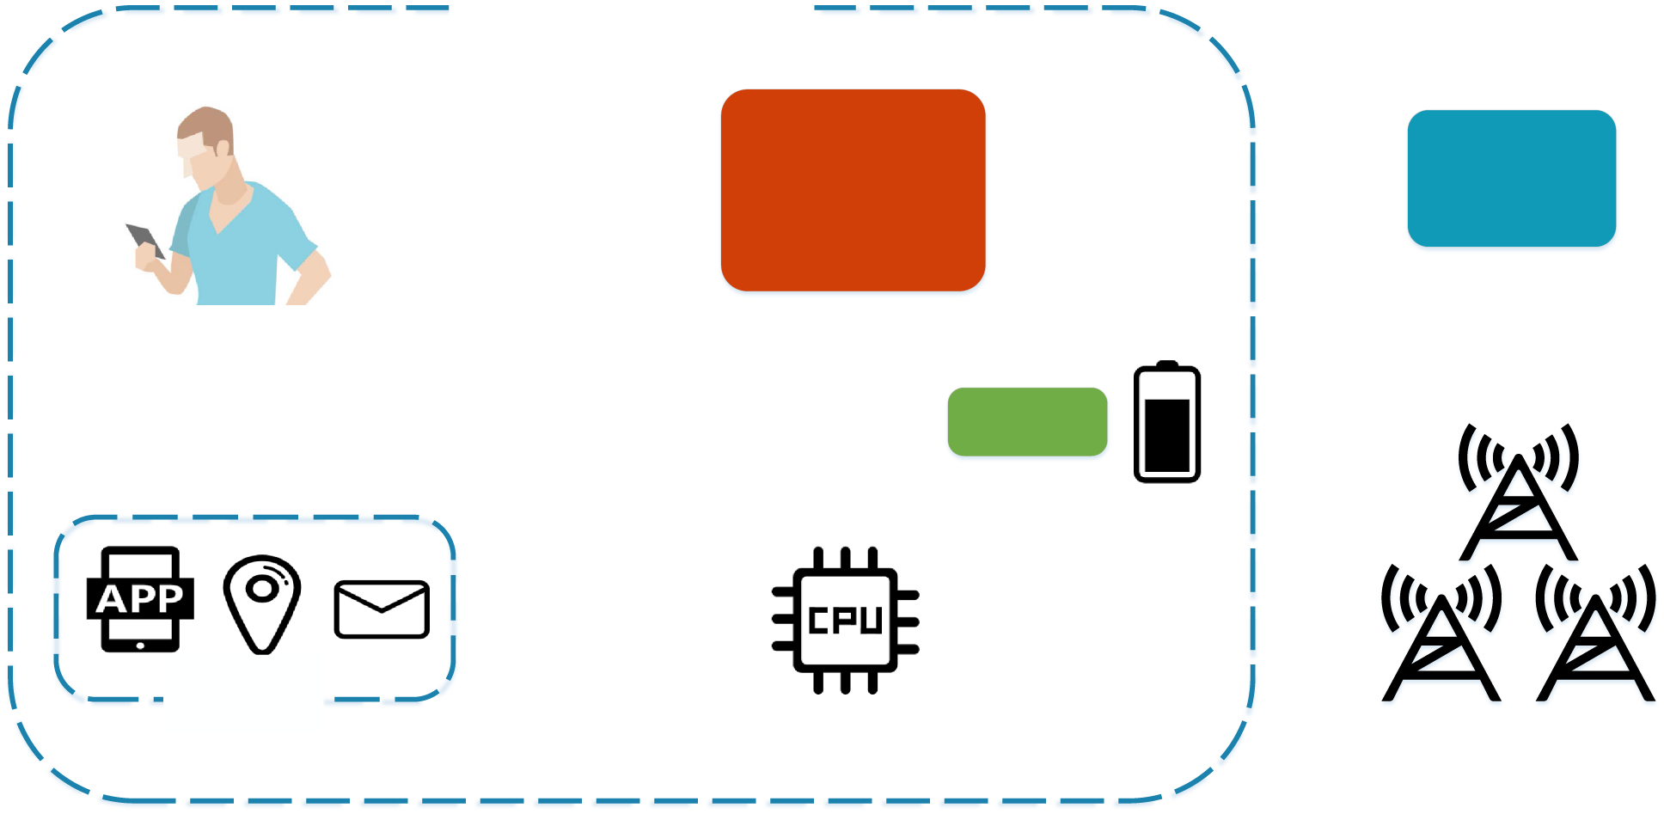
MEC System: How Task Offloading Works
Mobile Device
Limited CPU, battery; runs resource-heavy apps (AR, face recognition)
Wireless Channel
Quality depends on distance dk to server → determines offload ratio
MEC Server
10× more CPU than device; processes offloaded tasks in parallel
Fig. 1 — MEC System with Multiple Servers [Page 4]
Honest-but-Curious
Servers follow protocol but collude to infer user location from task sizes
Source: Section I & III-B | Page 4 | Fig. 1

Slide 3
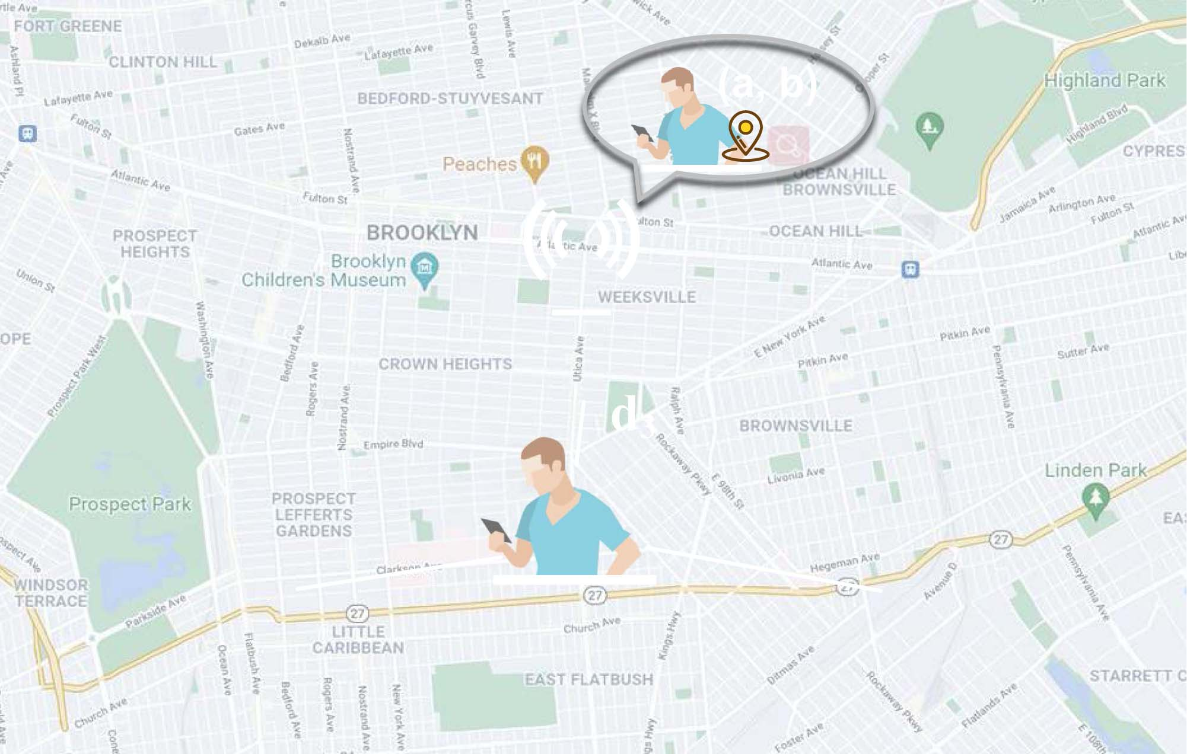
The Problem: Location Leakage via Task Offloading
HOW SERVERS INFER YOUR LOCATION
①
Server monitors size of tasks offloaded by user
②
Estimates channel rate Rk from task volume
③
Computes dk = [(Bn₀/p)·(2^(Rk/B)−1)]^(1/ϑ)
Distance Inference Formula [Eq. 16, Page 5]:
d_k = [ (Bn₀/p) · (2^(Rk/B) − 1) ]^(1/ϑ)
④
Single server → knows approximate distance
⑤
3 colluding servers → triangulate exact (a,b)
Fig. 2 — Location Disclosure in Multi-Server Scenario [Page 6]
Source: Section III-D | Pages 5–6 | Fig. 2 | Eq. 16

Slide 4
Privacy Foundation: Differential Privacy Definitions
Definition 1 — ε-Differential Privacy [Eq. 1, Page 4]:
Pr[M(D) ∈ O] ≤ e^ε · Pr[M(D') ∈ O]
Definition 2 — (ε,δ)-Differential Privacy [Eq. 2, Page 4]:
Pr[M(D) ∈ O] ≤ e^ε · Pr[M(D') ∈ O] + δ
Definition 3 — Global Sensitivity [Eq. 3, Page 4]:
Definition 4 — Laplace Mechanism [Eq. 4, Page 4]:
Δf = max_{D,D'∈𝒟} || f(D) − f(D') ||
M(D) = f(D) + Laplace(Δf / ε)
ε (epsilon):
Privacy budget — closer to 0 = stronger privacy
δ (delta):
Probability of privacy loss exceeding ε bound
M:
Randomized algorithm (mechanism)
D, D':
Adjacent datasets differing in ≤ 1 element
Source: Section III-A (Preliminaries) | Page 4 | Definitions 1–4

Slide 5
System Model & Computation Cost Formulation
Total Cost [Eq. 7, Page 5]:
Shannon Rate [Eq. 13, Page 5]:
C = (1 − λ)·D + λ·E
Rk = B·log₂(1 + Hk·p/(B·n₀))
where Hk = dk^(−ϑ)
Local Delay [Eq. 10]:
Local Energy [Eq. 11]:
Dl = Σᵢ (1−Σk xᵢk) · vᵢγ / fl
El = Σᵢ (1−Σk xᵢk) · κ·fl²·vᵢγ
Edge Delay [Eq. 12]:
Edge Energy [Eq. 14]:
Dk = Σᵢ xᵢk · (vᵢ/Rk + vᵢγ/fk)
Ek = Σᵢ xᵢk · vᵢ·p / Rk
Key Symbols:
• λ = weight delay vs energy
• fl/fk = CPU freq local/edge
• γ = CPU cycles/bit
• κ = energy/CPU cycle
• vᵢ = task size (bits)
• xᵢk = 1 if task i→server k
Source: Section III-B & III-C | Pages 4–5 | Eqs. 7–14

Slide 6
Design Objective: Maximizing System Utility
Master Objective [Eq. 17, Page 6]:
max U = max { −[(1−ω)·C + ω·PL] }
= max { −(1−ω)[λ·E + (1−λ)·D] − ω·PL }
Privacy Factor ω Controls Trade-off
Perturbation Region Sub-problem [Eqs. 21–22, Page 8]:
ζ = max_φ { −[(1−ω)(Cφ−Creal) + ω·PLφ] }
Cφ = ∫_φ Pr(ℓ|φ) · C dℓ
s.t. Σk xᵢk ≤ 1, xᵢk ∈ {0,1}
ω→0
Prioritise efficiency, accept higher privacy leakage
ω→1
Maximum privacy, higher computation cost
ω=0.3
Balanced — moderate privacy, near-optimal cost
ω=0.6
Privacy-first — suitable for sensitive users
Source: Section III-D & IV-C | Pages 5–8 | Eqs. 17, 21, 22

Slide 7
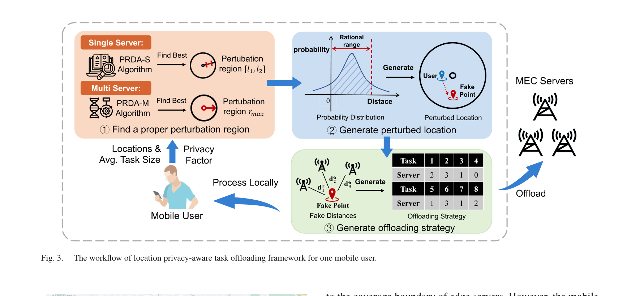
LPA-Offload Framework Workflow (Fig. 3)
Fig. 3 — Workflow of LPA-Offload for one mobile user [Page 7]
① Find Perturbation Region
② Generate Perturbed Location
③ Generate Offloading Strategy
PRDA-S / PRDA-M Algorithm
Bounded Laplace PDF (Eqs.18/19)
Traversal (single) / GA (multi)
Source: Section IV-A | Page 6–7 | Fig. 3

Slide 8
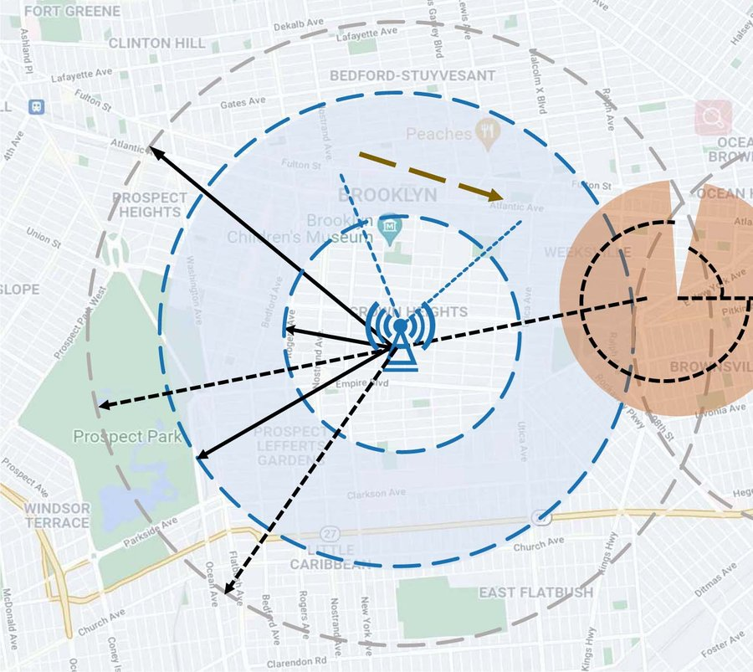
Location Perturbation: Single-Server + Fig. 4 Map
PDF for Distance Perturbation [Eq. 18, Page 6–7]:
pdf(l*|l) = { (ε/2Δl)·e^(−|l*−l|/Δl)·(1/K), l* ∈ [l₁,l₂]
{ 0, otherwise
K = 1 − ½·e^((l₁−l)/Δl) − ½·e^(−(l₂−l)/Δl)
Δl = l₂ − l₁ ; [l₁,l₂] ⊆ [0, l_max]
Theorem 2 — ε-DP Proof [Page 10]:
Pr(l*|l)/Pr(l*|l') = exp(|l*−l'|−|l*−l|/Δl) ≤ exp(|l−l'|/Δl) ≤ e^ε ✓ satisfies ε-DP
Why Redesign Laplace?
Fig. 4 — Location Perturbation: single (User₁) & multi-server (User₂) [Page 7]
Standard Laplace spans (−∞,+∞). Servers only cover [0,l_max]. Perturbation outside coverage makes no sense, so the PDF is clipped and renormalised to [l₁,l₂].
Source: Section IV-B | Pages 6–7 | Eq. 18 | Theorem 2 | Fig. 4

Slide 9
Location Perturbation: Multi-Server Scenario
2D Perturbation PDF — Multi-Server [Eq. 19, Page 7]:
Dε,R(r,θ) = (1/(θ₂−θ₁)) · (ε/2Δr) · e^(−εr/Δr) · (1/Z)
for r∈[0,R], θ∈[θ₁,θ₂] ; else 0
Z = (1−e^(−ε))/2 ; Δr = R
Λ* = (a + r·cosθ, b + r·sinθ)
Valid Angle Range [θ₁,θ₂] — stay inside coverage [Eq. 20, Page 7]:
θ₁ = −(π + arccos[(R²+(a−a₁)²+(b−b₁)²−L₁²) / (2R√((a−a₁)²+(b−b₁)²))] − arctan[(b−b₁)²/(a−a₁)²])
θ₂ = arccos[(R²+(a−a₂)²+(b−b₂)²−L₂²) / (2R√((a−a₂)²+(b−b₂)²))] − arctan[(b−b₂)²/(a−a₂)²]
Theorem 3 — (ε,δ)-DP Proof [Page 10]:
Pr(Λ*|Λ)/Pr(Λ*|Λ') = (θ₂'−θ₁')/(θ₂−θ₁) · e^ε ≤ e^ε + δ where δ = [(θ₂'−θ₁')/(θ₂−θ₁)−1]·e^ε·Pr(Λ*|Λ)
Source: Section IV-B & Theorem 3 | Pages 7, 10 | Eqs. 19, 20

Slide 10
Privacy Leakage Measurement (KL Divergence)
Privacy Leakage — Single-Server [Eq. 23, Page 8]:
PL[l₁,l₂] = −log ∫_{l₁}^{l₂} Q(l*|l) · log[ Q(l*|l) / P(l*|l) ] dl*
Privacy Leakage — Multi-Server [Eq. 24, Page 8]:
PL_R = −log ∫₀^R ∫_{θ₁}^{θ₂} Q(Λ*|Λ) · log[ Q(Λ*|Λ) / P(Λ*|Λ) ] dθ dr
Experimental Metric [Page 11]:
Average Cost Metric [Page 11]:
Privacy Leakage = (1/H) · Σⱼ I(dⱼ* ≤ d_min)
I(·) = 1 if perturbed location within d_min of real
H = total number of perturbation runs
AvgCost = (1/H) · Σⱼ C(j)
C(j) = computation cost at trial j
(real location, fake-derived strategy)
Insight: Larger perturbation region → lower PL (better privacy) but higher computation cost. KL divergence quantifies how much an adversary can distinguish real from perturbed location.
Source: Section IV-C & VI | Page 8, 11 | Eqs. 23, 24

Slide 11
Multi-Server Offloading: NP-Hard & Genetic Algorithm
Theorem 1: Offloading = NP-Hard [Page 9]
GA — Offloading Strategy [Page 9–10]
Special case (λ=0, ω=0, equal latency):
min_χ max_{k∈N} Σᵢ xᵢk·Dᵢ
s.t. Σk xᵢk ≤ 1, xᵢk ∈{0,1}
≡ Makespan min on parallel machines
→ NP-hard [Pinedo & Hadavi, 1992]
① Init s=200 random chromosomes
② Evaluate utility U = −[(1−ω)C + ω·PL]
③ Select s·α parents (α=0.7)
④ Crossover + mutate (β=0.2)
⑤ Keep top-s; repeat until convergence
⑥ Max-utility chromosome = χ*
Chromosome Encoding [Fig. 5, Page 10]:
Chromosome Gᵢ = [4, 3, 0, 2, 5]
→ t₁→s₄ t₂→s₃ t₃→local t₄→s₂ t₅→s₅
Utility: U = −[(1−ω)·C(χ) + ω·PL(χ)]
Settings: s=200 | α=0.7 | β=0.2 | Python, Intel i5, 8GB RAM
Source: Section IV-D & Theorem 1 | Pages 9–10 | Fig. 5

Slide 12
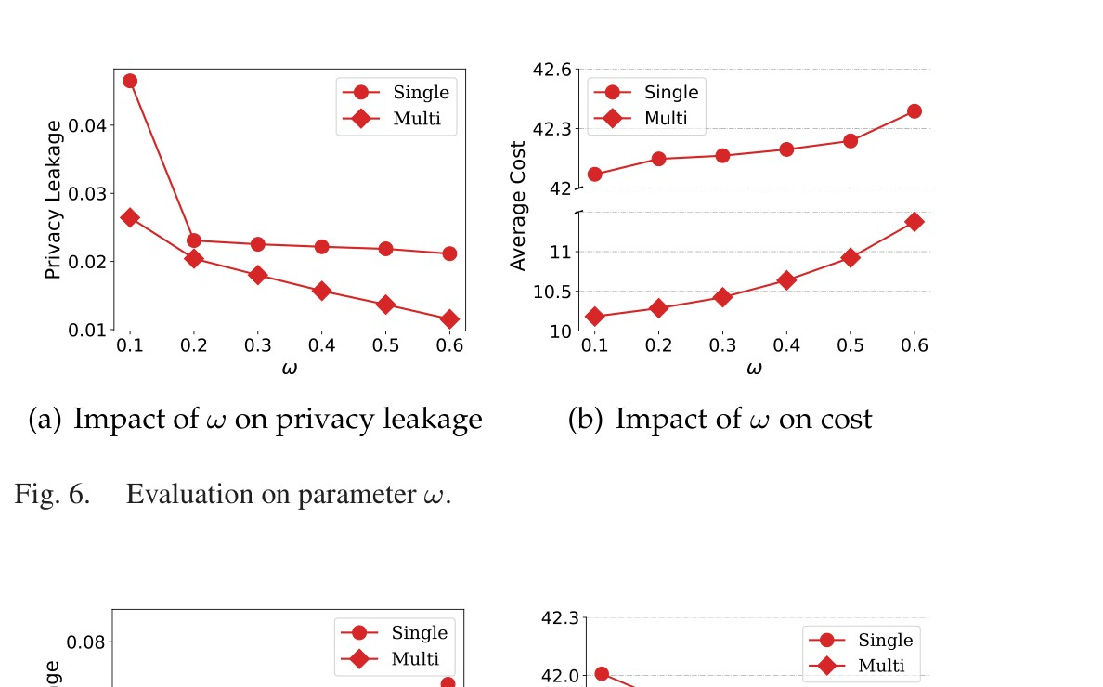
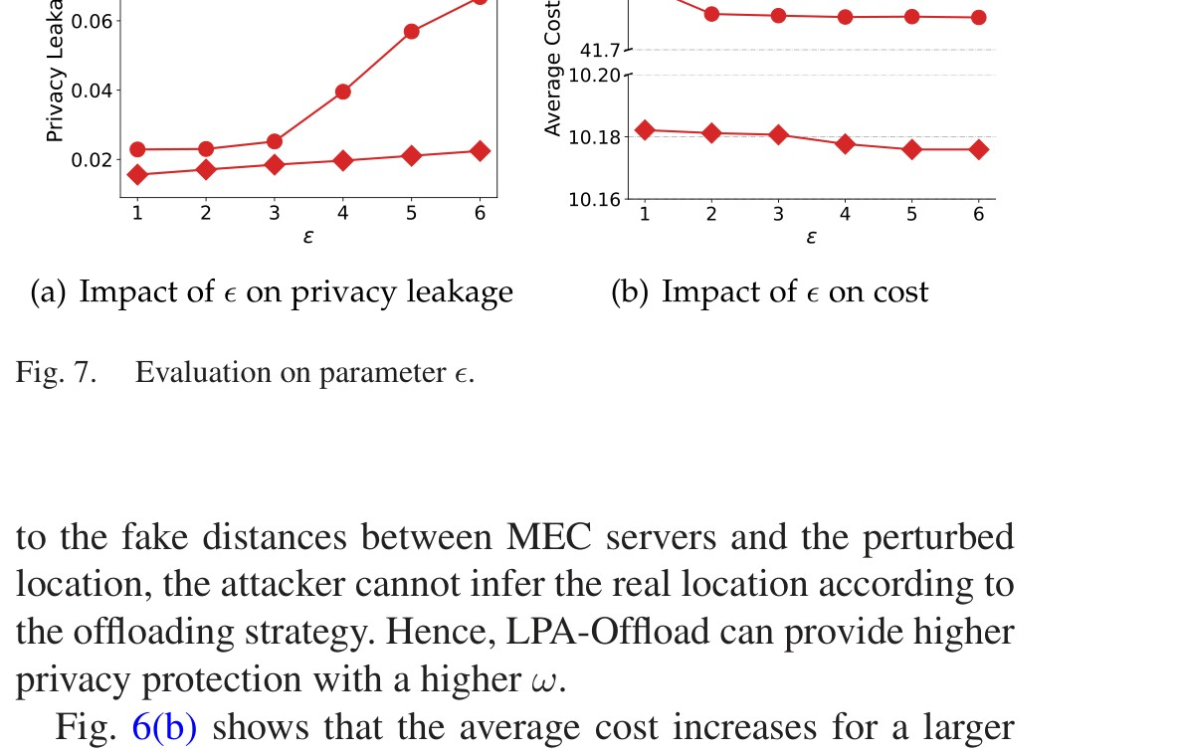
Parameter Evaluation: ω & ε Effects (Figs. 6 & 7)
↑ω → ↓ Privacy Leakage
Higher privacy factor → larger perturbation region → fake location farther from real → attacker cannot infer position
↑ω → ↑ Avg Cost
Larger region → fake location farther → offloading strategy deviates more from optimal → higher computation cost
↑ε → ↑ Privacy Leakage
Fig. 6 — PL & Cost vs ω (privacy factor) [Page 11]
Larger ε = weaker guarantee → perturbed location stays close to real → higher leakage risk, but lower cost
Multi < Single Cost
More parallel servers reduce computing delay. Smaller cost prompts system to expand perturbation region, so privacy leakage also drops.
Source: Section VI-A | Page 11 | Figs. 6, 7
Fig. 7 — PL & Cost vs ε (privacy budget) [Page 11]

Slide 13
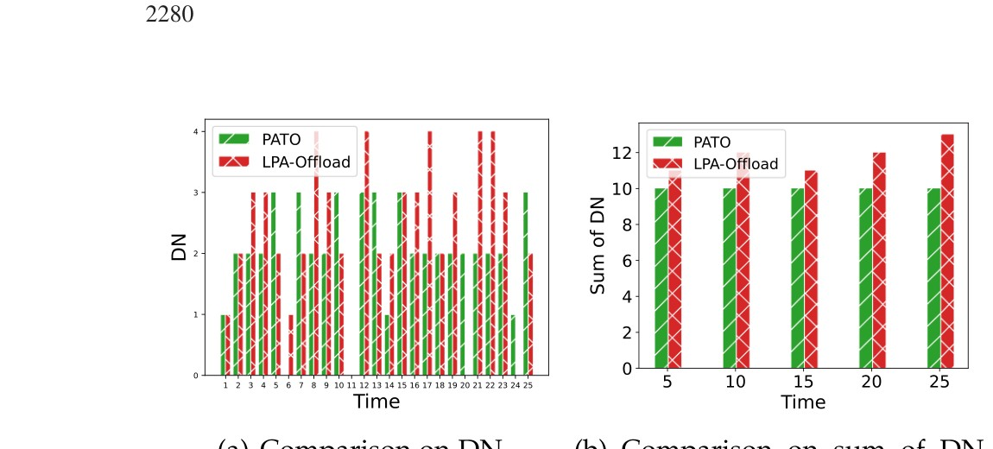
Inference Attack Evaluation (Fig. 8)
Fig. 8 — DN comparison PATO vs LPA-Offload (left: per time slot, right: sum over 5 slots) [Page 12]
PATO — Vulnerable ⚠
LPA-Offload — Resistant ✓
Why PATO Fails Long-Term
Sum of DN for 5 time slots = always 10 (constant). Attacker monitors this constant → deduces wireless channel conditions → infers real location over time.
DN varies randomly because differential privacy adds randomness to the offloading strategy. Attacker sees noise — cannot extract channel conditions or location.
PATO uses a static privacy threshold → constant difference between generated and offloaded tasks → attacker can track this regularity across time slots.
Source: Section VI-B | Page 12 | Fig. 8 | EUA Dataset (Melbourne)

Slide 14
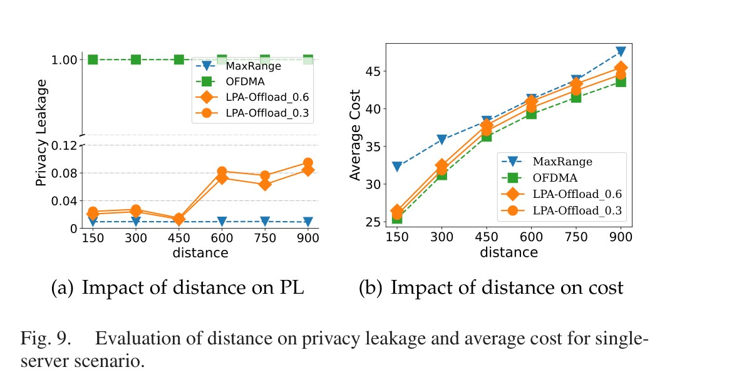
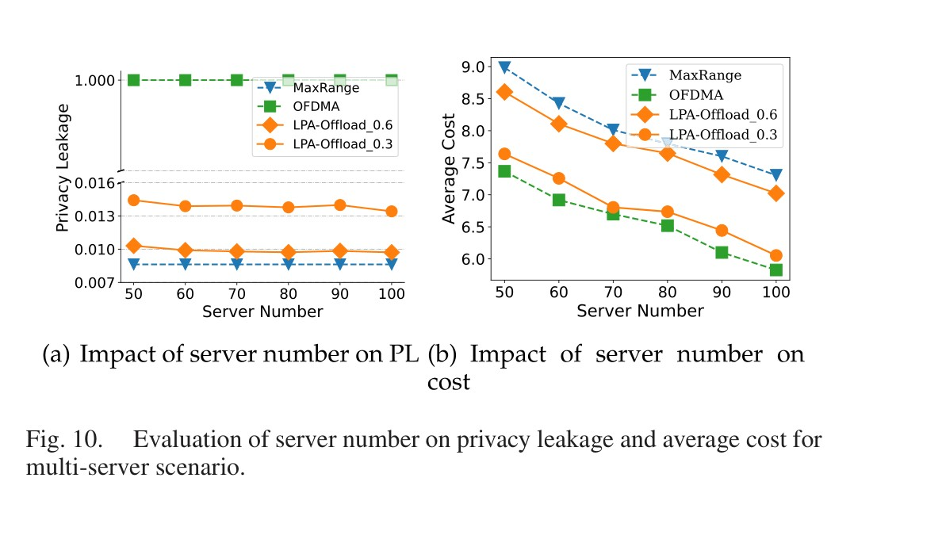
Performance vs Benchmarks (Figs. 9 & 10)
BENCHMARK COMPARISON
OFDMA [53]
PL: PL ≈ 1.0 (no protection) | Cost: Optimal
PATO [6]
PL: Static threshold, vulnerable long-term | Cost: Low overhead
Fig. 9 — PL & Cost vs Distance (single-server) [Page 12]
MaxRange
PL: Low PL (max region) | Cost: ~2× higher cost
LPA-Offload
PL: Low PL ≈ MaxRange | Cost: ≈ OFDMA ✓
Key: LPA-Offload achieves low privacy leakage comparable to MaxRange but at near-optimal computation cost — matching OFDMA which has zero privacy protection.
Source: Section VI-C | Pages 12–13 | Figs. 9, 10, 12
Fig. 10 — PL & Cost vs Server Number (multi-server) [Pages 12–13]

Slide 15
Benchmark Comparison Summary
Algorithm | Privacy Guarantee | Multi-Server | Inference Attack | Computation Cost | Personalized ω
OFDMA [53] | None (PL≈1) | ✗ | Vulnerable | Optimal | ✗
PATO [6] | Static threshold | ✗ | Vulnerable long-term | Low overhead | ✗
MaxRange | High (max region) | ✓ | Resistant | ~2× overhead | ✗
LPA-Offload (ours) | (ε,δ)-DP proven | ✓ | Resistant | ≈OFDMA | ✓
✔ LPA-Offload is the ONLY framework with: provable (ε,δ)-DP guarantee + multi-server collusion protection + personalized privacy factor ω + near-optimal computation cost.
Source: Section II, VI | Pages 3–4, 11–13

Slide 16
Conclusion
✓
LPA-Offload provides provable (ε,δ)-DP location privacy for BOTH single and multi-server MEC
✓
Three-stage pipeline: region determination → bounded Laplace perturbation → GA-based offloading
✓
Computation cost ≈ OFDMA (state-of-art without privacy) — privacy comes nearly for free
✓
Personalized ω lets users dynamically tune privacy-efficiency trade-off to their own needs
✓
Resistant to long-term inference attacks (unlike static-threshold methods like PATO)
IEEE TMC Vol. 23 No. 3 · DOI: 10.1109/TMC.2023.3254553

