Slide 1
GitHub Commits & Pull Requests
SISMID Lab
July 22 through July 24, 2026
A Human-AI Teaming Approach to Infectious Disease Modeling

Slide 2
Lecture Overview
Topic | Slides
1. General Housekeeping | 3
2. Lab Timeline | 4
3. Task Overviews | 5
4. Goal Output | 6
5. Task 1: GitHub Commits | 7–24
Commit via VS Code | 9–15
Commit via GitHub | 16–24
6. Task 2: Submitting a Pull Request | 25–30

Slide 3

General Housekeeping
Any slide with this icon contains the overview and
expected outputs for the included tasks. All outputs listed on these slides should be uploaded to the course GitHub repository for review.
Any slide with this icon indicates that it is time to complete a hands-on activity. Carefully follow the instructions provided, complete the required task, and verify your results.

Slide 4
Lab Timeline
We are here
Activity 1
Activity 2
Activity 3
Activity 4
Data Cleaning &
Visuals
Data
Exploration
Modeling & Forecasting
Evaluation
Activity 5 Incremental Revisions

Slide 5
Task Overviews
Task | Description
Task 1: GitHub Commits | Upload your output files to your GitHub fork. We cover two ways to do this: through VS Code and through the GitHub web portal.
Task 2: Submit a pull request | Open a pull request to merge the changes from your fork into the main class repository.

Slide 6
Goal Output
After completing this activity, you should have an updated GitHub fork with your results committed, and a pull request that merges those changes into the main class repository.
Activity Output | Description
Updated GitHub fork | Your output files committed and uploaded to your GitHub fork.
Pull request | A request to merge the changes in your fork into the main class repository.

Slide 7
Task 1: GitHub Commits (Uploading Results)
Notes:
Assumes Activity 1: Running R Code has been completed

Slide 8
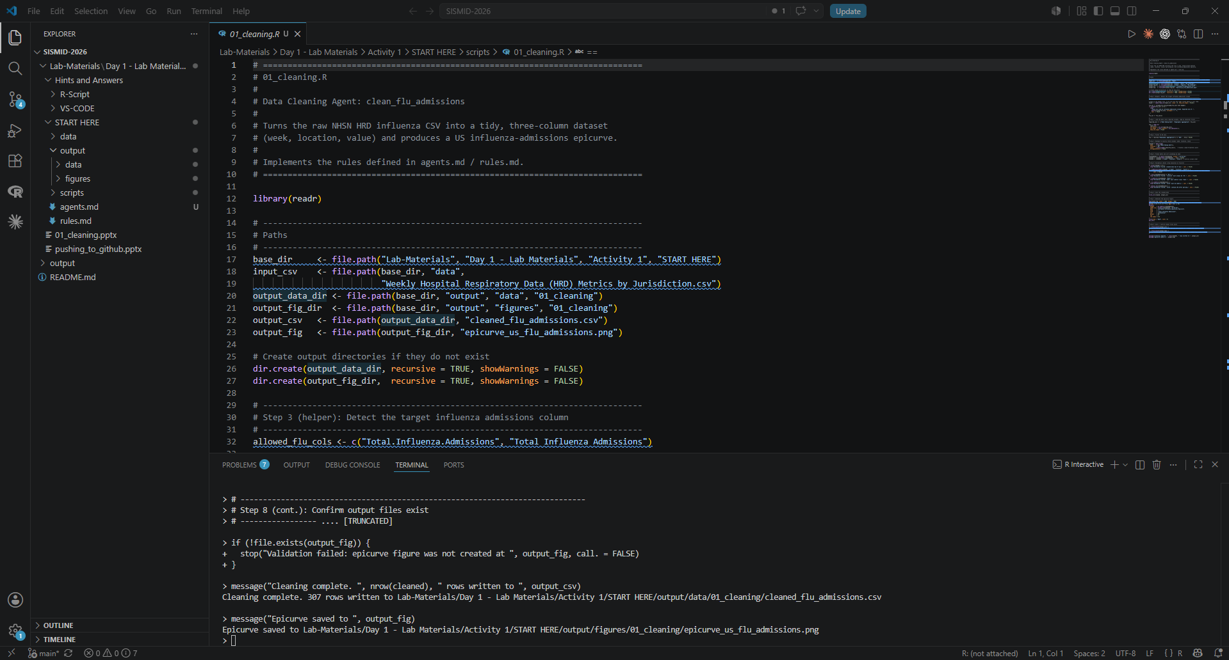
After completing Activity 1, you should now see an output folder, along with various figures and data files. We are going to walk through how to “push” or upload them to the course GitHub repository and your copy (fork). We will cover two ways of pushing to GitHub.

Slide 9
Commit via VS Code

Slide 10
Step 1: Open Source Control
The first thing we need to do is open the Source Control menu. This is the menu that allows us to version-control our changes and upload the changes to our forked repository in GitHub (copy of the course repository). To open the control menu, press: CTRL + SHIFT + G or click the icon on the left side of the screen.

Slide 11
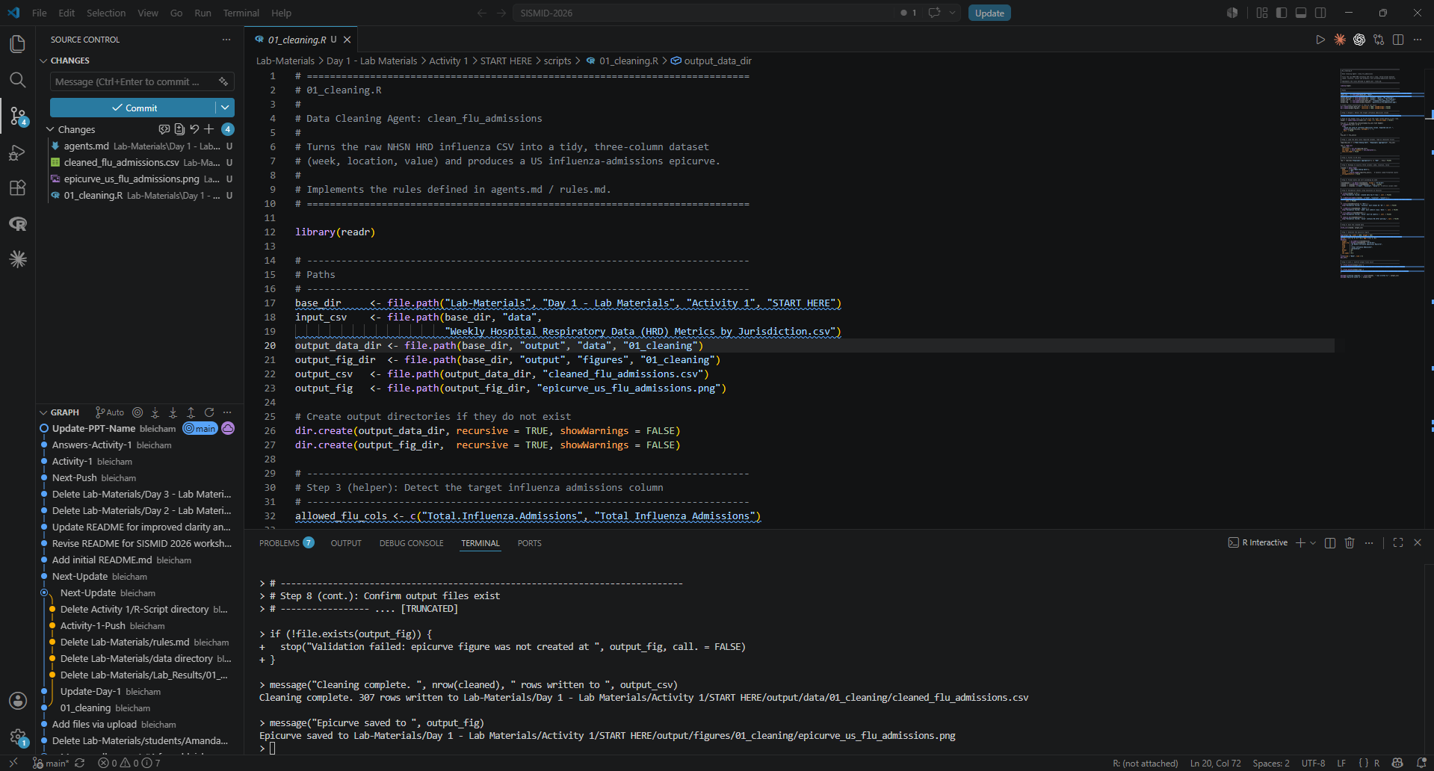
Step 2: Staging the Files
Staging files is how we tell Git which changes (files) to include in our next commit or upload. For this exercise, we will upload all files. In VS Code, this is achieved by clicking the + next to the ‘Changes’ drop down (Hint: Hover your cursor to see the options).

Slide 12
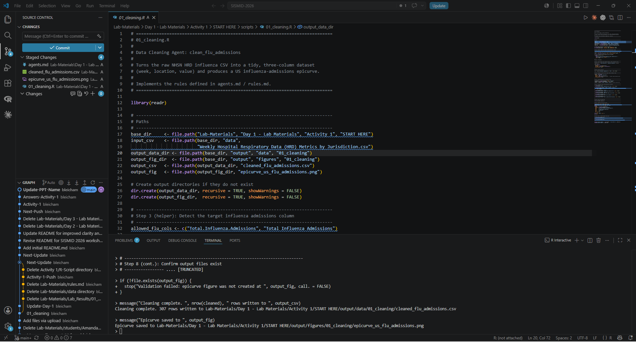
Step 3: Commit (Upload) to GitHub
After completing Step 2, you should now see that all of your changed files appear under the ‘Staged Changes’ drop down, rather than the ‘Changes’ drop down. Now, to start the process of moving these files to your GitHub repository (fork), we first need to provide a Commit message. This is a note or brief phrase indicating the change that is occurring with this upload. For our activity, we will type:
activity_1_upload
Finally, click Commit to begin the upload process.

Slide 13
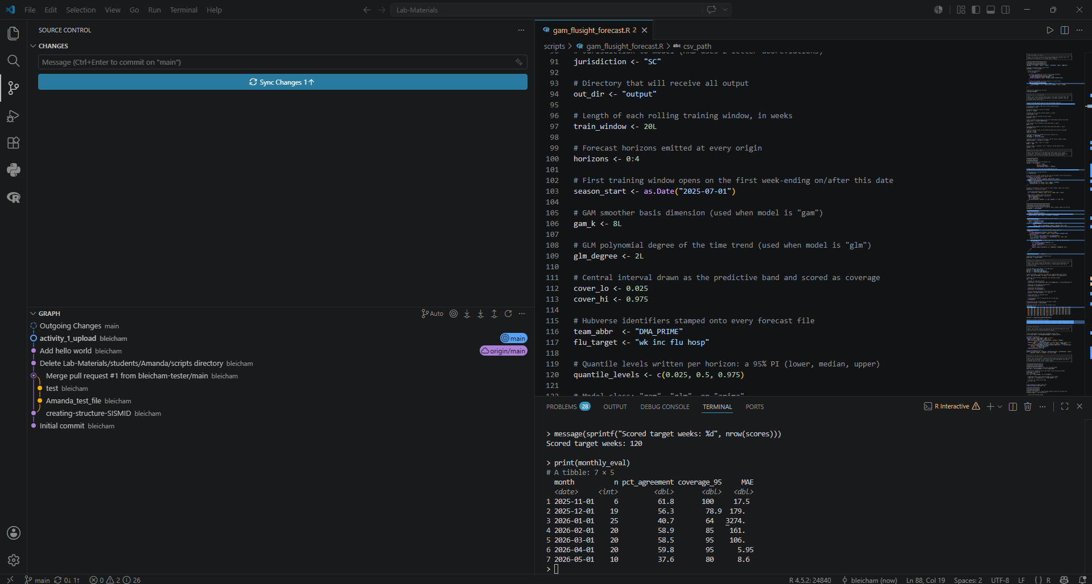
Step 4: Sync Changes
Syncing keeps your local work and the remote repository (GitHub) in agreement. When you click Sync Changes, VS Code does two things in one step: it pushes your committed changes up to the remote and pulls down any new changes made directly in GitHub. You'll find it at the bottom status bar or in the Source Control panel, often showing arrows with numbers, ↓ for commits waiting to come down, ↑ for commits waiting to go up. Committing saves your work locally; syncing is what shares it and brings you up to date. To sync your new changes, click Sync Changes.

Slide 14
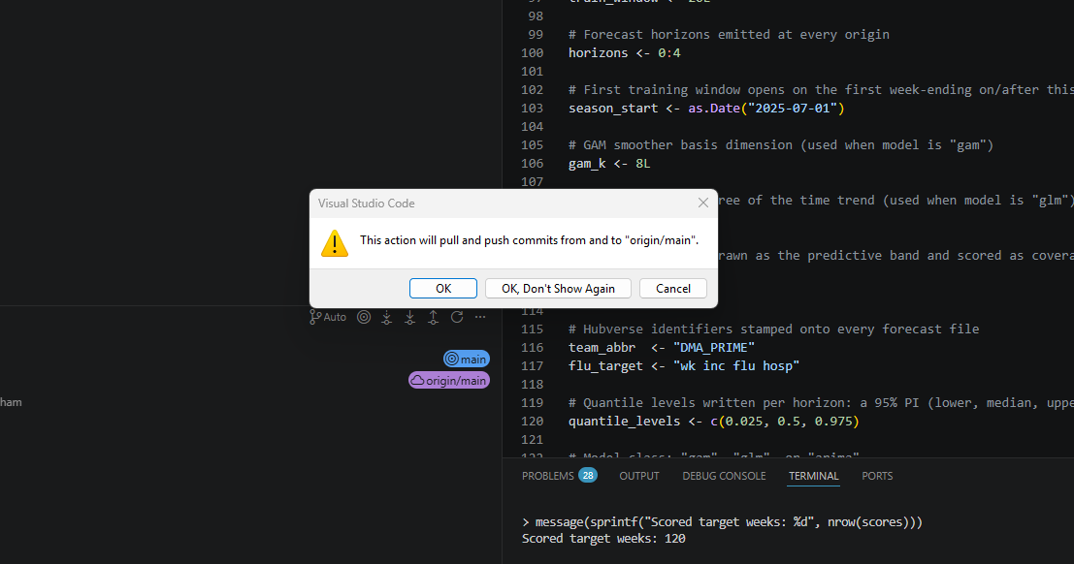
Step 5: Confirming Upload to the Main Branch
The main branch is your repository's official, up-to-date version of your project. It's what people see by default and what other branches typically merge back into once their changes are ready. Think of it as the trunk: experimental work happens on separate branches, but main holds the version you consider stable and current.
Click OK.
Note: You may be prompted to sign into GitHub after this step.

Slide 15
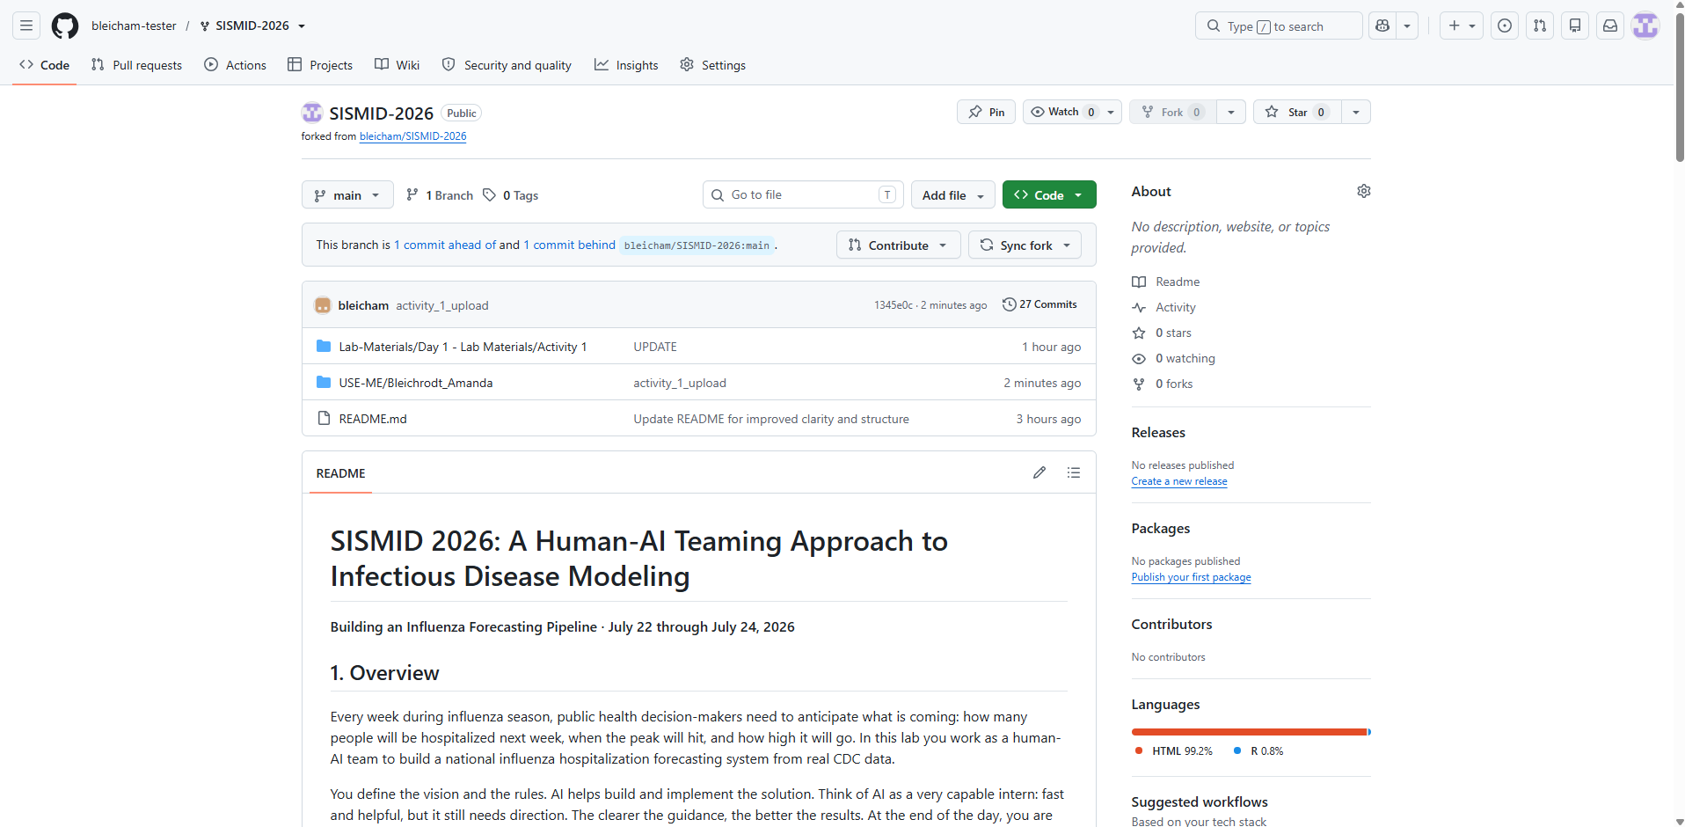
Step 6: Back to our Fork
Now, let’s double-check everything worked. First, navigate back to your forked repo and refresh the page. You should now see the newly committed (uploaded) folder within the USE-ME directory. As we continue through the lab, we will add more output to this folder.

Slide 16
Commit via GitHub
*Does not require Git download

Slide 17
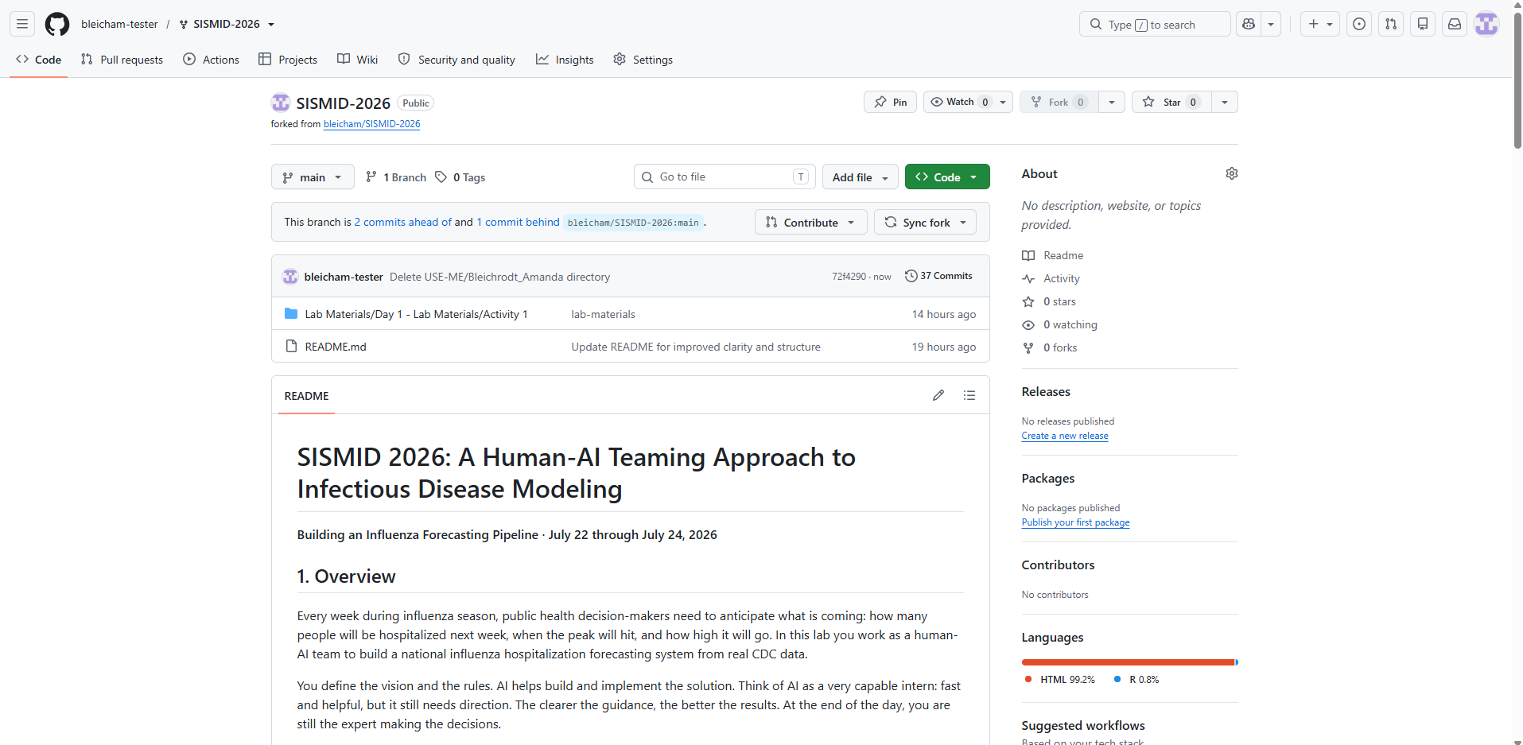
Step 1: Navigate to your GitHub Fork
We can also upload or commit our results via GitHub directly. This circumvents the need for the Git download we discussed earlier but takes a bit more time to upload files. First, you will want to navigate to your GitHub fork.

Slide 18
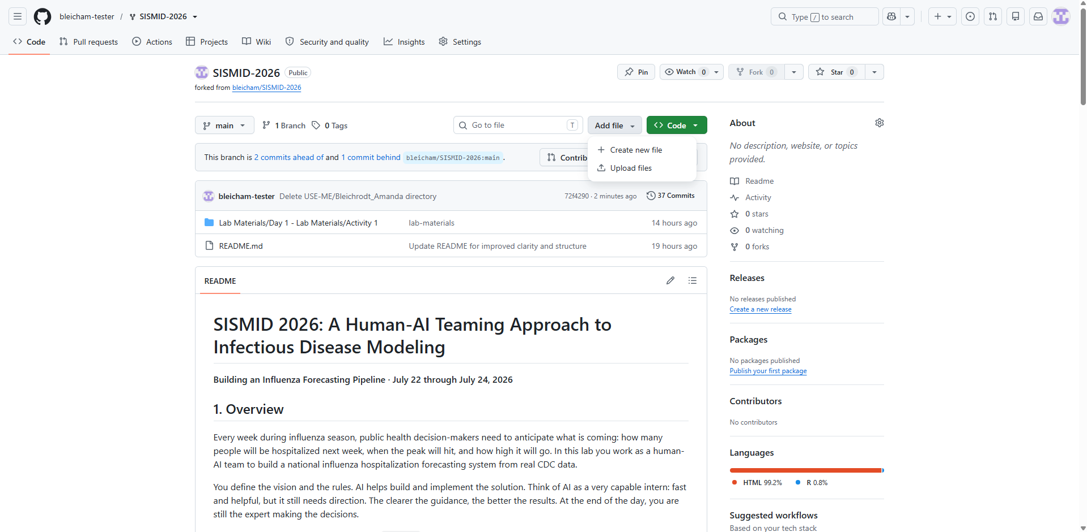
Step 2: Starting the Process of Uploading Files
To start the process of uploading our files, we first are going to click the Add file button in the upper right-hand corner.
As we already have the files on our local machine we want to upload to GitHub, we need to click Upload files rather than Create new file. This tells GitHub that we want to search our local machine rather than create something directly in GitHub.

Slide 19
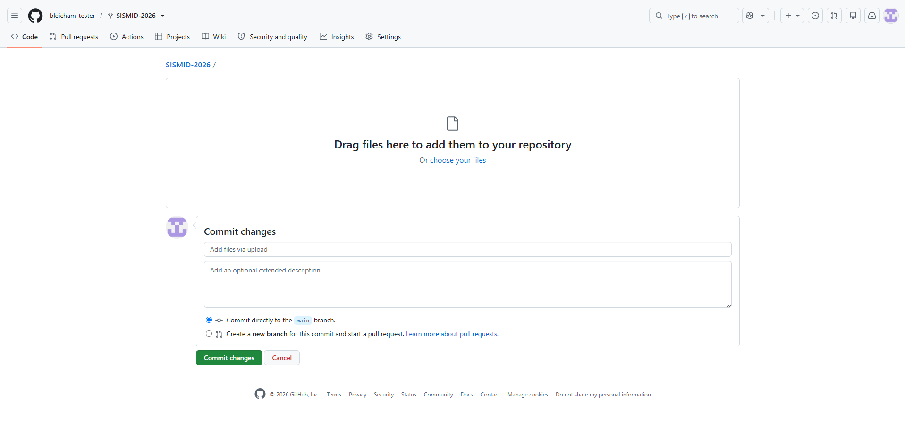
Step 3: Uploading the Files
To upload files, we are going to first click Choose your files. This will open our file explorer and allow us to drag over our entire USE-ME folder. GitHub does not allow you to select an entire folder to upload, only individual files. It will however let you drag over an entire folder, which is what we will do for this activity.

Slide 20
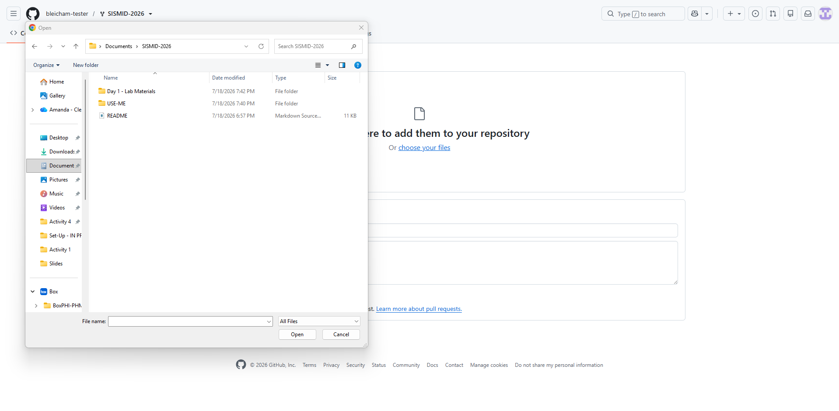
Step 4: Dragging the USE-ME folder
As discussed on the previous slide, we want to drag our USE-ME folder to GitHub. This ensures that the entire folder moves, and all files within the folder stay within it for the move.
To drag the folder, right click, and move your cursor over the Drag additional files here to add them to your repository rectangle on GitHub. Click Cancel to close out the popup.
Note: You may run into an issue where it says the folder is too big. If this happens, do not upload the data folder (i.e., the folder that contains the original data). You will have to remove this folder from the USE-ME folder prior to dragging into GitHub.

Slide 21
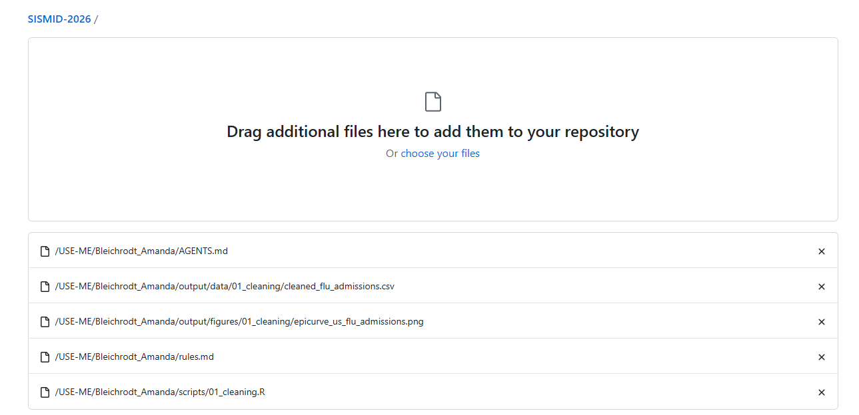
Step 5: Checking the Uploads
After dragging over the folder, you should see each individual component included within, as well as their respective file paths. If you notice any issues, please let us know and we can help debug!

Slide 22
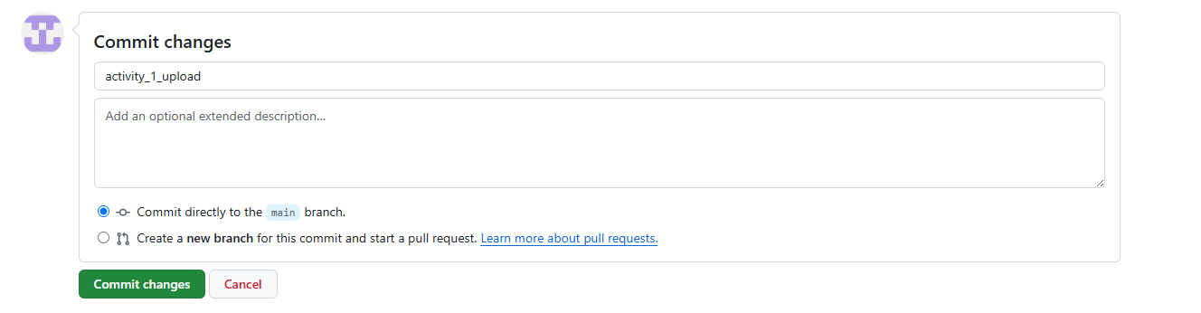
Step 6: Commit Changes
We are now ready to save our files to GitHub. First, GitHub asks us to give the change a short title, called a commit message. Delete the default text in the top box (it reads Add files via upload) and type activity_1_upload instead. Then click the green Commit changes button. From now on, always write clear commit messages, so you can easily tell what each change did later.

Slide 23
Step 7: Back to our Fork
Now, let’s double-check everything worked. First, navigate back to your forked repo and refresh the page. You should now see the newly committed (uploaded) folder within the USE-ME directory. As we continue through the lab, we will add more output to this folder.

Slide 24
Please note: When you update GitHub, you only need to upload the files that you changed. If a file did not change, do not re-upload it. This keeps you under GitHub's web upload limits, which only apply when you use the web portal.

Slide 25
Task 2: Submitting a Pull Request (Merging your fork and the class repository)
Notes:
Assumes Activity 1: Running R Code has been completed

Slide 26
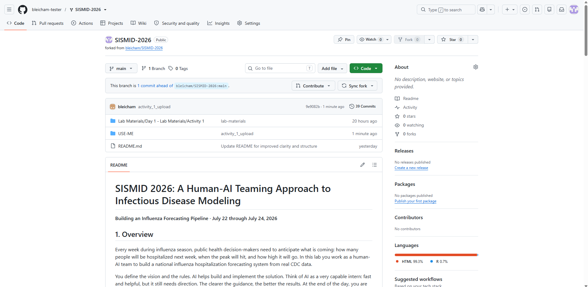
Step 1: Starting the Pull Request process
Now that we have updated our fork, we need to combine our updates with the main course repository. The goal of this is to get some additional practice with GitHub, including submitting a Pull Request. As a reminder, a Pull Request is a way of asking the owner of the main project to review the changes you made in your fork and add them to the original repository. In other words, you are saying, “Here is what I changed. Please pull it into the main project.”
Click Contribute to start this process.

Slide 27
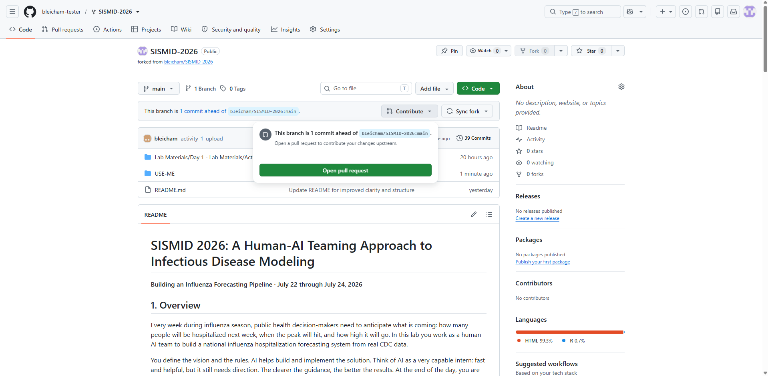
Step 2: Open the Pull Request
Next, we need to formally open the pull request. To do so, click Open pull request.

Slide 28
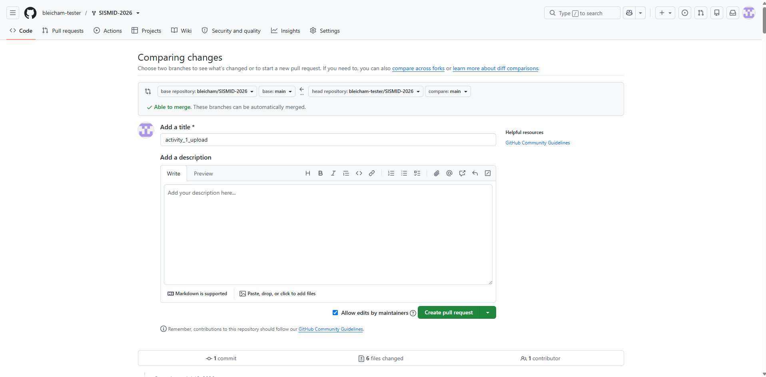
Step 3: Comparing changes
We do not need to do much on this page (everything should auto-populate). To finish submitting the pull request, click Create pull request.

Slide 29
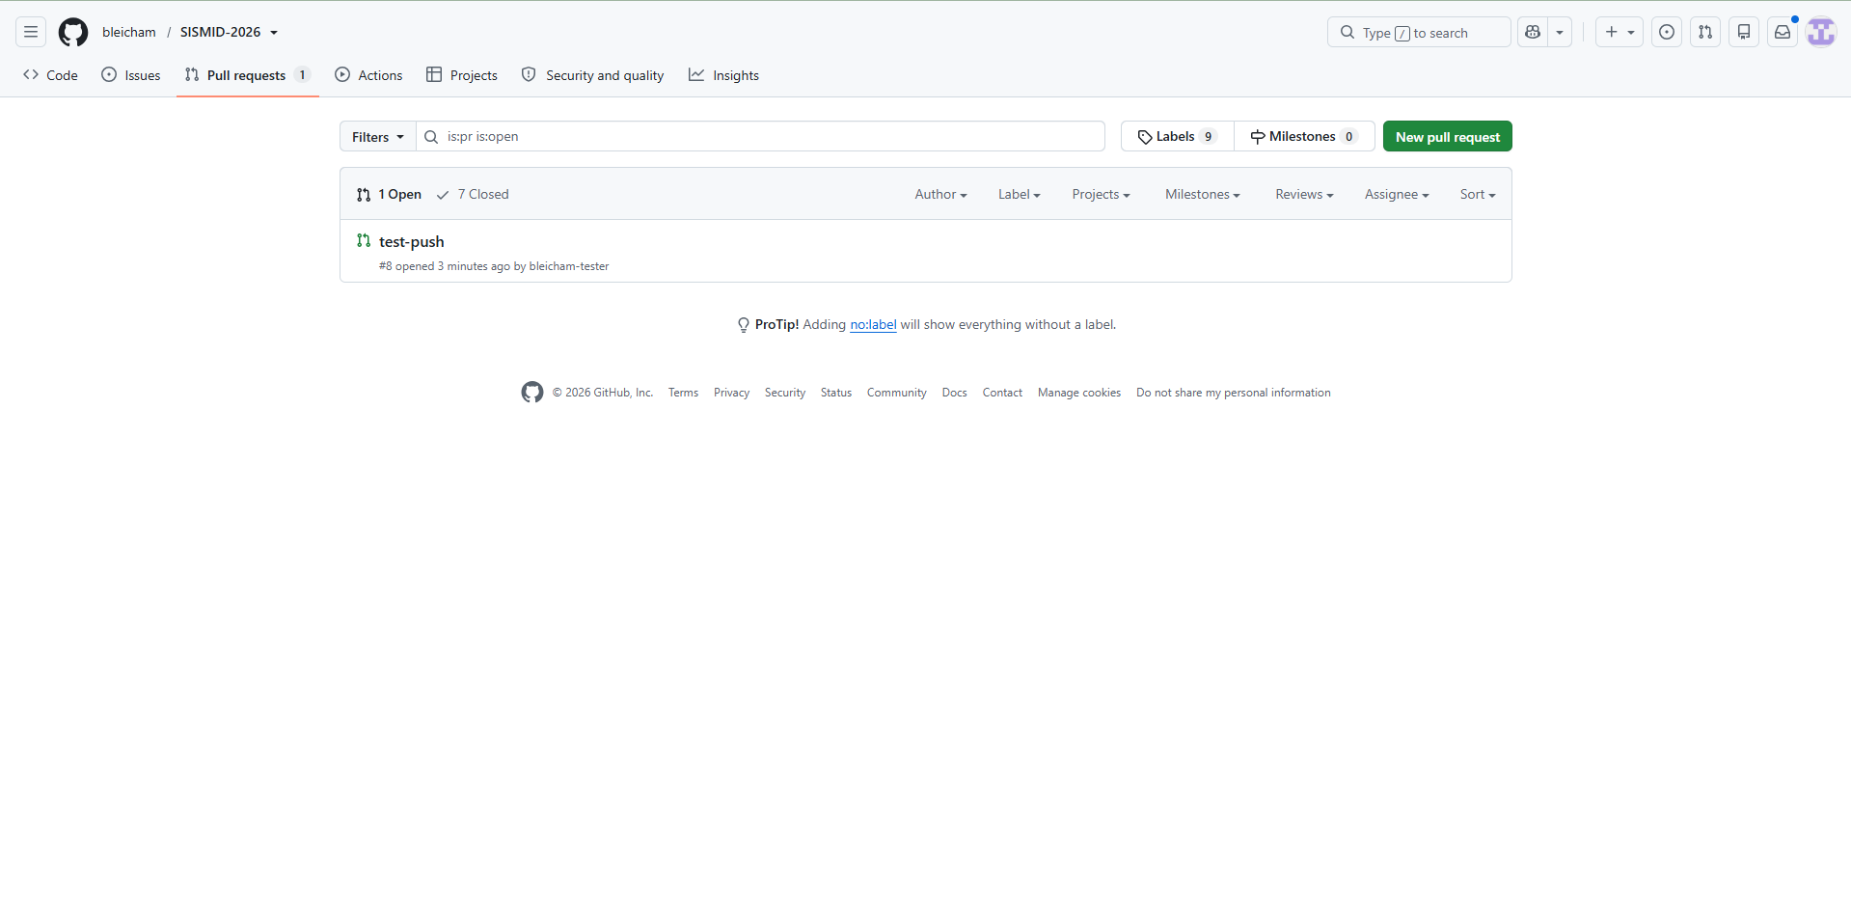
Step 4: Viewing the Pull Request
Our Pull Request has now been created. To view it, open the Pull requests tab at the top of the course repository. Any open requests are listed here, so ours, test-push, shows up as 1 Open. Click its title to see the details, including the changes we submitted and any comments from the reviewer.

Slide 30
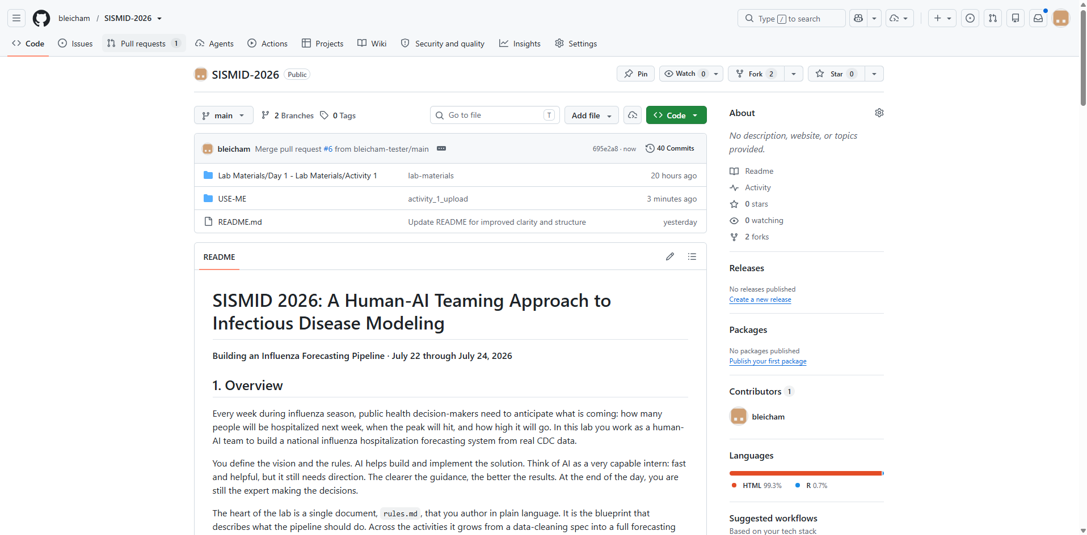
Step 5: Viewing the Merged Pull Request
Our Pull Request has now been merged, which means the changes from our fork are now part of the main repository. You can see this at the top of the file list, where the latest commit reads Merge pull request #6. The files we uploaded now appear in the repository.

Slide 31
Important Reminder
Every time you commit changes to your fork, remember to also submit a pull request to the course repository. This keeps your updates merged into the class repo so everyone stays in sync.

