Slide 1
Introduction to GitHub
SISMID Lab
July 22 through July 24, 2026
A Human-AI Teaming Approach to Infectious Disease Modeling

Slide 2
Lecture Overview
Topic | Slides
1. General Housekeeping | 3
2. Task Overviews | 4
3. Goal Output | 5
4. Course Format Note | 6
5. GitHub Overview | 7–13
6. Activity: Forking GitHub | 14–20
7. Exploring the Lab Materials Folder | 21–23
8. Exploring the USE-ME Folder | 24–27

Slide 3

General Housekeeping
Any slide with this icon contains the overview and
expected outputs for the included tasks. All outputs listed on these slides should be uploaded to the course GitHub repository for review.
Any slide with this icon indicates that it is time to complete a hands-on activity. Carefully follow the instructions provided, complete the required task, and verify your results.

Slide 4
Task Overviews
Task | Description
Task 1: Forking GitHub | We will walk through how to fork the course repository on GitHub to create your own personal copy. You will create the fork, navigate to it, and open it so it’s ready to work in during the lab.

Slide 5
Goal Output
From the activity (see previous slide), you should get your own fork of the lab’s GitHub repository — a personal copy of the course repo hosted under your own GitHub account. By the end, your fork will be ready to open and work in during the lab.
Activity Output | Description
Your fork — github.com/your-username/course-repo | A personal copy of the lab’s GitHub repository saved under your own GitHub account, which you fully control — browse files, make changes, and open pull requests throughout the lab.

Slide 6
A quick note before we dive in: This is an AI course — not an intro to GitHub. The tools we'll touch on are just that: tools, meant to support the real work, which is your modeling. We'll give you enough to feel confident and keep moving. And if you hit a snag along the way, don't worry — this is just a small piece of the picture, not the focus. If something sparks your curiosity or you want to go further, our door is always open.

Slide 7
GitHub Overview

Slide 8




What Is GitHub?
GitHub is a platform for storing, sharing, and collaborating on code and files. Think of it as a shared folder in the cloud — but with version history, quality checks, and structure.
Repository
Fork
A collection of folders on GitHub. Our class has one shared repository, made up of many folders.
Your own copy of the class repository on your GitHub account. You work here freely without affecting the original.
Commit
Pull Request
How you will upload your local changes from VS Code to GitHub. We will walk through this together after Activity 1 (Data Cleaning).
A request to merge your work into the main repository.

Slide 9

Key Tabs You'll Use
You don't need to know everything on GitHub for the labs — just these two tabs.
Browse all files in the repository. This is the home page. You'll see the shared data folder and all student folders here. Click into folders to see their contents.
Code
This is where you turn in your work. After you commit your changes, open a pull request here. You can see where your work sits in the queue to be merged and follow its status along the way.
Pull
Requests

Slide 10
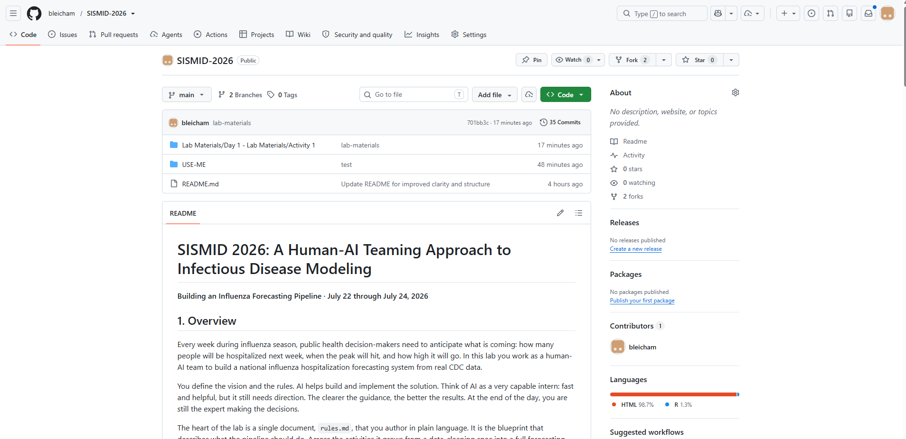
Our Course’s Repository

Slide 11
Lab Materials Folder: The Lab Materials folder contains the lab lectures and completed labs for all activities.
USE-ME Folder: The USE-ME folder is what we will primarily be working out of for the lab activities. It is where we will upload our results for each activity. We can think of it like a shared folder to store our labs.
Code Tab
The Code tab contains the repository’s files and folders, branch selector, commit history, and README file. Think of it as the main folder directory for the project.

Slide 12
Pull Requests Tab
A pull request (PR) is a proposed change to the main repository. The Pull Requests tab is where contributors submit changes, discuss updates, review code, and merge approved changes into the project. We will walk through how to create a pull request later in the lab.

Slide 13

Lab Workflow: How will we use GitHub?
Work Locally (Fork)
Commit to GitHub
Submit a Pull Request
Edit rules, generate code,
run scripts in VS Code.
Each time you make a change in your repository, you will also want to submit a ‘pull request’ to the course page.
Upload changes to your GitHub fork. Therefore, you will always have a GitHub-based repository with the code developed in this module.
You will repeat this cycle for each phase of the lab. Commit early and often — the agent gives you feedback each time and helps you keep a record of all your changes.

Slide 14
Activity: Forking GitHub

Slide 15
What Is a Fork?
A fork is your own complete copy of a repository on your GitHub account.
You can freely edit your fork without affecting the original.
When you're ready, you submit a pull request to merge your changes back.

Slide 16
Starting with the Course Repository
Step 1: Clicking ‘Fork’
To start the process of creating your ‘Fork’ of our GitHub repository, click the ‘Fork’ button in the upper right corner of the repository.

Slide 17
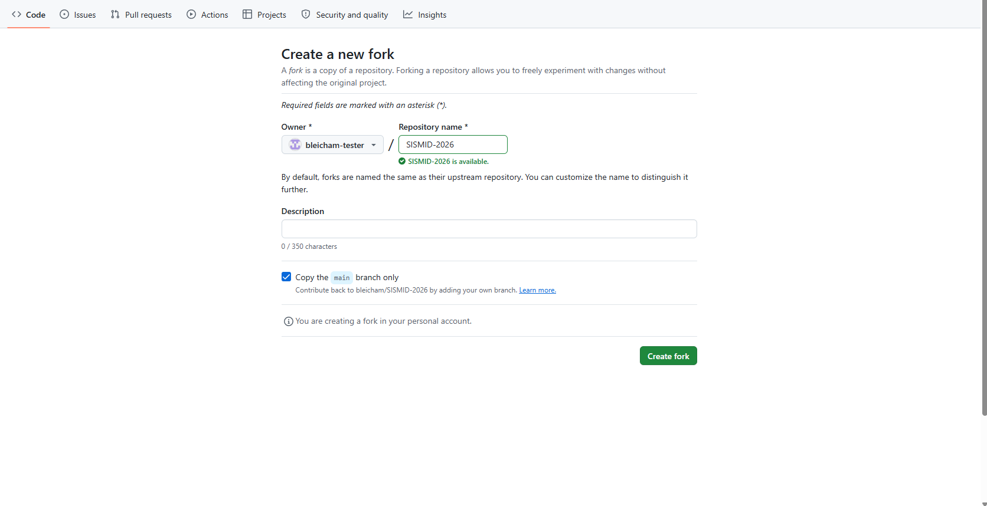
Step 2: Creating a New Fork
Prior to clicking the ‘Create fork’ button, you can set some customizations such as the name of the repository. You will also want to double-check that the correct `owner` is selected.
Once you are ready to copy the repository over to your account, click the ‘Create fork’ button.

Slide 18
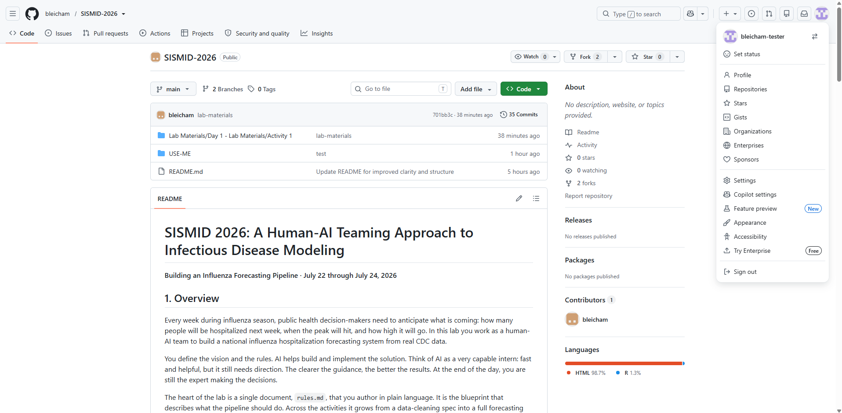
Navigating to our Fork
Step 3: Navigating to our Fork
Now that we have created our fork, or copy, of the course repository, we need to navigate to it within the list of our own repositories.
First, click on your GitHub icon in the upper right-hand corner. Next, click the Repositories menu option. This will open the list of all repositories that you own under this GitHub account.

Slide 19
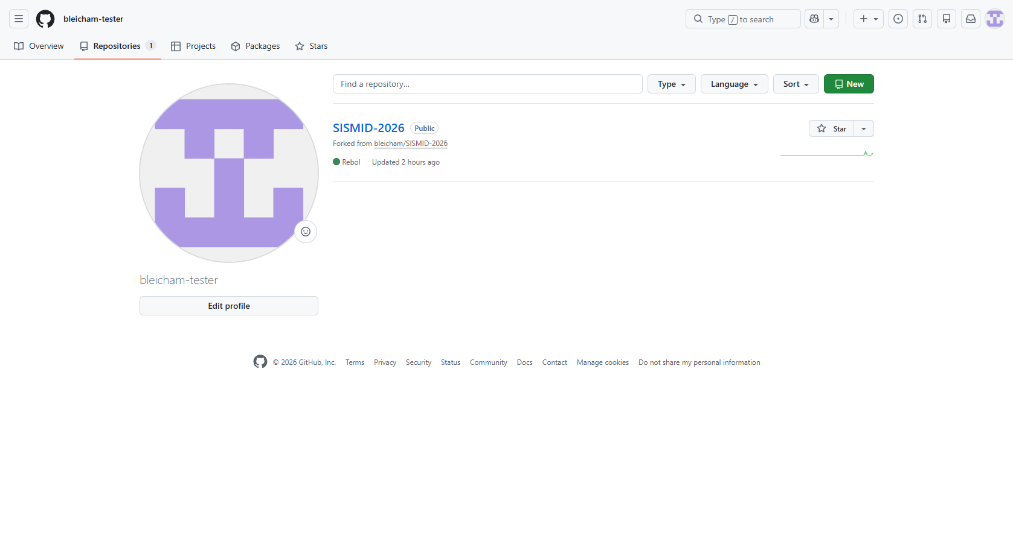
Step 4: Opening the Fork
Now that we have navigated over to our own GitHub repositories page, we need to open the fork. To do so, click the title of the repository (Blue title).

Slide 20
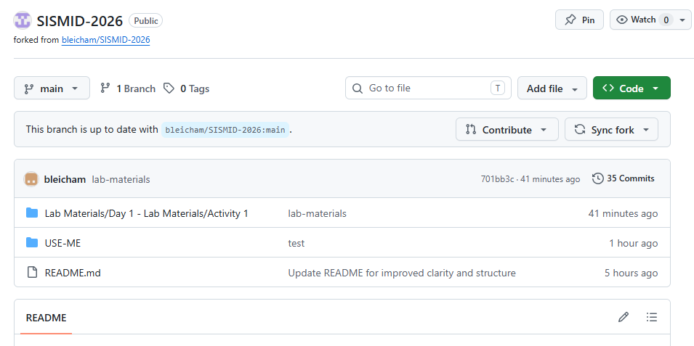
You should now see your fork (personal copy) of the course GitHub repository in your own GitHub account.
At the top of the page, you should see a message indicating that your branch is up to date with the original repository, along with Contribute and Sync fork buttons. We will discuss different ways to contribute changes back to the original repository later in the lab.
The Sync fork button allows you to pull in updates from the original repository, ensuring that your fork remains current with the latest changes.

Slide 21
Exploring the Lab Materials Folder

Slide 22
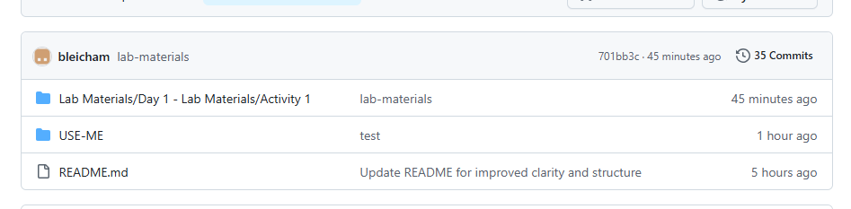
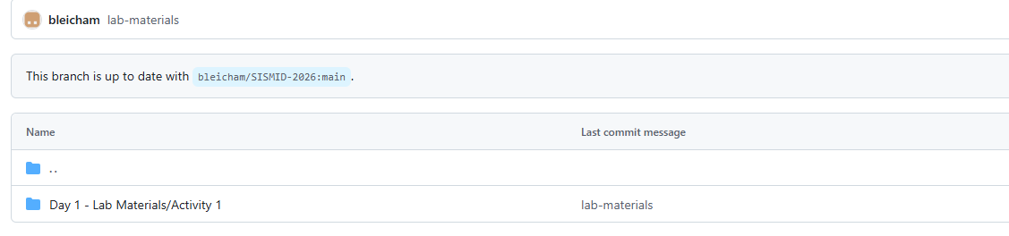
Directory Structure
Step 1: Opening the Lab Materials folder
To open the Lab Materials folder, first click the Lab Materials folder row on the main GitHub page.
Step 2: Activity Files
When you first open the Lab Materials folder, you will only see the Day 1 folder. Each day, a new folder will be added to this folder. To open, click the Day 1 row.

Slide 23
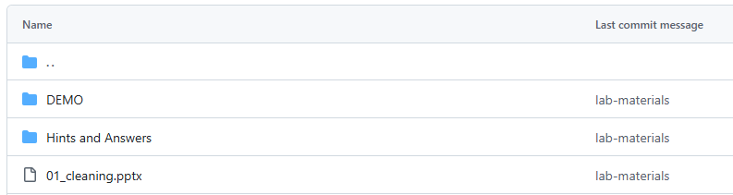
Step 3: Exploring the Activity folder structure
Although we're looking at the Day 1, Activity 1 folder, all Lab Materials folders follow the same format. Each contains a (1) Demo, (2) Hints and Answers, and (3) the PowerPoints for that activity.
Demo: The starting point for the lab. If you fall behind or get stuck as we move between activities, you can grab the starting materials here instead of building off your own. We will grab the contents of this folder in a bit (we will do this together).
Hints and Answers: The completed labs in VS Code along with the base R scripts.
PowerPoints: What we will review for each lab. These are also available on the course website.

Slide 24
Exploring the USE-ME Folder

Slide 25
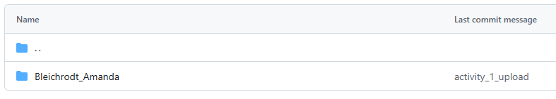
Directory Structure
Step 1: Opening the USE-ME folder
To open the USE-ME folder, first click the USE-ME folder row on the main GitHub page.
Step 2: Example Folder
As we move through the lab, you will see more folders show up here (one per person). We will cover the set-up in the next slide deck.

Slide 26
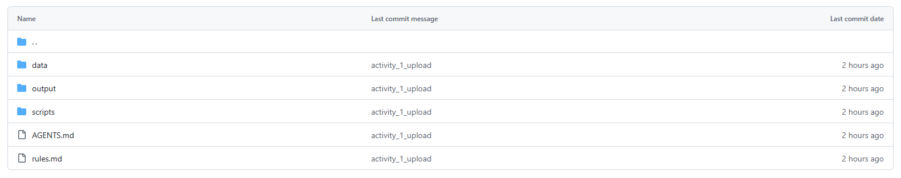
Step 3: Exploring the folder structure
Your named folder will contain five main items: (1) data, (2) output, (3) scripts, (4) AGENTS.md or agents.md, and (5) rules.md. As we move through each stage of the labs, we'll create and add these folders and files. The next slide covers the lab structure in more detail.
data: Contains the input data for the labs.
output: Where all lab output is saved; it's broken into several subfolders (see next slide).
scripts: Where each lab script is saved.

Slide 27
Final Directory Structure: Your Folder
NAMED FOLDER/
├── rules.md
├── AGENTS.md or agents.md
├── data/
│ └── Weekly Hospital Respiratory Data (HRD) Metrics by Jurisdiction.csv
└── output/
├── scripts/
│ ├── 01_cleaning.R
│ ├── 02_data_explore.R
│ ├── 03_forecast.R
│ ├── 04_evaluation.R
│ └── 05_improvements.R
├── data/
│ ├── 01_cleaning/
│ ├── 02_data_explore/
│ ├── 03_forecast/
│ ├── 04_evaluation/
│ └── 05_improvements/
└── figures/
├── 01_cleaning/
├── 02_data_explore/
├── 03_forecast/
├── 04_evaluation/
└── 05_improvements/
Notes:
Just a quick note of where we are headed – next slide deck will cover this in a little bit more detail.

