Slide 1

Speed Dating
Alejandro Salvat
Maxime
Daniel
Pol Pérez

Slide 2
Index
Data Preprocessing
Data cleaning
Imputation of null values
Errors values
Outliers treatment
Descriptive analysis
PCA
Clustering
Profiling
Conclusions

Slide 3
Topics, goals and urls
Is there any separability in how much you have been liked among the participants?
Which attributes of a partner do participants attach most importance to?
https://www.kaggle.com/datasets/ulrikthygepedersen/speed-dating

Slide 4
Data mining process
Data collection
Data selection
Data cleaning & preprocessing
Descriptive Analysis
Profiling
Clustering
PCA

Slide 5
Data cleaning
Reducing the size of our dataset
Changing the format of the values
Erase variables with unacceptable number of null values
d’0’ → 0
d’1’ → 1
8378 x 123
expected_num_interested_in_me
[0…1] → 1
[1…2] → 2
[2…3] → 3
.
.
.
[9…10] → 10
79%
NULL
8378 x 25

Slide 6
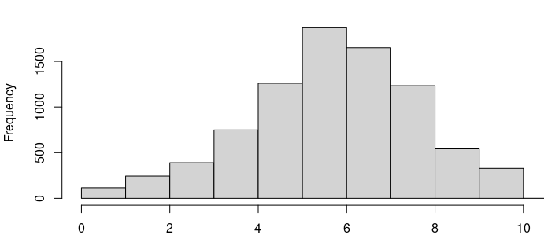
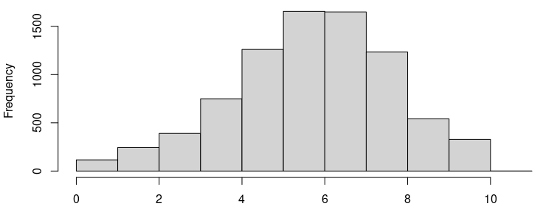
Preprocessing - Imputation of null values
Numerical variables: Mean Imputation
Histogram without imputation Histogram with mean imputation
Categorical variables: MCA Imputation

Slide 7
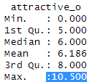
Preprocessing - Errors in values
Are the variables in the range that
they should be according to the
metadatafile?

Slide 8
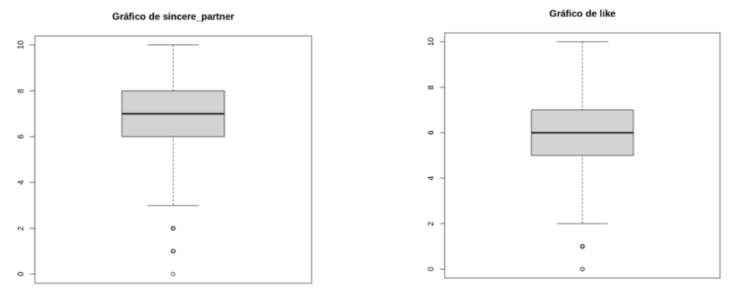
Preprocessing - Outliers treatment
BoxPlot “sincere_partner” BoxPlot “like”

Slide 9
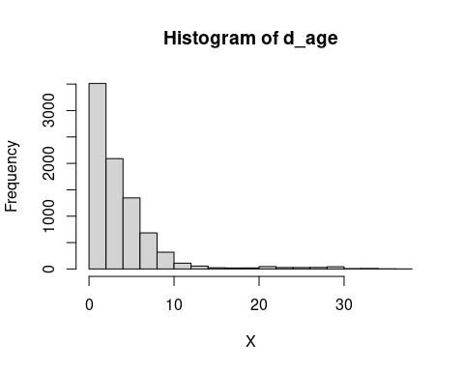
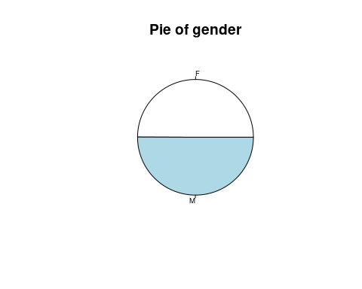
Descriptive analysis
Age difference
Gender at birth
Numerical
Binary

Slide 10
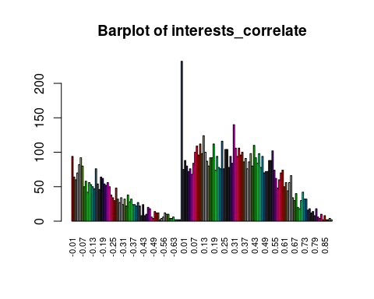
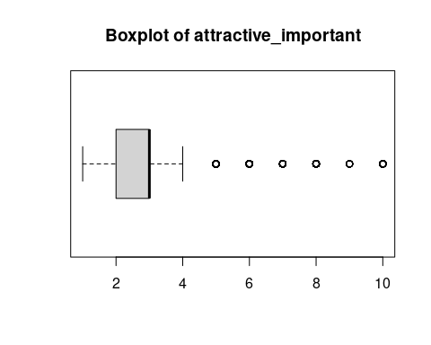
Descriptive analysis
Interest correlation
Importance of attractiveness
Numerical
Categorical

Slide 11
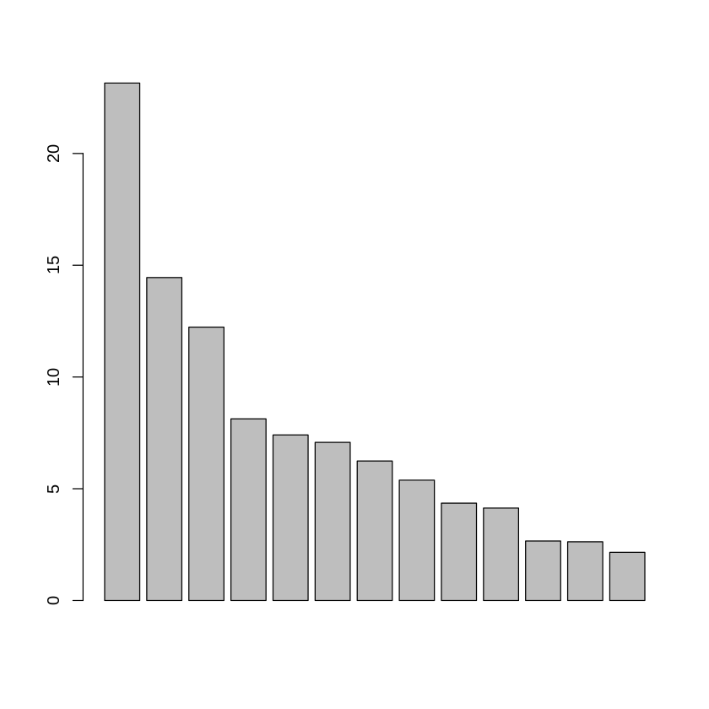
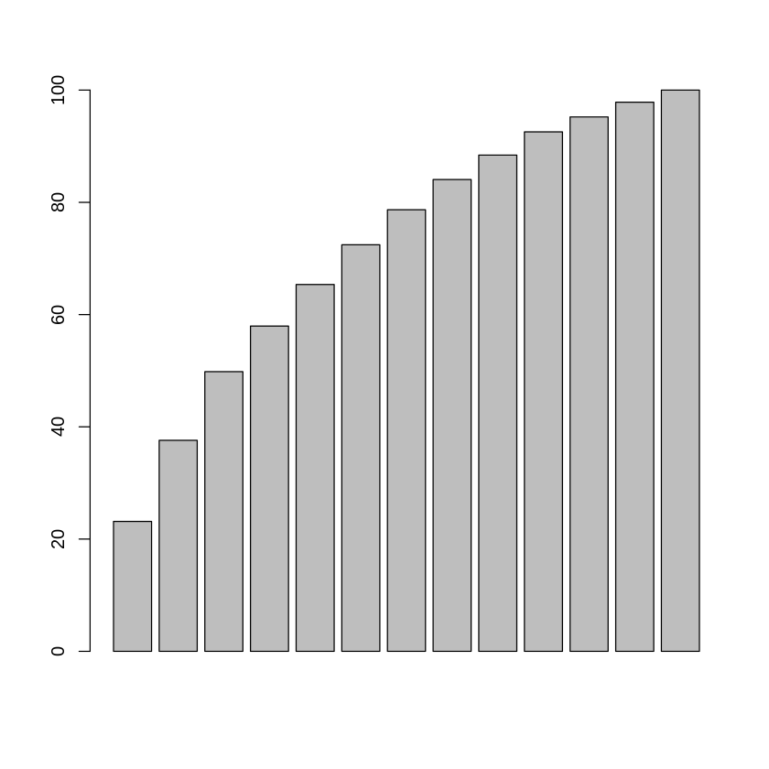
PCA
Intertia by dimensions
Acummulated inertia

Slide 12
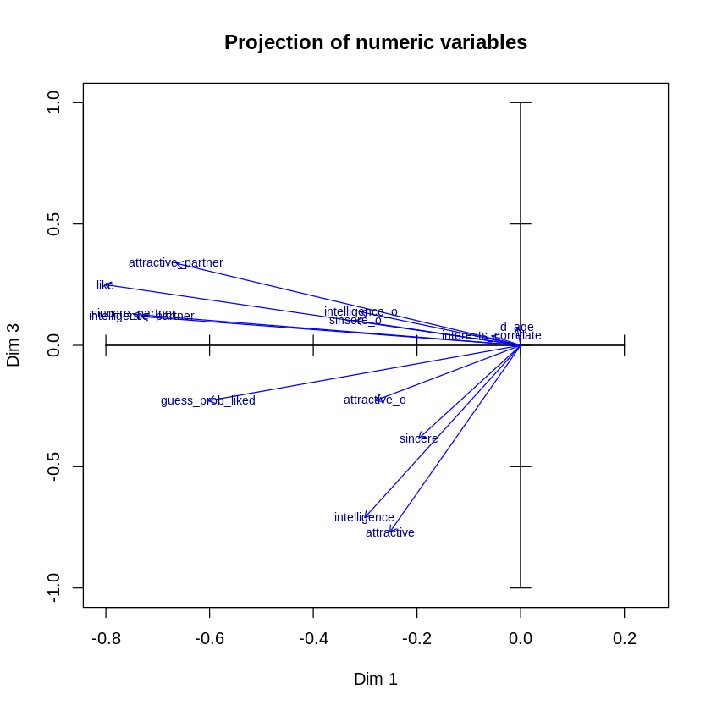
PCA
Subspace (1,3)
Projection of numerical variables

Slide 13
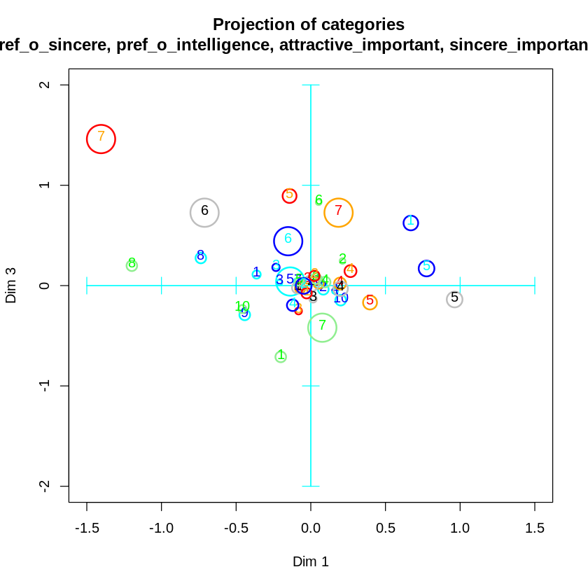
PCA
Subspace (1,3)
Projection of numerical and categorical variables

Slide 14
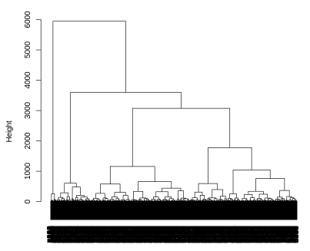
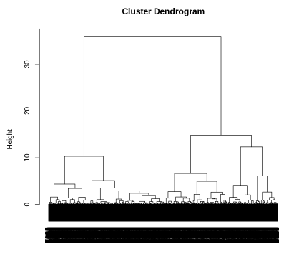
Clustering (only numerical variables)
Dendogram with distance
Dendogram with distMatrix
196 individuals of 8378 in c2
4112 individuals of 8378 in c2

Slide 15
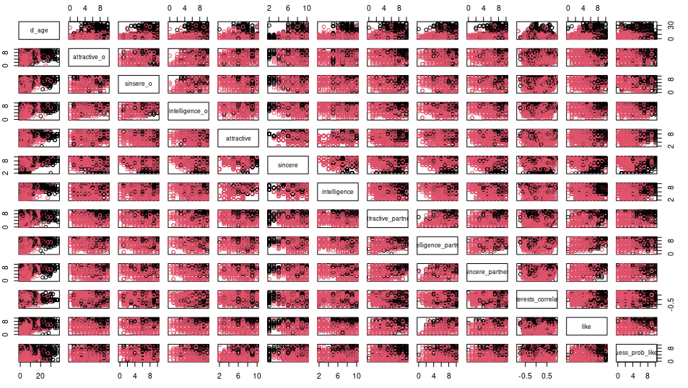
Clustering

Slide 16
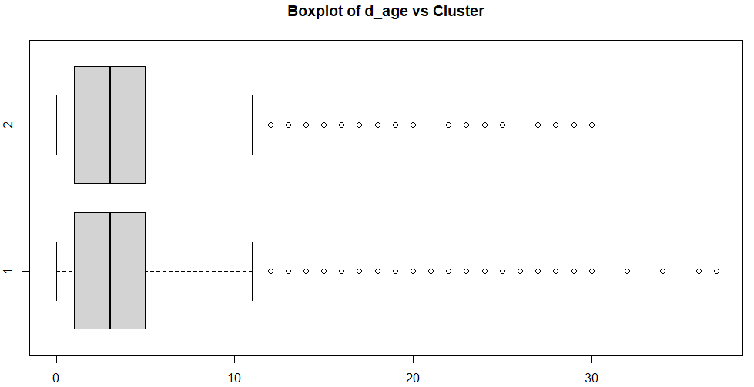
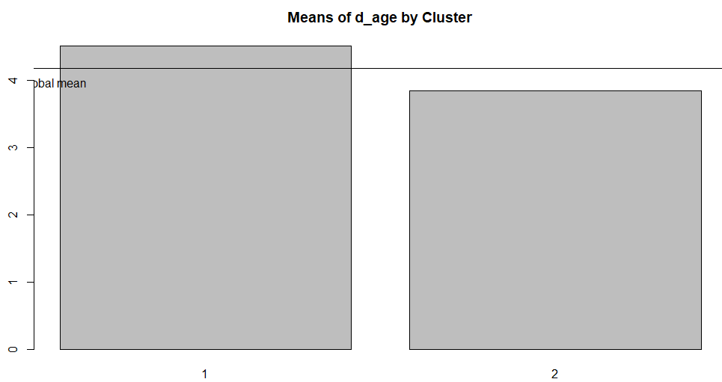
Profiling

Slide 17
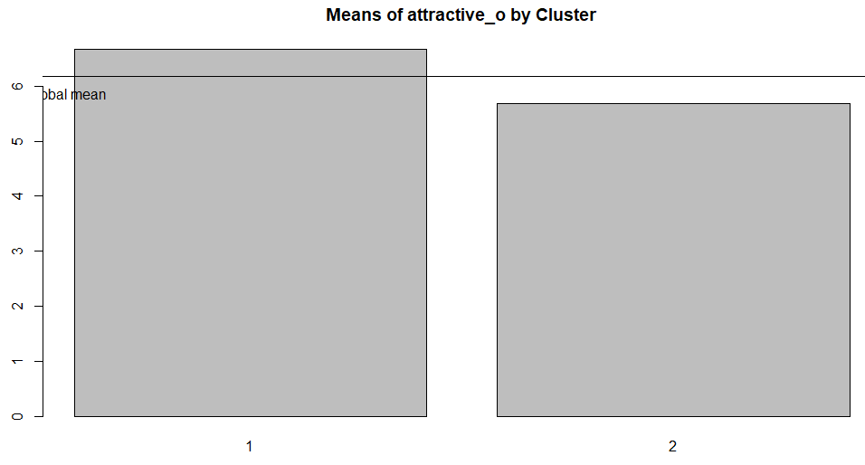
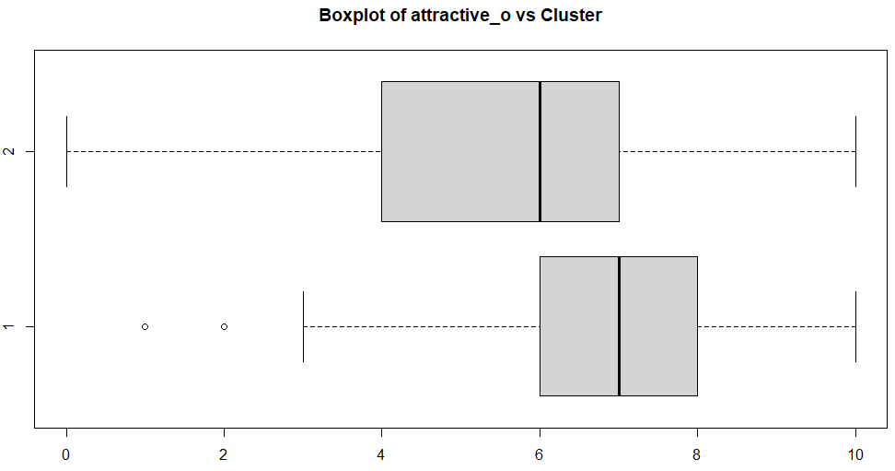

Slide 18
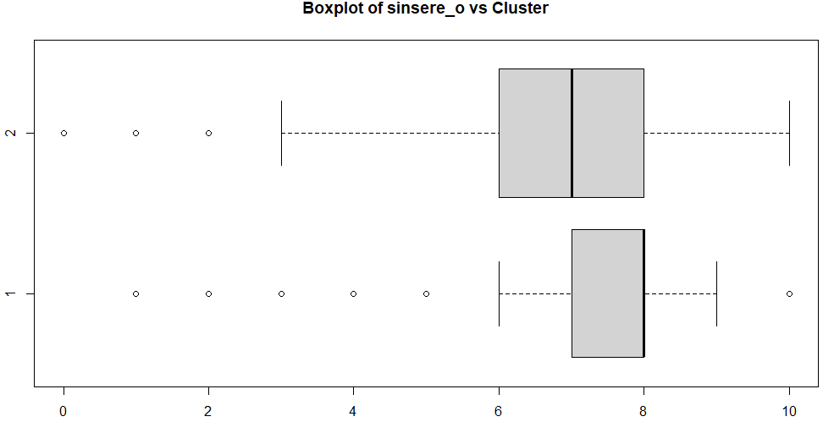
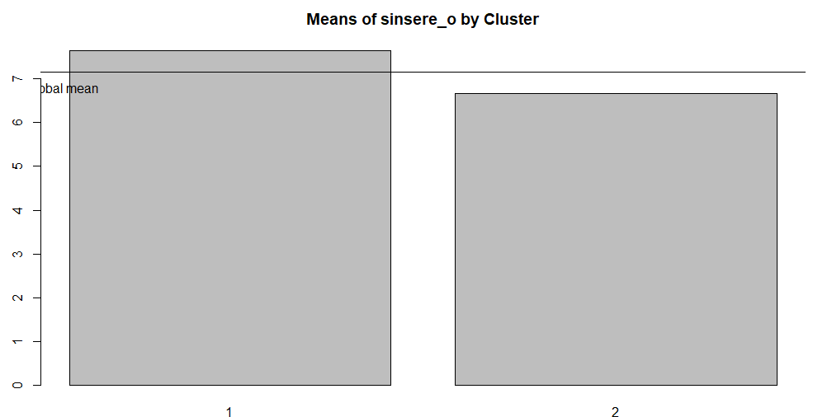

Slide 19
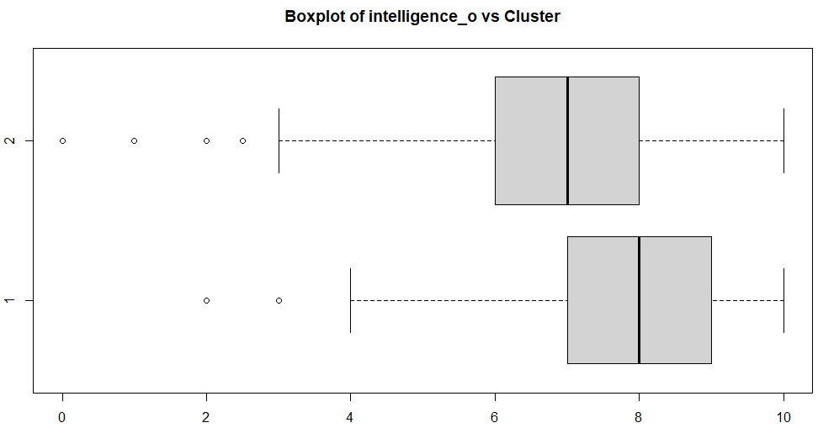
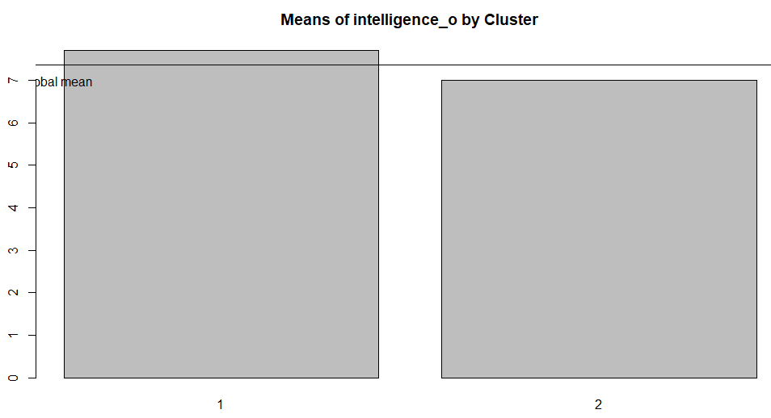

Slide 20
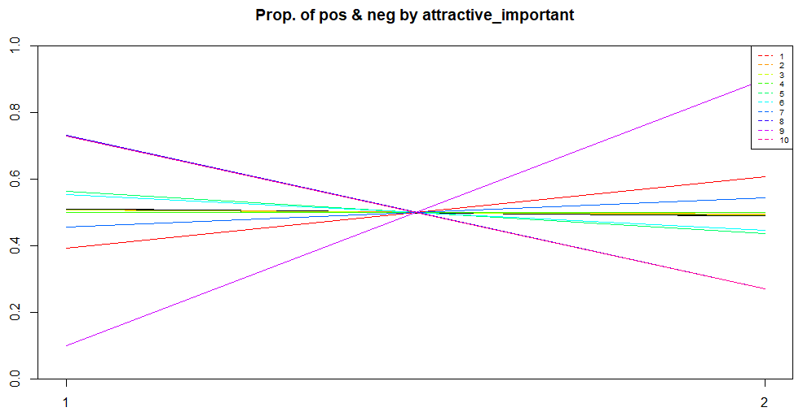
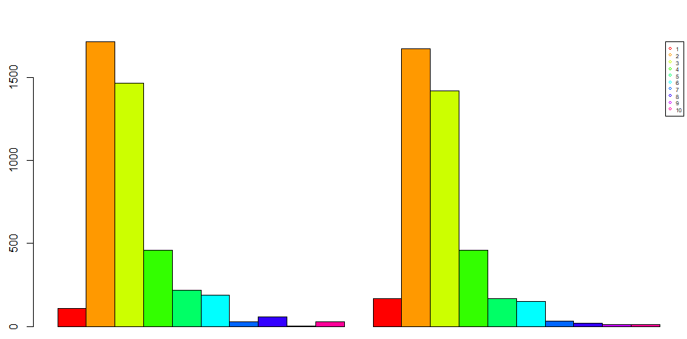

Slide 21
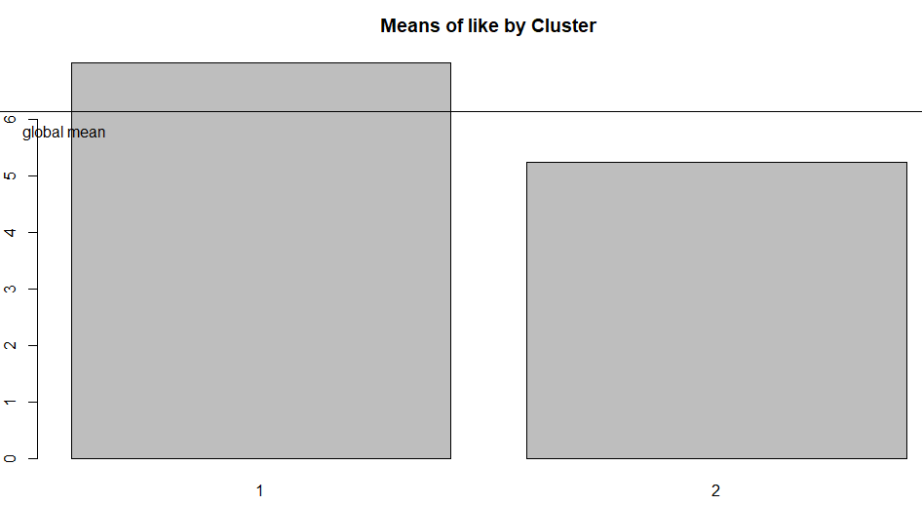
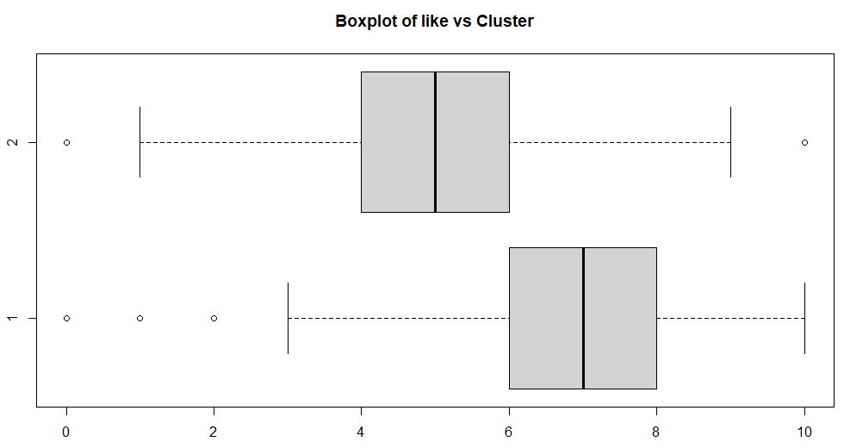

Slide 22

Conclusions
Separability in how much their partners like them
Intelligence > Sincere > Attractive

Slide 23
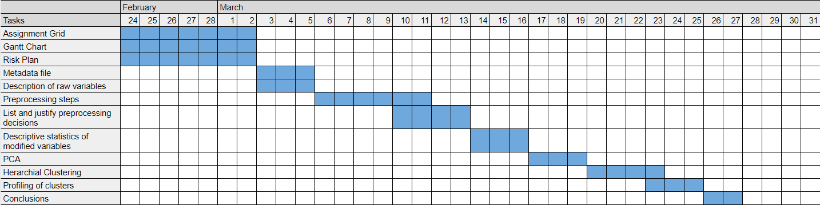
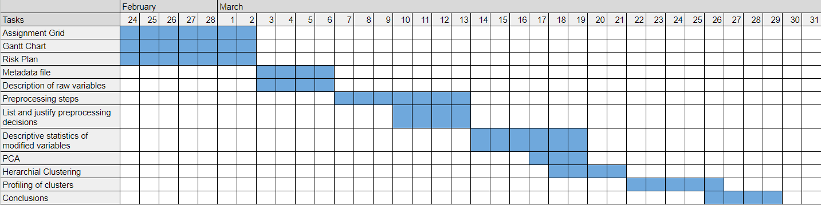
Original Scheduling
Final Scheduling

Slide 24

Questions ?

