Slide 1


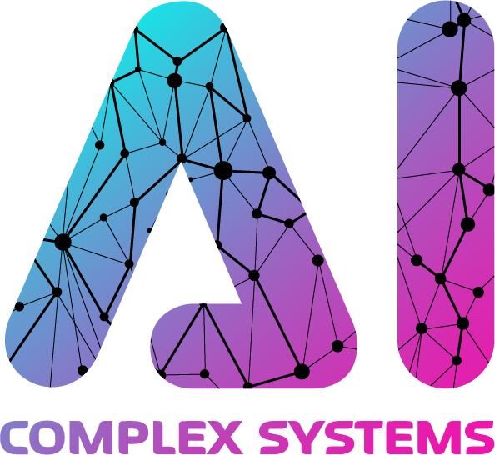
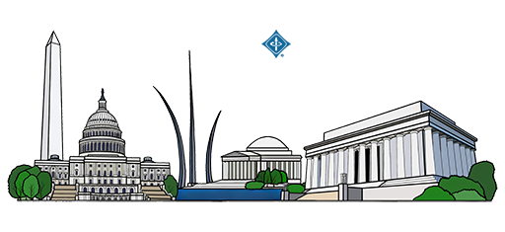

Legal Argument Mining the TCA’s Technology
Undertaking Exception with Turkish BERT
M. Mikail Demir and M. Abdullah Canbaz
Department of Information Science and Technology
College of Emergency Preparedness, Homeland Security, and Cybersecurity University at Albany, SUNY
Albany, New York, United States
Notes:
Hello everyone, I would like to start by giving thanks to chairs for putting this venue and hope many more editions will come in future
A little about me, I am Mikail Demir, I am a 2nd year PhD student at University at Albany SUNY, in Information Science program, before moving to the USA, I studied law and economics in Turkey, I admitted to Istanbul Bar Association and practiced as a lawyer in Turkey for 2 years, and this is actually my first conference experience so it is very exciting for me and I have put this work with my advisor Abdullah Canbaz so without further ado I want to start my presentation with motivation, why did we get into an effort to annotate some legal decisions and

Slide 2
Motivation
Authorities around the world publish vast amounts of complex, unstructured text in the form of decisions, laws and other types of binding/non-binding legal sources.
Effectively monitoring how authorities apply the law over time is essential for developing scientifically grounded arguments in support of more robust regulations.
Legal argument mining and extractive question answering provide effective means to systematically uncover and analyze how laws are applied in these textual sources.
Notes:
Legal documents are everywhere, and they're incredibly hard to read and analyze.
Think of all the court decisions and laws that governments and courts publish every day right so It's a massive amount of complex text.
The key is that this information is almost always unstructured, and does not give too much chances for prediction/analysis etc.
it is important to know how the law is actually being used in practice over time. Lawyers need this to better serve to their clients, society needs this so that they can understand and argue in favor or against the rules that govern us.
By tracking how judges and authorities apply the law, we can gather real evidence to argue for and create better, smarter, and fairer new regulations for the future.
With this motivation, we tried to put existing argument mining and extractive question answering frameworks into test to see can we build a model that can effectively points us and enables monitoring where a rule is being applied.

Slide 3
Related Work on Legal Argument Mining / Extractive Question Answering
The Classic Model
Early work (e.g., Mochales & Moens) focused on classifying sentences as Premise or Conclusion.
This simplified model, often inspired by Walton's argumentation schemes, became a common NLP approach.
The "Richness Gap”
A "major discrepancy" exists between the simple premise/conclusion model and how legal experts actually analyze arguments.
Legal theory employs a "rich typology" of arguments (e.g., Teleological Interpretation), which is critical for analysis.
Habernal et al. (2023) address this with a new scheme of 16 fine-grained, legally-grounded argument types.
Key Challenges in the Field
A single clause can be a premise in one context and a conclusion in another.
Models are often limited to single paragraphs, but legal experts may require document-level context.
Datasets are often highly imbalanced
Arguments are often subtle or "implicit" rather than explicitly stated in a single sentence.
Legal Argument Mining
Extractive Question Answering
Notes:
OK, so I want to start with related work on these fields, I will start with the legal argument mining
"The foundational work in this area, by researchers like Mochales and Moens, established the core task. Their approach, which was adopted by many, was to take a legal text, segment it (usually by sentence), and classify each segment into its basic argumentative components like Premises and Conclusions.
"This premise-conclusion model was often inspired by theoretical frameworks like Walton's argumentation schemes.
"However, this classic model led to what the literature now calls the 'richness gap.’
"The Habernal et al. paper, from 2023, is a key text here. They argue there's a 'major discrepancy' between the simple premise-conclusion model that NLP researchers were using, and the 'rich typology' of arguments that legal experts, scholars, and judges actually use in their reasoning.
"To fix this, Habernal and his team—a mix of NLP and legal scholars—created a new, massive dataset from the European Court of Human Rights. Instead of just 'premise,' they annotated 16 fine-grained, legally-grounded argument types.
"So, this evolution from a simple model to a rich, complex one has highlighted four key challenges that define the field today.
"First, Data Ambiguity. This is the central finding from the Al Zubaer paper. Their GPT models failed, not because they couldn't reason, but because the data itself is inherently ambiguous. They found the exact same legal clause was correctly annotated as a 'premise' in one argument and a 'conclusion' in another. This isn't a data error; it's a fundamental property of legal text that the classic binary classification model struggles with.
"Second, the Need for Context. Their model often made mistakes that the human legal experts on their team could only resolve by reading the entire document. The model, which was limited to single paragraphs, was failing because it didn't have the full context.
"Third, Data Imbalance. This is a practical but critical problem. The Al Zubaer paper notes their dataset is 'heavily imbalanced' with far more premises than conclusions. The Habernal dataset is even more extreme.
"And finally, Implicit Reasoning. This is a challenge we investigate deeply in our paper. Often, the reasoning is subtle. In the Habernal study, they found many errors were in these highly ambiguous, context-dependent cases.

Slide 4
Related Work on Legal Argument Mining / Extractive Question Answering
Extractive Question Answering
Extractive Question Answering (EQA) is the task of extracting a span of text from a given context paragraph as the answer to a specified question (Pearce et al., 2021)
SQuAD is one of the most popular datasets for EQA, which consists of context-question-answer span triplets (Rajpurkar et al., 2018)
By framing a legal analysis as a series of targeted questions, a QA framework effectively deconstructs a complex document into its structured components.
Legal Argument Mining
Extractive Question Answering
Notes:
Detailed Talking Notes for Your Presentation
I now want to switch to the second, parallel field that our work builds on: Extractive Question Answering, or EQA. This field provides the methodology for how we find those arguments.
"At its core, EQA is a form of Reading Comprehension. The task is simple to define: you give a model a 'context'—a piece of text—and a 'question.' The model’s job is to read the context and extract the literal span of text that contains the answer.
"This entire field was essentially standardized by the SQuAD, the Stanford Question Answering Dataset. SQuAD introduced the (Context, Question, Answer-Span) triplet. It became the de facto benchmark for this kind of task.
"This EQA framework is a very natural fit for the legal domain. A core part of legal work isn't always creative writing; it's precision retrieval. It's about finding the exact clause in a 100-page contract, the specific fact in a case file, or the key sentence of a judge's reasoning.
"By framing a complex legal analysis as a series of targeted questions, the EQA framework allows us to deconstruct a massive, unstructured document into its core, structured components.
"And we've seen this methodology validated across the legal NLP literature. There has been a recent surge in datasets that apply this 'reading comprehension' model to legal texts.
"For example, the MAUD dataset is a key benchmark here. It's a large-scale, expert-annotated dataset with over 47,000 questions about English-language merger agreements.
"But it's not the only one. We have Koreeda & Manning (2021), who applied this to nondisclosure agreements. We have Zheng et al. (2021), who created a massive multiple-choice dataset from US case law citations. And in other languages, Duan et al. (2019) created a 50,000-question, expert-annotated dataset for Chinese judicial rulings called CRJC.
"So, the literature clearly shows that EQA is a robust, validated, and state-of-the-art method for handling complex legal texts.

Slide 5
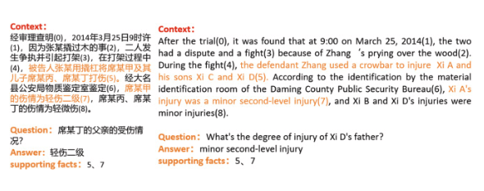
Related Work on Legal Argument Mining / Extractive Question Answering
Extractive Question Answering
Extractive Question Answering (EQA) is the task of extracting a span of text from a given context paragraph as the answer to a specified question (Pearce et al., 2021)
SQuAD is one of the most popular datasets for EQA, which consists of context-question-answer span triplets (Rajpurkar et al., 2018)
By framing a legal analysis as a series of targeted questions, a QA framework effectively deconstructs a complex document into its structured components.
Legal Argument Mining
Extractive Question Answering
Notes:
Detailed Talking Notes for Your Presentation
I now want to switch to the second, parallel field that our work builds on: Extractive Question Answering, or EQA. This field provides the methodology for how we find those arguments.
"At its core, EQA is a form of Reading Comprehension. The task is simple to define: you give a model a 'context'—a piece of text—and a 'question.' The model’s job is to read the context and extract the literal span of text that contains the answer.
"This entire field was essentially standardized by the SQuAD, the Stanford Question Answering Dataset. SQuAD introduced the (Context, Question, Answer-Span) triplet. It became the de facto benchmark for this kind of task.
"This EQA framework is a very natural fit for the legal domain. A core part of legal work isn't always creative writing; it's precision retrieval. It's about finding the exact clause in a 100-page contract, the specific fact in a case file, or the key sentence of a judge's reasoning.
"By framing a complex legal analysis as a series of targeted questions, the EQA framework allows us to deconstruct a massive, unstructured document into its core, structured components.
"And we've seen this methodology validated across the legal NLP literature. There has been a recent surge in datasets that apply this 'reading comprehension' model to legal texts.
"For example, the MAUD dataset is a key benchmark here. It's a large-scale, expert-annotated dataset with over 47,000 questions about English-language merger agreements.
"But it's not the only one. We have Koreeda & Manning (2021), who applied this to nondisclosure agreements. We have Zheng et al. (2021), who created a massive multiple-choice dataset from US case law citations. And in other languages, Duan et al. (2019) created a 50,000-question, expert-annotated dataset for Chinese judicial rulings called CRJC.
For example this is a figure from the MENG et al paper which uses CRJC dataset, they have also used BERT

Slide 6
Related Work on Legal Argument Mining / Extractive Question Answering
Applying them together
Legal schemes does not always reflect the linguistic scheme which had been applied in the NLP domain predominantly (issue – evidence – rule – conclusion) (Habernal, et al., 2023)
To bridge this gap, Question Answering (QA) and reading comprehension have become an established framework for performing targeted legal NLP tasks. Prominent efforts, such as the creation of the large-scale, expert-annotated Merger Agreement Understanding Dataset (MAUD), explicitly model complex legal work like contract review as a QA challenge, where models learn to answer specific, standardized questions based on extracted legal clauses (Wang et al., 2023)
For that reason, we integrated QA style annotation scheme for legal argument extraction to gain insight about the application of a rule by tracking the decision that applies that rule
Legal Argument Mining
Extractive Question Answering
Notes:
So, this slide brings it all together and shows exactly where our study fits in this landscape. Our work is built at the intersection of Legal Argument Mining and Extractive Question Answering.
"This is where Question Answering (QA) and reading comprehension have become an established framework for performing targeted NLP tasks. A typical reading comprehension test consists of some context and many different questions that targets different sections of the context, here we inquire by operationalizing the application of legal rule and creating a set of questions that reveals the underlying reasoning, and then using this fixed questions on different legal judgments to verify whether can we see the answers to this fixed questions.
It gives us a precise tool. Instead of just classifying every sentence and hoping for the best, a QA framework allows us to ask a specific, targeted question to find a specific component of reasoning.
"And for that reason, we integrated a QA-style annotation scheme for our own legal argument extraction task.

Slide 7
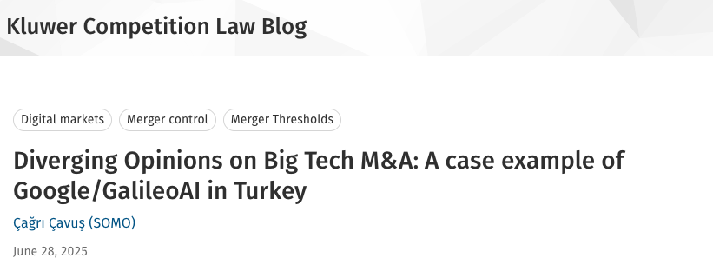
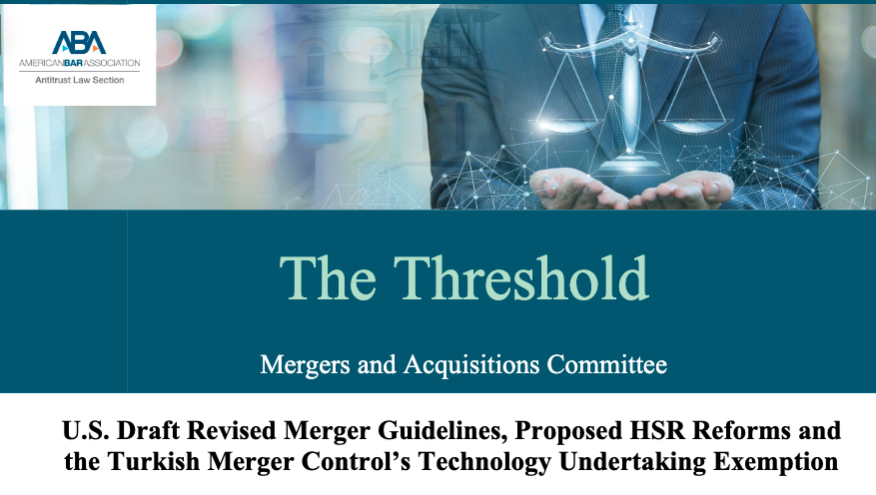
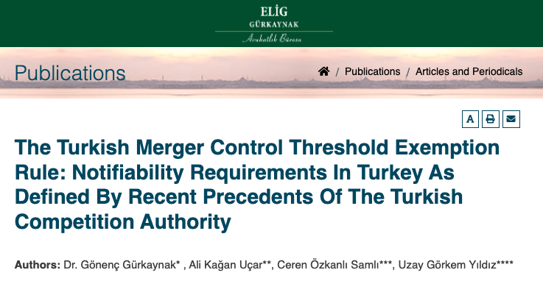
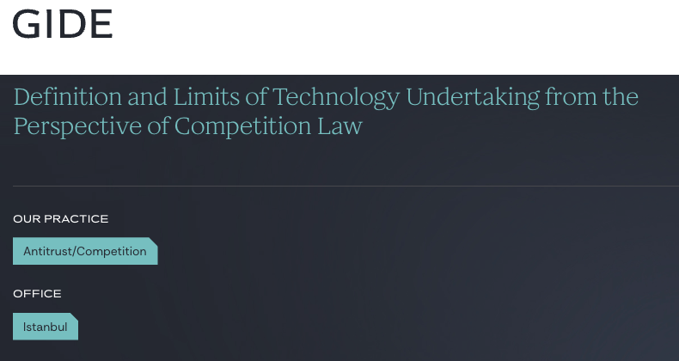
Background – Technology Undertaking Exception Rule
Introduced by the Turkish Competition Authority (TCA) in March 2022
Extends merger control rules to nascent technology companies
Waives turnover thresholds when the target qualifies as a “technology undertaking”
Notes:
(Slide Opens: "Background – Technology Undertaking Exception Rule")
"Okay, so to understand our project, we first need to understand the real-world legal problem we're solving. It’s about this new rule from the Turkish Competition Authority, or TCA.
(Click to: 'Introduced by the Turkish Competition Authority...')
"The TCA is Turkey's main market regulator. Their job is to make sure competition is fair, similar to the FTC or DOJ here in the U.S. In March 2022, they introduced this new rule.
"This rule is part of their 'merger control' regime. The whole purpose of merger control is to prevent monopolies. Regulators want to review large business deals—mergers or acquisitions—to stop one or two companies from getting so big that they can control an entire market and harm consumers.
"But this creates a trade-off: it's simply not logical review every single transaction so there is a revenue threshold, if the companies in the deal make less than a certain amount of money, they do not have to let TCA know about that. The deal is too small to worry about.
"The problem is tech startups. A startup can have a revolutionary product, millions of users, and a billion-dollar valuation, but almost zero revenue.
"Under the old rules, a huge company could buy—and shut down—a small, innovative competitor and the deal would be under the revenue threshold. The TCA couldn't legally review it.
"This new rule is the fix. It says: if the company you are buying is a 'technology undertaking,' the old local revenue thresholds for the target company are no longer applied. This effectively relaxes the criteria, expanding the TCA's jurisdiction so it now has the power to review these deals. We do not have to deal with the numbers because it is unnecessary for this task, but
"This is the core of our research problem. The rule is simple, but its application is not. It has created a massive 'gray area'. What is a 'technology undertaking’? For example lets say the target company, company you want to buy is a roofing company in the DC area, they are basically contractors, but lets say these folks use a mobile application to better connect with their customers, is this a technology undertaking? questions are endless so while the rule is simple, since it is too simple it creates a lot of questions
"The only way to find answers is to see how the TCA decides in its first cases. This has led to a flood of analysis from law firms, all trying to dissect these new decisions to find a pattern: which companies are being considered 'technology undertakings,' and what counts as a 'market nexus’?
"It is this exact, high-stakes, manual analysis—reading decisions to find the TCA's hidden reasoning—that we are modeling as an automated extraction problem."

Slide 8
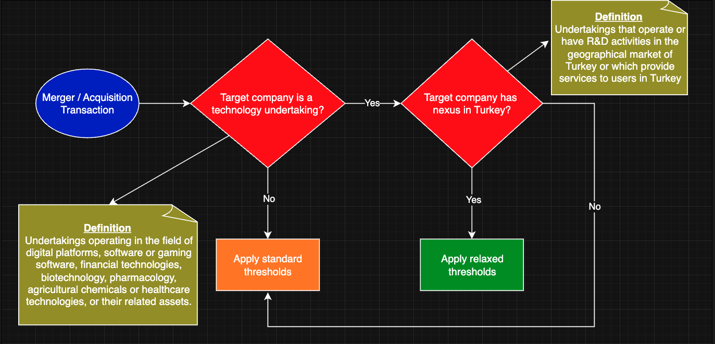
Background – Technology Undertaking Exception Rule
Q1/Q2
Q3
Q4
Notes:
"So, how does this new rule actually work? This flowchart visualizes the core analytical task that the Turkish Competition Authority and any legal practitioner must now perform.
"This is the two-part test that the TCA itself established to determine if the new exception applies.
(Point to the Blue Oval)
"Everything starts with a 'Merger or Acquisition Transaction.'
"The first test is the 'what': The TCA must determine if the target company is a 'technology undertaking'.
"As the definition box on the left shows, this is a broad, substantive definition. The law, defines these as undertakings operating in fields like 'digital platforms, software or gaming software, financial technologies, biotechnology, pharmacology,' and so on.
"If the answer is 'No'—for example, the target is a cement company—this exception is irrelevant. The TCA simply moves on and 'Applies the standard thresholds', and the analysis for this rule ends.
"But, if the answer is 'Yes', the analysis continues. Just being a tech company isn't enough.
"This brings us to the second test, the 'where': The TCA must ask if the target company has a 'nexus in Turkey’.
"The law is also specific about this. The nexus is established if the company 'operate[s] or have[s] R&D activities in the geographical market of Turkey or... provide[s] services to users in Turkey'.
"If the answer here is 'No'—say, it's a small German biotech firm with no R&D, operations, or users in Turkey—the rule again does not apply, and you revert to the 'standard thresholds.'
(Trace the final 'Yes' arrow to the Green Box)
"However, if the answer to both of these questions is 'Yes'...
It is a technology undertaking, AND
It does have a nexus in Turkey...
"...then the exception is triggered, and the TCA will 'Apply relaxed thresholds.'
"This is the crucial outcome. As the Communiqué states, this means the standard 'two hundred and fifty million TL thresholds... shall not apply'. This action expands the TCA's jurisdiction, allowing it to review a transaction that otherwise would have been too small to be notifiable.
(Final Summary - Connecting to your paper)
"This two-part, four-step logical process is the 'semantically complex' rule we're talking about.
"And this is precisely what our paper models. This flowchart is our annotation schema. Our four annotation questions are designed to extract the exact sentences from the TCA's decisions that correspond to each step of this diagram :
Q1 (Business Description) and Q2 (Legal Classification) map to this first diamond.
Q3 (Market Nexus) maps to this second diamond.
And Q4 (Threshold Application) maps to the final outcome—whether the TCA landed in the orange box or the green one.
"What we have done is take this complex legal workflow and operationalize it as an extractive NLP task."

Slide 9
Research Questions
RQ1: To what extent can a fine-tuned BERT model, framed within an extractive QA task, effectively and accurately extract the components of a complex legal argument from specialized, non-English legal documents?
RQ2: How does the model's performance differ across various types of argumentative components, and what does this variation reveal about the nature of the legal text itself?
RQ3: What is the role of context length in the model's performance on this legal QA task, particularly for identifying implicit reasoning?
Notes:
[Click to RQ1] "Our first question, RQ1, establishes the baseline: To what extent can a fine-tuned BERT model, framed within an extractive QA task, effectively and accurately extract the components of a complex legal argument from specialized, non-English legal documents?
[Click to RQ2] "Our second question, RQ2, digs deeper into the performance: How does the model's performance differ across various types of argumentative components, and what does this variation reveal about the nature of the legal text itself?
[Click to RQ3] "And our third question, RQ3, tests our main hypothesis about the key challenge: What is the role of context length in the model's performance on this legal QA task, particularly for identifying implicit reasoning?"

Slide 10
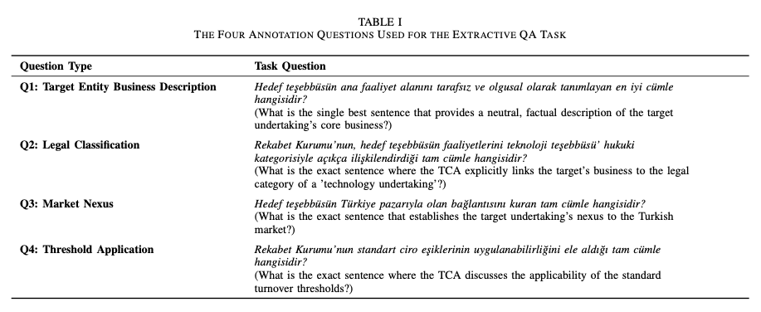
Methodology
Notes:
Thank you. So, having established our research questions, let's dive into the methodology. This slide shows Table I from our paper, which is the absolute core of our contribution
"To build our dataset, we worked with a domain expert—a qualified Turkish competition law attorney.
Together, we deconstructed the 'Technology Undertaking Exception' into its essential reasoning components. This analytical workflow is what resulted in these four specific questions.
"Let's quickly map them back to the flowchart:
Q1 (Business Description) and Q2 (Legal Classification) are the two steps for the first diamond: 'Is this a technology undertaking?' Q1 finds the factual basis for the claim, and Q2 finds the explicit legal link the TCA makes .
Q3 (Market Nexus) maps directly to the second diamond: 'Does it have a nexus in Turkey?' .
And Q4 (Threshold Application) maps to the final outcome: the sentence where the TCA discusses whether the standard thresholds apply or are relaxed .
"So, this is a domain-expert-driven schema designed to mirror the exact reasoning process of the legal authority we are modeling.
"In our SQuAD-style framework, these four questions serve as the fixed 'Question' in our (Context, Question, Answer) triplets, which the model is trained to answer by extracting a text span."

Slide 11
Methodology
Data Collection:
We scraped all of the publicly available merger & acquisition decisions from TCA’s website (4552 decisions)
Keyword Filtering:
To isolate relevant cases, we filtered this collection to only include that contained the specific legal term “technology undertaking” (152 decisions)
Content Extraction:
From these 152 decisions, we extracted only the core analytical section known as the “Examination and Evaluation” section.
Notes:
So, this is how we built our dataset. It was a three-step process designed to create a small, dense, and highly relevant corpus.
"First, Data Collection. We started by programmatically scraping all publicly available merger and acquisition decisions from the Turkish Competition Authority's website. This gave us a large, raw corpus of 4,552 unique decisions.
"Second, Keyword Filtering. This large corpus contains all sorts of decisions, but we were only interested in our specific legal problem. So, we filtered this entire collection to find only the documents that contained the exact legal term 'teknoloji teşebbüsü,' which means 'technology undertaking'. This yielded 152 relevant decisions.
"Third, Content Extraction. This is a critical step, which, as you'll see, relates directly to our third research question on context length. A single legal decision is full of procedural details and boilerplate text, so we first had to isolate the core reasoning.
"TCA decisions follow a semi-standard structure, so we used a regular expression to automatically extract only the core analytical section, which is known as the 'İNCELEME VE DEĞERLENDİRME' or 'Examination and Evaluation' section .
This gave us our final 152 focused 'context' documents.

Slide 12
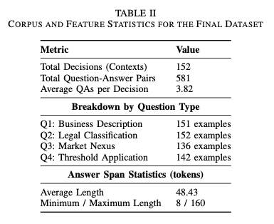
Methodology
Notes:
"This three-step process resulted in the final corpus, and this table shows its statistical breakdown.
"As you can see, our 152 decisions (or 'Contexts') yielded a total of 581 Question-Answer pairs. This gives us an average of about 3.8 QA pairs per decision. so some questions does not have answer according to our annotation.
"Now, the most important part of this table is the 'Breakdown by Question Type'. You'll immediately notice that the numbers are not equal. We have an answer for Q1 (Business Description) and Q2 (Legal Classification) in nearly every single document.
"But Q3 (Market Nexus) and Q4 (Threshold Application) are less frequent, with only 136 and 142 examples, respectively.
"This is not a data collection error; this is a key finding of our paper. It's an expected outcome, as we state, because the TCA's reasoning and explicit statements can vary.
"Finally, you can see the Answer Span Statistics. We were annotating full sentences, so the average length is about 48 tokens, with a wide range from 8 to 160 tokens."

Slide 13
Methodology
Core Experimental Design
Base Model: dbmdz/bert-base-turkish-cased (BERT-base architecture).
Fine-Tuning & Validation
Task Formulation: Extractive Question Answering (SQuAD format).
The model predicts the start and end token indices of the answer span.
Framework: HuggingFace transformers and datasets libraries.
Hyperparameters (Optimized): Learning Rate: 3e-5, Batch Size: 2, Epochs: 4,Weight Decay: 0.01
Validation Strategy: 5-Fold Cross-Validation
Ablation Study: Context Impact
Objective: To quantify the performance bottleneck caused by high signal-to-noise ratio in legal texts.
Method: A "Truncated-Span Context" dataset was generated using a heuristic.
For each document, context was programmatically reduced to the minimal substring spanning from the start of the earliest answer to the end of the latest answer.
This isolates the impact of extraneous text on model accuracy.
Notes:
(Point to: 'Core Experimental Design')
"First, the Core Experimental Design.
"For our Base Model, we selected the dbmdz/bert-base-turkish-cased model. This was a deliberate choice: it's a BERT-base architecture specifically pre-trained on a large, cased corpus of Turkish text, and it has demonstrated strong performance on other downstream Turkish NLP tasks.
"As we've discussed, our Task Formulation is Extractive Question Answering. We converted our entire 581 QA-pair dataset into the SQuAD format .
"This means the model is not generating text; it is a classification task. It's trained to predict two things: the start and end token indices of the answer span within the given context.
"All of this was implemented using the standard HuggingFace transformers and datasets libraries, which allows for easy replication.
(Point to: 'Fine-Tuning & Validation')
"Second, our Fine-Tuning and Validation strategy.
"The Hyperparameters you see here were selected after a systematic hyperparameter search. The final configuration gave us the most consistent performance
"We used a 5-Fold Cross-Validation strategy. This mitigates the risk of an unrepresentative test set.
(Point to: 'Ablation Study: Context Impact’)
"Finally, our Ablation Study. This was designed to directly answer our third research question: What is the role of context length?
"The Objective was to empirically quantify the performance bottleneck caused by the high signal-to-noise ratio that we know is present in legal texts.
"To do this, we created a second, parallel dataset called the 'Truncated-Span Context' dataset.
"The Method was a heuristic: For each document, we programmatically created a minimal text window. We defined this as the substring starting at the character index of the earliest answer and ending at the character index of the latest answer for that document. This effectively created a 'perfect,' dense context with no extraneous text.
"I want to be clear, as we state in the paper, this is not a practical pre-processing technique; it's a true ablation that relies on knowing the answers' locations in advance. Its purpose is to isolate the impact of that extraneous text and give us a benchmark for how much performance is being lost to noise ."

Slide 14
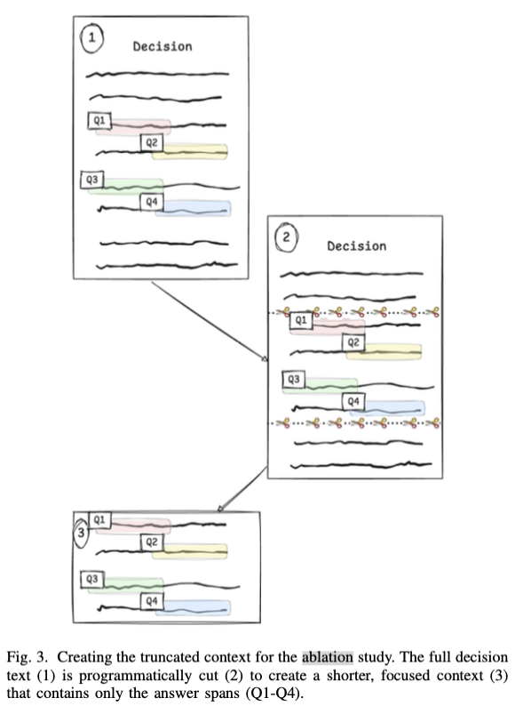
Methodology
Notes:
"So, to make the methodology for our ablation study even clearer, this figure from our paper visually illustrates the 'Truncated-Span Context' process.
"On the top left, in image (1), we have our starting point. This represents the full 'Examination and Evaluation' section of a decision. As you can see, the four answer spans—Q1, Q2, Q3, and Q4—are present, but they are surrounded by a lot of other text, which is the 'noise' we want to measure.
"Image (2) represents the heuristic we applied. We programmatically find the character start index of the earliest answer—in this case, Q1—and the character end index of the latest answer—in this case, Q4.
(Point to image (3) - Truncated Context)
"The model then 'cuts' the document at these two points, removing all the extraneous text before the first answer and after the last answer.
"The result, shown in image (3), is our 'Truncated-Span Context'. This new, minimal context is all the model sees in the ablation experiment. It's a 'perfect' context that is dense with answers and has almost zero noise.
"Again, this isn't a practical pre-processing step, but an experimental control. By training and testing a model on this truncated dataset and comparing its performance to our primary model, we can empirically measure the exact performance drop caused by the surrounding text, which directly answers our third research question."

Slide 15
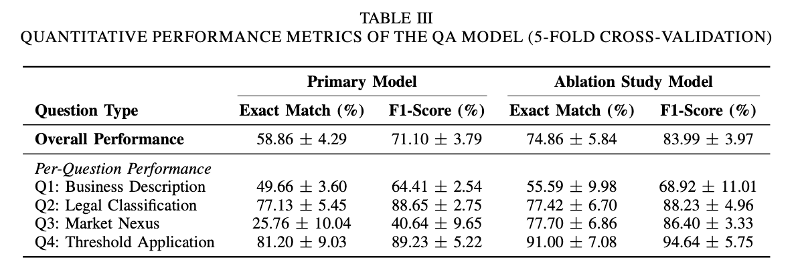
Experiment Results – Quantitative Findings
Notes:
"Alright, let's dive into the performance of our model. We evaluated it using 5-fold cross-validation, and the results reveal a fascinating split in performance that tells us a lot about the legal text itself.”
1. Overall Performance: A Strong Baseline
Our primary model achieved a solid overall F1-score of 71.10%. This confirms that the Extractive QA approach is a viable and effective framework for this legal argument mining task.
2. Per-Question Analysis: The Performance Divide
"But when we break this down by question type, a clear pattern emerges. The model's performance is directly correlated with the explicitness of the legal language it's trying to find."
High Performance on Formulaic Statements (Q2 & Q4)
The model excelled on tasks requiring the extraction of clear, standardized legal conclusions.
Q2 (Legal Classification) and Q4 (Threshold Application) achieved very high F1-scores of approximately 89%.
Interpretation: These parts of the legal argument are often written in formulaic, explicit language, making them easy for the model to identify.
Low Performance on Substantive Reasoning (Q1 & Q3)
Conversely, the model struggled significantly with tasks that required understanding nuanced, implicit reasoning.
Q1 (Business Description) was more modest at ~64% F1.
Q3 (Market Nexus) was the most challenging task by far, with a very low F1-score of only ~41%.
Interpretation: This suggests the reasoning for Market Nexus is often implicit, stylistically variable, or buried in dense text, making it difficult to extract as a single, clear sentence.
3. The Ablation Study: Proving Context is the Bottleneck
"So, why did the model struggle so much with Q3? Our ablation study gives us a clear answer: the problem isn't that the answer is missing; it's that it's being obscured by noise."
By radically reducing the context to only the most relevant sentences, the overall F1-score jumped nearly 13 points to 83.99%.
The most dramatic result was for our most difficult task, Q3 (Market Nexus). Its F1-score skyrocketed from 40.64% to 86.40%—an improvement of over 45 points.
Key Takeaway: This demonstrates that context length is the primary performance bottleneck. The correct answers for even the most implicit reasoning are present in the text, and unlocking higher performance will require more advanced context retrieval and noise reduction techniques.

Slide 16
Experiment Results – Quantitative Findings
Evaluation Metric
Exact Match (EM) score is a strict, binary metric that measures the percentage of predictions where the predicted text span is identical to the ground-truth answer
More than 1 acceptable answer (qualitative findings), punctuation marks
Influence of Answer Length on Prediction Performance
The answer length is negatively correlated with performance in EQA systems.
The negative correlation is described as a strong effect found in the analysis of DistilBERT on SQuAD data.
Specifically, going from an answer length of 1 to an answer length of 5 reduces the exact match by almost a factor of 2 (Farea et al., 2024).
Notes:
"Okay, before we look at the numbers in Table III, it's critical to discuss how we're evaluating performance and some of the important nuances of the metrics we chose.
(Point to: 'Exact Match (EM)')
"Our primary metric is Exact Match (EM). As the slide says, this is a very strict, all-or-nothing score. The predicted text span must be 100% identical to the expert-annotated ground-truth answer to get any credit.
"This metric is also challenged by the nature of legal text itself. "For example, the TCA might state the 'Market Nexus' in two different, equally valid sentences. Our dataset labels one of them as the ground truth. If our model correctly extracts the other valid sentence, a strict EM score marks it as a zero. It's a failure, even though the model's extraction was correct. Even a simple difference in punctuation can cause the model to fail this metric.
"Finally, we have to consider the influence of answer length on performance. This is a well-documented phenomenon in EQA.
"The key takeaway from the literature is that answer length is negatively correlated with performance. Longer answers are harder for models to get exactly right.
"This is described as a strong effect, for instance, in analyses of DistilBERT on the SQuAD dataset.
"To give you a concrete example, recent work by Farea et al. found that just going from an answer length of 1 to 5 tokens can reduce the exact match score by almost a factor of 2.
"This is highly relevant for us, because as you saw in our data, our average answer length is quite long—about 48 tokens. This context is important for interpreting our own scores, as it helps explain the gap you'll see between our strict Exact Match and our more lenient F1-scores."

Slide 17
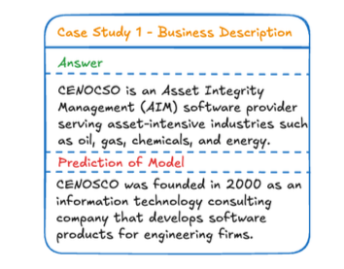
Experiment Results – Qualitative Findings
What is the single best sentence that provides a neutral, factual description of the target undertaking’s core business?
  Abundance of information
  A direct result of being constrained to single best-sentence
Notes:
This question addresses the first substantive condition of the technology undertaking exception, seeking the factual basis required to classify the target company’s activities.
The primary challenge with this question stems not from a lack of information, but from an abundance of it. Unlike the more formulaic legal conclusions, TCA decisions often contain multiple sentences describing the target undertaking’s business. These descriptions are presented for various purposes, such as defining the affected markets, detailing global operations, or outlining specific activities in Turkey.
This creates a significant challenge for the annotation task, which required selecting the single best sentence that was both neutral and provided a comprehensive overview of the company’s core activities.
So, in this case model selects a descriptive sentence that is factually correct but suboptimal. The annotated answer describes what the target company, CENOCSO, currently does: it is an ”Asset Integrity Management (AIM) software provider” serving specific industries. The model’s prediction, however, describes what the company used to be or its historical origins: it ”was founded in 2000 as an information technology consulting company.” While this sentence is also a valid description of the company, it is less relevant for the legal analysis, which is concerned with the company’s present-day activities.

Slide 18
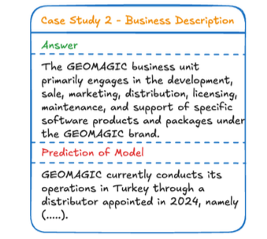
Experiment Results – Qualitative Findings
What is the single best sentence that provides a neutral, factual description of the target undertaking’s core business?
  Relevant sentence, but not for this question
  Our analysis of the 152-decision corpus revealed that only four decisions contained an explicit sentence that both discussed and confirmed the market nexus condition.
Notes:
The model was prompted for the target’s Business Description (Q1), which requires a factual statement of the company’s core commercial activities. The ground- truth answer correctly identifies GEOMAGIC’s role in soft- ware development and support. However, the model instead extracted a sentence detailing the company’s ”operations in Turkey through a distributor.” This prediction, while factually correct, is a textbook answer for the Market Nexus (Q3) question, The error is significant because the model did not simply fail; it correctly identified a legally relevant sentence but misapplied it to the wrong analytical task.
For the vast majority of cases, our annotator was therefore required to select the best available proxy sentence—one that implicitly established the target’s presence in Turkey. Common examples of such implicit sentences included statements about the target’s Turkish market share, its turnover generated in Turkey, or its business dealings with other Turkish companies.

Slide 19
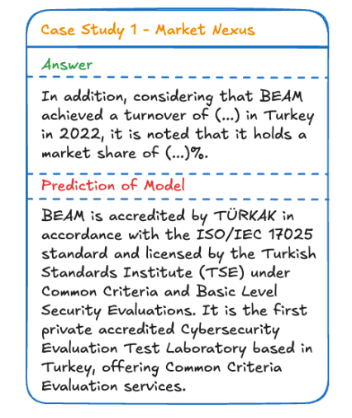
Experiment Results – Qualitative Findings
What is the exact sentence that establishes the target undertaking’s nexus to the Turkish market?
  Contextually plausible but not the one we are looking for.
Notes:
Here is an example to that constraint and how it led to error in our model,
For this decision, the annotated answer establishes the market nexus by citing the target company’s (BEAM) turnover and market share in Turkey. This is an implicit but legally sufficient fact. The model, however, failed to identify this sentence. Instead, the model predicted a different sentence that describes BEAM’s technical accreditations and its status as a ”Cybersecurity Evaluation Test Laboratory based in Turkey.”
This error is a classic example of a plausible distractor. The model correctly identified the target entity and latched onto the relevant keyword ”Turkey,” but it selected a sentence describing the company’s general capabilities rather than its specific economic activity. This highlights a key limitation: the model struggles to distinguish between a general descriptive statement and the specific, jurisdictionally relevant fact when both are contextually plausible.

Slide 20
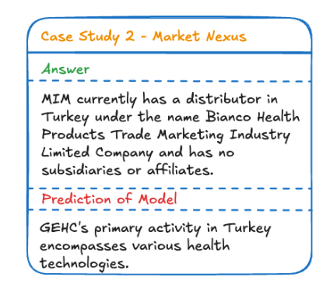
Experiment Results – Qualitative Findings
What is the exact sentence that establishes the target undertaking’s nexus to the Turkish market?
  Contextually plausible but not the one we are looking for.
Notes:
Figure 7 illustrates a more fundamental error of entity confusion. In this case, the model was tasked with finding the market nexus for the target undertaking, MIM. The correct answer appropriately identifies MIM’s distributor in Turkey.
The model, however, extracted a sentence describing the Turkish activities of a different company, GEHC, which was the acquiring undertaking in the decision. This type of failure is significant because it reveals that the model correctly understood the semantic pattern of a market nexus sentence (i.e., a company’s activity in Turkey).
However, it failed to correctly ground this pattern to the specific entity at the heart of the query (the target, MIM). This suggests that while the model is effective at pattern matching, its ability to maintain a consistent focus on the correct entity can be fragile, especially when multiple companies are discussed in close proximity within the text.

Slide 21
Limitation and Future Work
Positive and Monolingual Data
Turkish only
Context & Noise Problem
Single Best Answer Problem
Implicit v. Explicit Reasoning
Lack of negative example
Ablation study
Need for a retriever stage
Multiple sentences can be correct
Multi-span annotation or preference-based frameworks
Formulaic questions (Q2, Q4) vs implicit questions (Q1, Q3)
From pattern matching to legal reasoning with LLMs
Notes:
1. The Data Bias Problem: Positive and Monolingual Data
Our dataset comes with two major biases. First, it’s monolingual — everything is in Turkish. That means we can’t really compare our results with other legal QA datasets or models trained in English, like LegalBERT.
But the bigger issue is that the dataset only includes positive examples — cases where the TCA actually applied the exception. The model never sees what it looks like when the rule doesn’t apply. So it learns what the rule looks like in action, but not where its boundaries are.
In future work, we plan to address both of these limitations. We’ll start by translating the dataset into English to allow for cross-linguistic benchmarking. And we’ll also try to create a balanced corpus — ideally by including negative examples, or, if that’s not possible, generating synthetic counterexamples through data augmentation. That will help the model learn not just when the rule holds, but also when it doesn’t.
2. The Context & Noise Problem: Finding the Signal
Our ablation study made something very clear — too much context is actually hurting performance. When we removed the surrounding “noise” from the text, the model’s accuracy on the most difficult implicit reasoning task jumped by more than 45 points.
So instead of giving the model the entire document, we need a smarter way to focus its attention. The next step is to design a two-stage Retriever-Reader system.
In this setup, the Retriever will first scan the whole document and pick out a few candidate passages. Then the Reader — which is basically our current QA model — will dive into those passages and do the detailed reasoning. This should help the model find the right signal without getting lost in irrelevant text.
3. The “Single Best Answer” Problem: The Limits of SQuAD
Another limitation comes from the framework we used — SQuAD. It assumes that every question has exactly one correct answer span. But legal reasoning doesn’t always work that way.
When we looked at the results qualitatively, we found that many questions actually have multiple valid answers. Sometimes, different sentences express the same idea in slightly different ways, but the model gets penalized for choosing any answer that isn’t exactly the one annotated.
To fix this, we want to move beyond the single-span setup. In future versions, we’ll look into multi-span annotation, where all valid answers are marked. We’re also considering preference-based approaches, where the model learns to identify a set of good answers rather than just one “official” answer.
4. The Model Capability Problem: Implicit vs. Explicit Reasoning
Finally, our results clearly show a gap between question types. The model does really well on formulaic, pattern-based questions — but it struggles when the reasoning is implicit or abstract.
This highlights the limits of traditional models like BERT. They’re great at matching patterns, but not at understanding the deeper logic or reasoning behind the text.
That’s where large language models come in. With their larger context windows and emerging reasoning abilities, LLMs are much better equipped for these kinds of nuanced, implicit arguments. So in our next phase, we plan to benchmark our dataset against modern LLMs to see how far we can push these results.

Slide 22
Thanks for listening.
Q&A?
Notes:
Thanks for listening and if we have time we can do Q&A.

