Slide 1


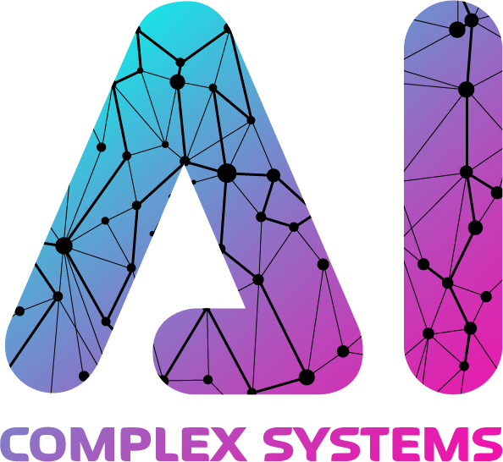
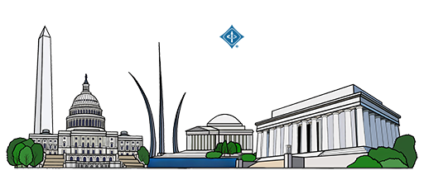

Legal Argument Mining the TCA’s Technology
Undertaking Exception with Turkish BERT
M. Mikail Demir and M. Abdullah Canbaz
Department of Information Science and Technology
College of Emergency Preparedness, Homeland Security, and Cybersecurity University at Albany, SUNY
Albany, New York, United States
Notes:
Hello everyone, I would like to start by giving thanks to chairs for putting this venue and hope many more editions will come in future
A little about me, I am Mikail Demir, I am a 2nd year PhD student at University at Albany SUNY, in Information Science program, before moving to the USA, I studied law and economics in Turkey,
I admitted to Istanbul Bar Association and practiced as a lawyer in Turkey for 2 years, and this is actually my first paper talk experience so it is very exciting for me and I have put this work with my advisor Abdullah Canbaz so without further ado I want to start my presentation with motivation, why did we get into this effort

Slide 2
Motivation
Vast amounts of complex, unstructured text in the form of decisions, laws
Effective monitoring is key for robust regulations
Legal Argument Mining 🤝 Extractive Question Answering
Notes:
Legal documents are everywhere, and they're incredibly hard to read and analyze.
Think of all the court decisions and laws that governments and courts publish every day right so It's a massive amount of complex text.
The key is that this information is almost always unstructured, and does not give too much chances for prediction/analysis etc.
it is important to know how the law is actually being used in practice over time. Lawyers need this to better serve to their clients, society needs this so that they can understand and argue in favor or against the rules that govern us.
With this motivation, we tried to put existing argument mining and extractive question answering frameworks into test to see can we build a model that can effectively points us and enables monitoring where a rule is being applied.

Slide 3
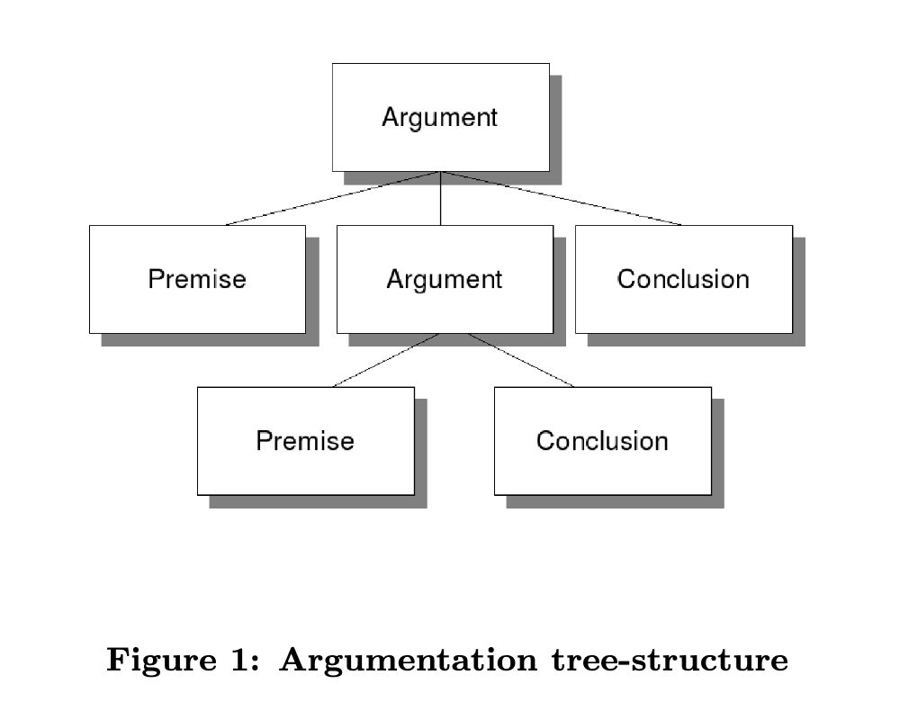
Related Work on Legal Argument Mining / Extractive Question Answering
Legal Argument Mining
Extractive Question Answering
The "Richness Gap”
Major discrepancy between classic model and rich typology in legal documents (Habernal et al., 2023)
Key Challenges in the Field
Long Context
Expensive annotation
Utility of existing schemes
Notes:
OK, so I want to start with related work on these fields, I will start with the legal argument mining
"The foundational work in this area, by researchers like Mochales and Moens, established the core task. Their approach, which was adopted by many, was to take a legal text, segment it (usually by sentence), and classify each segment into its basic argumentative components like Premises and Conclusions.
"This premise-conclusion model was often inspired by theoretical frameworks like Walton's argumentation schemes.
"However, this classic model led to what the literature now calls the 'richness gap.’
"The Habernal et al. paper, from 2023, is a key text here. They argue there's a 'major discrepancy' between the simple premise-conclusion model that NLP researchers were using, and the 'rich typology' of arguments that legal experts, scholars, and judges actually use in their reasoning.
"To fix this, Habernal and his team—a mix of NLP and legal scholars—created a new, massive dataset from the European Court of Human Rights. Instead of just 'premise,' they annotated 16 fine-grained, legally-grounded argument types.
"So, this evolution from a simple model to a rich, complex one has highlighted three key challenges that define the field today.
”First, the Need for Context. In literature, legal argument mining extraction models often made mistakes that the human legal experts on their team could only resolve by reading the entire document. The model, which was limited to single paragraphs, was failing because it didn't have the full context.
”Second Cost. This is a practical but critical problem. The data is "extremely expensive" to create because it requires labeling by legal experts. The annotation task itself is "difficult task" even for these human experts.
Third, Utility of Existing Schemes: The suitability of common argument mining schemes, such as those inspired by Walton, for legal discourse "lacks solid empirical evidence". The utility of the simple premise/conclusion model for legal analysis "remains unaddressed".

Slide 4
Related Work on Legal Argument Mining / Extractive Question Answering
Extractive Question Answering
Extractive Question Answering (EQA) is the task of extracting a span of text from a given context paragraph as the answer to a specified question.
SQuAD is one of the most popular datasets for EQA, which consists of context-question-answer span triplets .
By framing a legal analysis as a series of targeted questions, a QA framework effectively deconstructs a complex document into its structured components.
Legal Argument Mining
Extractive Question Answering
Notes:
I now want to switch to the second, parallel field that our work builds on: Extractive Question Answering, or EQA. This field provides the methodology for how we find those arguments.
"At its core, EQA is a form of Reading Comprehension. The task is simple to define: you give a model a 'context'—a piece of text—and a 'question.' The model’s job is to read the context and extract the literal span of text that contains the answer.
"This entire field was essentially standardized by the SQuAD, the Stanford Question Answering Dataset. SQuAD introduced the (Context, Question, Answer-Span) triplet. It became the de facto benchmark for this kind of task.
"This EQA framework is a very natural fit for the legal domain. A core part of legal work isn't always creative writing; it's precision retrieval. It's about finding the exact clause in a 100-page contract, the specific fact in a case file, or the key sentence of a judge's reasoning.
"By framing a complex legal analysis as a series of targeted questions, the EQA framework allows us to deconstruct a massive, unstructured document into its core, structured components.
"And we've seen this methodology validated across the legal NLP literature. There has been a recent surge in datasets that apply this 'reading comprehension' model to legal texts.
"For example, the MAUD dataset is a key benchmark here. It's a large-scale, expert-annotated dataset with over 47,000 questions about English-language merger agreements.
"But it's not the only one. We have Koreeda & Manning (2021), who applied this to nondisclosure agreements. We have Zheng et al. (2021), who created a massive multiple-choice dataset from US case law citations. And in other languages, Duan et al. (2019) created a 50,000-question, expert-annotated dataset for Chinese judicial rulings called CRJC.
"So, the literature clearly shows that EQA is a robust, validated, and state-of-the-art method for handling complex legal texts.

Slide 5
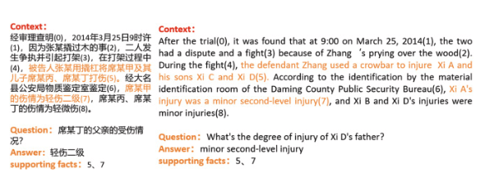
Related Work on Legal Argument Mining / Extractive Question Answering
Extractive Question Answering
Extractive Question Answering (EQA) is the task of extracting a span of text from a given context paragraph as the answer to a specified question (Pearce et al., 2021)
SQuAD is one of the most popular datasets for EQA, which consists of context-question-answer span triplets (Rajpurkar et al., 2018)
By framing a legal analysis as a series of targeted questions, a QA framework effectively deconstructs a complex document into its structured components.
Legal Argument Mining
Extractive Question Answering
Notes:
For example, this is a figure from the MENG et al paper which uses CRJC dataset, here you can see the supporting facts are located with their start/end token indices

Slide 6
Related Work on Legal Argument Mining / Extractive Question Answering
Applying them together
Legal Argument Mining
Extractive Question Answering
Notes:
In this study we inquire whether can we operationalize the application of legal rule and creating a set of questions that reveals the underlying reasoning and then using this fixed questions on different legal judgments to verify whether can we see the answers to this fixed questions.

Slide 7
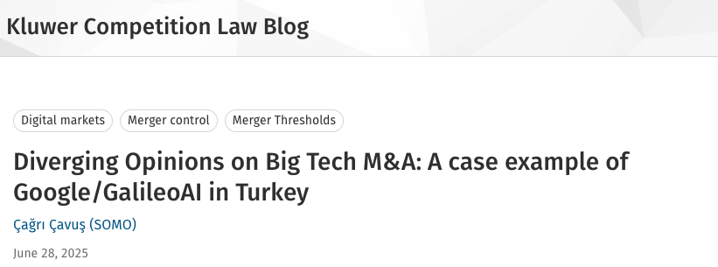

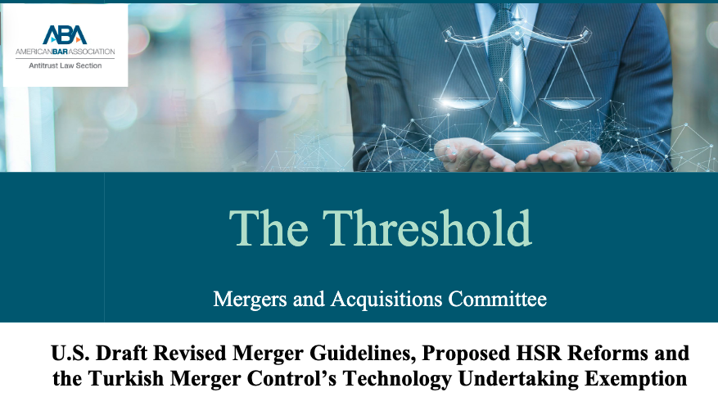
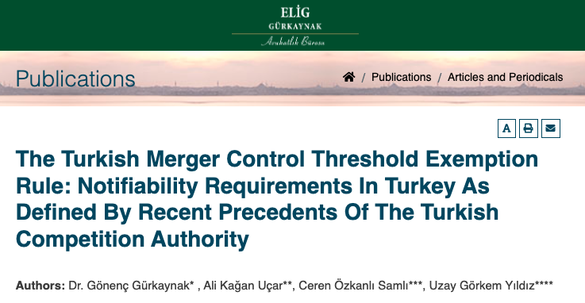
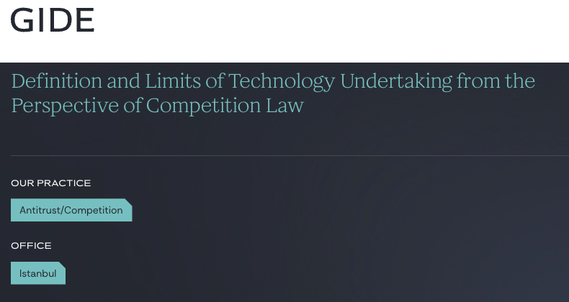
Background – Technology Undertaking Exception Rule
Introduced by the Turkish Competition Authority (TCA) in March 2022
Extends merger control rules to nascent technology companies
Waives turnover thresholds when the target qualifies as a “technology undertaking”
Notes:
"Okay, so to understand our project, we first need to understand the real-world legal problem we're solving. It’s about this new rule from the Turkish Competition Authority, or TCA.
"The TCA is Turkey's main market regulator. Their job is to make sure competition is fair, similar to the FTC or DOJ here in the U.S. In March 2022, they introduced this new rule.
"This rule is part of their 'merger control' regime. The whole purpose of merger control is to prevent monopolies. Regulators want to review large business deals to stop one or two companies from getting so big that they can control an entire market and harm consumers.
"But this creates a trade-off for the regulator it's simply not logical review every single transaction so there is a revenue threshold, if the companies in the deal make less than a certain amount of money, they do not have to let TCA know about that. The deal is too small to worry about. This is the classic assumption in antitrust law.
"The problem is tech startups. A startup can have a revolutionary product, millions of users, and a billion-dollar valuation, but almost zero revenue.
"Under the old rules, a huge company could buy—and shut down—a small, innovative competitor and the deal would be under the revenue threshold. The TCA couldn't legally review it.
So all around the world authorities trying to fix this phenomen called killer acqusutions and this rule shares the exact line of thinking if the company you are buying is a 'technology undertaking,’I will not apply some of the threshold, specifically the target company related one, This effectively relaxes the criteria, because some of the thresholds are not being looked for anymore which expands the TCA's jurisdiction so it now has the power to review these deals. This means more deals should be notified which brings a legal and compliance overhead to companies.
The rule is simple, but its application is not. It has created a massive 'gray area'. What is a 'technology undertaking? TCA gives us a definition which I will explain in the next slide but For example lets say the target company, company you want to buy is a roofing company, they are basically contractors, but lets say these folks use a mobile application to better connect with their customers, take orders etc. is this a technology undertaking? This is a legal interpretation problem and questions are endless so while the rule is simple it creates a lot of questions. "The only way to find answers is to see how the TCA decides in its first cases. This has led to a flood of analysis from law firms, all trying to dissect these new decisions to find a pattern: which companies are being considered 'technology undertakings,' and what counts as a 'market nexus’?

Slide 8
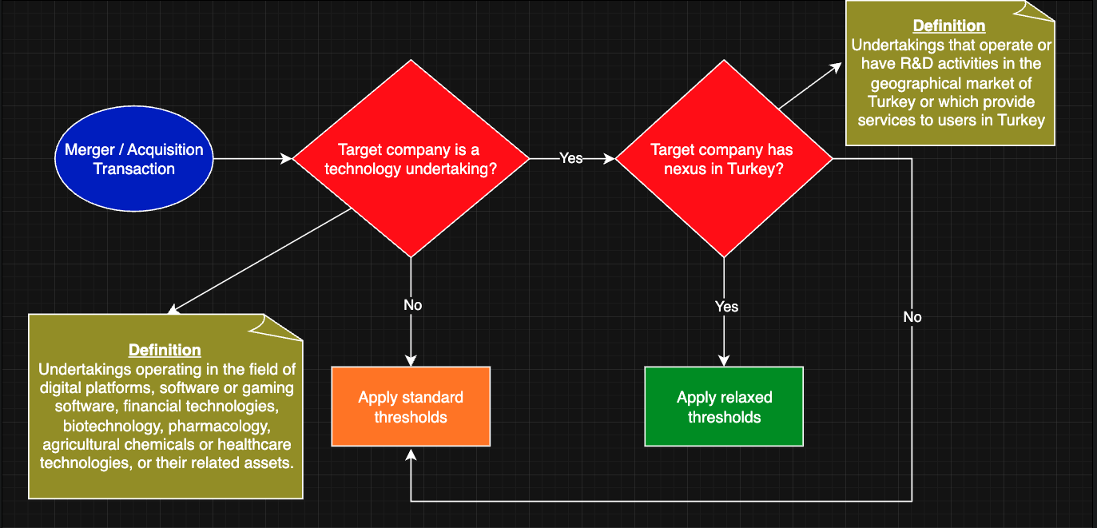
Background – Technology Undertaking Exception Rule
Q1/Q2
Q3
Q4
Notes:
"So, how does this new rule actually work? This flowchart visualizes the core analytical task that the Turkish Competition Authority and any legal practitioner must now perform.
"Everything starts with a 'Merger or Acquisition Transaction.’
"The first test is the 'what': The TCA must determine if the target company is a 'technology undertaking’.
"As the definition box on the left shows, this is a broad, substantive definition. The law, defines these as undertakings operating in fields like 'digital platforms, software or gaming software, financial technologies, biotechnology, pharmacology,' and so on.
"If the answer is 'No’ this exception is irrelevant. The TCA simply moves on and 'Applies the standard, strict thresholds', and the analysis for this rule ends.
"But, if the answer is 'Yes', the analysis continues. Just being a tech company isn't enough.
"This brings us to the second test, the 'where': The TCA must ask if the target company has a 'nexus in Turkey’.
"The law is also specific about this. The nexus is established if the company 'operate[s] or have[s] R&D activities in the geographical market of Turkey or... provide[s] services to users in Turkey’.
"If the answer here is ‘No, the rule again does not apply, and you revert to the 'standard thresholds.'
"However, if the answer to both of these questions is 'Yes'...
TCA applies relaxed thresholds. This action expands the TCA's jurisdiction, allowing it to review a transaction that otherwise would have been too small to be notifiable.
"This two-part, four-step logical process is the 'semantically complex' rule we're talking about.
"And this is precisely what our paper models. This flowchart is our annotation schema.
Our four annotation questions are designed to extract the exact sentences from the TCA's decisions that correspond to each step of this diagram :
Q1 (Business Description) and Q2 (Legal Classification) map to this first diamond.
Q3 (Market Nexus) maps to this second diamond.
And Q4 (Threshold Application) maps to the final outcome—whether the TCA landed in the orange box or the green one.
"What we have done is take this complex legal workflow and operationalize it as an extractive NLP task."

Slide 9
Research Questions
RQ1: To what extent can a fine-tuned BERT model, framed within an extractive QA task, effectively and accurately extract the components of a complex legal argument from specialized, non-English legal documents?
RQ2: How does the model's performance differ across various types of argumentative components, and what does this variation reveal about the nature of the legal text itself?
RQ3: What is the role of context length in the model's performance on this legal QA task, particularly for identifying implicit reasoning?
Notes:
To what extent can a fine-tuned BERT model, framed within an extractive QA task, effectively and accurately extract the components of a complex legal argument from specialized, non-English legal documents?
How does the model's performance differ across various types of argumentative components, and what does this variation reveal about the nature of the legal text itself?
And our third question, RQ3, tests our main hypothesis about the key challenge: What is the role of context length in the model's performance on this legal QA task, particularly for identifying implicit reasoning?"

Slide 10
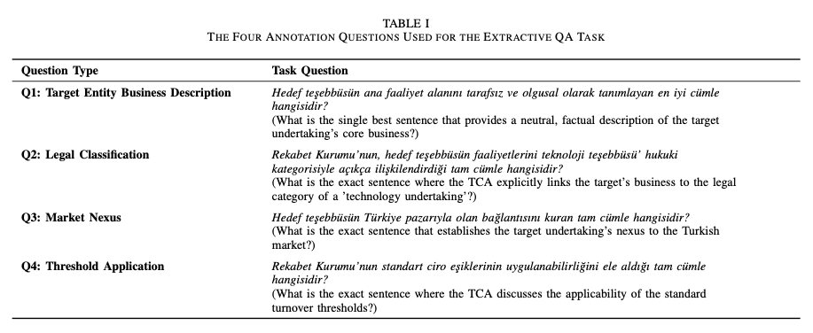
Methodology
Notes:
"So, as I just mentioned, we operationalized that complex legal workflow into an extractive NLP task. This table shows the exact four questions we designed to do this.
These questions are the core of our model's task. They are designed to mirror the four-step legal analysis from the flowchart.
For Q1, the 'Business Description,' we're looking for the factual basis. What does this company actually do? The answer we expect is a neutral, factual description of its core business, like 'Company X is a software provider for the energy sector.' We're not looking for legal analysis here, just the facts.
For Q2, the 'Legal Classification,' we're asking the model to find the specific sentence where the TCA explicitly links that business description to the legal rule. The answer we're looking for is the direct legal conclusion, something like, '...it is determined that the target's activities in software development fall under the definition of a technology undertaking.’
Q3, 'Market Nexus,' was our most challenging task. Here, we're looking for the sentence that establishes the company's connection to Turkey. The problem, as we'll see, is that the TCA is often implicit about this. So, the answer isn't always a clean 'Company X has an office in Turkey.' More often, the "correct" answer is a proxy, like a sentence discussing its 'turnover generated in Turkey' or its 'local distributor.’
Finally, Q4, 'Threshold Application,' is the final legal outcome. This is the 'so what' of the analysis. We're extracting the single sentence where the TCA applies the rule and states whether the standard turnover thresholds are waived or not.
As you can see, these four questions create a one-to-one mapping from the legal workflow to a concrete, SQUAD-style dataset. This allows us to train the model to "think" like a legal analyst, extracting the four key components of the argument

Slide 11
Methodology
Data Collection:
We scraped all of the publicly available merger & acquisition decisions from TCA’s website (4552 decisions)
Keyword Filtering:
To isolate relevant cases, we filtered this collection to only include that contained the specific legal term “technology undertaking” (152 decisions)
Content Extraction:
From these 152 decisions, we extracted only the core analytical section known as the “Examination and Evaluation” section.
Notes:
So, this is how we built our dataset. It was a three-step process designed to create a small, dense, and highly relevant corpus. We basically scraped the authority’s official website and filtered out technology exception decisions using keywords, I could happily discuss this step in the QA if anyone is curious
"First, Data Collection. We started by programmatically scraping all publicly available merger and acquisition decisions from the Turkish Competition Authority's website. This gave us a large, raw corpus of 4,552 unique decisions.
"Second, Keyword Filtering. This large corpus contains all sorts of decisions, but we were only interested in our specific legal problem. So, we filtered this entire collection to find only the documents that contained the exact legal term 'teknoloji teşebbüsü,' which means 'technology undertaking'. This yielded 152 relevant decisions.
"Third, Content Extraction. This is a critical step, which, as you'll see, relates directly to our third research question on context length. A single legal decision is full of procedural details and boilerplate text, so we first had to isolate the core reasoning.
"TCA decisions follow a semi-standard structure, so we used a regular expression to automatically extract only the core analytical section, which is known as the 'İNCELEME VE DEĞERLENDİRME' or 'Examination and Evaluation' section . This gave us our final 152 focused 'context' documents.

Slide 12
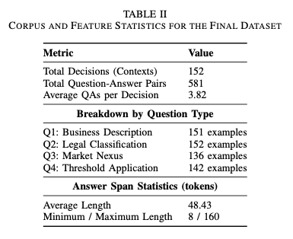
Methodology
Notes:
"As you can see, our 152 decisions (or 'Contexts') yielded a total of 581 Question-Answer pairs.
You'll immediately notice that the numbers are not equal. We have an answer for Q1 (Business Description) and Q2 (Legal Classification) in nearly every single document.
"But Q3 (Market Nexus) and Q4 (Threshold Application) are less frequent, with only 136 and 142 examples, respectively.
"This is not a data collection error; this is a key finding of our paper. It's an expected outcome, as we state, because the TCA's reasoning and explicit statements can vary.
"Finally, you can see the Answer Span Statistics. We were annotating full sentences, so the average length is about 48 tokens, with a wide range from 8 to 160 tokens."

Slide 13
Methodology
Core Experimental Design
Base Model: dbmdz/bert-base-turkish-cased (BERT-base architecture).
Fine-Tuning & Validation
Task Formulation: Extractive Question Answering (SQuAD format).
The model predicts the start and end token indices of the answer span.
Framework: HuggingFace transformers and datasets libraries.
Hyperparameters (Optimized): Learning Rate: 3e-5, Batch Size: 2, Epochs: 4,Weight Decay: 0.01
Validation Strategy: 5-Fold Cross-Validation
Ablation Study: Context Impact
Objective: To quantify the performance bottleneck caused by high signal-to-noise ratio in legal texts.
Method: A "Truncated-Span Context" dataset was generated using a heuristic.
For each document, context was programmatically reduced to the minimal substring spanning from the start of the earliest answer to the end of the latest answer.
This isolates the impact of extraneous text on model accuracy.
Notes:
"For our Base Model, we selected the dbmdz/bert-base-turkish-cased model. This was a deliberate choice: it's a BERT-base architecture specifically pre-trained on a large, cased corpus of Turkish text, and it has demonstrated strong performance on other downstream Turkish NLP tasks.
We converted our entire 581 QA-pair dataset into the SQuAD format .
"This means the model is not generating text; it is a classification task. It's trained to predict two things: the start and end token indices of the answer span within the given context.
All of this was implemented using the standard HuggingFace transformers and datasets libraries, which allows for easy replication.
"Second, our Fine-Tuning and Validation strategy.
"The Hyperparameters you see here were selected after a systematic hyperparameter search. The final configuration gave us the most consistent performance "We used a 5-Fold Cross-Validation strategy. This mitigates the risk of an unrepresentative test set.
(Point to: 'Ablation Study: Context Impact’)
"Finally, our Ablation Study. This was designed to directly answer our third research question: What is the role of context length?
"The Objective was to empirically quantify the performance bottleneck caused by the high signal-to-noise ratio that we know is present in legal texts.

Slide 14
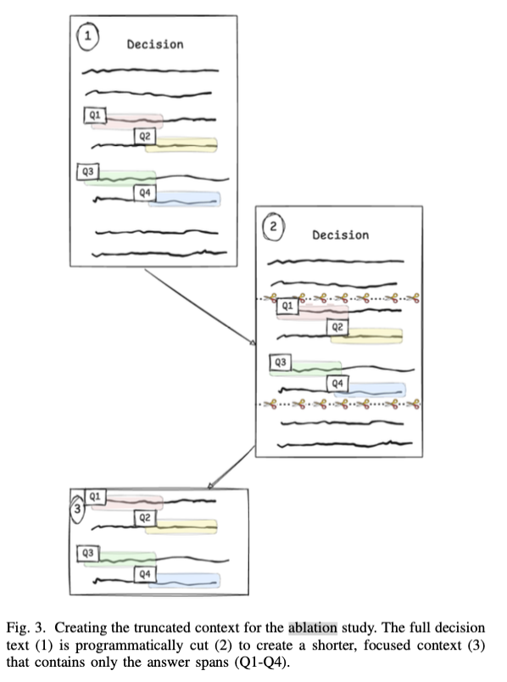
Methodology
Notes:
"To do this, we created a second, parallel dataset called the 'Truncated-Span Context' dataset.
"The Method was a heuristic: For each document, we programmatically created a minimal text window. We defined this as the substring starting at the character index of the earliest answer and ending at the character index of the latest answer for that document. This effectively created a 'perfect,' dense context with no extraneous text.
"I want to be clear, as we state in the paper, this is not a practical pre-processing technique; it's a true ablation that relies on knowing the answers' locations in advance. Its purpose is to isolate the impact of that extraneous text and give us a benchmark for how much performance is being lost to noise ."

Slide 15
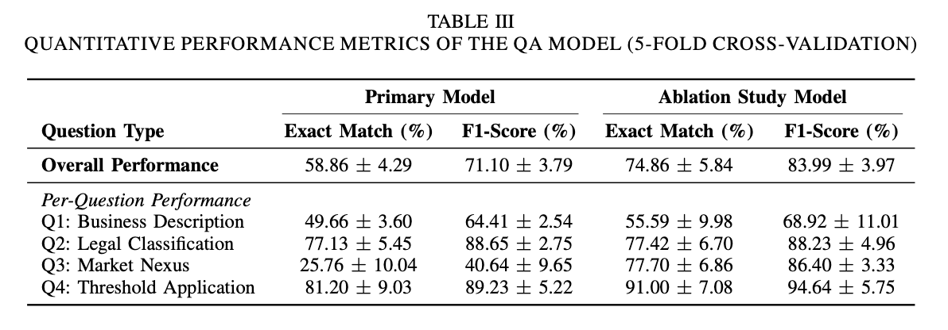
Experiment Results – Quantitative Findings
Notes:
"Alright, let's dive into the performance of our model. We evaluated it using 5-fold cross-validation, and the results reveal a fascinating split in performance that tells us a lot about the legal text itself.”
1. Overall Performance: A Strong Baseline
Our primary model achieved overall F1-score of 71.10% and 58 percent EM score We believe this is an acceptable baseline at this point.
2. Per-Question Analysis: The Performance Divide
"But when we break this down by question type, a clear pattern emerges. The model's performance is directly correlated with the explicitness of the legal language it's trying to find."
High Performance on Formulaic Statements (Q2 & Q4)
The model excelled on tasks requiring the extraction of clear, standardized legal conclusions.
Q2 (Legal Classification) and Q4 (Threshold Application) achieved very high F1-scores of approximately 89% because these parts of the legal argument are often written in formulaic, explicit language, making them easy for the model to identify.
Low Performance on Substantive Reasoning (Q1 & Q3): Conversely, the model struggled significantly with tasks that required understanding nuanced, implicit reasoning. Q1 (Business Description) was more modest at ~64% F1 Q3 (Market Nexus) was the most challenging task by far, with a very low F1-score of only ~41%
This suggests the reasoning for Market Nexus is often implicit, stylistically variable, or buried in dense text, making it difficult to extract as a single, clear sentence.
3. The Ablation Study: Proving Context is the Bottleneck
"So, why did the model struggle so much with Q3? Our ablation study gives us a clear answer: the problem isn't that the answer is missing; it's that it's being obscured by noise.” which we believe we can utilize in the future by introducing a smarter retrieval stage

Slide 16
Experiment Results – Quantitative Findings
Evaluation Metric
Exact Match (EM) score is a strict, binary metric that measures the percentage of predictions where the predicted text span is identical to the ground-truth answer
More than 1 acceptable answer (qualitative findings), punctuation marks
Influence of Answer Length on Prediction Performance
The answer length is negatively correlated with performance in EQA systems.
The negative correlation is described as a strong effect found in the analysis of DistilBERT on SQuAD data.
Specifically, going from an answer length of 1 to an answer length of 5 reduces the exact match by almost a factor of 2 (Farea et al., 2024).
Notes:
A little bit about the EM metric
"Our primary metric is Exact Match (EM). As the slide says, this is a very strict, all-or-nothing score. The predicted text span must be 100% identical to the expert-annotated ground-truth answer to get any credit.
"This metric is also challenged by the nature of legal text itself.
In some cases TCA might state the 'Market Nexus' in two different, equally valid sentences. Our dataset labels one of them as the ground truth.
If our model correctly extracts the other valid sentence, a strict EM score marks it as a zero. It's a failure, even though the model's extraction was correct.
Even a simple difference in punctuation can cause the model to fail this metric.
"Finally, we have to consider the influence of answer length on performance. This is a well-documented phenomenon in EQA.
"The key takeaway from the literature is that answer length is negatively correlated with performance. Longer answers are harder for models to get exactly right.
"To give you a concrete example, recent work by Farea et al. found that just going from an answer length of 1 to 5 tokens can reduce the exact match score by almost a factor of 2.
"This is highly relevant for us, because as you saw in our data, our average answer length is quite long—about 48 tokens. This context is important for interpreting our own scores, as it helps explain the gap you'll see between our strict Exact Match and our more lenient F1-scores.”

Slide 17
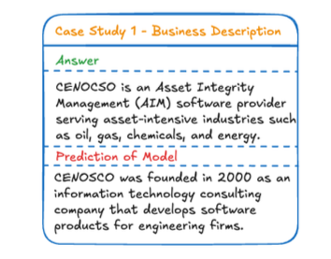
Experiment Results – Qualitative Findings
What is the single best sentence that provides a neutral, factual description of the target undertaking’s core business?
Abundance of information
A direct result of being constrained to single best-sentence
Notes:
This question addresses the first substantive condition of the technology undertaking exception, seeking the factual basis required to classify the target company’s activities.
The primary challenge with this question stems not from a lack of information, but from an abundance of it. Unlike the more formulaic legal conclusions, TCA decisions often contain multiple sentences describing the target undertaking’s business. These descriptions are presented for various purposes, such as defining the affected markets, detailing global operations, or outlining specific activities in Turkey.
This creates a significant challenge for the annotation task, which required selecting the single best sentence that was both neutral and provided a comprehensive overview of the company’s core activities.
So, in this case model selects a descriptive sentence that is factually correct but suboptimal. The annotated answer describes what the target company, CENOCSO, currently does: it is an ”Asset Integrity Management (AIM) software provider” serving specific industries. The model’s prediction, however, describes what the company used to be or its historical origins: it ”was founded in 2000 as an information technology consulting company.” While this sentence is also a valid description of the company, it is less relevant for the legal analysis, which is concerned with the company’s present-day activities.

Slide 18
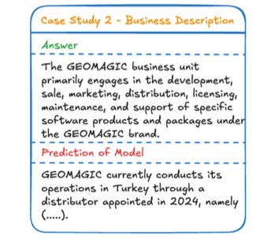
Experiment Results – Qualitative Findings
What is the single best sentence that provides a neutral, factual description of the target undertaking’s core business?
Relevant sentence, but not for this question
Our analysis of the 152-decision corpus revealed that only four decisions contained an explicit sentence that both discussed and confirmed the market nexus condition.
Notes:
The model was prompted for the target’s Business Description (Q1), which requires a factual statement of the company’s core commercial activities. The ground- truth answer correctly identifies GEOMAGIC’s role in soft- ware development and support. However, the model instead extracted a sentence detailing the company’s ”operations in Turkey through a distributor.” This prediction, while factually correct, is a textbook answer for the Market Nexus (Q3) question, The error is significant because the model did not simply fail; it correctly identified a legally relevant sentence but misapplied it to the wrong analytical task.
For the vast majority of cases, our annotator was therefore required to select the best available proxy sentence—one that implicitly established the target’s presence in Turkey. Common examples of such implicit sentences included statements about the target’s Turkish market share, its turnover generated in Turkey, or its business dealings with other Turkish companies.

Slide 19
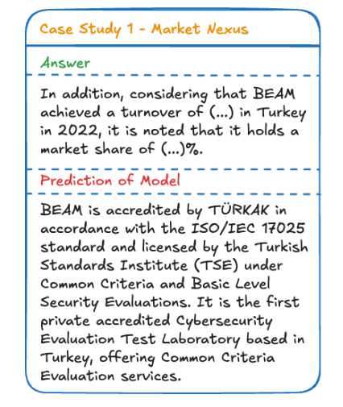
Experiment Results – Qualitative Findings
What is the exact sentence that establishes the target undertaking’s nexus to the Turkish market?
Contextually plausible but not the one we are looking for.
Notes:
Here is an example to that constraint and how it led to error in our model,
For this decision, the annotated answer establishes the market nexus by citing the target company’s (BEAM) turnover and market share in Turkey. This is an implicit but legally sufficient fact. The model, however, failed to identify this sentence. Instead, the model predicted a different sentence that describes BEAM’s technical accreditations and its status as a ”Cybersecurity Evaluation Test Laboratory based in Turkey.”
This error is a classic example of a plausible distractor. The model correctly identified the target entity and latched onto the relevant keyword ”Turkey,” but it selected a sentence describing the company’s general capabilities rather than its specific economic activity. This highlights a key limitation: the model struggles to distinguish between a general descriptive statement and the specific, jurisdictionally relevant fact when both are contextually plausible.

Slide 20
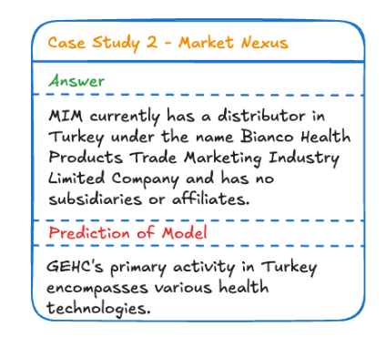
Experiment Results – Qualitative Findings
What is the exact sentence that establishes the target undertaking’s nexus to the Turkish market?
Contextually plausible but not the one we are looking for.
Notes:
Figure 7 illustrates a more fundamental error of entity confusion. In this case, the model was tasked with finding the market nexus for the target undertaking, MIM. The correct answer appropriately identifies MIM’s distributor in Turkey.
The model, however, extracted a sentence describing the Turkish activities of a different company, GEHC, which was the acquiring undertaking in the decision. This type of failure is significant because it reveals that the model correctly understood the semantic pattern of a market nexus sentence (i.e., a company’s activity in Turkey).
However, it failed to correctly ground this pattern to the specific entity at the heart of the query (the target, MIM). This suggests that while the model is effective at pattern matching, its ability to maintain a consistent focus on the correct entity can be fragile, especially when multiple companies are discussed in close proximity within the text.

Slide 21
Limitation and Future Work
Positive and Monolingual Data
Turkish only
Context & Noise Problem
Single Best Answer Problem
Implicit v. Explicit Reasoning
Lack of negative example
Ablation study
Need for a retriever stage
Multiple sentences can be correct
Multi-span annotation or preference-based frameworks
Formulaic questions (Q2, Q4) vs implicit questions (Q1, Q3)
From pattern matching to legal reasoning with LLMs
Notes:
1. The Data Bias Problem: Positive and Monolingual Data
Our dataset comes with two major biases. First, it’s monolingual — everything is in Turkish. That means we can’t really compare our results with other legal QA datasets or models trained in English, like LegalBERT.
But the bigger issue is that the dataset only includes positive examples — cases where the TCA actually applied the exception. The model never sees what it looks like when the rule doesn’t apply. So it learns what the rule looks like in action, but not where its boundaries are.
In future work, we plan to address both of these limitations. We’ll start by translating the dataset into English to allow for cross-linguistic benchmarking. And we’ll also try to create a balanced corpus — ideally by including negative examples, or, if that’s not possible, generating synthetic counterexamples through data augmentation. That will help the model learn not just when the rule holds, but also when it doesn’t.
2. The Context & Noise Problem: Finding the Signal
Our ablation study made something very clear — too much context is actually hurting performance. When we removed the surrounding “noise” from the text, the model’s accuracy on the most difficult implicit reasoning task jumped by more than 45 points.
So instead of giving the model the entire document, we need a smarter way to focus its attention. The next step is to design a two-stage Retriever-Reader system.
In this setup, the Retriever will first scan the whole document and pick out a few candidate passages. Then the Reader — which is basically our current QA model — will dive into those passages and do the detailed reasoning. This should help the model find the right signal without getting lost in irrelevant text.
3. The “Single Best Answer” Problem: The Limits of SQuAD
Another limitation comes from the framework we used — SQuAD. It assumes that every question has exactly one correct answer span. But legal reasoning doesn’t always work that way.
When we looked at the results qualitatively, we found that many questions actually have multiple valid answers. Sometimes, different sentences express the same idea in slightly different ways, but the model gets penalized for choosing any answer that isn’t exactly the one annotated.
To fix this, we want to move beyond the single-span setup. In future versions, we’ll look into multi-span annotation, where all valid answers are marked. We’re also considering preference-based approaches, where the model learns to identify a set of good answers rather than just one “official” answer.
4. The Model Capability Problem: Implicit vs. Explicit Reasoning
Finally, our results clearly show a gap between question types. The model does really well on formulaic, pattern-based questions — but it struggles when the reasoning is implicit or abstract.
This highlights the limits of traditional models like BERT. They’re great at matching patterns, but not at understanding the deeper logic or reasoning behind the text.
That’s where large language models come in. With their larger context windows and emerging reasoning abilities, LLMs are much better equipped for these kinds of nuanced, implicit arguments. So in our next phase, we plan to benchmark our dataset against modern LLMs to see how far we can push these results.

Slide 22
Thanks for listening. Q&A?
Notes:
Thanks for listening and if we have time we can do Q&A.

