Slide 1
Distilling a Neural Network Into a Soft Decision Tree
Nicholas Frosst, Geoffrey Hinton
Google Brain Team

Slide 2
Motivation
Deep neural network is a very effective way for classification tasks.
But it is hard to explain why a network makes a particular classification decision.
Deep neural network → hierarchical representations
Try to extract the knowledge from DNN and express the same knowledge in another hierarchical model (soft decision tree)

Slide 3
Conclusion
The precision of the soft decision tree created from a neural network is higher than a tree learned directly from the training data,
but lower than the neural network.
With a soft decision tree, explaining a particular decision would be much easier.

Slide 4


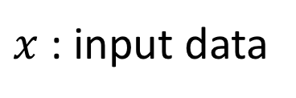


Soft binary decision tree
Inner Node $i$
$x$: input data
$$p_{i}=σ(w_{i}x+b_{i})$$
$$1−p_{i}$$
$$p_{i}$$

Slide 5
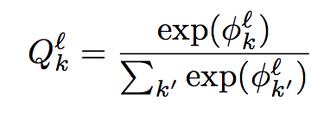
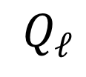

Soft binary decision tree
Leaf Node $ℓ$
Each leaf node stores a probability distribution over classes
$$Q_{ℓ}$$

Slide 6
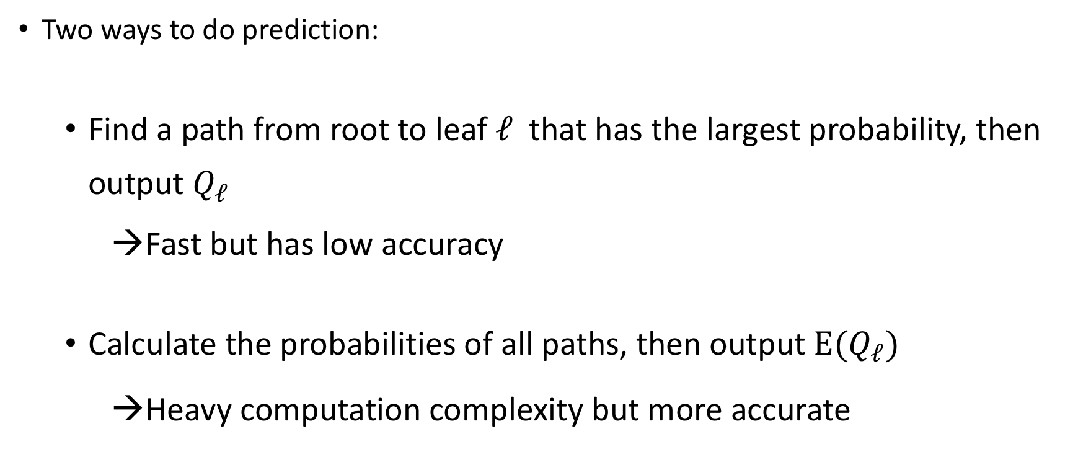
Soft binary decision tree
Two ways to do prediction:
Find a path from root to leaf $ℓ$that has the largest probability, then output $Q_{ℓ}$
→Fast but has low accuracy
Calculate the probabilities of all paths, then output $E(Q_{ℓ})$
→Heavy computation complexity but more accurate

Slide 7
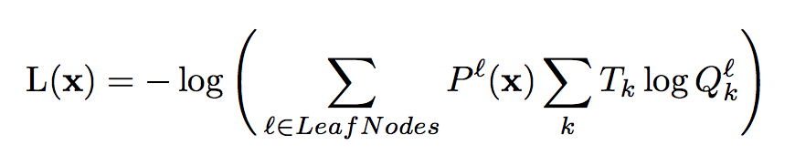

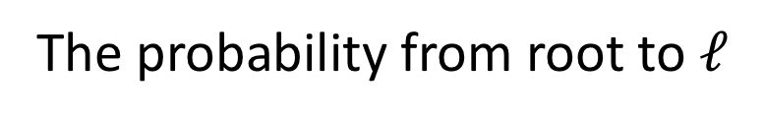
How to train a soft binary decision tree
1) Decide the layer number of the decision tree
2) Train parameters $w_{i}$, $b_{i}$, $φ_{ℓ}$ by Mini-batch SGD
minimize loss:
Target distribution
Cross Entropy
The probability from root to $ℓ$

Slide 8
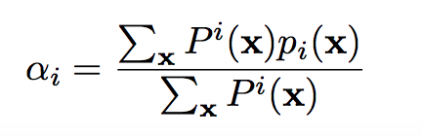
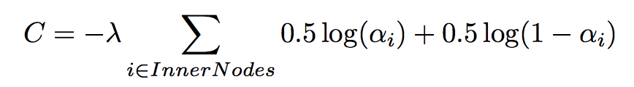
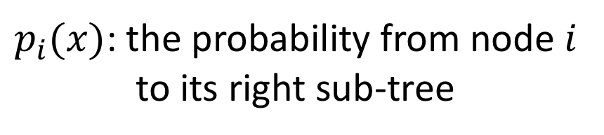
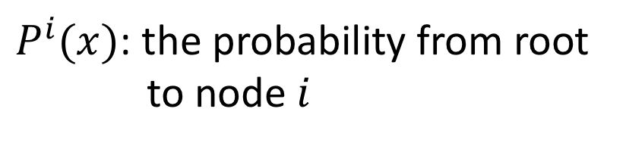
Regularization
To guarantee that each internal node makes equal use of both left and right sub-tree
$P^{i}(x)$: the probability from root
to node $i$
$p_{i}(x)$: the probability from node $i$
to its right sub-tree

Slide 9
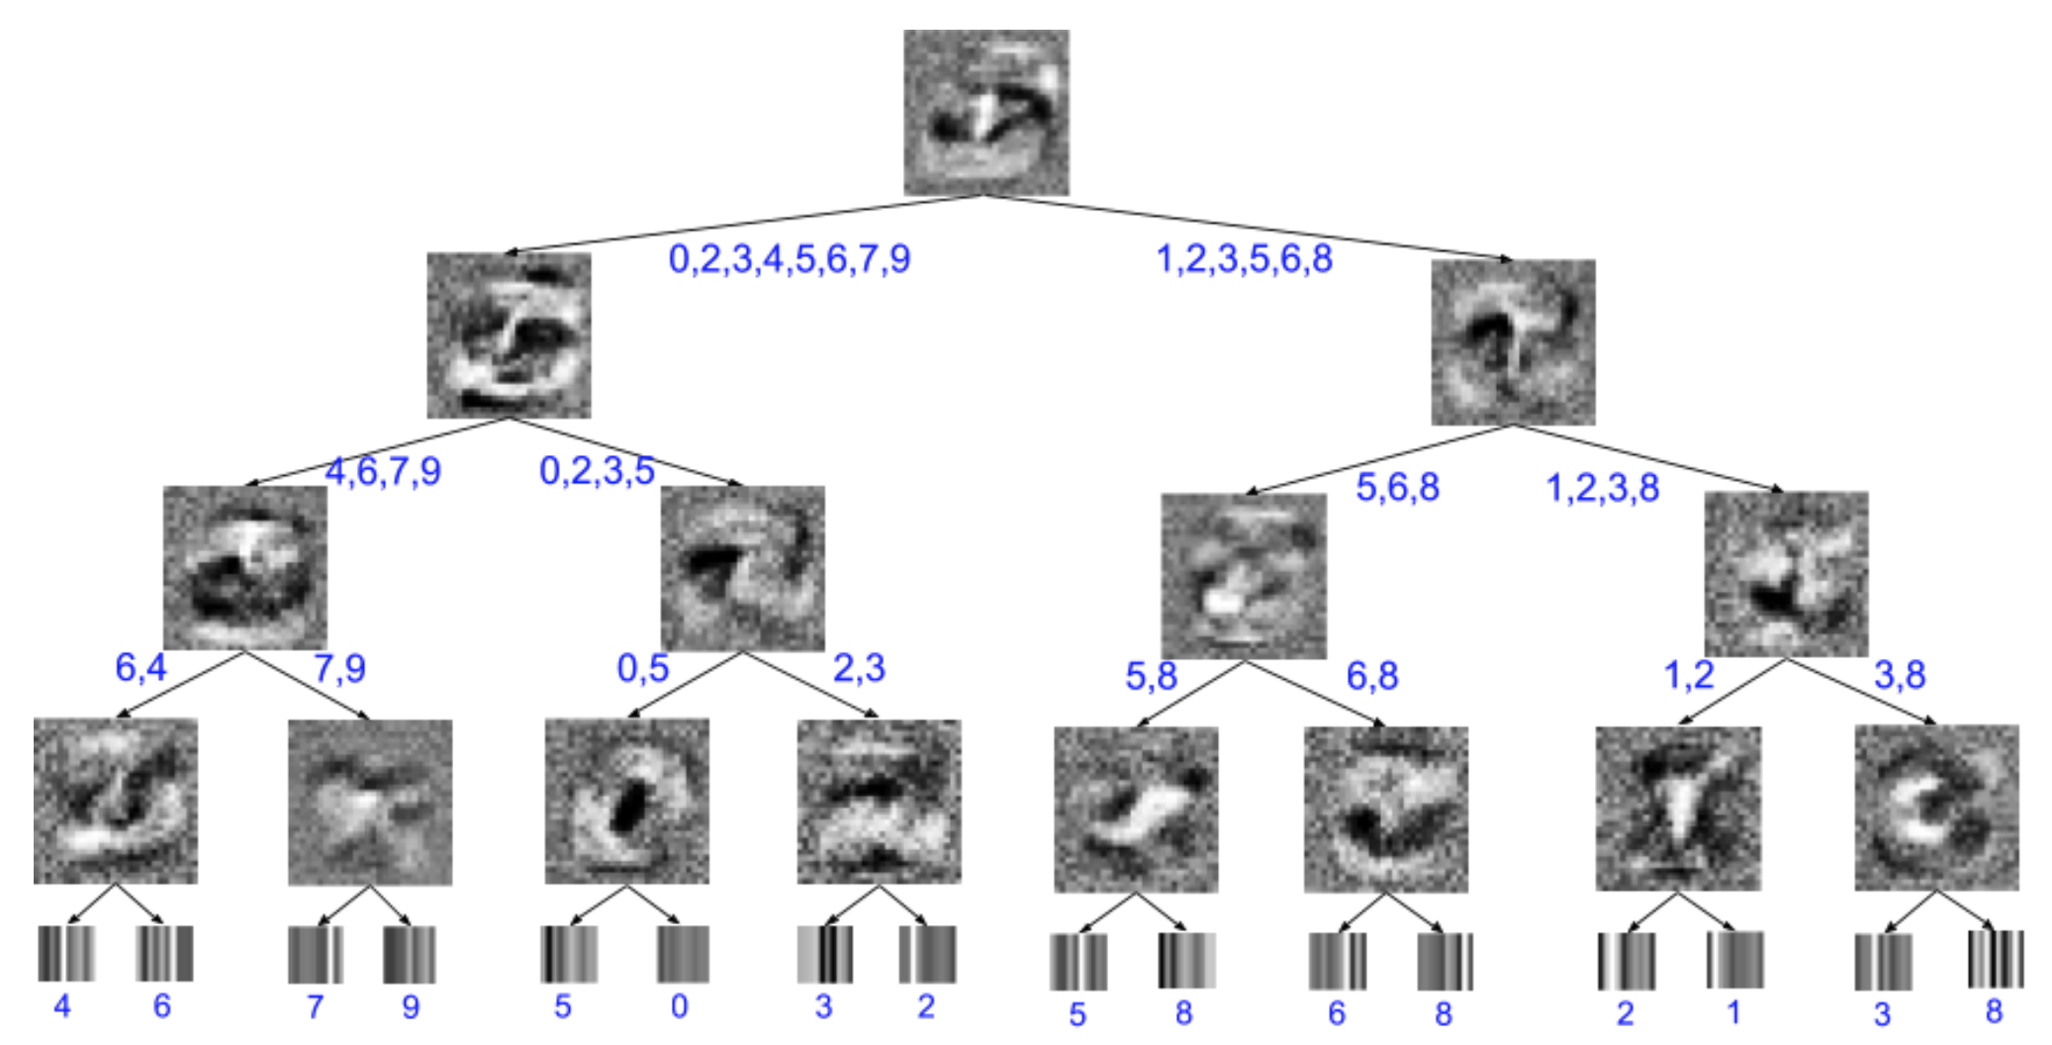
MNIST Visualization

Slide 10

How to benefit from a trained neural network
Substitute the target distribution by
the output of a neural network

Slide 11
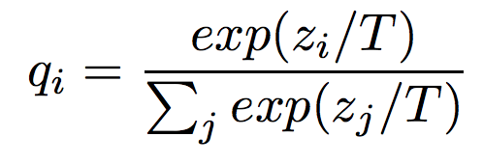
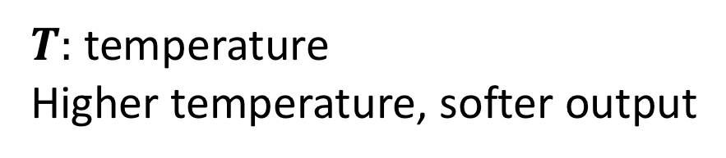
Distillation？
[Hinton et al., 2015] Distilling the knowledge in a neural network
→ distilling the knowledge in an ensemble of models into a single model to reduce the size of models
Distillation: train a small model with two loss components:
(1) cross entropy over true label with T=1
(2) cross entropy over the output of a large model with T>1
$T:$ temperature
Higher temperature, softer output

Slide 12
Result from [Hinton et al., 2015]
MNIST 60000 training cases
Large Model： two hidden layers of 1200 rectified linear hidden unit
Dropout + weight regularization
Small Model： two hidden layers of 800 rectified linear hidden unit
No regularization
Precision: Large: 67 errors ，Small: 146 errors，
Small distillation：74 errors

Slide 13
Results from this paper
MNIST
Neural network:
two convolutional hidden layers and a fully connected layer
99.21%
Soft decision tree:
8 layers
94.45%（directly train），96.76%（distillation from CNN）

Slide 14
Results from this paper
Connect4 dataset：
board states of the popular child’s game connect 4
Soft decision tree：
8 layers
test accuracy：78.63% （directly train），
80.6%（distill from DNN）
other decision trees from [Norouzi et al., 2015]
test accuracy： 76.50% （8 layers），77.45%（20 layers）

Slide 15
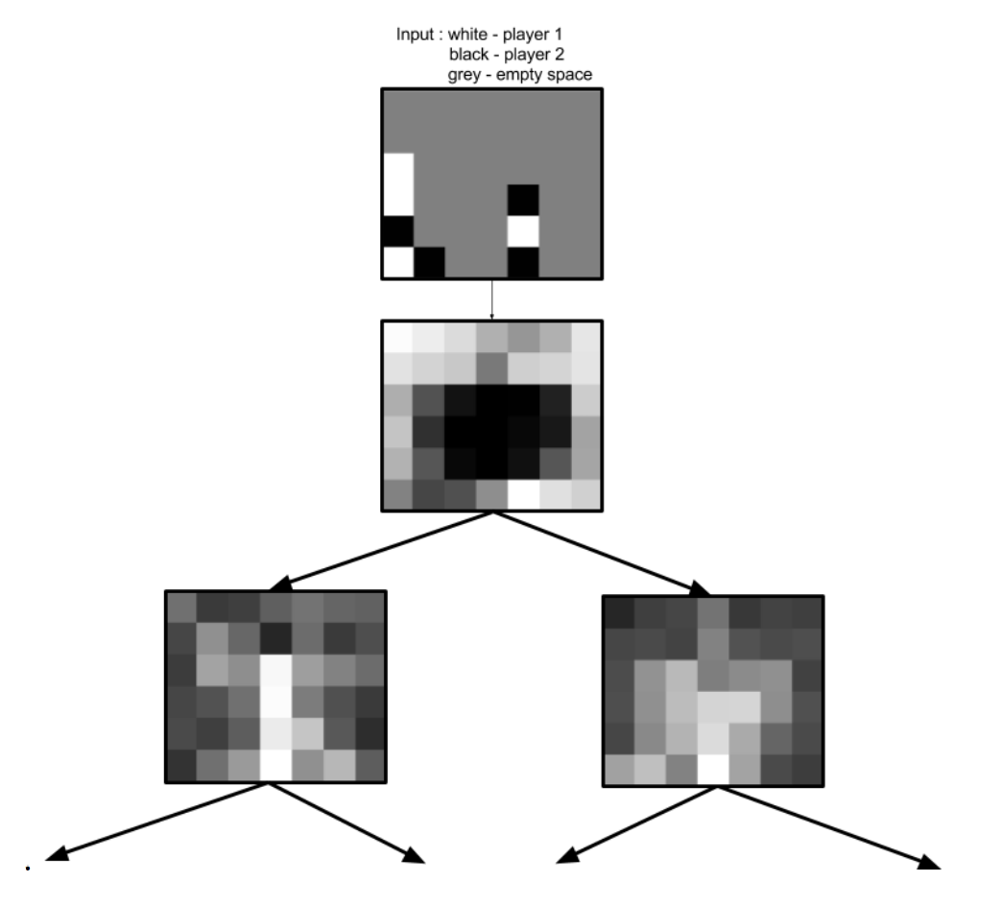
Connect4 Visualization

Slide 16
Results from this paper
Letter dataset [Lichman, 2013]
Soft decision tree
9 layers
Test accuracy: 78.0%（directly train），81.0%（distill from DNN）
ensemble of neural nets
Test accuracy: 95.9%

Slide 17
Conclusion
describe a method for using a trained neural network to create a more explicable model in the form of a soft decision tree
generalizes better than one trained on the data directly
but performs worse than the neural network

Slide 18
Q & A
Thanks!

