Slide 1
Scalable Linear Algebra on a Relational Database System Shangyu Luo, Zekai J. Gao, Michael Gubanov, Luis L. Perez, Christopher Jermaine [ICDE 2017 best paper]
Presented by Zhipeng Zhang
Notes:
ML can help database, like learning memory access patterns, index in database, what database can help?
Conceptual contribution is more important. We understand database, can we use it to solve other problems?
This is real science.

Slide 2
Summary
Distributed relational database can be reused as a scalable linear algebra system and the performance is comparable with other state-of-the-art .

Slide 3
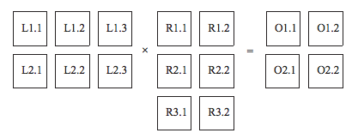
Background
Need to take care of:
1. Computation 2. Communication
3. Storage 4. Optimization
Scalable linear algebra (SLA): operating big matrix in a distributed setting
Spark MLlib.linalg
SciDB
…
Distributed relational databases systems(RDBMS)
Oracle database
IBM DB2
…
Notes:
As data becomes larger, Machine learning to handle distributed

Slide 4
Motivation
Most data is locked in RDB.
We understand RDB very well.
SQL is efficient and easy to use.
Can we make a very small set of changes to the relational model and a RDBMS software to render them suitable for in-database linear algebra?

Slide 5
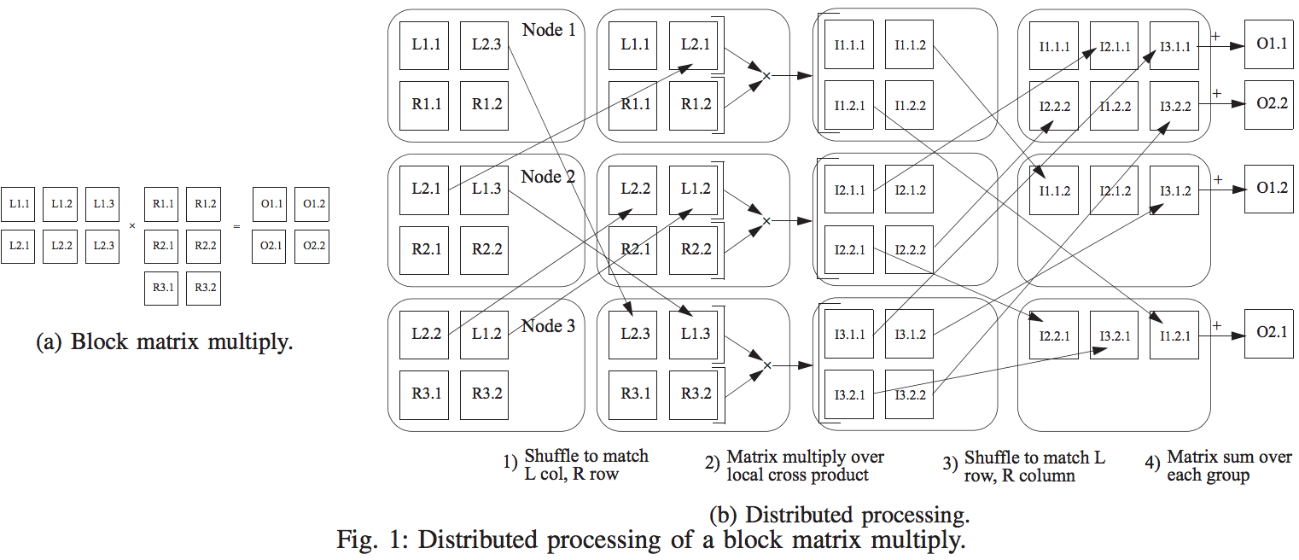
Connection between SLA and RDB
JOIN
GROUPBY
SUM
Distributed matrix multiplication can be expressed with a series of operators in RDB.
Notes:
This is really a relational algebra computation over the blocks on L and R.
The first two steps are essentially a join: Shuffle to match Li* and R*j, local computation of block matrices.
The third step is also join on jk give I_ijk.
Lji, Rik to be in the same node, and then after multiply, get I_ijk
Shuffle – join == Then projection== Then groupBy ==Then summation

Slide 6
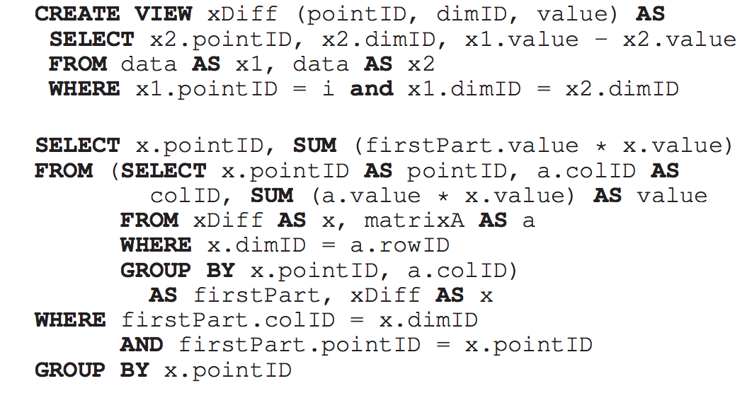

Challenges
Hard to write SQL.
Performance may not be good.
E.g., compute distance between x_i and every other data point x’?

Slide 7
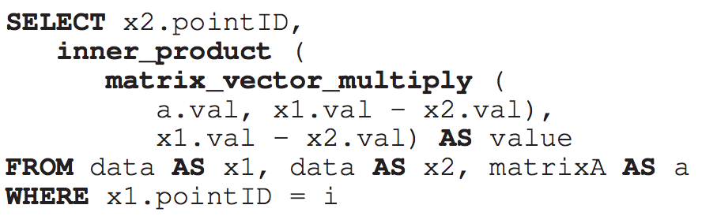


Solution
New data types
LABELED_SCALAR, e.g., LABELED_SCALAR (y_i, i)
VECTOR, e.g., VECTOR [ dim ]
MATRIX, e.g., MATRIX [ rowNum ][ colNum ]
Notes:
Moving between data types

Slide 8
Logic Details
Aggregation (Include moving between data types, like: LABELED_SCALAR to VECTOR, VECTOR to MATRIX)
VECTORIZE
ROWMATRIX
COLMATRIX
Notes:
Moving between data types

Slide 9
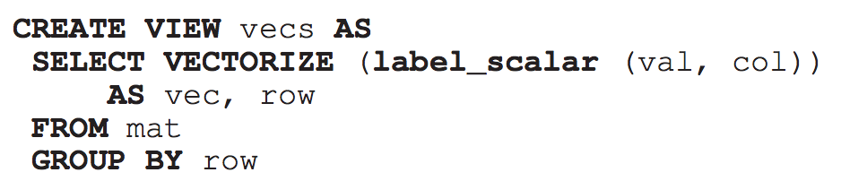
Moving between Data Types
Notes:
Moving between data types

Slide 10
Implementation Details
Storage:
No distributed matrix.
Vector is stored in a dense fashion.
Matrix is stored as sparse lists of vectors.
Algebra operations:
Partly implemented in Java (extract diagonal elements of a matrix, outer product of two vectors, etc.)
Partly by calling BLAS (e.g., matrix inverse, matrix-matrix multiplication)
Notes:
Moving between data types

Slide 11
Implementation Details
Optimizations:
Get to know size of matrix and vectors in advance.
Operations like matrix multiplication, diag, etc.
If cannot get size, estimate it via statistics from relational database.
Notes:
Moving between data types

Slide 12
Experimental Setup
10 Amazon EC2 m2.4xlarge machines, each with 8 CPU cores.
Competitors:
SimSQL
SciDB
SystemML
Spark MLlib.linalg
SimSQL is a scalable, parallel, relational database system compiles SQL queries into Java codes that run on top of Hadoop.
Notes:
No distributed matrix. Big matrix are divided into small ones and compute via block matrix.
Storage: vectors in dense, matrix in sparse list of vectors

Slide 13


Experiments
Workload:
Gram matrix computation:
Least square linear regression:
Outlier detection:
 | Gram matrix computation | Linear regression | Outlier detection
Number of data point | 100K | 100K | 10K
Dimension of data point | 10, 100, 1000 | 10, 100, 1000 | 10, 100, 1000
Notes:
No distributed matrix. Big matrix are divided into small ones and compute via block matrix.
Storage: vectors in dense, matrix in sparse list of vectors

Slide 14
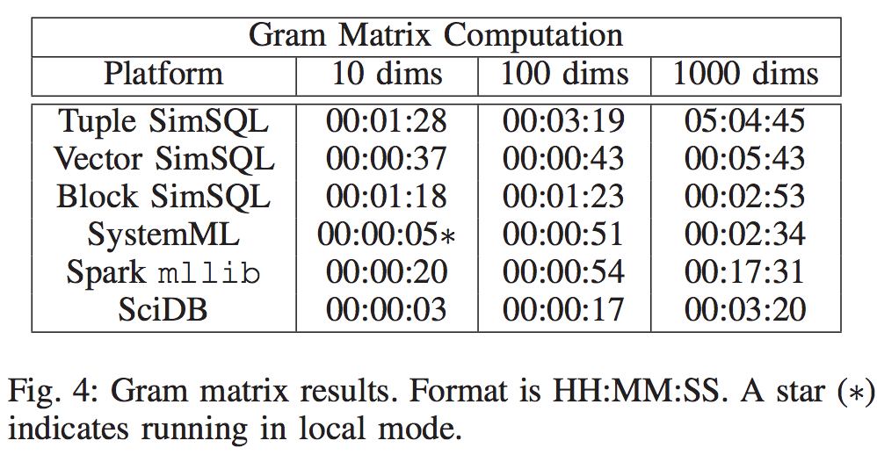
Experimental Results
Notes:
Linear alg on Spark should be built on top of RDB, rather than dataflow.

Slide 15
Summary
Distributed relational database can be reused as a scalable linear algebra system and the performance is comparable.
This paper is cool for its conceptual contribution!

Slide 16
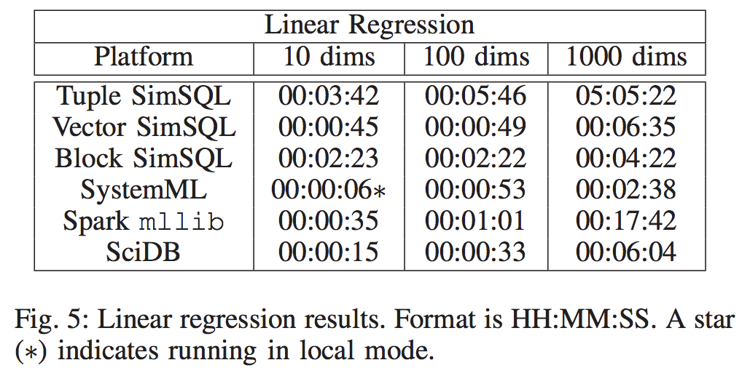
Experimental Results
Notes:
No distributed matrix. Big matrix are divided into small ones and compute via block matrix.
Storage: vectors in dense, matrix in sparse list of vectors

Slide 17
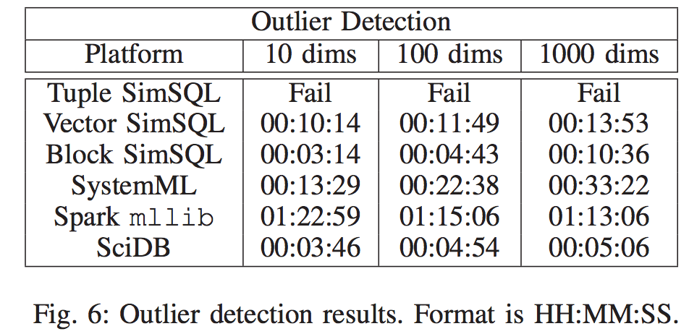
Experimental Results
Notes:
No distributed matrix. Big matrix are divided into small ones and compute via block matrix.
Storage: vectors in dense, matrix in sparse list of vectors

Slide 18
Implementation
ETH Zurich
No distributed matrix
Storage: dense vector, matrix as sparse lists of vectors
Algebra operation: +-*/
Aggregation: SUM, AVERAGE, etc. Special ones like: VECTORIZE, ROWMATRIX, COLMATRIX, ways to construct a vector or a matrix. Implemented via hashing.
Notes:
No distributed matrix. Big matrix are divided into small ones and compute via block matrix.
Storage: vectors in dense, matrix in sparse list of vectors

Slide 19
Typing and Optimization
ETH Zurich
Get to know the size of matrix and vectors, then do some optimization
If not know, estimate via the statistics from SimSQL.
Notes:
No distributed matrix. Big matrix are divided into small ones and compute via block matrix.
Storage: vectors in dense, matrix in sparse list of vectors

