Slide 1


Parallel Feature Selection inspired by Group Testing
—— NIPS 2014
Xue Huanran 1701214297
2018.7.30

Slide 2
Background

Slide 3

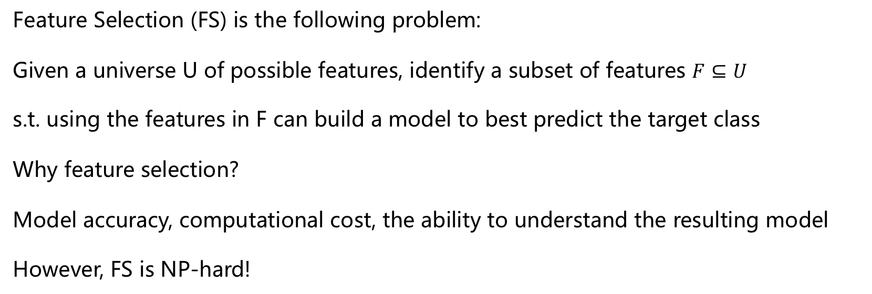
Introduction
Peking University
Feature Selection (FS) is the following problem:
Given a universe U of possible features, identify a subset of features $F⊆U$
s.t. using the features in F can build a model to best predict the target class
Why feature selection?
Model accuracy, computational cost, the ability to understand the resulting model
However, FS is NP-hard!

Slide 4
Related Work
Peking University
Filter
No classifier used, features are selected based on statistical properties or information theory
Wrapper
A classifier is used as a black-box to test on any subset of features
Embedded
Combine learning and FS through regularization

Slide 5
Approach in this paper

Slide 6
Group Testing
Peking University
Identify a small subset of "positive items" from all possible items

Slide 7
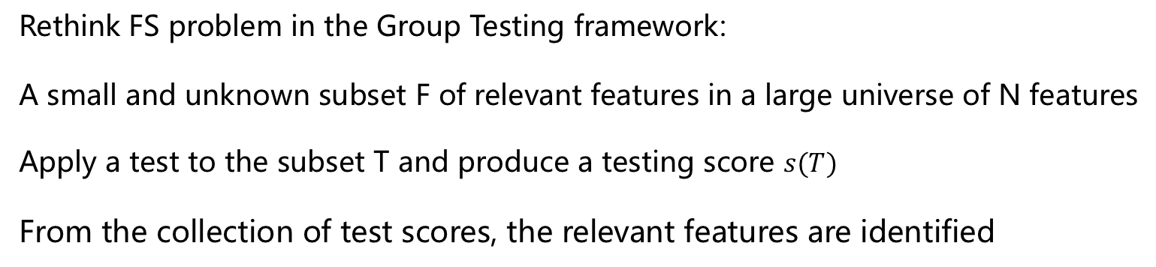
Motivation
Peking University
Rethink FS problem in the Group Testing framework:
A small and unknown subset F of relevant features in a large universe of N features
Apply a test to the subset T and produce a testing score $s(T)$
From the collection of test scores, the relevant features are identified

Slide 8
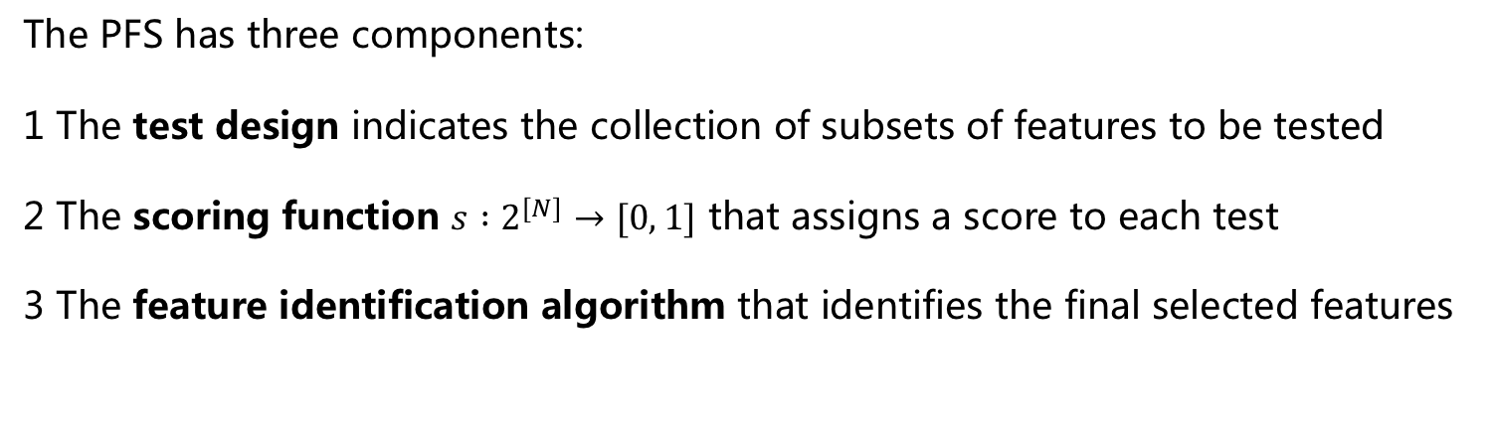
Parallel Feature Selection (PFS)
Peking University
The PFS has three components:
1 The test design indicates the collection of subsets of features to be tested
2 The scoring function $s :2^{[N]}→[0, 1]$ that assigns a score to each test
3 The feature identification algorithm that identifies the final selected features

Slide 9
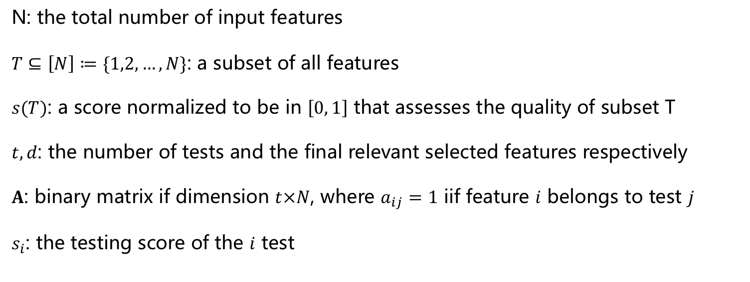
General Setting
Peking University
N: the total number of input features
$T⊆\left[N\right]≔\{1,2,…,N\}$: a subset of all features
$s(T)$: a score normalized to be in $\left[0, 1\right]$ that assesses the quality of subset T
$t, d$: the number of tests and the final relevant selected features respectively
$A$: binary matrix if dimension $t×N$, where $a_{ij}=1$ iif feature $i$ belongs to test $j$
$s_{i}$: the testing score of the $i$ test

Slide 10
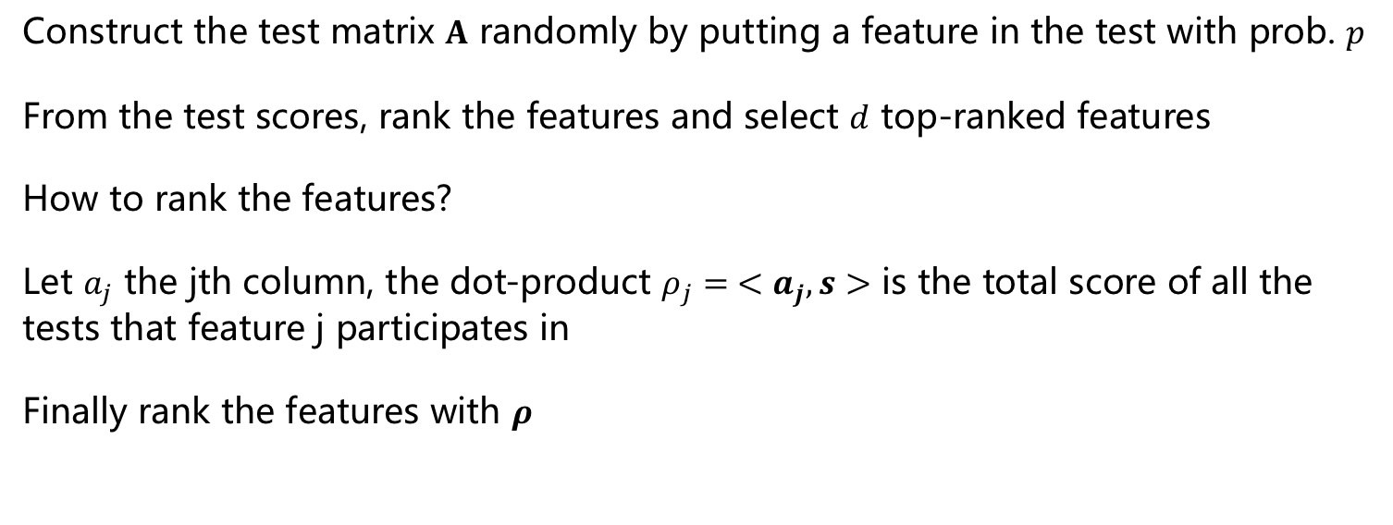
Test design and feature identification
Peking University
Construct the test matrix $A$ randomly by putting a feature in the test with prob. $p$
From the test scores, rank the features and select $d$ top-ranked features
How to rank the features?
Let $a_{j}$ the jth column, the dot-product $ρ_{j}= <a_{j},s>$ is the total score of all the tests that feature j participates in
Finally rank the features with $ρ$

Slide 11
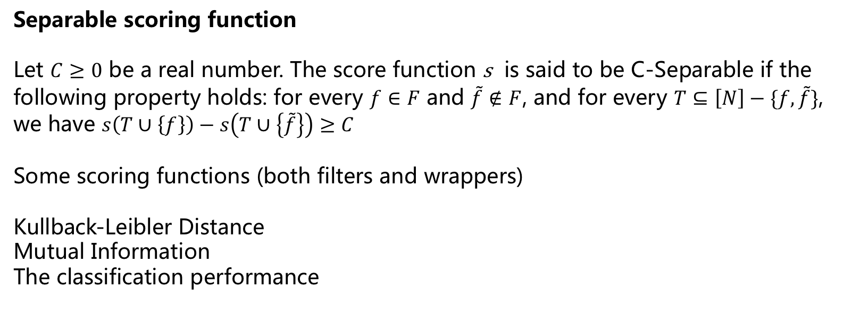
Scoring Function
Peking University
Separable scoring function
Let $C≥0$ be a real number. The score function s is said to be C-Separable if the following property holds: for every $f∈F$ and $\tilde{f}∉F$, and for every $T⊆\left[N\right]−\{f,\tilde{f}\}$,
we have $s\left(T∪\left\{f\right\}\right)−s\left(T∪\left\{\tilde{f}\right\}\right)≥C$
Some scoring functions (both filters and wrappers)
Kullback-Leibler Distance
Mutual Information
The classification performance

Slide 12
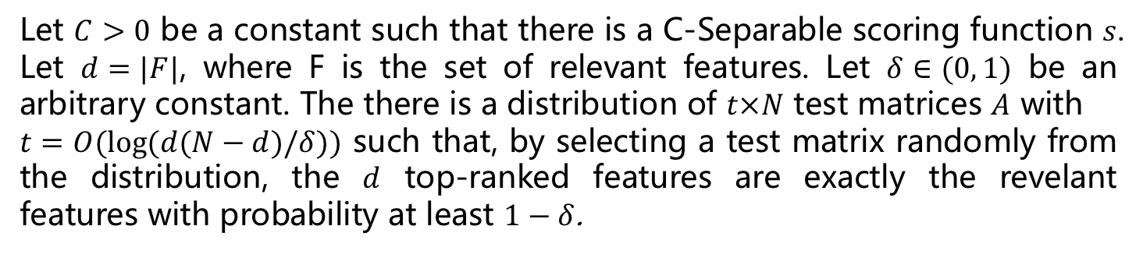
Theory Support
Peking University
Let $C>0$ be a constant such that there is a C-Separable scoring function $s$.
Let $d=|F|$, where F is the set of relevant features. Let $δ∈(0, 1)$ be an arbitrary constant. The there is a distribution of $t×N$ test matrices $A$ with
$t=O(log⁡(d(N−d)/δ))$ such that, by selecting a test matrix randomly from the distribution, the $d$ top-ranked features are exactly the revelant features with probability at least $1−δ$.

Slide 13
Experiments

Slide 14
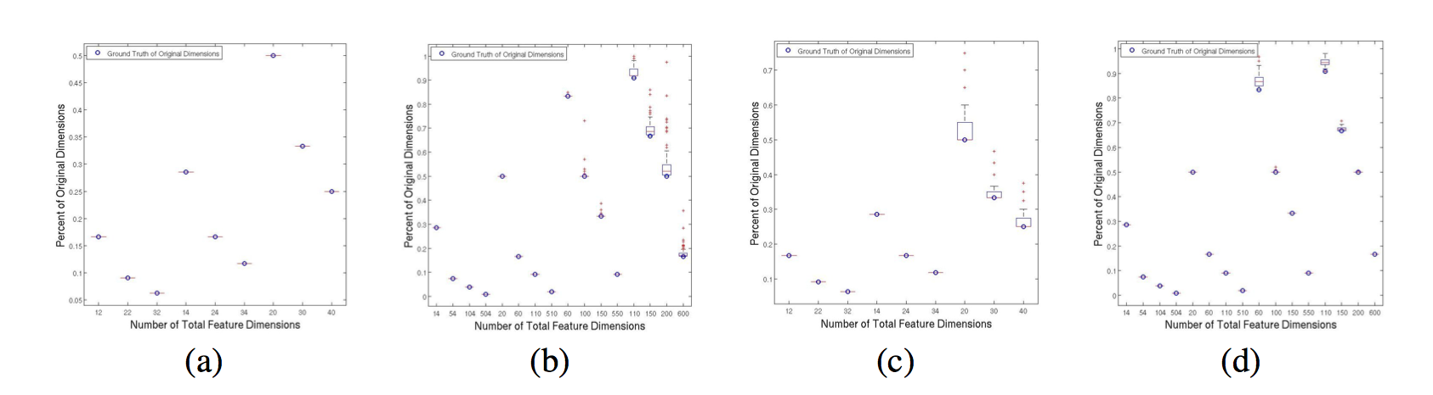
Synthetic Dataset
Peking University
Run every experiment 1000 times, the top features contains all the relevant features almost time

Slide 15
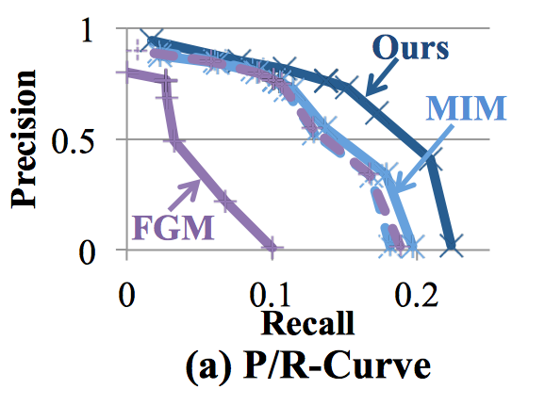
Large Dataset
Peking University
TAC-KBP: The number of samples and dimensions in millions

Slide 16
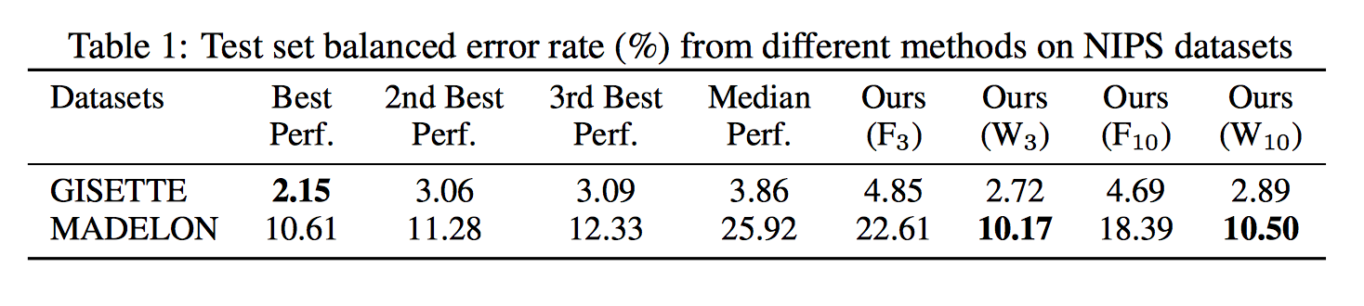
Medium Datasets
Peking University
GISETTE and MADELON: the number of dimensions in the thousands.
Mutual information is the filter method, the algorithm for wrapper is logistic regression and the final classification algorithm is knn.

Slide 17
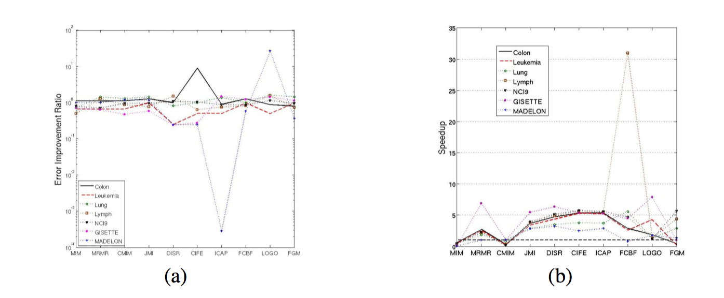
Small Datasets
Peking University
Colon, Leukemia, Lymph, NCI9, Lung from UCI, a few hundreds to a few thounds variables and tens of data samples

Slide 18
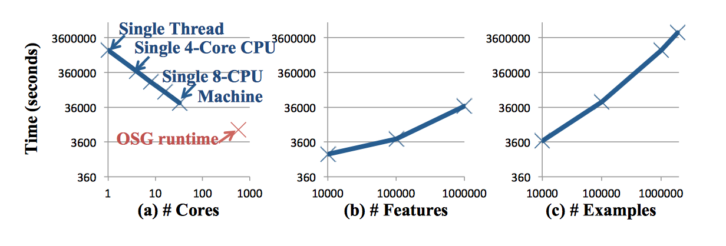
Scalability
Peking University

Slide 19
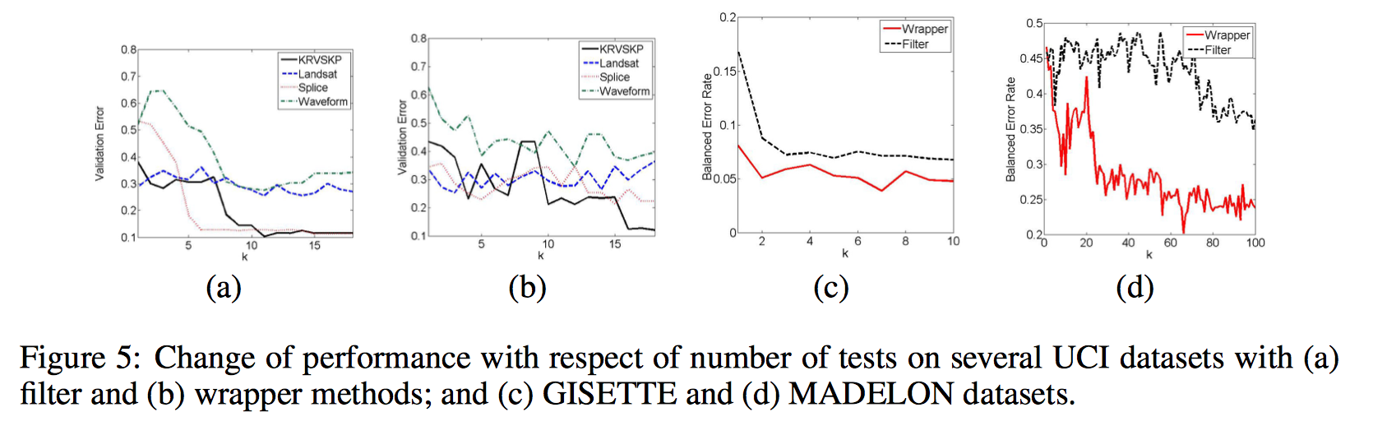
Robustness
Peking University
Apart from MADELON, the performance converges fast, normally around k= 10 ~ 15

Slide 20
Concolusion

Slide 21
Conclusion
Peking University
Advantage
Flexibility, Theory Support
Disadvantage
To many hyperparameters, Problem in the experiment section

Slide 22
Peking University
Q & A

