Slide 1
Planning chemical syntheses with deep neural networks and symbolic AI
杨明钰
2018.04.19

Slide 2
Outline
Introduction
Algorithm structure
Result
Challenge

Slide 3
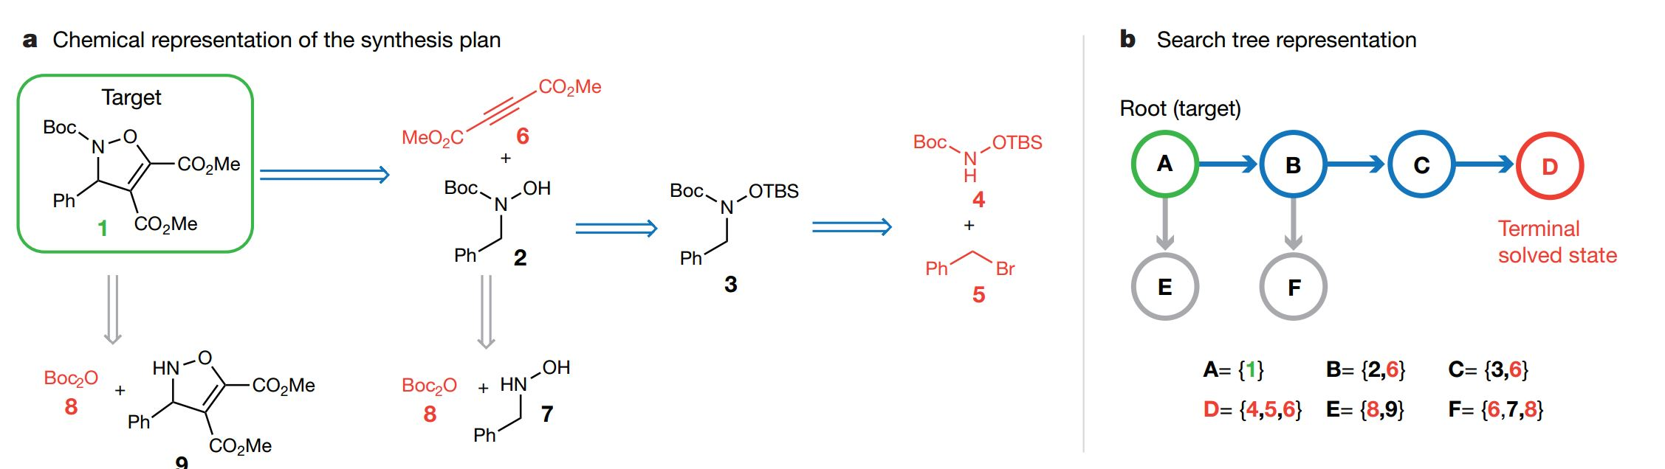
Retrosynthetic analysis
Hard to connect

Slide 4
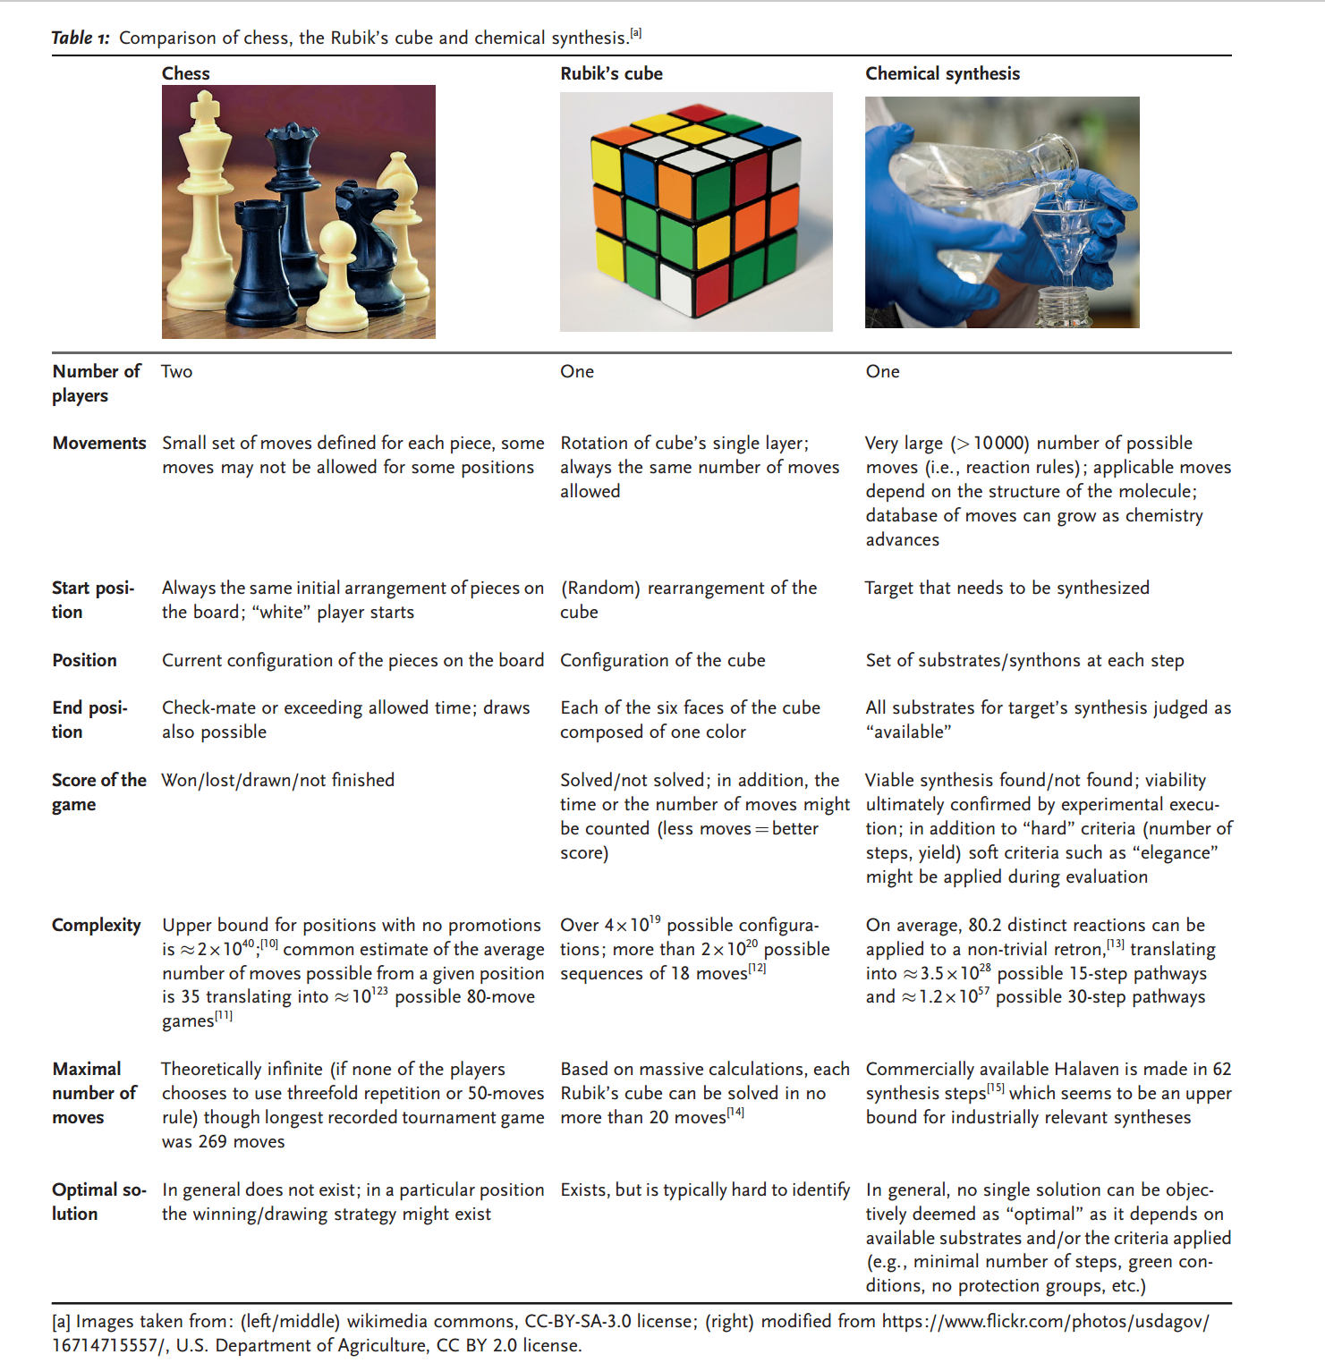

Slide 5
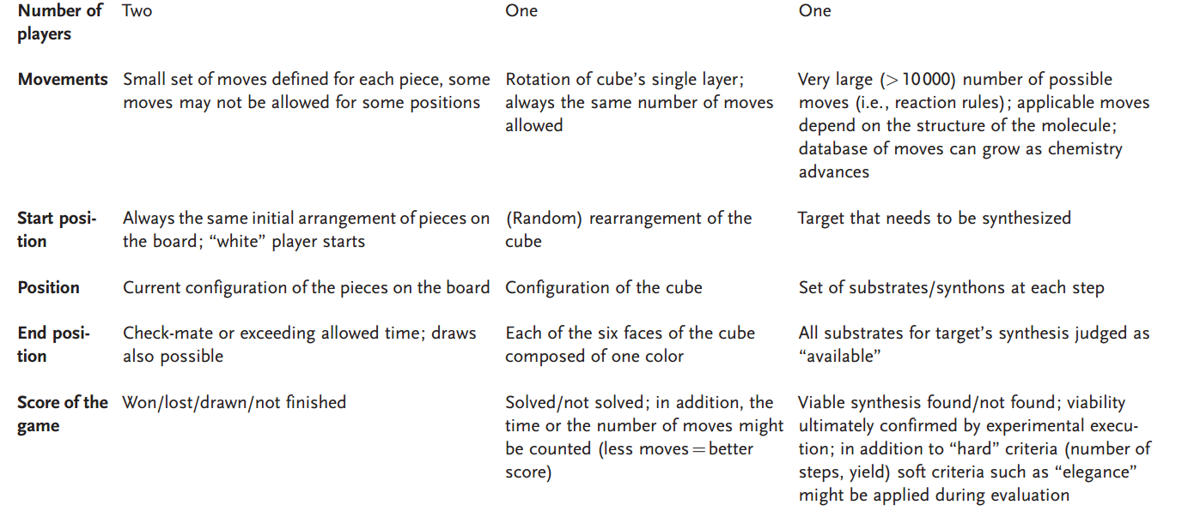

Slide 6
Algorithm structure(MCTS with DNN)
Start with a root node.
Select a node by position score.
Expansion
Search moves with a highway DNN
Check moves with another highway DNN
Rollout with another NN
Update position score

Slide 7
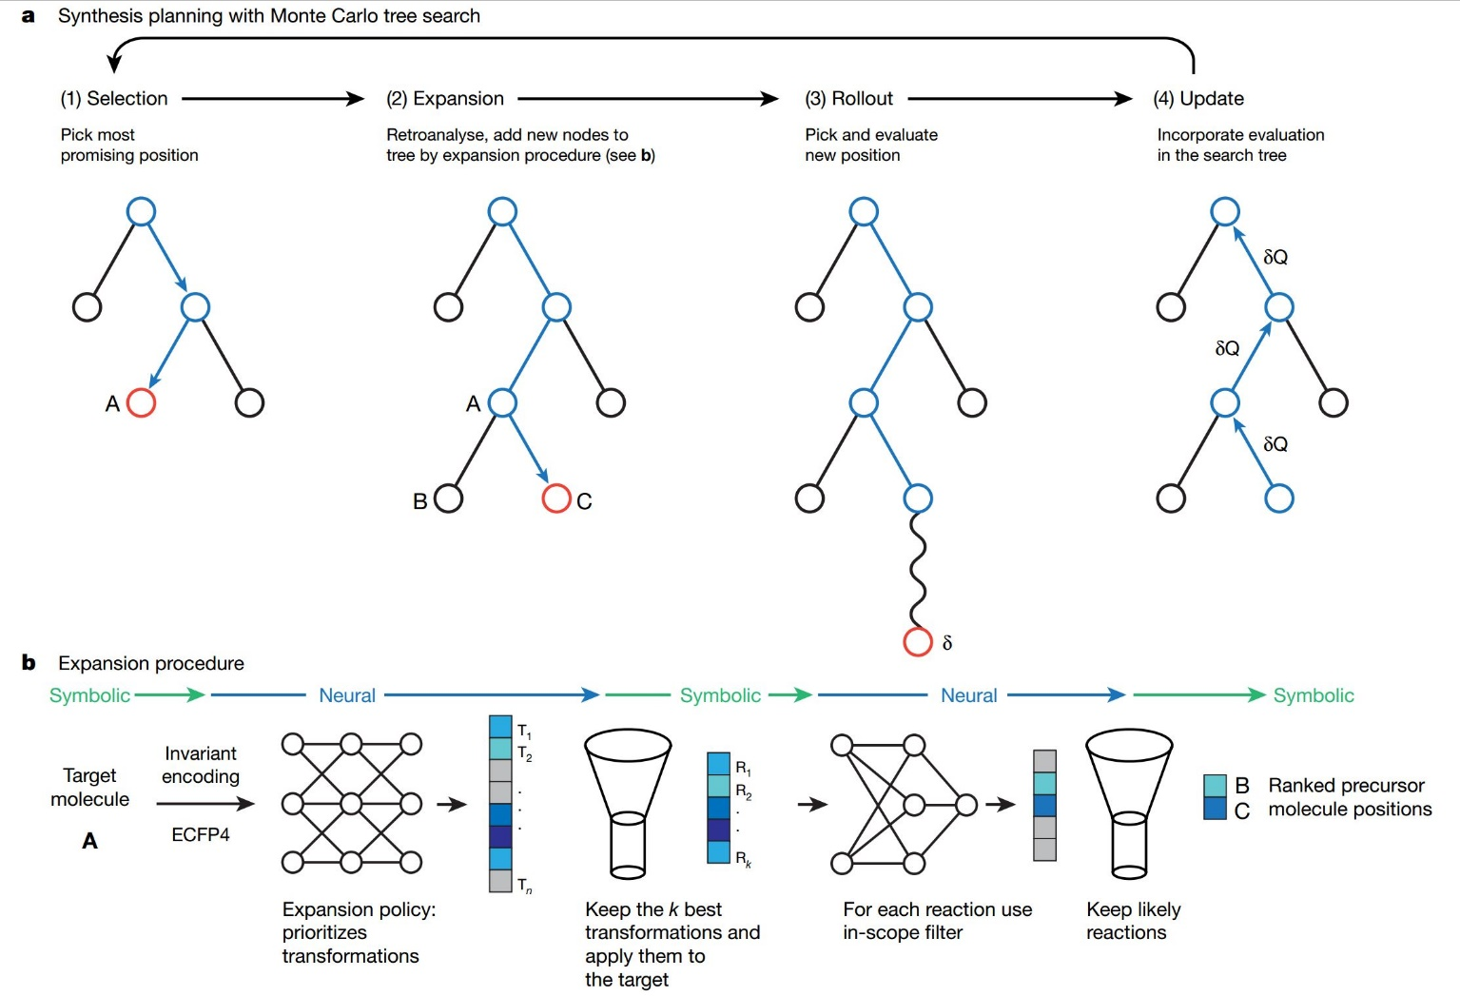

Slide 8
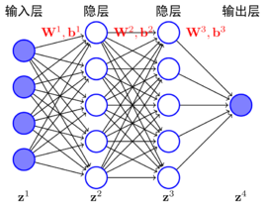
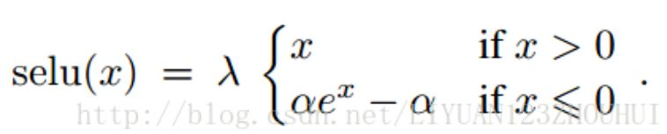
Expansion policies training
Trained by published reactions
5 hidden layers
Molecular described by ECFP4
32681 dimensions selected with information of chemical centers and their neighbor
Activated by ELU
Output the next move.
T

Slide 9
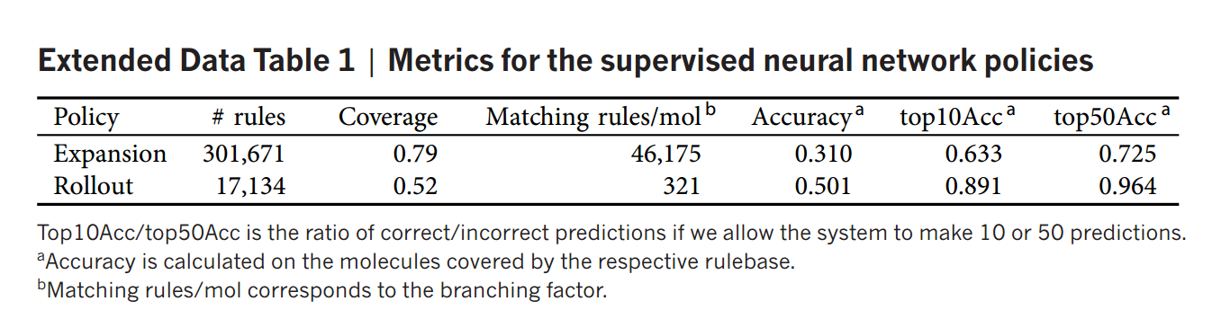

Slide 10
In-scope filter training
Trained by published reactions and decoys generated by shuffling
5 hidden layers
Molecular described by ECFP4
Activated by ELU
Output the probability.
T

Slide 11
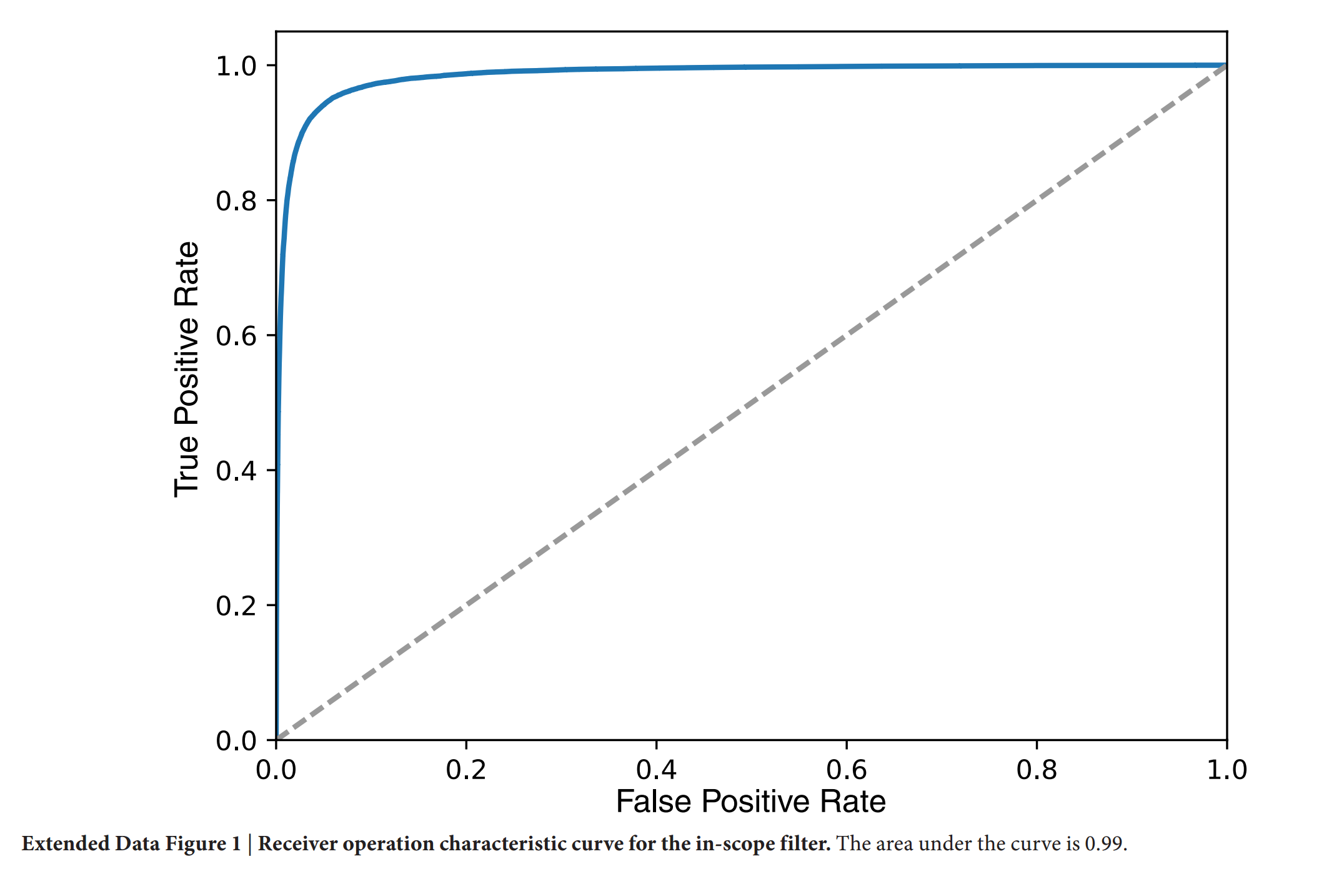
S=0.94

Slide 12
Rollout policies training
Trained by published reactions
1 hidden layers
Molecular described by ECFP4
8192 dimensions selected with information of chemical centers
Activated by ELU
Output the next move.

Slide 14
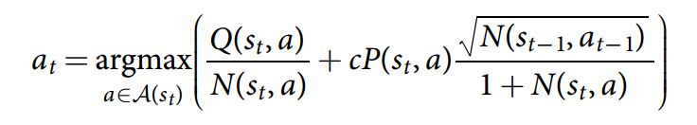
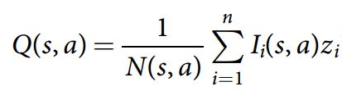

Slide 15
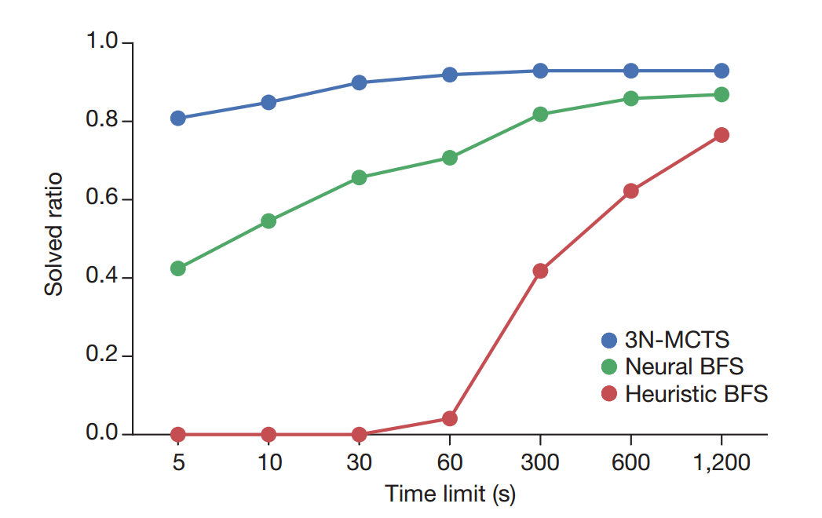

Slide 16
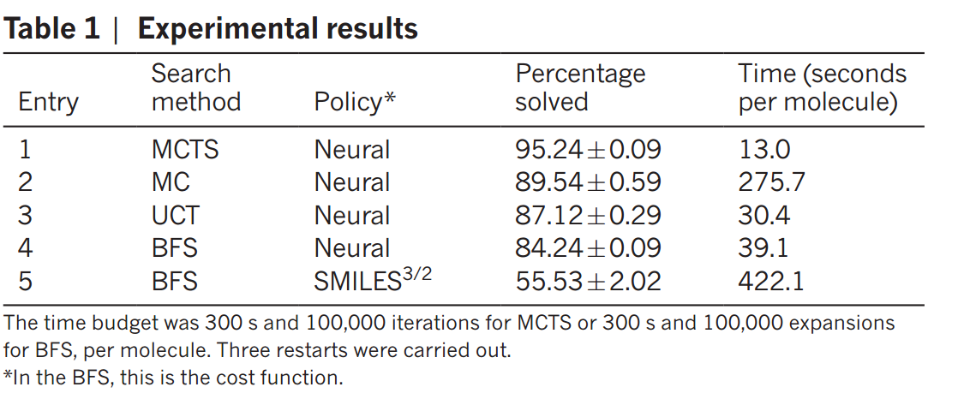

Slide 17
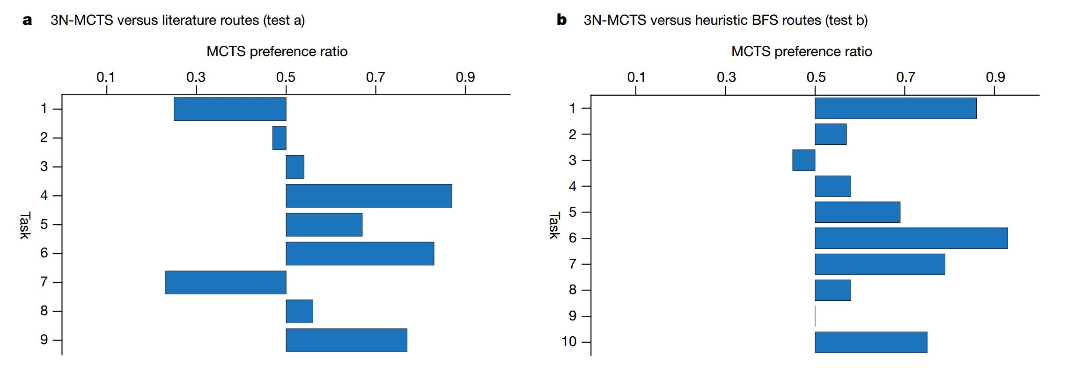
Result

Slide 18
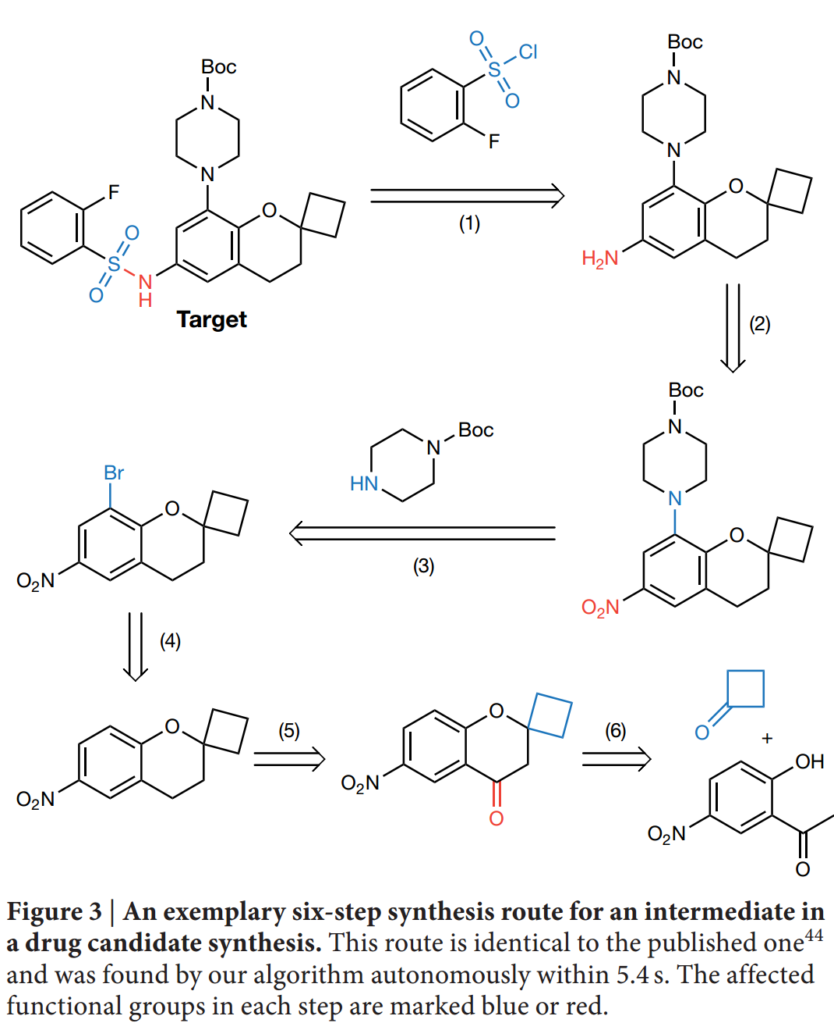

Slide 19
Challenge
Natural molecular
Condition prediction
Conformation
Material preference

Slide 20
Reference
[1] Szymkuc´, S. et al. Computer-assisted synthetic planning: the end of the beginning. Angew. Chem. Int. Ed. 55, 5904–5937 (2016). [2] Planning chemical syntheses with deep neural networks and symbolic AI marwin h. S. Segler mike Preuss & mark P. Waller doi:10.1038/nature25978

Slide 21
Thank you

