Slide 1
COBRA: A combined regression strategy
Journal of Multivariate Analysis
2018.05.24
张文涛

Slide 2
目录
Contents
第一章
Introduction
第二章
Method
第三章
Implementation
第四章
Experiments
第五章
Conclusion
第六章
Superknn
第七章
Our work

Slide 3
Introduction
a nonparametric approach based on an original proximity criterion to combine estimators
nonlinear, data-dependent
a regression collective over the given basic machines

Slide 4
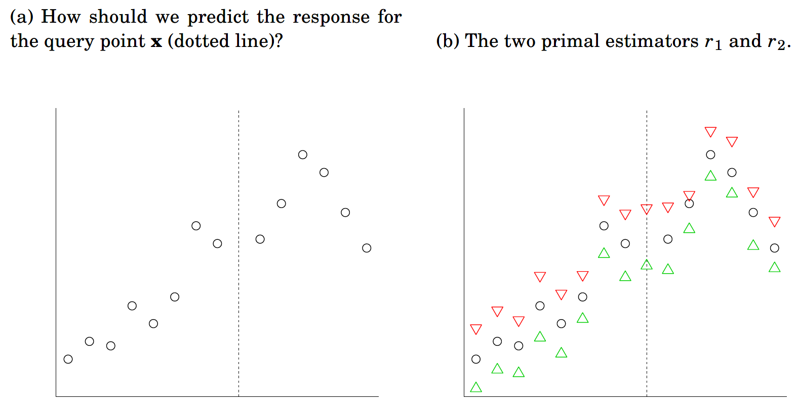



Method
$$○true label$$
$∆ label predicted$ by r1
$∇ label predicted$ by r2

Slide 5
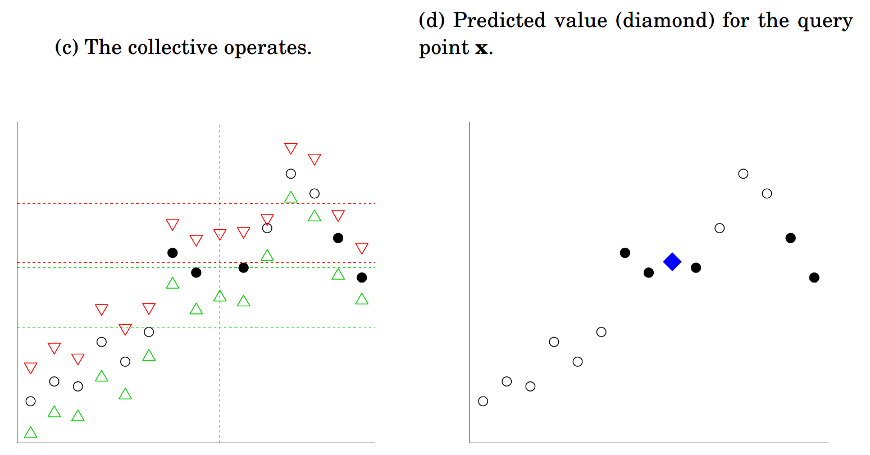


Method
$$r_{2}\left(x\right)$$
$$r_{1}\left(x\right)$$
$$○true label$$
$∆ label predicted$ by r1
$∇ label predicted$ by r2

Slide 6
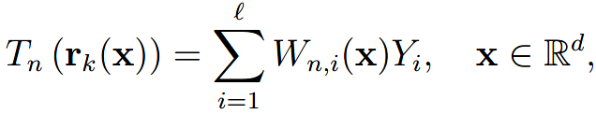
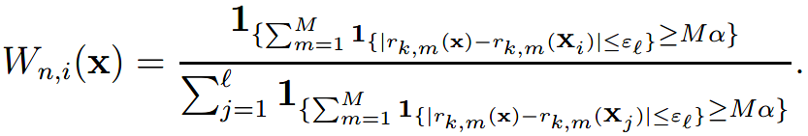

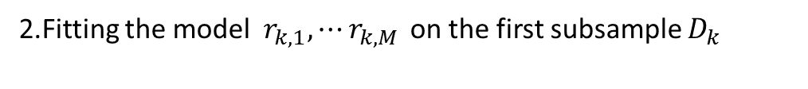


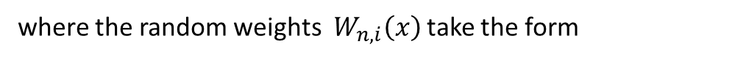
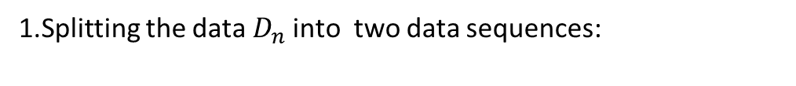
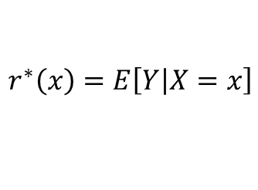
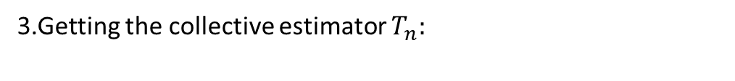
Implementation
Traing data:
Goal:
$$D_{n}=\left\{\left(X_{1},Y_{1}\right),⋯\left(X_{n},Y_{n}\right)\right\}$$
$$r^{∗}\left(x\right)=E\left[Y\left|X=x\right.\right]$$
Process:
1.Splitting the data${ D}_{n}$ into two data sequences:
$$D_{k}=\left\{\left(X_{1},Y_{1}\right),⋯\left(X_{k},Y_{k}\right)\right\}$$
$D_{l}=\left\{\left(X_{k+1},Y_{k+1}\right),⋯\left(X_{l},Y_{l}\right)\right\}$ $=\left\{\left(X_{1},Y_{1}\right),⋯\left(X_{l},Y_{l}\right)\right\}$
2.Fitting the model $r_{k,1},⋯r_{k,M }$on the first subsample $D_{k}$
3.Getting the collective estimator $T_{n}:$
where the random weights $W_{n,i}\left(x\right)$ take the form

Slide 7
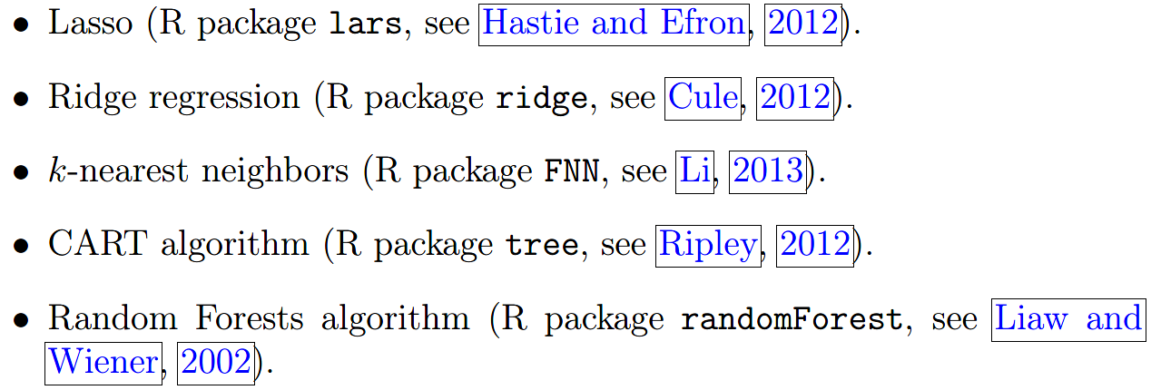
Experiments
Base model:

Slide 8
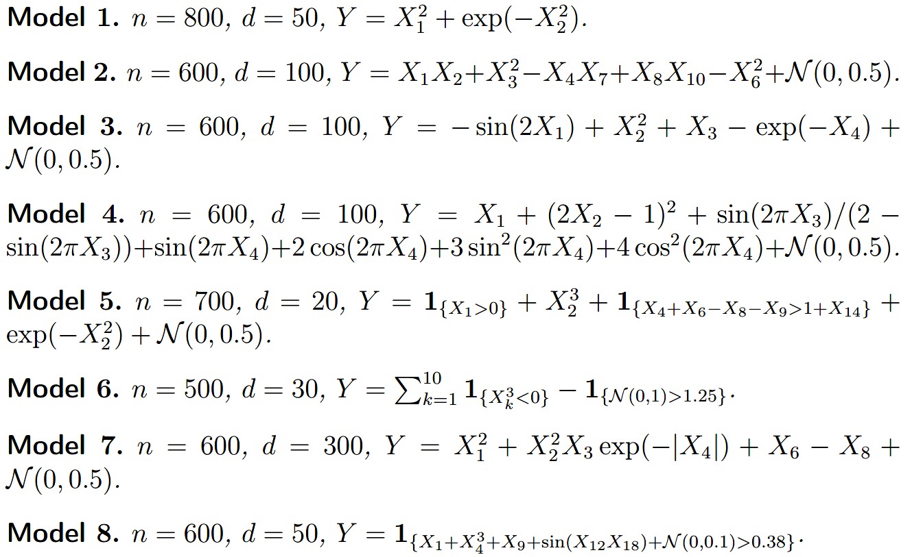
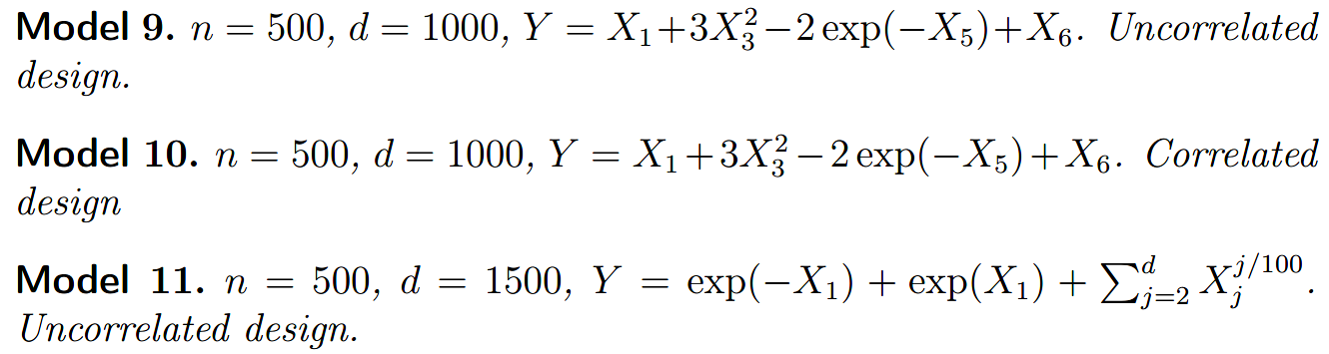
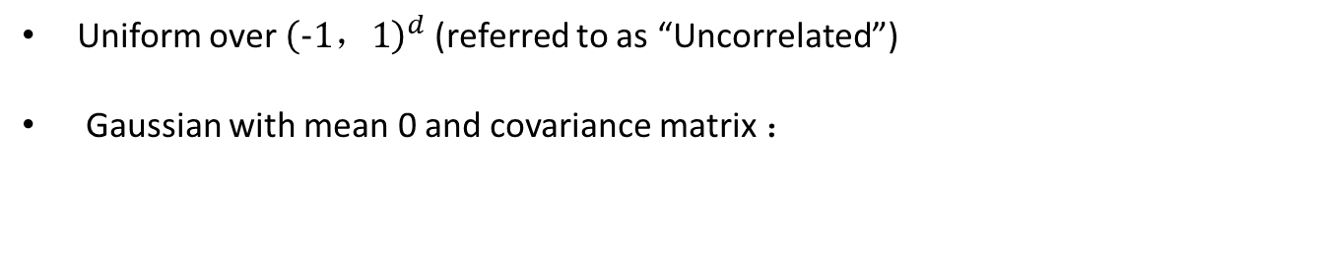
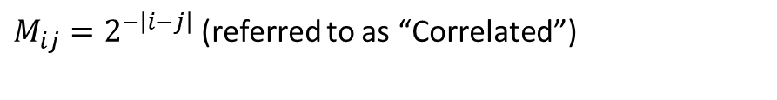
Experiments
1.On synthetic data:
Uniform over ${\left(−1，1\right)}^{d}$ (referred to as “Uncorrelated”)
Gaussian with mean 0 and covariance matrix ：
$M_{ij}=2^{−\left|i−j\right|}$ (referred to as “Correlated”)

Slide 9
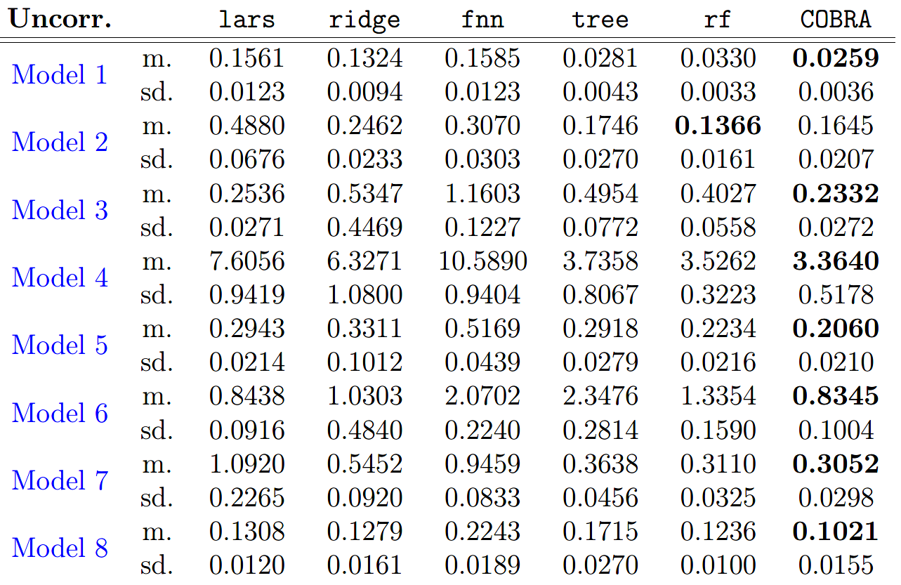
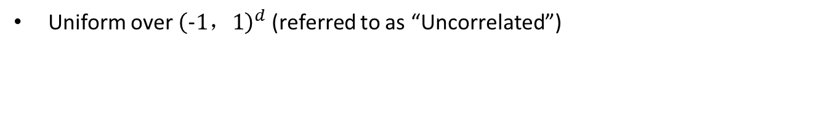
Experiments
1.On synthetic data:
Uniform over ${\left(−1，1\right)}^{d}$ (referred to as “Uncorrelated”)

Slide 10
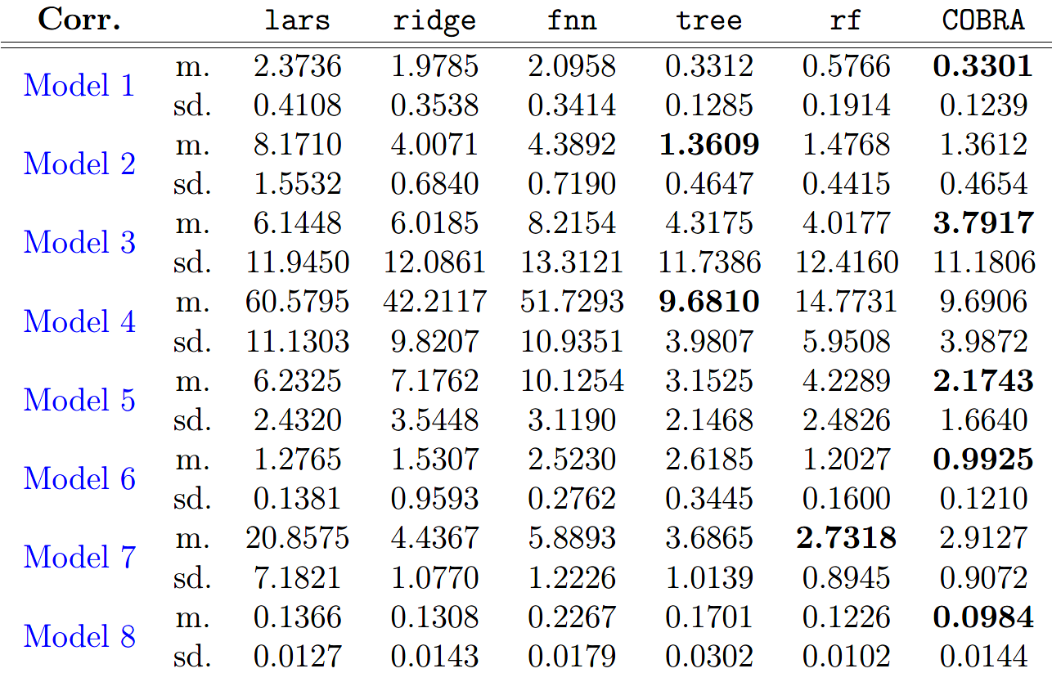
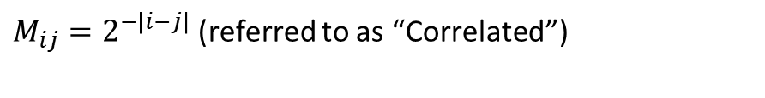
Experiments
1.On synthetic data:
Gaussian with mean 0 and covariance matrix ：
$M_{ij}=2^{−\left|i−j\right|}$ (referred to as “Correlated”)

Slide 11
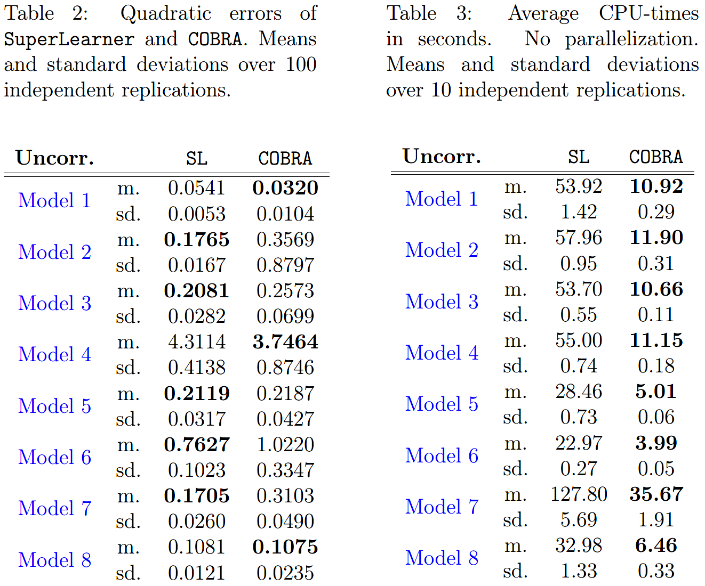
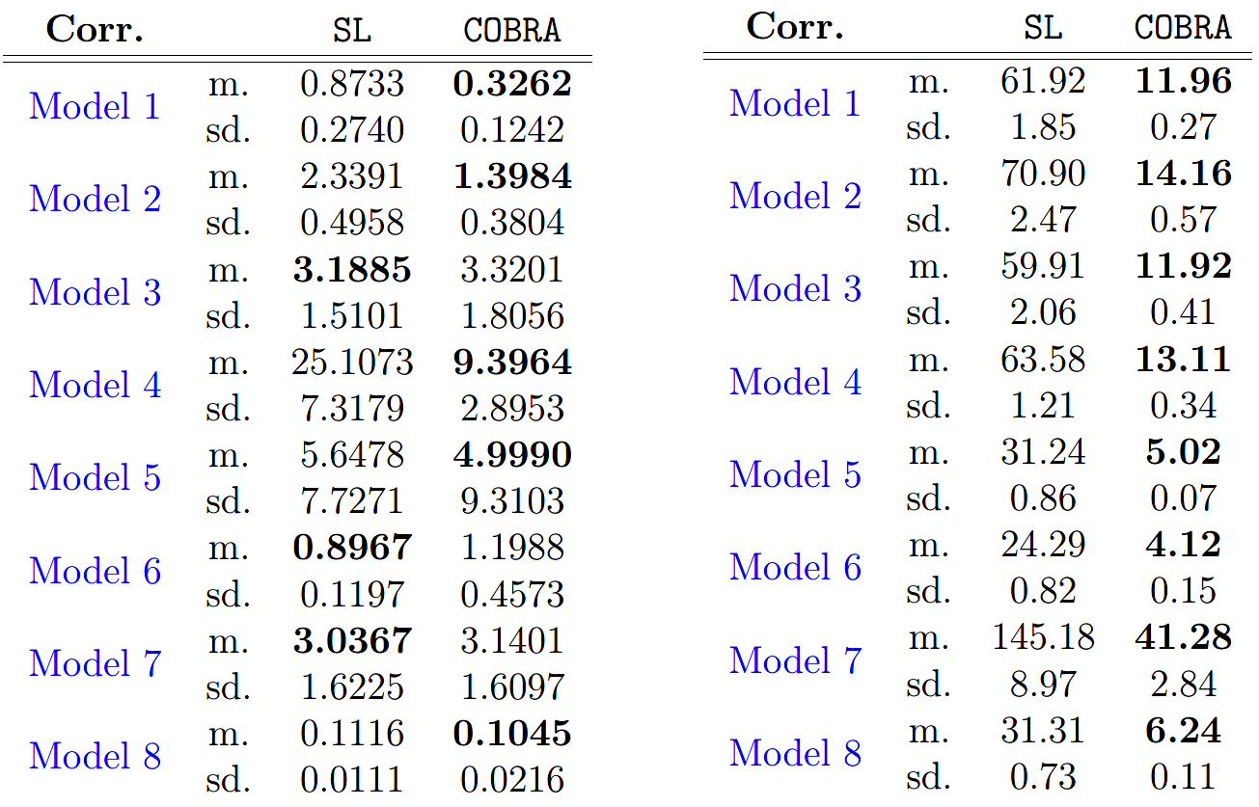
Experiments
1.On synthetic data:
Compare with superlearner:

Slide 12
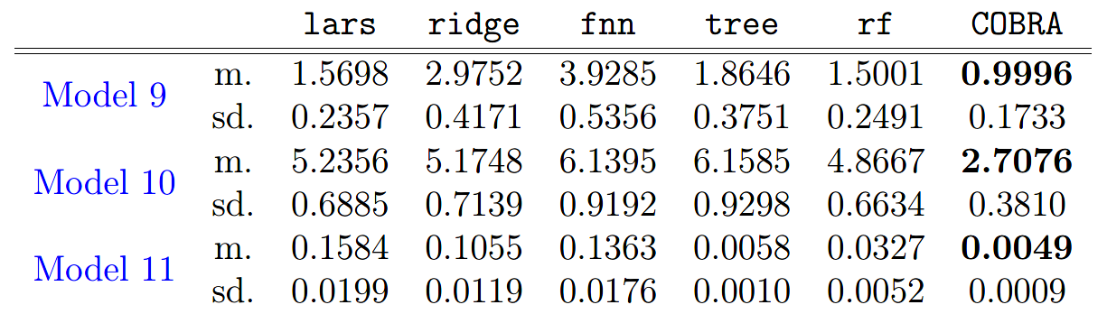
Experiments
1.On synthetic data:
Result on high dimensional data:

Slide 13
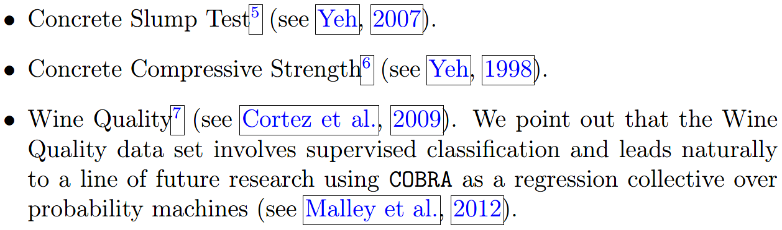
Experiments
2.On Real data:

Slide 14
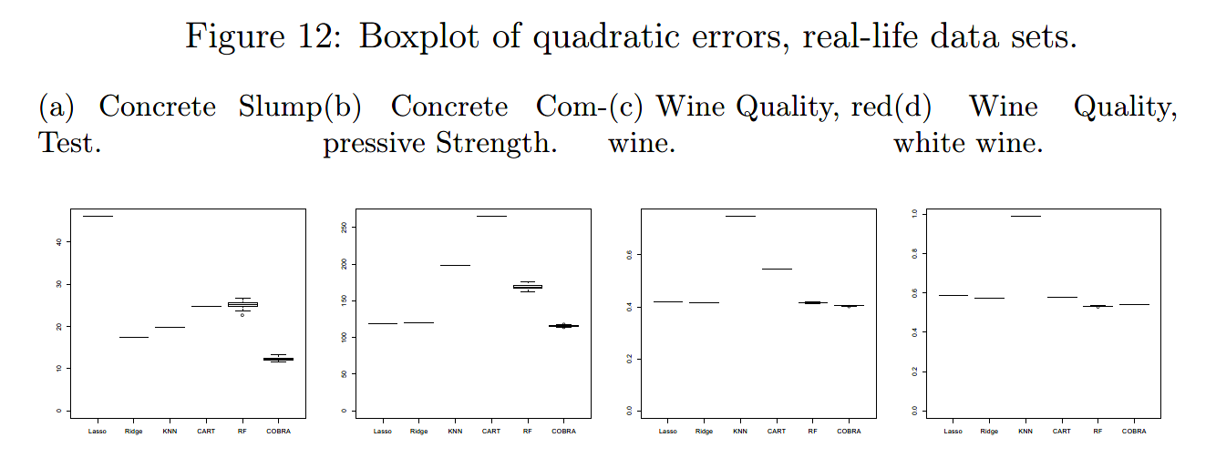
Experiments
2.On real data:

Slide 15
Conclusion
1.Advantage
Very Fast
Model-free
Perform asymptotically at least as well as the best basic estimators
2.Improvements Needed
The data is not fully utilized
Difficulty in finding the optimal parameters
Not suitable for the classification task
The process of the predict task can still be improved

Slide 16
SuperKNN
1.Disadvantage of KNN
The k th data in the train set may not close to the forecast data
Overfitting when the k value is small
Calculating the distance directly based on the original feature
When the variance of training set is large or it has many irrelevant features, the performance of KNN will drop sharply.
2.Disadvantage of Stacking
Multiple collinearity
Overfitting

Slide 17



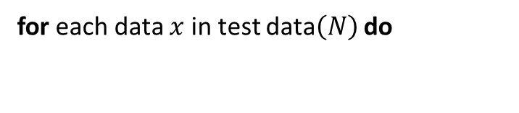
SuperKNN
1.For regression
Split the train data into k folds each with train and validate sets;
for each fold in k folds do
for each learner in ensemble do
Train learner on train set in fold;
Get predict values from learner on validate set in fold;
Stacking
Get predict values from learner on test set;
end
end
Get predictions matrix of the train data$\left(M\right)$ and the test data$\left(N\right)$
for each data $x$ in test data$\left(N\right)$ do
Select all the data $x_{i}$ which satisfies
in the train data$\left(M\right)$
Assign the weight of $x_{i}$according to the distance between $x$ and $x_{i}$
KNN
Predict the label of $x$ according to label and weight of $x_{i}$

Slide 18
SuperKNN
2.For classification
Split the train data into k folds each with train and validate sets;
for each fold in k folds do
for each learner in ensemble do
Train learner on train set in fold;
Get class probabilities from learner on validate set in fold;
Stacking
Get class probabilities from learner on test set ;
end
end
Get predictions matrix of the train data$\left(M\right)$ and the test data$\left(N\right)$
for each data $x$ in test data$\left(N\right)$ do
Select all the data $x_{i}$ which satisfies
in the train data$\left(M\right)$
Assign the weight of $x_{i}$according to the distance between $x$ and $x_{i}$
KNN
Predict the label of $x$ according to label and weight of $x_{i}$

Slide 19
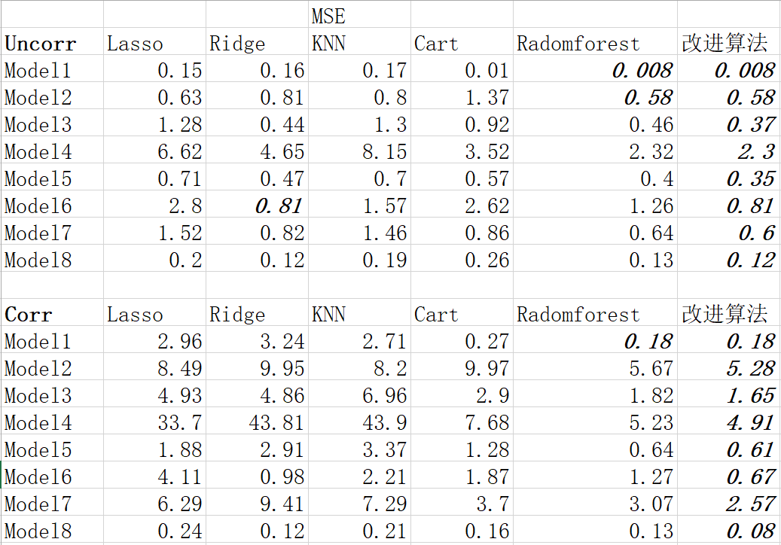
SuperKNN
Experiment on synthetic data:

Slide 20
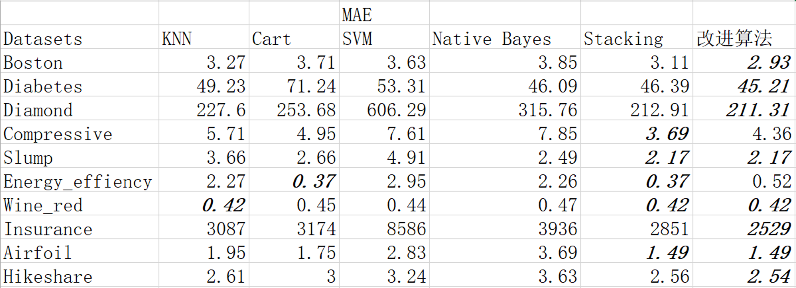
SuperKNN
Experiment of regression

Slide 21
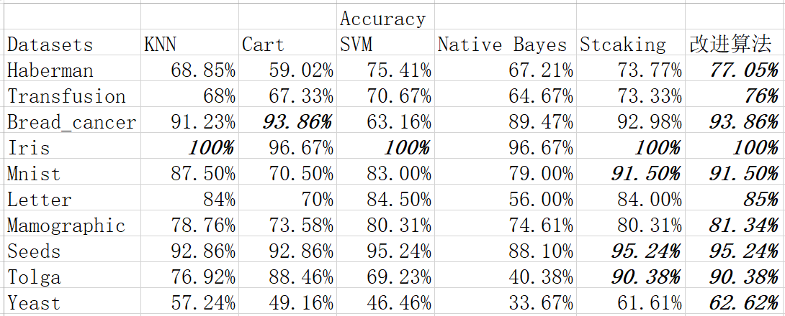
SuperKNN
Experiment of classification

Slide 22
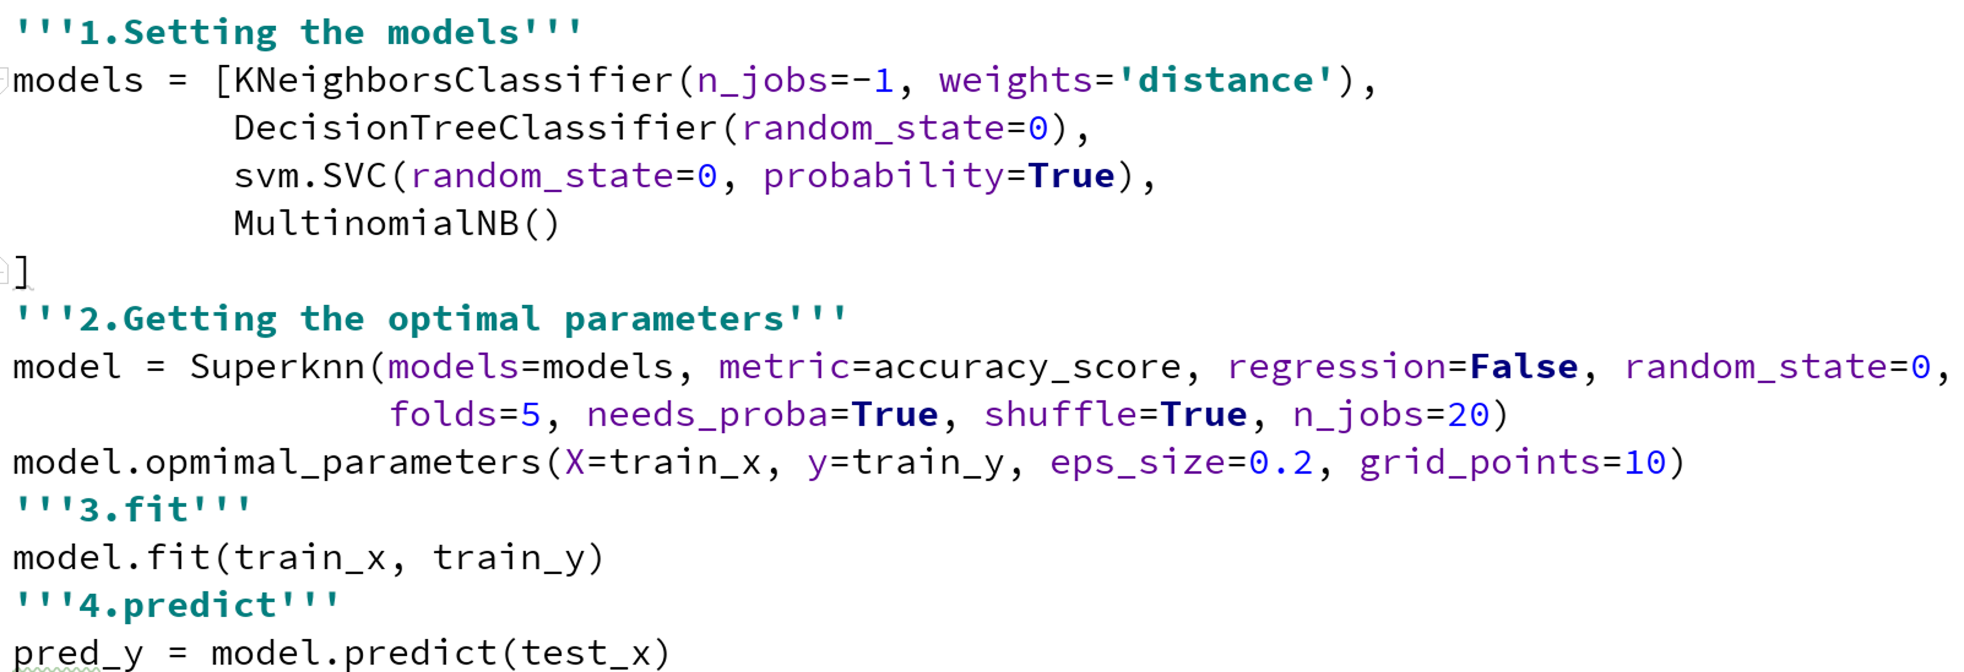
SuperKNN
Implementation

Slide 23
SuperKNN
1.Compared with cobra
The data is fully utilized
Only have two hyper parameters
Both suitable for regression and classification task
Assign the weights according to the distance
2.Compared with KNN
All the selected data is close to the forecast data as we don’t need to fix the K value
We can avoid overfitting by finding suitable K value for each forecast data
Calculating the distance based on the stacked data
The variance of stacked data is small and all features are relevant to the label
3.Compared with stacking
The multiple collinearity will not affect the performance as we use the KNN model
We can avoid overfitting by finding suitable K value for each forecast data
Better performance, especially in classification task

Slide 24
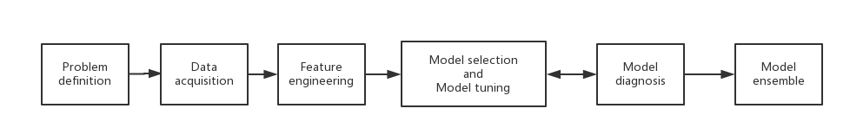
Our work
1.Machine learning process
2.Common ensemble methods
Bagging
Boosting
Stacking(*)
Blend(*)
Cobra(*)
Superknn(*)
Subsemble(*)
Deep super learner(*)

