Slide 1
Communication-efficient machine learning in MapReduce

Slide 2
Background
Communication in distributed machine learning can be expensive.
master
Exchange gradient
or model
worker
worker
worker

Slide 3
Background
CommunicationCost = {costPerIteration} * {#iteration}
Various ways to optimize the communication:
Compress the gradients: 1-bit SGD, TernGrad, DGC, ZipML, SketchML, etc.
Synchronization protocol: BSP, SSP, ASP (MapReduce, AllReduce, parameter servers)
How about reduce number of inter-machine communication?
Notes:
(1) For linear model, do larger model that cannot be held in a single machine --- Feature Parallel
(2) Do other complex model --- MF or LDA
(3) Do hetegeous enviroment like distributed cluster with multi-core machines ---- how would you do this?
(4) GPU cluster?
(5) Use more advanced techs like RL?

Slide 4
Solution
Each worker contains a subset of data and does stochastic algorithms.
Each worker average the model from all workers per multiple local iterations.

Slide 5
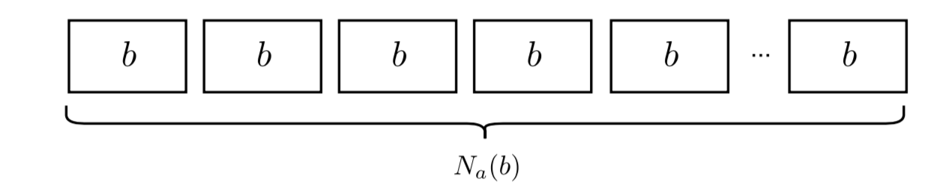
Sequential stochastic method

Slide 6
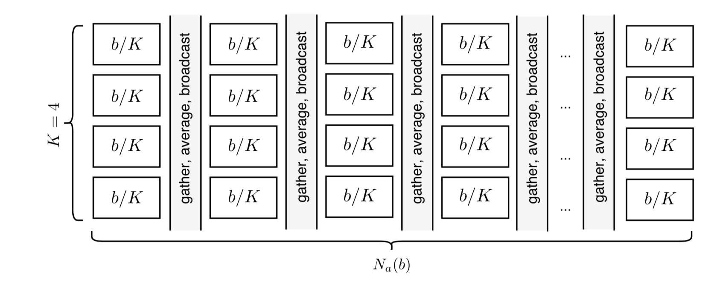
Parallel stochastic method (1)

Slide 7
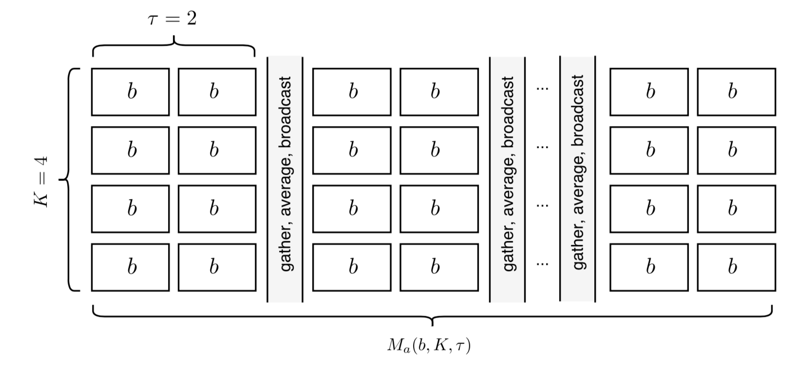
Parallel stochastic method (2)

Slide 8
Splash
Yuchen Zhang, Micheal Jordan
AMP Lab, UC Berkeley
Arxiv 2015

Slide 9
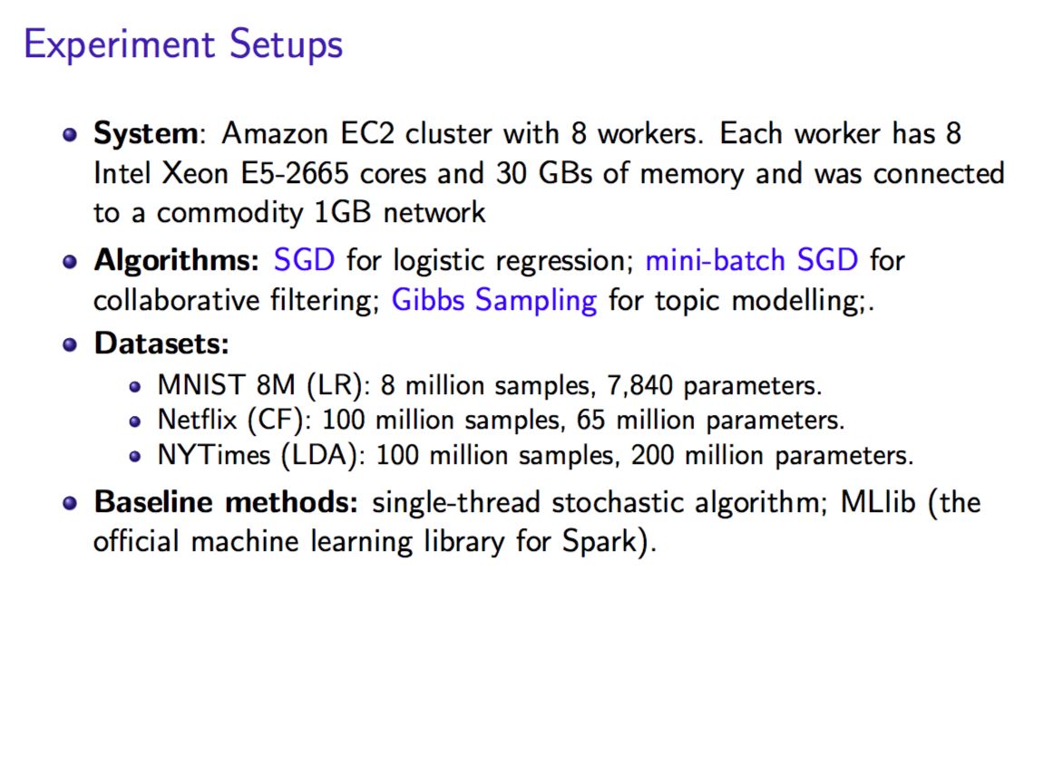
Notes:
Splash suffers for really big model.

Slide 10
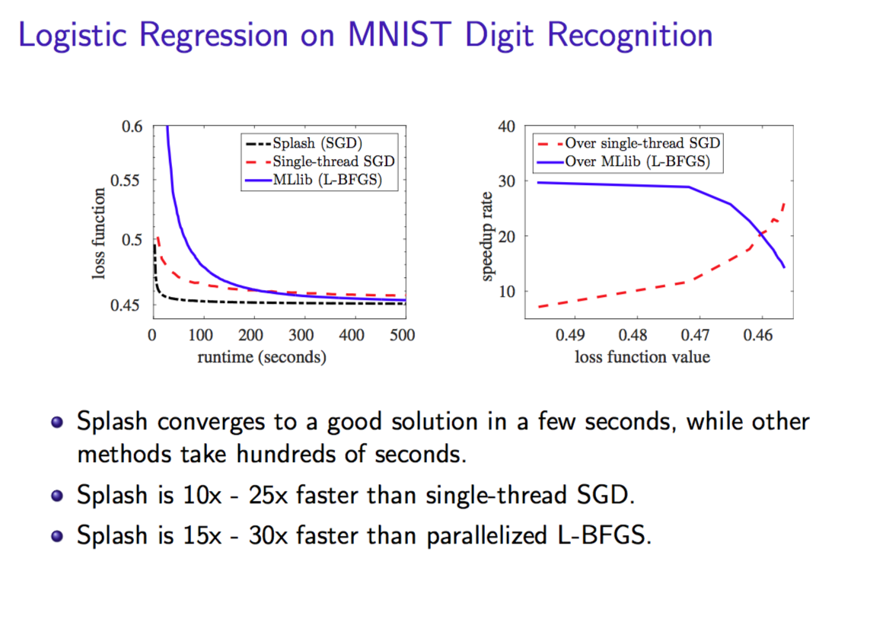

Slide 11
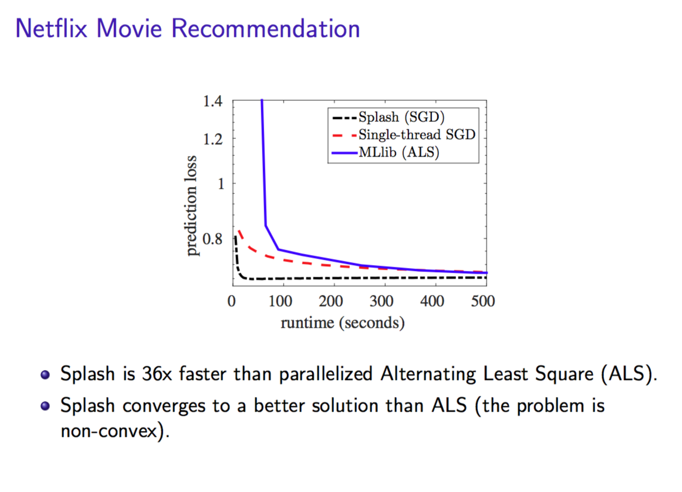

Slide 12
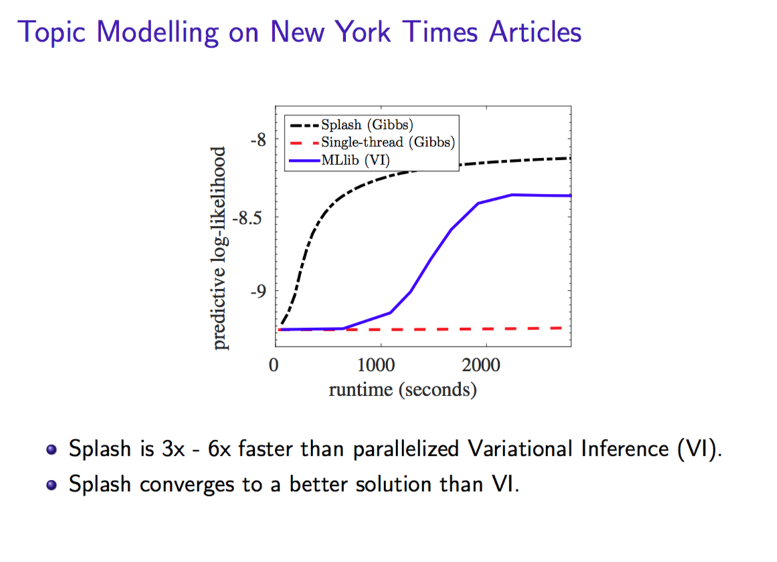

Slide 13
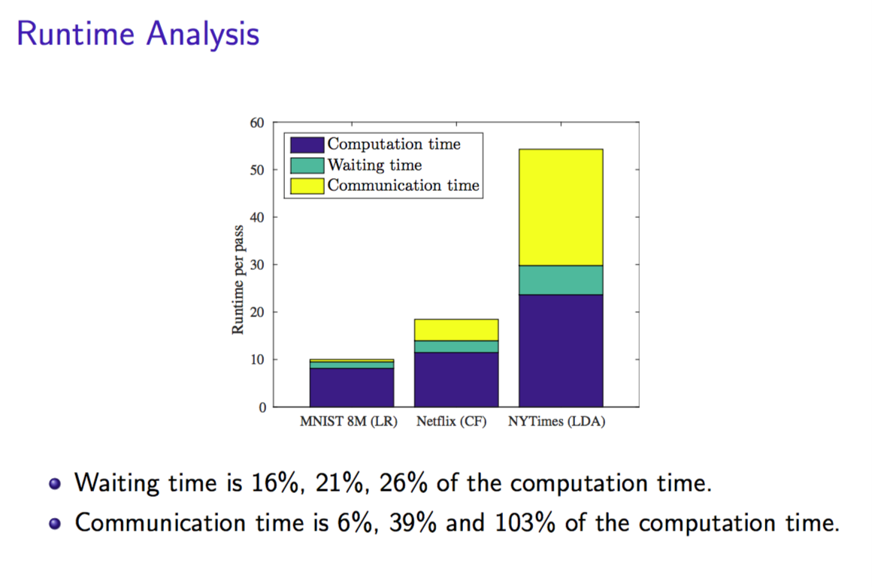

Slide 14
SparkNet
Philipp Moritz∗, Robert Nishihara∗, Ion Stoica, Michael I. Jordan
AMP Lab, UC Berkeley
ICLR 2016

Slide 15
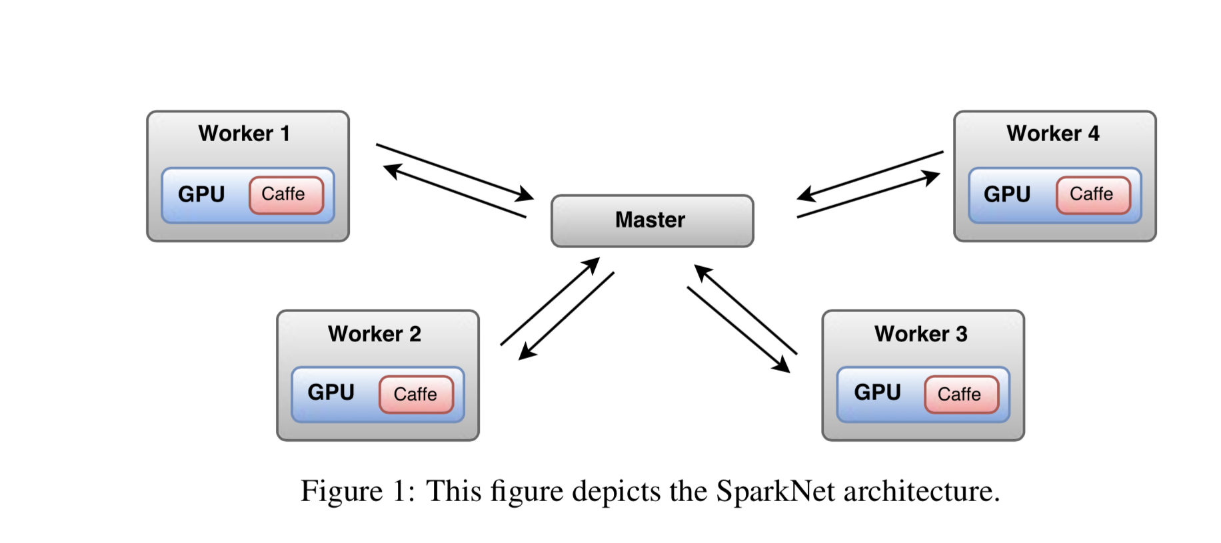

Slide 16
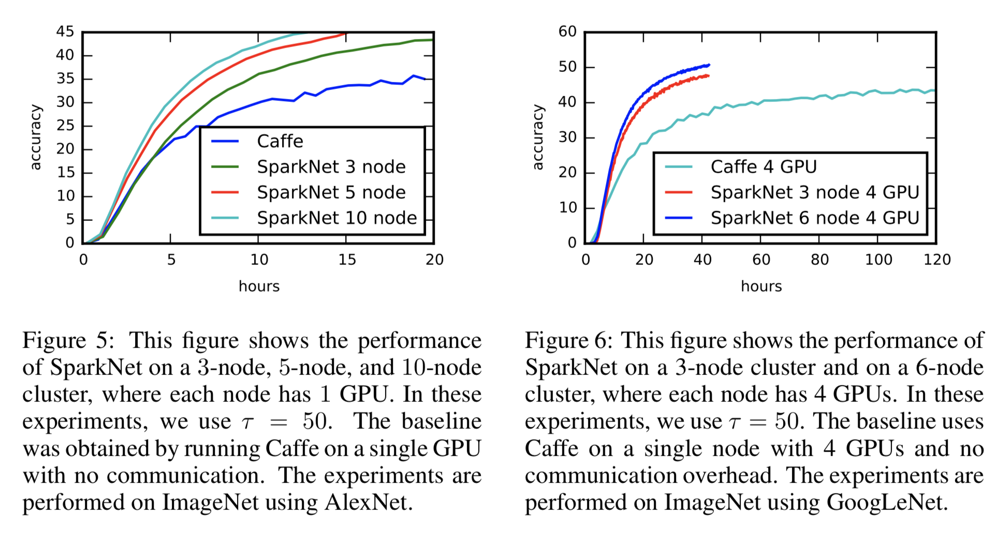

Slide 17
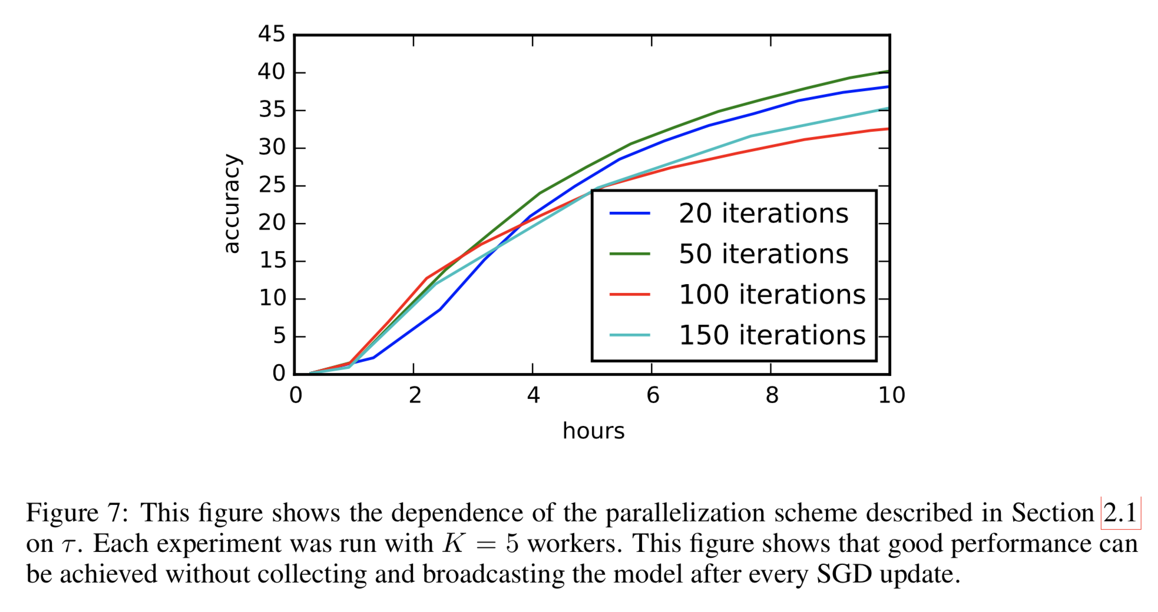

Slide 18
Other works
From Yuchen Zhang, Martin Jaggie, Micheal Jordan, etc.
COCOA

