Slide 1
COBRA: A combined regression strategy
Journal of Multivariate Analysis
2018.05.24
张文涛

Slide 2
目录
Contents
第一章
Introduction
第二章
Method
第三章
Implementation
第四章
Experiments
第五章
Conclusion
第六章
Superknn
第七章
Our work

Slide 3
Introduction
a nonparametric approach based on an original proximity criterion to combine estimators
nonlinear, data-dependent
a regression collective over the given basic machines

Slide 4
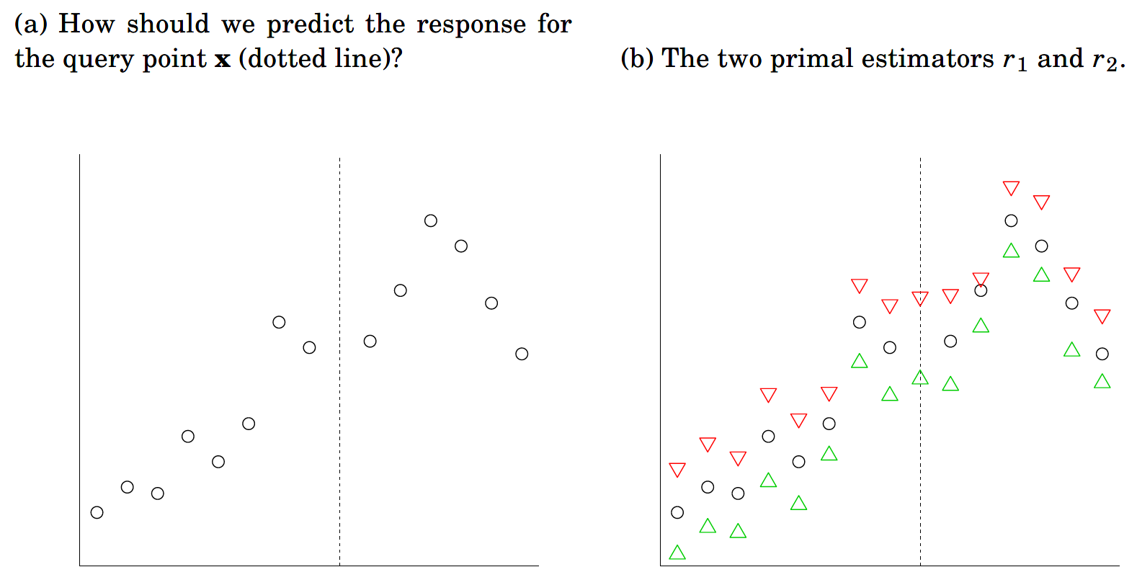



Method
$$○true label$$
$∆ label predicted$ by r1
$∇ label predicted$ by r2

Slide 5
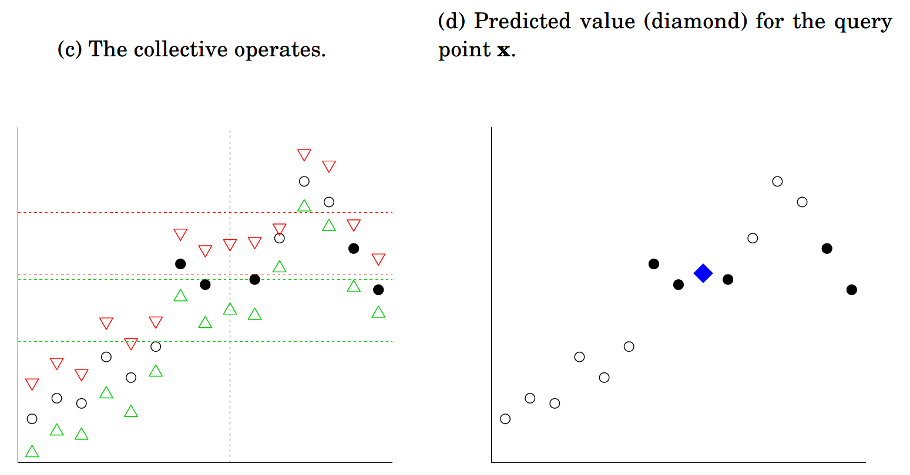


Method
$$r_{2}\left(x\right)$$
$$r_{1}\left(x\right)$$
$$○true label$$
$∆ label predicted$ by r1
$∇ label predicted$ by r2

Slide 6
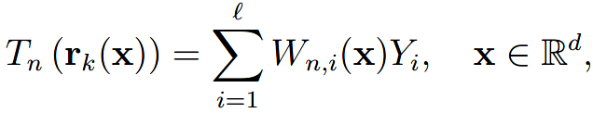
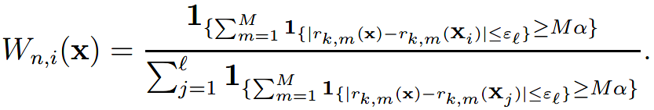

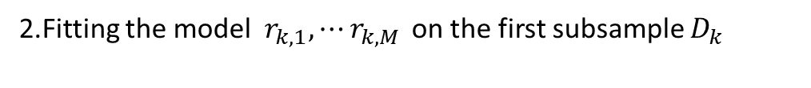


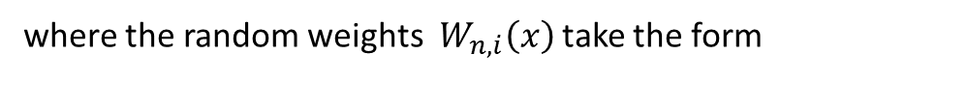
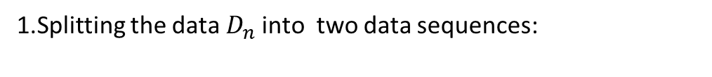
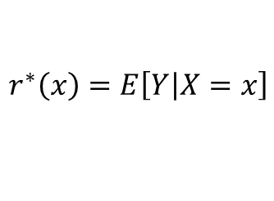
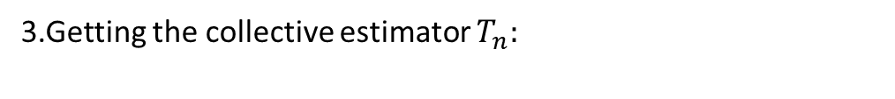
Implementation
Traing data:
Goal:
$$D_{n}=\left\{\left(X_{1},Y_{1}\right),⋯\left(X_{n},Y_{n}\right)\right\}$$
$$r^{∗}\left(x\right)=E\left[Y\left|X=x\right.\right]$$
Process:
1.Splitting the data${ D}_{n}$ into two data sequences:
$$D_{k}=\left\{\left(X_{1},Y_{1}\right),⋯\left(X_{k},Y_{k}\right)\right\}$$
$D_{l}=\left\{\left(X_{k+1},Y_{k+1}\right),⋯\left(X_{l},Y_{l}\right)\right\}$ $=\left\{\left(X_{1},Y_{1}\right),⋯\left(X_{l},Y_{l}\right)\right\}$
2.Fitting the model $r_{k,1},⋯r_{k,M }$on the first subsample $D_{k}$
3.Getting the collective estimator $T_{n}:$
where the random weights $W_{n,i}\left(x\right)$ take the form

Slide 7
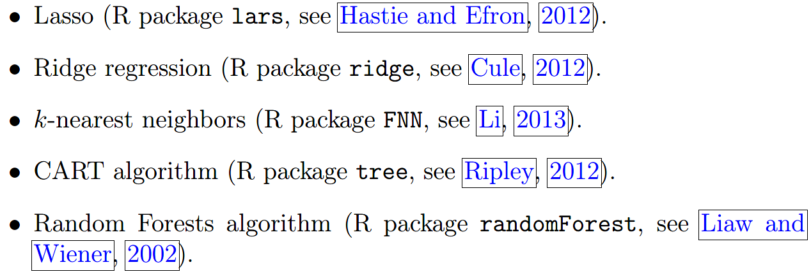
Experiments
Base model:

Slide 8
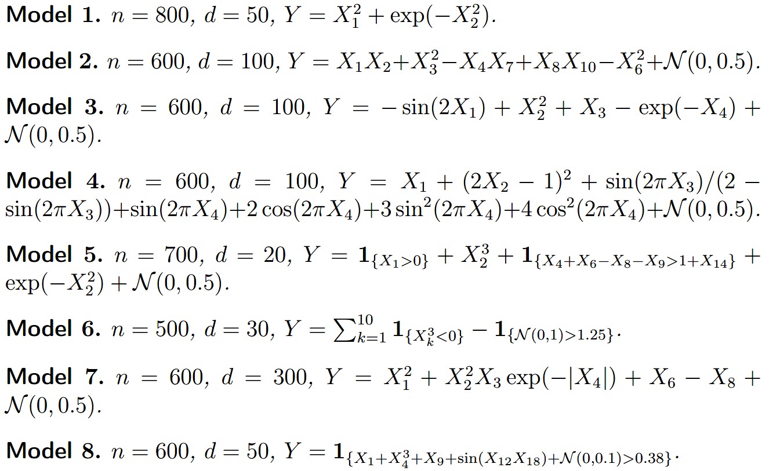
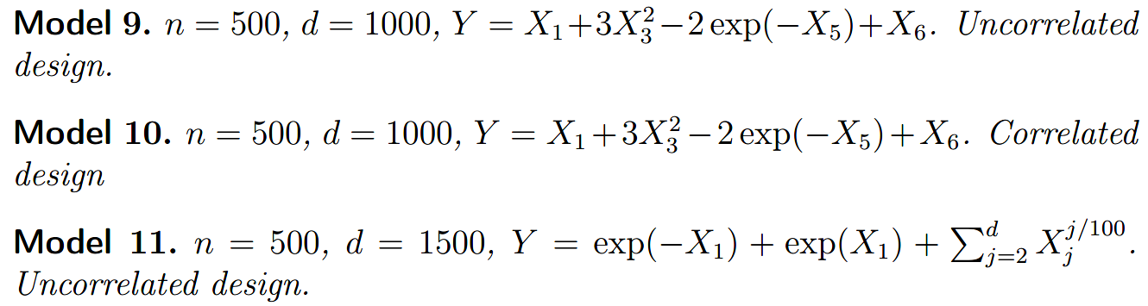
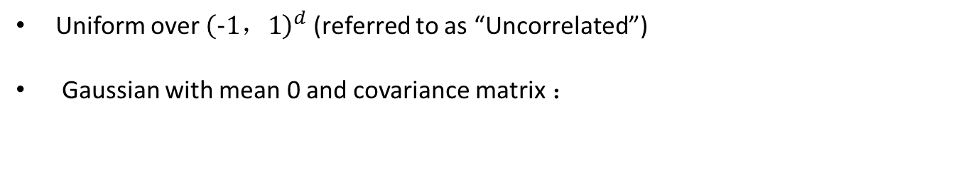
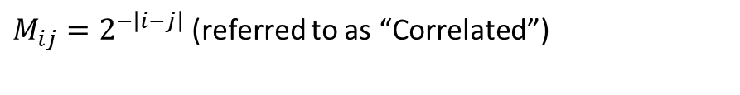
Experiments
1.On synthetic data:
Uniform over ${\left(−1，1\right)}^{d}$ (referred to as “Uncorrelated”)
Gaussian with mean 0 and covariance matrix ：
$M_{ij}=2^{−\left|i−j\right|}$ (referred to as “Correlated”)

Slide 9
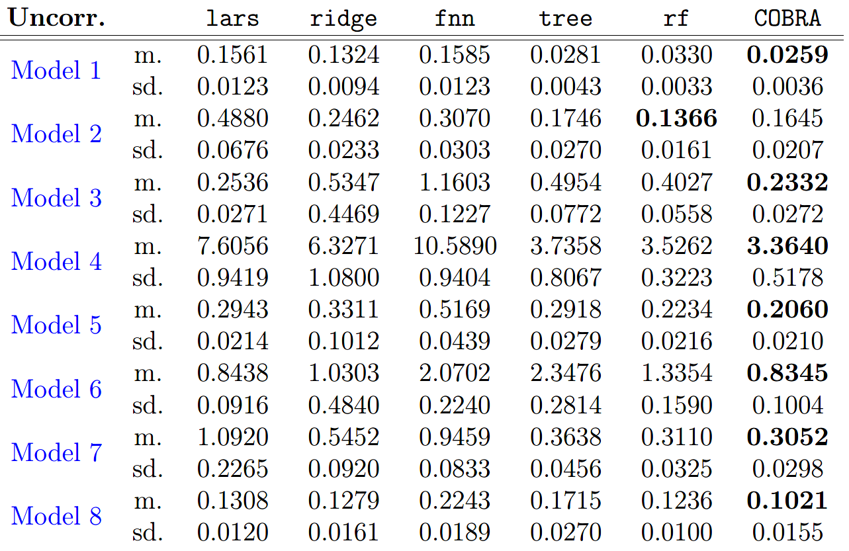
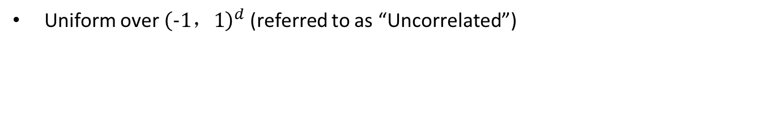
Experiments
1.On synthetic data:
Uniform over ${\left(−1，1\right)}^{d}$ (referred to as “Uncorrelated”)

Slide 10
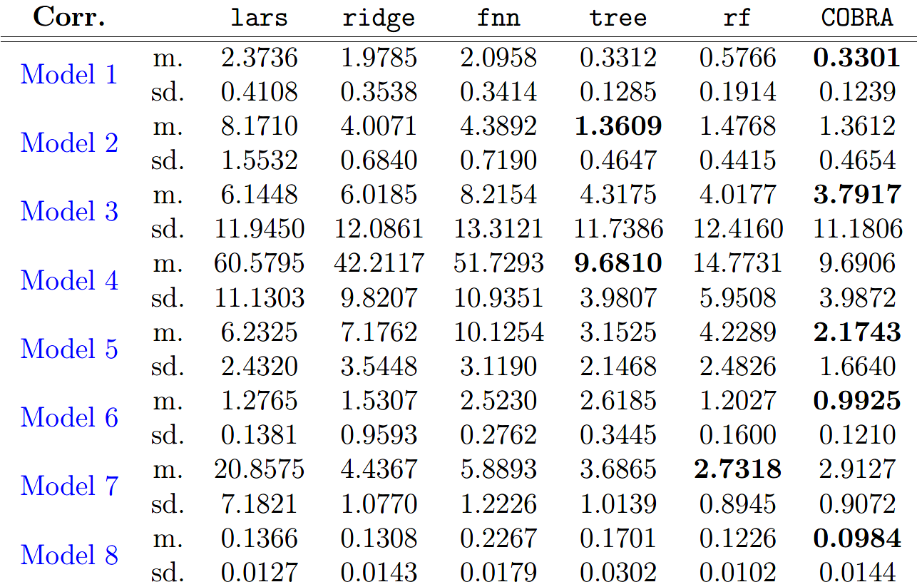
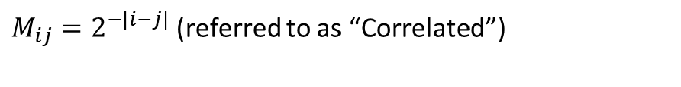
Experiments
1.On synthetic data:
Gaussian with mean 0 and covariance matrix ：
$M_{ij}=2^{−\left|i−j\right|}$ (referred to as “Correlated”)

Slide 11
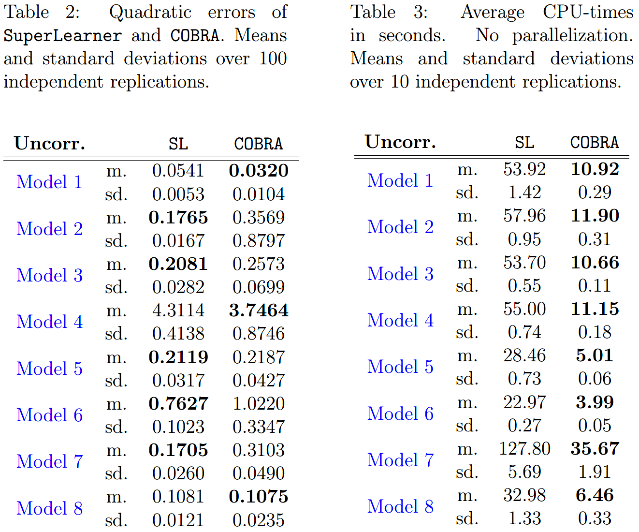
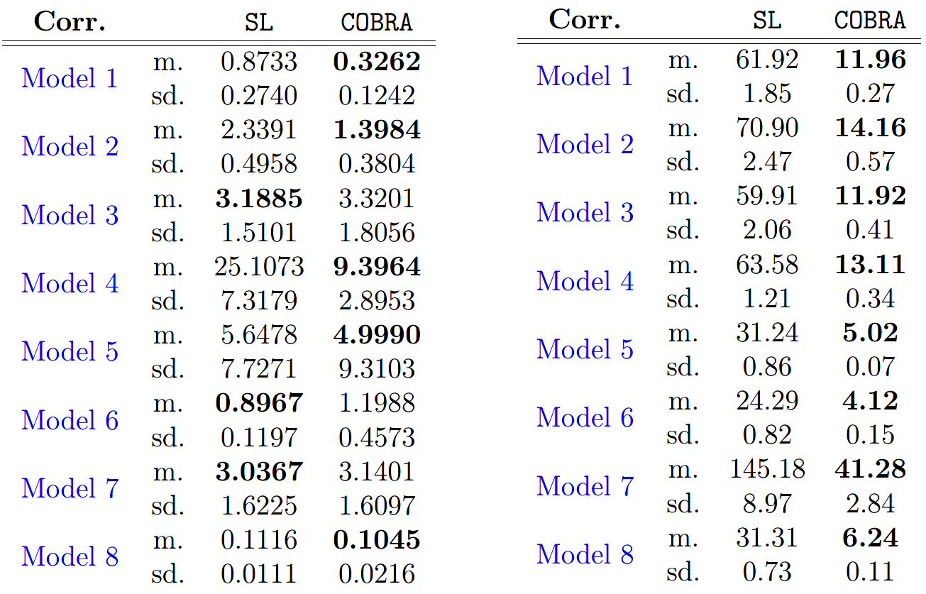
Experiments
1.On synthetic data:
Compare with superlearner:

Slide 12
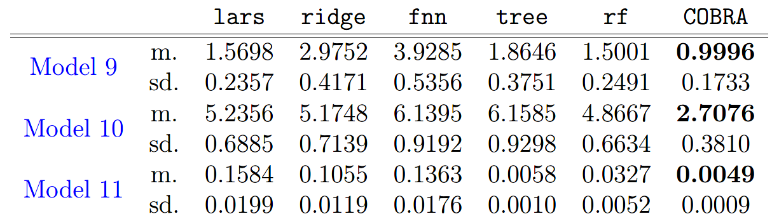
Experiments
1.On synthetic data:
Result on high dimensional data:

Slide 13
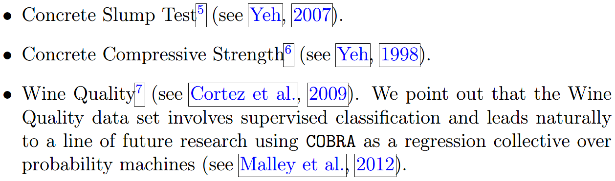
Experiments
2.On Real data:

Slide 14
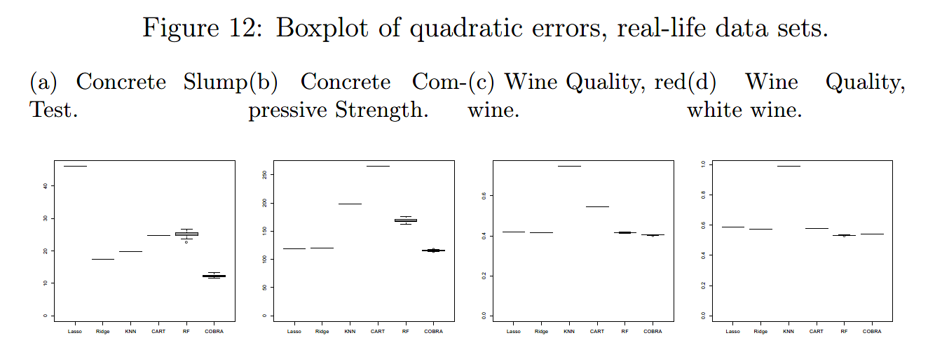
Experiments
2.On real data:

Slide 15
Conclusion
1.Advantage
Very Fast
Model-free
Perform asymptotically at least as well as the best basic estimators
2.Improvements Needed
The data is not fully utilized
Difficulty in finding the optimal parameters
Not suitable for the classification task
The process of the predict task can still be improved

Slide 16
SuperKNN
1.Disadvantage of KNN
The k th data in the train set may not close to the forecast data
Overfitting when the k value is small
Calculating the distance directly based on the original feature
When the variance of training set is large or it has many irrelevant features, the performance of KNN will drop sharply.
2.Disadvantage of Stacking
Multiple collinearity
Overfitting

