Slide 1

Gradient Coding: Avoiding Stragglers in Distributed Learning
Rashish Tandon Qi Lei
Alexandros G. Dimakis Nikos Karampatziakis
Presented by Fangcheng Fu
2018/07/16

Slide 2
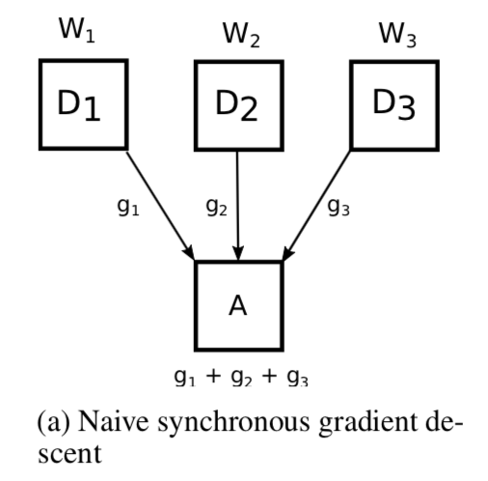
Background and Motivation – Stragglers in Distributed SGD
➣ Master waits for all workers
➣ Key problem: Stragglers. The distributed system is only as fast as the slowest worker

Slide 3
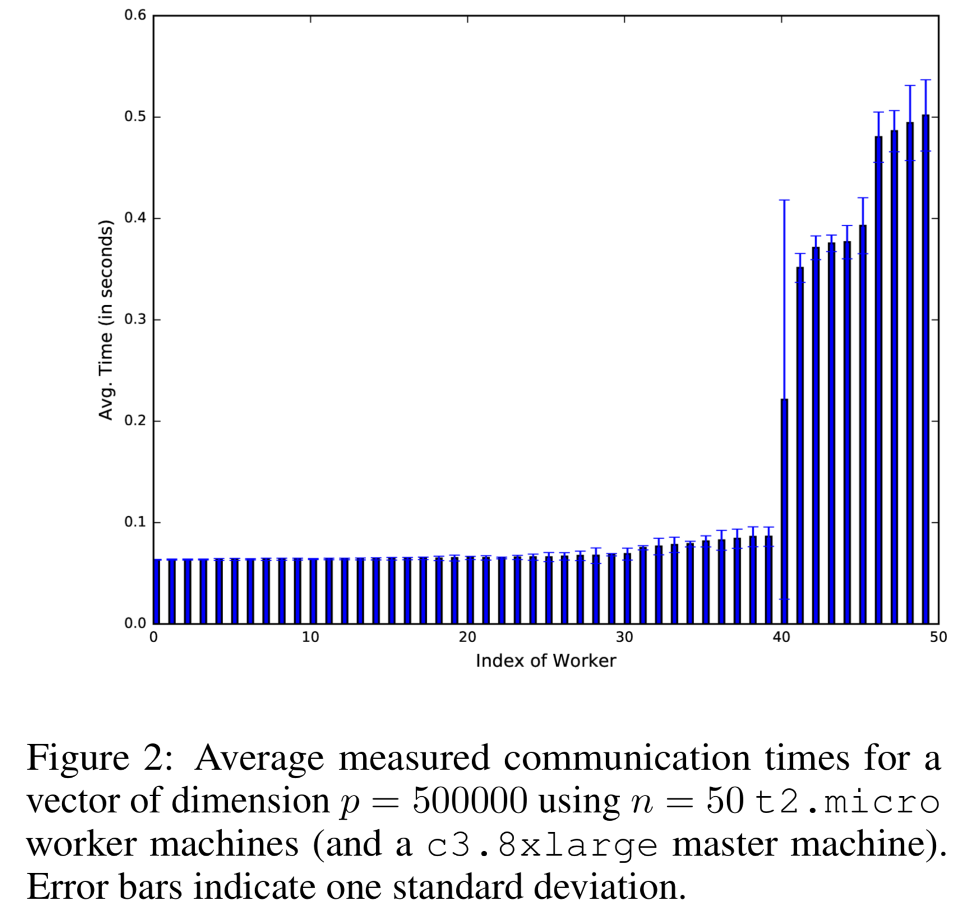
Background and Motivation – Stragglers in Distributed SGD
➣ How slow can stragglers be?
Notes:
Up to 5X
Straggling behavior was consistent in the same machine
Having Burstable Performance
Low-cost machines have higher variety

Slide 4
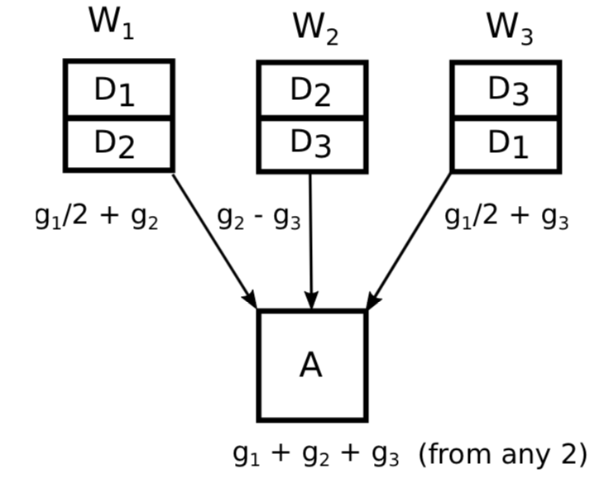
Background and Motivation – Mitigating Stragglers
➣ Duplicate data partitions to mitigate stragglers, with extra communication overhead
➣ This work shows that the communication overhead is unnecessary

Slide 5
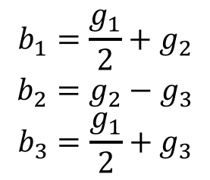
Background and Motivation – Mitigating Stragglers
$$b_{1}=\frac{g_{1}}{2}+g_{2}$$
$$b_{2}=g_{2}−g_{3}$$
$$b_{3}=\frac{g_{1}}{2}+g_{3}$$
➣ $g_{1}+g_{2}+g_{3}$ lies in the span of any 2 out of $\{b_{1}, b_{2},b_{3}\}$

Slide 6


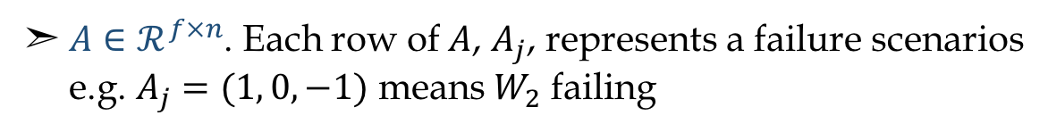
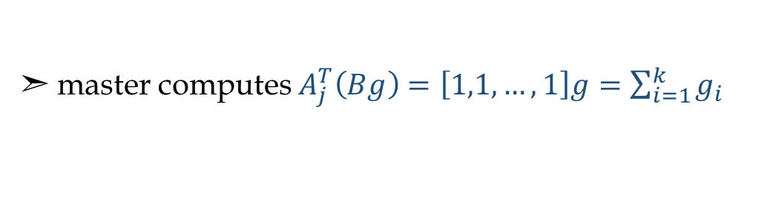
Idea – General Setup
➣ $n$ workers $W=\{W_{1},W_{2},…,W_{n}\}$, $s$ stragglers
➣ $k$ data partitions $D=\{D_{1},D_{2},…,D_{k}\}$, distributed among $n$ workers
➣ $k$ partial gradients $g={\left(g_{1},g_{2},…,g_{k}\right)}^{T}$, correspond to $k$ data partitions
➣ Want to design matrices $A, B, s.t. AB=1_{f×k}$
➣ $B∈ℛ^{n×k}$. Its i-th row, $B_{i}$, corresponds to worker $W_{i}$. Worker $W_{i}$ transmits $b_{i}g$
➣ $A∈ℛ^{f×n}$. Each row of $A$, $A_{j}$, represents a failure scenarios
e.g. $A_{j}=(1, 0, −1)$ means $W_{2}$ failing
➣ master computes $A_{j}^{T}\left(Bg\right)=\left[1,1,…,1\right]g=\sum_{i=1}^{k}{g_{i}}$

Slide 7
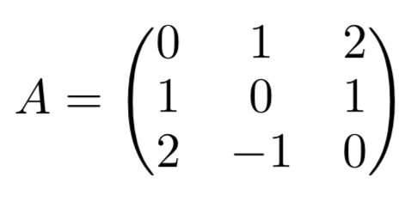
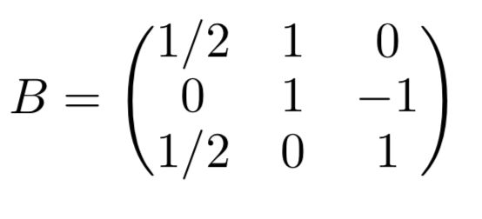
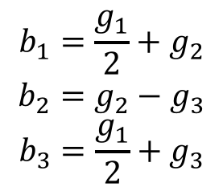
Idea – Previous Example
$$b_{1}=\frac{g_{1}}{2}+g_{2}$$
$$b_{2}=g_{2}−g_{3}$$
$$b_{3}=\frac{g_{1}}{2}+g_{3}$$

Slide 8
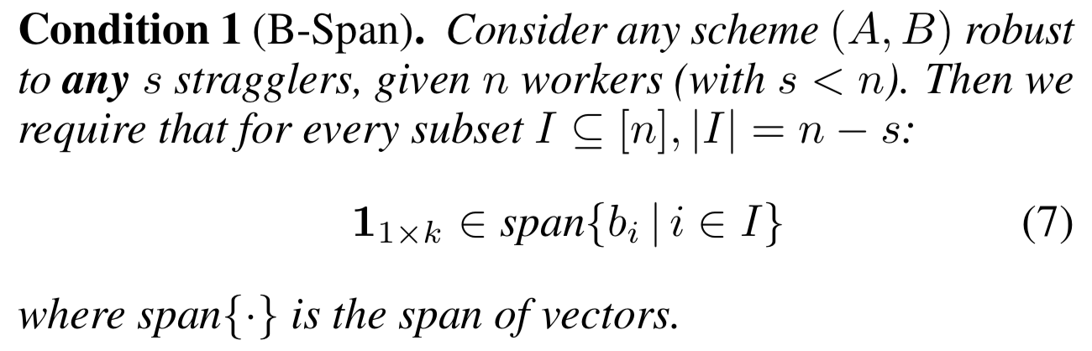

Gradient Coding – Full Stragglers
➣ Want to be robust to any $s$ stragglers
➣ Necessity: of course
➣ Sufficiency: Given a $B$ satisfying Condition-1, we can construct $A$ such that $AB=1_{f×k}$
Notes:
Necessity: 线性相关，有无用的值

Slide 9

Gradient Coding – Full Stragglers
➣ Trivial if $B$ is all ones, but we want to minimize the amount of work per machine,
i.e., the number of non-zeros per row of $B$
➣ Each worker has $\frac{s+1}{n}$ fraction of data, independent of $k$, thus we let $k=n$
➣ $f=number of failure scenrios=(\begin{matrix}n \\ s\end{matrix})$
➣ This work proposes two schemes, Fractional Repetition Scheme and Cyclic Repetition Scheme

Slide 10
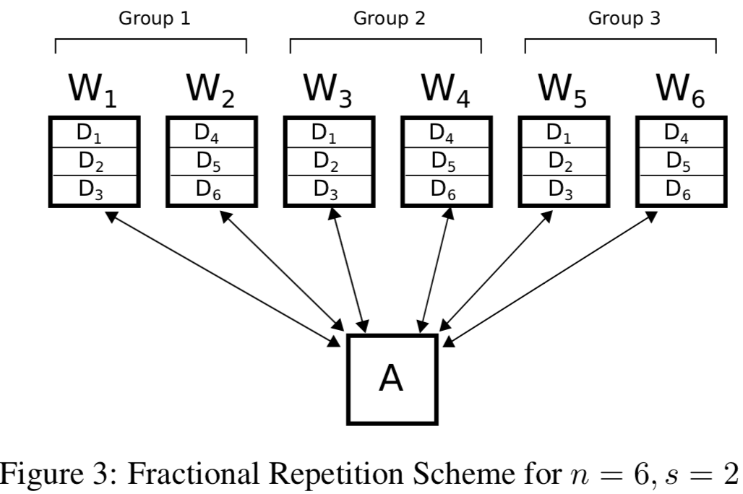
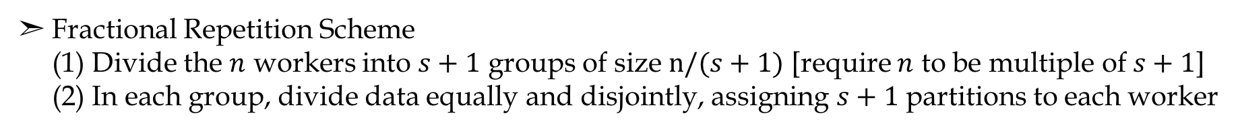
Gradient Coding – Full Stragglers
➣ Fractional Repetition Scheme
(1) Divide the $n$ workers into $s+1$ groups of size $n/(s+1)$ [require $n$ to be multiple of $s+1$]
(2) In each group, divide data equally and disjointly, assigning $s+1$ partitions to each worker

Slide 11
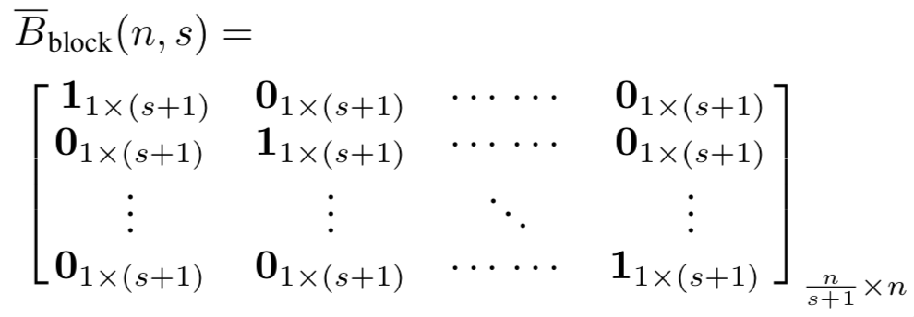
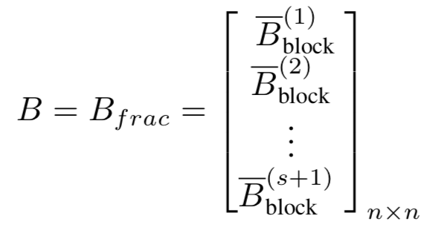
Gradient Coding – Full Stragglers
➣ Fractional Repetition Scheme
(1) Divide the $n$ workers into $s+1$ groups of size $n/(s+1)$ [require $n$ to be multiple of $s+1$]
(2) In each group, divide data equally and disjointly, assigning $s+1$ partitions to each worker

Slide 12
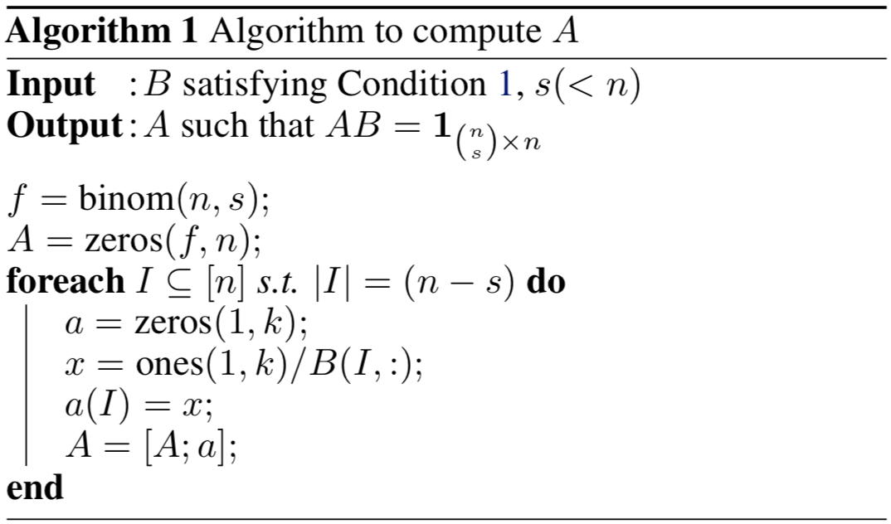
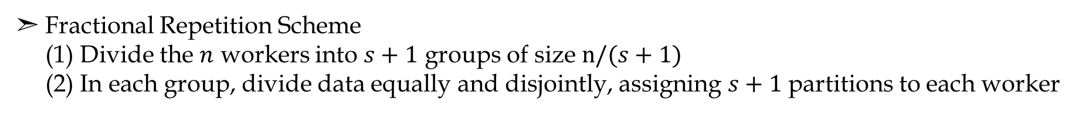
Gradient Coding – Full Stragglers
➣ Fractional Repetition Scheme
(1) Divide the $n$ workers into $s+1$ groups of size $n/(s+1)$
(2) In each group, divide data equally and disjointly, assigning $s+1$ partitions to each worker
Notes:
S+1 groups in total, any s stragglers would have at least 1 non-straggler processing it

Slide 13
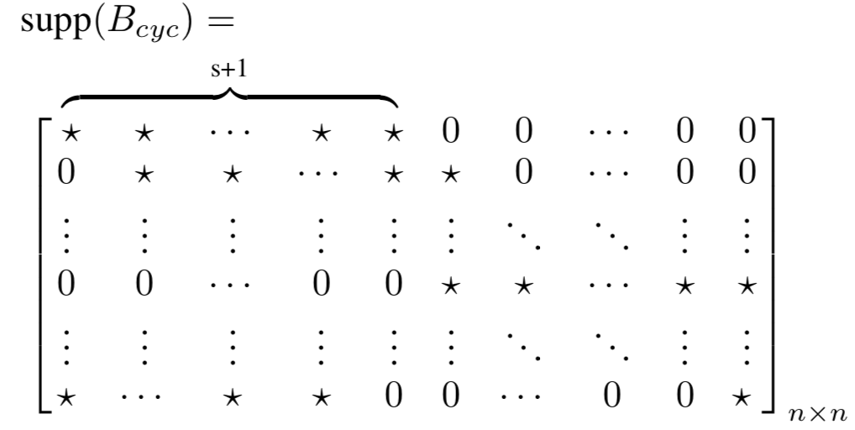
Gradient Coding – Full Stragglers
➣ Cyclic Repetition Scheme – Structure

Slide 14
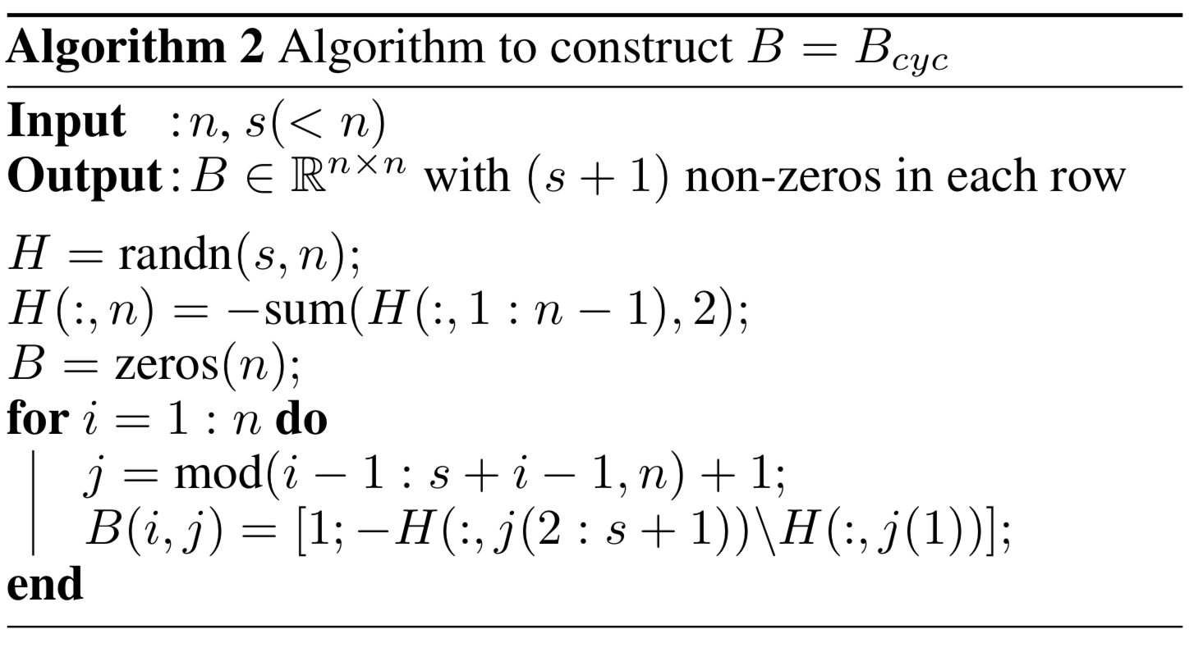
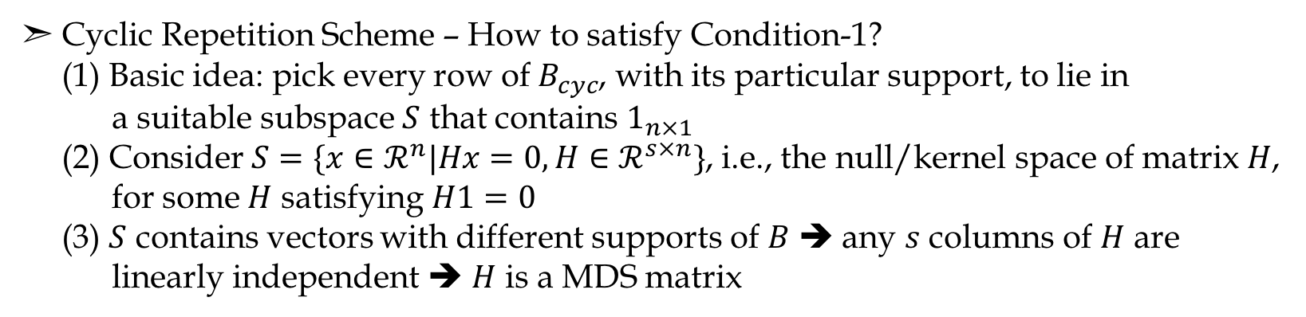
Gradient Coding – Full Stragglers
➣ Cyclic Repetition Scheme – How to satisfy Condition-1?
(1) Basic idea: pick every row of $B_{cyc}$, with its particular support, to lie in
a suitable subspace $S$ that contains $1_{n×1}$
(2) Consider $S=\{x∈ℛ^{n}|Hx=0, H∈ℛ^{s×n}\}$, i.e., the null/kernel space of matrix $H$,
for some $H$ satisfying $H1=0$
(3) $S$ contains vectors with different supports of $B$ ➔ any $s$ columns of $H$ are
linearly independent ➔ $H$ is a MDS matrix

Slide 15
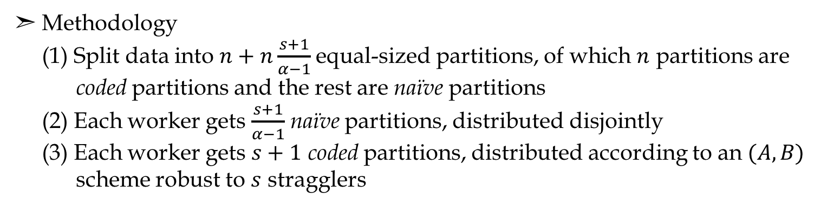
Gradient Coding – Partial Stragglers
➣ Suppose stragglers are not arbitrarily slow, but have a slowdown factor $α(>1)$
➣ Reduce computation overhead by allowing some work to be done on slow workers
➣ Methodology
(1) Split data into $n+n\frac{s+1}{α−1}$ equal-sized partitions, of which $n$ partitions are
coded partitions and the rest are naïve partitions
(2) Each worker gets $\frac{s+1}{α−1}$ naïve partitions, distributed disjointly
(3) Each worker gets $s+1$ coded partitions, distributed according to an $(A, B)$
scheme robust to $s$ stragglers
➣ Each worker only has to process $\frac{s+1}{n}\frac{α}{s+α}$ fraction of data, instead of $\frac{s+1}{n}$

Slide 16
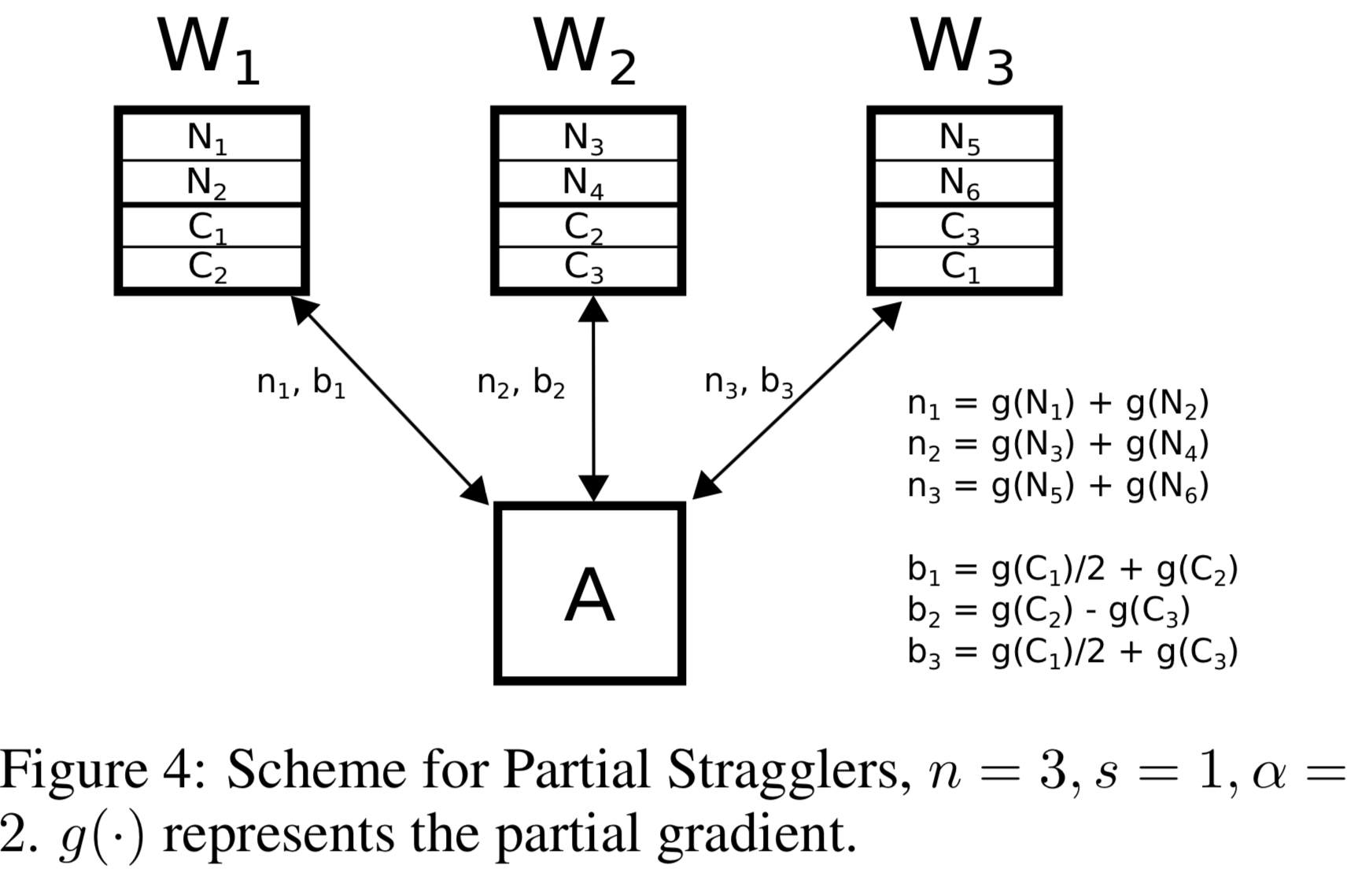
Gradient Coding – Partial Stragglers
➣ Each worker gets $\frac{4}{9}=0.44$ fraction of data, instead of $\frac{2}{3}=0.67$
➣ Drawback: one extra round of communication needed

Slide 17
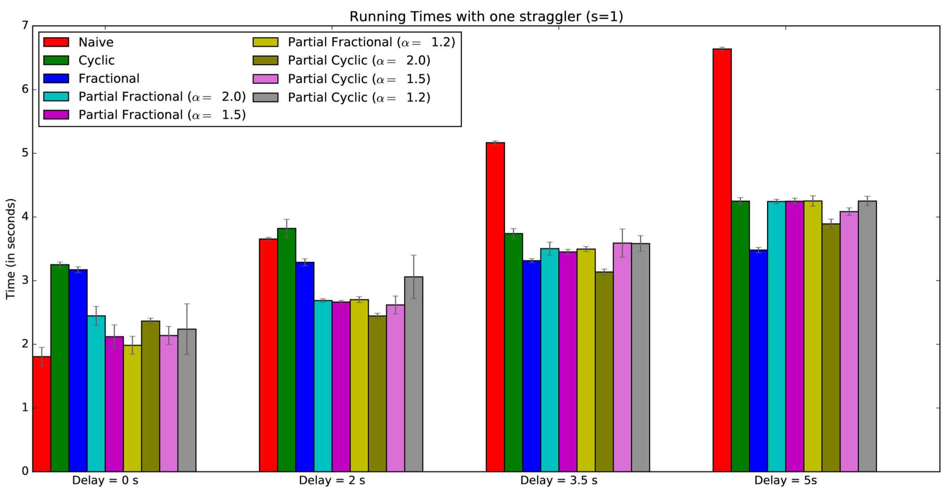
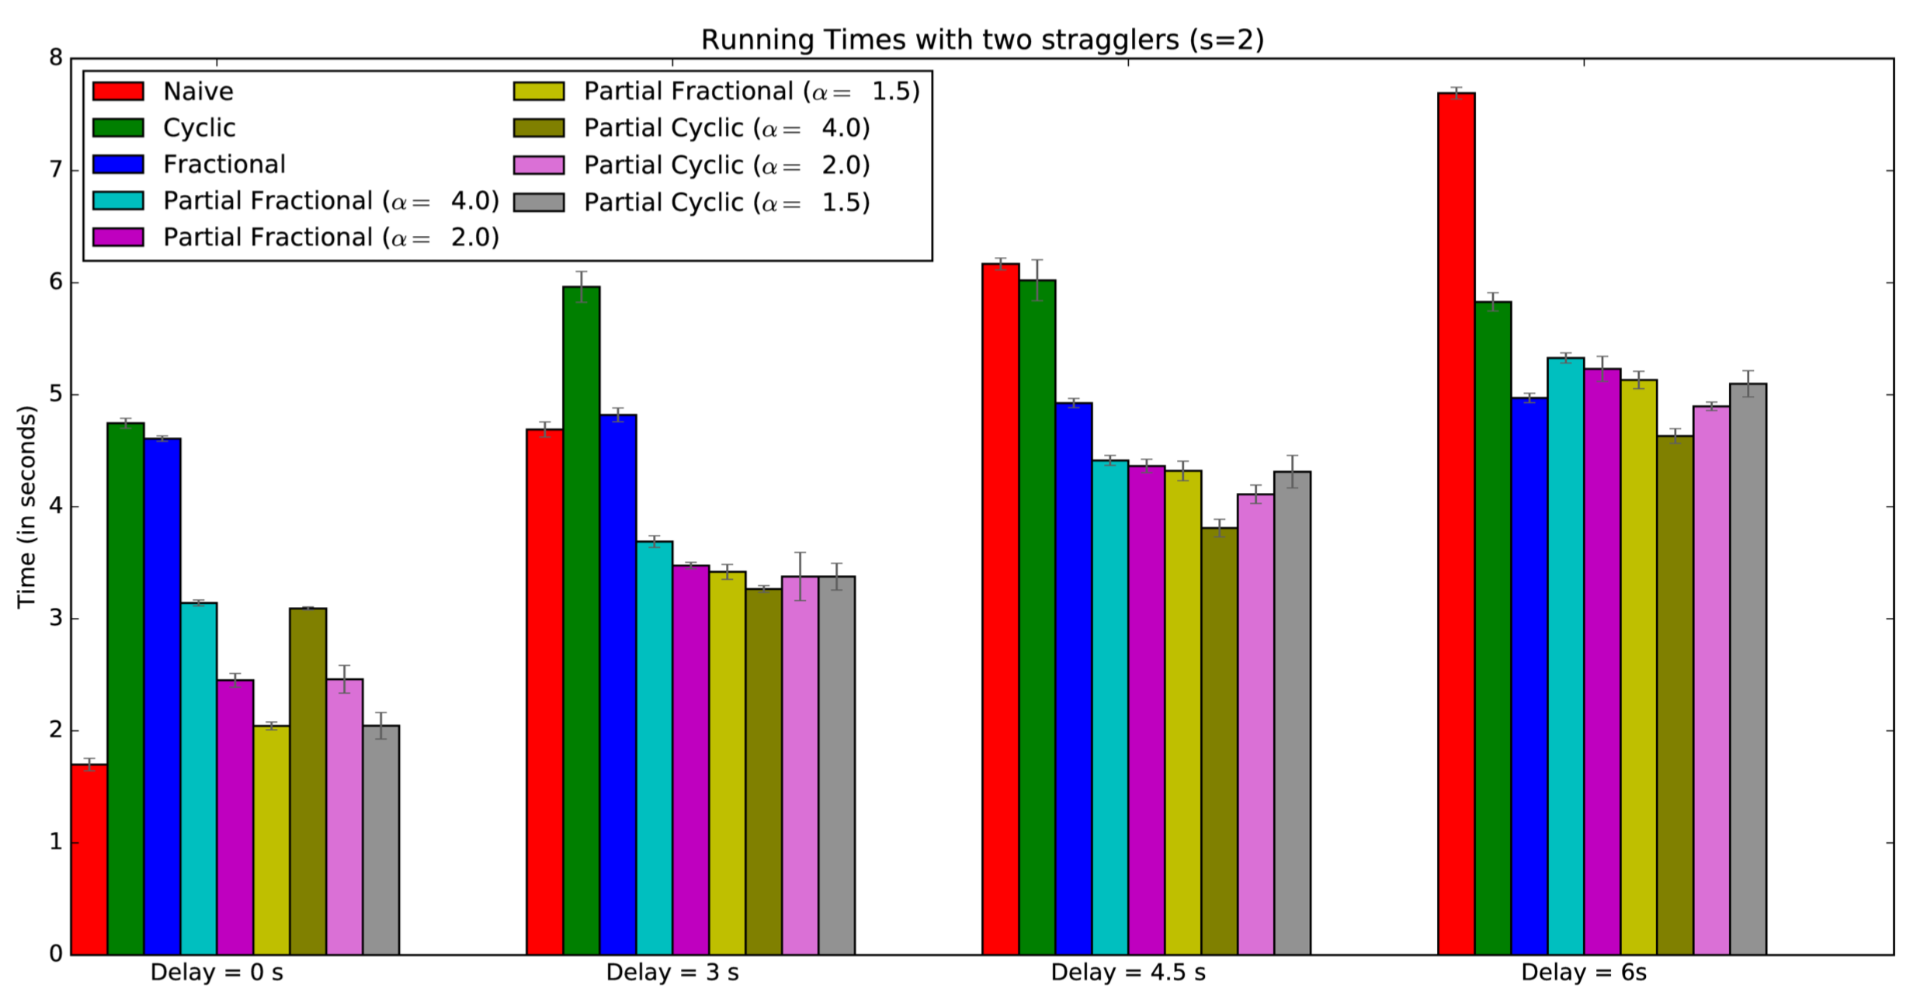
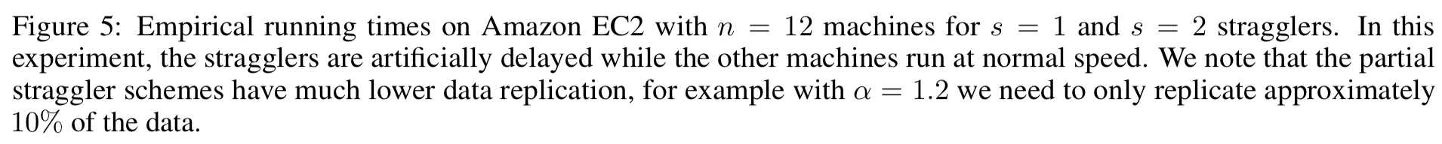
Experiments
Notes:
Artificial datasets and delays

Slide 18
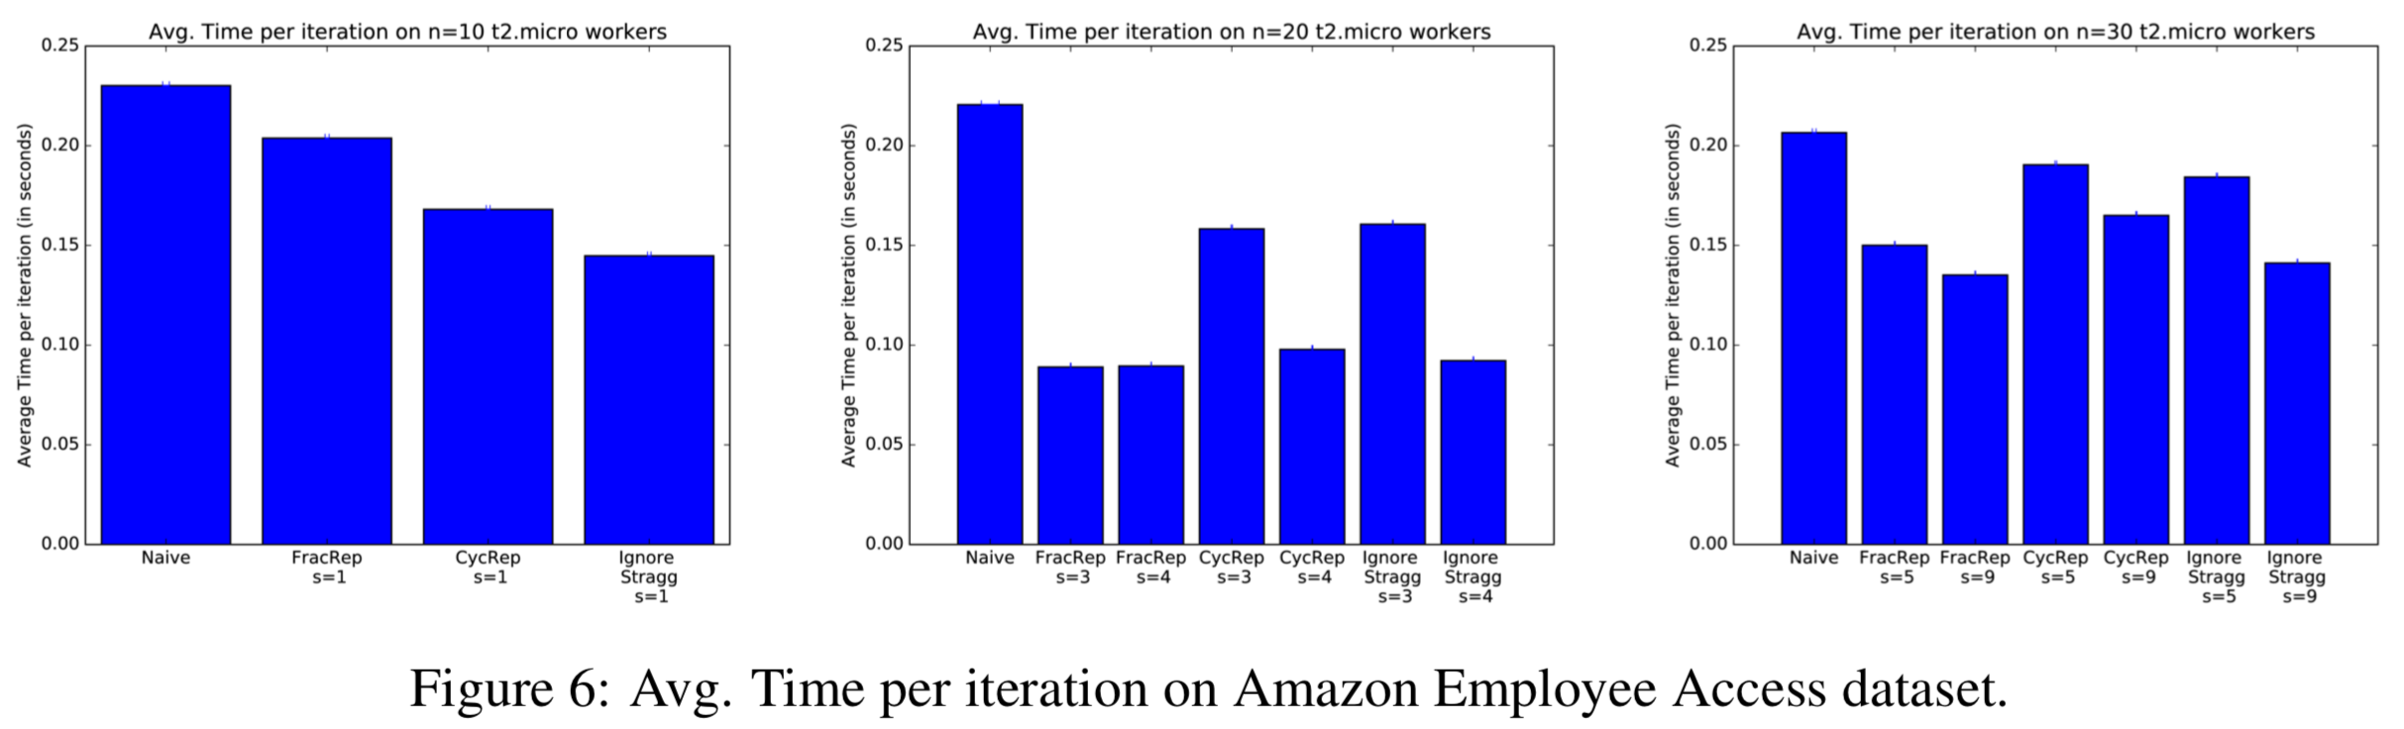
Experiments
Notes:
Without artificial delays
All delays incurred from the AWS cluster

Slide 19
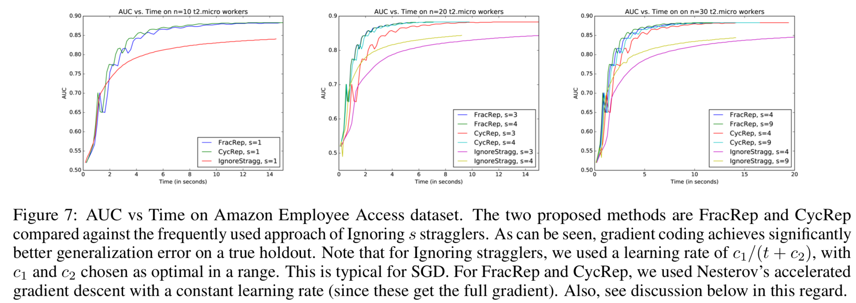
Experiments
Notes:
stochastic gradient vs. full gradient
same distribution
If a particular machine is more likely to be a straggler, samples on that machine will likely be underrepresented in the final model, unless particular countermeasures are deployed.
For example, in structured models such as linear-chain CRFs, the computation of the gradient is proportional to the length of the sequence. Therefore, extraordinarily long examples can be ignored very frequently.

Slide 20
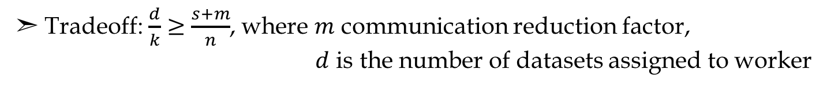
Further
➣ Three parameters: computation load, straggler tolerance and communication cost
➣ Tradeoff: $\frac{d}{k}≥\frac{s+m}{n}$, where $m$ communication reduction factor,
$d$ is the number of datasets assigned to worker
➣ When $m=1$, the same as work of Tandon et. al
Communication-Computation Efficient Gradient Coding. Min Ye, Emmanuel Abbe. ICML 2018

Slide 21
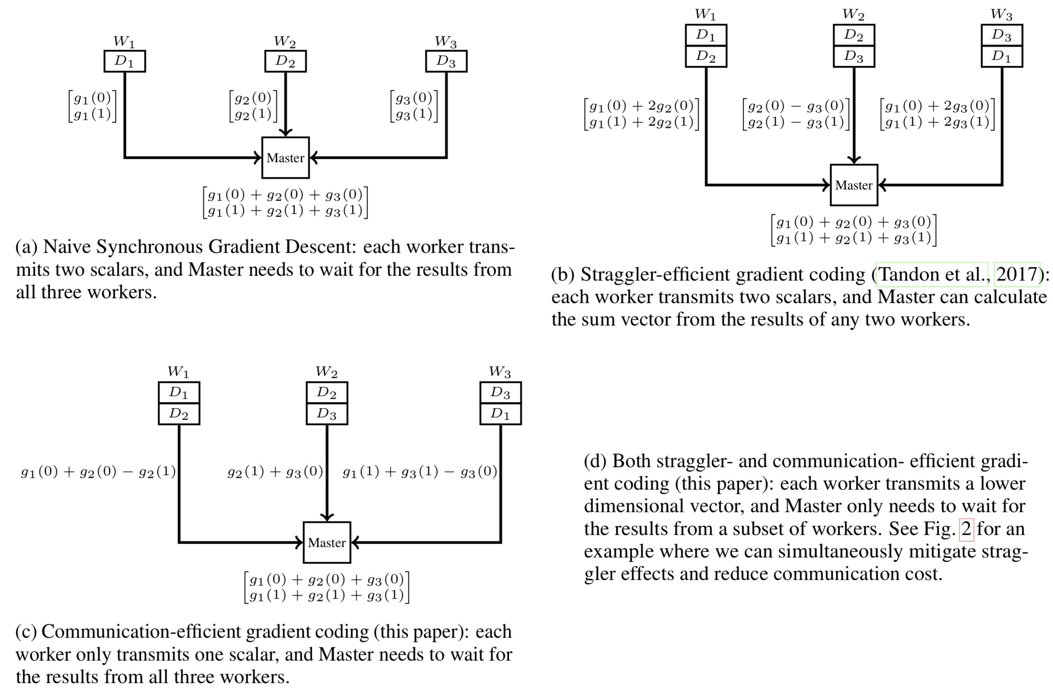
Further
Communication-Computation Efficient Gradient Coding. Min Ye, Emmanuel Abbe. ICML 2018

Slide 22
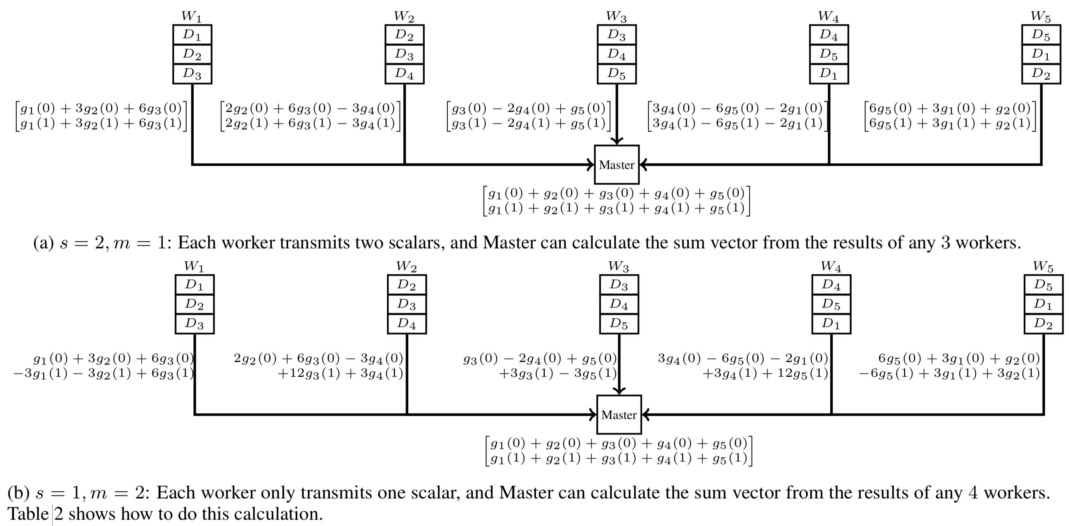
Further
Communication-Computation Efficient Gradient Coding. Min Ye, Emmanuel Abbe. ICML 2018

Slide 23
Q & A

