Slide 1
Reading Group
DMA

Slide 2
形式：
每周1，4下午1:00-2：00，每次分享一篇paper，30-40分钟
目标：
养成读paper的习惯；了解最新研究；加强交流
Notes:
share knowledge，have more communication

Slide 3
FlexPS: Flexible Parallelism Control in Parameter Server Architecture
Yuzhen Huang, James Cheng et al. [CUHK]
VLDB 2018
Presenter: Zhipeng Zhang
Notes:
def SGD with increasing batch size
definition of parallelism → worker threads
The key of this paper is to utilize the tradeoff between communication and computation, then propose implementations for small parallelism, also optimization.
data distributed, use scheduling to enable uniform sampling → no theorey.
one stage != one iteration, != stage in Spark → one stage has the same parallelism

Slide 4
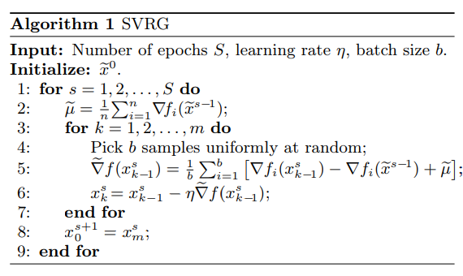
Motivation
Dynamic workloads exist in parameter server-based distributed machine learning:
(1) Mini-batch gradient descent (MGD) with increasing batch size.
(2) Stochastic variance reduced gradient descent (SVRG).
Notes:
def dynamic parallelism.
Different batch size has different best parallelism. Resource & time.

Slide 5
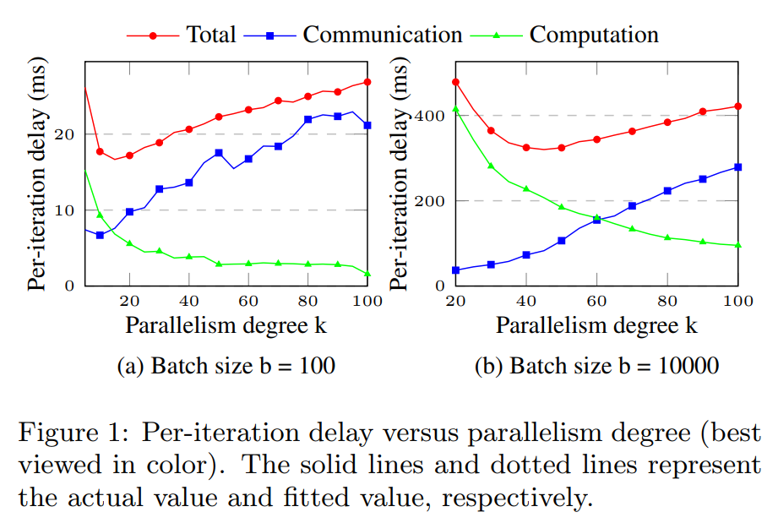
Motivation
→ We need dynamic parallelism for dynamic workload.
Notes:
LR with SGD.
time + resource.

Slide 6
Challenges
Problem: No existing PS-based ML systems support dynamic parallelism.
Implement dynamic parallelism in existing PS-based ML systems is either inefficient or need big engineering effort. No good programming abstraction.
→ FlexPS

Slide 7
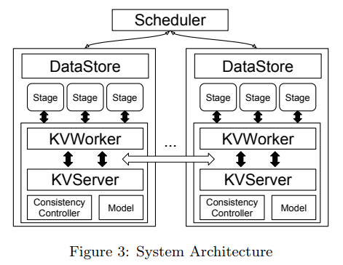
System Architechture

Slide 8
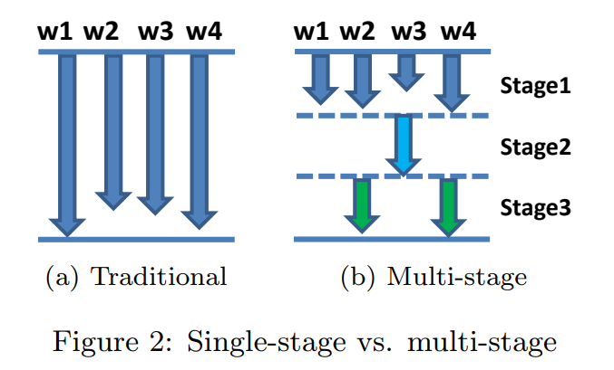
Programming Abstraction
Split each machine learning task into many stages.
Each stage has the same parallelism, e.g, MGD with increasing batch size, SVRG.

Slide 9
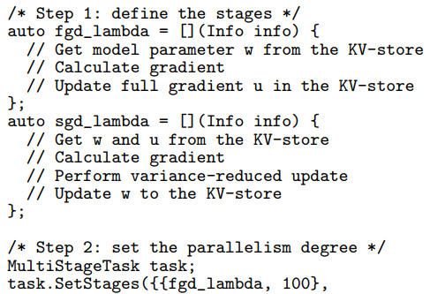
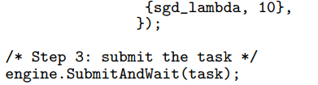
Programming Example

Slide 10
Implementation details
Data store:
Distributed data store.
Use scheduling to ensure uniform sampling (don’t move data).
Stage scheduler:
Try to allocate workers on small number of machines.
use different machines at different iteration(to model data movement).
Consistency controller inside one stage.
Auto-parallelism:
split stage into sub-stages, guess the best parallelism
Notes:
The key is use as less machines as possible so as to reduce the number of machines.

Slide 11
Optimizations for Small Parallelism(single machine)
Move PS things to the machine:
Local model store and consistency controller.
Chunk-based race control:
Sparse update.

Slide 12
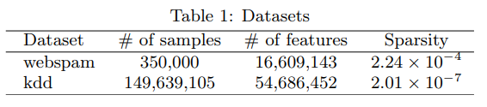
Experiments
20 machines, 2 CPUs with 12 physical cores each machine, 48GB RAM, 1Gbps.

Slide 13
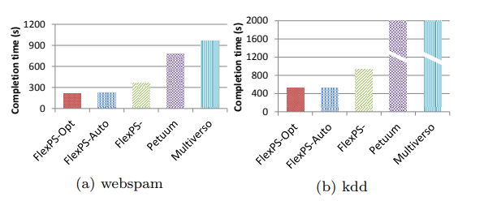
Effect of FlexPS
LR with SVRG
Notes:
Petuum not well implemented?
No reg?
no convergence curve.

Slide 14
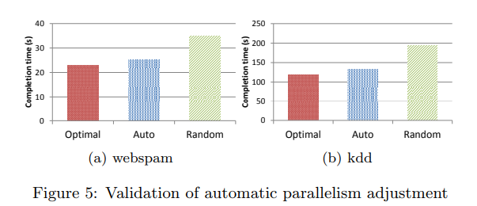
Automatic Parallelism
Workload: SVM with SGD (constant batch size)

Slide 15
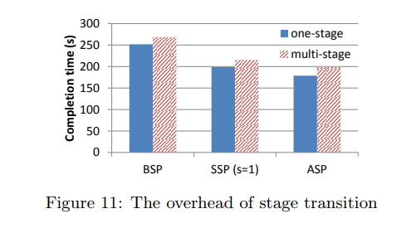
Overhead of Stage Transition
Workload: SVM with SGD (constant batch size)

Slide 16
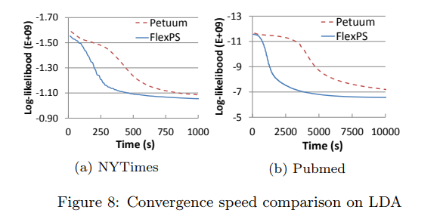
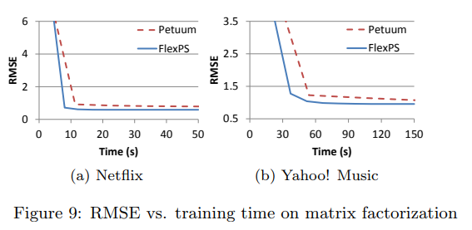
Other experiments (LDA and MF)

Slide 17
Conclusion
Main idea:
tradeoff between communication and computation → dynamic parallelism → resource and efficiency
Drawback:
(1) no theory for uniform sampling, (2) no convergence comparison, (3) no experiments about resource consumption.
Notes:
dynamic parallelism → tradeoff between communication and computation → resource and efficiency

Slide 18
Parameter Server
[OSDI14]
Angel
[NSR17]
Petuum
[KDD16]
Kunpeng
[KDD17]
FlexPS
[VLDB18]
2014 2015 2016 2017 2018
Gaia
[NDSI17]
?
Multiverso
[Microsoft15]
GeePS
[EuroSys16]
Heter-PS
[SIGMOD17]
LightLDA
[WWW15]
Poseidon
[ATC17]
General CPU cluster
CPU-GPU cluster
Heterogeneous cluster
Application-specific
LDA*
[VLDB2017]
TecentBoost
[ICDE2017]
Notes:
consistency controller + ML characteristics
new archi

Slide 19
Parameter Server-
ML characteristics (ML not accurate):
Consistency controller (Petuum, Gaia, Heter-PS, Angel)
System level:
Heter-cluster, GPU (Heter-PS, Gaia, Poseidon, GeePS)
Application-specific:
LDA, GBT, etc.
Notes:
Possible direction:
scheduler by cost model
application-specific PS
PS for graphs?

Slide 20
Disscussion
General PS:
Parameter Server [OSDI14] ⇒ start of parameter server (distributed shared memory)
Petuum[KDD16] ⇒ ssp + model parallelism (characteristics of machine learning)
Gaia[NSDI17] ⇒ geo-distributed machine learning (new background + approximate sync parallel, i.e., lots of gradients are not necessary)
Heter-PS[SIGMOD17] ⇒ weigh more for parameters in faster workers
FlexPS[VLDB18] ⇒ dynamic parallelism for better utilizing resource and efficiency
Angel[NSR17], Kunpeng[KDD17]
Note: These are only for general clusters. If for modern hardware, there are some other PSs, like CPU-GPU heter cluster(Poseidon[ATC17], GeePS[EuroSys16]), PS in tensorflow and MXNet, etc. If for application-specific PSs: LDA*, lightLDA, TecentBoost, etc.
Notes:
Q1. why PSs only for machine learning? how about others? like graph? Q2: what can we further do for PS in angel? Is PS going to die?

