Slide 1
Learning Memory Access Patterns
Milad Hashemi, etc.
Google, Stanford, UCSC
Presenter: Zhipeng Zhang

Slide 2
Background -- Memory Access
Memory access pattern:
Sequence of memory instruction and data address:
(PC1, Addr1), (PC2, Addr2), …, (PC_k, Addr_k), (_, ?)
Memory
// int a[10000]
int i = 0;
while (i < 10000){
a[i] += 1;
i ++;
}
CPU

Slide 3
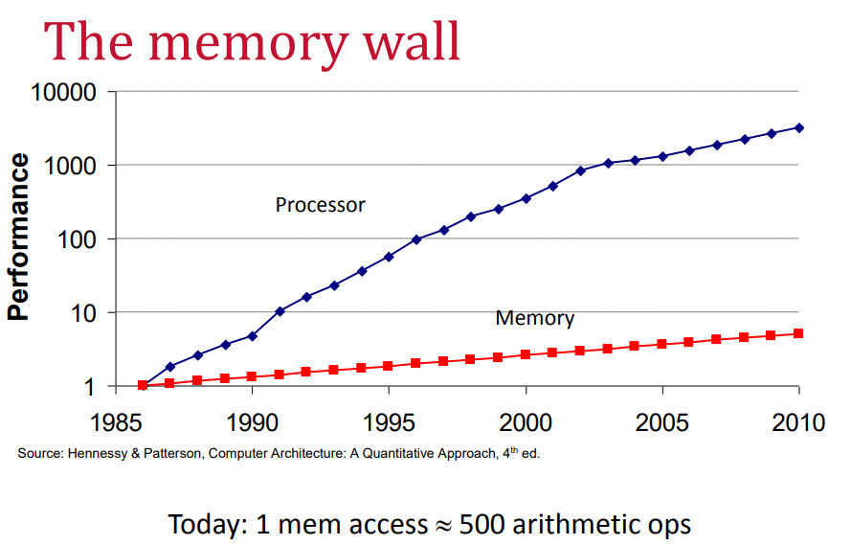
Background -- Memory Wall
prefetch
Memory
CPU
cache

Slide 4
Background -- Current Approaches
Hardware prefetcher (rule-based):
stream-based
stride-based
correlation-based
Software prefetcher.

Slide 5
Motivation
When the size of working sets get larger, the rules are not enough.
Machine learning is good at learning from history, replacing heuristics. Can ML help to get a better prefetcher?

Slide 6
Problem Formulation
input:
Sequence of instruction address and memory address : (PC1, Addr1), (PC2, Addr2), …, (PC_k, Addr_k)
Output:
(_, ?)
// int a[10000], b[10000]
int i = 0;
while (i < 10000){
a[i] += 1;
b[i] += 1;
i ++;
}
Model it as a classification problem, relate to n-gram in language modeling.

Slide 7
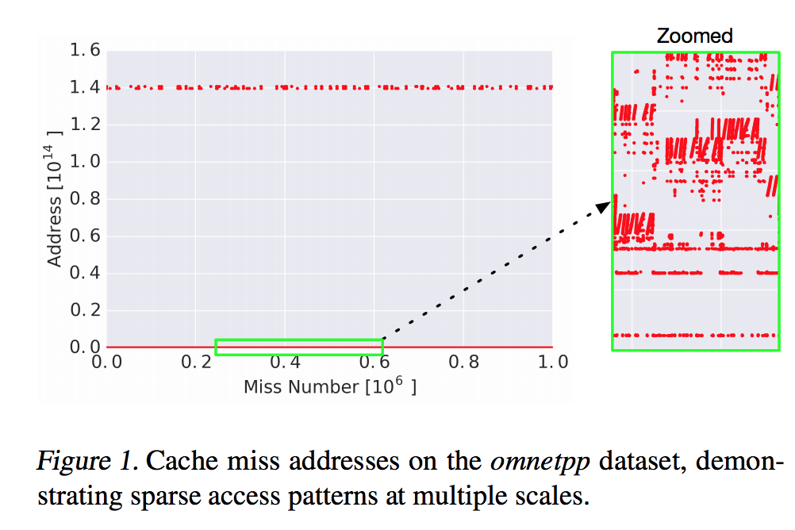
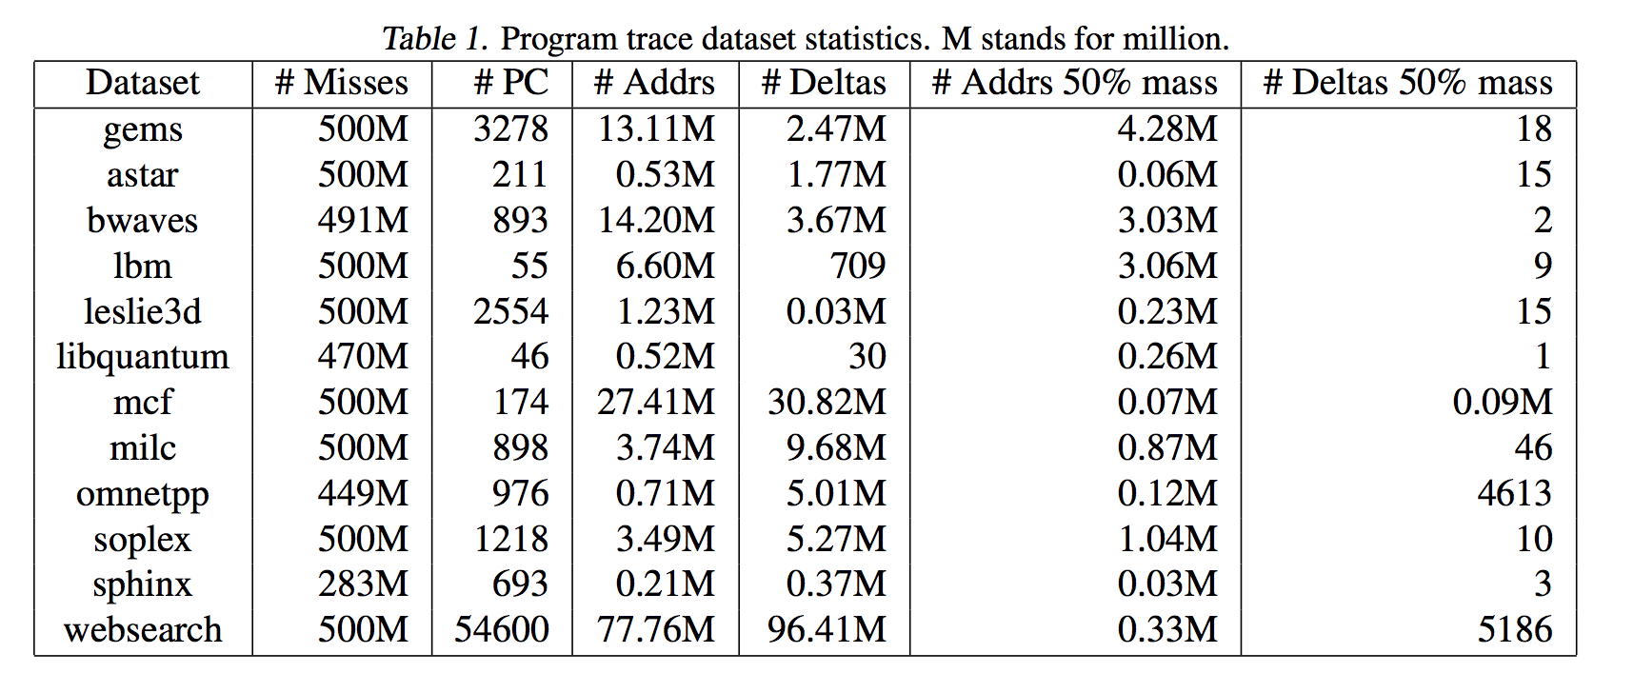
Chanllenge
Too many output targets (2^64) → let’s cut it and predict \deltas (security and smaller space).
Notes:
Just use the addresses that are seen during training
Clustering the addresses: locality of code.

Slide 8
Problem Formulation (new)
input:
Sequence of instruction and memory address : (PC1, \delta_1), (PC2, \delta_2), …, (PC_k, \delta_k)
Output:
(_, ?)
Notes:
(not only for cache miss)
paper: only for cache miss. Why?

Slide 9
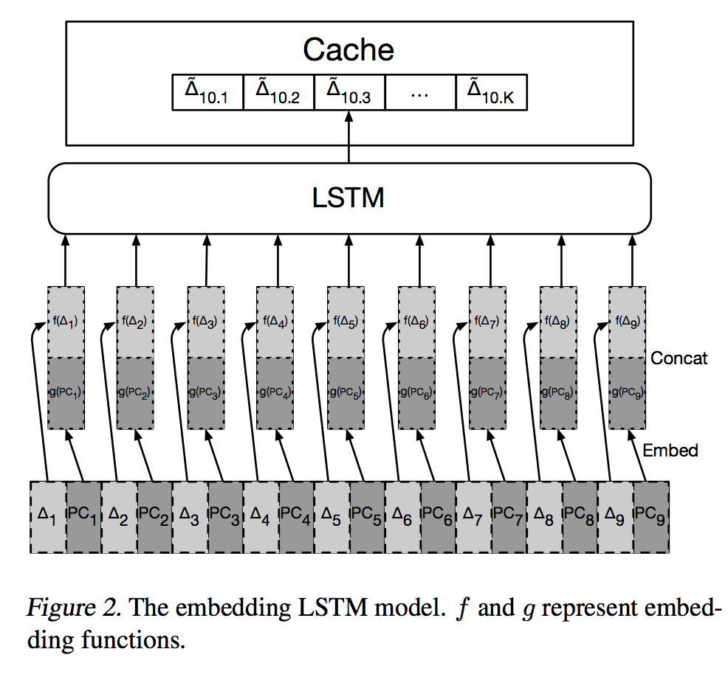
Archi 1. Embedding + LSTM
Notes:
only pick top10.

Slide 10
What about locality in memory address?
e.g.,
// int a[10000], b[10000], c[10000]
int i = 0;
while (i < 10000){
a[i] = b[i] + c[i];
i ++;
}

Slide 11
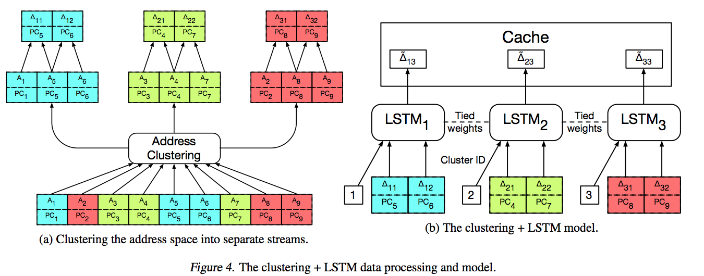
Archi 2. Clustering + LSTM

Slide 12
Experimental setup
Workload:
SPEC CPU2006 ( a memory intensive application)
Google web search workload
Baselines:
Stream-based
Correlation-based
Metrics:
precision@10
recall@10

Slide 13
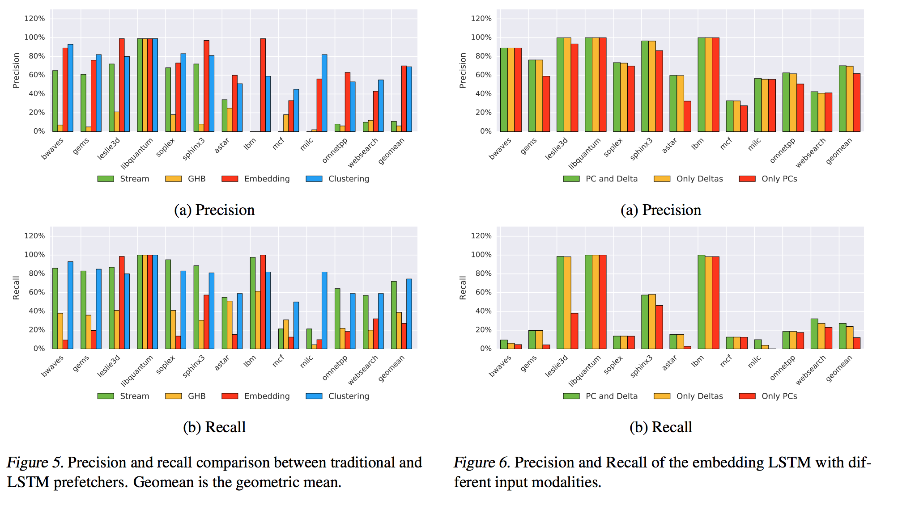
Experimental results
Notes:
precision is better
recall is not.
stream-based. Correlation-based

Slide 14
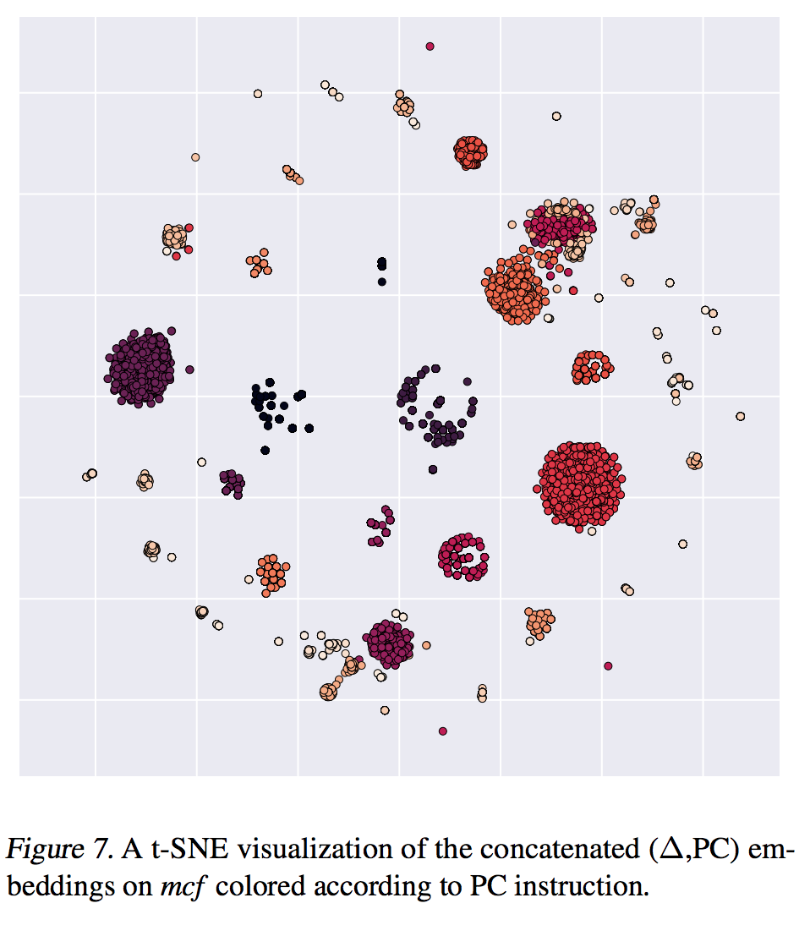
Experimental results (Interpreting)

Slide 15
ML is changing the world!
recommendation,
index and tunning for database,
cache prefetching, branch prediction, memory controller for micro-architecture,
biology,
economy,
education…
Traditional machine learning is good at summarizing, approximation, not accuracy.
Notes:
Can we have extreme-accurate machine learning?

Slide 16
Conclusion & drawbacks
Not practical, but a research trend.
Train on cache miss data and cannot handle dynamic execution.
Only predict one step.
No overhead analysis.
No hardware implementation, just a simulator.

