Slide 1
Optimization Methods for Large-Scale Machine Learning
Xu Xie
2018.4.16

Slide 2
CONTENT
Background
01
03
Analyses of SG
Motivation for SG
Beyond SG
02
04

Slide 3
Background
01

Slide 4
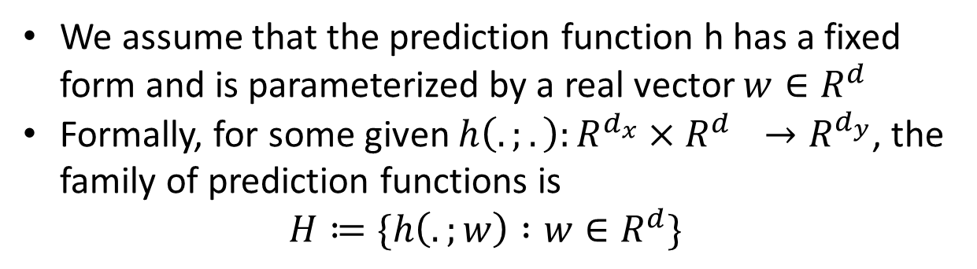
01
Background
Prediction
We assume that the prediction function h has a fixed form and is parameterized by a real vector $w∈R^{d}$
Formally, for some given $h\left(.;.\right):R^{d_{x}}×R^{d_{}}→R^{d_{y}}$, the family of prediction functions is
$$H≔\{h\left(.;w\right) :w∈R^{d}\}$$

Slide 5
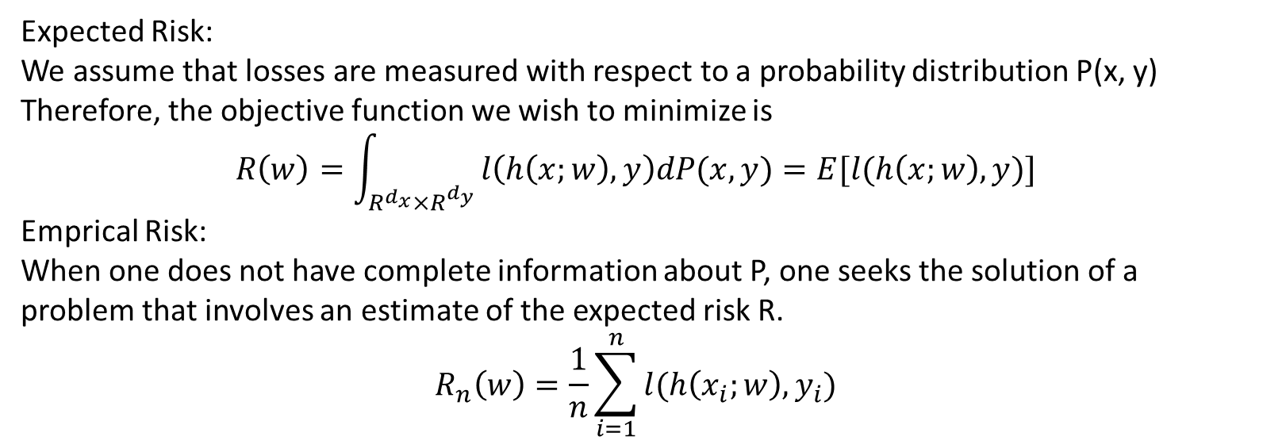
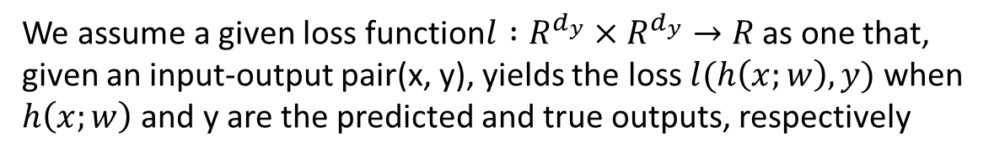
01
Background
Loss function
We assume a given loss function$l :R^{d_{y}}×R^{d_{y}}→R$ as one that, given an input-output pair(x, y), yields the loss $l(h\left(x;w\right),y)$ when $h\left(x;w\right)$ and y are the predicted and true outputs, respectively
Expected Risk:
We assume that losses are measured with respect to a probability distribution P(x, y) Therefore, the objective function we wish to minimize is
$$R\left(w\right)=\int_{R^{d_{x}}×R^{d_{y}}}{l\left(h\left(x;w\right), y\right)dP(x,y)}=E[l(h\left(x;w\right), y)]$$
Emprical Risk:
When one does not have complete information about P, one seeks the solution of a problem that involves an estimate of the expected risk R.
$$R_{n}\left(w\right)=\frac{1}{n}\sum_{i=1}^{n}{l(h\left(x_{i};w\right),y_{i})}$$

Slide 6
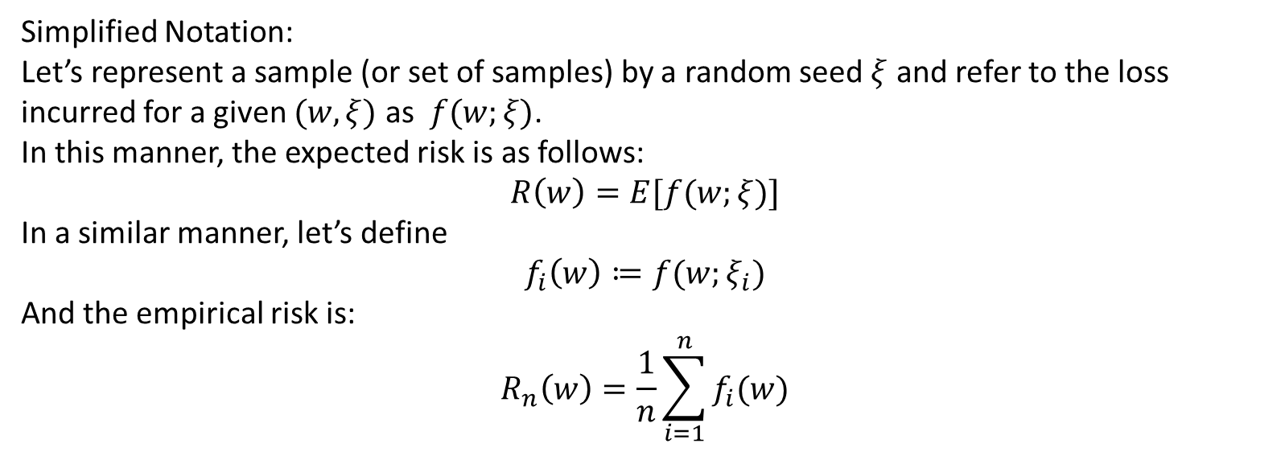
01
Background
Loss function
We assume a given loss function$l :R^{d_{y}}×R^{d_{y}}→R$ as one that, given an input-output pair(x, y), yields the loss $l(h\left(x;w\right),y)$ when $h\left(x;w\right)$ and y are the predicted and true outputs, respectively
Simplified Notation:
Let’s represent a sample (or set of samples) by a random seed $ξ$ and refer to the loss incurred for a given $(w, ξ)$ as $f(w;ξ)$.
In this manner, the expected risk is as follows:
$$R\left(w\right)=E[f(w;ξ)]$$
In a similar manner, let’s define
$$f_{i}\left(w\right)≔f(w;ξ_{i})$$
And the empirical risk is:
$$R_{n}\left(w\right)=\frac{1}{n}\sum_{i=1}^{n}{f_{i}(w)}$$

Slide 7
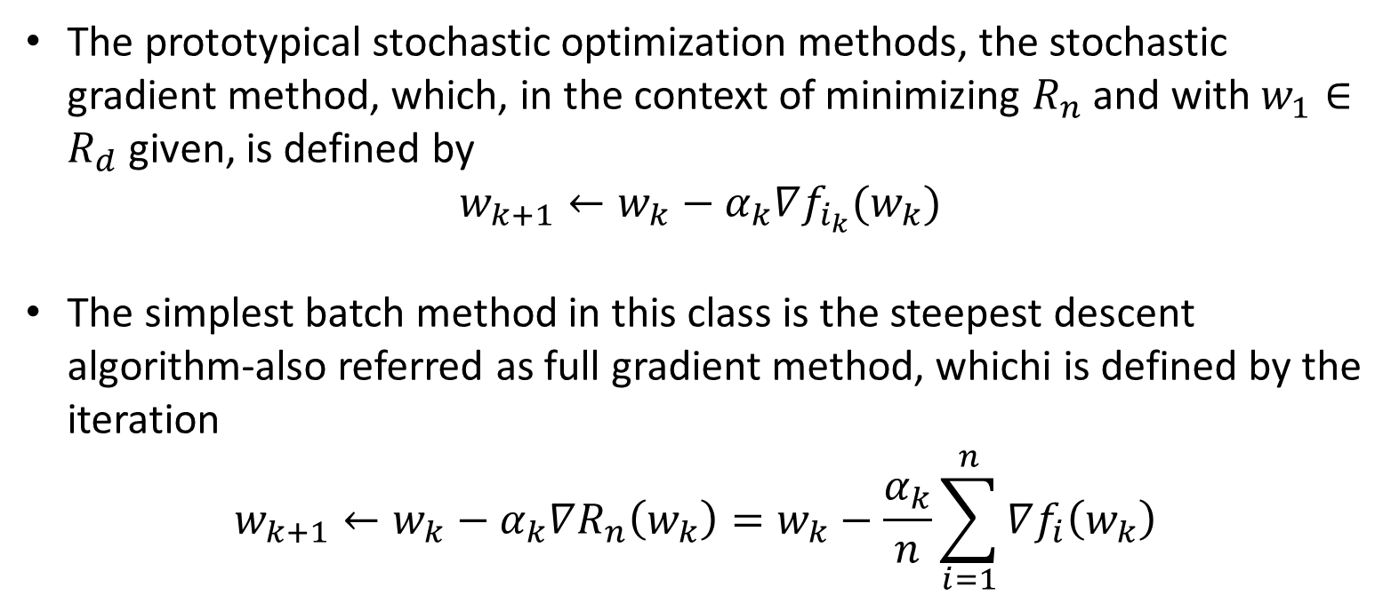
01
Background
Stochastic v.s. Batch
The prototypical stochastic optimization methods, the stochastic gradient method, which, in the context of minimizing $R_{n}$ and with $w_{1}∈R_{d}$ given, is defined by
$$w_{k+1}←w_{k}−α_{k}∇f_{i_{k}}(w_{k})$$
The simplest batch method in this class is the steepest descent algorithm-also referred as full gradient method, whichi is defined by the iteration
$$w_{k+1}←w_{k}−α_{k}∇R_{n}\left(w_{k}\right)=w_{k}−\frac{α_{k}}{n}\sum_{i=1}^{n}{∇f_{i}\left(w_{k}\right)}$$

Slide 8
01
Background
Stochastic v.s. Batch
Stochastic and batch approaches offer different trade-offs in terms of per-iteration costs and expected per-iteration improvement in minimizing emprical risk.
But, why has the stochastic method risen to sunch prominence in the context of large-scale machine learning?

Slide 9
Motivation for SG
02

Slide 10



02
Motivation for SG
Intuitive
Practical
Theoretical

Slide 11
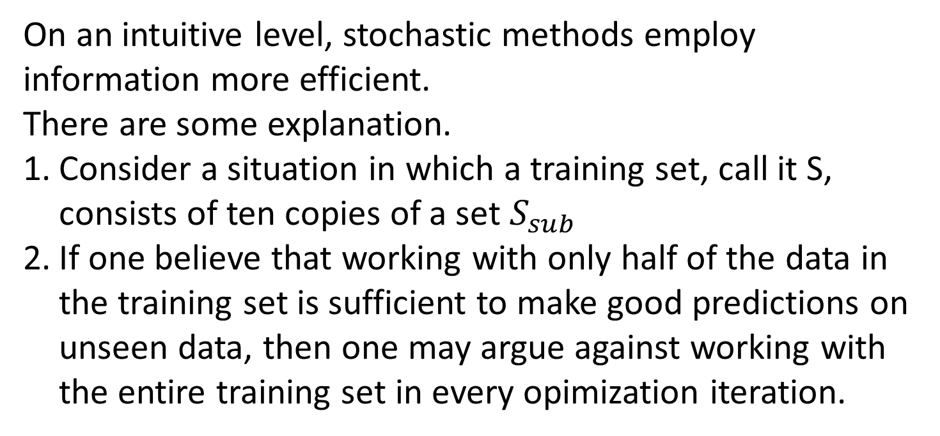
02
Motivation for SG
Intuitive
On an intuitive level, stochastic methods employ information more efficient.
There are some explanation.
Consider a situation in which a training set, call it S, consists of ten copies of a set $S_{sub}$
If one believe that working with only half of the data in the training set is sufficient to make good predictions on unseen data, then one may argue against working with the entire training set in every opimization iteration.

Slide 12
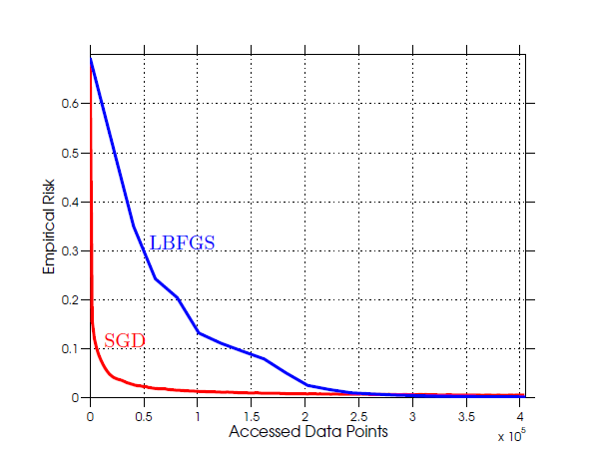
02
Motivation for SG
Practical
A constant step size on a binary classfication problem using a logistic loss objective function and the data from the RCV1 dataset

Slide 13
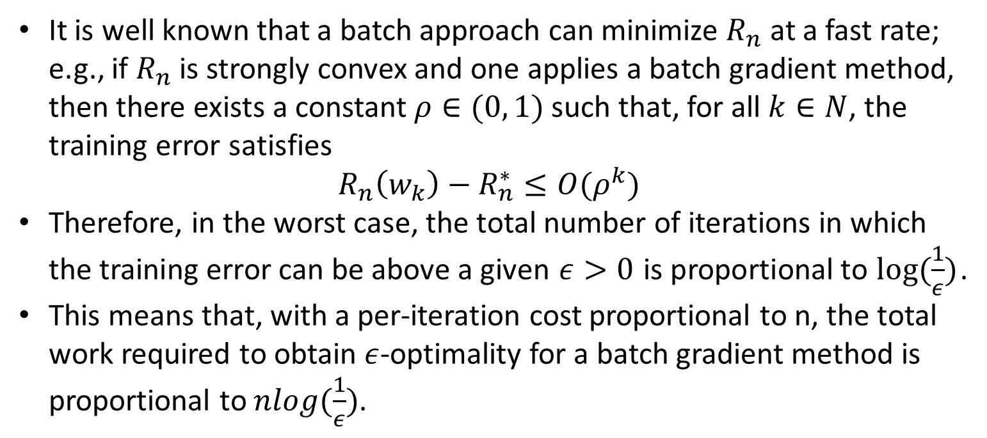
02
Motivation for SG
Theoretical
It is well known that a batch approach can minimize $R_{n}$ at a fast rate; e.g., if $R_{n}$ is strongly convex and one applies a batch gradient method, then there exists a constant $ρ∈(0, 1)$ such that, for all $k∈N$, the training error satisfies
$$R_{n}\left(w_{k}\right)−R_{n}^{∗}≤O(ρ^{k})$$
Therefore, in the worst case, the total number of iterations in which the training error can be above a given $ε>0$ is proportional to $log⁡(\frac{1}{ε})$.
This means that, with a per-iteration cost proportional to n, the total work required to obtain $ε$-optimality for a batch gradient method is proportional to $nlog(\frac{1}{ε})$.

Slide 14
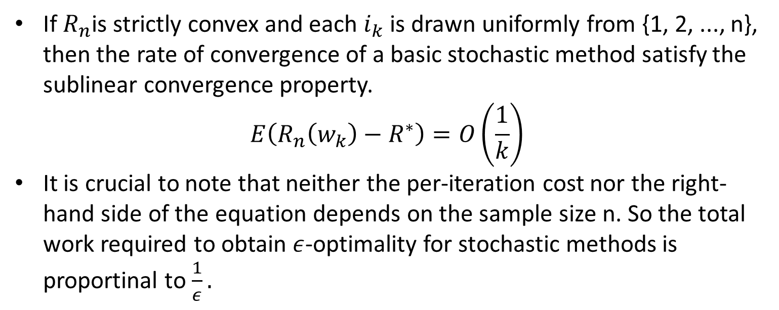
02
Motivation for SG
Theoretical
If $R_{n}$is strictly convex and each $i_{k}$ is drawn uniformly from {1, 2, ..., n}, then the rate of convergence of a basic stochastic method satisfy the sublinear convergence property.
$$E\left(R_{n}\left(w_{k}\right)−R^{∗}\right)=O\left(\frac{1}{k}\right)$$
It is crucial to note that neither the per-iteration cost nor the right-hand side of the equation depends on the sample size n. So the total work required to obtain $ε$-optimality for stochastic methods is proportinal to $\frac{1}{ε}.$

Slide 15
02
Motivation for SG
Notice
We do not claim that batch methods have no place in practice. For one thing, if we consider a larger number of epochs, then one would find the batch approach eventually overtake the stochastic method and yield a lower training error.
Moreover, the stochastic method iteration is difficult to prarllelize and requires excessive communication between nodes in a distributed computing setting.

Slide 16
Analyses of SG
03

Slide 17
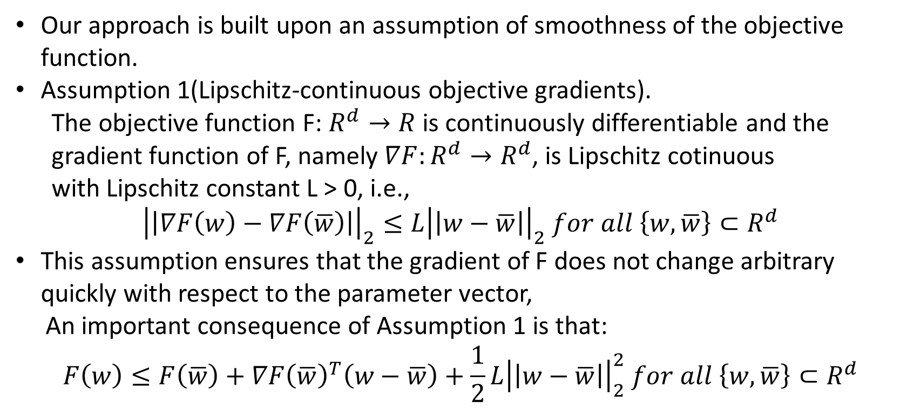
03
Analyses for SG
Assumption 1
Our approach is built upon an assumption of smoothness of the objective function.
Assumption 1(Lipschitz-continuous objective gradients).
The objective function F: $R^{d}→R$ is continuously differentiable and the
gradient function of F, namely $∇F:R^{d}→R^{d}$, is Lipschitz cotinuous
with Lipschitz constant L > 0, i.e.,
$${\left|\left|∇F\left(w\right)−∇F\left(\overline{w}\right)\right|\right|}_{2}≤L{\left|\left|w−\overline{w}\right|\right|}_{2} for all \left\{w, \overline{w}\right\}⊂R^{d}$$
This assumption ensures that the gradient of F does not change arbitrary quickly with respect to the parameter vector,
An important consequence of Assumption 1 is that:
$$F\left(w\right)≤F\left(\overline{w}\right)+∇F{\left(\overline{w}\right)}^{T}\left(w−\overline{w}\right)+\frac{1}{2}L{\left|\left|w−\overline{w}\right|\right|}_{2}^{2} for all \left\{w, \overline{w}\right\}⊂R^{d}$$

Slide 18
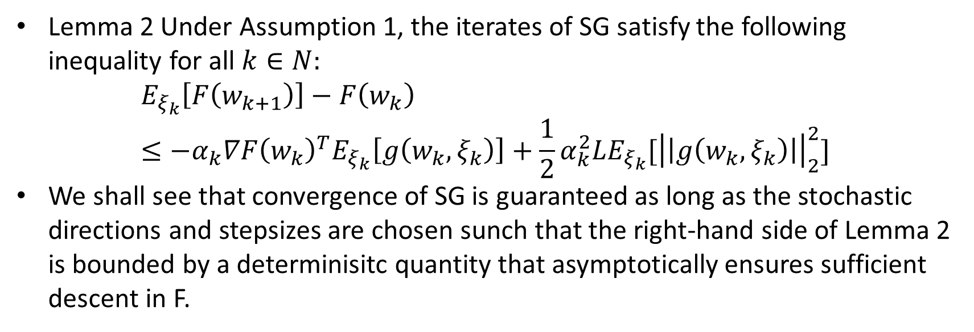
03
Analyses for SG
Lemma 2
Lemma 2 Under Assumption 1, the iterates of SG satisfy the following inequality for all $k∈N:$
$$E_{ξ_{k}}\left[F\left(w_{k+1}\right)\right]−F\left(w_{k}\right)≤−α_{k}∇F{\left(w_{k}\right)}^{T}E_{ξ_{k}}\left[g\left(w_{k}, ξ_{k}\right)\right]+\frac{1}{2}α_{k}^{2}LE_{ξ_{k}}[{\left|\left|g\left(w_{k},ξ_{k}\right)\right|\right|}_{2}^{2}]$$
We shall see that convergence of SG is guaranteed as long as the stochastic directions and stepsizes are chosen sunch that the right-hand side of Lemma 2 is bounded by a determinisitc quantity that asymptotically ensures sufficient descent in F.

Slide 19
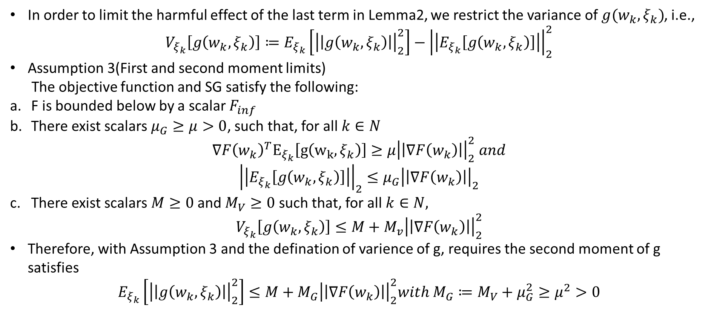
03
Analyses for SG
Assumption 3
In order to limit the harmful effect of the last term in Lemma2, we restrict the variance of $g(w_{k}, ξ_{k})$, i.e.,
$$V_{ξ_{k}}\left[g\left(w_{k},ξ_{k}\right)\right]≔E_{ξ_{k}}\left[{\left|\left|g\left(w_{k}, ξ_{k}\right)\right|\right|}_{2}^{2}\right]−{\left|\left|E_{ξ_{k}}\left[g\left(w_{k},ξ_{k}\right)\right]\right|\right|}_{2}^{2}$$
Assumption 3(First and second moment limits)
The objective function and SG satisfy the following:
F is bounded below by a scalar $F_{inf}$
There exist scalars $μ_{G}≥μ>0$, such that, for all $k∈N$
$$∇F{\left(w_{k}\right)}^{T}E_{ξ_{k}}\left[g\left(w_{k},ξ_{k}\right)\right]≥μ{\left|\left|∇F\left(w_{k}\right)\right|\right|}_{2}^{2} and$$
$${\left|\left|E_{ξ_{k}}\left[g\left(w_{k},ξ_{k}\right)\right]\right|\right|}_{2}≤μ_{G}{\left|\left|∇F\left(w_{k}\right)\right|\right|}_{2}$$
There exist scalars $M≥0$ and $M_{V}≥0$ such that, for all $k∈N,$
$$V_{ξ_{k}}\left[g\left(w_{k},ξ_{k}\right)\right]≤M+M_{v}{\left|\left|∇F\left(w_{k}\right)\right|\right|}_{2}^{2}$$
Therefore, with Assumption 3 and the defination of varience of g, requires the second moment of g satisfies
$$E_{ξ_{k}}\left[{\left|\left|g\left(w_{k},ξ_{k}\right)\right|\right|}_{2}^{2}\right]≤M+M_{G}{\left|\left|∇F\left(w_{k}\right)\right|\right|}_{2}^{2}with M_{G}≔M_{V}+μ_{G}^{2}≥μ^{2}>0$$

Slide 20
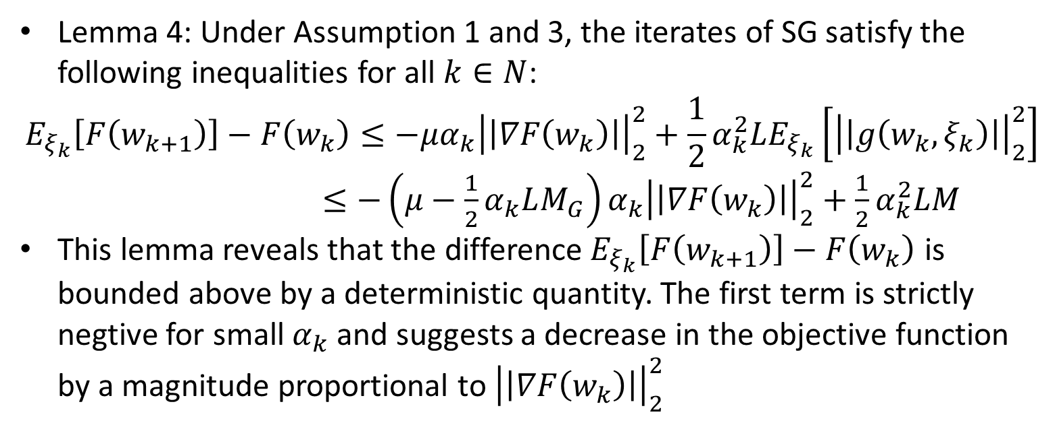
03
Analyses for SG
Lemma 4
Lemma 4: Under Assumption 1 and 3, the iterates of SG satisfy the following inequalities for all $k∈N$:
$$E_{ξ_{k}}\left[F\left(w_{k+1}\right)\right]−F\left(w_{k}\right)≤−μα_{k}{\left|\left|∇F\left(w_{k}\right)\right|\right|}_{2}^{2}+\frac{1}{2}α_{k}^{2}LE_{ξ_{k}}\left[{\left|\left|g\left(w_{k}, ξ_{k}\right)\right|\right|}_{2}^{2}\right]$$
$≤−\left(μ−\frac{1}{2}α_{k}LM_{G}\right)α_{k}{\left|\left|∇F\left(w_{k}\right)\right|\right|}_{2}^{2}+\frac{1}{2}α_{k}^{2}LM$
This lemma reveals that the difference${ E}_{ξ_{k}}\left[F\left(w_{k+1}\right)\right]−F\left(w_{k}\right)$ is bounded above by a deterministic quantity. The first term is strictly negtive for small $α_{k}$ and suggests a decrease in the objective function by a magnitude proportional to ${\left|\left|∇F\left(w_{k}\right)\right|\right|}_{2}^{2}$

Slide 21
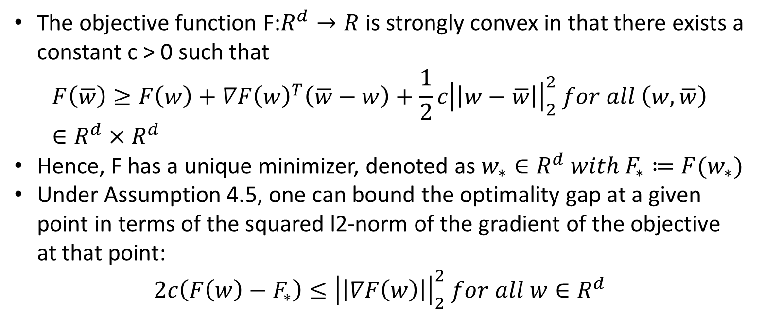
03
Analyses for SG
Assumption 5(Strong convexity)
The objective function F:$R^{d}→R$ is strongly convex in that there exists a constant c > 0 such that
$$F\left(\overline{w}\right)≥F\left(w\right)+∇F{\left(w\right)}^{T}\left(\overline{w}−w\right)+\frac{1}{2}c{\left|\left|w−\overline{w}\right|\right|}_{2}^{2} for all \left(w, \overline{w}\right)∈R^{d}×R^{d}$$
Hence, F has a unique minimizer, denoted as $w_{∗}∈R^{d} with F_{∗}≔F(w_{∗})$
Under Assumption 4.5, one can bound the optimality gap at a given point in terms of the squared l2-norm of the gradient of the objective at that point:
$$2c\left(F\left(w\right)−F_{∗}\right)≤{\left|\left|∇F\left(w\right)\right|\right|}_{2}^{2} for all w∈R^{d}$$

Slide 22
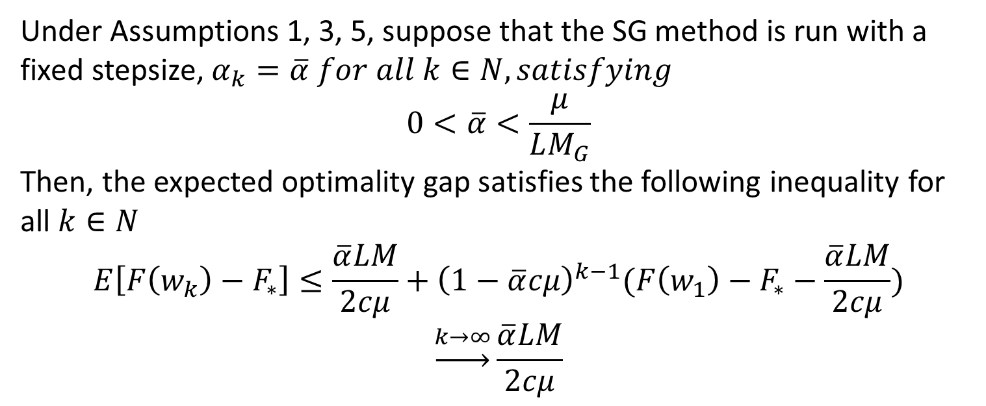
03
Analyses for SG
Theorem 6(Strongly Convex Objective, Fixed Stepsize)
Under Assumptions 1, 3, 5, suppose that the SG method is run with a fixed stepsize, $α_{k}=\overline{α} for all k∈N, satisfying$
$$0<\overline{α}<\frac{μ}{LM_{G}}$$
Then, the expected optimality gap satisfies the following inequality for all $k∈N$
$$E\left[F\left(w_{k}\right)−F_{∗}\right]≤\frac{\overline{α}LM}{2cμ}+{\left(1−\overline{α}cμ\right)}^{k−1}(F\left(w_{1}\right)−F_{∗}−\frac{\overline{α}LM}{2cμ})$$
$$\underset{→}{k→∞}\frac{\overline{α}LM}{2cμ}$$

Slide 23
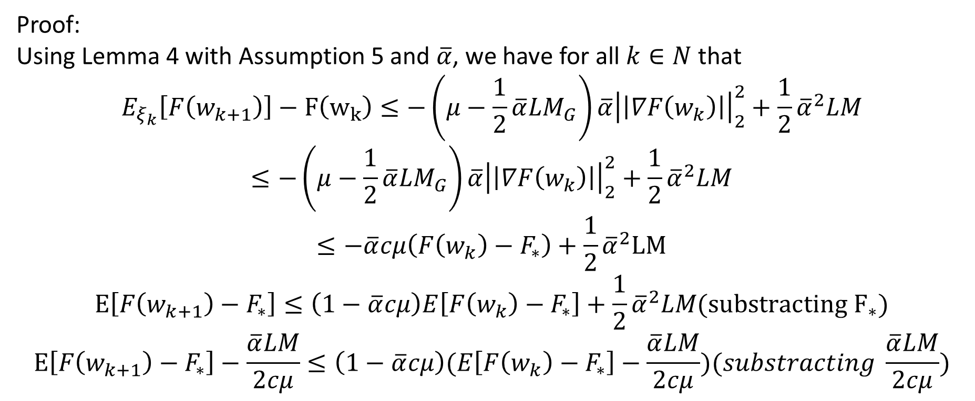
03
Analyses for SG
Theorem 6(Strongly Convex Objective, Fixed Stepsize)
Proof:
Using Lemma 4 with Assumption 5 and $\overline{α}$, we have for all $k∈N$ that
$$E_{ξ_{k}}\left[F\left(w_{k+1}\right)\right]−F\left(w_{k}\right)≤−\left(μ−\frac{1}{2}\overline{α}LM_{G}\right)\overline{α}{\left|\left|∇F\left(w_{k}\right)\right|\right|}_{2}^{2}+\frac{1}{2}{\overline{α}}^{2}LM$$
$$≤−\left(μ−\frac{1}{2}{\overline{α}LM}_{G}\right)\overline{α}{\left|\left|∇F\left(w_{k}\right)\right|\right|}_{2}^{2}+\frac{1}{2}{\overline{α}}^{2}LM$$
$$≤−\overline{α}cμ\left(F\left(w_{k}\right)−F_{∗}\right)+\frac{1}{2}{\overline{α}}^{2}LM$$
$$E\left[F\left(w_{k+1}\right)−F_{∗}\right]≤\left(1−\overline{α}cμ\right)E\left[F\left(w_{k}\right)−F_{∗}\right]+\frac{1}{2}{\overline{α}}^{2}LM({substracting F}_{∗})$$
$$E\left[F\left(w_{k+1}\right)−F_{∗}\right]−\frac{\overline{α}LM}{2cμ}≤\left(1−\overline{α}cμ\right)(E\left[F\left(w_{k}\right)−F_{∗}\right]−\frac{\overline{α}LM}{2cμ})(substracting \frac{\overline{α}LM}{2cμ})$$

Slide 24
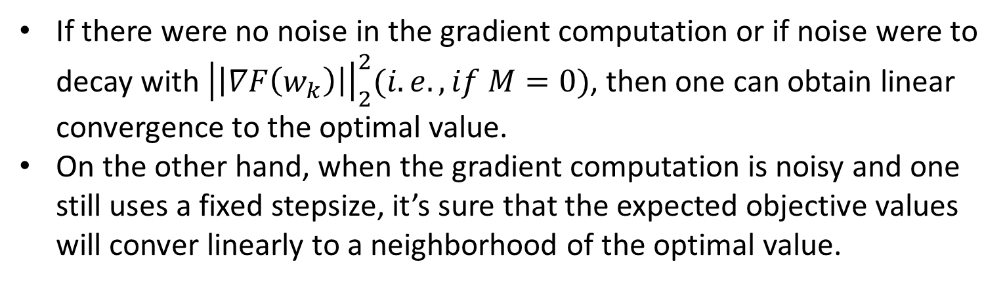
03
Analyses for SG
Theorem 6(Strongly Convex Objective, Fixed Stepsize)
If there were no noise in the gradient computation or if noise were to decay with ${\left|\left|∇F\left(w_{k}\right)\right|\right|}_{2}^{2}(i.e., if M=0)$, then one can obtain linear convergence to the optimal value.
On the other hand, when the gradient computation is noisy and one still uses a fixed stepsize, it’s sure that the expected objective values will conver linearly to a neighborhood of the optimal value.

Slide 25
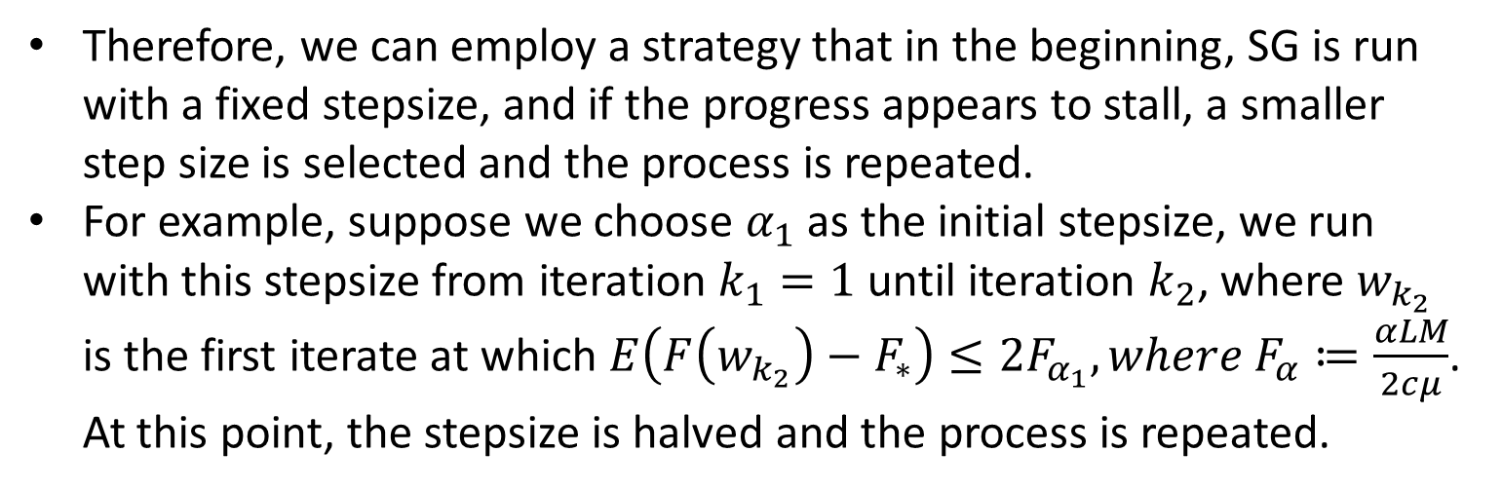
03
Analyses for SG
Diminishing Stepsize
Therefore, we can employ a strategy that in the beginning, SG is run with a fixed stepsize, and if the progress appears to stall, a smaller step size is selected and the process is repeated.
For example, suppose we choose $α_{1}$ as the initial stepsize, we run with this stepsize from iteration $k_{1}=1$ until iteration $k_{2}$, where $w_{k_{2}}$ is the first iterate at which $E\left(F\left(w_{k_{2}}\right)−F_{∗}\right)≤2F_{α_{1}}, where F_{α}≔\frac{αLM}{2cμ}$. At this point, the stepsize is halved and the process is repeated.

Slide 26
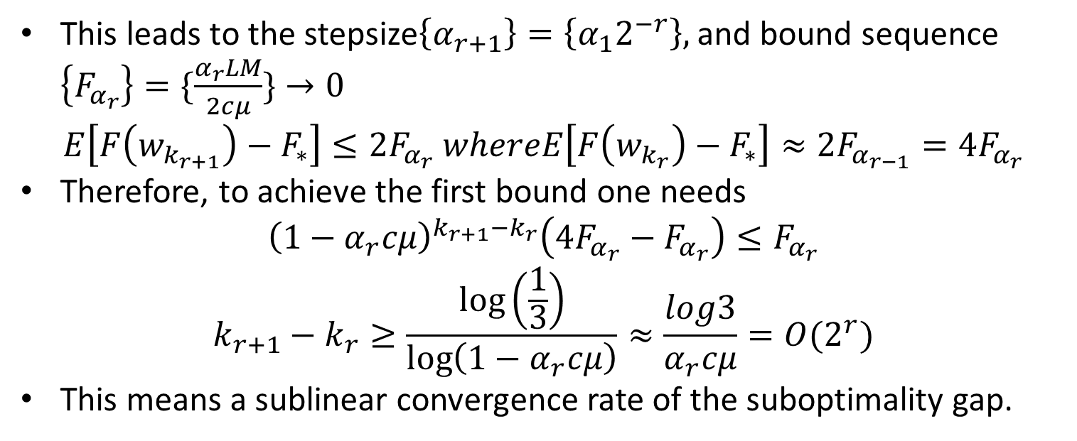
03
Analyses for SG
Diminishing Stepsize
This leads to the stepsize$\left\{α_{r+1}\right\}=\left\{α_{1}2^{−r}\right\},$ and bound sequence $\left\{F_{α_{r}}\right\}=\{\frac{α_{r}LM}{2cμ}\}→0$
$$E\left[F\left(w_{k_{r+1}}\right)−F_{∗}\right]≤2F_{α_{r}} whereE\left[F\left(w_{k_{r}}\right)−F_{∗}\right]≈2F_{α_{r−1}}=4F_{α_{r}}$$
Therefore, to achieve the first bound one needs
$${\left(1−α_{r}cμ\right)}^{k_{r+1}−k_{r}}\left(4F_{α_{r}}−F_{α_{r}}\right)≤F_{α_{r}}$$
$$k_{r+1}−k_{r}≥\frac{\log\left(\frac{1}{3}\right)}{\log\left(1−α_{r}cμ\right)}≈\frac{log3}{α_{r}cμ}=O(2^{r})$$
This means a sublinear convergence rate of the suboptimality gap.

Slide 27
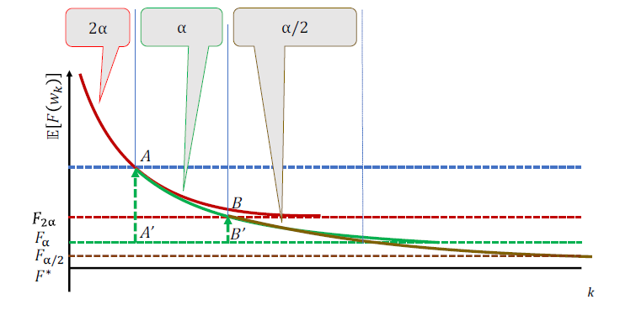
03
Analyses for SG
Diminishing Stepsize

Slide 28
Beyond SG
04

Slide 29
04
Beyond SG
Noise Reduction
Second Order
Others

Slide 30
04
Beyond SG
Noise Reduction
We consider achieve noise reduction in a manner that allows them to possess a linear rate of convergence to the optimal value using a fixed stepsize
Gradient Aggregation
We can achieve a lower variance by reusing previously computed
information

Slide 31
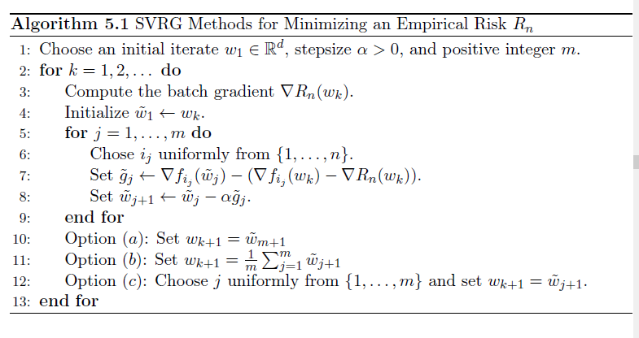
04
Beyond SG
Noise Reduction
SVRG

Slide 32
04
Beyond SG
Second Order
The usual motivation for second-order algorithms comes from that the full gradient iteration works with a model that is only first-order accurate.
Stochastic Quasi-Newton Methods

Slide 33
Q&A

